Slide 1

UDL: Practical Strategies for the University CFL Classroom
Jessica Wang (She/Her)
Associate Lecturer
Jessica.wang@curtin.edu.au
School of education
Curtin University

Slide 2
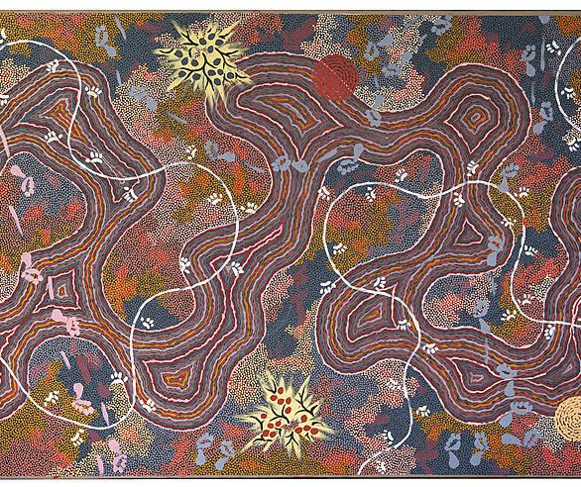
Acknowledge to Country
I’d like to acknowledge the Whadjuk people of the Noongar Nation, the Traditional Custodians of the land where I am on today. I recognise their deep connection to this Country, which continues to this day. I pay my respect to Elders past, present, and emerging.
This Photo by Unknown Author is licensed under CC BY-SA

Slide 3
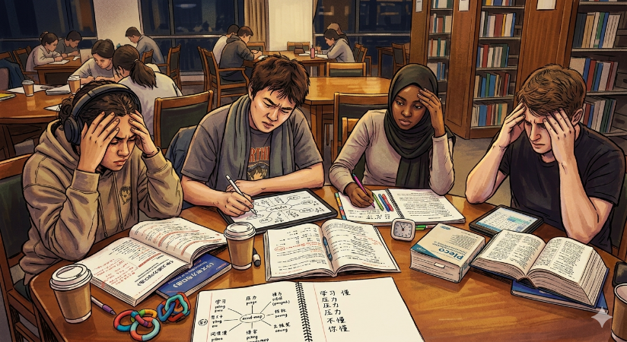
1. The Challenge: Heavy Content Loads
The Problem
Chinese as a Foreign Language (CFL) courses carry significant cognitive demands — character recognition, tonality, oral anxiety, and diverse learner needs all create systemic barriers.
The Solution
A comprehensive course redesign applying UDL 3.0 guidelines to foster autonomous "expert learners" through a "buffet" of multi-modal tools.

Slide 4
2. UDL 3.0: Three Core Principles
Representation
Engagement
Action & Expression
Multiple ways to access and process content
Multiple ways to motivate and sustain learning
Multiple ways to demonstrate knowledge
Together, these principles reduce barriers and allow students to customise their own learning path based on individual needs.

Slide 5
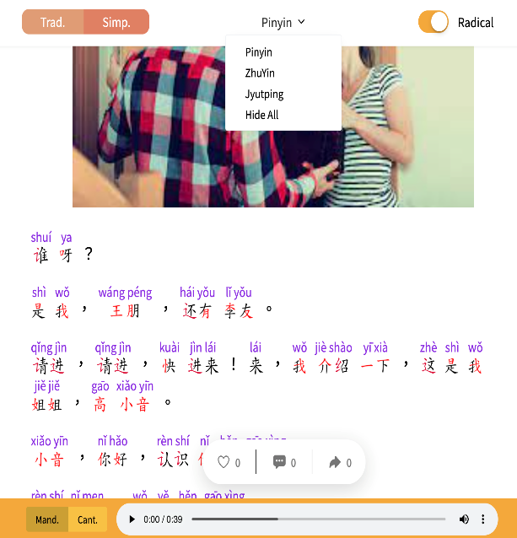
3. Multiple Means of Representation
Ricciwawa Platform
Students toggle between Simplified/Traditional characters and adjust Pinyin/Zhuyin visibility and audio speeds.
CHIN1000 L.5 Dia.1
Reduced Cognitive Load
Customisable digital text directly addresses the cognitive demands of character recognition and tonality.

Slide 6

4. iLectures: Building Autonomous Learners
Pre & After Class Preparation
A key indicator of impact is students‘ ability to proactively use iLectures for pre and after class preparation — a sign of growing learner autonomy and self-regulation.
CHIN3000 L.1 iLecture
Student self-efficacy is the ultimate measure of UDL success in this course.

Slide 7
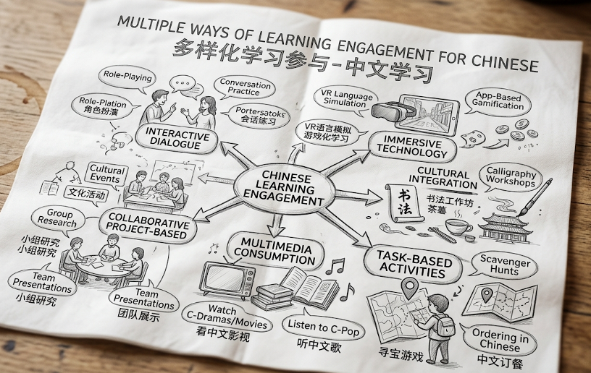
5. Multiple Means of Engagement
Physical Flashcards
Customisable, tactile learning for hands-on vocabulary acquisition
Gamified Platforms
Quizlet, Wordwall, and Blooket transform rote memorisation into "Joy and Play"
Students regulate their own level of challenge, choosing the tools that best match their learning style.

Slide 8
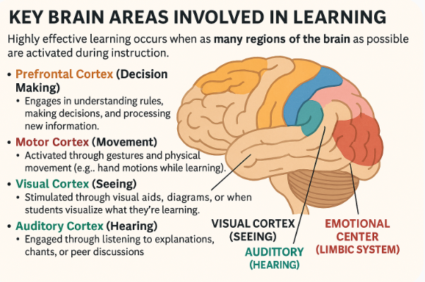
Key Brain Areas Involved in Learning

Slide 9

Image 1 - Outside

Slide 10
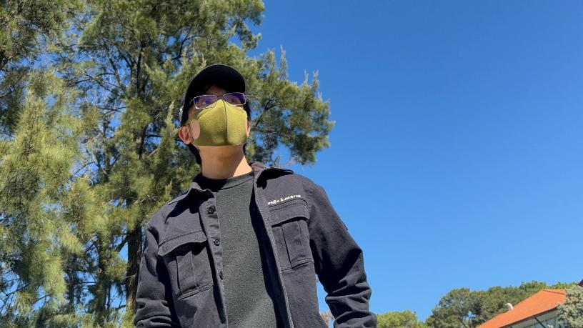
Image 2 - Outside

Slide 11
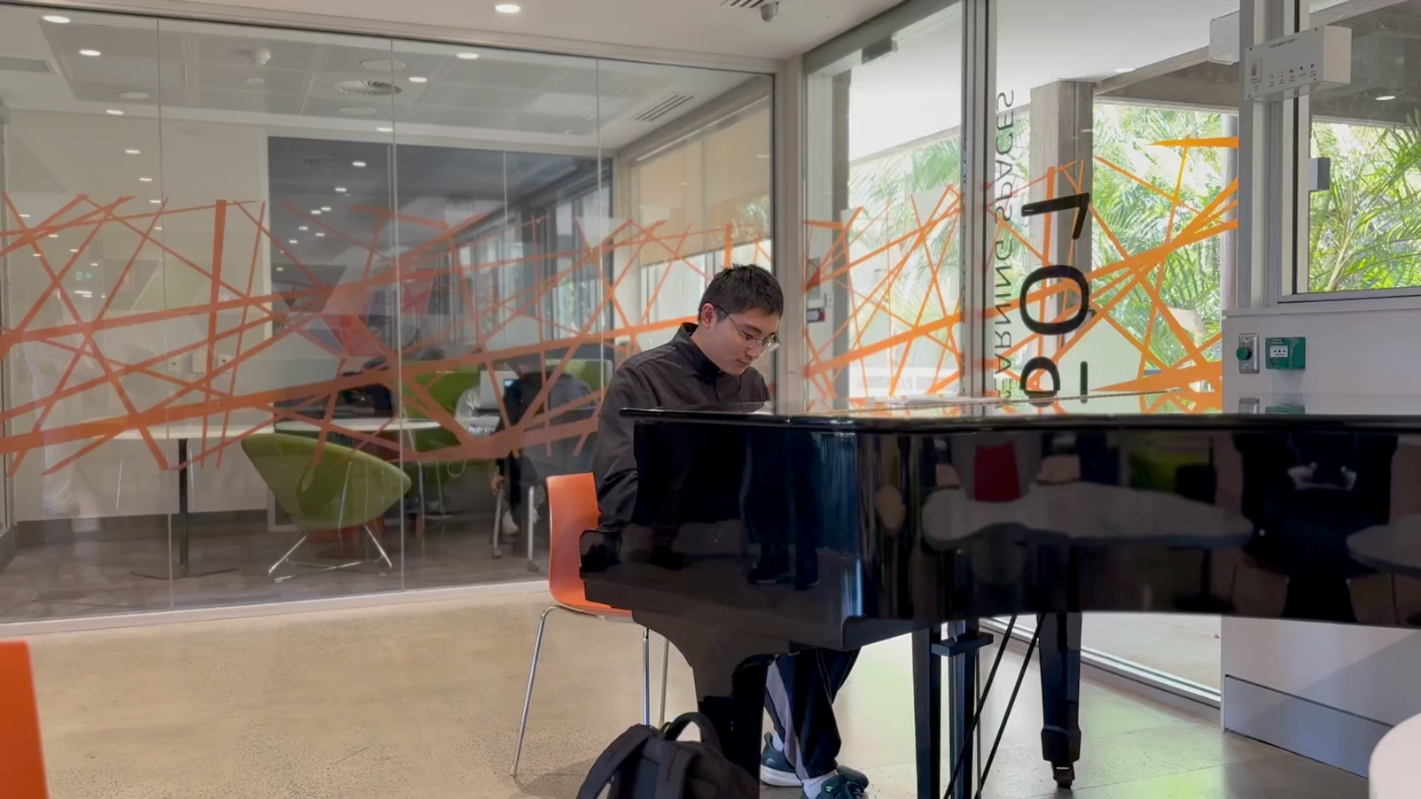
Video – Piano Player

Slide 12
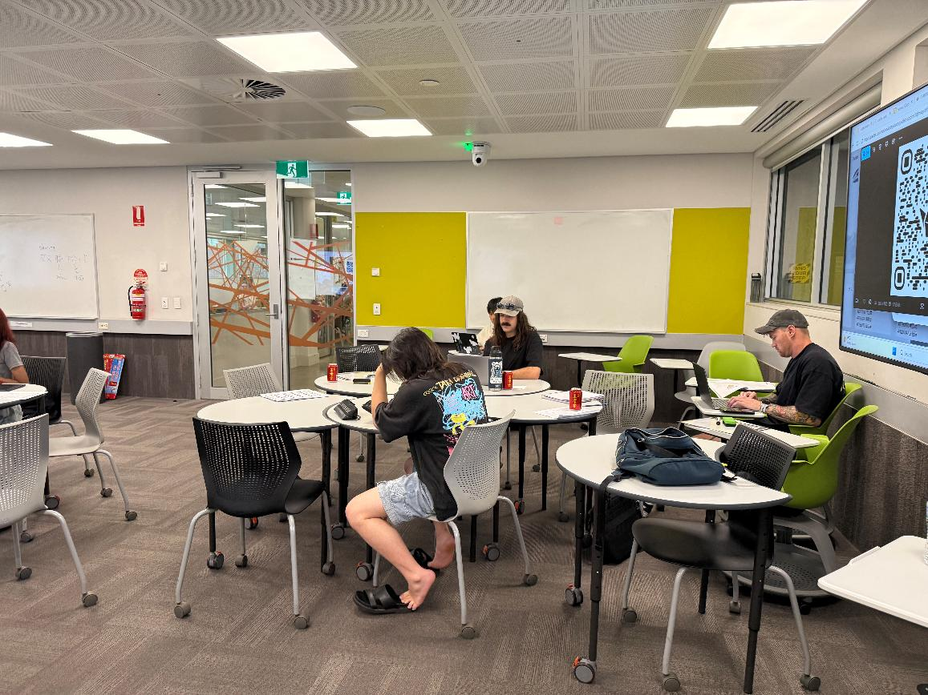
Image 1 – Inside Classroom

Slide 13
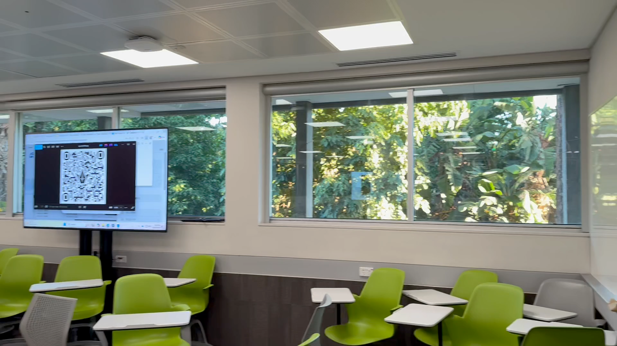
Video – Classroom

Slide 14
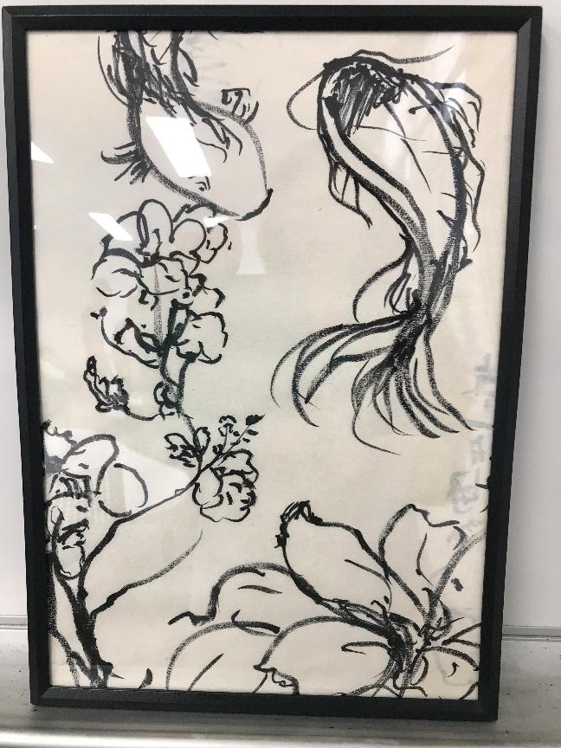
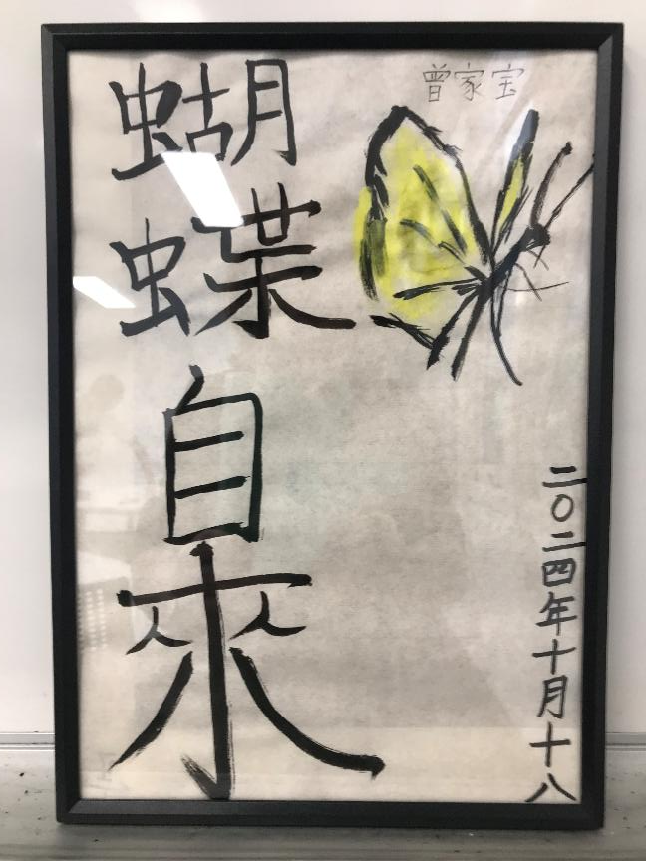
Image 1 – Paintings

Slide 15
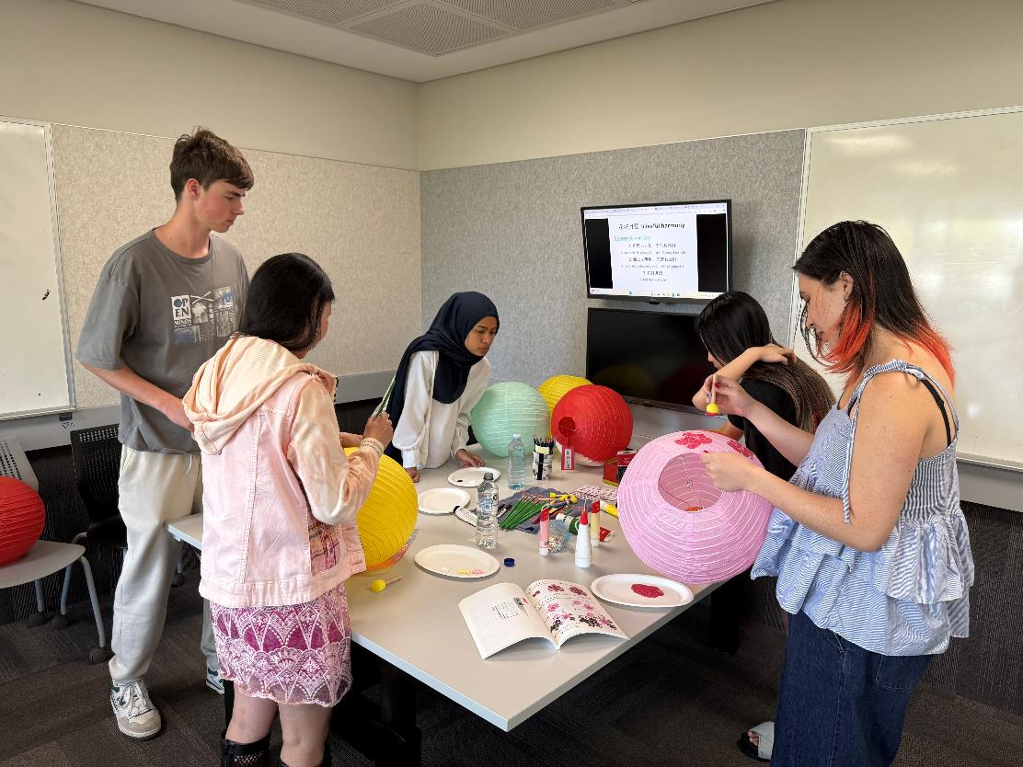
Image 2 – Art Activity

Slide 16
6. Digital vocabulary learning tool: Quizlet
CHIN1000 L.5 DIA.1
Quizlet: L.5 Dia 1 Vocabulary Quizlet (Digital flashcard)
L.5 Dia.1 Sentences (digital flashcard)

Slide 17
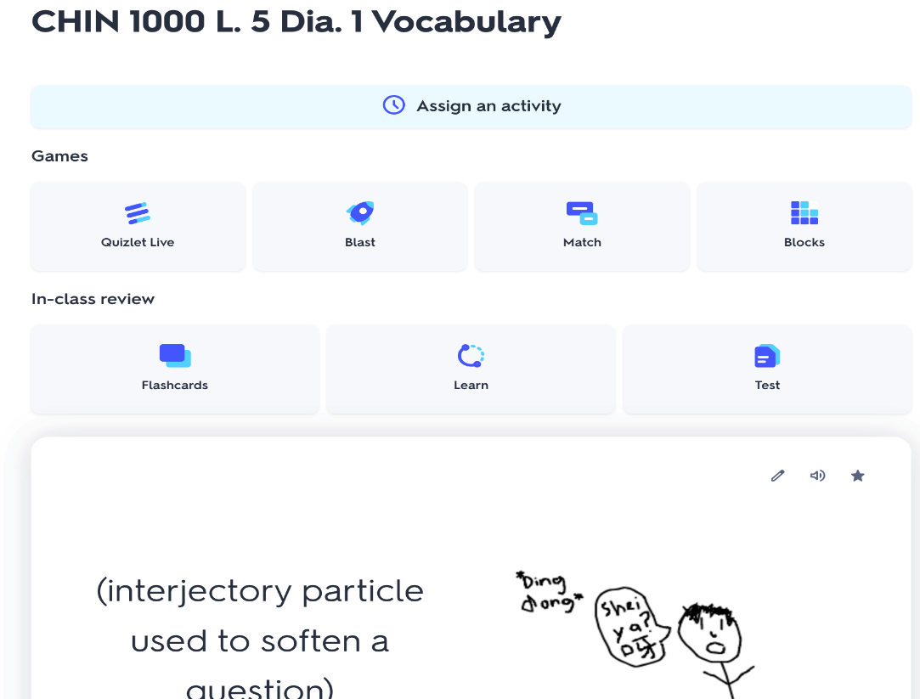
Screenshot – Learning Activity

Slide 18
Digital vocabulary learning tool: Blooket
CHIN1000 L.5 DIA.1
Blooket: L.5 Dia.1 Blooket

Slide 19
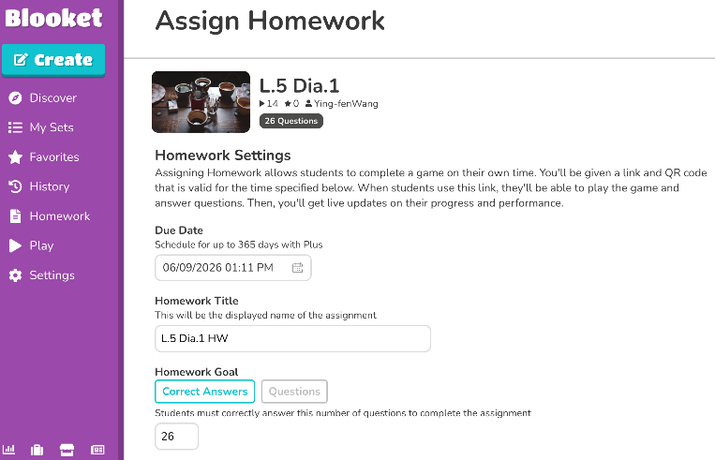
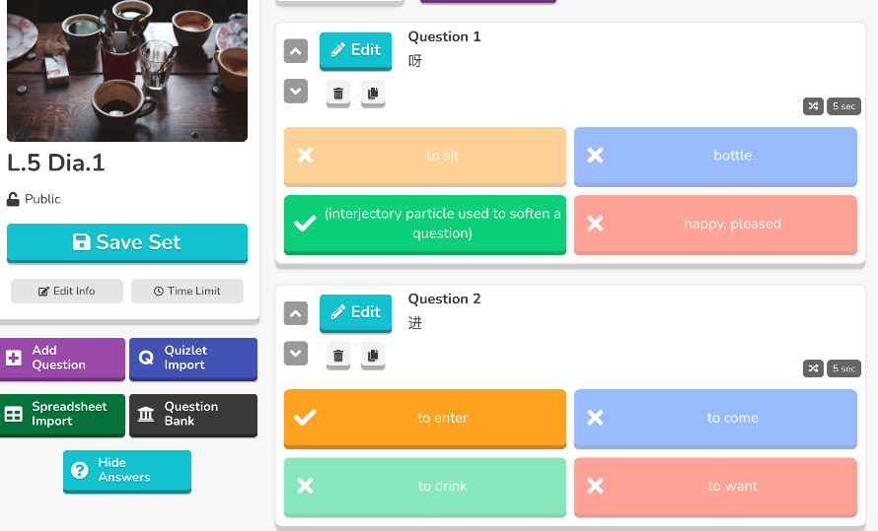
Screenshot – Learning Activities

Slide 20
Digital vocabulary learning tool: wordwall
CHIN1000 L.5 DIA.1
Wordwall: CHIN1000 L.5 Dia.1 Vocabulary (Recognition)

Slide 21
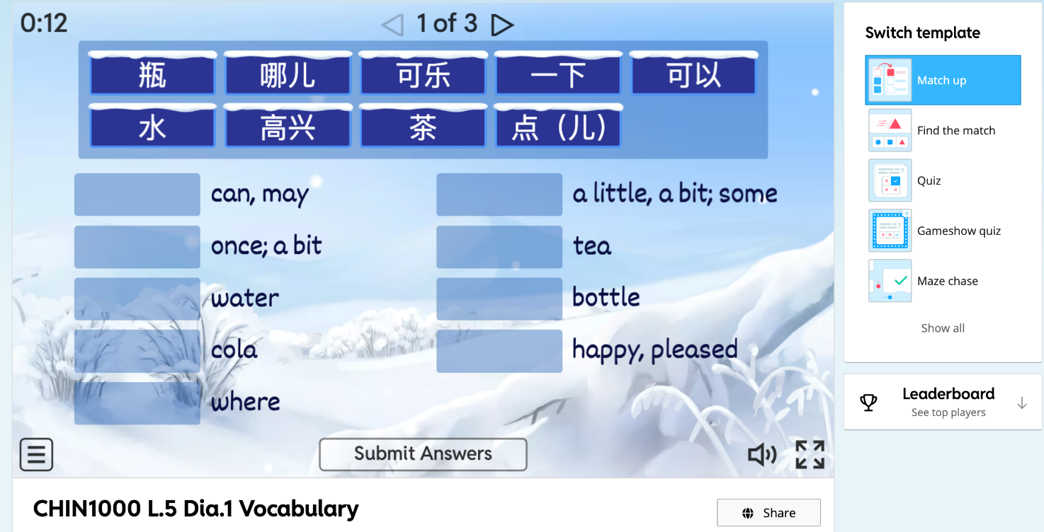
Screenshot - Vocabulary

Slide 22
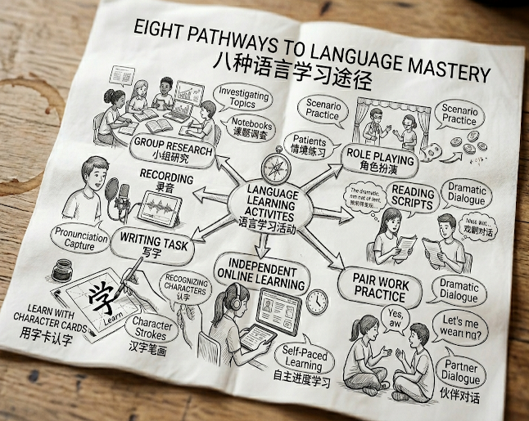
7. Multiple Means of Action & Expression
Immersive Roleplay
Lower Affective Filter
Students perform as news anchors or voice actors after teacher-led coaching
Creative framing replaces oral anxiety with social interaction
Measurable Impact
Higher oral proficiency, text comprehension, and self-efficacy

Slide 23
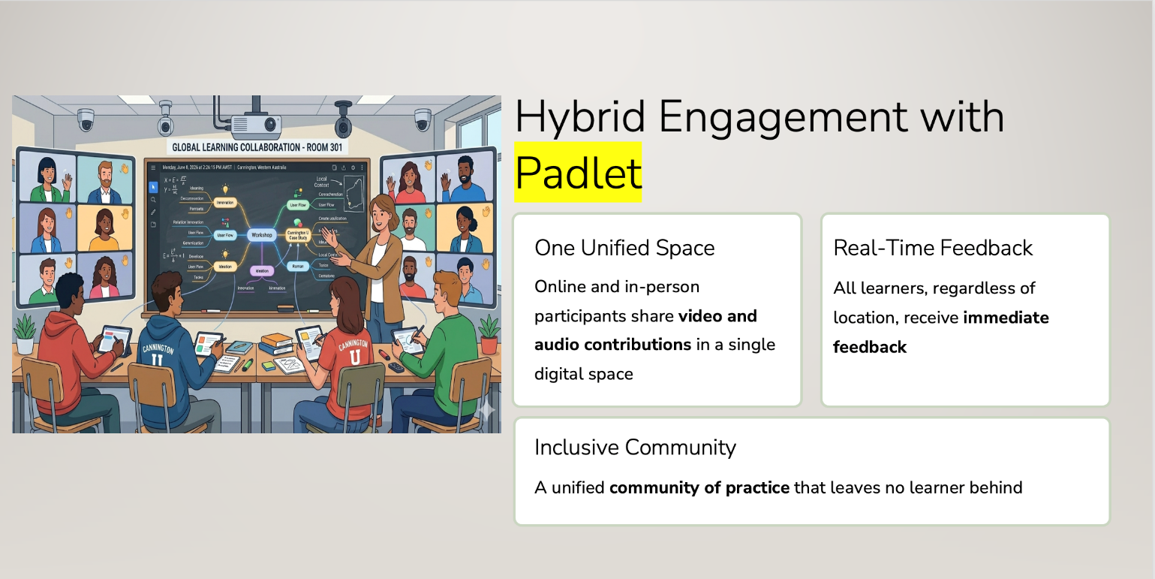
8. Hybrid Engagement with Padlet
8.

Slide 24
9. Padlet – a powerful tool for lesson presentation, student participation, expression and interaction
Speaking (L.1) Students' first time using Paldet
Writing (L.2)
establiah a peer-to-peer international network

Slide 25

10. The Full UDL Buffet
Representation
Hybrid Engagement
Engagement
Action & Expression
Each strategy targets a specific barrier — together they create a flexible, inclusive CFL learning environment where every student can thrive.

Slide 26

11. Key Takeaways
1
Reduce barriers, not standards
UDL 3.0 removes systemic obstacles while maintaining rigorous learning outcomes.
2
Choice drives ownership
A "buffet" of tools lets students regulate challenge and build genuine self-efficacy.
3
Creativity unlocks expression
Roleplay and play-based tools transform anxiety into engagement and oral proficiency.

Slide 27
12. Reference
Levey, S. (2021). Universal Design for Learning. Journal of Education, 203, 479 - 487. https://doi.org/10.1177/00220574211031954
Millikin, C. C. (2023). Future-Proof your Instructional Design with Universal Design for Learning and Translanguaging. Literacy Information and Computer Education Journal. https://doi.org/10.20533/licej.2040.2589.2023.0488
Kasch, H. (2019). Experimental Studies of the Affordances of Assistive Multimodal Learning Designs: Universal Design for Learning in Modern Language Classrooms.. 93-107.
Vogt, K. (2021). Equitable and Inclusive (Classroom-Based) Foreign Language Assessment Using Universal Design for Learning. Handbook of Research on Policies and Practices for Assessing Inclusive Teaching and Learning. https://doi.org/10.4018/978-1-7998-8579-5.ch006
Xu, L. (2023). Support inclusive teaching and learning with CALL technologies in the beginning-level Chinese language classroom. EuroCALL 2023. CALL for all Languages - Short Papers. https://doi.org/10.4995/eurocall2023.2023.16912
Yu, Q., Lei, Y., & Lu, L. (2024). A UDL blended curriculum metamodel for proficiency-oriented Chinese instruction. Chinese as a Second Language (漢語教學研究—美國中文教師學會學報). The journal of the Chinese Language Teachers Association, USA. https://doi.org/10.1075/csl.00049.yu
Zhang, Y., Xiang, W., & Xue, Q. (2018). Design and Implementation of Chinese as Second Language Learning. Handbook of Mobile Teaching and Learning. https://doi.org/10.1007/978-3-642-41981-2_102-1

Slide 28
Thank you & Q&A
Thank you for your time, and I welcome your questions and feedback.
Let’s Connect:
Jessica Wang
Jessica.wang@curtin.edu.au
School of Education
Curtin University
(08) 9266 4461

