Slide 1

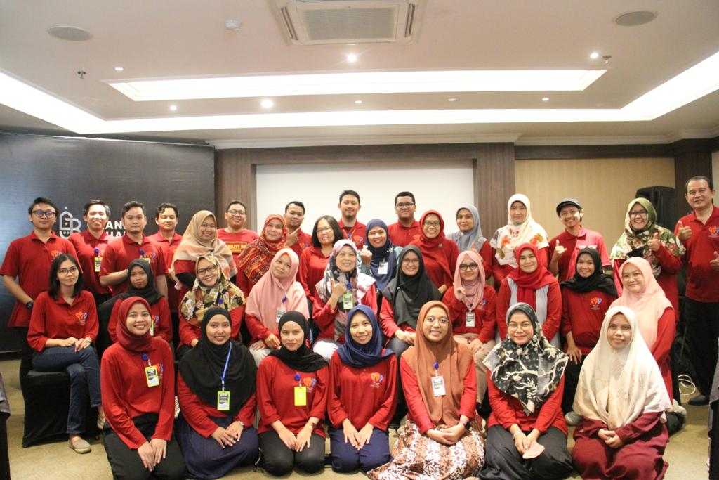
Scaling UDL in Indonesian Higher Education
Capacity Building Through Workshops, Mentoring, and MOOCs
Pujaningsih, Ed.D & Nur Azizah Ph.D
Universitas Negeri Yogyakarta
ADCET UDL Symposium 2026

Slide 2
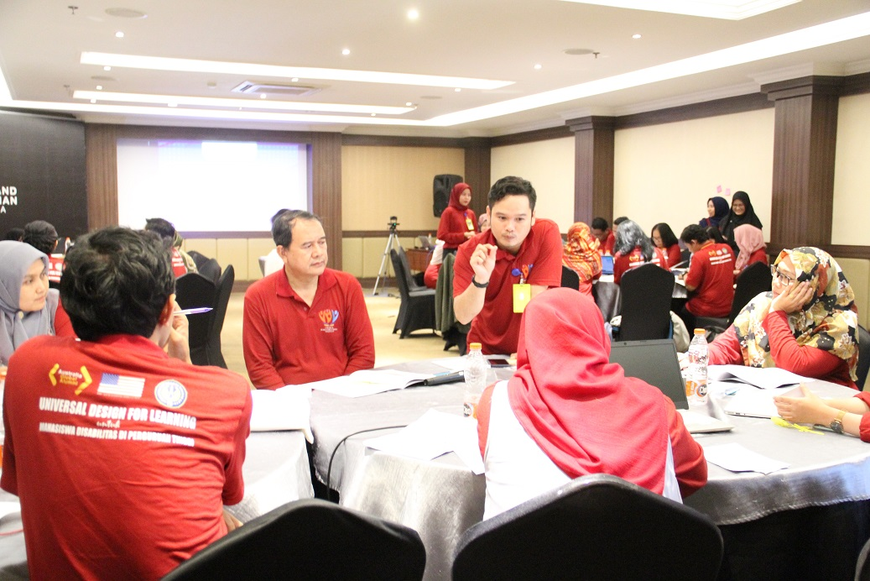
Why This Matters
Students with disabilities remain underrepresented in Indonesian higher education
2.8%
291
71
Higher Education Completion
Institutions Enrolling Students
Disability Services Units (ULD)
The Challenge: Despite national legislation, students encounter barriers in accessibility, support services, and campus culture.
The Opportunity: Indonesia's massive higher education system requires scalable inclusive teaching to widen participation.
The Goal: Implementing UDL to improve student success and systemic equity.
ADCET UDL Symposium 2026

Slide 3
Designing for Learner Variability
Challenge: Individual Accommodations vs. Proactive Design
Many lecturers were willing to support students but relied on reactive, individual accommodations. Our approach shifted focus toward proactive, universal design using UDL 3.0.
Engagement
Representation
Action & Expression
Building Attitudes
• Exploring microaggressions
• Role-play activities
• Hearing directly from students with disabilities
Case-Based Learning
• Real student experiences
• Multi-disciplinary examples
• Workshops, mentoring, & MOOCs
Inclusive Redesign
• Redesigning lesson plans
• Flexible learning activities
• Applying UDL in own courses
ADCET UDL Symposium 2026

Slide 4
Project Goal
Improving Access to Universal Design for Learning in Higher Institutions for Students with Disabilities
Objective 1: Training & Planning
Objective 2: Mentoring & Achievement
Provide training workshops for lecturers in higher institutions on Universal Design of Learning (UDL) to provide accommodations of learning.
Provide mentoring for lecturers on campus during UDL implementation to improve learning flexibility and boost student success.
+50%
+30%
UDL Lesson Plans
Learning Achievement
ADCET UDL Symposium 2026

Slide 5

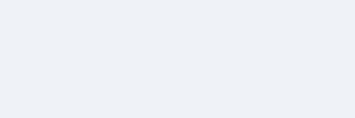

Scaling Strategy & Sustainability
From Individual Awareness to Systemic Educational Transformation
STAGE 01
Awareness
STAGE 02
UDL Workshops
STAGE 03
Implementation
STAGE 04
Mentoring
PHASE: SUSTAIN
Sustainability
PHASE: SUSTAIN
MOOCs
PHASE: SUSTAIN
System Change
PHASE: SUSTAIN
Community of Practice
Continuous Feedback Loop: Engagement → Representation → Action & Expression
ADCET UDL Symposium 2026

Slide 6
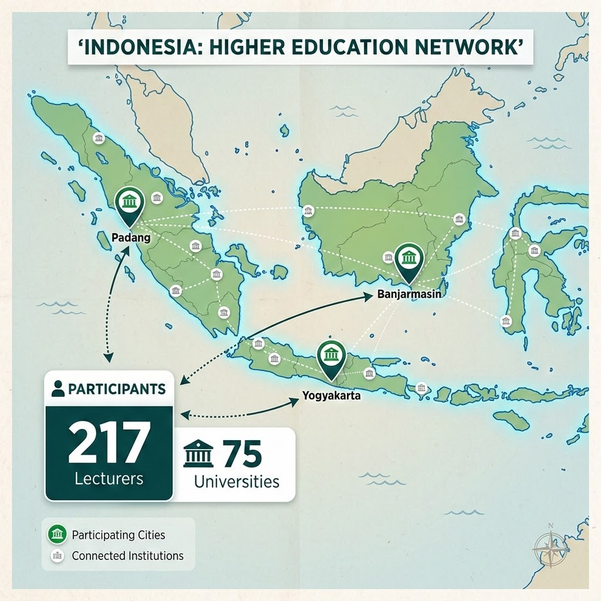
Level 1: UDL Workshops
Building Awareness and Initial Competence
PURPOSE
Develop positive attitudes toward disability
Increase understanding of learner variability
Introduce UDL principles
Support initial redesign of teaching practices
ACTIVITIES
Disability awareness activities
Student voice and lived experiences
Case studies
UDL lesson planning
ADCET UDL Symposium 2026

Slide 7
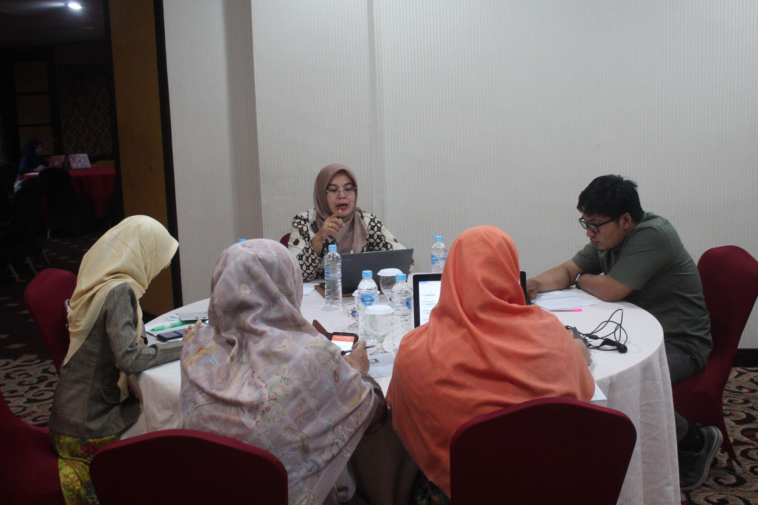
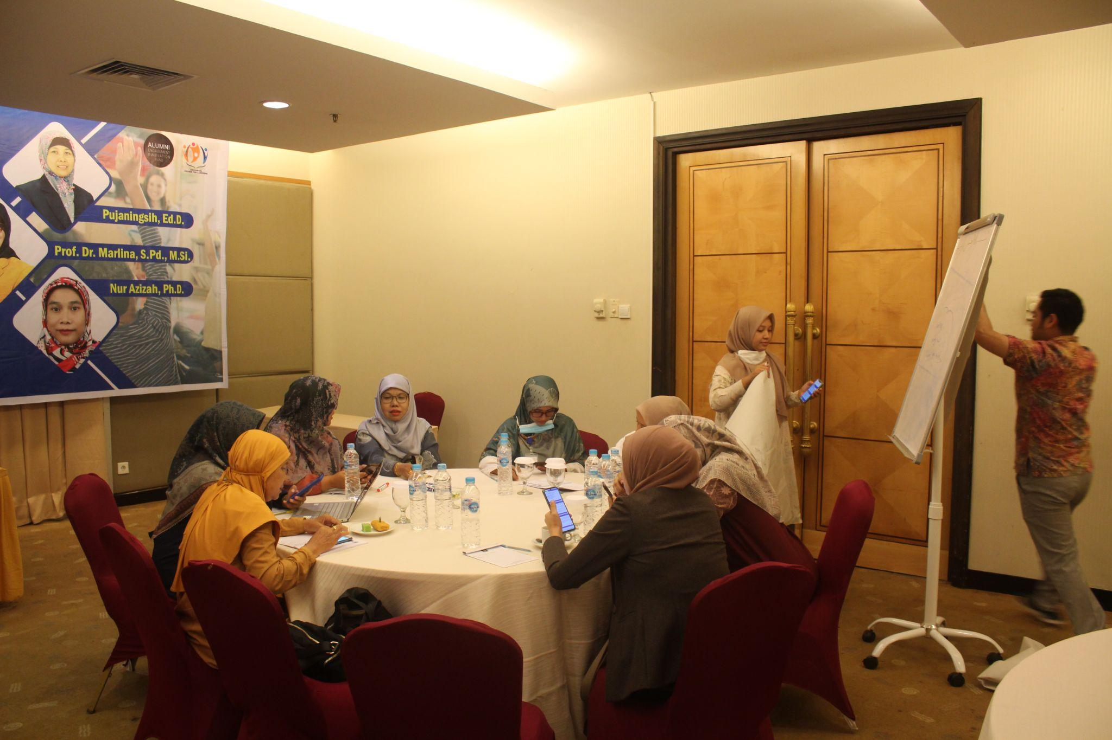
What Did Participants Learn?
Three core workshop components for inclusive education
Understanding Barriers
Inclusive Environments
Designing UDL Courses
Disability perspectives
Student voices
Reducing microaggressions
Inclusive culture
Flexible instruction
Flexible assessment
ADCET UDL Symposium 2026

Slide 8
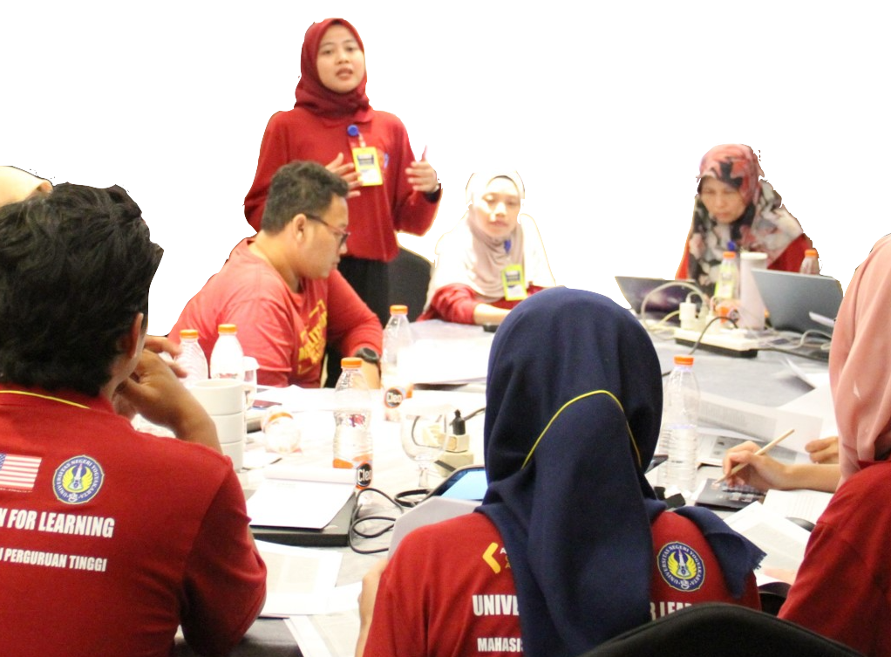
Student Voice Matters
The most impactful component of the UDL project
DIRECT LIVED EXPERIENCES
Students shared their journey directly with lecturers, focusing on specific needs:
Students with Autism: Insights into sensory processing and structured environments.
Students with Hearing Impairment: Clarity on communication barriers and visual aids.
This shift moved the focus from "fixing the student" to "designing out the barriers."
CRITICAL REFLECTION QUESTION
What barriers exist in our teaching vs. the student?
ADCET UDL Symposium 2026

Slide 9
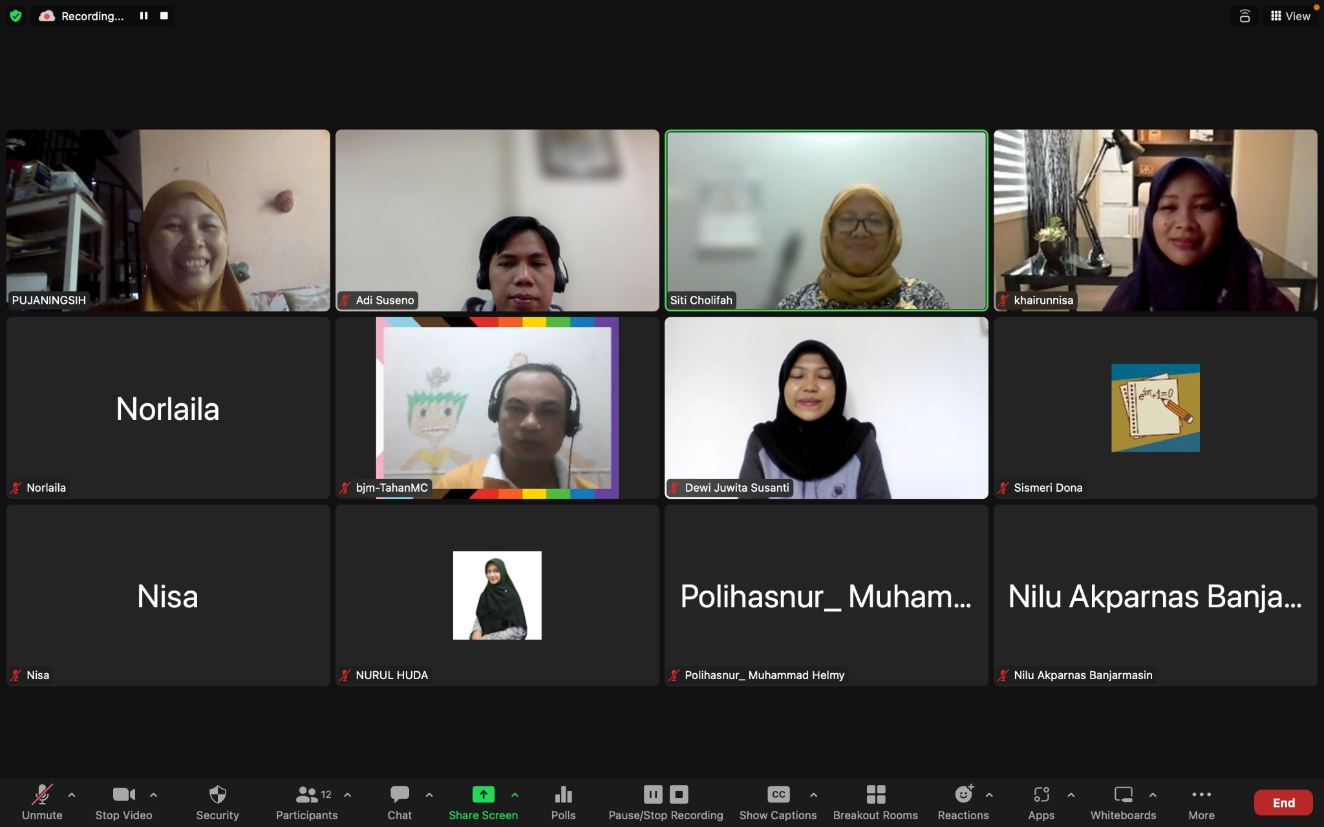
Level 2: Mentoring & Implementation
Supporting UDL Application in Real Courses
PURPOSE & FOCUS
Move from understanding to active application:
Identifying learning barriers
Developing action plans
Redesigning learning activities
Reflection and refinement
> 50%
51
Why it matters: This was where the actual instructional change occurred.
IMPLEMENTED UDL PRINCIPLES
ACTION PLANS DEVELOPED
ADCET UDL Symposium 2026

Slide 10
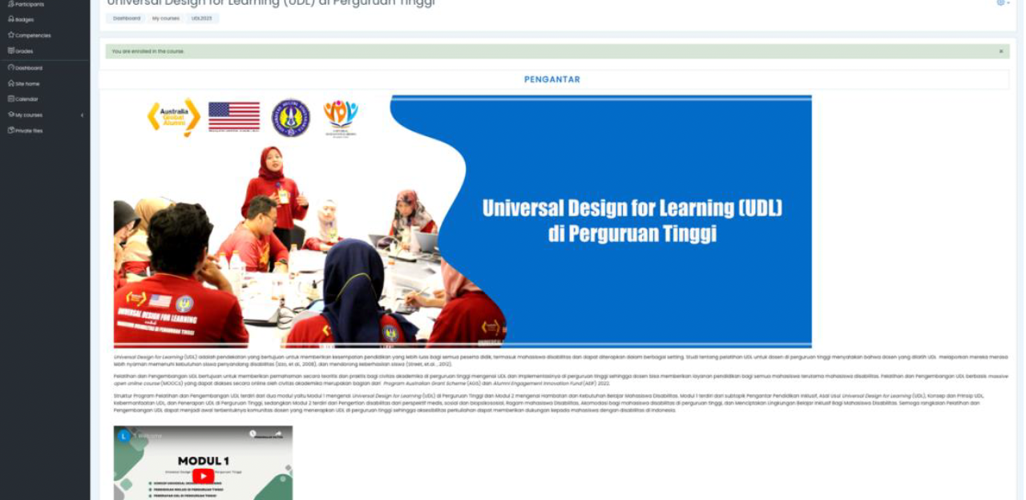
Level 3: MOOCs
Expanding Access and Sustainability
PURPOSE
Provide scalable access to UDL learning beyond face-to-face workshops.
Key Modules:
UDL in Higher Education
Disability and Learning Barriers
BENEFITS
Why MOOCs matter: Knowledge remains available after project funding ends.
Self-paced learning
Open access
Wider reach
Ongoing resource
ADCET UDL Symposium 2026

Slide 11
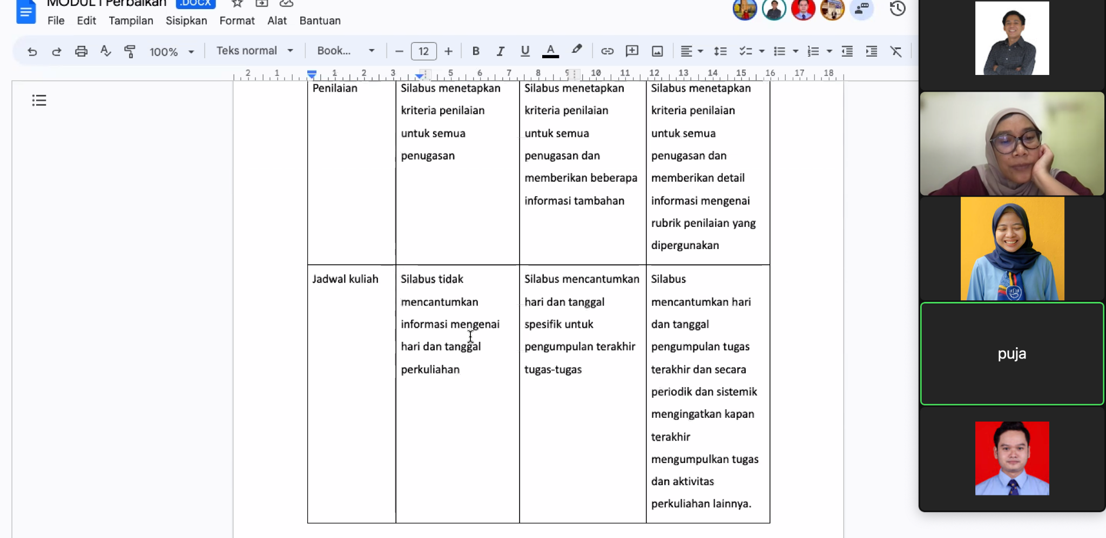
Level 4: Community of Practice
Sustaining Long-Term Change Emerging from the UDL Summit
SUMMIT OUTCOMES
Lecturers sharing best practices and experiences
Cross-institutional networking for collaborative growth
Resource exchange and systemic alignment
Development of localized UDL champions
349
71
Why communities matter: Inclusive teaching requires peer support, shared problem-solving, and continuous innovation.
PARTICIPANTS
UNIVERSITIES
ADCET UDL Symposium 2026

Slide 12
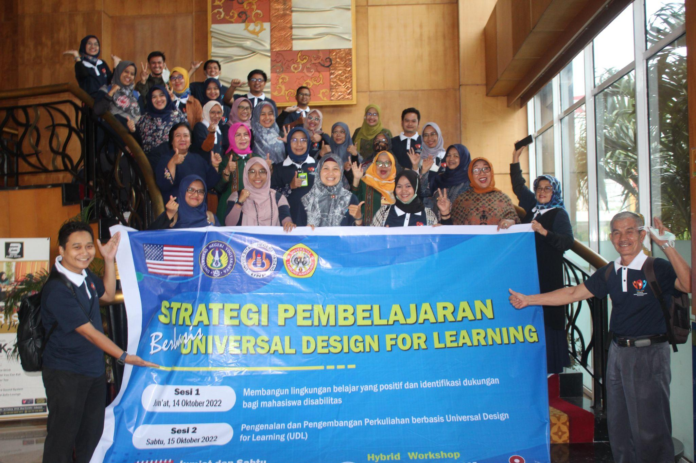

Evidence of Change: From Awareness to Action
Professional Development & Mentoring Outcomes
WORKSHOP OUTCOMES
Lecturers identified barriers and created plans to redesign learning:
Target Achieved: > 50% developed action plans
51 UDL Action Plans fully developed
217
75
LECTURERS
UNIVERSITIES
MENTORING IMPLEMENTATION
> 50% of lecturers implemented at least one UDL principle following mentoring sessions.
Redesigning course materials
Increasing flexibility in activities
Alternative participation methods
Adapting assessment approaches
ADCET UDL Symposium 2026

Slide 13
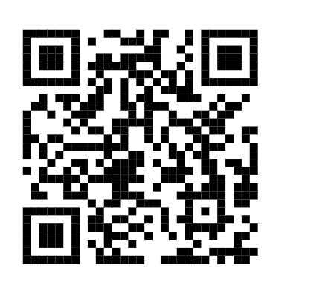
Thank You
Advancing Inclusive Education Together
CONTACT & RESOURCES
Get in touch:
Email: puja@uny.ac.id nur_azizah@uny.ac.id
Learn more:
Visit the website for UDL resources, MOOC access, and community updates
(Indonesian Bahasa)
ADCET UDL Symposium 2026

