Slide 1
INSIGHT Framework
Operationalising UDL in Assessment
ADCET UDL Symposium 2026
Dr Mariko Francis and Dr Elise Waghorn
School of Education,
College of Design and Social Context
RMIT University, Australia

Slide 2
Acknowledgement of Country

Slide 3
Questions we explore today
Assessment exclusion
Participation barriers
Planning with UDL
Where do assessment tasks unintentionally exclude students?
What kinds of participation barriers emerge when we analyse assessment structure closely?
How can UDL 3.0 guidelines be applied during planning rather than retrofitted afterwards?

Slide 4

Workshop structure
Analyse
Identify
Redesign
Analyse one assessment task from your own context
Identify structural participation barriers
Redesign one component using the INSIGHT Framework and UDL
Output
One redesigned assessment condition and a clear rationale for preserving the standard

Slide 5
Workshop structure (cont)
Inclusive intent
Address barriers
UDL endorsed
Learner variability acknowledged
Available support
From principle to design decision
Access
Participation
Judgement
Evidence
Output
What is the task intended to assess, and what additional access conditions does it create?

Slide 6
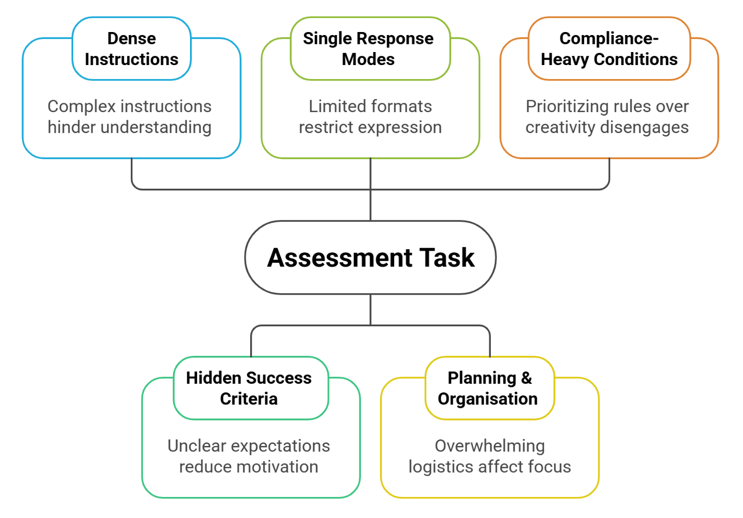
UDL in assessment design
ENGAGEMENT
purpose, value, relevance, & support
REPRESENTATION
access & interpret information needed for the task.
ACTION & EXPRESSION
valid ways to plan, respond, communicate understanding

Slide 7
Pilot study initial findings
UDL endorsement
Barrier anticipation
Design action
Clearer identification of assessment barriers in instructions, response modes, sequencing, and participation conditions
Stronger redesign decisions linked to access and valid demonstration of learning.
More explicit attention to learner variability at Tier 1 and prospective planning.
Preliminary findings
Stronger design reasoning in artefacts
Inclusive thinking more accessible & visible in students’ work

Slide 8
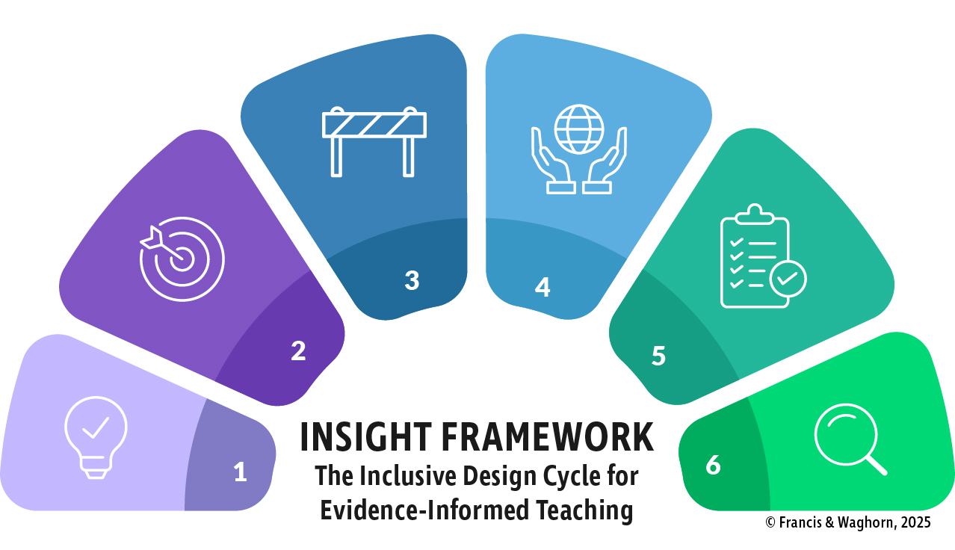
The INSIGHT Framework:
Assessment design
https://tinyurl.com/INSIGHTframework

Slide 9
How the INSIGHT Framework and UDL work together in assessment design
What is the learning goal?
What evidence is required?
What else does the task demand?
Where might students be excluded?
What can be redesigned while preserving the standard?

Slide 10
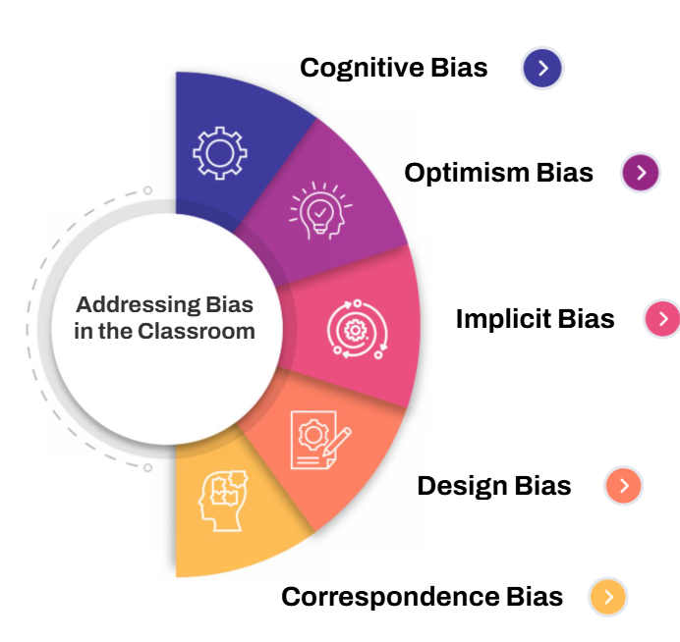
Bias and assumptions checkpoint:
Pre-task analysis
Assumptions
Neutrality
Attribution
What am I assuming a competent student will already know or be able to do?
What features of this task am I treating as neutral?
Am I reading likely difficulty as a learner problem or a task problem?
tinyURL.com/RMIT-bias

Slide 11
Worked example:
Assessment Outline
PYSXXX assessment materials
Assessment Outline
Evidence-based practice
Form groups
Select an academic paper
Develop a PICO(T)
Search a database
What does the student need to understand, access, organise, negotiate, use, or tolerate to begin and complete this task?
Copilot summary critique
?
Annotate PDF
Tree plot and 95% CI
Submit required files
Viva

Slide 12

Stage 1: Reflective assessment and planning
Assessment Outline
Evidence-based practice
Clinical question
What does the student need to understand, access, organise, negotiate, use, or tolerate to begin and complete this task?
What conditions shape participation before the student can demonstrate evidence-based physiotherapy practice?
Search strategies
Critical appraisal
Outcome measure criteria
Statistical interpretation
Task released
AI critique
Tree plot and 95% CI
Submit required files
Viva
INSIGHT Stage 1

Slide 13
Stage 2: Clarify purpose and goals
Capabilities assessed
Evidence-based practice
Clinical question
Search strategy
What evidence would convince us that the student has developed the intended capability?
Critical appraisal
Outcome measures
Statistical interpretation
AI critique
Clinical reasoning
Confidence in intervention
Professional judgement
INSIGHT Stage 2

Slide 14
Stage 3: Identify barriers
Assessment Condition
Group co-ordination
→ social access, schedules, role negotiation
First-in paper claim
→ speed, early certainty, access to support
Canvas discussion board
→ LMS fluency, public posting
Copilot use
→ tool access, AI literacy, critique confidence
Yellow PDF highlighting
→ software, visual access, file-handling fluency
Mark caps and penalties
→ procedural tracking
Viva questioning
→ processing time, oral confidence, live response
Share your thoughts in the chat:
This task assumes the student can…
INSIGHT Stage 3

Slide 15
Stage 3 continued:
Construct relevance
Assessment evidence
Evidence-based practice
Form groups
Select an academic paper
Construct relevance check:
Does this demand help us judge the intended capability?
?
Develop a PICO(T)
Search a database
Critical appraisal
Statistical interpretation
AI critique
Clinical reasoning
Viva
INSIGHT Stage 3

Slide 16
Stage 4: Design for variability
Example: PDF
The penalty structure reduces available marks when the format condition is missed
Original condition
Attach the article as a PDF
Highlight sections in yellow.
Redesigned condition
Students show traceable evidence from the article through one of the approved formats:
→ A highlighted PDF
→ Or a PDF with comments or annotations
→ Or an evidence extraction table with page, section, or paragraph references
The redesign keeps the evidence-tracing requirement but widens the format.
INSIGHT Stage 4

Slide 17
Stage 4 continued: design supports with assessment integrity preservation of standards
Design supports
Assessment integrity
Flexible evidence tracing
Clear instructions
Examples
Accessible templates
Student support pathway
Evidence located
Claim connected
Source verifiable
Judgement consistent
Moderation possible
HE
learning outcomes, academic standards, moderation
VET
fairness, flexibility, validity, reliability, sufficiency, authenticity, currency
INSIGHT Stage 4

Slide 18

Stage 5: Implement and monitor progress
Good redesign demands operational clarity
Student instructions
Task sheet wording
LMS setup
Student instructions
Timelines
Student examples
Evidence extraction template
Marker guidance
Moderation sample
Reasonable adjustment process
Appraisal evidence
Show where your appraisal evidence appears in the article.
You may use a highlighted PDF, add “comments” on the article, or an evidence extraction table.
INSIGHT Stage 5

Slide 19
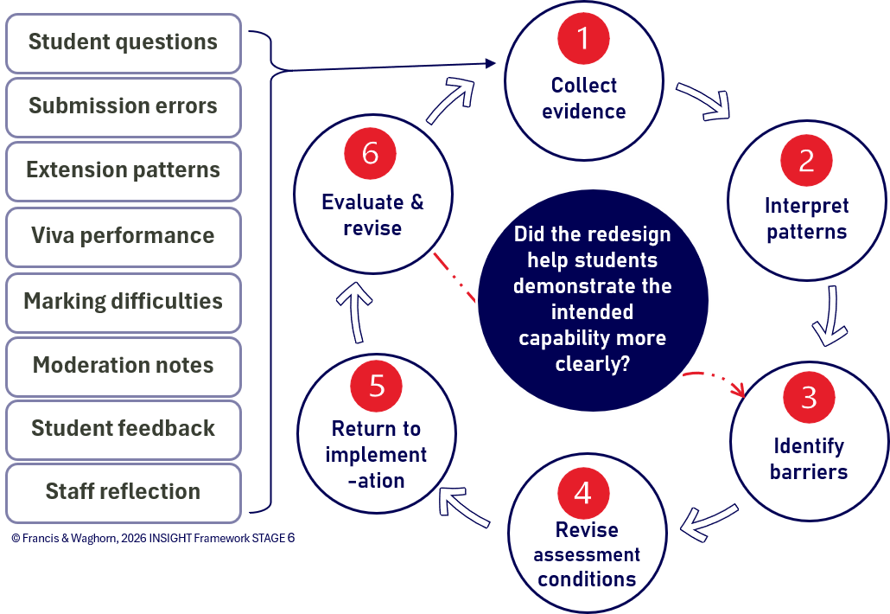
Stage 6: Reflective and data –based decision making
INSIGHT Stage 6

Slide 20
Breakout activity
One assessment condition
One redesign
One preserved standard
8 minutes
One sentence
1
2
3
4
Choose one assessment condition
Name the barrier
Redesign that condition
State the standard being preserved
5
Share your response in the chat
We would redesign [condition] by [change], so students can demonstrate [capability] through [evidence], while preserving [standard].

Slide 21
Whole-room debrief
Condition redesigned
What changed?
Barrier addressed
Which access demand was reduced?
Evidence preserved
What capability is still shown?
Judgement maintained
How will markers judge it fairly?

Slide 22
Applying INSIGHT to your own assessment
1
Reflective Assessment & Planning
What conditions shape participation?
2
Clarify Purpose & Goals
What is the intended capability?
3
Identify & Address Barriers
What access or participation barriers are built in?

Slide 23
Applying INSIGHT to your own assessment (cont)
4
Design for Variability
What can be redesigned while preserving the standard?
5
Implement & Monitor Progress
What instructions, supports, and systems are needed?
6
Reflective & Data-based Decision Making
What evidence will inform revision?

Slide 24
HE and VET transfer
HE
VET
learning outcomes
academic standards
assessment validity
reasonable adjustment
moderation
student participation
competency evidence
fair and flexible assessment
validity and reliability
sufficiency, authenticity, currency
workplace relevance
validation
Shared question: Does the assessment allow learners to generate valid evidence of the intended capability?

Slide 25
Check local requirements before redesign
Assessment redesign must align with governance and accreditation
Design method vs Governance Review
institutional assessment policy
reasonable adjustment procedures
academic integrity requirements
moderation requirements
professional accreditation expectations
VET training product requirements
placement or clinical safety requirements
course approval processes

Slide 26
Valid evidence pathways
Inclusive assessment preserves standards through better design
UDL 3.0
Design for learner variability and agency
INSIGHT Framework
Staged assessment design process
What is one assessment condition you will review next?
BIAS Checkpoint
Self-awareness of assumptions and biases
Assessment Integrity
Maintenance of evidence and judgement

Slide 27
To learn more
Dr Mariko Francis
Course Coordinator and Lecturer - Inclusive Education
School of Education
College of Design and Social Context | RMIT University
Email: mariko.francis@rmit.edu.au
Dr Elise Waghorn
Lecturer and Program Manager
School of Education
College of Design and Social Context | RMIT University
Email: elise.waghorn@rmit.edu.au

