Slide 1
Universal Design for Learning in initial teacher education: Do we practice what we preach?
Dr Samantha Woo
Theme: Engagement, joy and play

Slide 2
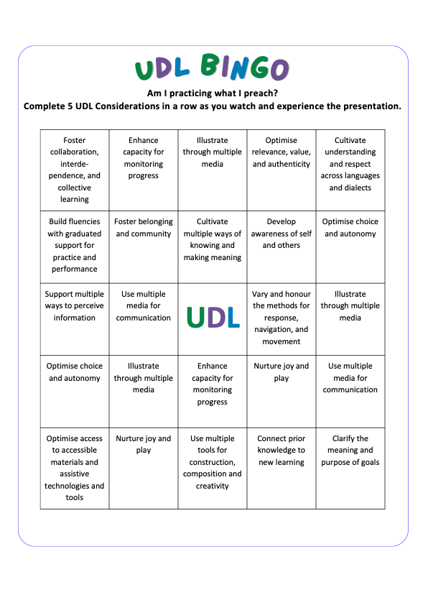
UDL BINGO

Slide 3

Context
Growing global emphasis on
inclusive higher education (HE)
Australian HE = ⬆️ learner diversity
Inclusive education established in primary and secondary education

Slide 4
Problematic?
Limited professional learning and training opportunities on Universal Design for Learning (UDL)
Limited UDL implementation in Australian HE
Initial teacher educators (ITEs) teach UDL
However, Content ≠ Delivery

Slide 5
Research questions
2. Do initial teacher educators who teach UDL practice inclusive education?
1. What do initial teacher educators know about UDL?
3. What are preservice teachers' perceptions of their initial teacher educators' pedagogy and teaching style?

Slide 6
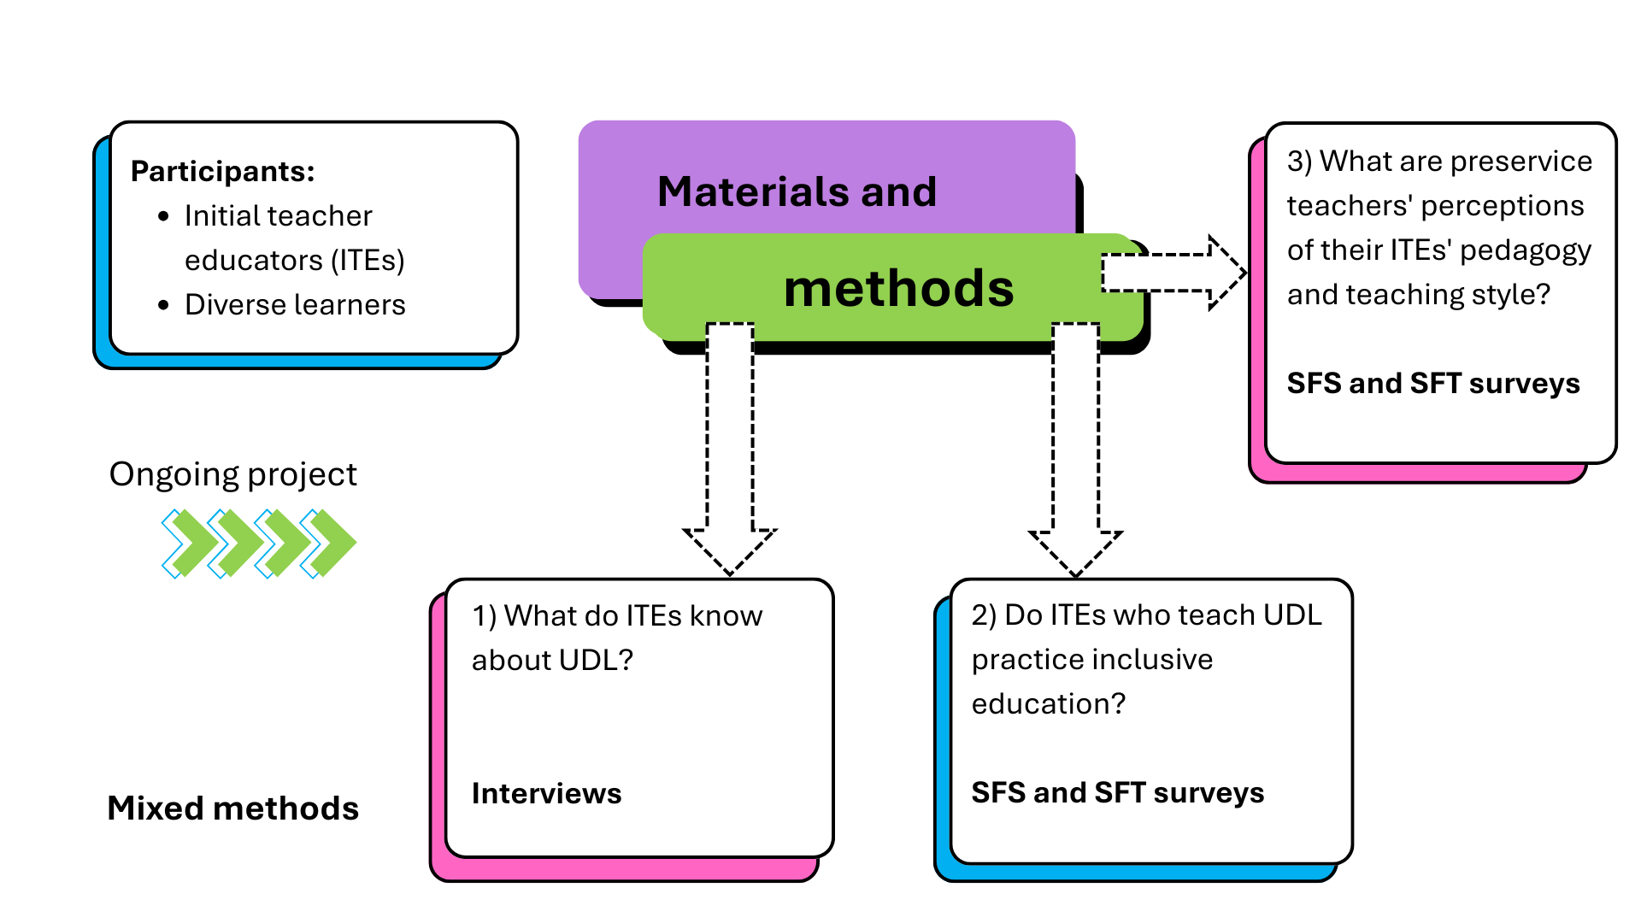
Materials and methods

Slide 7
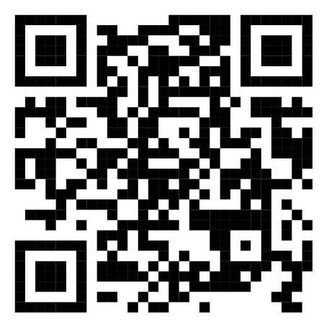
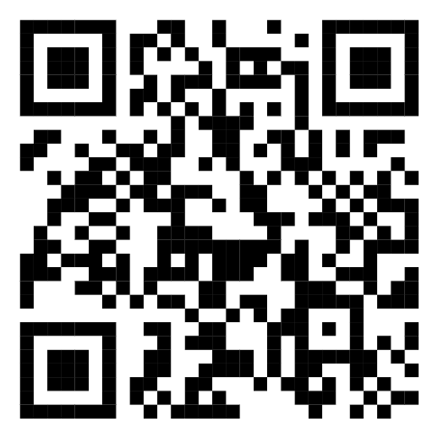
Do we practice what we preach?
Online survey
Paper survey
Gamefied survey

Slide 8
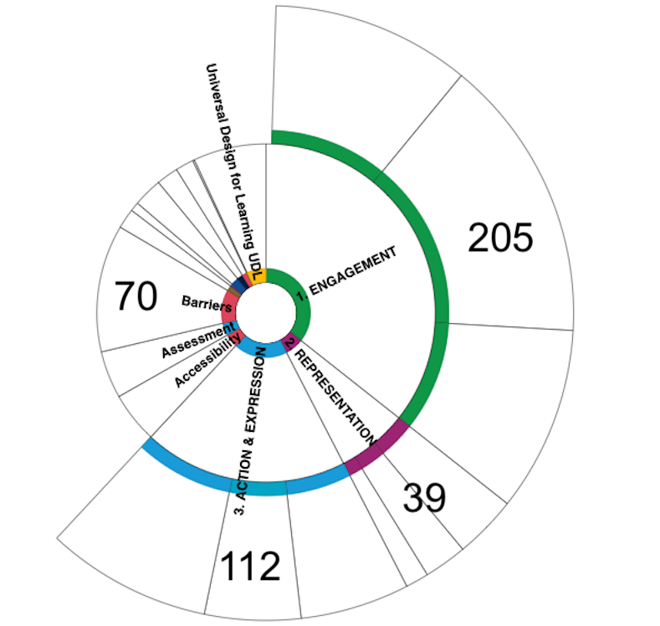
Initial findings
RQ1

Slide 9
Interview overview
No. of coding references | Tutor 1 | Tutor 2 | Tutor 3 | Tutor 4
Barriers | 25 | 20 | 14 | 11
Engagement | 65 | 67 | 42 | 31
Representation | 9 | 24 | 1 | 5
Action & Expression | 28 | 46 | 25 | 13
RQ1

Slide 10
What do ITEs know about UDL?
“I just think the whole funding process is really problematic… some of the assessments are just not suited to the types of students that we have.”
Tutor 1
“When you've got an assignment with one question and [one set of] instructions about… criteria...very, very often, there is just one way that students are expected meet that [criteria].” Tutor 4
RQ1

Slide 11
What else do ITEs know about UDL?
“First tutorial… I ask them to tell me their name ... Tell me something you have difficulty with and then something that you're good at. I can put a name to [the] person and the thing that they said and then find ways to connect.” Tutor 2
“Relational. Relational. And relational. … if you can't reach them, you can't teach them… At the heart of education is the education of the heart. I believe that absolutely. After 52 years, no one will ever convince me otherwise.” Tutor 3
RQ1

Slide 12

A tale of two tutors
RQ2
RQ3
buzzword: play

Slide 13
Do ITEs who teach UDL practice inclusive education?
RQ2
A Tale of Two Tutors Survey item 8. I was satisfied with the quality of this staff member's teaching:
Year/Semester | Explicit Agreement Tutor 2 | Explicit Agreement Tutor 3 | Explicit Agreement School | Explicit Agreement University
2024 Autumn | 80% | 100% | 82% | 85%
2024 Spring | 0% | 100% | 81% | 85%
2025 Autumn | 33% | 100% | 81% | 83%

Slide 14
What are preservice teachers' perceptions of their ITEs' pedagogy and teaching style?
RQ2
RQ3
“Tutor 2 is a lovely teacher and subject coordinator however I did not enjoy any aspect of this unit. The content was very interesting, but delivery methods and activities were repetitive … tedious. Classes were not engaging at all and rather boring. Time seemed to stop whilst in this class.”
“Everything! Is there anything Tutor 3 can't do? OK specifics. Role model for how I should be running my classes, has amazing social skills, again a role model for teacher-student relations. Encourages participation, ties humour in with teaching.
Too much to list.”
“I have never been so dissatisfied with the behaviour and lack of empathy of a subject coordinator [Tutor 2]”

Slide 15
Final thoughts
RQ2
RQ3
“I was incredibly lucky to have Tutor 3. She is engaging, knowledgeable, and an incredible role model ... our first tutorial, she stated teaching is about relationships. We went around the room and introduced ourselves. She then went around the room and remembered all our names. This activity made me feel acknowledged and was the first time in my Master’s degree I understood teaching is so much more than curriculums and standards.”
“Tutor 2 was approachable and interacted with all of her students.”
“Tutor 2’s class is not engaging, and the provided literature is not relevant.”

Slide 16

Any questions?

