Slide 1
Simple Yet Significant Steps Towards Inclusion – A Faculty Partnership
“An Incomplete Odyssey,
An Unfinished Epic…”
Steve Morgan - Manager, Access & Inclusion, Deakin University

Slide 2

Acknowledgement of Country

Slide 3
The Context
Broad Context
Gaps
  Students with disabilities experience gaps in success, retention, career outcomes and sense of belonging.
Barriers Persist
  Individual barriers but fail to tackle systemic issues in course design and culture.
Burden on Students
  Students experience need for disclose needs and navigate processes, creating ongoing stress and inequities.
Evaluation
  Broader reforms are essential to ensure inclusive education without reliance on individual adjustments.
Deakin Context
Rising engagement with Disability Resource Centre
  Disability support registrations increased 178%, reflecting broader trends in awareness and diagnosis.
Pressure on staff and students
  Traditional indiviualised support and adjustments face challenges from increasing wait times, complex needs risk of staff burn out.
Incremental changes to service and practice
  Multiple modes of engagement, action and representation
  Student voice via Advisory Group
  Improvements in systems and processes
  Slight (very slight) increase in Disability Liaison Officer FTE over the last few years

Slide 4

February 2025

Slide 5

March 2025

Slide 6

Not so fast…

Slide 7
The thinking
Identified 2 objectives to improve the experience of students with disability:
Immediate support for under resourced services
Strategic initiatives to explore sustainable support model and embedding of inclusive practices
To support work and projects across:
Digital Accessibility, Accessible Materials and Assistive Technology
Project Coordination
Faculty Partnerships – to embed UDL knowledge, forward plan, understand and capability build

Slide 8
The refinement
“Will this work?”
Scope refined and finally approved…
From 4 faculties, down to 1…. And as a 12-month pilot.

Slide 9
The Faculty of Health Partnership
Why Faculty of Health?
High enrolments for Students with Disability
Diverse courses across all campuses
WIL and Placement complexities
But most of all… Relationships

Slide 10
The Launch
Recruitment of Elizabeth Williams
Getting the word out via Associate Dean Teaching and Learning and Associate Heads of Schools
Membership of the Faculty Teaching and Learning Committee
Regular engagement with Learning Design Leads

Slide 11
The Work
T&L Committees and standing meetings
Course wide approach
PoC for teaching teams to discuss reasonable adjustments and embed inclusive practices
PoC WIL and placement teams to embed Inclusive Practices
Digital Accessibility Working Group and Capability building opportunities
Capability building activities and resources

Slide 12
The Work (cont.)
Disability Inclusive health Professionals Education Alliance ANZ
Lead by Laura Gray is Director of the Damion Drapac Centre for Equity in Health Professions Education at Deakin University
Advancing disability inclusion in medical education by supporting the implementation of the Inclusive Medical Education Guidelines developed by the Medical Deans of Australia and New Zealand (MDANZ).
Project team has designed national professional development program centred on the Disability Inclusion Self-Assessment Tool (SAT) to help medical schools evaluate and improve inclusive practices across the student lifecycle
Workshops include:
Building an inclusive culture: language, training and support.
Supporting applicants with disabilities
Inclusive practices in admissions
Reasonable adjustments: necessary but not sufficient
Inclusive practices in teaching and learning
Inclusive practices in clinical placement
Inclusive practices in medical school assessment

Slide 13
The Spanner In The Work
M
W
C

Slide 14
Sept 2026

Slide 15
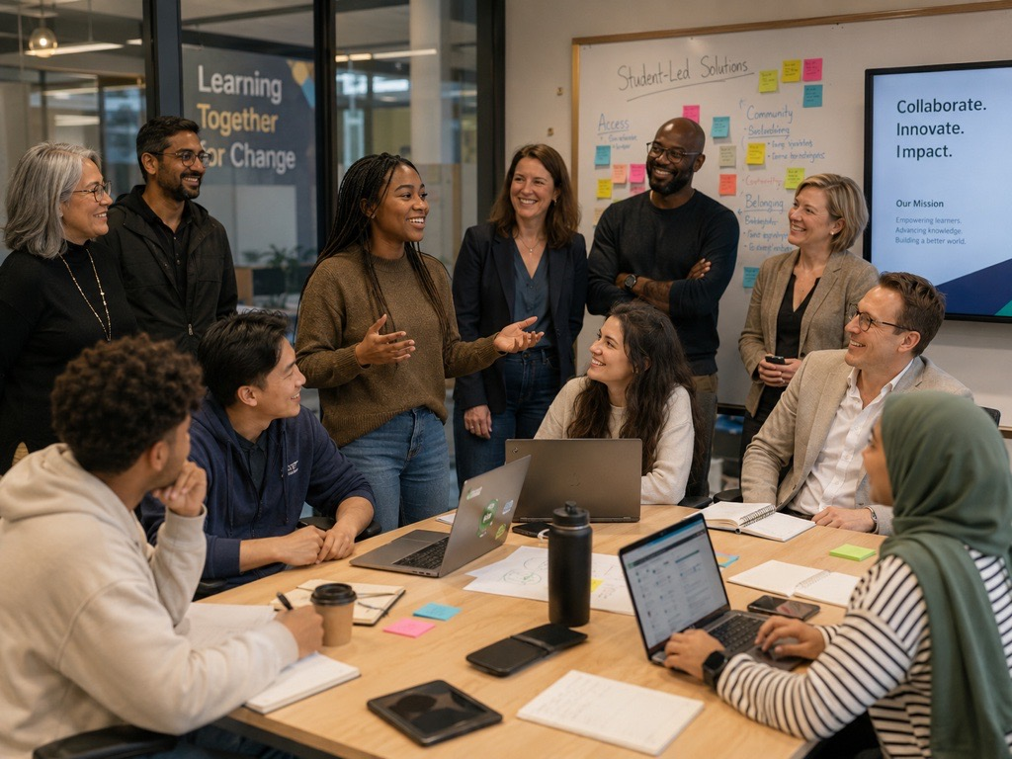
June 2026 – January 2027
Higher Education Disability Support Program - Department of Education, Australian Government - A disability governance committee as a subcommittee of the university’s principal governing body (including publishing the membership and terms of reference)

