Slide 1
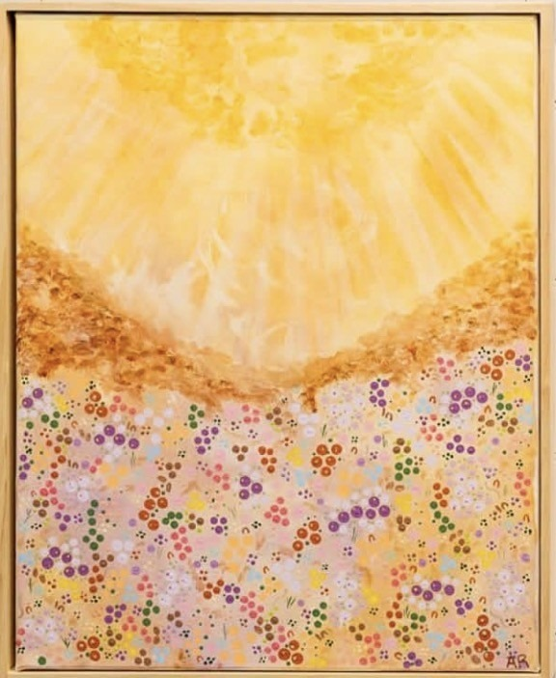
Acknowledgement of Country
We acknowledge First Nations peoples in Australia and across the world whose songlines traverse the globe. We pay our respects to their elders, past, present, and emerging whose cultural traditions inspire and continue to educate.
Instagram: Annie_richos_art

Slide 2

UDL in Action:
Rethinking 'Representation'
Rebecca Rosenberg & Elisabeth Arnold

Slide 3


Your Facilitators
Rebecca Rosenberg
Elisabeth Arnold
Lecturer (Curriculum & Pedagogy – Special Education), UniSQ and PhD Candidate, Monash University
Casual Academic (Visual Communication Design) and PhD (Design) Candidate, The University of Newcastle

Slide 4
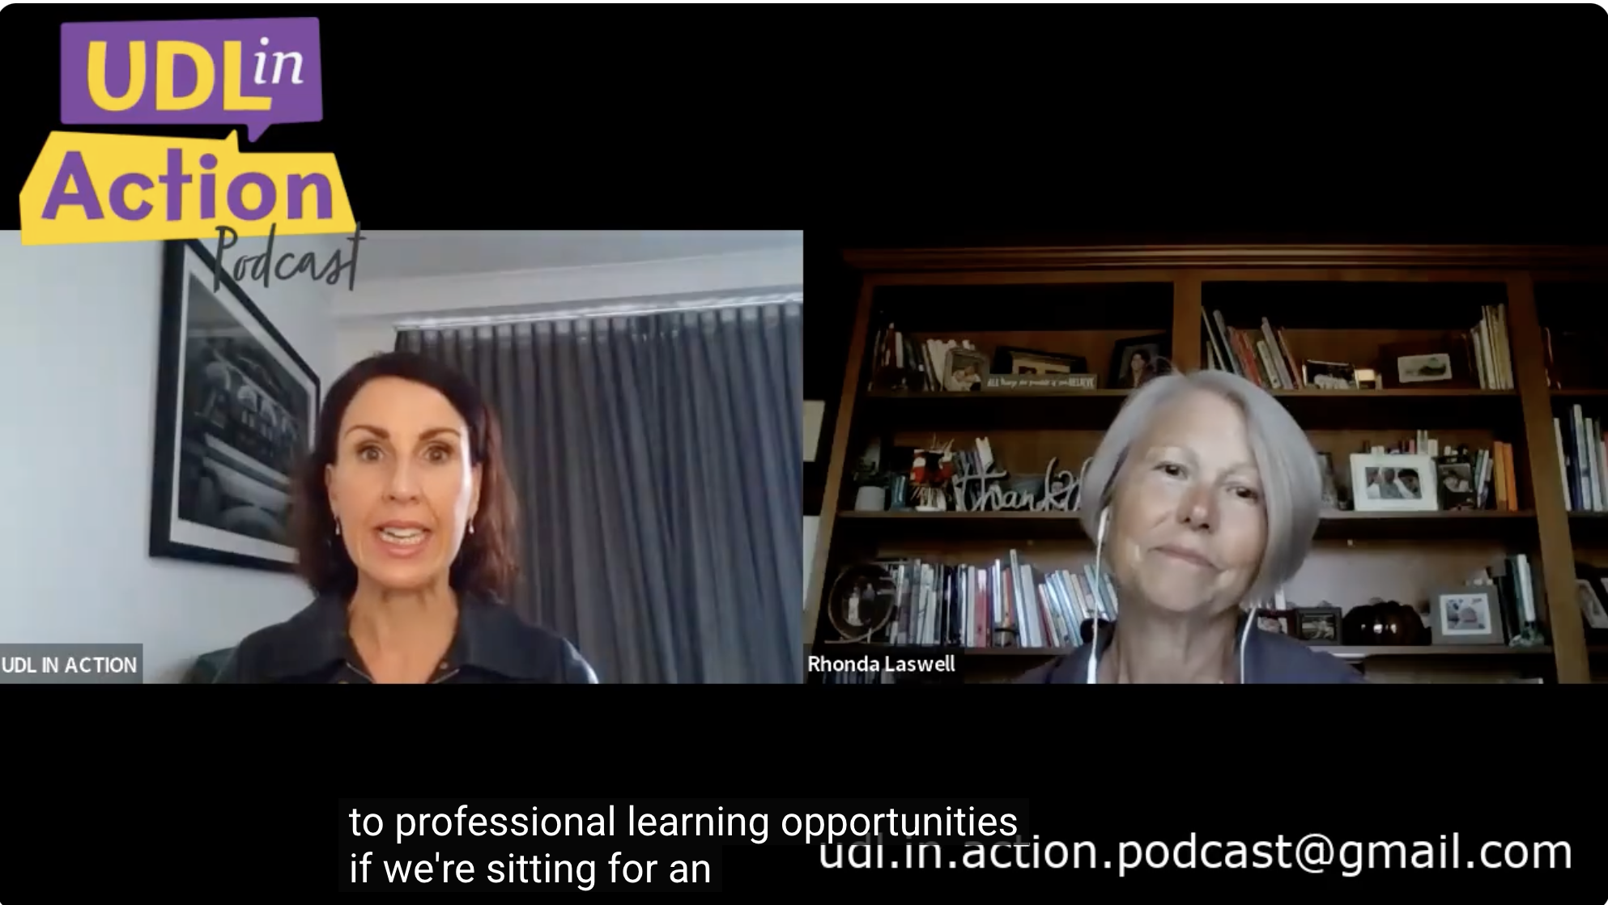
UDL in Action Podcast
Podcast brings together voices from Australia and the United States, bridging educational approaches and shared Universal Design for Learning (UDL) values across global contexts. Whether you're in a rural school with under 90 students or a large district pioneering inclusion, the principles are the same and powerful.

Slide 5

Goal
To understand how we, as educators, can support teachers in our schools to reflect on their practice and apply “Representation” strategies based on Framework to enhance cognitive accessibility.
Why
Because how information is designed directly shapes learner access and engagement, long before instruction begins.

Slide 6

Agenda
I Do (Explicit Meaning)
Introducing UDL principle ‘Representation’
We Do (Collaboration & Discussion)
Learning about Cognitive Accessibility and Identifying inaccessibility in examples.
You Do (Application)
Applying this knowledge to an inaccessible learning material.

Slide 7


I Do (Explicit Meaning)
Introducing UDL principle ‘Representation’

Slide 8

UDL VS
Differentiation
By Katie Novak

Slide 9
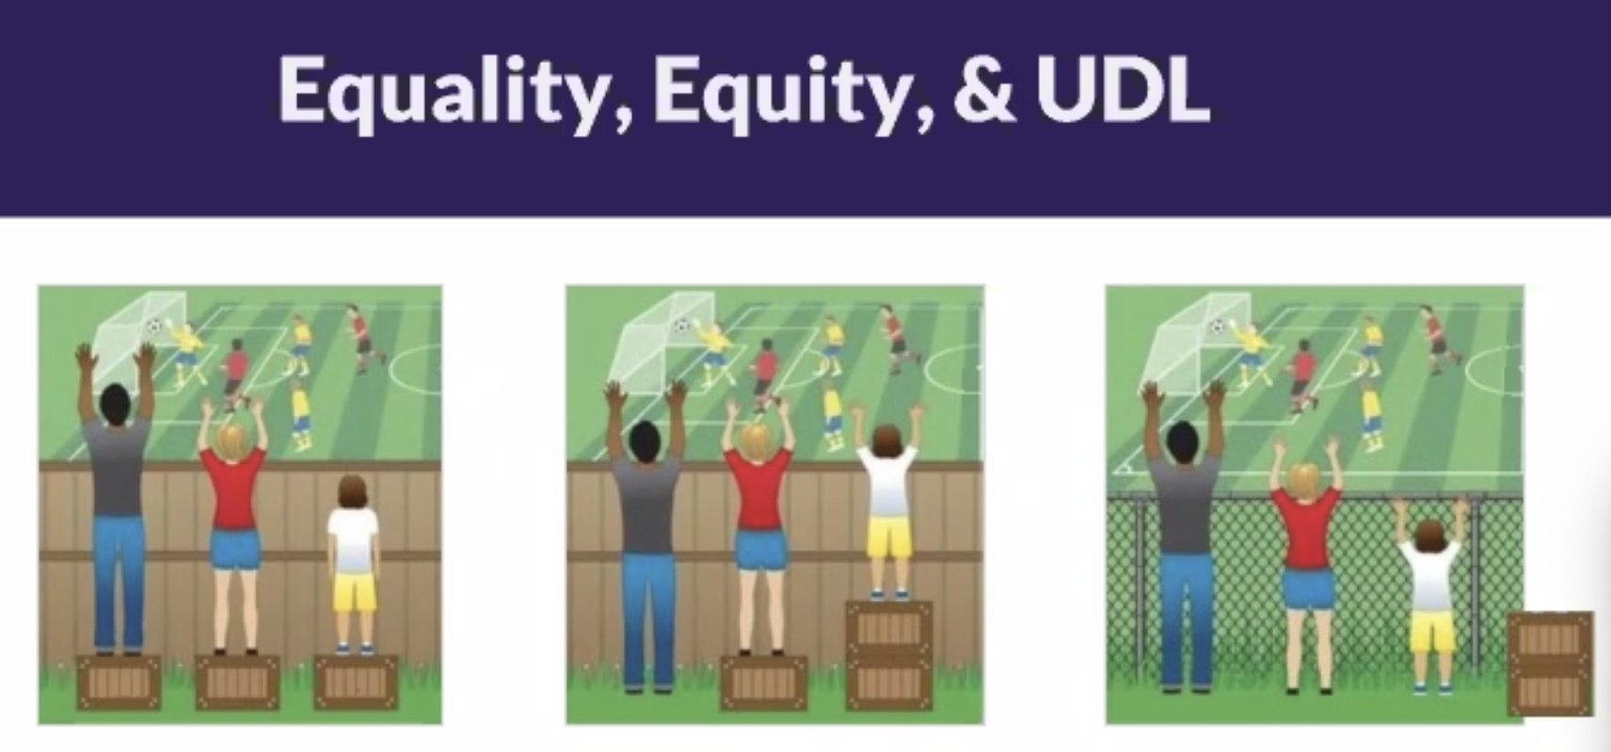
Equality, Equity, and UDL

Slide 10
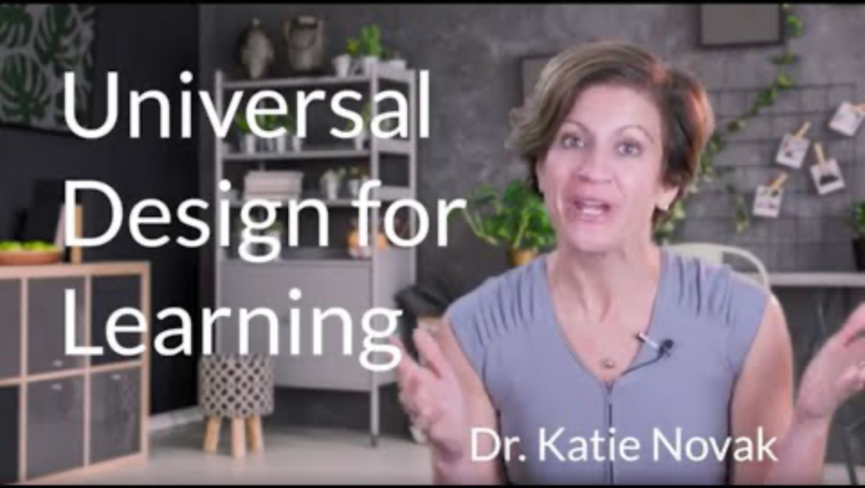
What is UDL

Slide 11
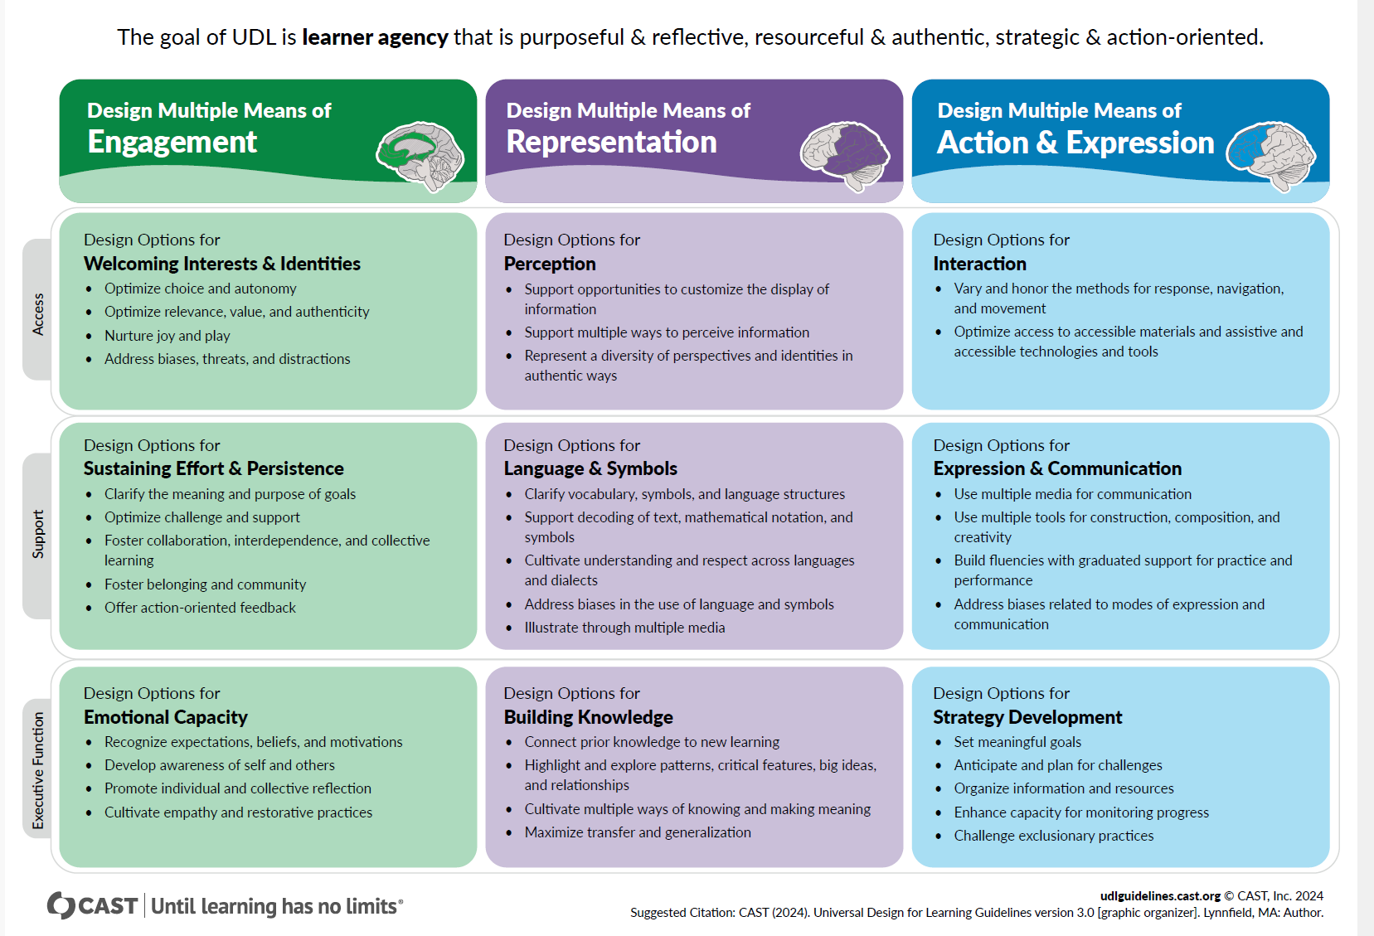
UDL Guidelines

Slide 12
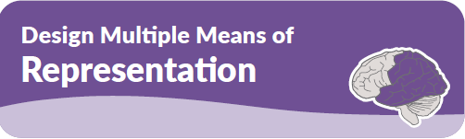
The "what" of learning
Perception | Language and Symbols | Building Knowledge
Support opportunities to customize the display of information | Clarify vocabulary, symbols, and language structures | Connect prior knowledge to new learning
Support multiple ways to perceive information | Support decoding of text, mathematical notation and symbols | Highlight and explore patterns, critical features, big ideas and relationships
Represent a diversity of perspectives and identities in authentic ways | Cultivating understanding and respect across languages and dialects | Cultivate multiple ways of knowing and making meaning
 | Address biases in the use of language and symbols | Maximize transfer and generalization
 | Illustrate through multiple media

Slide 13
UDL Representation: Framework for Inclusion
UDL Representation Principle​
UDL transforms accessibility guidelines into practical confident inclusive knowledge
Offers multiple ways to present information
Empowering Educators​
Thoughtful Instructional Design​
Background And Purpose
Inclusion is integral to good teaching with layout and language
Design choices focussed on clarity and flexibility
Integrating Inclusion and Teaching​

Slide 14

Take a moment to consider

Slide 15

We Do (Collaboration and Discussion)
Learning about Cognitive Accessibility and Identifying inaccessibility in examples.

Slide 16
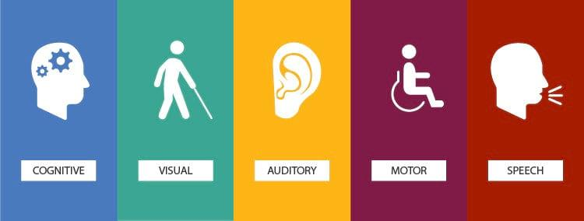
Accessible design categories

Slide 17
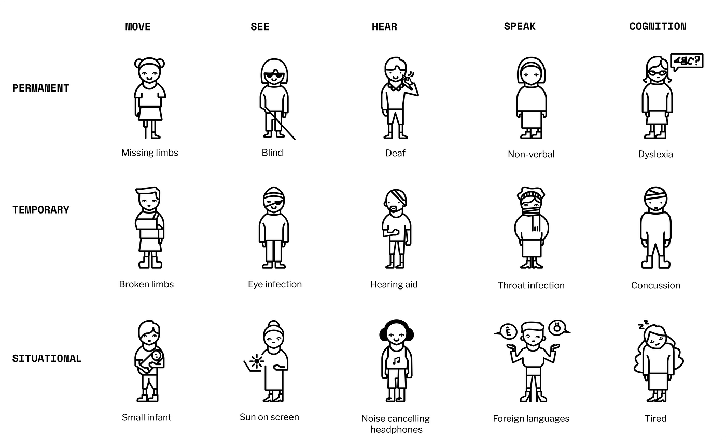
Disability need spectrum

Slide 18
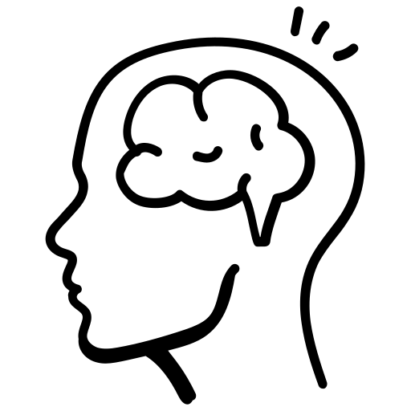
What is Cognitive Accessibility?

Slide 19
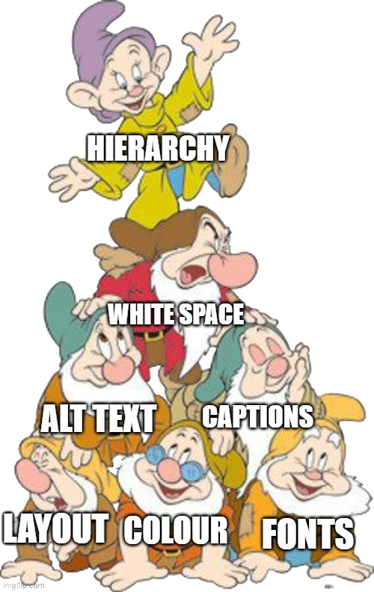
7 dwarfs of accessibility

Slide 20


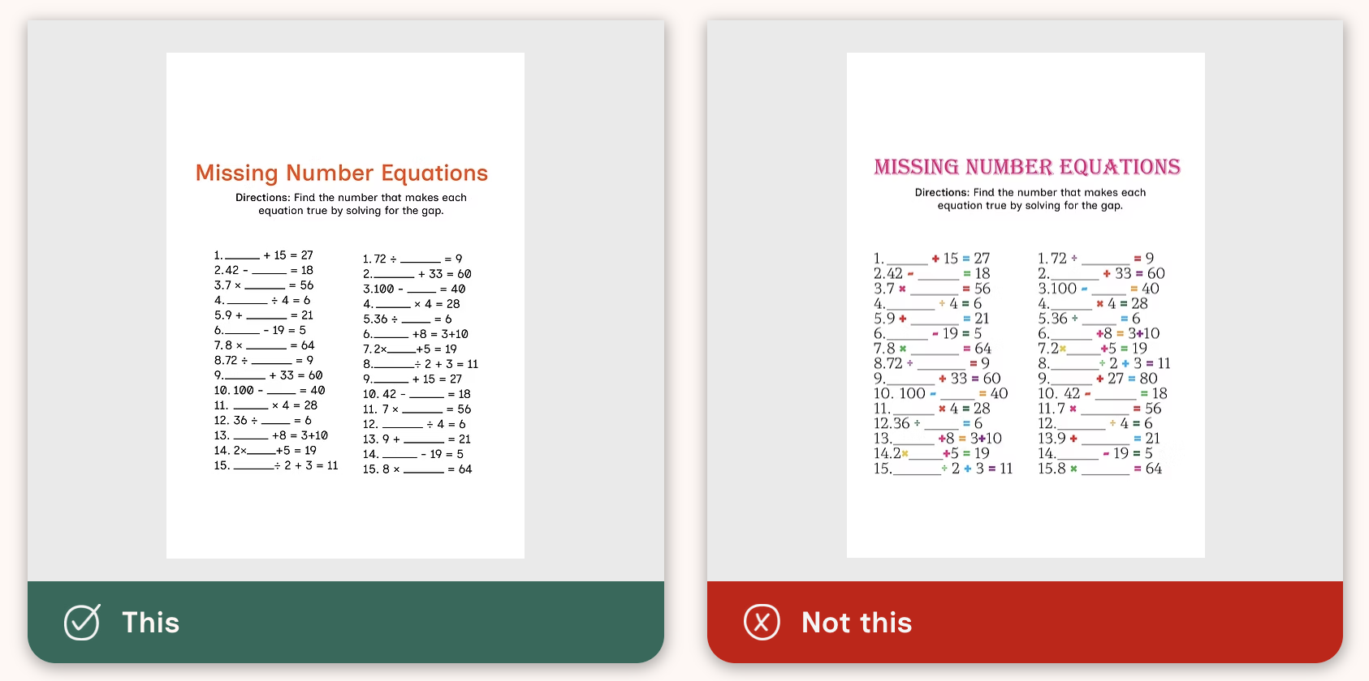
Printed Content
Worksheets, Posters etc.
Tips:
Colour contrast needs to be strong
Visual Cues
Don’t use white background with black text
Logical layout
Headings and Hierarchy
Chunking information

Slide 21

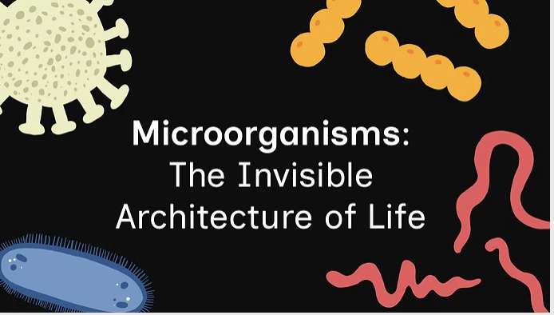
Digital Content
Presentations, websites etc.
Tips:
Colour contrast needs to be strong
Visual Cues
Don’t use white background with black text
Logical layout
Headings and Hierarchy
Chunking information
Alt text
Field titles
Keyboard navigation

Slide 22
Video Content
Youtube, animation, motion graphic
Tips:
Colour contrast needs to be strong
Captions
Pause, Hide and Stop
Flashing less than 3 seconds
Alternative to the video
Reduce motion
Don’t rely on the motion to communicate

Slide 23
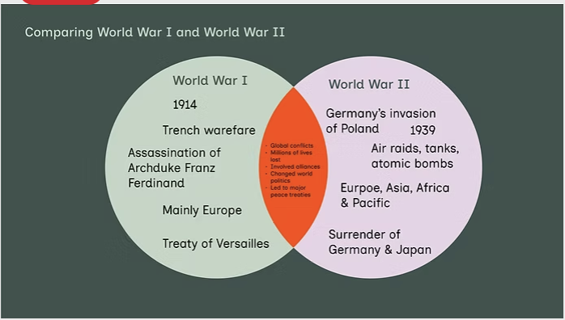
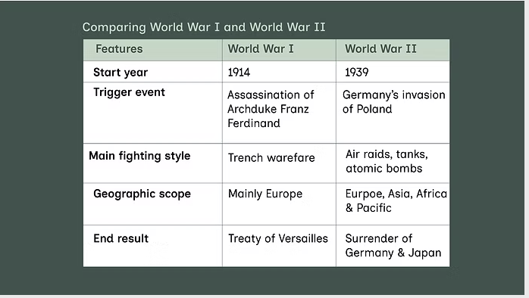
Images/ Visuals
Illustrations, graphics, tables, figures, diagrams etc.
Tips:
Colour contrast needs to be strong
Simplified forms
Text alternatives
Relate it to the information

Slide 24
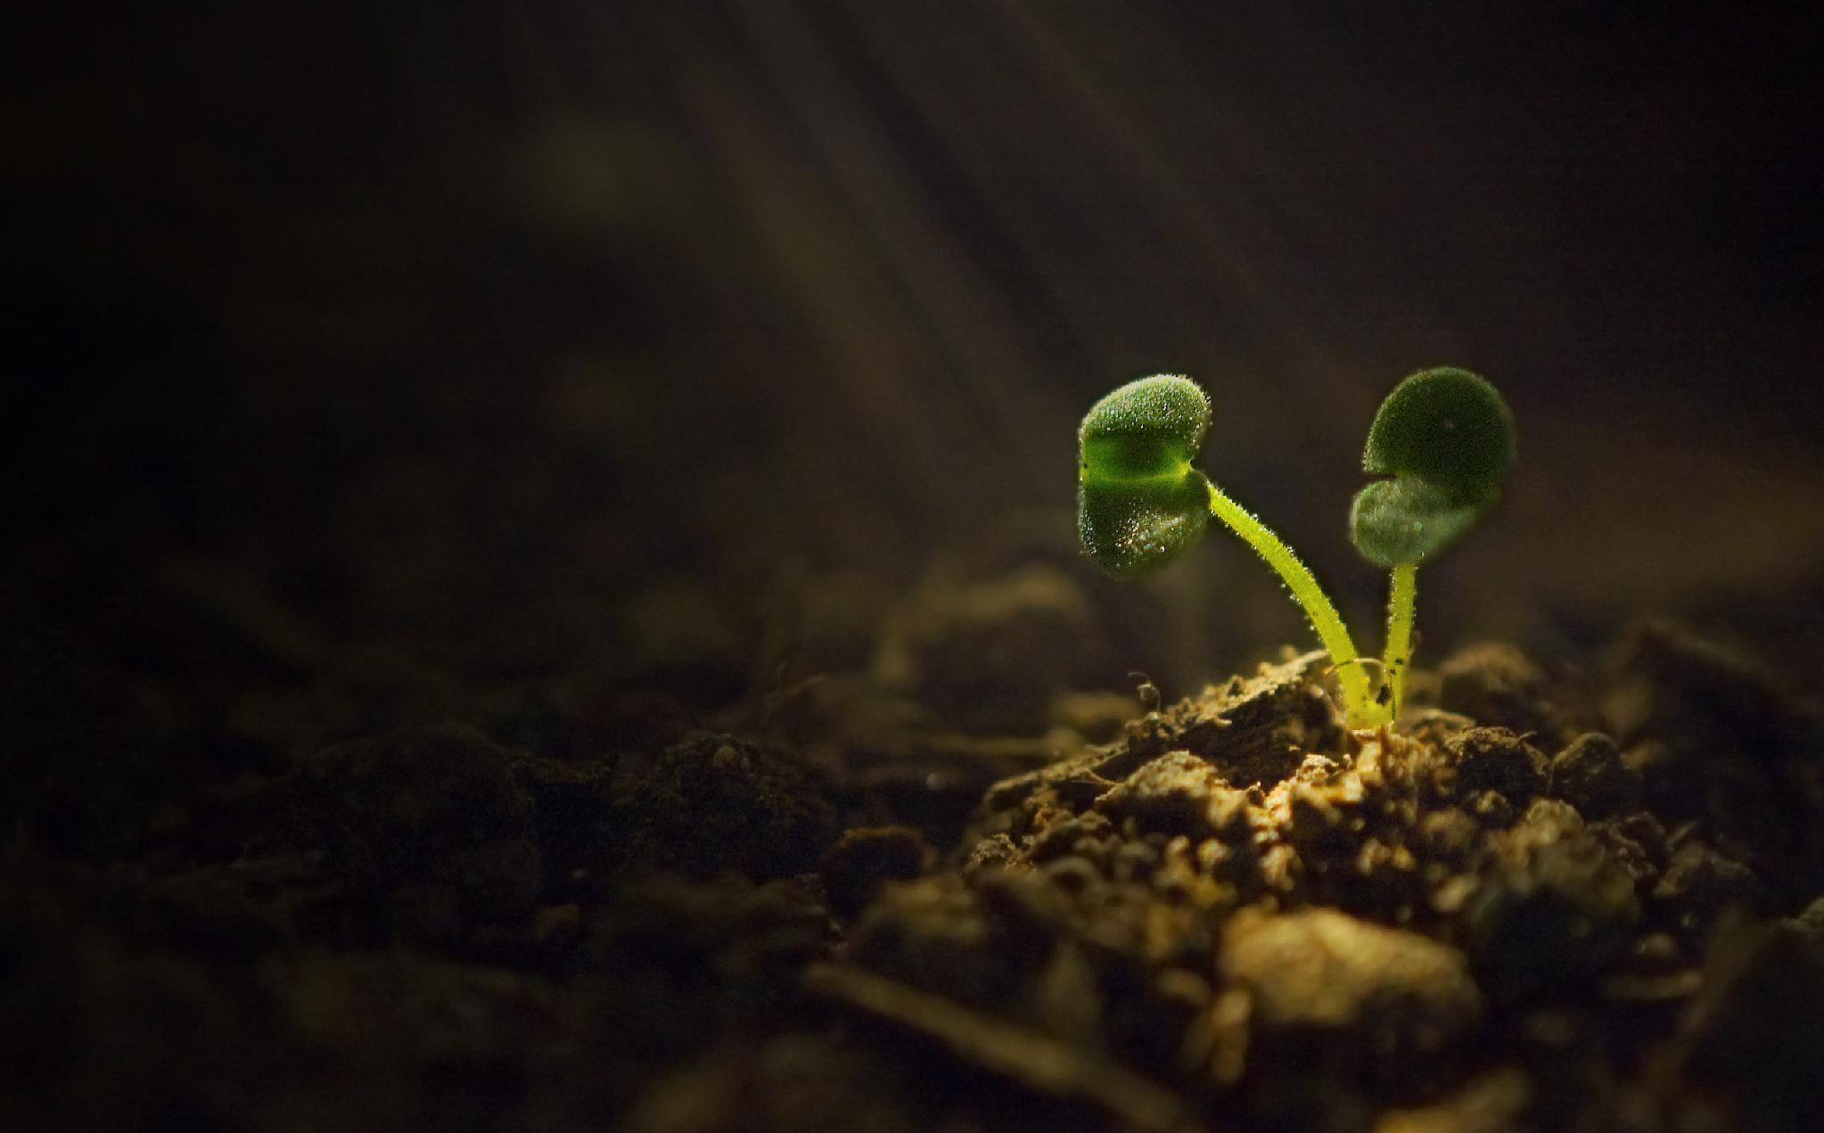
Photosynthesis slide
Photosynthesis is the process by which plants, algae, and some bacteria convert light energy into chemical energy stored in glucose. This process occurs in the chloroplasts and involves chlorophyll absorbing light. 6CO2 + 6H2O + light energy → C6H12O6 + 6O2 Photosynthesis is essential for life and includes light-dependent reactions and the Calvin cycle.

Slide 25
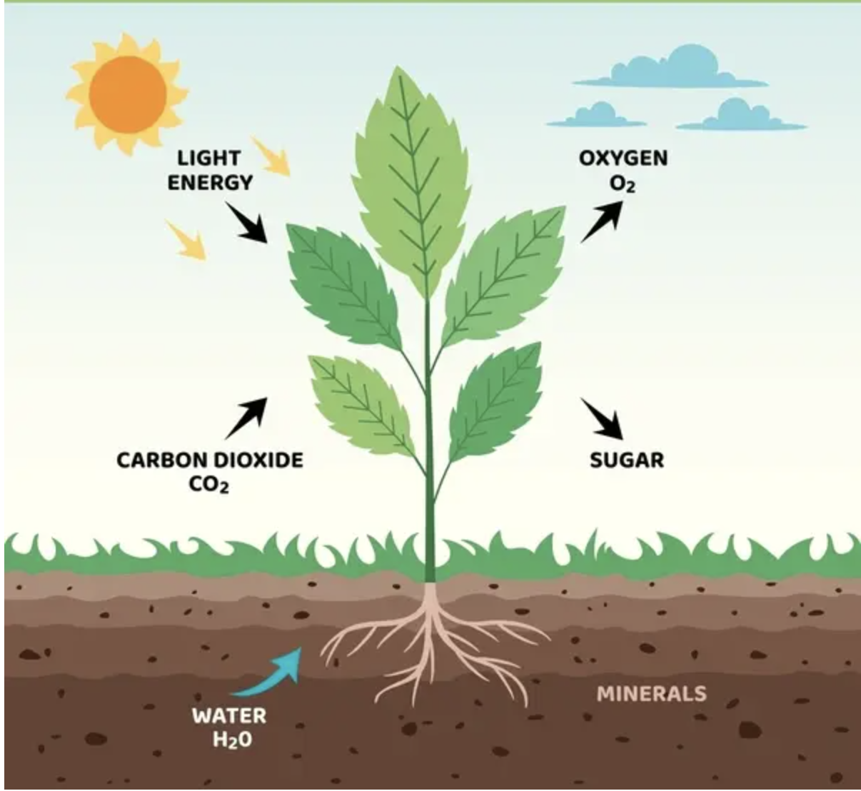
Photosynthesis
What is it?
Plants use sunlight to make food
What plants need:
Sunlight, Water, Carbon dioxide
What is produced
Glucose (food), Oxygen
Key idea
Sunlight energy → food for plants

Slide 26

What Changed?
Reduced text (less overload)
Clear structure
Key ideas highlighted
Simpler language
Image that directly illustrates the text
Consistent font
Reduced colours
Increased negative space
Image proportional

Slide 27

K-6 Scenario

Slide 28

Mr. James – Year 6 Class
Mr James is a passionate Year 6 teacher known for his creative lesson ideas. However, he has been increasingly frustrated by his students’ inconsistent engagement in his lessons, particularly from three students:
1. Ali, who experiences high anxiety
2. Sienna, who has sensory processing challenges
3. Ty, who has ADHD

Slide 29

  What UDL Representation strategies could we implement to help:
  Ali – High anxiety
  Sienna – Sensory processing challenges
  Ty - ADHD

Slide 30
  What Cognitive strategies could we implement to help:
  Ali – High anxiety
  Sienna – Sensory processing challenges
  Ty - ADHD

Slide 31
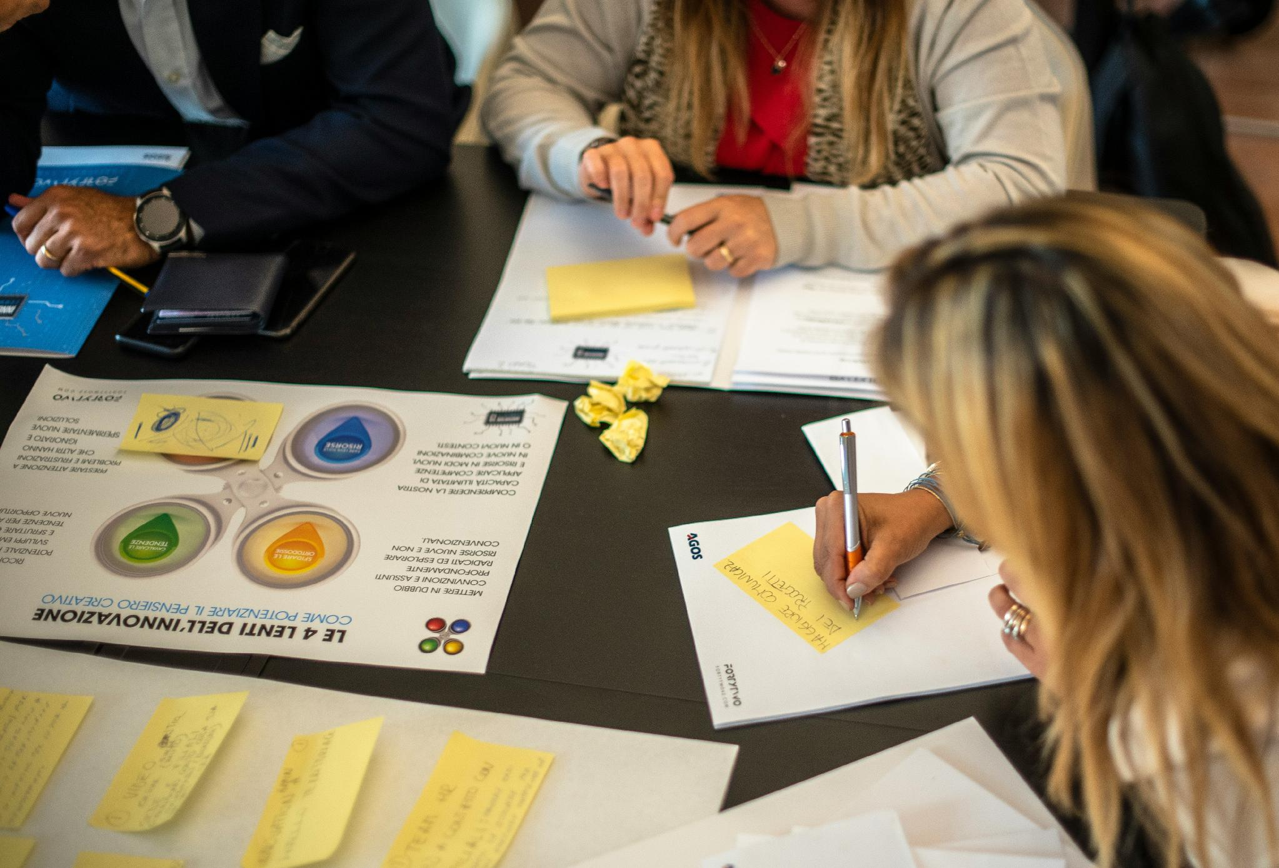
You Do (Application)
Applying this knowledge to an inaccessible learning material.

Slide 32
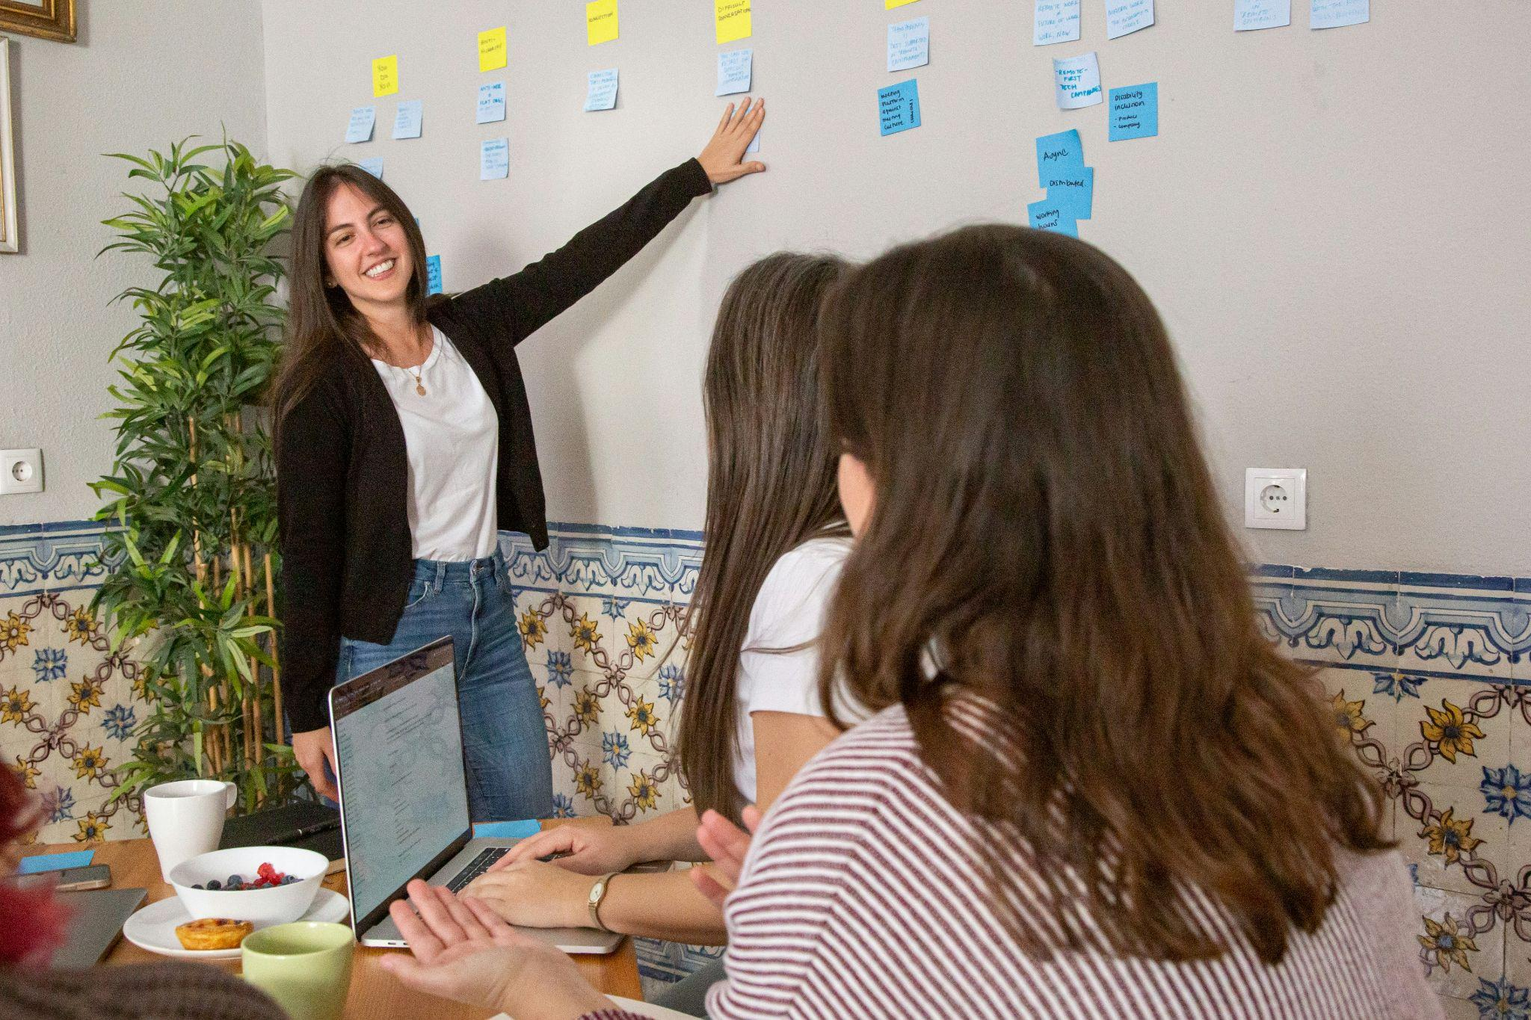
Over to you!
Collaborative Strategy Exploration​
Identify multiple effective design choices that reduce cognitive load
Cognitive Accessibility Techniques​
Consider techniques - i.e. chunking information and simplifying sentences

Slide 33
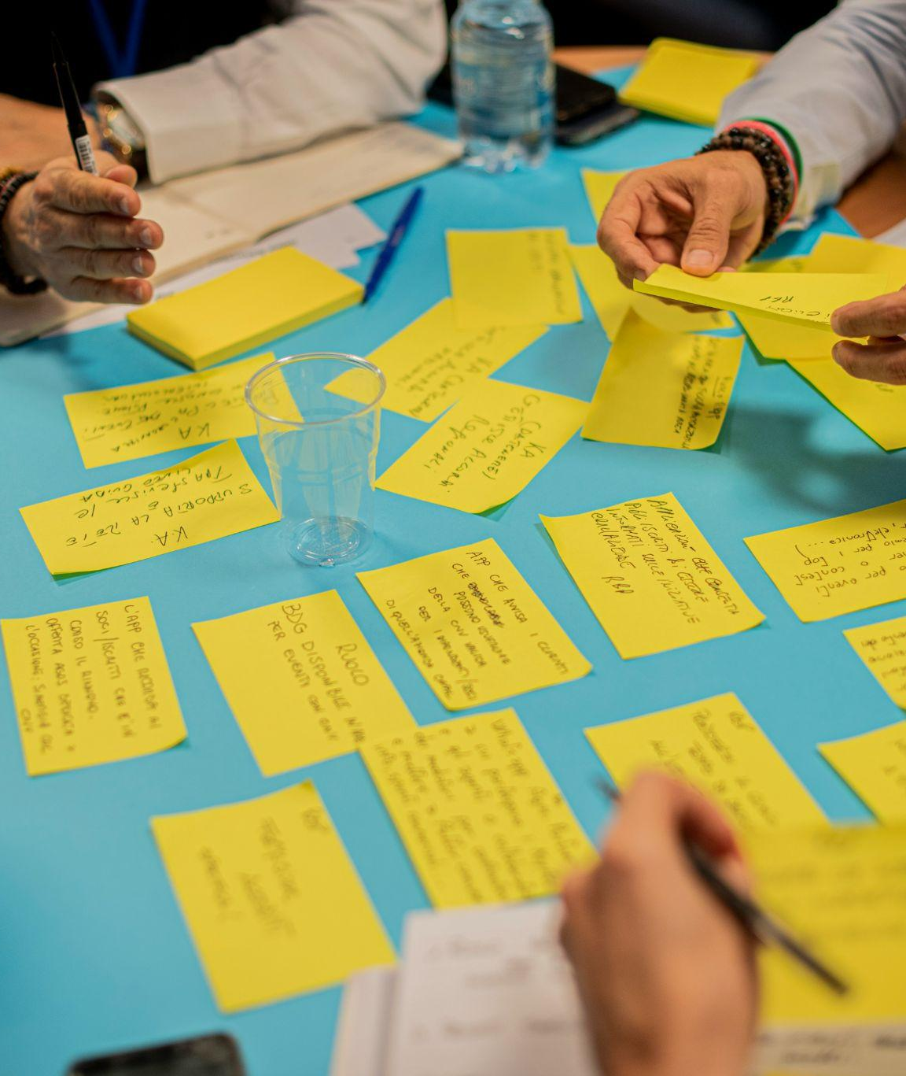
Independent or Collaborative Application
Inclusive Design Dialogue​
Share ideas and questions
Practical UDL Application​
UDL principles can be integrated into existing practices without new resources.

Slide 34

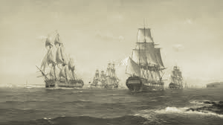

Colonization in Aus
Colonization began in 1788 when the First Fleet arrived in Sydney. This was the start of British settlement in Australia. Over time, more colonies were formed, and the population grew. However, this had a major negative impact on Indigenous Australians, including losing their land and population decline. These events shaped the development of modern Australia.

Slide 35

Reflection & Ongoing learning
Structured Reflection​
How have your views about accessibility and representation evolved?
Immediate Design Changes​
What design challenges are you going to immediately implement?
Ongoing Learning Resources​
Consider ongoing learning opportunities
e.g., podcasts and curated materials

Slide 36
Remember
Building inclusive teaching is a continuous journey supported by practical tools and deep conceptual understanding

Slide 37
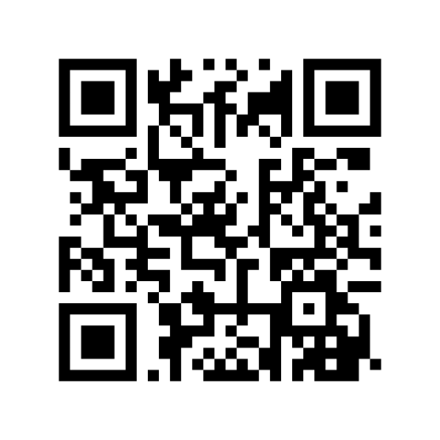
Listen to the podcast!

Slide 38
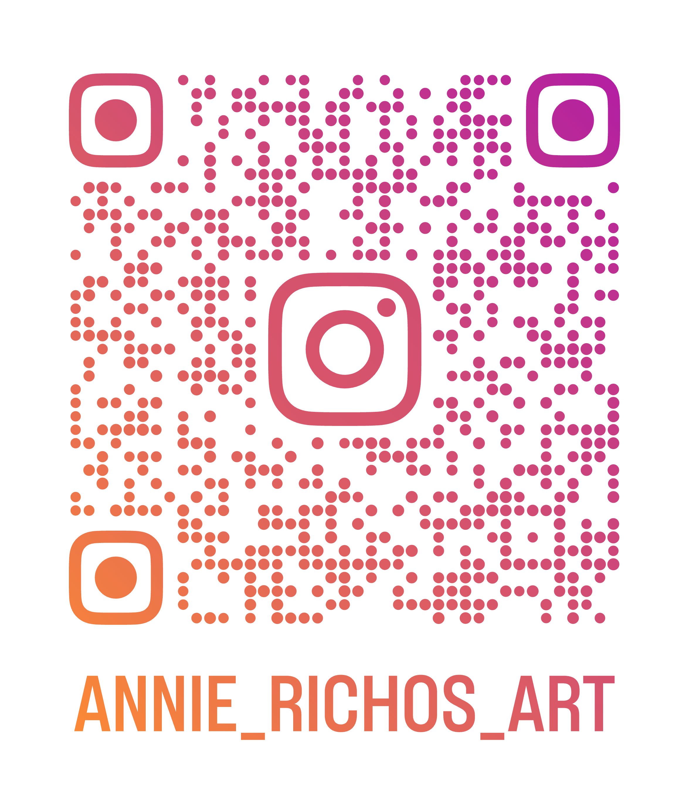
Thank you
Rebecca Rosenberg
  Email: rebecca.rosenberg@usq.edu.au
Elisabeth Arnold
  Email: Elisabeth.arnold@uon.edu.au

