Slide 1
UDL Beyond the Course: Designing Program Structures for Access and Inclusion
Dr Rachel Kasturi and Dr Freddy Ha

Slide 2
Today’s Agenda
Curriculum Transformation
Pedagogical Principles
Scaling UDL for Programs

Slide 3
UNSW Strategy: Progress for All
Through accessible education, empower current and future generations.

Slide 4
Curriculum Transformation
Assessment and Feedback
Pedagogical Principles
Flex-Semester Alignment
Laying the foundations to transition to the Flex-Semester calendar

Slide 5
Pedagogical Principles
Universal Design for Learning
Prioritising the cultural and emotional dimensions of learning
Societal impact through education
Embedding Indigenous Knowledges in curriculum
Development of future-focused skills
Foster curious, autonomous lifelong learners
Learner-centred, contextualised and connected education
Use of evidence-informed curriculum and assessment practice

Slide 6
Transforming Education for UNSW’s Future
Our Foundational Pedagogical Principles
Universal Design for Learning
2. Prioritising cultural and emotional dimensions of learning
All programs, all courses
Commitment not Compliance

Slide 7
A commitment to UDL for all programs and courses

Slide 8
What does this look like in practice?
Program versus course
Commitment versus compliance
“Done” versus iterative
“Scalable” versus one size fits all
Shared responsibility versus personal inclusive pedagogy
Authenticity

Slide 9
Scaling UDL: Where policy, implementation and evidence collide
Hollingshead et al. (2026) caution that UDL is not simply “3 principles, 9 guidelines, and 31 checkpoints.”
The framework also involves:
learner variability
barriers to curricula
intentional and iterative design
expert learning
contextualised implementation

Slide 10
Why think about UDL at program level?
Student experience does not come only from individual classes
Students in the same program do not have the same learning needs
The cost of not designing for variability is uneven student success
UNSW Student Feedback
Our Student Experience Survey (2025) indicated that Program Quality and Teaching Staff Quality:
Mostly predict overall satisfaction for all students
Dominate themes found in 'Needs Improvement’ section in student comments

Slide 11
Three Focus Areas for Program-level UDL
Accessibility and predictability
Expectations and hidden curriculum
Assessment variety, pacing and progression

Slide 12
Facilitating Proactive Identification of Student Barriers
Accessibility and predictability
Program Awareness Check-in (Accessibility and UDL)
Expectations and hidden curriculum
Learner perspective exercise
Assessment, pacing and progression
Assessment Mix Activity

Slide 13
Assessment Mix through a UDL Lens
Early low-stakes practice (UDL 5.3)
Manageable timing (UDL 8.2)
Format variety (UDL 5.2)
Balanced weighting (UDL 5.4)

Slide 14
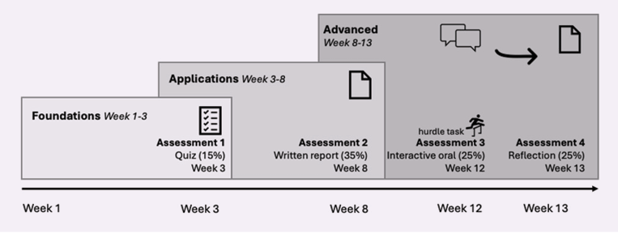
Assessment Mix Activity
Diagram from the Inclusive Teaching Guide (pp.34)

Slide 15
Student Program Journey Mapping Exercise
Visual
Narrative

Slide 16
Tracking and iteratively strengthening inclusive and supportive practices over time

Slide 17
“Shared Baseline Plus One” template
Shared Baseline
Engagement
(Practice 1)
Representation
(Practice 2)
Action & Expression
(Practice 3)
Plus One
Update Shared Baseline once expectations met or exceeded
Individual educators add an intentional, context-specific change based on student feedback or priorities
Adapted from Tobin 2024

Slide 18
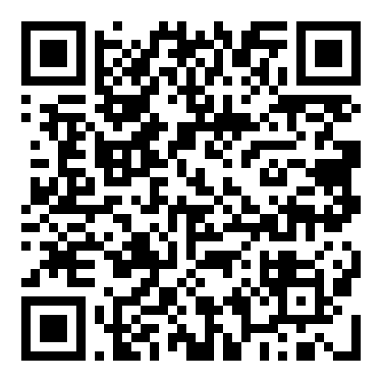
Questions?
Rachel Kasturi | LinkedIn
r.kasturi@unsw.edu.au

Slide 19
References
ADCET Academy. (n.d.). Universal Design for Learning 3.0 in tertiary education. https://adcetacademy.edu.au/courses/universal-design-for-learning-3-0-in-tertiary-education/
Advance HE. (2024). Framework for inclusive learning and teaching. https://www.advance-he.ac.uk/knowledge-hub/framework-inclusive-learning-and-teaching
CAST (2024). CAST Universal Design for Learning Guidelines version 3.0. Retrieved from https://udlguidelines.cast.org
Center for Teaching, Learning and Mentoring. (n.d.). Providing flexibility to students during times of disruption. University of Wisconsin–Madison. https://ctlm.wisc.edu/resources/flexibility/
Hollingshead, A., Lowrey, K. A., & Howery, K. (2026). Universal Design for Learning research: Where policy, implementation, and evidence collide. Journal of Disability Policy Studies, 1–11. https://doi.org/10.1177/10442073261435095
Kane, J., & Mushtare, R. (Hosts). (2026, May 27). UDL at scale (No. 447) [Audio podcast episode]. In Tea for Teaching. https://teaforteaching.com/447-udl-at-scale/
Moreu, G. & Brauer, M. (2022). Inclusive teaching practices in post-secondary education: What instructors can do to reduce the achievement gap at U.S. colleges. International Journal of Teaching and Learning in Higher Education, 34(1), 170-182.
Naylor, R., & Mifsud, N. (2019). Structural inequality in higher education: Creating institutional cultures that enable all students. National Centre for Student Equity in Higher Education.
Teague, M., Head, K., Osborne-Crowley, K., Ridolfo, H., Jellema, L., Fitzsimmons, D., Turnbull, K., Robertshawe, E., Odewahn, S., Bennett, A., Mansfield, M., Clarke, S., Denham, R., & Bridgeman, A. (2024). Inclusive teaching: A guide to teaching first-year university students from underrepresented backgrounds. https://unireadytoolkit.com.au/wp-content/uploads/2024/08/Inclusive-teaching-guide-FINAL.pdf
Tobin, T (2024, June). ADCET UDL symposium keynote: Scaling up with universal design for learning and how to get colleagues to join you. https://www.adcet.edu.au/resource/11727/adcet-udl-symposium-keynote-scaling-up-with-universal-design-for-learning-and-how-to-get-colleagues-to-join-you

