Slide 1
UDL Driven Design for Remote Adult Learners in the VET Sector
ADCET UDL Symposium 2026
24-26 June, 2026 |

Slide 2
How will I do this?
📖 Explain what SEE Distance Learning is
📡 The Reality of Remote Delivery
🚸 The Problem facing learners at Onboarding
🔧 What we changed – and how
💬 What learners said and think
🚀 How we went from ideas to impact

Slide 3
What is SEE Distance Learning?

Slide 4
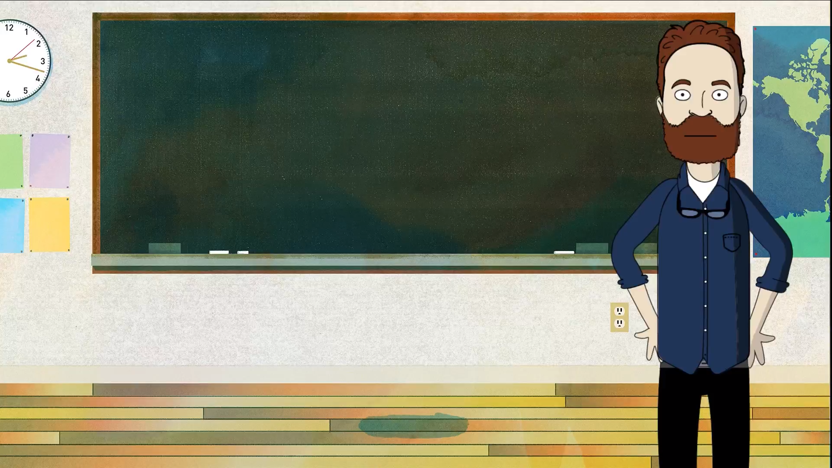
PLACEHOLDER – Cartoon Glenn 1

Slide 5

The Reality of Remote
Delivery and SEE
Digital barriers
Continuous intake, asynchronous delivery
& mutual obligations
Booklets do the onboarding and orientation
Paper-based = limited 1-on-1 contact time
Isolated & vulnerable
Progression → education & employment outcomes

Slide 6
The Stand Out Problem – Onboarding & Orientation
👉 Referral → ⏳ Wait
→ 📝 PTA Kit → ⏳ Wait
→ 📞 PTA Interview → ⏳ Wait
→ 📞 Commencement → 📆 Start
❌ Couldn’t understand what to do
❌ Couldn’t get started without support
❌ Dropped out before learning began
51% → commence. Why?

Slide 7
Onboarding materials

Slide 8
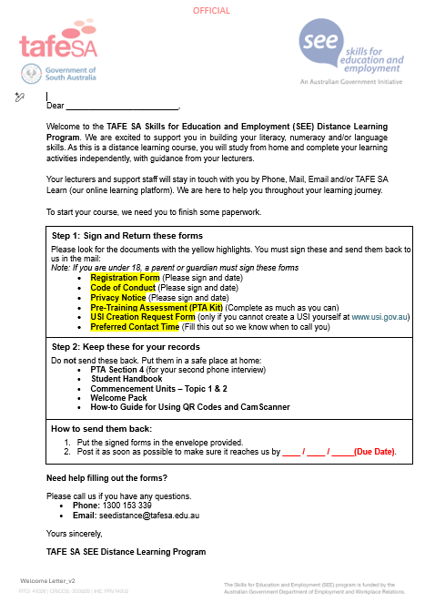
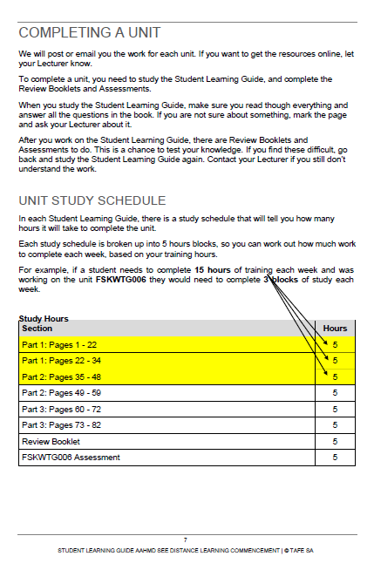
Onboarding materials examples

Slide 9
Onboarding materials - problems
❌ Unfamiliar language
❌ Text heavy
❌ Work it out alone

Slide 10
What we changed:
🌈A UDL-Driven Approach
We redesigned for:
🌱 Confidence & clarity
🧠 Reduced cognitive load
🚶‍♀️ Independence
Learner considerations:
🌏 The world learners are in
📱 Visual, colourful, multimodal,
💬 Social media & attention
🤝 Belonging
🎉 Engagement
🌏 Multiple ways of meaning

Slide 11
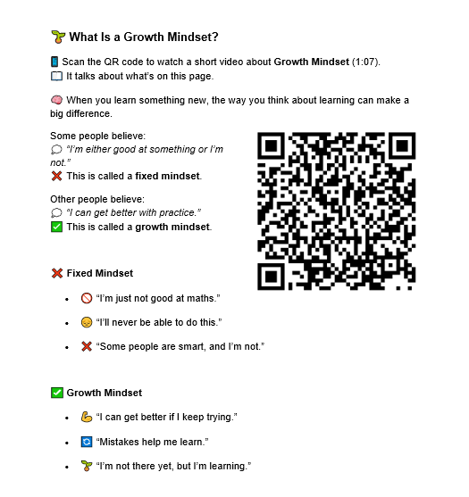
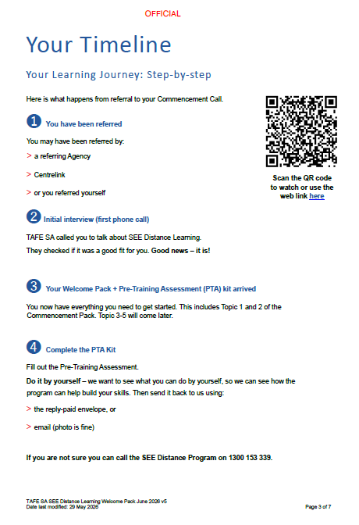
What we changed – Your Timeline

Slide 12
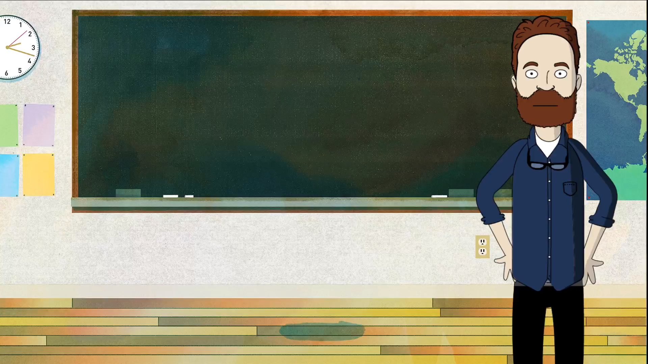
PLACEHOLDER – Cartoon Glenn 2

Slide 13
UDL in motion 💫
🎧🎥📖 Multiple ways in ➡ Independent learning
👫 Belonging 🎇 Joy/Play 🌏 Meaning

Slide 14
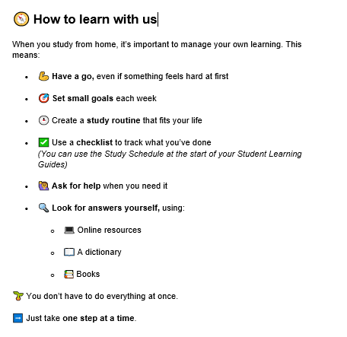
UDL in motion - example
🎧🎥📖 Multiple ways in ➡ Independent learning
👫 Belonging 🎇 Joy/Play 🌏 Meaning

Slide 15
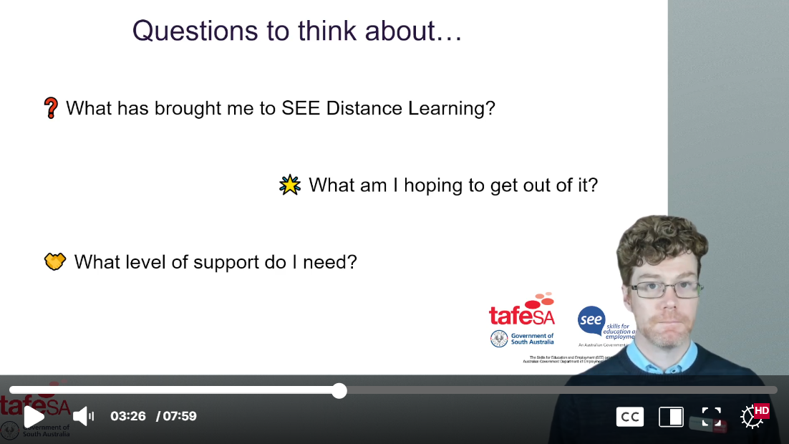
UDL in motion – Questions to think about…

Slide 16
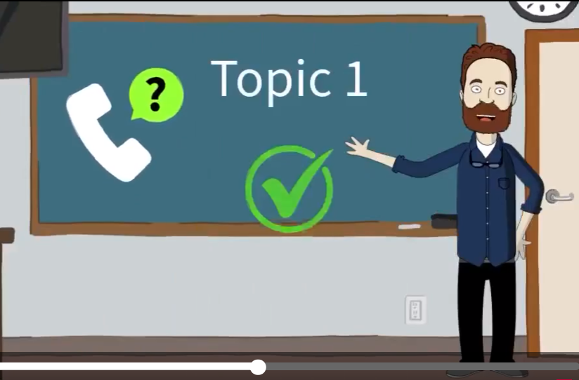
UDL in motion – Video Image

Slide 17
Read along audio

Slide 18
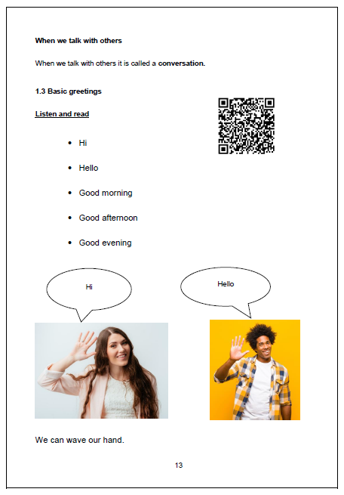
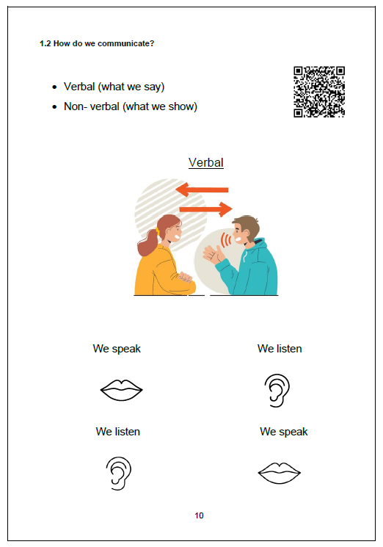
Read along audio – When we talk with others

Slide 19
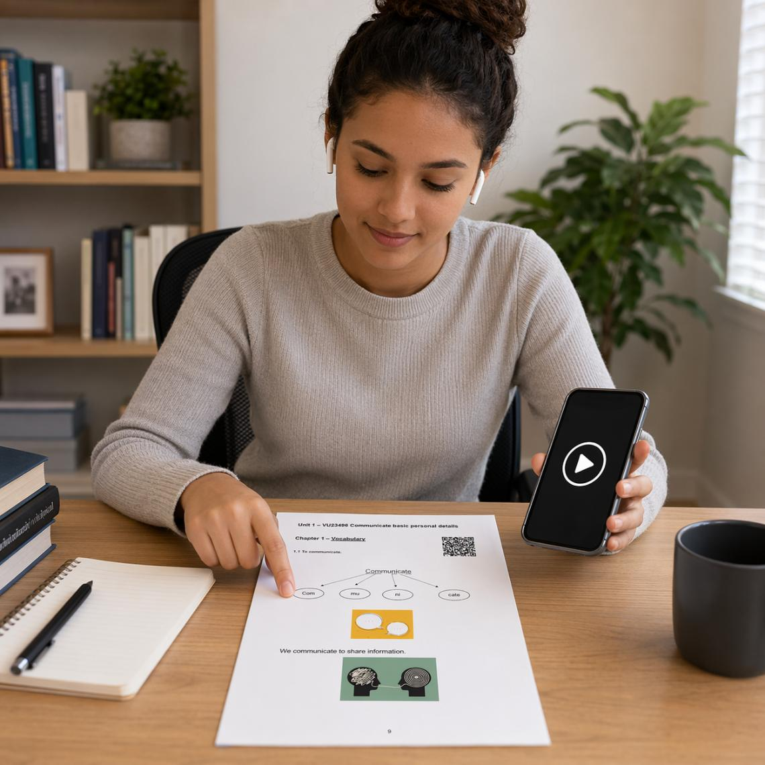
Read along audio cont.

Slide 20

How we designed this – Easy Read pages
Prompt:
“Can you simplify the following to ACSF Level 1 and make more engaging with the use of suitable emojis, headings, dot points, bold, emphasis, and lots of white space.”
AI Experimentation
‘Level’ prompts
Repeatable
Chunked

Slide 21
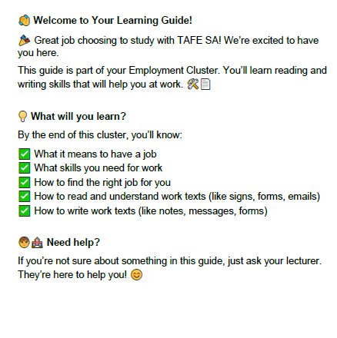
How we designed this – Easy Read pages cont.

Slide 22
Designing beyond text
– AI images
🎈 Fun for all!
🧪 Experimentation led to consistency
🎨 UDL embedded – inclusivity/representation
🚸 USE WITH CAUTION

Slide 23
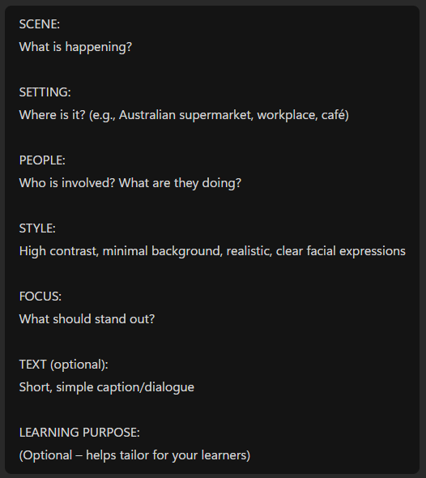
Designing beyond text
– AI images (prompts)
🎈 Fun for all!
🧪 Experimentation led to consistency
🎨 UDL embedded – inclusivity/representation
🚸 USE WITH CAUTION

Slide 24
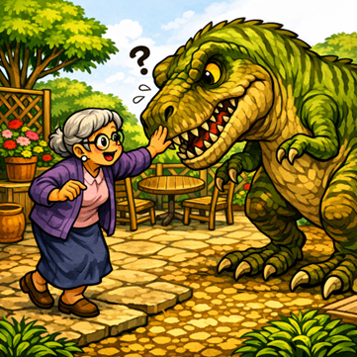
Can Nan pat Rex?
Yes or No?

Slide 25

Can Nan pat Rex?
Yes or No?

Slide 26
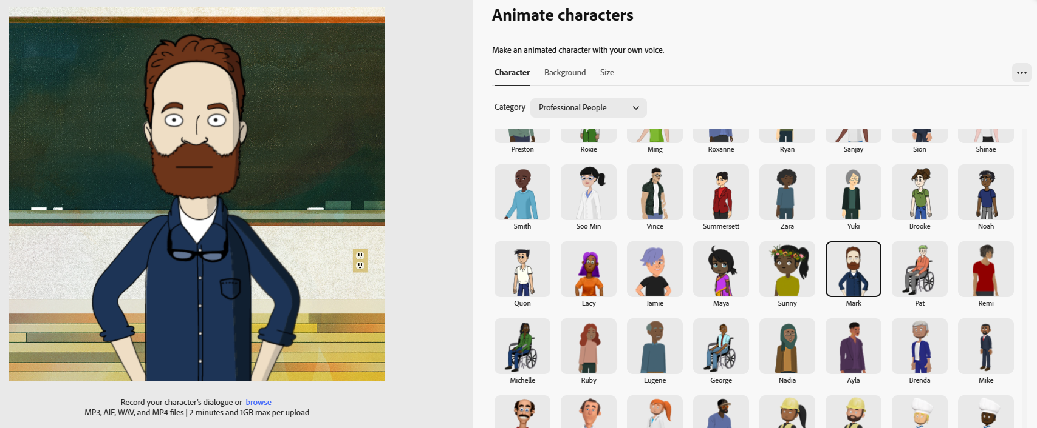
Designing beyond text – Adobe Express and Eleven Labs

Slide 27
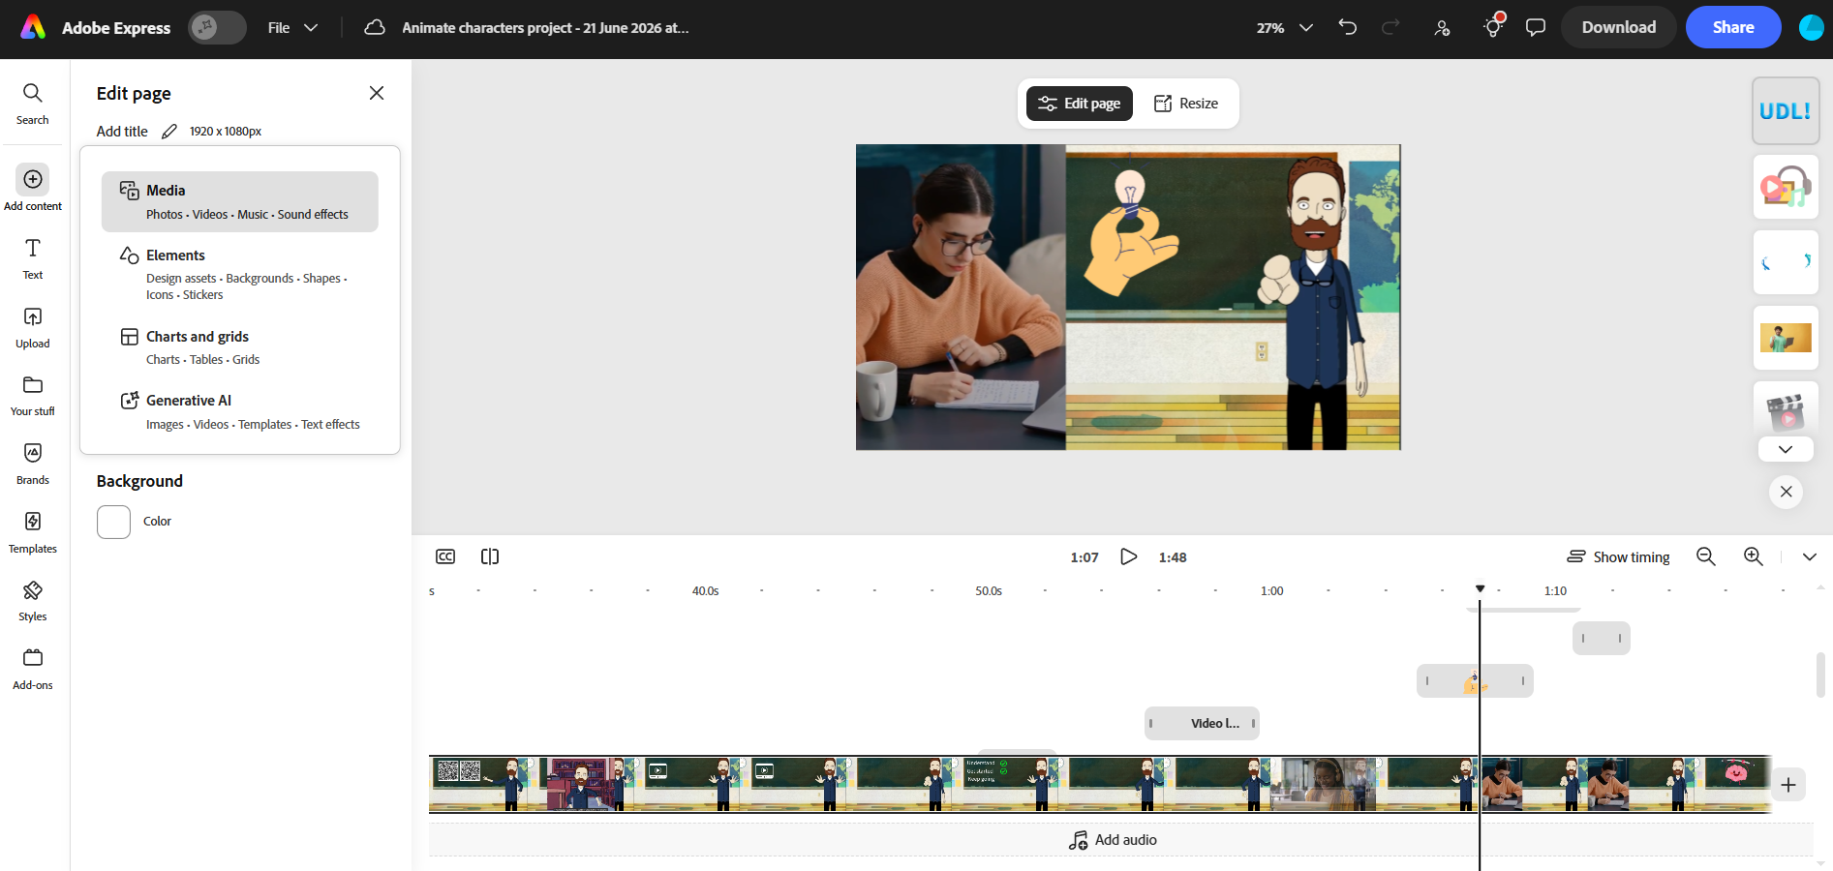
Designing beyond text – Adobe Express and Eleven Labs cont

Slide 28
What learners told us
📖✅ Easy read pages & video content
“I love the emojis. I see them first, then reading is just easier.”
“Very organised, easy reading.”
“Glenn made things easier to learn by being comprehensive and taking the time to step through it at my pace.”
“The helped me to understand more of what I am doing”
“The videos are so much fun and help me understand what I need to do, instead of getting tired quickly when I’m reading.”
📖🔊 Read along audio
“The read along pages help me learn the words better.”
“It was easier to understand.”
"At the moment easier to learn"

Slide 29
Early learner feedback
Q: The easy reading pages (emojis, headings, dot points, space) helped me
🔎 Find where to look – 2
📃 Read the words – 1
😐 Did not help – 0
🧠 Know what the page is about – 2
Q: The page design made the work feel
😄 Easier – 5
🙂 About the same – 2
😕 Harder – 0

Slide 30
From ideas ➡
➡ to impact
📖 Making it easier to understand, learn, and act independently ✅
Text heavy, formalised ➡ clear, multimodal learning experiences
Paper, video, audio, page design ➡ understanding, confidence, independence
Belonging ▪ Joy ▪ Multiple ways of making meaning ➡ Learning that works for more people

Slide 31
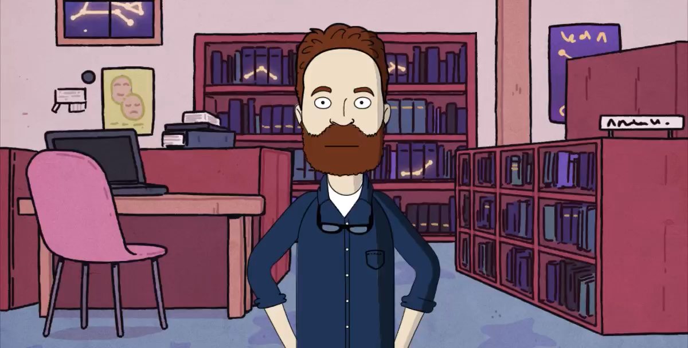
PLACEHOLDER – Cartoon Glenn 3

Slide 32
QUESTIONS?

Slide 33
THANK YOU

