Slide 1
Designing Accessible Laboratories: Applying UDL 3.0 in Wet Labs, Anatomy and High-Risk Teaching Spaces
Presented by Catherine Parr
25th June 2026

Slide 2
Acknowledgment of Country
We honour and respect our Aboriginal and Torres Strait Islander Traditional Custodians, Elders and communities past, present, and emerging.
For thousands of years, they have held a deep connection to the land, sharing and exchanging their knowledge across innumerable generations for the benefit of all.

Slide 3
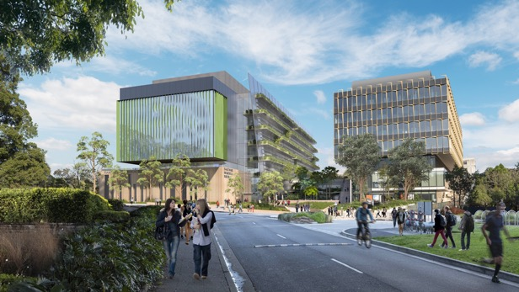
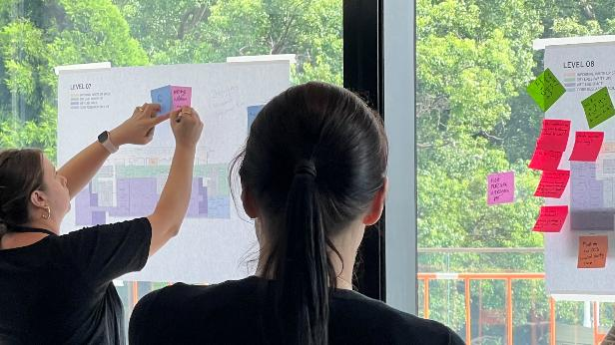
Agenda
About the Sydney Biomedical Accelerator (SBA)
Overview of Workflows project
UDL in laboratories
UDL in anatomy teaching
UDL in general workplaces
Q&A

Slide 4
About the SBA

Slide 5
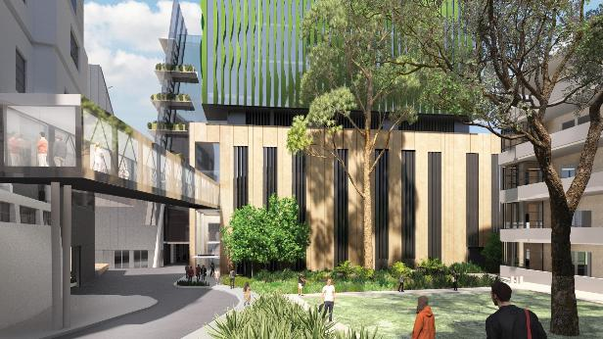
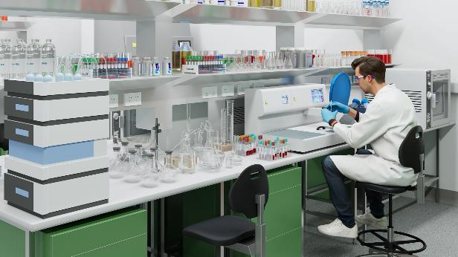
SBA at a glance
$780m co-funded partnership between the University of Sydney, Sydney Local Health District and the NSW Government
Will house 1,200 biomedical researchers and clinician scientists
Anticipated completion: 2028

Slide 6
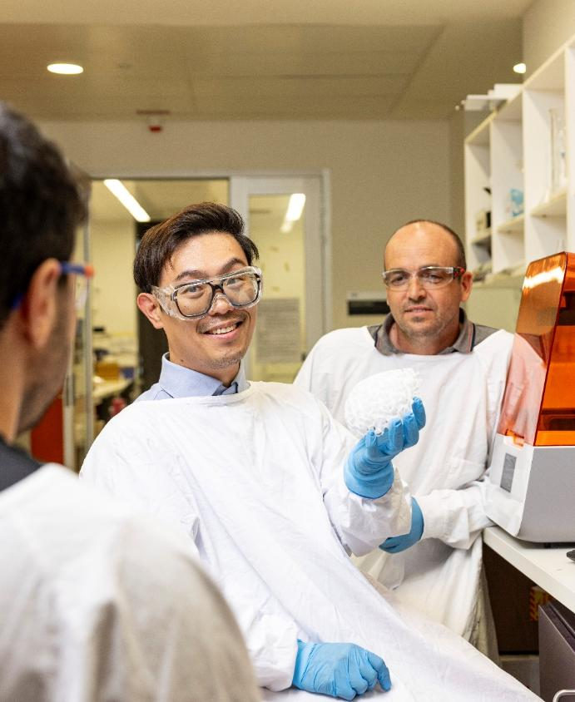
Our aspiration
The SBA will be a globally significant hub for biomedical research, innovation and translation in Sydney.
Clinical and consumer leadership will ensure real-world experience shapes the problems addressed and the solutions found.

Slide 7
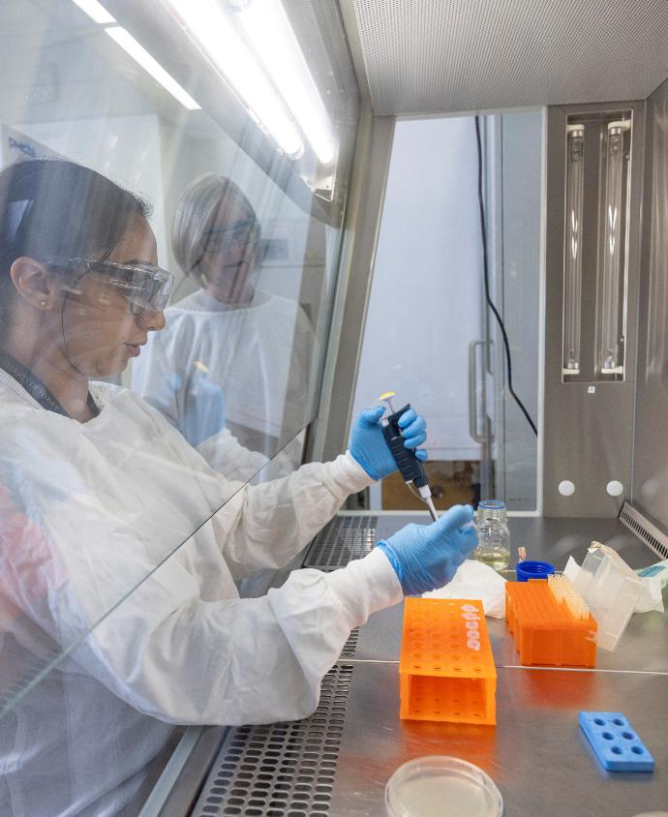
World-class facilities
PC2 and PC3 labs
Biobank
Surgery, mortuary, and anatomy research and teaching
Core research facilities
Collaboration spaces

Slide 8
Overview of Workflows project

Slide 9
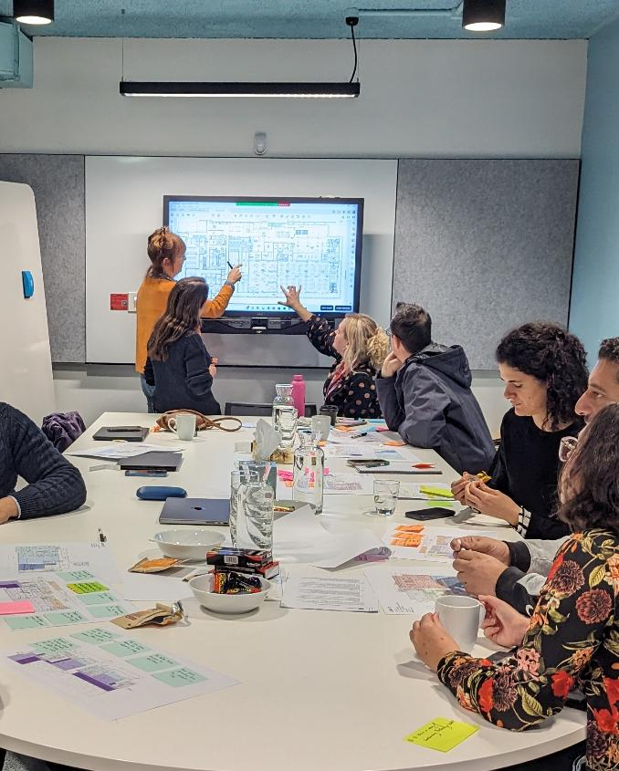
Project context
Tasked with reviewing end-to-end workflows across facilities
Identify issues that require design changes and/or operational planning

Slide 10
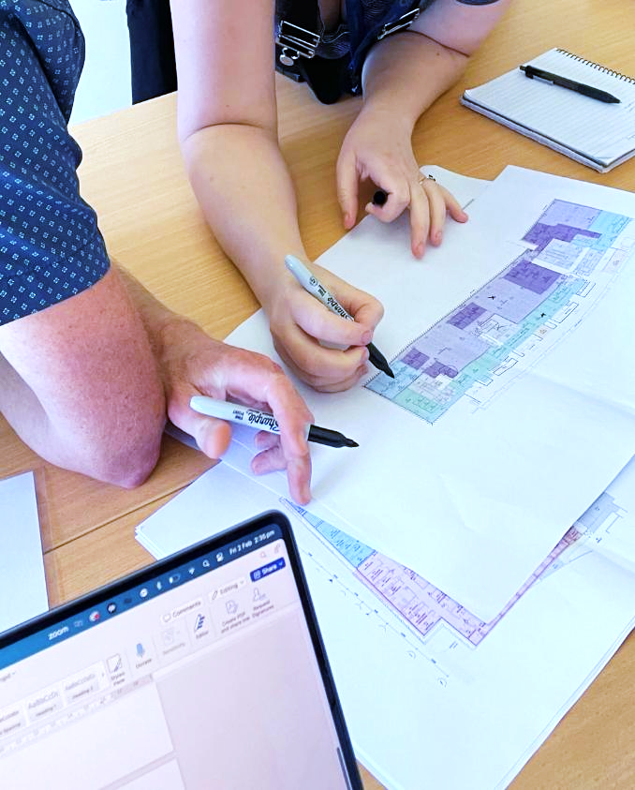
Research objectives
Understand current workflows and how they would be carried out in the building
Identify pain points
Interrogate possible future needs
Test and validate the designs against user needs

Slide 11
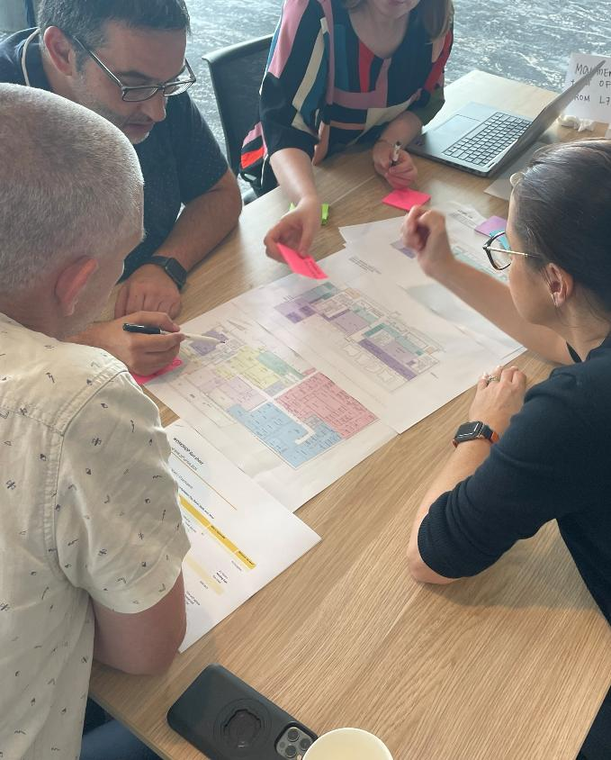
Participant mix
Three researchers
Three research operations/technical staff
Four others (HR, student advocate, Inclusion & Disability Services)

Slide 12
UDL in laboratories

Slide 13
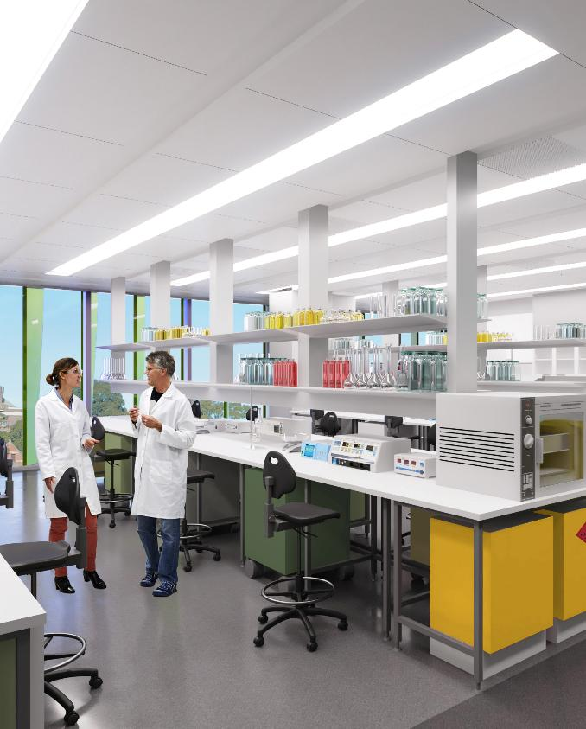
What is a PC2 lab?
Physical Containment Level 2 (PC2)
Resources include biosafety cabinets, fume hoods, and dangerous goods cabinets

Slide 14
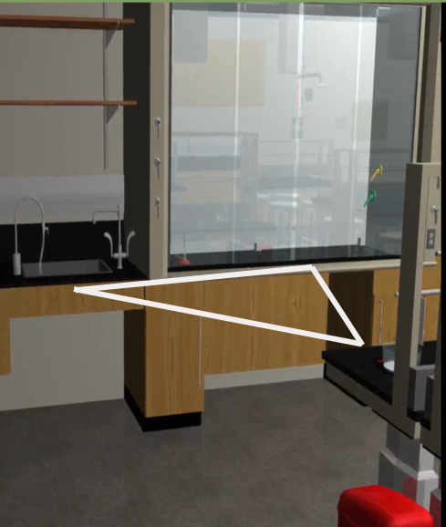
Lab spaces
Provide enough circulation space
Co-locate accessible equipment
Include flexible connections to services
Explore solutions for environmental controls
UDL Principle 4:
Design options for interaction
Source: StemEd Hub

Slide 15

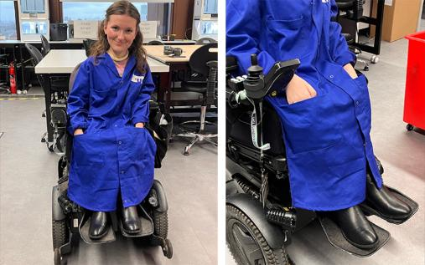
Lab equipment
Have a dedicated fund for assistive tools and technologies
Create a list of some available technologies
Streamline processes for procurement and implementation
4. Design options for interaction
Source (top): Technology Networks
Source (bottom): UCL

Slide 16
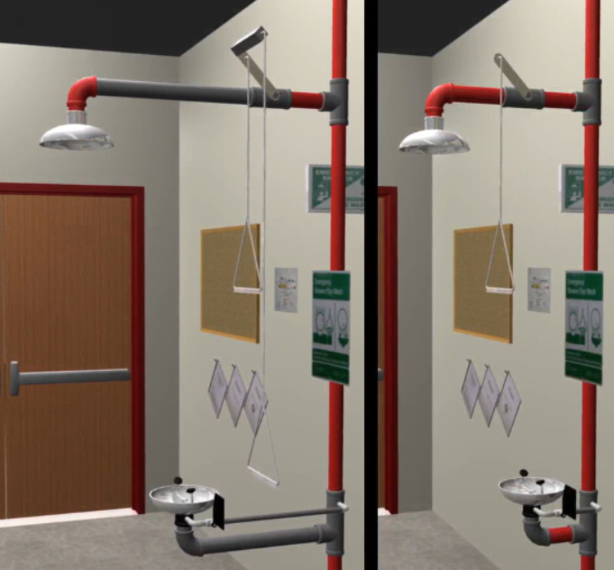
Lab safety
Ensure non-slip mats are available in areas with high spills risk
First aid kits and fire blankets at accessible heights
Accessible emergency stations and eyewash bottles
4. Design options for interaction
Source: StemEd Hub

Slide 17
Universal design in anatomy teaching

Slide 18
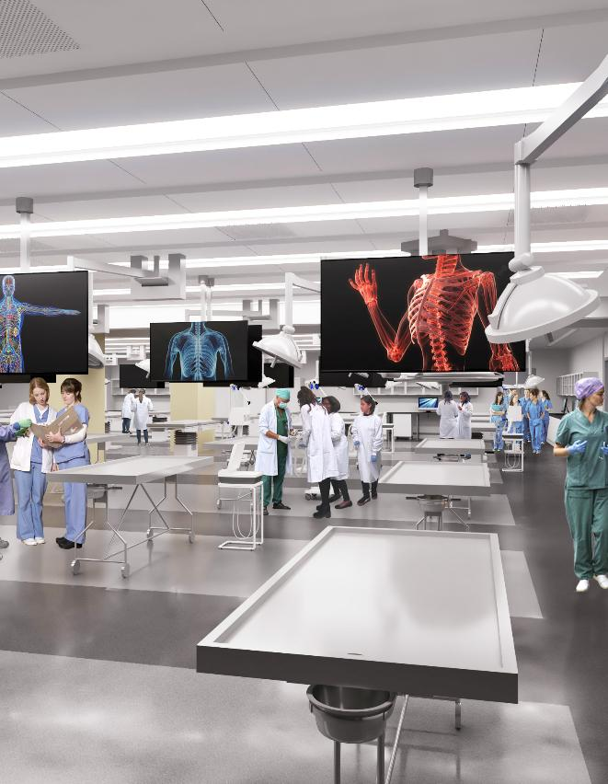
How is anatomy taught?
PC2 lab with specialised equipment
Cadaver-based education enhances learning
Electronic devices with a camera are not allowed for privacy reasons

Slide 19
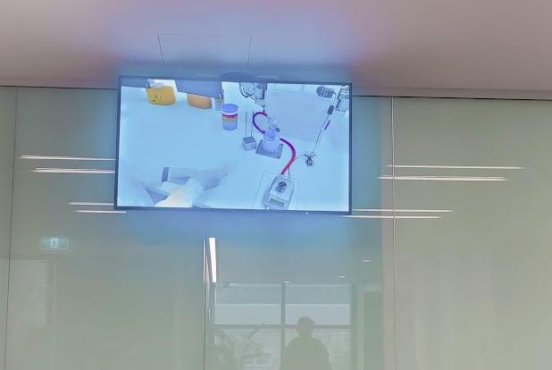
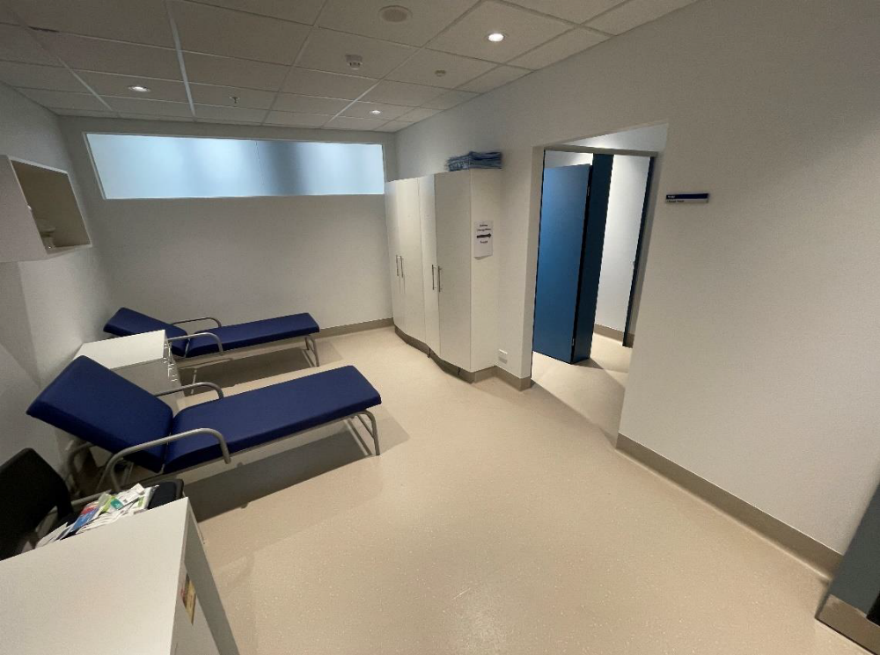
Safety in learning
Provide briefings to prepare students
Provide chairs for recovery
Offer a safe, quiet space for recovery
9. Design options for emotional capacity

Slide 20
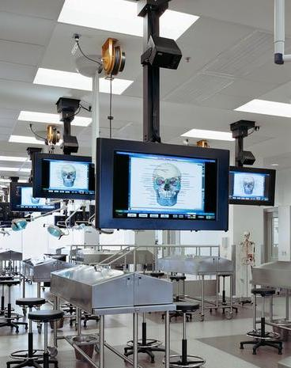
Digital technology
Use screens to record and project demonstrations
Embed AV that generates high-quality recordings
Use digital workbooks and whiteboards
3. Design options for building knowledge
Source: Vanderbilt University

Slide 21
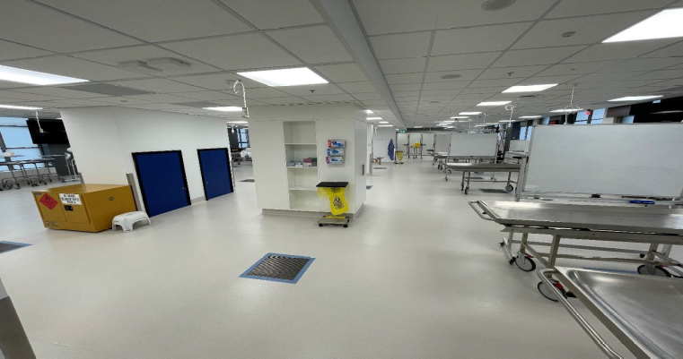
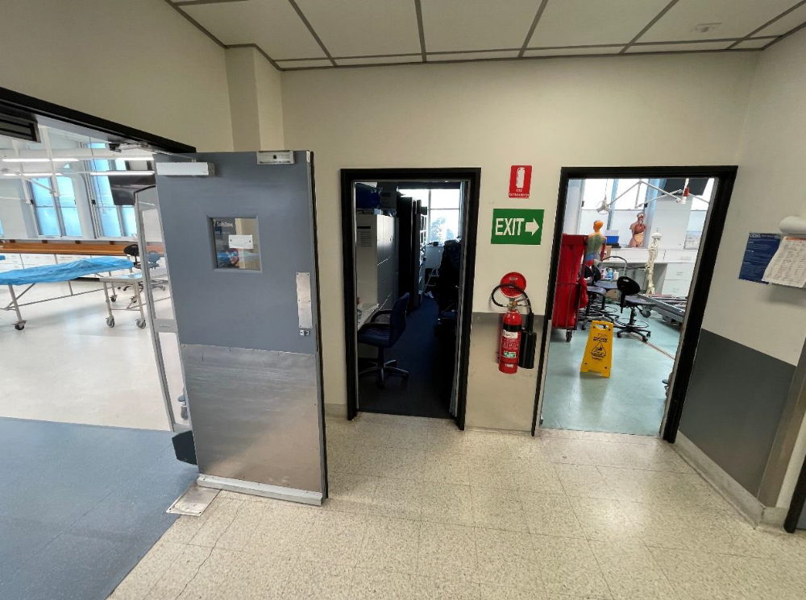
Physical space
Use height-adjustable tables and offer step stools and chairs
Standardise door widths
Plan timetables to minimise congestion
Position some lockers in student gathering space
3. Design options for building knowledge

Slide 22
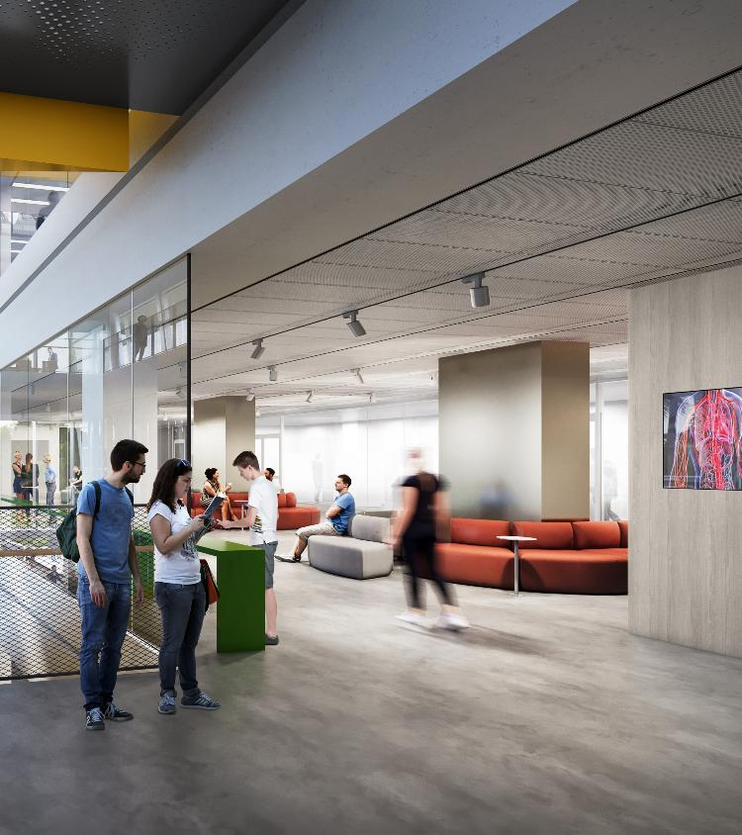
Student-led learning
Provide adequately labelled specimens
Position some lockers in student gathering space
Enable access to Anatomy Museum and improve wayfinding
3. Design options for building knowledge

Slide 23
Universal design in general workplaces

Slide 24
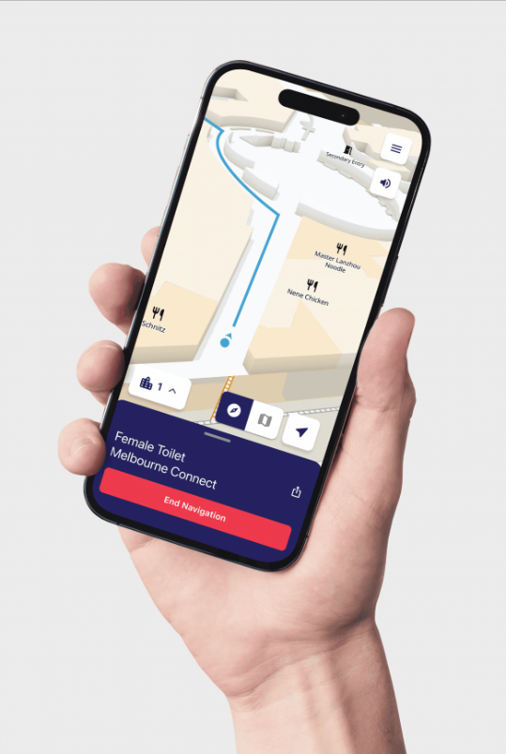
Wayfinding and navigation
Accessibility principles should be embedded into the selection of colourways and signage
Wayfinding apps such as Bindi Maps should be considered for the SBA and the campus
Use different floor colouring to indicate accessible pathways
4. Design options for interaction
Source: BindiMaps

Slide 25
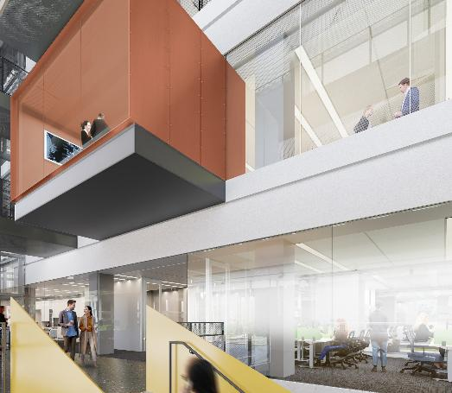
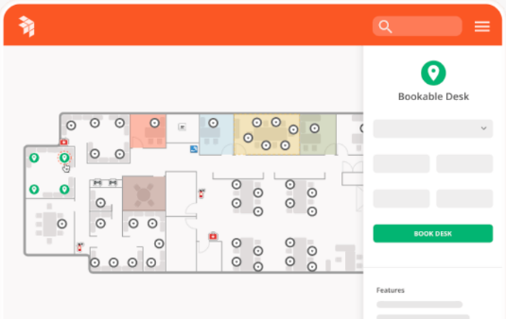
Workstations
Provide desks, focus rooms, and meeting rooms
Utilise a flexible booking system for hot desking and focus rooms
Consider accessibility of control panels, power points, and white boards
4. Design options for interaction
Source (bottom): Office Space Software

Slide 26
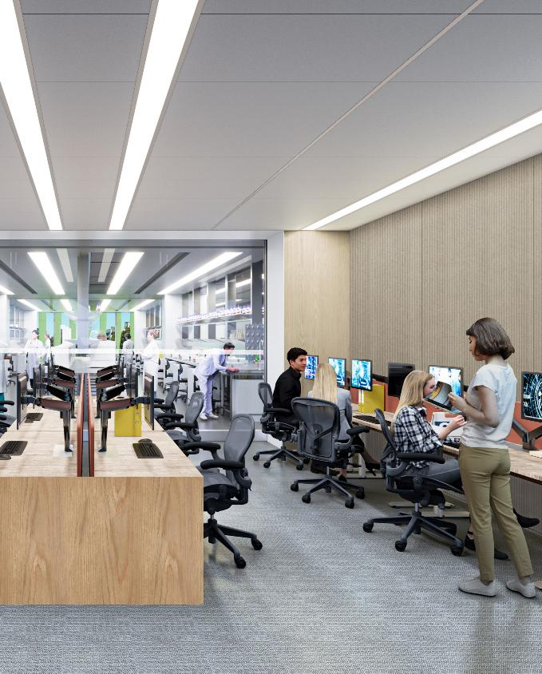
Culture
Provide information about accessibility at induction
Tell stories of diverse perspectives
Offer separate respite rooms for staff and students
8. Design options for sustaining effort & persistence

Slide 27
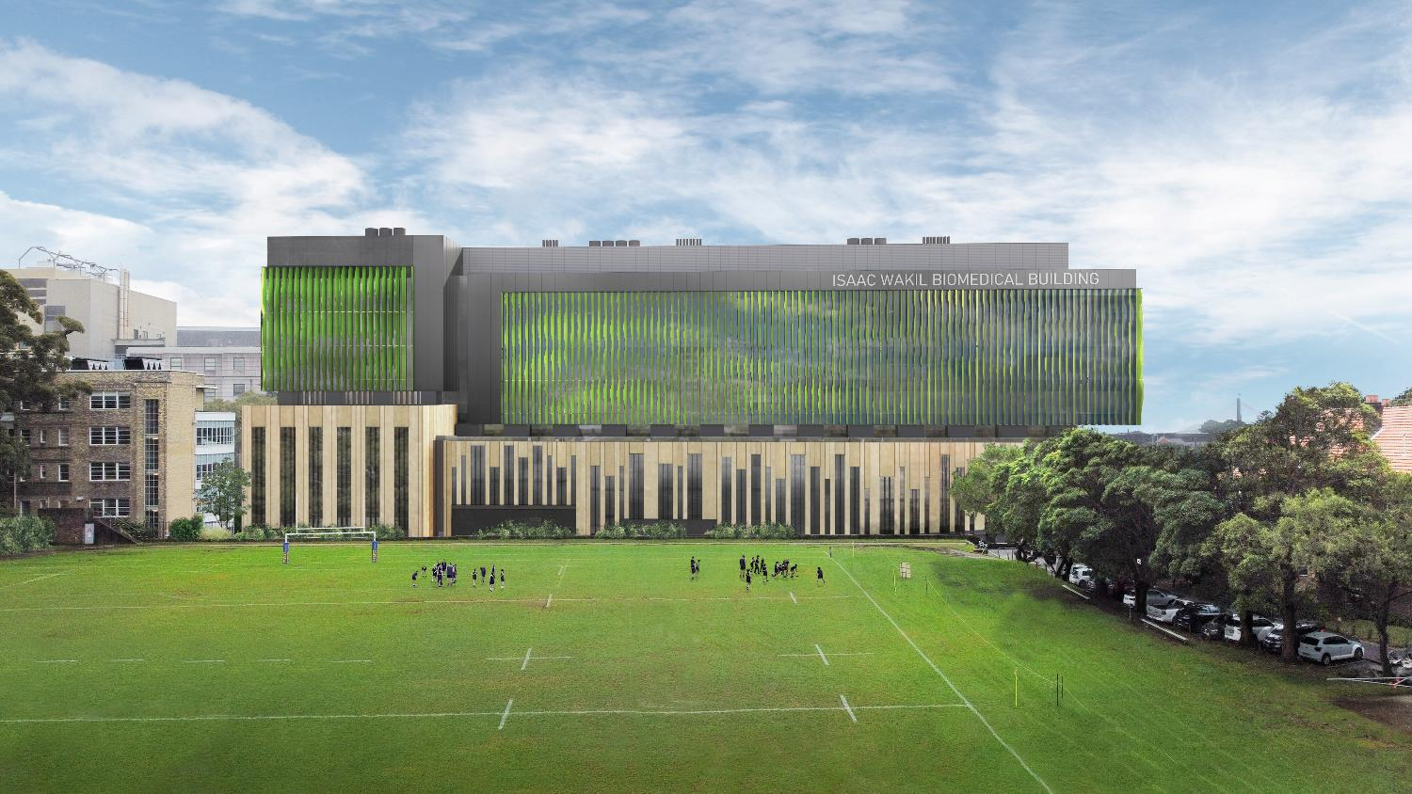
Thank you!
Special thanks for the following individuals for contributing to this valuable work: Annie Gao, Avrill Aspland, Elsa Darmalingum, Macarena Rodriguez, Rachel White, Sabina Popin, Shriya Srinagesh, and Stephanie Wood

Slide 28

Contact me!
Catherine Parr
catherine.parr@sydney.edu.au
Add me on LinkedIn

