Slide 1
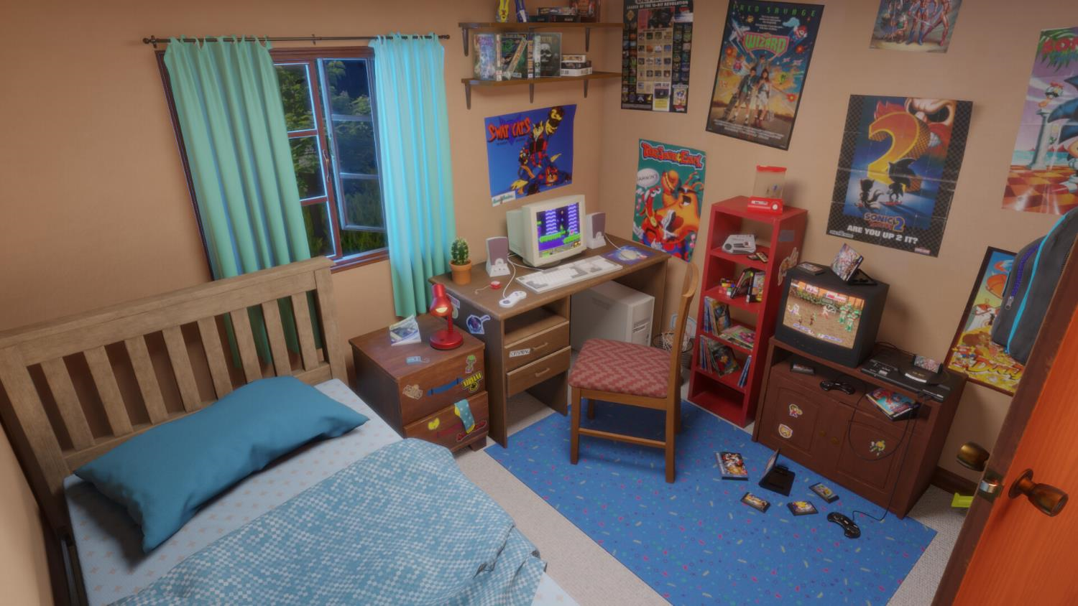

Slide 2





Slide 3



Slide 4
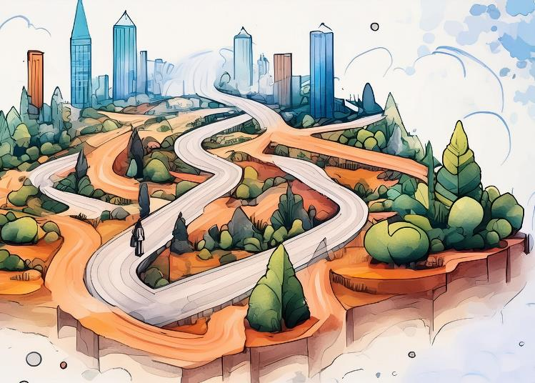

Choose Your Own Assessment
Mike Widjaja & Osu Lilje

Slide 5


Choose Your Workshop…
Podcast
Poster
Presentation

Slide 6
Choose Your Workshop…
Presentation

Slide 7

BIOL1009: From Molecules, Cells and Organisms
~320 students in 2026
  Basic biology
  First-year, first-semester
  School of Pharmacy
Diverse cohort

Slide 8
CYOA
Groups of 3 – 4 (self-nominated)
  81 groups
Science communication medium
  Disease and related pharmaceutical
Choice of:
    Poster (A3)
    Pamphlet (2x A4)
    Podcast (8 min)
    Recorded presentation (6 min)
    Video (6 min)
    Storybook (15 pages)
Different outputs, same standards. Rubric:
  Content
  Overall Flow
  Engagement
  Language

Slide 9
Enables agency, inclusivity, authentic assessment, and communication skills

Slide 10
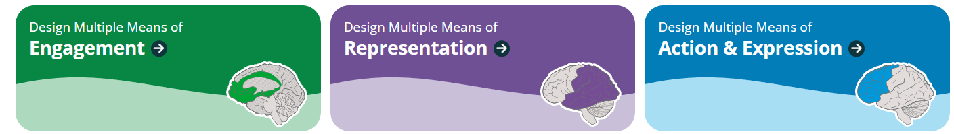

Grounded in UDL Framework
Universal Design for Learning (UDL)
Create inclusive learning environments by designing for diversity
Multiple pathways to success
More engaging and effective learning experiences for all students
Aligns with contemporary pedagogical best practices

Slide 11
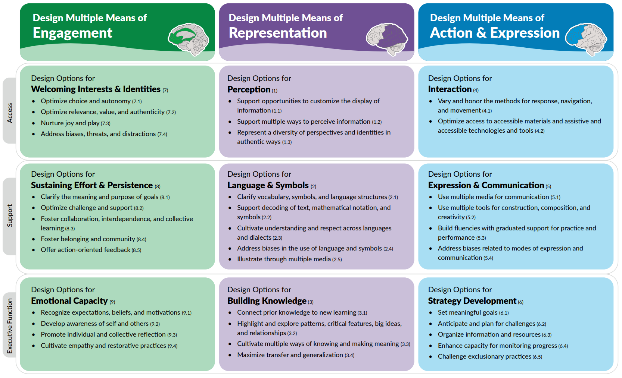

Slide 12
Student Agency &
Proud students
What works for them?
Fun
Their strengths
Lifelong friends

Slide 13
Fun for all
Students:
I strongly believe the major assignment was enjoyable and engaging as it allowed us to work creatively and collaborate as a team
The freedom to choose our own disease encourages high quality research
I was able to use both an artistic and informational lens on my chosen format of a poster
Staff:
Strong narratives and teamwork
The option to submit any piece… allowed students to express their creativity and gave us fun submissions to mark.

Slide 14
Where it started?
Posters and pamphlets
  Similar format
Catered to those that enjoy posters and visuals
  What about those that prefer to listen?
Some asked about presentations?
  Sure, why not?

Slide 15
Exemplars

Slide 16
Results
Submitted media average: 10/12 (~83%)
    Storybook ~98%
    Podcasts ~92%
    Recorded Presentations ~86%
    Posters ~83%
    Pamphlets ~83%
    Videos ~82%

Slide 17
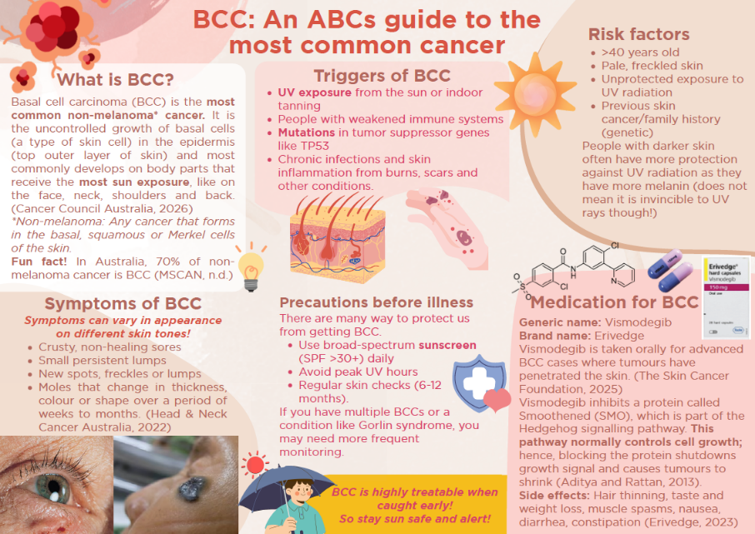

~41% Pamphlets
~28% Posters

Slide 18


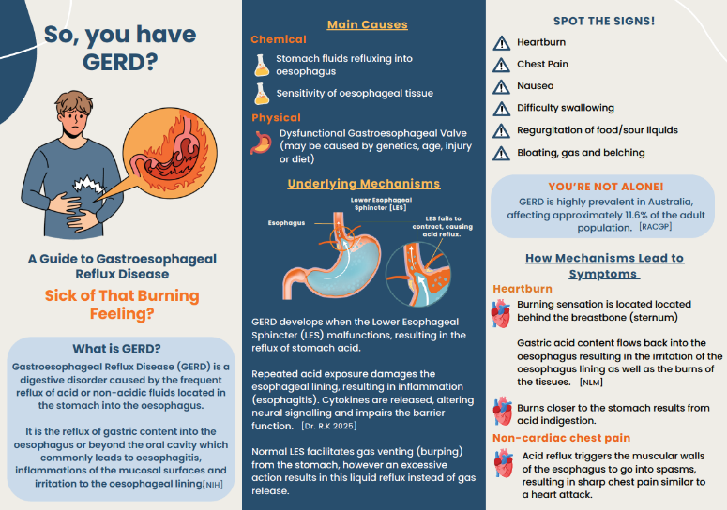
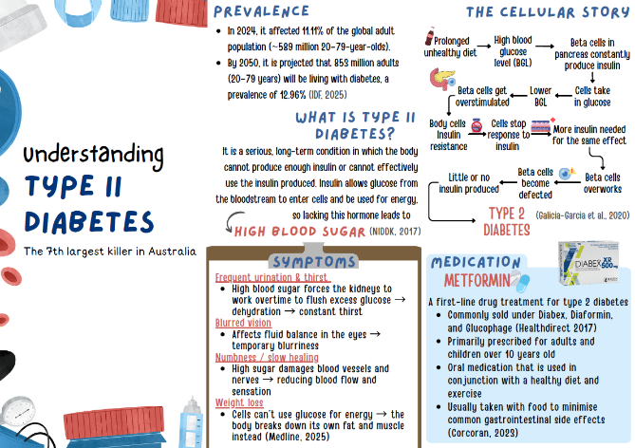
~41% Pamphlets
~28% Posters

Slide 19

Introduction by ‘Dose of Reality’
Role playing by ‘8 min Pharmacogenomics’
and ‘Chronic but Iconic’
~7% Podcasts
~6% Videos
~16% Presentations

Slide 20
Scene by ‘The Burning Truth About UTIs’
Animation by ‘Saving Your Baby with a Virus’
Introduction by ‘Hyemoglobeen’s Science Talk’
Walk and Talk by ‘Lab-radoodles’

Slide 21
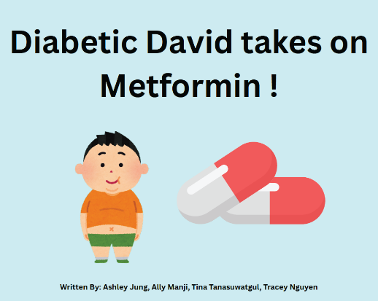

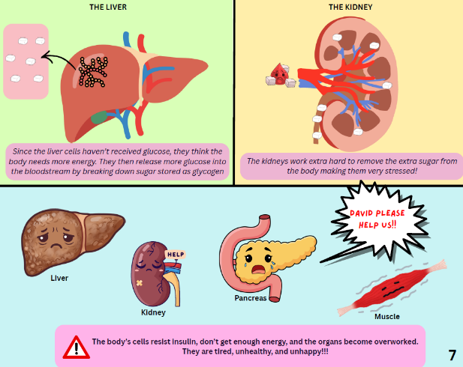
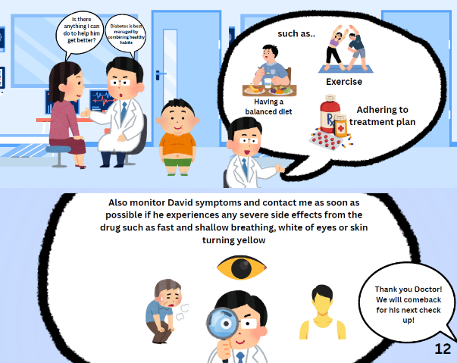

Slide 22
Choose Your Workshop…
Podcast

Slide 23
Choose Your Workshop…
Poster

Slide 24
Your turn to choose

Slide 25
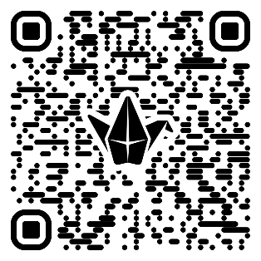
Workshop Activity
Creating your list:
In your groups, choose one existing assessment from one of your own subjects (can be common amongst all members)
  Testing knowledge and understanding (exams, oral)
  Experimental report or data analysis
  Case studies or research findings
  Portfolios or journals
  Presentations
  Etc
https://padlet.com/sydney/UDLCYOA

Slide 26
Workshop Activity
2) Big Sky Ideas:
Imagine all possible ways in which students could complete the outcomes for the group’s chosen assessment
  An experimental plan can be:
    Written report
    Experimental protocol/SOP
    Research grant application
    Conference presentation (in person or video recording)
    Pitch
    Poster
    Discussion/ thesis defence
    etc
https://padlet.com/sydney/UDLCYOA

Slide 27
Workshop Activity
3) Reality Check:
Narrow your list to 2 – 5 assessment types. Consider the following complexities/realities:
  Resource requirements
    Marking budget, team size, time
  Cohort configuration and scalability
    Groups or individual
    Scalable across different cohort sizes
  Diversity/complexity of rubrics required
    Separate rubrics
    All cover same learning outcomes
  Student effort
    Same effort across all formats to complete?
    Inclusive to all student groups (personal diversity, technology access)
    AI applicable

Slide 28
Workshop Activity
4) Share your adventure:
2-3 min pitch, the group chooses how?
https://padlet.com/sydney/UDLCYOA

Slide 29
Concluding arc in our Story

Slide 30
Choosing This Assessment For You
Transferrable to other units
  Ideas
  Concepts
  Case study analyses
Adaptable
  Weighting
  Duration
Means of engagement
FASS
Architecture
Business
Engineering
FMH
Music
Law
Science

Slide 31
Where you can start?
Start small
  2-3 choices for assessments
  Class activities?
  Choice in lectures
Big workload upfront
  Very well worth it
You can do it!

Slide 32

CYOA

