Slide 1
Designing for confidence: A UDL 3.0-aligned digital practice OSCE
Speech Pathology | Learner Agency | Assessment Readiness
Dr Frances Cochrane
PhD, BSpPath (Hons IIA), GCertEd (Academic Practice), CPSP, MSPA, FHEA
Senior Lecturer and Course Coordinator
James Cook University

Slide 2
What is an OSCE?
Objective Structured Clinical Examination
Widely used as an assessment strategy for clinical competence across health curricula.
In speech pathology, OSCEs have been used in the practice areas of post-stroke aphasia, and assessment of developmental and acquired communication and swallowing disorders across the lifespan (Hill et al., 2023; Quigley & Regan, 2021; Zraick et al., 2003).
OSCEs may be structured using an array of approaches including use of simulated or standardised patients, technology-enhanced using audio/video and imagery, and question stations (Mitchell et al., 2015).
OSCEs typically include show how, or application of skill and knowledge, components to assess areas related to cognitive, affective and psychomotor skills (Miller, 1990).
An OSCE typically involves students progressing through a series of time-limited tasks or scenarios (Mitchell et al., 2015).

Slide 3

What is the biggest barrier students face when preparing for OSCEs (or other high-stakes assessment)?
Use the mentimeter to respond with your ideas: https://www.menti.com/albe49rc5trg

Slide 4
Interpreting OSCE challenges UDL ‘Engagement’
Welcoming interests and Identities (UDL Guideline 7)
  OSCEs may trigger threat responses (e.g. fear of failure, public evaluation), reducing cognitive capacity for clinical reasoning.
  Students disengage when environments feel high-risk or identity-threatening.
Sustaining effort and persistence (UDL Guideline 8)
  Unclear expectations, format or marking criteria leads to surface preparation (e.g. memorisation) rather than meaningful learning.
  Engagement drops when goals are unclear.
Emotional capacity (UDL Guideline 9)
  Low self-efficacy; students doubt their ability to perform under pressure.
  OSCEs require simultaneous integration of skills (clinical reasoning, communication, procedural accuracy) which can lead to increased anxiety and reduced working memory capacity.
  Self-efficacy is shaped by practice opportunities, feedback, modelling and building confidence.

Slide 5
The problem
Objective Structured Clinician Examination (OSCE) - affective overload overwhelms engagement; high stakes assessment, high stress, low confidence.
Novice learners’ experience - Anxiety, stress, uncertainty; reduced agency and self-efficacy; low assessment literacy.
Practice opportunities are often infrequent, unstructured and high-pressure.

Slide 6
Design Aim
Our Goals
  Design a scalable digital OSCE that supports learning and builds confidence;
  Create efficiencies for staff in provision of practice and feedback.
We focused on:
  LMS integration
  Learner agency
  Emotional safety
  Assessment readiness
  Accessibility (UDL 3.0)

Slide 7
Theoretical frameworks
Theoretical framework | Description
Clinical reasoning pedagogy | Authentic professional practice Rich, content-specific, organized knowledge Hypothesis-driven learning Sustained practice Reflective practice
Assessment literacy | Assessment literacy precedes performance Students must understand standards, criteria and quality before they can demonstrate them. Authentic and iterative practice Rehearsal mirrors OSCE format, cognitive load, and decision- making demands. Students judge quality Self assessment, comparison with exemplars, reflection Dialogic feedback Feedback information is interpreted, applied, and revisited. Structured and cumulative reflection Moving beyond what went well to clinical reasoning and future action.
ADDIE | Analyse, Design, Develop, Implement, Evaluate Structured process
UDL 3.0 | Inclusive design

Slide 8
ADDIE Overview
Analyse | Design | Develop | Implement | Evaluate
Informal staff and student feedback about OSCE experiences and student outcomes | Collaboration with content matter and learning technology experts Refined discrete skills for OSCE (voice disorders: assessment of voice, hypothesis generation & case note documentation) LMS-integration Pilot | Content, case studies, audio files, instructional materials, automated feedback, exemplars Aligned with OSCE best practice guidelines Integrated professional learning skills (e.g. self/peer assessment; critical reflection) Timed and untimed cases to reflect OSCE structure Repeated practice | Deployed in LMS Subject-specific but also enabled in other subjects as part of evaluation. Guided support in-class. | Evaluation aligned with Level 1 of Kirkpatrick's Training Evaluation Model HREC approval (H9516). Written feedback questionnaire.
(Branch, 2009; Kirkpatrick, 1996)

Slide 9
How did we operationalise UDL?
UDL Principle | Design Features
Engagement | Clear expectations, gamification*, authentic cases, self-paced, repeated practice, promoted reflection
Representation | Audio, test features, exemplars, vocabulary clarified (e.g. SOAP)
Action and Expression | Timed/time-limited tasks, repeated practice; back-forwards navigation, feedback, peer/self-review

Slide 10
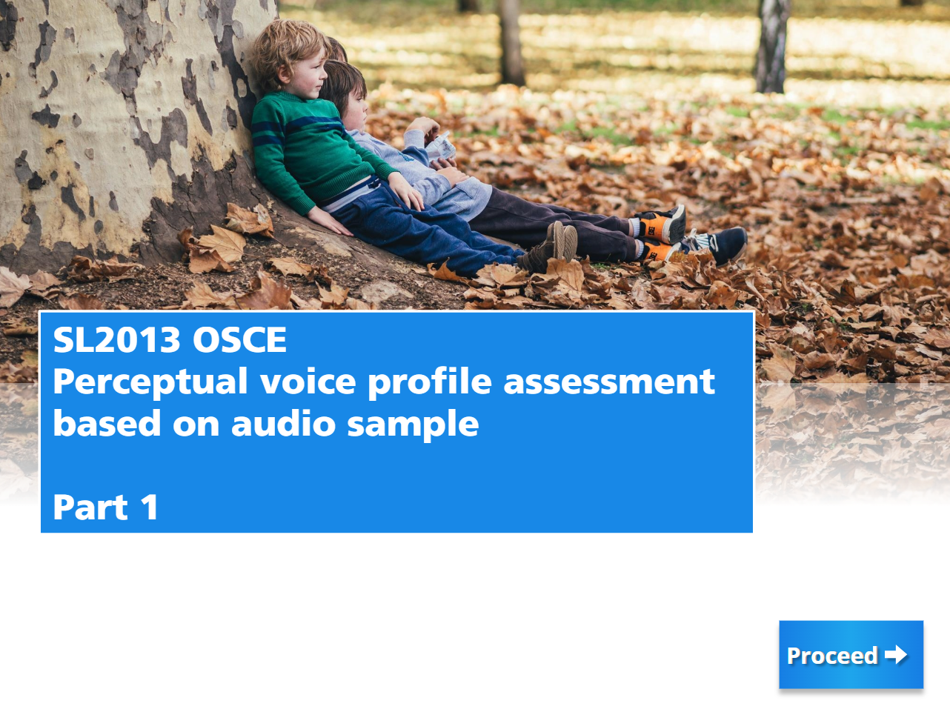
Digital OSCE Walkthrough – Design 1

Slide 11
What did students report?
Themes: ‘Supported Practice’ and ‘Reassurance’
Enjoyable | Ease of Use | Replicated real OSCE | Practice Opportunity | Internalisation of learning
“It was easy, engaging and honestly a lot of fun (like an online game)!” "willingness to learn and practice” | “user-friendly language” “I was able to quickly find and move between different scenarios” “breaking information into numerical points would have been easier to comprehend” “the line spacing of the scenario text could have been bigger for easier reading” | “the content was comprehensive and aligned with the expectations of a real OSCE, making it an excellent preparation tool”. “no amount of verbal preparation can compete with having the tools to practice working with a case very similar to exam conditions”. | “practice at my own pace” “track my progress” “It was a great experience because it allowed me to practice and refine my clinical skills in a structured and interactive way” “I could compare my PVP ratings against the expert’s ratings to see if I needed further practice” | “The immediate feedback after each scenario helped me identify my strengths and areas for improvement, which was really beneficial for my learning” “I found this [self-evaluation prompts] beneficial to my learning as it allowed me to reflect on my knowledge and identify gaps”. “[the exemplars] showed the key points to cover and the ideal way to communicate or perform a voice assessment, which helped me understand the level of detail and professionalism expected”

Slide 12
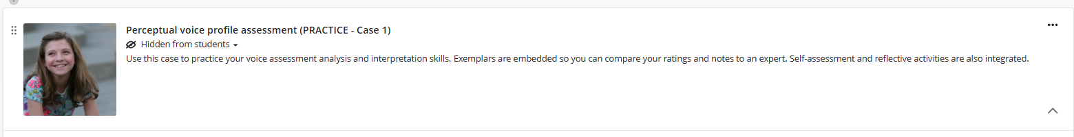
Digital OSCE Walkthrough – Design 2

Slide 13
CONFIDE MODEL
Clarify standards and expectations
Define goals and criteria
Alignment to learning outcomes
Normalise uncertainty & address challenges
Offer multimodal access
Provide varied ways to engage
Varied ways to perceive information
Clarify vocabulary and terms
Test features (e.g. audio check)
Normalise practice
Encourage regular low-stakes use
Promote individual/peer collaboration and collective learning
Tools for constructing knowledge
Scaffolded support for practice
Timed/untimed tasks
Facilitate feedback
Make guidance timely and usable
Develop self-awareness
Develop assessment literacy
Integrate interaction
Support choice and ownership
Varied tools for responses and learning (e.g. text box, templates, AI conversation)
Accessible layout and content with customizable elements (Blackboard Ally)
Embed authenticity
Connect tasks to real contexts to promote motivation
Applied clinical reasoning, not just recall (communication skills, clinical decision-making, professional behaviours)

Slide 14

Any questions? frances.cochrane1@jcu.edu.au

Slide 15
References
Branch, R.M. (2009). Instructional design: the ADDIE approach. Springer.
Hill, E., Timms, L., & Brewer, M. (2023). A Pilot Study of Objective Structured Clinical Examinations in a Postgraduate Speech Pathology Program. Journal of Clinical Practice in Speech-Language Pathology, 25(3), 134-139. https://doi.org/10.1080/22087168.2023.12370413
Kirkpatrick, D. (1996). Great ideas revisited: Revisiting Kirkpatrick’s Four-Level Model. Training and Development, 50(1), 54-60.
Miller, G.E. (1990). The assessment of clinical skills/competence/performance. Academic Medicine, 65(9), 63-37. https://doi.org/10.1097/00001888-199009000-00045
Mitchell, M., Henderson, A., Jeffrey, C., Nulty, D., Groves, M., Kelly, M., Knight, S., & Glover, P. (2015). Application of the best practice guidelines for OSCEs – An Australian evaluation of their feasibility and value. Nurse Education Today, 35, 700-705. http://dx.doi.org/10.1016/j.nedt.2015.01.007
Quigley, D., & Regan, J. (2021). Introduction of the Objective Structured Clinical Examination in Speech and Language Therapy Education: Student Perspectives. Folia Phoniatrica et Logopaedica, 73(4), 316-325. https://doi.org/10.1159/000508445
Zraick, R., Allen, R., & Johnson, S. (2003). The use of standardized patients to teach and test interpersonal and communication skills with students in speech-language pathology. Advances in Health Science Education Theory and Practice, 8(3),237-48. https://doi.org/10.1023/a:1026015430376.

