Slide 1


Art-Based Learning:
A Creative Approach to Teaching Theory
Annika Patmore
Occupational Therapist
and Lecturer

Slide 2

What I’ll cover today:
The challenges of teaching theory
Rethinking the teaching design
Discuss the ‘Art Series’ in practice now
Examples of the ‘Art Series’
Pedagogical foundations

Slide 3

For questions…
Send through your questions via this Padlet
We can discuss at the end

Slide 4



The Challenge of Teaching
(and Learning)
Theory
Padlet Link
For Questions

Slide 5
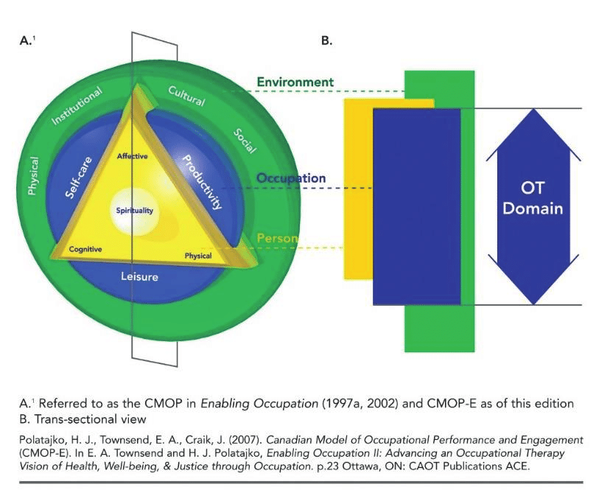
CMOP-E
Padlet Link
For Questions
(Polatajko & Townsend, 2007)

Slide 6
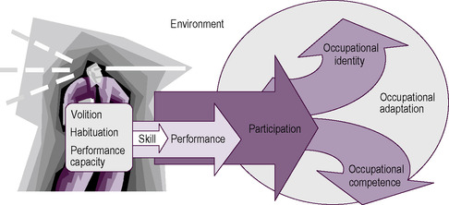
MOHO
Padlet Link
For Questions
(Kielhofner, 2008)

Slide 7



Padlet Link
Padlet Link
For Questions

Slide 8
How it used to be
Padlet Link
For Questions

Slide 9
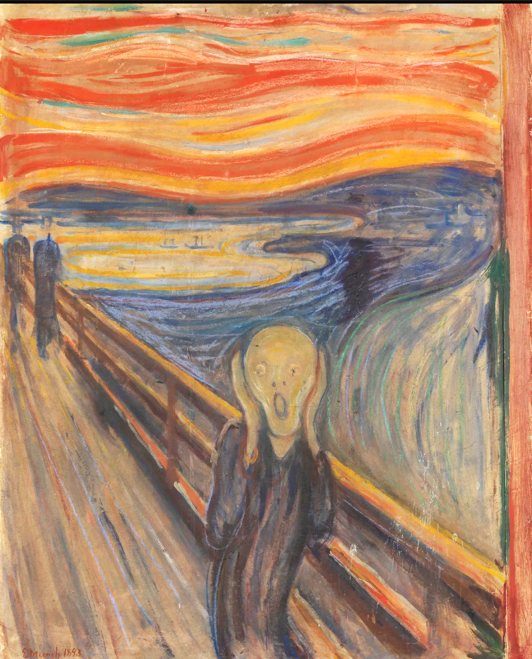
The pressure is real
‘The Scream’
Edvard Munch, 1893
Padlet Link
For Questions

Slide 10
Rethinking the Design
Padlet Link
For Questions

Slide 11
‘Art Series’
in Practice
Padlet Link
For Questions

Slide 12
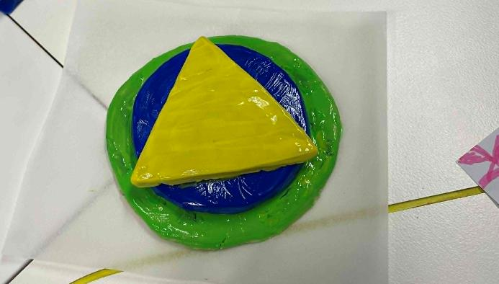
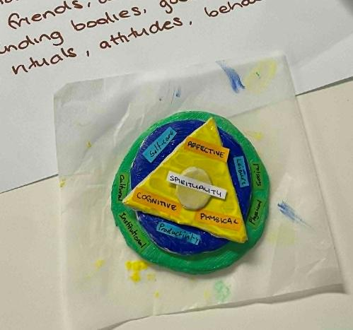
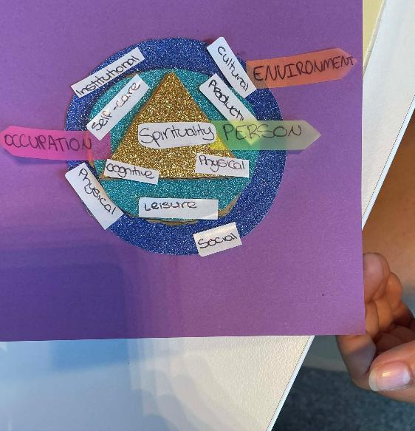
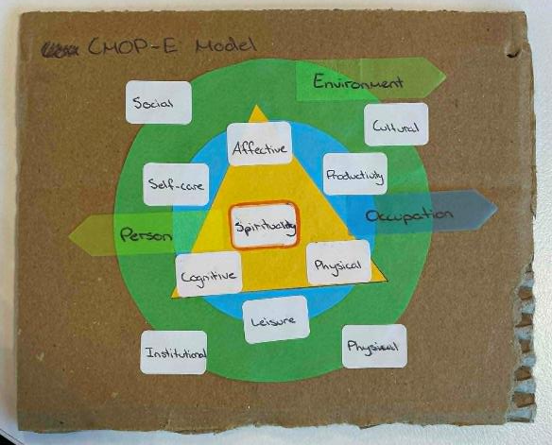
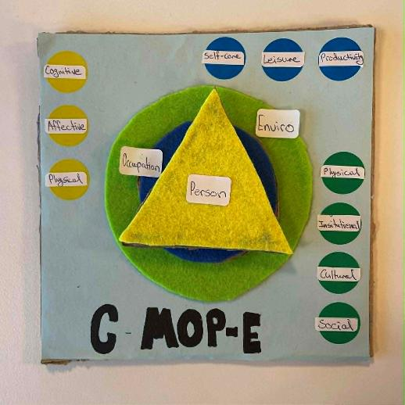
CMOP-E Model ‘Art Series’ Examples

Slide 13
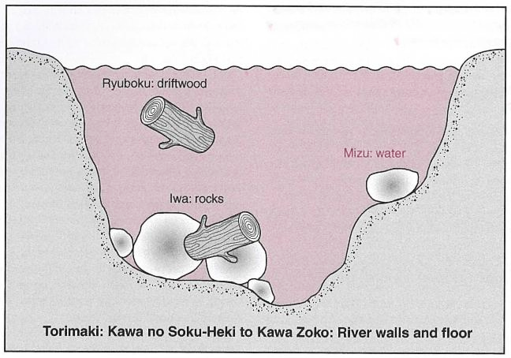
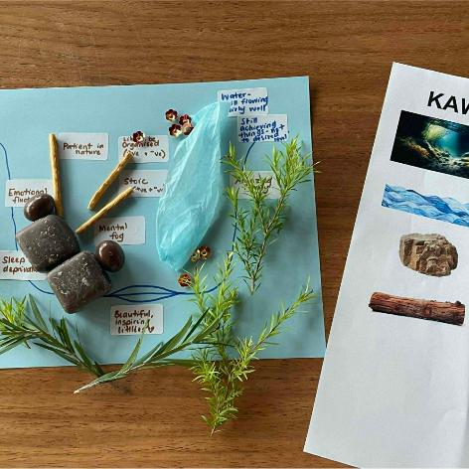
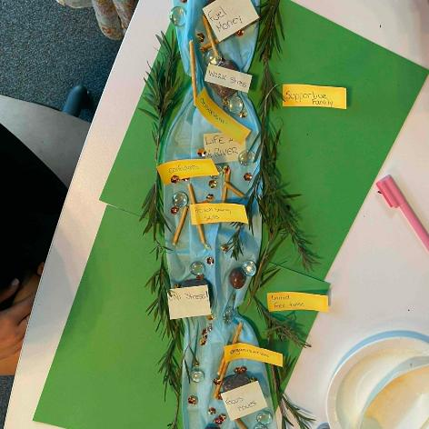
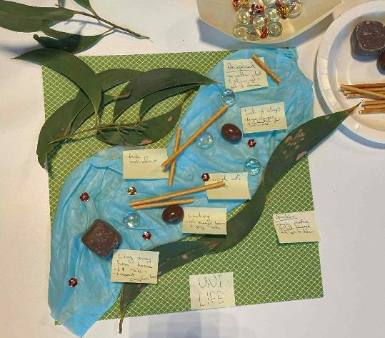
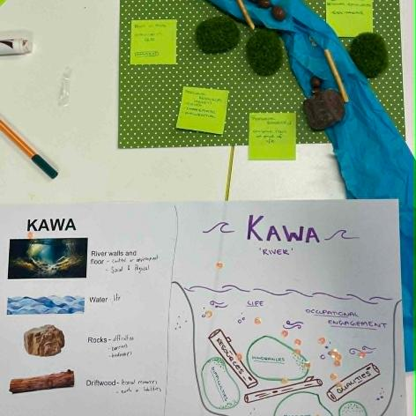
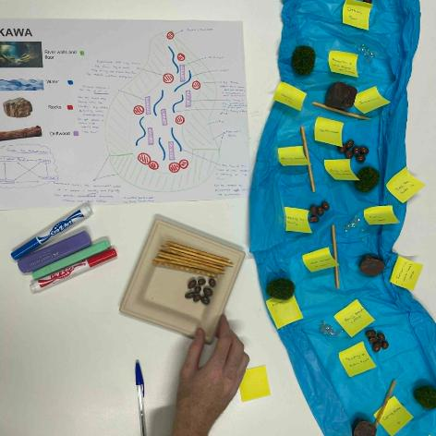
The Kawa Model ‘Art Series’ Examples

Slide 14
The
Impact
Padlet Link
For Questions

Slide 15

Examples of Student Feedback
  “It was very interactive and [the art series] helped me understand the content better than just typing the information”
“It helped us understand the frameworks more in depth while making learning fun”
“I found the "hands-on" activities, such as drawing diagrams in class, really helpful as I was able to visualise challenging topics”
    “I enjoyed the making of the models and breaking every step down, so it was clearer and answered my questions that I had before having to ask”

Slide 16
Lessons
Learnt
Along the Way
Padlet Link
For Questions

Slide 17
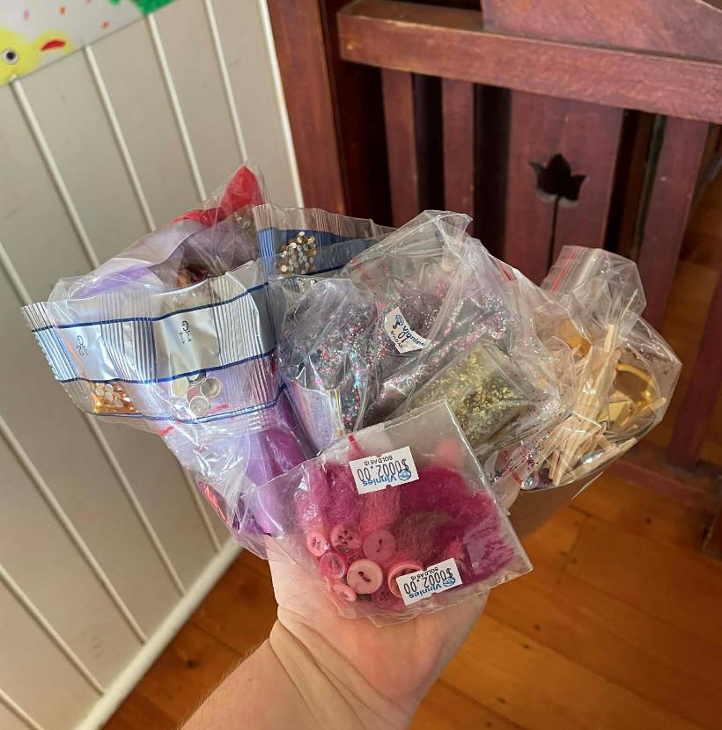
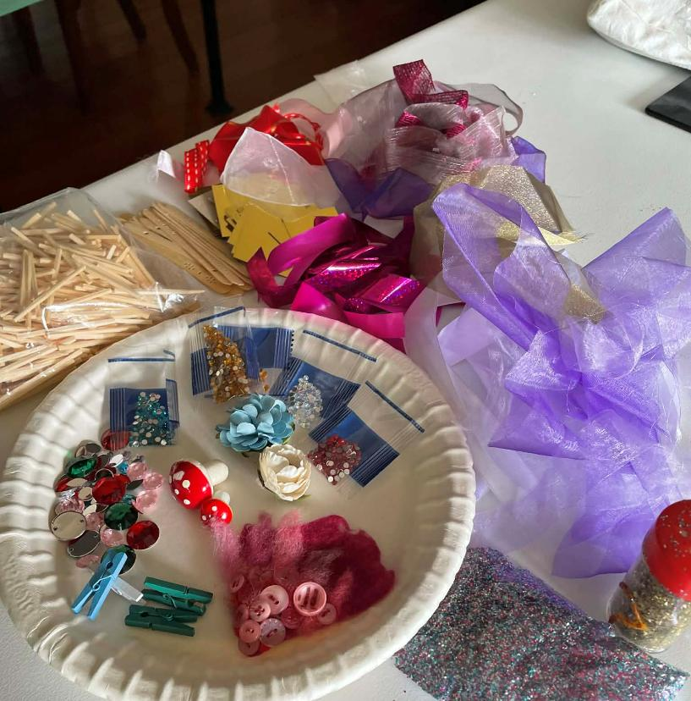
Art and craft item examples
Padlet Link
For Questions

Slide 18
Pedagogical Foundations
Padlet Link
For Questions

Slide 19
Conclusion
Padlet Link
For Questions

Slide 20
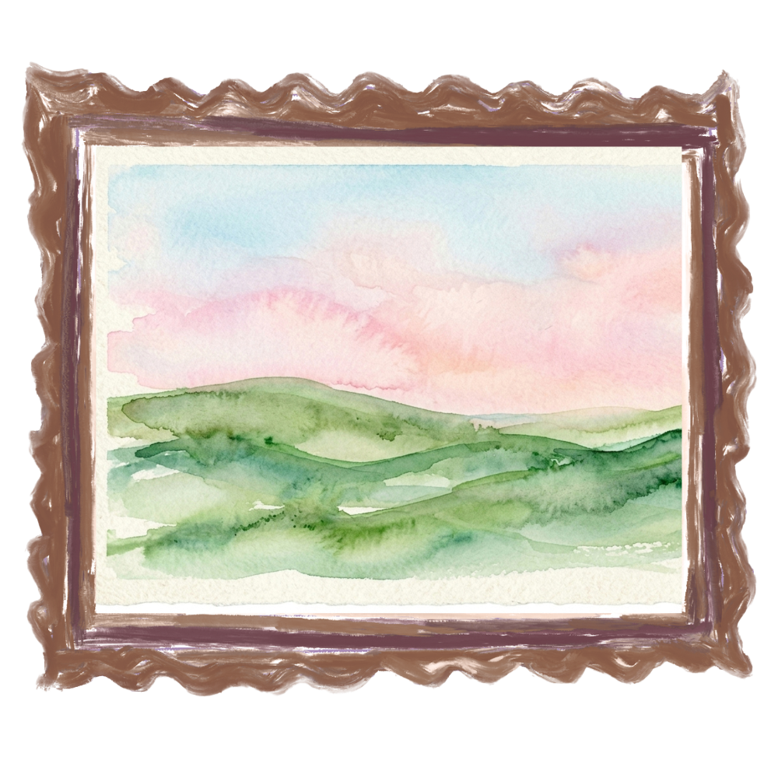

Questions
Padlet Link
For Questions

Slide 21

References
Kielhofner, G. (2008). A model of human occupation: Theory and application (4th ed.). Lippincott Williams & Wilkins.
Polatajko, H.J., Townsend, E.A. & Craik, J. (2007). Canadian Model of Occupational Performance and Engagement (CMOP-E). In E. Townsend & H. Polatajko (Eds.), Enabling Occupation II: Advancing an Occupational Therapy Vision for Health, Well-Being, & Justice through Occupation. (pp. 23). CAOT.
Regional Aboriginal Education Team [RAET]. (2026, June 13). 8 Aboriginal Ways of Learning: Aboriginal Pedagogy. NSW Department of Education. https://www.8ways.online/
    Zaczek, I. (2026, June 8). The Scream: Painting by Edvard Munch. Encyclopædia Britannica. https://www.britannica.com/topic/The-Scream-by-Munch

