Slide 1
A Universal Design for Learning Initiative for 1st Year Humanities Students
Professor Rebecca Walker, Professor Judith Dinham, Professor Nicole Slatter, Associate Professor Madeleine Dobson, Matt Reed, Humira Mirza, Stephanie Lee, Marcelo Vilches, Simon Daniele, Jesse Parmar, Salma Mohammad Yazid, KP Chua
1

Slide 2
Presentation Overview
Introductions
Background
Project Overview
UDL Response
Professional Learning
Resources
Initial findings

Slide 3
Background: Context
Data analysis of first-year Humanities students at a large Australian university revealed concerning accessibility gaps
Courses/units delivered F2F/blended/online and online via partner
Disproportionately high fail and withdrawal rates among equity students
Low rates of disability disclosure through university systems
High numbers of assessment extensions
Significant overlap between assessment extension applications and equity students

Slide 4
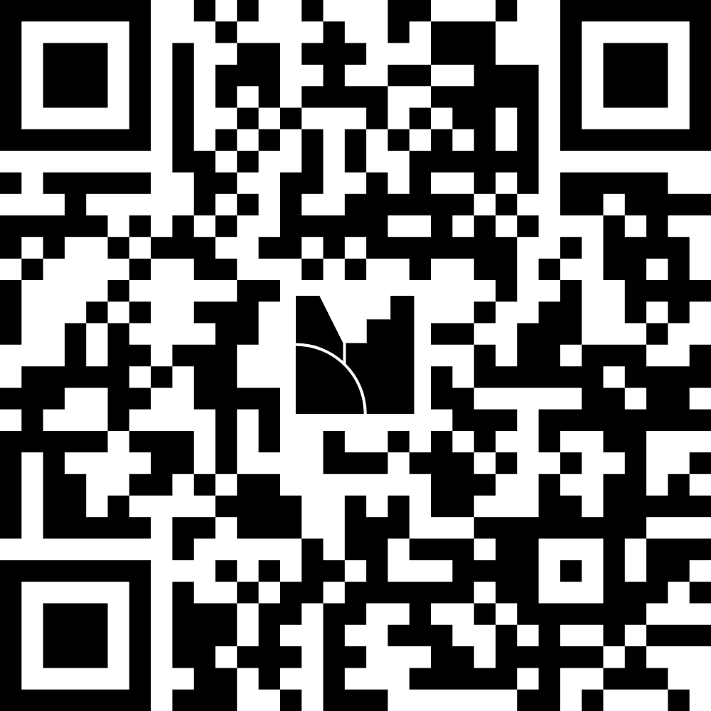
Mentimeter 1
How does your institution track equity student outcomes at unit level?
menti.com
use code7413 1078

Slide 5
Background: Data 1
6,715
Students
(2025)
60%
Equity students
13
Core units
analysed
4,444
Assessment extensions
Core first-year Humanities units, 2023–2025.

Slide 6
Background: Data 2
46.3%
Non-equity
53.7%
Equity students
27.3% Non-equity
72.7%
Equity students
F2F/online/blended
Total Enrolment= 4391
Partner: Online
Total Enrolment: 2324

Slide 7
Background: Data 3
73.1%
Partner
Online
69.9%
Partner
Online
72.7%
Partner
Online
53.7%
F2F, online, blended
48.2%
F2F, online, blended
40.2%
F2F, online, blended
2023
2024
2025

Slide 8
Background: Unit Example
Partner online unit | Approximately 800 students/year
2023
614 of 846
245
40%
56
9%
313
51%
2024
522 of 777
244
47%
33
6%
245
47%
2025
547 of 791
293
54%
27
5%
277
41%
Passed
Withdrew
Failed
Equity students (with and without disability/CAP)

Slide 9
Background: UDL
Remove barriers in student learning (Florian, 2021)
Meet the needs of all students (Meyer et al., 2014)
Support teacher preparation and instruction (Mackey, 2019)
Improve student-teacher interactions (Mackey, 2019)
Improve students from diverse backgrounds academic ability in acquiring and using new knowledge (Boothe et al., 2018)
Increase student confidence and relationships with their teachers (Seymour, 2024)
Lead to positive learning outcomes for students with and without a disability (Schreffler et al., 2019)

Slide 10
Project Overview
Aim: Improve outcomes for 1st year students with a disability, including those experiencing intersecting forms of disadvantage
Unit redesign: Embed UDL principles into the learning management system and assessments in 9 1st-year Humanities higher education units
Quantitative: Quasi-experimental pre-post research design with sample size ~7000 students
Data collected: Pass rates, withdrawals, AE requests, disability disclosure rates, and LMS accessibility scores
Qualitative: Focus groups and semi-structured interviews

Slide 11
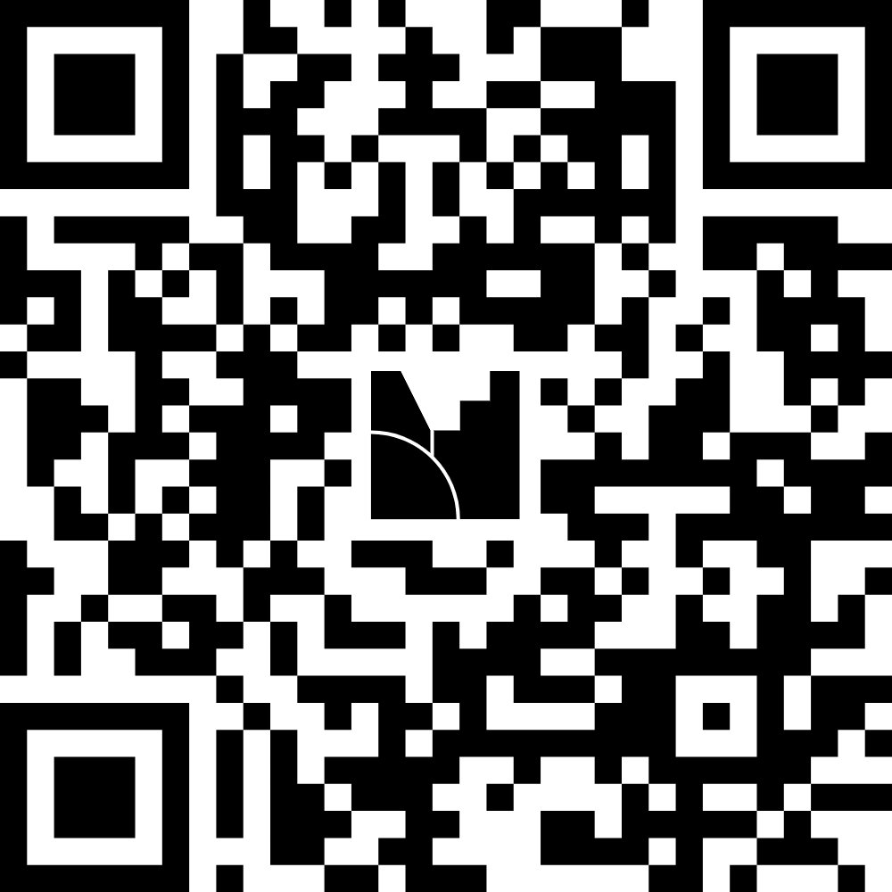
Mentimeter - 2
What barriers exist to systemic UDL - and who holds the levers?
menti.com
use code7413 1078

Slide 12
UDL Response
UDL 3.0 Unit Redesign
Professional Learning
9 first-year Humanities units focusing on LMS and assessments.
Structured program for Unit Coordinators/teaching staff to support unit redesign.
Student Advisory Group
Resource Development
Students with lived experience co-developing improvements. Led by students.
Resources created and collated to support unit redesign and all teaching staff.

Slide 13
Professional Learning Framework
One-on-one consultation
Personalised sessions tailored to each staff member's needs and goals.
Targeted workshops
Group sessions built around shared priorities and practical skills.
Structured guidance
Resources created and collated to support all teaching staff.
Project team meetings with staff
Responsive to needs, feedback, peer sharing, information and accountability

Slide 14
Professional Learning: Examples
UDL Overview and Practical Strategies – Key note speakers
Transition Pedagogies and Embedding UDL Workshop – Sally Kift
UDL Resources, sharing and pledge – UDL Project team
1:1 Digital Consultations –Digital Project team
1:1 Assessment Design – Assessment 2030 team
Text to Multimedia – Digital Project team
Collaborating online – Digital Project team

Slide 15
Resources: Examples
Staff Portal UDL page: Created and accessible to all staff
Digital resource guidance notes
Digital toolkits: Rubrics, Think Together Collections, Assets and Audio Collection
Explore video series
Pledge document
Collation of existing resources

Slide 16
Initial Student Feedback 1
Provide assessment format choice
Exemplar assessments at each grade level
Explicitly indicate in the rubric where marks are allocated
Rubrics that can be read by a screen reader
‘Lock down browser’:
  Introduce through low-weighted assessments first
  Allow for scheduled breaks
  Include clear instructions on how to use

Slide 17
Initial Student Feedback 2
Oral presentations:
  Focus on application of content not memory of content
  Assess individually, rather than by group
  Create a low-pressure environment
  Allow for supporting materials like notes
AI tool that supports studying and critical thinking, rather than tools that provide answers

Slide 18
Initial Project Staff Feedback
Different needs to support redevelopment
Expectations of online students
Challenges in changing practice
Early responders have taken up other initiatives
Workload allocation assisted
1:1 sessions and meetings with peer sharing were helpful
Introduced the pledge to structure redevelopment
Other areas and staff approaches to share ‘work’

Slide 19
Invitation to Dialogue
How do you build staff capacity without creating compliance fatigue?
What does meaningful student co-design look like in your context?

Slide 20
Thank you
Questions
Humira Mirza: Humira.Mirza@curtin.edu.au
Rebecca Walker: Rebecca.M.Walker@curtin.edu.au

