Slide 1
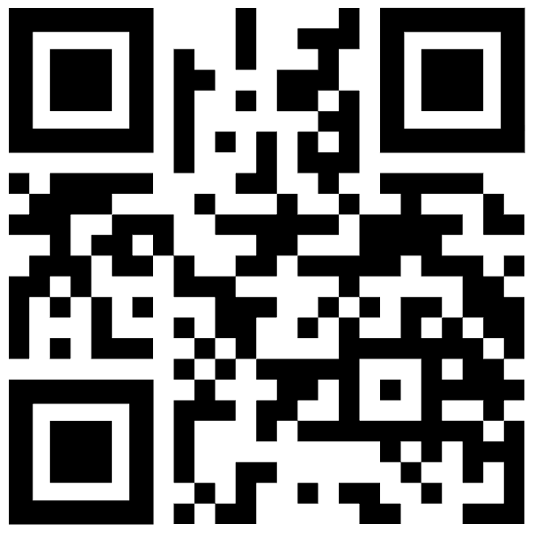
Measuring Impact: A UDL-Aligned Inclusive Assessment Self-Evaluation Tool
Talia Lewis (Senior Coordinator, Inclusive Teaching and Learning) | RMIT
Link alternative: https://shorturl.at/4JyLS

Slide 2
Acknowledgement of Country

Slide 3
The Problem
Inclusive assessment is often:
  Retrofitted as accommodations for ELPs
  Inconsistently implemented
  Expertise-dependent
  Hard to measure
  What we were missing: ways for scoping and embedding inclusive design priorities, and tracking change/impact

Slide 4
Tool + Purpose
What it provides:
Structured UDL-aligned prompts for reflection
Automated feedback identifying:
    Strengths
    Opportunities/ quick wins
    Strategies + resource links including internal teams/contacts
What it enables:
Conversation scaffold and inclusive project scoping
Shared responsibility
Baseline development and measurable impact
Link alternative: https://shorturl.at/4JyLS

Slide 5
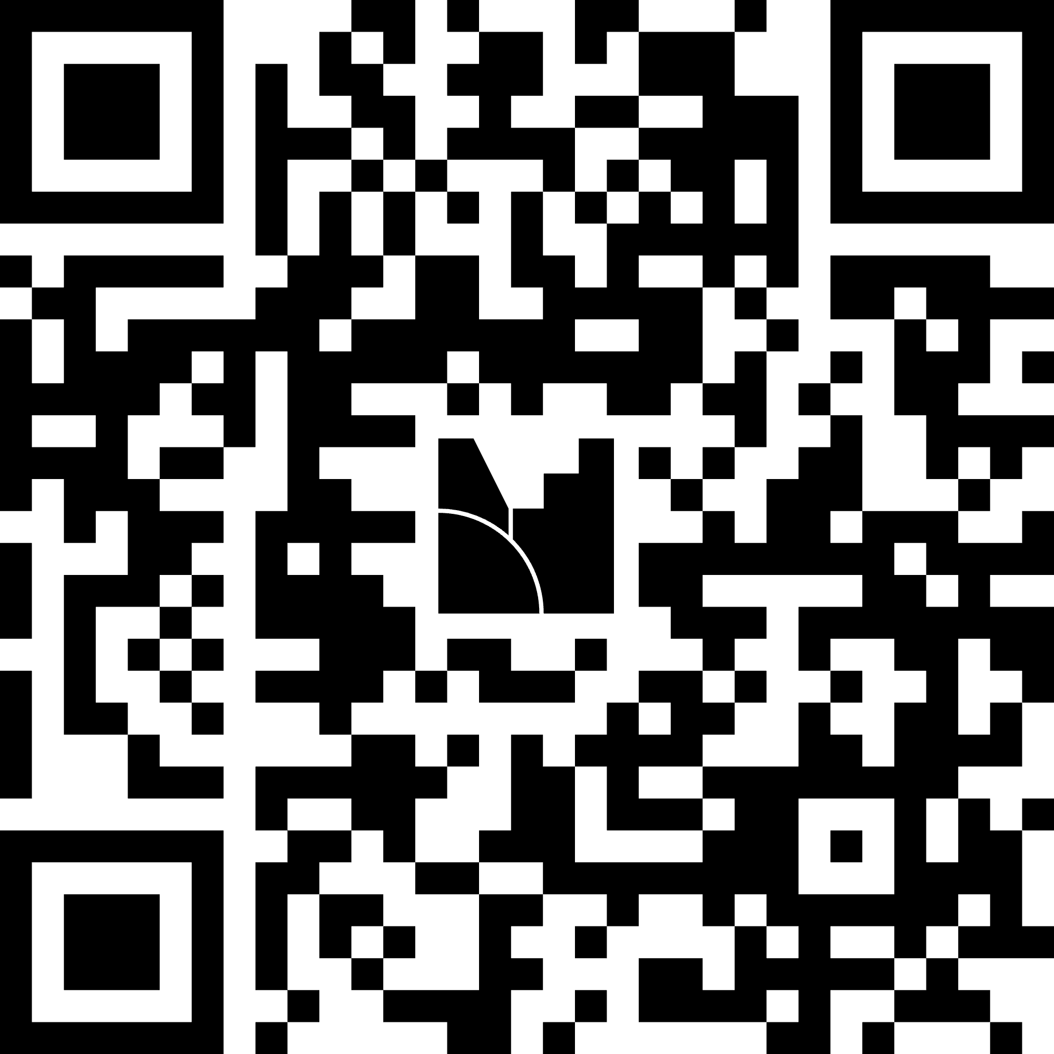
Activity: Co-design simulation
Task materials:
Self-assessment tool
Case study assessment
Task instructions:
In person: Turn to the person next to you. Assign roles as academic or learning designer. Online: Play the role of academic.
Use the self-assessment tool to review the assessment. Identify one key priority for redesigning the assessment. If working alone, identify key opportunities for support/ questions.
Reflect: How did the tool shape your conversation/ surface priorities? Share your thoughts to the Menti.
Roles:
Academic
Learning Designer
Goal:
Use the tool to guide assessment review.
Tool link alternative: https://shorturl.at/4JyLS
Menti link alternative: https://www.menti.com/altcqm52uo27

Slide 6
Embedding Impact in Workflow
Capturing change over time
Baseline self-evaluation
Guided co-design conversation
Re-evaluation after design/ during QA
Enables:
visibility of improvement
aggregation across courses/programs

Slide 7
From Reflection to Insight
Ecosystem: Browser-based tool → SharePoint data collection → Power Automate → Power BI
Outcome:
Patterns across courses
Track improvement over time
Evidence program-level impact

Slide 8
Guiding questions for adapting this approach to your context
Where would this sit in your workflow?
Whose impact are you measuring? Who are you communicating impact to?
How will you capture/visualise change within your ecosystem?
Who are your key stakeholders and how will you involve them in co-designing your solution?
What kind of language resonates with my stakeholders?

Slide 9
Q&A

