Slide 1

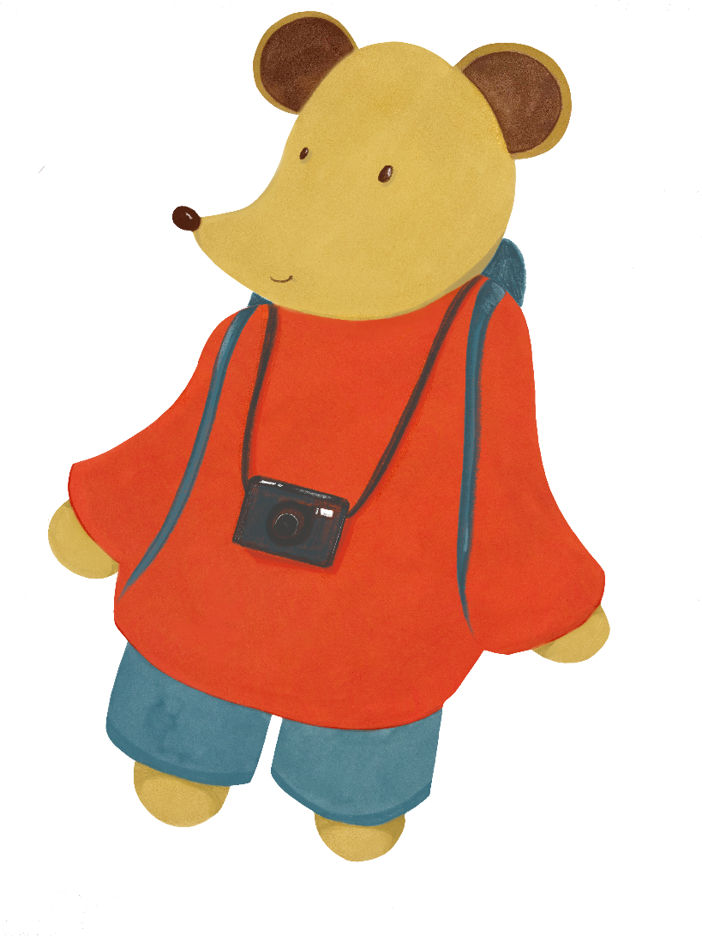
Exploring the Third Space: Facilitating learner engagement in higher education academic/professional binaries
Dr. Lucy Petchell & Amelia Yarwood, University of Sydney

Slide 2
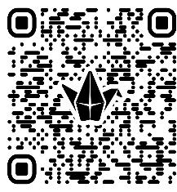
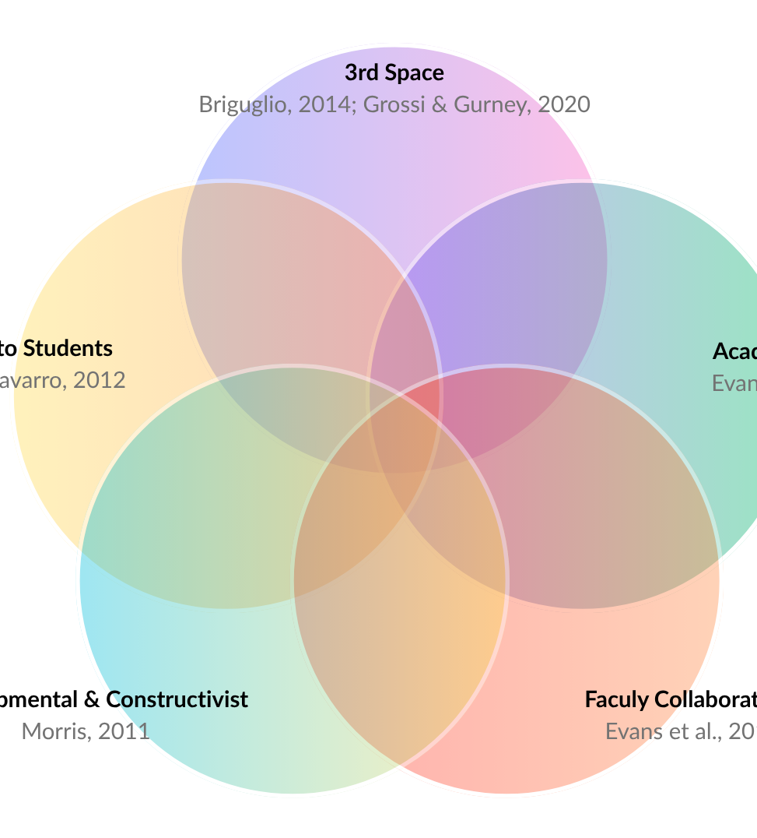
The advising context

Slide 3
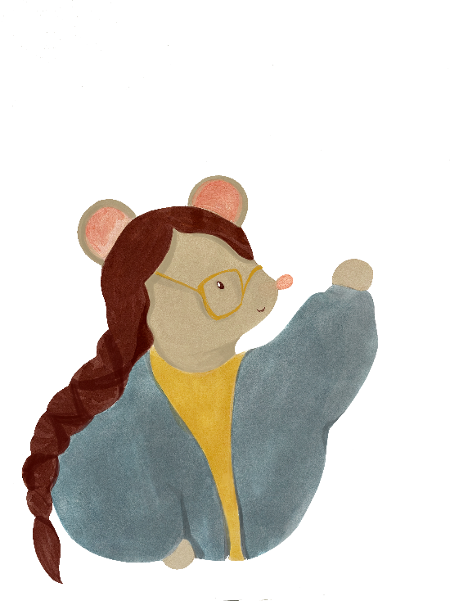

Gaps in university UDL
HE tends to be split along professional/academic divides
UDL materials in HE often focus on classroom use
Our goal is to:
Raise awareness of the collaborative opportunities that exist for supporting and scaffolding individual development, especially for navigating university life

Slide 4

Introducing Noor
“I am interested in changing/ dropping my major or changing my degree and would like to understand my options surrounding that”
Goal: to graduate on time
Strengths: curiosity, one-on-one communication
Challenges: balancing work/study/care responsibilities, feeling overwhelmed

Slide 5
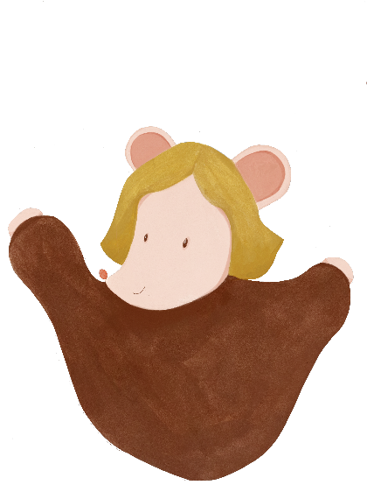
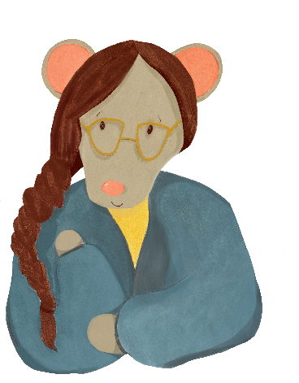
Supporting Noor through advising
Navigating HE administrative processes alongside other responsibilities is impacting Noor’s classroom learning
Third space support outside the classroom can increase Noor’s engagement IN the classroom
We’re going to show you how we supported Noor across two different university third space services

Slide 6


Noor meets Student Success Team (1)
Framing the conversation
clarifies Noor’s goals
optimises relevance and value (7.2) by ensuring suggestions are tailored to Noor
“It sounds like you’d like to finish your degree as quickly as possible but also keep your options open for future study, and you’d also like to get some support right now with managing time. Is that right?”

Slide 7

Noor meets Student Success Team (2)
“Sometimes we think of our degree as a river carrying us to a distant shore. But maybe it’s more like a path that we are digging. The kind of path we make will depend on the tools that we’re using, but we do have agency in deciding where it will go. What do you think?”
Degree planning
contextualises administrative processes within Noor’s learning goals
scaffolds pathway to Noor’s desired outcomes
creates space for play and joy in unit choices (7.4)

Slide 8
Noor meets Student Success Team (3)
“You mentioned that time management has felt difficult. If you like I could put in a referral to the Learning Hub so that they can reach out to you. It’s free and confidential. Would that be helpful?
Referrals
support executive functioning
foster collaboration (8.3) across HE learning environment
removing barriers outside the classroom supports Noor’s capacity for learning IN the classroom

Slide 9


Noor goes to the Learning Hub (1)
“Students in similar situations to yours have aimed for different things, from just passing to maintaining a distinction average - What is your goal for this semester?”
Open questions
give Noor autonomy over what she shares and prioritises
provides the foundation for developmental, strengths-based advising approaches

Slide 10
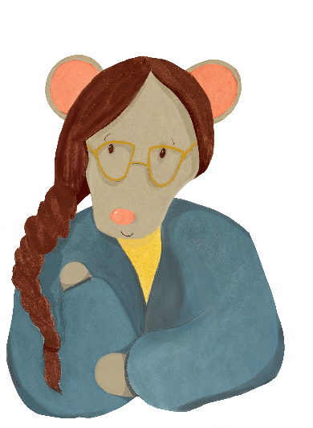
Noor goes to the Learning Hub (2)
“Listening to your metaphor, I am struck by the idea of an ocean. This makes me think you’re feeling like the present hardship is endlessness. Would that be an accurate interpretation?”
Giving space
allows Noor to feel her emotions and recognise what expectations and beliefs these relate to
allows for trust to be build

Slide 11
Noor goes to the Learning Hub (3)
Collaborating on a plan
gives Noor agency of her future course of action by scaffolding planning and strategy development
ensures relevancy by taking into account lived experience and personal perspectives
“Based on our discussion so far, what do you feel is your priority? Especially in terms of next steps.”

Slide 12
Call to action
Noor's case acts as an example of:
one student's experience
wraparound care where there is a coordinated effort to provide individualised support
the necessity of an institution-wide approach to UDL in which individual teams are aware of what other teams can offer

Slide 13
Why does it matter?
“It's pretty cool and empowering the way you have shone the light on my path to greatness, showing me the ropes.”
“Useful information inspired me, and gave me a pushing power”
“[In the past] I have often felt that I am on trial and must defend my poor grades… [this time] I felt understood and helped, I came into a judgement free space with an open dialogue that was really helpful and kind.”

Slide 14
So, what's your +1?
Let us know what you’ll be taking away with you through the Padlet. We’d love to know:
Which third spaces can you collaborate with in your learning context?
How do you support student engagement?
If you’d like to reach out to us directly, please email:
amelia.yarwood@sydney.edu.au and lucy.petchell@sydney.edu.au

Slide 15
References
Evans, S., Henderson, A., & Ashton-Hay, S. (2019). Defining the dynamic role of Australian academic skills advisors. Higher Education Research & Development, 38(6), 1121–1137. https://doi.org/10.1080/07294360.2019.1616676
Fenton-Smith, B., & Gurney, L. (2022). Collaborator, applied linguist, academic, expense? Exploring the professional identities of academic language and learning professionals. Higher Education Pedagogies, 7(1), 160–178. https://doi.org/10.1080/23752696.2022.2130390
Norman, L., & Newham, E. (2018). The role of learning advisors and support staff within an increasingly differentiated student community. Journal of Academic Language & Learning, 12(1), 128-140. Retrieved from https://journal.aall.org.au/index.php/jall/article/view/545
Illustrations for this PowerPoint were done by Lucy Petchell

