Slide 1
Making the Visual Accessible: Fashion, Art and Beyond
Dr Julie Gork & Dr Belinda Johnson

Slide 2
Acknowledgement of Country

Slide 3
Experiencing Fashion: A Nonvisual Perspective
Fashion's visual nature can exclude people who are blind or have vision loss.
Students with low vision or blindness remain underrepresented in fashion education.

Slide 4
Image and Audio Describing as a Core Pedagogical Practice
Descriptive skills remove learning barriers through a multimodal approach
Aligns with UDL principles:
  Supports multiple ways to perceive information
  Clarifies vocabulary
  Expands perceptual access for all learners

Slide 5
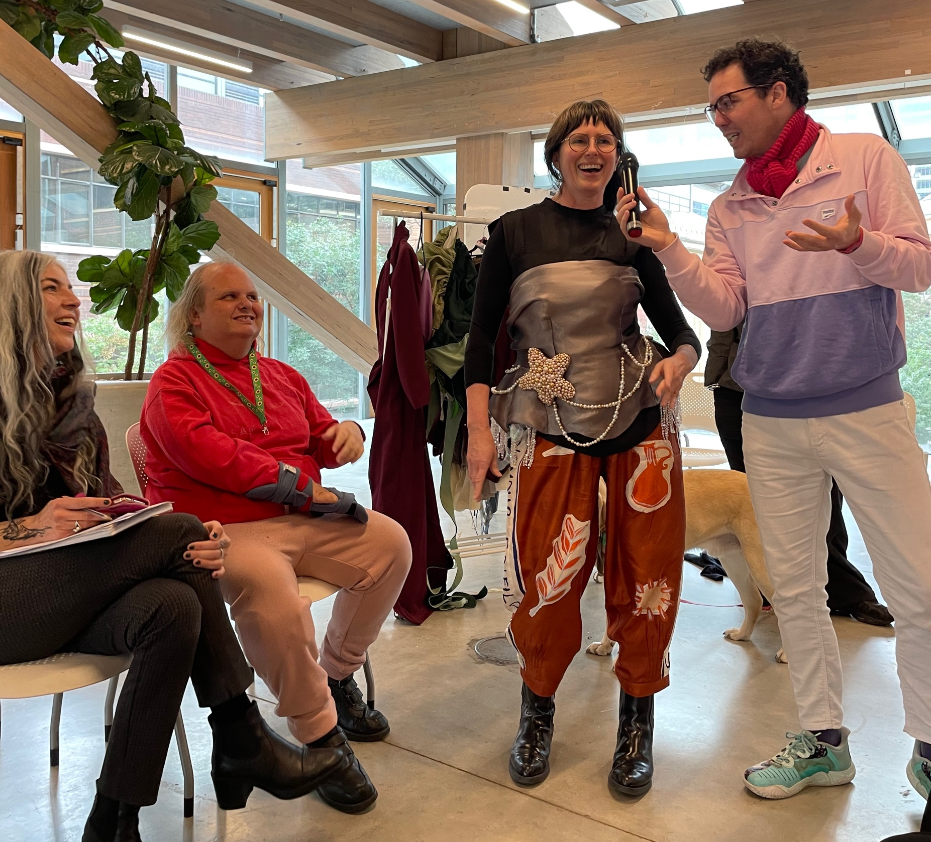
The Pilot: The Catwalk Speaks
MFW (2025) public workshop on Audio Description for fashion.
From this, we learnt about the need for tailored workshops for specific cohorts.

Slide 6
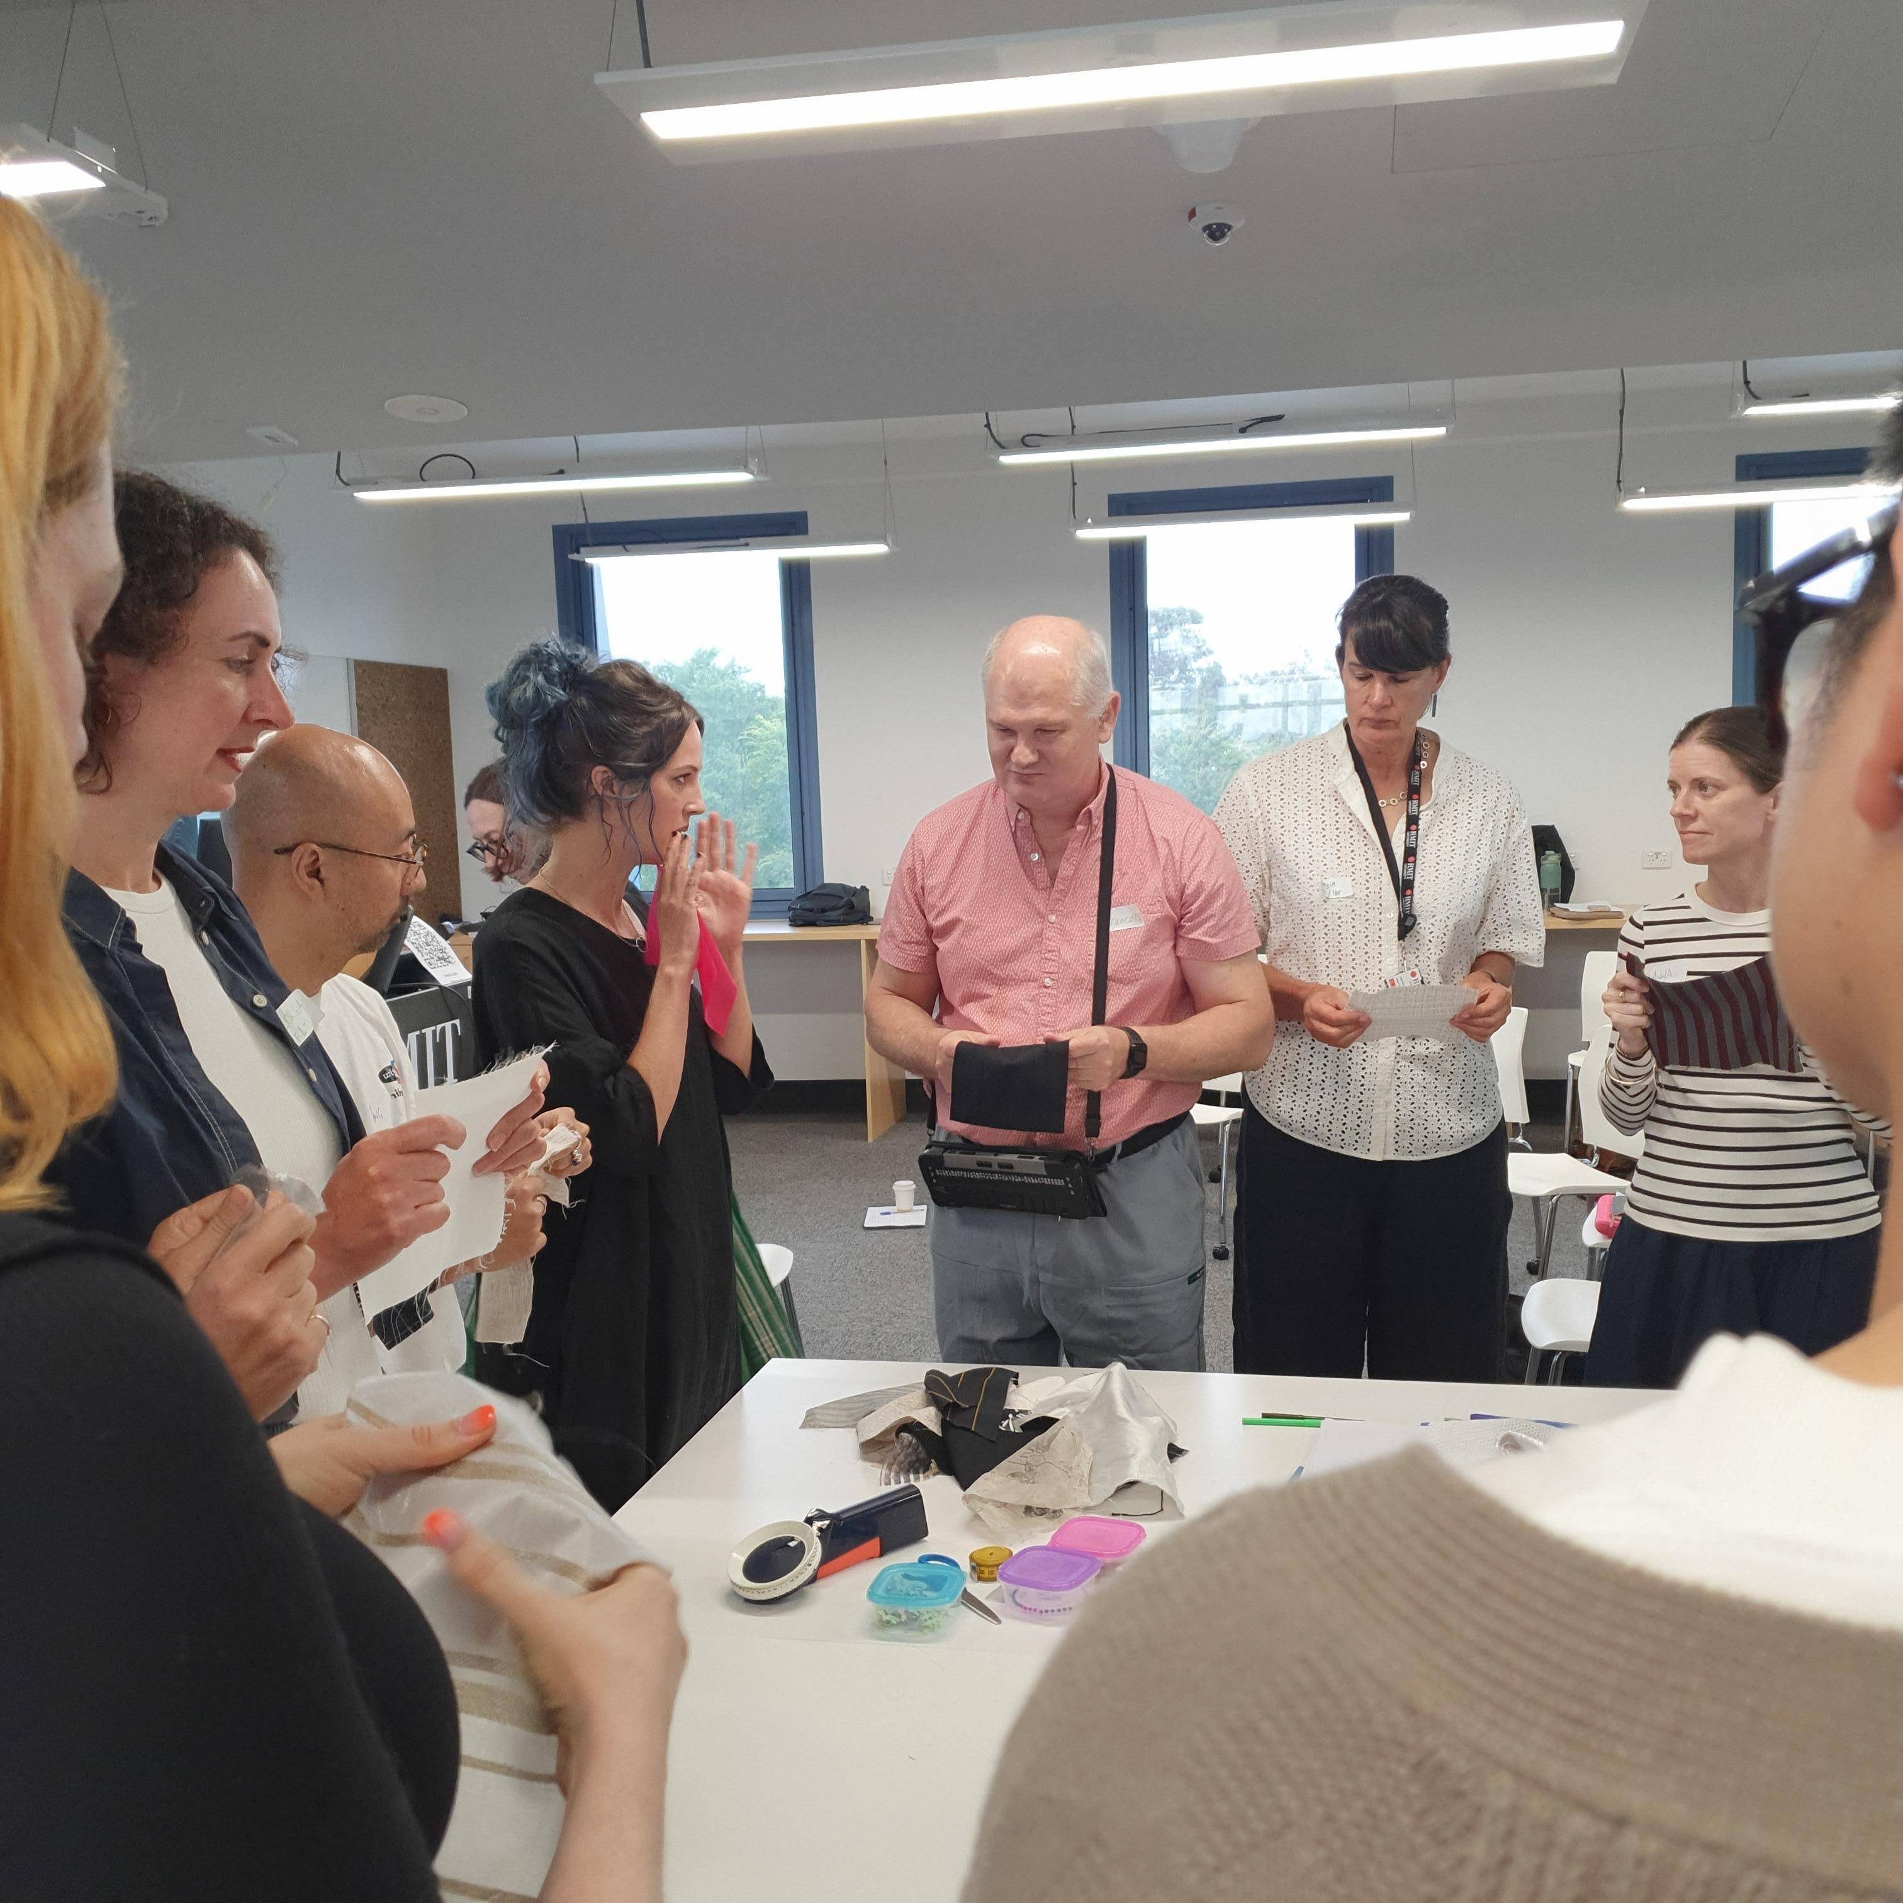
The Project: Description Workshops for Fashion & Arts Educators
Workshops addressed:
Image description for course visual content
Audio description for live classroom contexts
Development of multisensory vocabulary

Slide 7
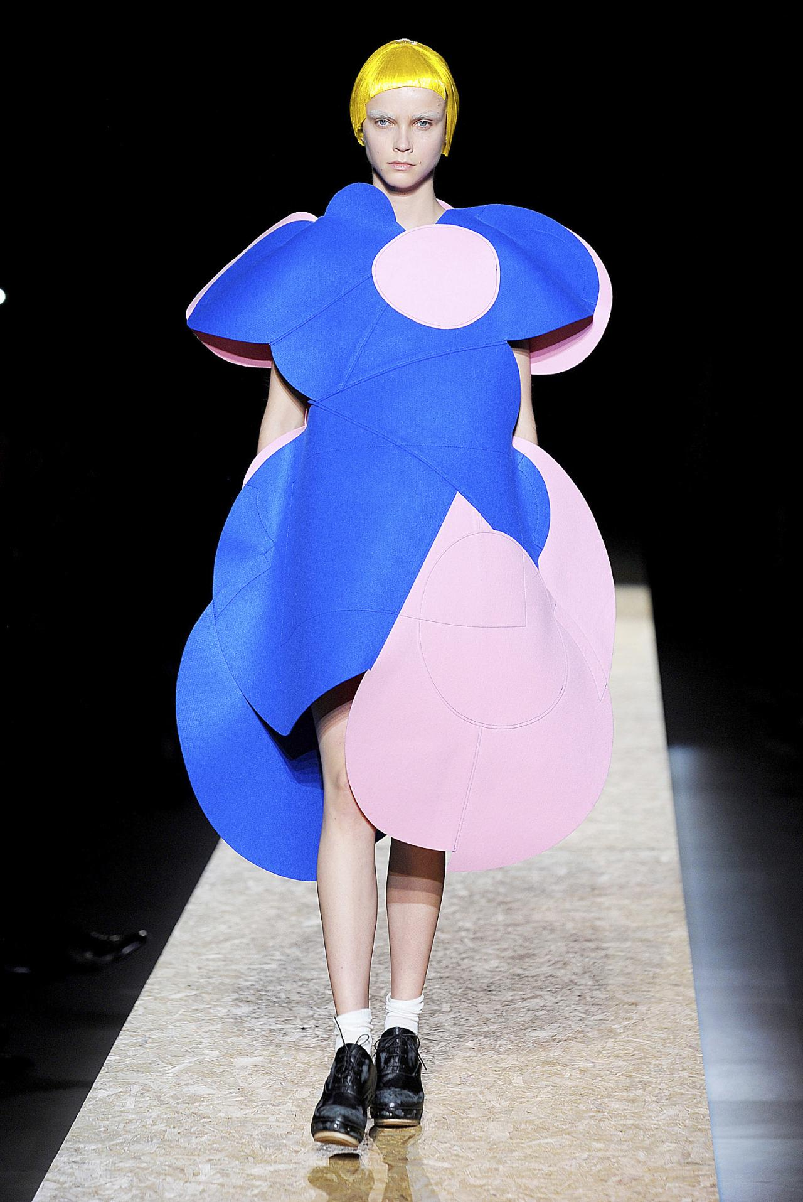
Image Description Invitation
How would you describe this image to someone who is blind or has low vision?
Please add your description to the chat.

Slide 8
Image Description Reflection
What visual factors did you consider?
What was the most important information to convey?

Slide 9
Findings and Learnings
Participants reported increased confidence and awareness of visual bias.
Demonstrated a willingness to make mistakes, while offering specialist insight.
Findings will inform the development of guidelines.

Slide 10
Next Steps
Development of a guide for practice.
Further workshops: Interdisciplinary transfer.
Scholarly impact through theorising equitable access through the fashion sensorium.

Slide 11
References
barbarabrownie. (2014, December 4). The Sound of Fashion. Costume & Culture. https://barbarabrownie.wordpress.com/2014/12/04/the-sound-of-fashion/
Barry, B., & Christel, D. A. (2023). Beauty to be Recognized: Making the Fashion Show Accessible. In Fashion Education. Intellect.
Czupryna, P. (2025, August 16). Blind models work the runway at fashion show for the visually impaired. TCA Regional News. https://www.proquest.com/docview/3240045991/citation/4EBBE68FD6DA482APQ/1
Fels, D. I., & Snyder, J. (n.d.). Audio Description as an Aesthetic Innovation. Audiovisual Division Part of the American Translators Association. Retrieved December 12, 2025, from https://www.ata-divisions.org/AVD/ata-60-recap-audio-description-as-an-aesthetic-innovation/
Trevonne, N. (2022, March 16). Blind and Low-Vision Viewers Care About Screen Style—So Why Does Audio Description Skip It? Popsugar. https://www.popsugar.com/fashion/how-audio-description-fails-to-address-fashion-48753035
Udo, J. P., & Fels, D. I. (2010). The rogue poster-children of universal design: Closed captioning and audio description. Journal of Engineering Design, 21(2–3), 207–221. https://doi.org/10.1080/09544820903310691

