Slide 1
Supporting the Whole Student:
Using Trauma‑Responsive Practice and UDL in Higher Education Student Success.
Sarah Irvine and Kacie Fahey
Senior Learning Advisors
University of Southern Queensland

Slide 2
Acknowledgement of Country

Slide 3
Trigger warning
This workshop discusses experiences of trauma including:
Domestic and family violence, adverse childhood experiences, systemic and institutional harm, mental illness and homelessness.
If anything feels overwhelming, feel free to do what you need to do to feel safe which might look like, leaving the room, taking a walk, turning off microphone/video, or reaching out for professional support such as:
Lifeline: 13 11 14
13 YARN: 13 9276

Slide 4
Outline for the workshop
Introduction and context
The framework
Case study small group task
Key takeaways
Questions

Slide 5
Trauma-informed vs Trauma-responsive
Trauma-informed
Trauma-responsive
Being trauma-informed means being aware of the causes of trauma, the manifestations of trauma, and the micro, meso and macro impacts of trauma.
Being trauma-responsive means engaging in practices and actions that actively consider harm reduction, avoidance of re-traumatisation, and are designed from the outset with consideration of service-users potential trauma.

Slide 6
Introduction and context
Learning Advisors at a regional Queensland university
Seeing students in 1-1 appointments from diverse backgrounds and experiences.
Being third-space practitioners, we are passionate about the whole student journey and understand how students navigate their academic pursuits with what’s going on for them in life.

Slide 7
Literature
UDL
Trauma responsive practice

Slide 8
Literature Similarities
Similarities | UDL guidelines | Trauma-responsiveness | Relevant theory
Overall goal | Remove barriers to curriculum access through flexible design | Create psychological and physiological safety as a precondition for learning | Maib and Holyoke (2024) Moses et al., (2023)
Proactive focus | Anticipates learner variability at the design stage rather than retrofitting accommodations | Plans for the likelihood of trauma exposure - and also responsive to the whole learner | Moses et al., (2023) Capp (2017)

Slide 9
Literature Differences
Differences | UDL guidelines | Trauma-responsiveness | Relevant theory
Educator relationship | Educator as curriculum designer — relationship is implicit, embedded in design choices | Educator as relational partner — trustworthiness, peer support, and collaboration are explicit, named principles | Maib and Holyoke (2024) Miller et al., (2024)
Scope of practice | Instructional design — focuses on how materials, assessments, and activities are structured | Instructional + relational + institutional; requires whole-of-community implementation | Watson et al., (2024). Maib and Holyoke (2024)

Slide 10
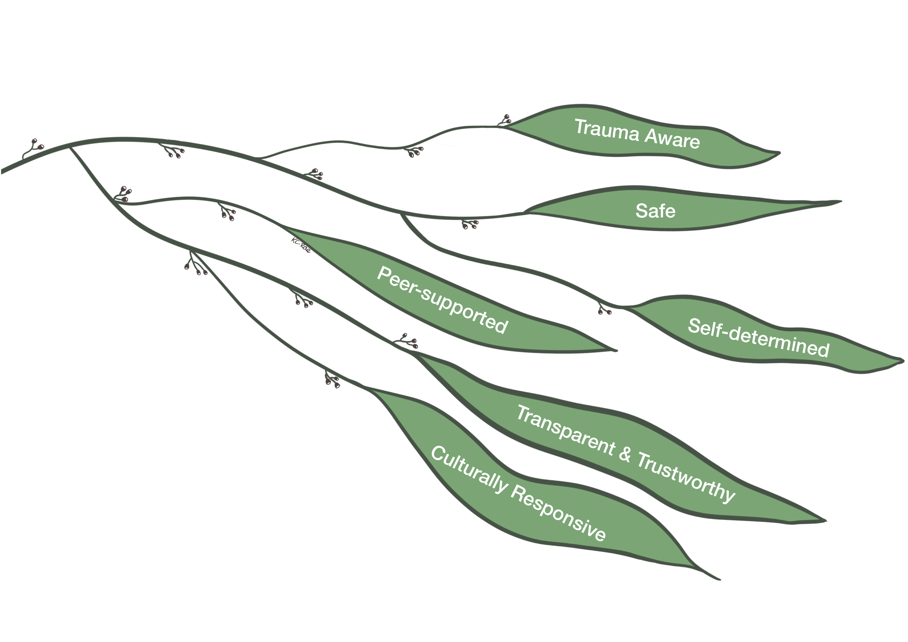
Trauma Responsive Learning Advising

Slide 11
Essence of the framework
Trauma Aware
  Objective Snapshot: Understanding of, what trauma is, how it can exhibit, its symptoms, and the influence identity and lived-and-survived experiences have on its manifestation.
Safe
  Objective Snapshot: Establishing service user and staff informed spaces that promote physical, virtual, emotional and psychological safety to reduce traumatisation and re-traumatisation
Transparent & Trustworthy
  Objective Snapshot: Establishing transparency and trust through relational communication, information sharing, confidentiality, and clear processes.

Slide 12
Essence of the framework (cont)
Self-determined
  Objective Snapshot: Developing self-efficacy and empowerment to enable collaboration, voice, and choice.
Peer-supported
  Objective Snapshot: Leveraging peer connections, knowledges, and experiences to provide support from a lived-experience perspective.
Culturally Responsive
  Objective Snapshot: Establishing approaches that are conscious of, and responsive to, historical, cultural, and societal marginalisation to mitigate the replication of trauma in an institutional setting

Slide 13
Engagement, Representation and Action and Expression Table
Engagement | Representation | Action & Expression
Welcoming Interests & Identities Framework Element/s: Trauma Aware, Self-determined, Culturally Responsive | Perception Framework Element/s: Safe, Transparent & Trustworthy, Peer Support | Interaction Framework Element/s: Safe
Sustaining Effort & Persistence Framework Element/s: Self-determined, Transparent & Trustworthy, Peer Support | Language & Symbols Framework Element/s: Safe, Transparent & Trustworthy | Expression & Communication Framework Element/s: Safe, Culturally Responsive
Emotional Capacity Framework Element/s: Trauma Aware, Cultural Responsiveness | Building Knowledge Framework Element/s: Trauma Aware, Cultural Responsiveness | Strategy Development Framework Element/s: Trauma Aware, Cultural Responsiveness

Slide 14
Case study small group task
Instructions
Each group will be provided with
Case study with working table
Trauma informed framework
Pens for scribing.
Note that at the end of the whole activity, we would like to invite you to share what you discussed with the wider group.

Slide 15
Case study small group task – Step 1
Step 1 (10mins)
Read the case carefully. How would you respond to this case using a UDL lens?

Slide 16
Case study small group task – Step 2
Step 2 (10mins)
Now consider the following questions about your case:
How would you respond to this student using the trauma responsive framework as a lens?
what principles from the trauma-responsive framework would you consider for this case?

Slide 17
Case study small group task – Step 3
Step 3 (10mins)
Now consider the following question about your case:
What did you notice when you linked both practices together?

Slide 18

Reflections (15mins)
Please feel free to share your reflections from each of the cases presented.
You may like to consider:
What felt different about working with the trauma-responsive framework?
Did you see any overlap with UDL and trauma-responsiveness?

Slide 19
Key takeaways
Trauma Responsive Practice (TRP) doesn't replace UDL — it asks a prior question: "Is this student in a state where they can access what we've designed?"
Supporting the whole student means considering not just making education accessible but also recognising the student comes with their unique history, experiences, identity etc.
Both UDL and TRP have deep evidence-based roots. Learning from each makes us better practitioners because being trauma informed and responsive is all our responsibility.

Slide 20
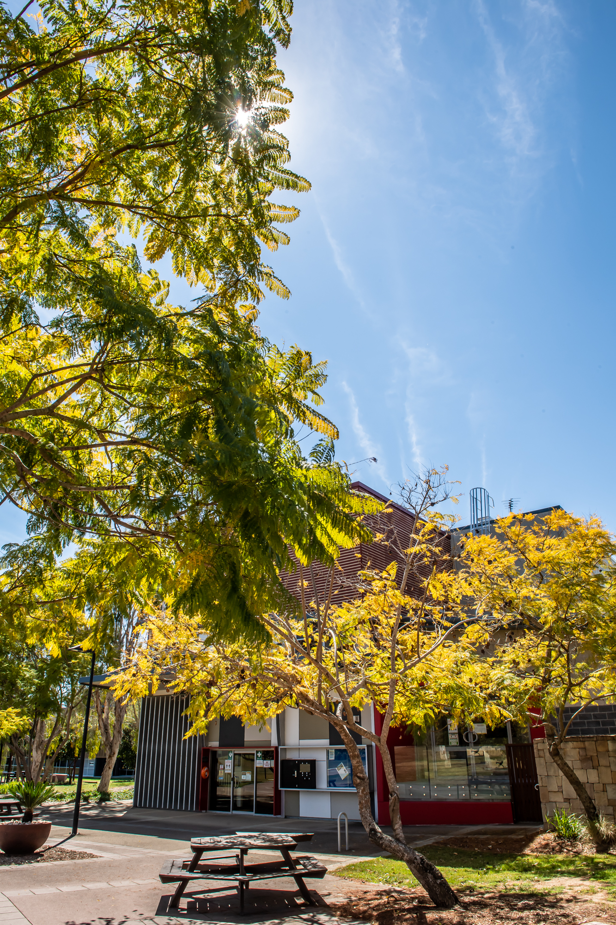
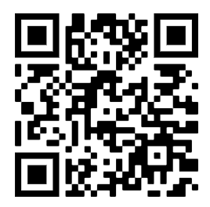
Thank-you for listening!
Access to slides:
Remember, if you need professional support to reach out to:
Lifeline: 13 11 14 or
13 YARN: 13 9276

Slide 21
References
Capp, M. J. (2017). The effectiveness of universal design for learning: a meta-analysis of literature between 2013 and 2016. International Journal of Inclusive Education, 21(8), 791–807. https://doi.org/10.1080/13603116.2017.1325074
CAST. (2024). Recognize expectations, beliefs, and motivations (UDL Guidelines 3.0 – Checkpoint 9.1). https://udlguidelines.cast.org/engagement/emotional-capacity/expectations-beliefs-motivations/
Maib, H. E., & Holyoke, L. (2024). A conceptual framework for trauma-informed instructional and programmatic design. ERIC. ED673738.
Miller, A., Yohn, H., & Trochmann, M. B. (2024). Meeting the moment: Trauma-responsive teaching for student success. Journal of Public Affairs Education, 30(1), 28–51. https://doi.org/10.1080/15236803.2023.2263129
Moses, J. D., Bayne, H. B., & Moore, R. L. (2023). Guiding course development: Trauma-informed rubrics for asynchronous online learning environments. Journal of Applied Instructional Design, 12(2). https://doi.org/10.59668/722.13025
O’Shae, S., & Martinussen, M. (2025). Trauma awareness: A new priority for higher education. EduResearch Matters. https://blog.aare.edu.au/trauma-awareness-a-new-priority-for-higher-education/
Watson, K. R., Astor, R. A., Capp, G. P., & Benbenishty, R. (2024). School social workers' reports of differences in policies and practices in trauma-informed and non-trauma-informed schools. Behavioral Sciences, 14(11), 991. https://doi.org/10.3390/bs14110991

