Slide 1
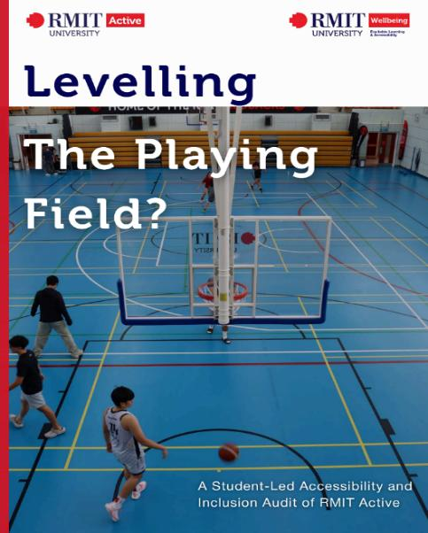
Levelling the Playing Field: Co-Designing Inclusive Sport and Wellbeing Through Student-Led UDL Practice

Slide 2
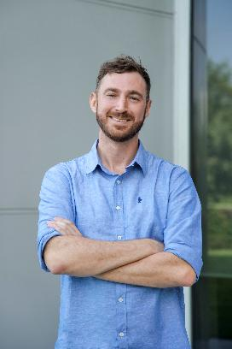
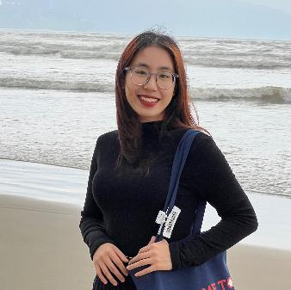
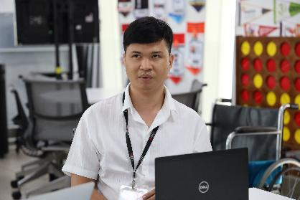
Presenters
Tran Van Bau
Minh Anh Bui
Simon O’Donoghue

Slide 3
What if access was designed before students had to ask?

Slide 4
"We know exactly what we need; so as designers, we intuitively understand our requests."
How have we been involving in sports at campus?
Judoka
Inconvenience in Sport Facilities: walkway, inaccessible equipment, etc.
Gather students with same concerns and CO-DESIGN the sport space.
Tran Van Bau

Slide 5
What students did
(co-design the whole process)
Co-shaping audit tool
Spaces inspect + Staff interviews
Ranking recommendation priorities
Discussing what matter most
Report finalization
Writing
Editing
Designing

Slide 6
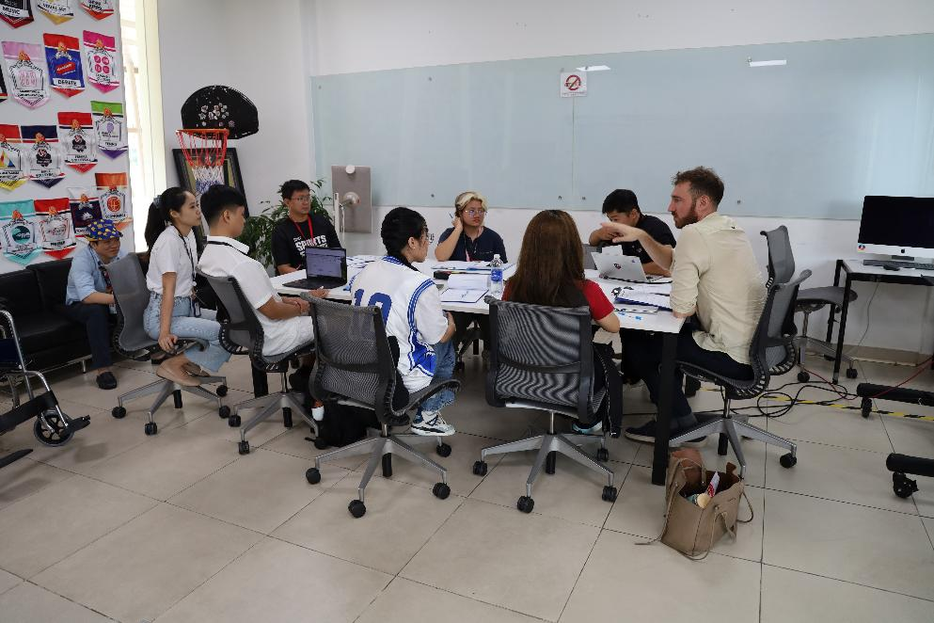
What students did
(co-design the whole process 1)
Co-shaping audit tool
Spaces inspect + Staff interviews
Ranking recommendation priorities
Discussing what matter most
Report finalization
Writing
Editing
Designing

Slide 7
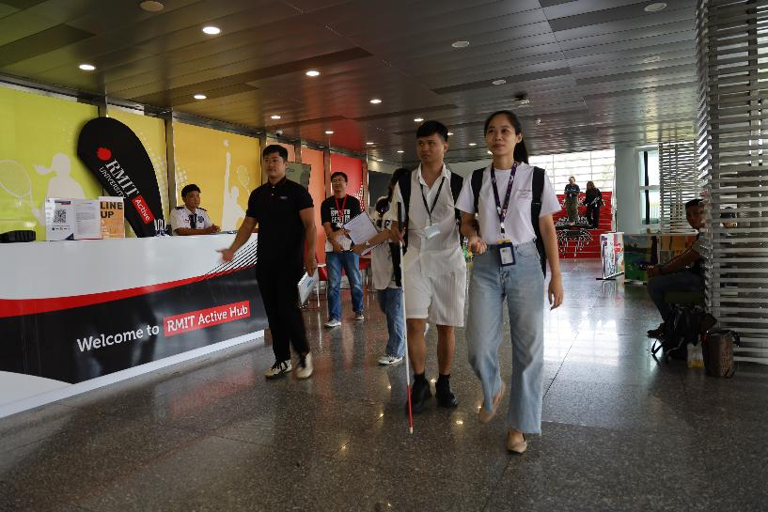
What students did
(co-design the whole process 2)
Co-shaping audit tool
Spaces inspect + Staff interviews
Ranking recommendation priorities
Discussing what matter most
Report finalization
Writing
Editing
Designing

Slide 8
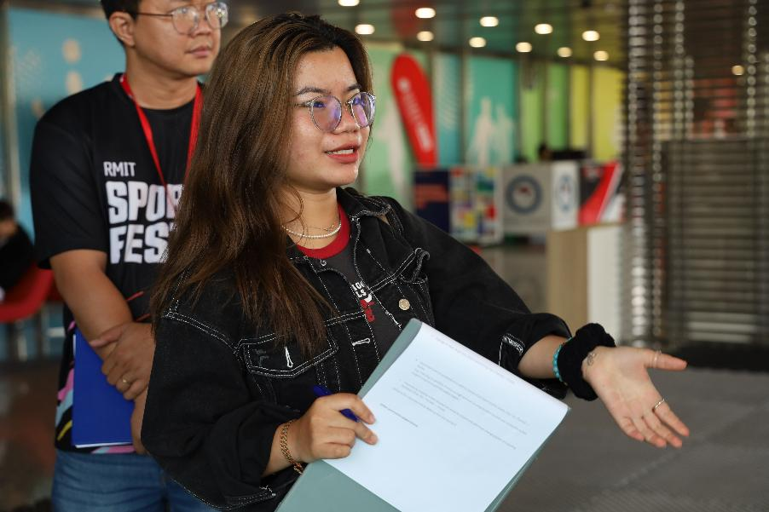
What students did
(co-design the whole process 3)
Co-shaping audit tool
Spaces inspect + Staff interviews
Ranking recommendation priorities
Discussing what matter most
Report finalization
Writing
Editing
Designing

Slide 9
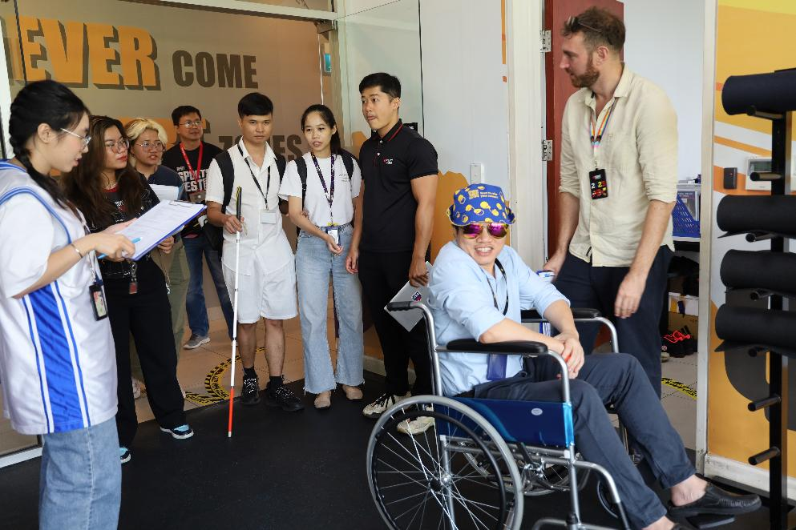
What students did
(co-design the whole process 4)
Co-shaping audit tool
Spaces inspect + Staff interviews
Ranking recommendation priorities
Discussing what matter most
Report finalization
Writing
Editing
Designing

Slide 10
“Students were not just giving feedback on access.
They were producing access knowledge.”

Slide 11

What students did
(co-design the whole process) (cont.)
Co-shaping audit tool
Spaces inspect + Staff interviews
Ranking recommendation priorities
Discussing what matter most
Report finalization
Writing
Editing
Designing
+ Embedding UDL Principles
ENGAGEMENT
REPRESENTATION
ACTION & EXPRESSION
Optimizing student choice, psychological safety, sensory comfort, and opt-in roles.
Communications by various forms (visual, tactile, verbal, digital formats).
Students discussed, wrote, ranked, photographed, mapped, designed & presented.

Slide 12
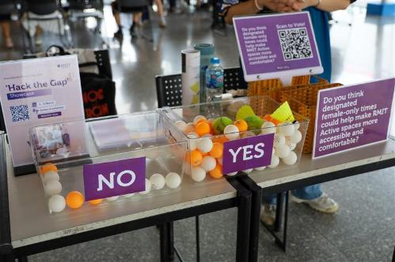
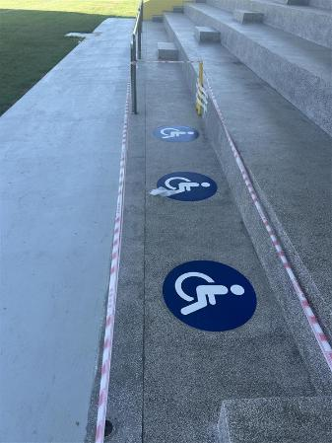
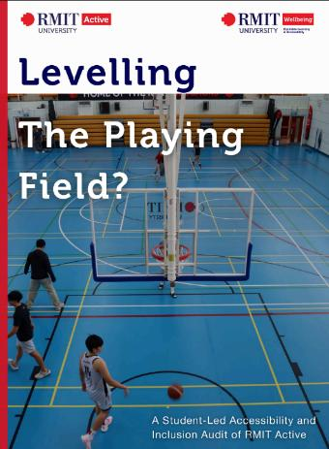
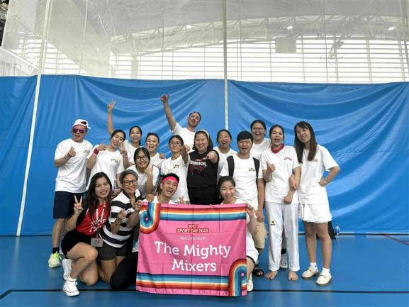
Tangible Impact

Slide 13


Intangible Impact – Students’ personal growth
Confidence – More willingness to participate in campus life
Peer friendship – Belonging – Feeling seen

Slide 14
Transferable Co-Design Framework
Invite lived experience early
Create psychological and sensory safety
Let students shape the tool, not just answer it
Translate findings into prioritised recommendations
Close the loop by showing what changed

Slide 15
Questions?

Slide 16
Thank you

