Slide 1
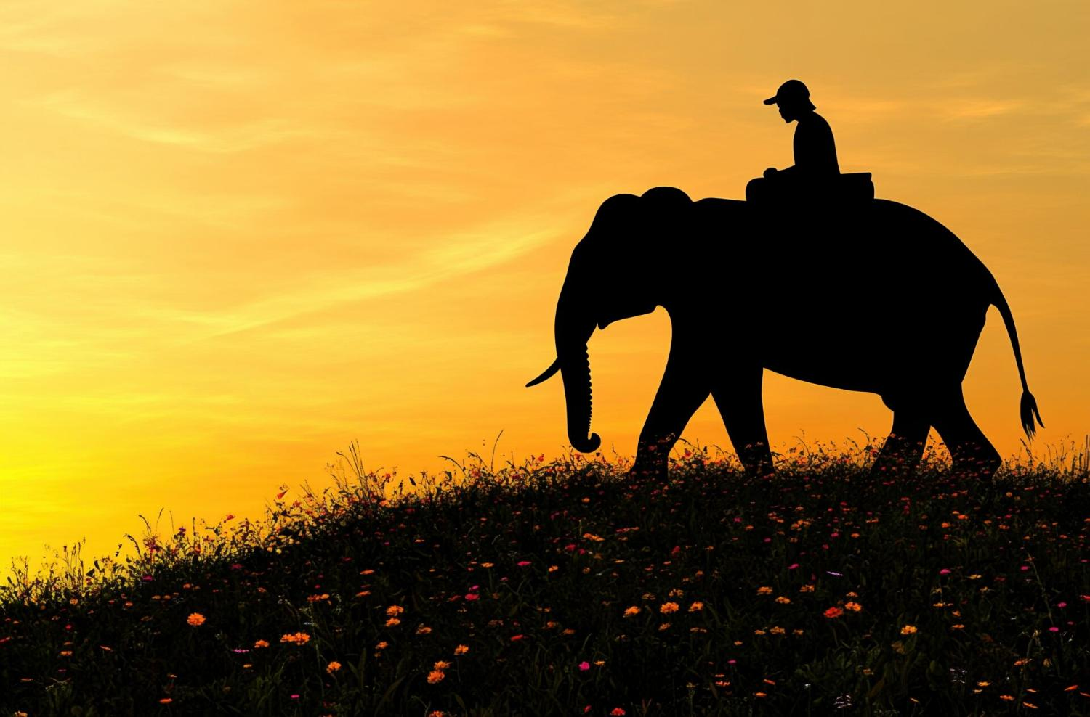
The Architecture of Empathy
Telling the Stories that Transform Tertiary Education

Slide 2

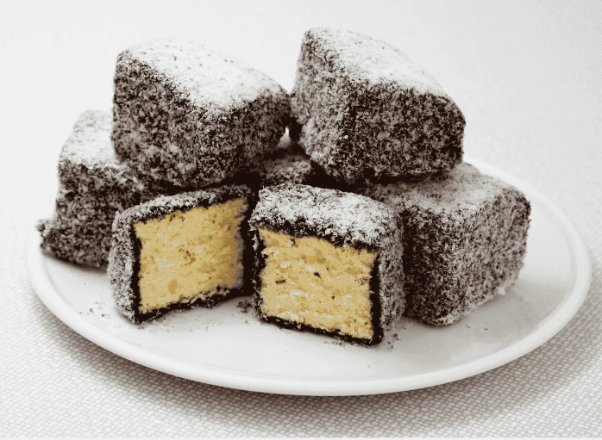
Story: My first Australian food dilemma

Slide 3
The Rider & the Elephant
Introduced by Dr. Jonathan Haidt, Professor of Ethical Leadership at New York University, in his book The Happiness Hypothesis (2006) describes human decision‑making as a collaboration between a rider and an elephant.

Slide 4
The Rider
represents your conscious, rational, and analytical mind.

Slide 5
The Elephant
represents your automatic, emotional, and instinctual drives.

Slide 6
Reason & Emotion
Our logical brain often attempts to control or direct our powerful emotional instincts, but the emotional elephant is usually the one actually running the show.
Human decision‑making is driven mostly by emotion rather than reason.

Slide 7
The Metaphor of the Rider & the Elephant
The rider can try to steer, but the elephant’s instincts and feelings have far more power; real change happens when the rider motivates and aligns the elephant instead of trying to overpower it.

Slide 8
The Lesson in the Metaphor
People don’t change because of data.
They change because of stories that move the elephant.
Empathy is what helps us speak to the emotional truth of an experience.

Slide 9
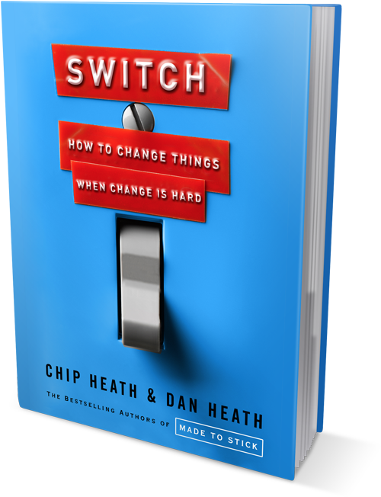
From Understanding to Action
Chip Heath, Professor of Organizational Behavior at Stanford University, and Dan Heath, Senior Fellow in Social Entrepreneurship at Duke University operationalized Haidt’s paradigm in their book Switch: How to Change Things When Change is Hard.
They added one more key component, the path on which the elephant travels. One must “Shape the Path.”

Slide 10

Framework for Change: The Switch Model
Direct the Rider
Motivate the Elephant
Shape the Path

Slide 11
Coordi nated Change requires all 3
Direct the Rider
Find the bright spots
Script the critical moves
Point to the destination
Motivate the Elephant
Find the Feeling
Shrink the Change (Don’t Spook the Elephant)
Grow Your People
Shape the Path
Tweak the Environment
Build Habits
Rally the Herd

Slide 12


Research Directs the Rider
Direct the Rider
Find the bright spots
Script the critical moves
Point to the destination

Slide 13
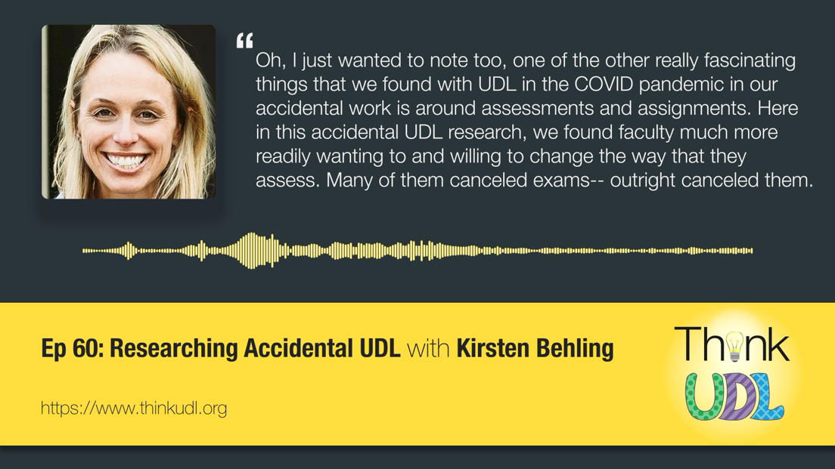
Find the bright spots
Think UDL Ep 60 LINK

Slide 14
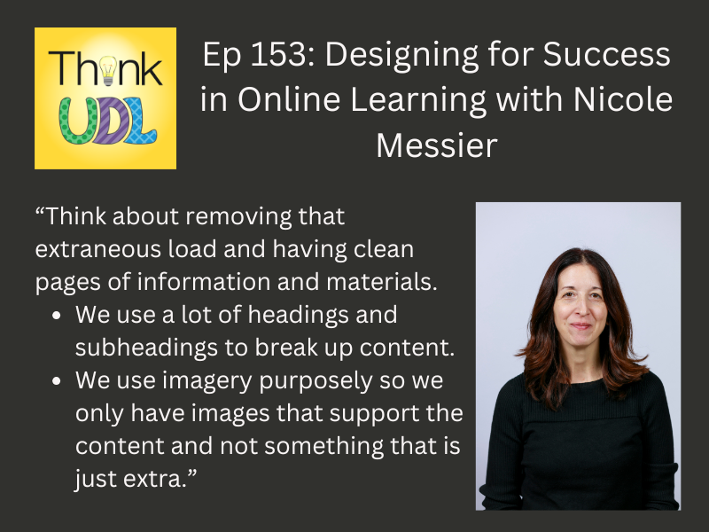
Script the Critical Moves
Think UDL Ep 153 LINK

Slide 15
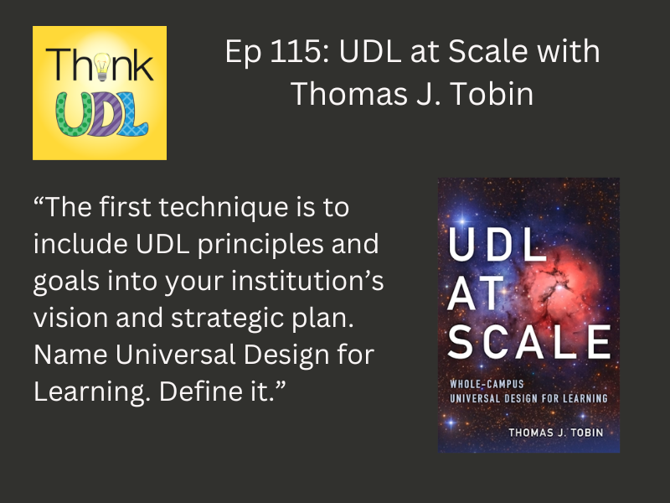
Point to the destination
Think UDL Ep 115 LINK

Slide 16


Empathy Moves the Elephant
Motivate the Elephant
Find the Feeling
Shrink the Change (Don’t Spook the Elephant)
Grow Your People

Slide 17
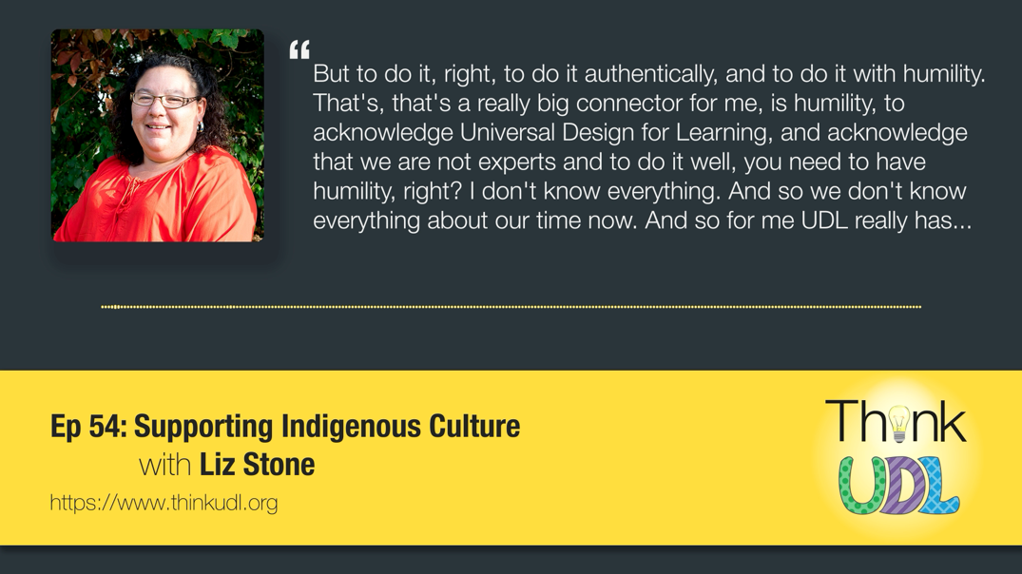
Find the Feeling
Think UDL Ep 54 LINK

Slide 18
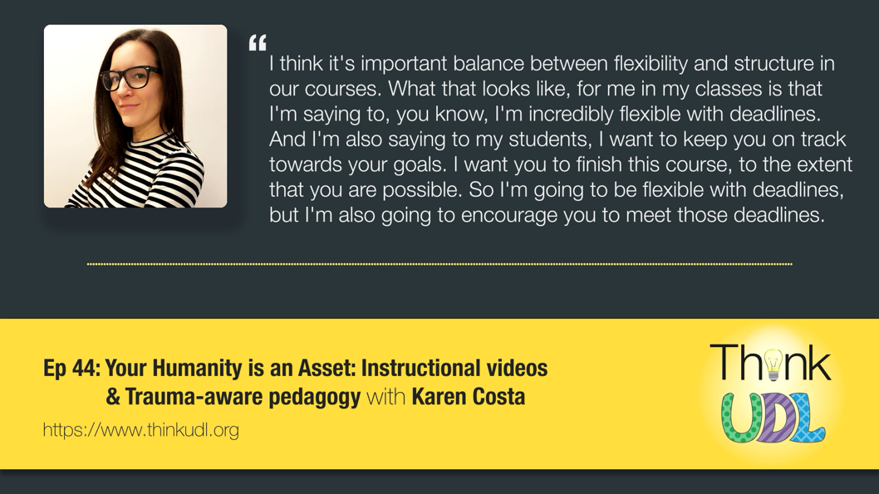
Shrink the Change
Think UDL Ep 44 LINK

Slide 19
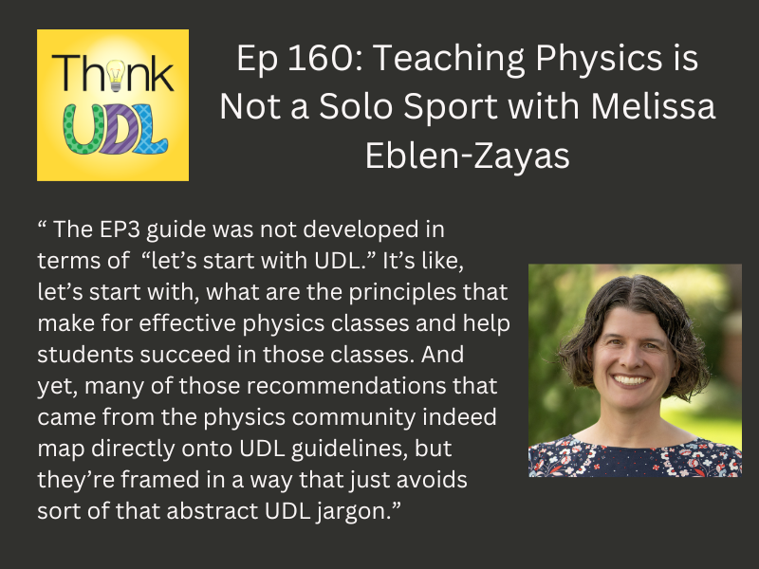

Grow Your People
Think UDL Ep 160 LINK

Slide 20

What Empathy is and does
Empathy is not a feeling. It is a practice, a story, and a shared act of meaning‑making.
Empathy becomes visible through:
The stories we tell
The language we use
The ways we invite others into experiences different from their own

Slide 21
Empathy as Practice
Curiosity: asking, not assuming
Presence: listening without rushing to fix
Reflection: naming what we hear with care
Empathy is a discipline of attention.

Slide 22
Empathy as Story, Empathetic stories build:
Trust
Understanding
Connection
Meaning

Slide 23

Empathy as Shared Meaning-Making
Empathy becomes transformative when it shapes:
Structural design
Cultural narratives
Relational practices

Slide 24
Empathy as Structural, Cultural, and Relational Change
Structural empathy:
Designing systems that reduce friction, not increase it.
Cultural empathy:
Creating communities where difference is not an exception but an expectation.
Relational empathy:
Building trust through presence, listening, and shared humanity.

Slide 25

Why Empathy Matters
Reshapes systems and institutional narratives
Expands imagination
Reduces barriers
Strengthens belonging
Creates inclusive universities by shaping policies, practices & pedagogies

Slide 26

UDL Shapes the Path
Shape the Path
Tweak the Environment
Build Habits
Rally the Herd

Slide 27

Tweak the Environment
Think UDL Ep 131 LINK

Slide 28
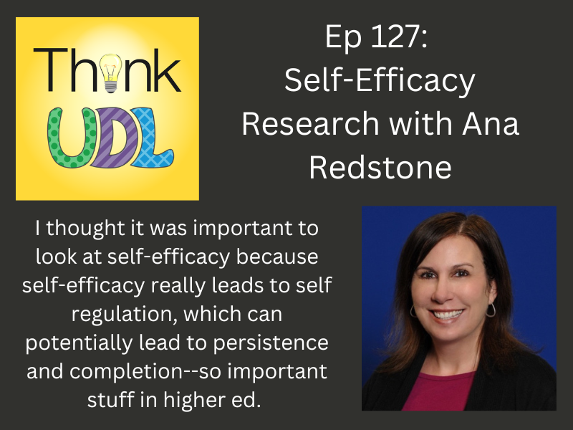
Build Habits
Think UDL Ep 127 LINK

Slide 29
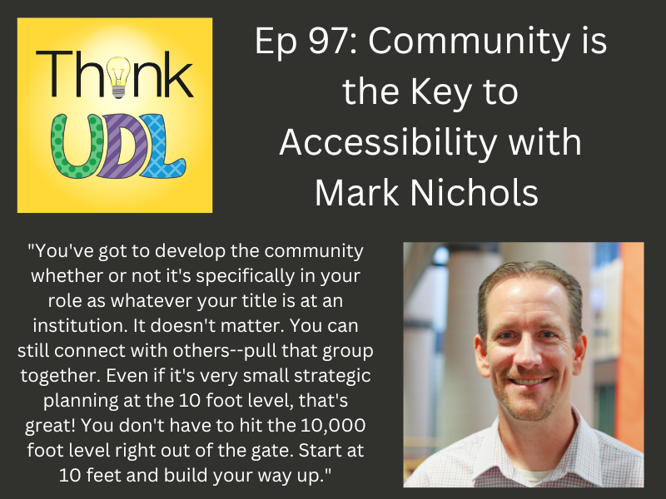
Rally the Herd
Think UDL Ep 97 LINK

Slide 30
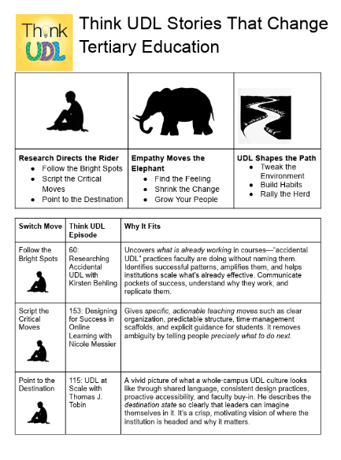
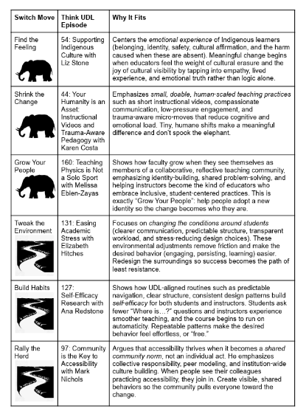
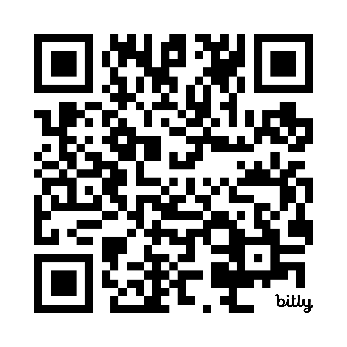
Think UDL Stories That Change Tertiary Education
Link: https://bit.ly/4evd5g9

Slide 31
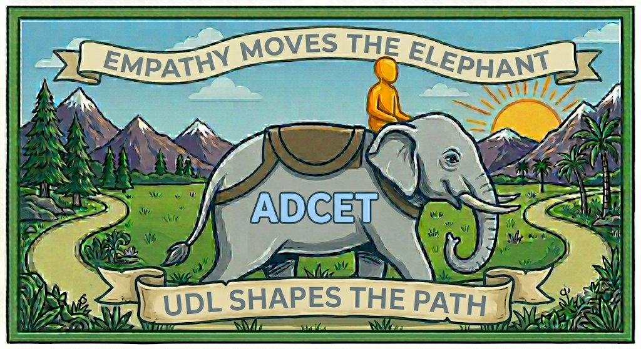
“Script the Critical Moves” Swag (Sticker option 1)

Slide 32
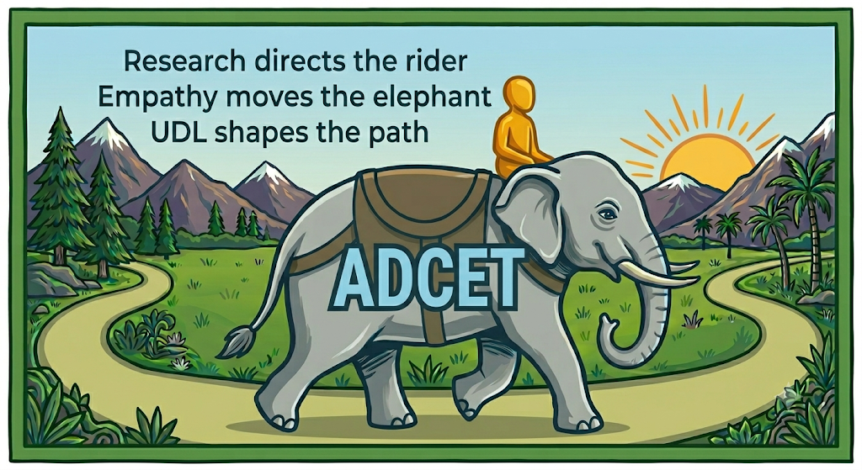
“Script the Critical Moves” Swag (Sticker option 2)

Slide 33



“Find the Feeling” Swag: Stickers & Buttons

Slide 34
UDL and Empathy in Action
UDL begins with the recognition of variability.
Empathy helps us see difference not as a problem, but as information.
Compassion moves us to redesign environments so all learners can thrive.
UDL = empathy turned into design

