Slide 1

2026
Accessibility in Action Awards
Celebration

Slide 2

Acknowledgement of country
ADCET is committed to the self-determination of First Nations people.
We acknowledge the palawa/pakana peoples of lutruwita upon whose lands ADCET is hosted.
We also acknowledge the traditional custodians of all the lands across Australia and pay our deep respect to Elders past and present.

Slide 3
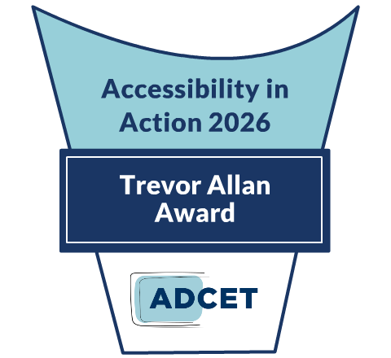
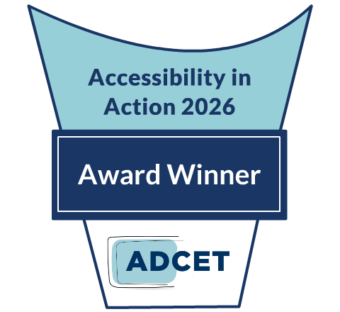
About the AIA Awards
ADCET proudly celebrates our Accessibility in Action awards winners in support of Global Accessibility Awareness Day (held annually in May).
These awards provide an opportunity to highlight and showcase the amazing work by individuals and teams in advancing accessibility and inclusive practice across the tertiary education sector in Australia and New Zealand.

Slide 4
First off, Thank you
To everyone who nominated an individual or a team/project this year.
To our fabulous panel of judges that assisted us this year in evaluating the nominations.
To everyone who missed out this year, and to the numerous staff and students across the sector that continue to make education more inclusive and accessible.

Slide 5
Trevor Allan Award
Excellence in Disability Inclusion and Accessibility
Named after Trevor Allan, a renowned champion and leader in the disability and tertiary sector, this award recognises and celebrates those who have made significant and sustained contributions to creating an equitable and inclusive learning environment for all students.

Slide 6
Professor Paul Harper OAM
Trevor Allan Award - Excellence in Disability Inclusion and Accessibility

Slide 7
Individual Award Winners
(Champions of Accessibility)

Slide 8
Aaron Saint-James
Individual Award - Champion of Accessibility
Simplifii / Diversified
University of New South Wales

Slide 9
Dr Betsi Beem
Individual Award - Champion of Accessibility
Inclusive by Design:
Disrupting traditional pedagogy to remove barriers to learning
University of Sydney

Slide 10
Elpitha (Peta) Spyrou
Individual Award - Champion of Accessibility
Adelaide Law School’s
Student Access, Support, and Inclusion Program
Adelaide University

Slide 11
Dr Kevan Walter Jones
Individual Award - Champion of Accessibility
UQ Neurodivergent Hub
University of Queensland

Slide 12
Lynette Blayney
Individual Award - Champion of Accessibility
Trauma-Informed Education:
Removing Barriers and Empowering Students with Disability and Psychosocial Challenges Across the Tertiary Sector
Transformational Institute

Slide 13
Naomi McGrath
Individual Award - Champion of Accessibility
Advocacy and Leadership in Accessibility and Inclusion
TAFE NSW

Slide 14
Rebecca McNeil
Individual Award - Champion of Accessibility
Macquarie University Neurodiversity Community of Practice
Macquarie University

Slide 15
Sandy Houston
Individual Award - Champion of Accessibility
User testing and product uplift
RMIT University

Slide 16
Sue Sharpe
Individual Award - Champion of Accessibility
Inclusive Education Program: Embedding Accessibility, Equity and Ethical Generative AI in Curriculum and Assessment (2025–2026)
Deakin University

Slide 17
Teagan Menhenett
Individual Award - Champion of Accessibility
Supporting Neurodivergent Students
Deakin University

Slide 18
Timothy Boye
Individual Award - Champion of Accessibility
Empowering Disabled Engineering and IT Students in
Work-Integrated Learning through
Participatory Research and Systemic Reform
University of Technology Sydney

Slide 19
Student
Project/Team
Award Winners

Slide 20
University of Sydney Student Representatives Coalition
Student Team/Project Winner
University of Sydney
Gemma Lucy Smart, Sarah Huffman, Grace Street, Remy Lebreton,
Kayla Hill, Vince Tafea, Victor Zhang

Slide 21
Sensory Spaces
Student Team/Project Winner
Griffith University
Julia Robertson, Oliver Brown, Bella Darvall and Rachel Yuen

Slide 22
Levelling the Playing Field? A Student Led Accessibility Audit of RMIT Active
Student Team/Project Winner
RMIT Vietnam
Thu Nguyen Truong Hoang, Khai Duong Tan, Adi Ofir, Minh Duong, Nguyet Minh Thai, Hang Tran Thi Thuy, Chau Ngyuen Thi Ngoc,
Minh Anh Bui and Bau Tran

Slide 23
Project/Team
Award Winners

Slide 24
Body Doubling Pilot
Team/Project Winner
Charles Sturt University
Dr Jess Macer-Wright, Samantha Tiernan, Students - Patience Peitsch,
Deanna Martinazzo, Jessica Anderson, August Jacups, Chloe Baldry,
Adriana Duncan, Sally Young, Mikayla Check

Slide 25
Citizen Research Essentials:
A Short Course
Team/Project Winner
Griffith University
Dr Kelsey Chapman, Rebekah Barker, Joe-Anne Kek-Pamenter,
Jenny Camagnolo, Renee Denham, Mark Lawson and Rae Jobst

Slide 26
Co-designing Accessible Digital Learning with Visually Impaired Students
Team/Project Winner
RMIT Vietnam
Giang Le, Quyen Tran and Binh Nguyen

Slide 27
DysCalculator - a calculator app for people with dyscalculia or maths anxiety
Team/Project Winner
ExplainIT, New Zealand
Gary Sharpe, Hannah Hughson, Philip Schlup, Keitha Sharpe and Michael Grawe

Slide 28
Inherent Requirements Framework Project
Team/Project Winner
Edith Cowan University
Susan Edgar, Dr Fiona Navin, with the support of the Inherent Requirements Staff Working Group (14 members) and
Inherent Requirements Student Advisory Group (40 members

Slide 29
Making the Inaccessible Accessible: Transforming Visual Biochemistry Education for Blind and Low Vision Students
Team/Project Winner
Deakin University
Alona Charuvi, Anbu Vanangamudi and Marcelo Tavares de Oliveira

Slide 30
Neurodivergent Support
@ RMIT Library
Team/Project Winner
RMIT University
Adam Ferris, Blue Mahy, Joshua Muir, Jacinta Jones O’Mera, Kesh Legget,
Ruth de Jager, Plia Vaisman Caspi

Slide 31
Neurodiversity Community of Practice: Capacity Building, Co‑design and Cultural Change Initiative
Team/Project Winner
Macquarie University
Rebecca McNeil, Linda Ban, Lauren Perlidis, Linden Misselbrook and Diana Tan

Slide 32
Sensory Friendly Graduations
Team/Project Winner
Deakin University
Ross Buchan, Kaine Leonard, Kerryn Black, Jarred Jans, Kim Hooper, Sue Lever, Katheryn Hackett (Graduations and Events),
Em Leeds and Emma Clyne (Access and Inclusion)

Slide 33
Students with Disability Leadership Collective (SDLC)
Team/Project Winner
Student Voice Australasia
Jennifer Lowe, Swinburne University of Technology and
Belinda Brear, National SVA Coordinator

Slide 34
The Neurodiversity Hub
Team/Project Winner
Charles Darwin University
Julia Ash, Chloe Hay, Rosie Burge and Ace Bista

Slide 35

Congratulations
Look out for some of our amazing winners in future webinars, podcasts and articles!
For more information on AIA visit:
www.adcet.edu.au/our-work/accessibility-in-action-award

Slide 36
Thank You

