Slide 1
Acknowledgement of country

Slide 2

What We’re Learning-Empowering Disability Services in Australian Higher Education Darlene McLennan ACSES Equity Fellow

Slide 3

Fellowship
This fellowship has examined how disability services in Australian universities can better support students with disability as demand grows.

Slide 4
Students with Disability in Australian Universities
98,061 domestic undergraduate students identified as having a disability in 2024
That's 13.5% of all undergraduates
Numbers have more than doubled since 2012 (from ~46,500 to nearly 100,000)
Rates vary significantly across universities — from 5.1% to 23.3% depending on the institution
ACSES Data Program. (2025). Students with disability in Australian higher education: Analysis of 2024 data (2025 update). Australian Centre for Student Equity and Success (ACSES), Perth: Curtin University. ISBN 978-0-646-70241-4 - https://www.acses.edu.au/publication/students-with-disability-analysis-of-2024-data-2025-update/

Slide 5
Drivers for change
Royal Commission into Violence, Abuse, Exploitation of People with Disability
Autism strategy
Universities accord
Disability Discrimination Act review
Higher Education Standards Framework consultation
Higher Education Disability Roundtable
Increase funding DSF, NPP & CBF
Reporting – Student Support Policy

Slide 6
New Oversight and accountability
Australian Tertiary Education Commission
National Student Ombudsman Office

Slide 7
Setting the scene
Students with Disabilities: Code of Practice for Australian Tertiary Institutions - 1998
Professionalising Disability Services in Tertiary Education - 2002
Universities Australia (AVCC) Guidelines relating to Students with a Disability - 2006
ATEND Members Professional Standards of Practice and Code of Ethics 2013
Students with Disabilities: Code of Practice for Australian Tertiary Institutions - https://www.adcet.edu.au/resource/7014/students-with-disabilities-code-of-practice-for-australian-tertiary-institutions
Pathways 6 - Professionalising Disability Services - https://www.adcet.edu.au/resource/4834/pathways-6-professionalising-disability-services
Universities Australia (AVCC) Guidelines relating to Students with a Disability - 2006 - https://www.adcet.edu.au/resource/5351/universities-australia-avcc-guidelines-relating-to-students-with-a-disability-2006
Join the Australian Tertiary Education Network on Disability (ATEND) Membership - https://www.atend.com.au/membership

Slide 8
How we collected the evidence
Manager’s Survey
Student and Practitioner Survey
In-depth Interviews
Workshops

Slide 9
Data and insights collected
Manager survey: ~90% response rate, collecting data on service operations, leadership, effectiveness, and practitioner/staff capacity and capabilities
Practitioner and student survey: 220+ responses on student experiences of support provision and practitioner experiences of working contexts and professional development
In-depth practitioner and student interviews
Workshops and engagement: connecting with over 80 participants across several workshops + other stakeholder engagement
Overseen by an advisory group

Slide 10

Student Experience

Slide 11
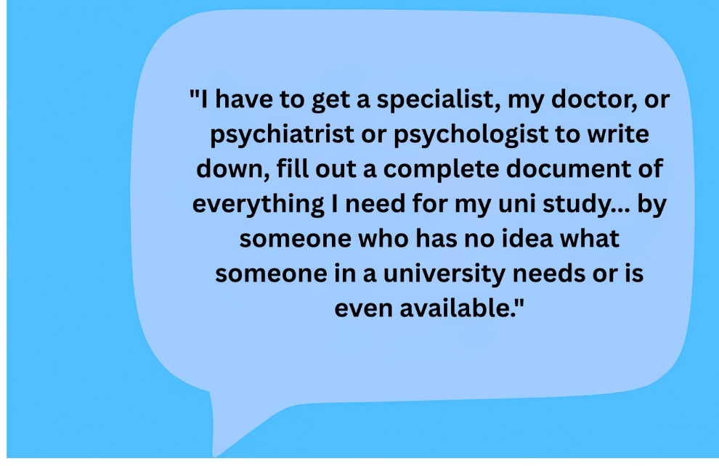
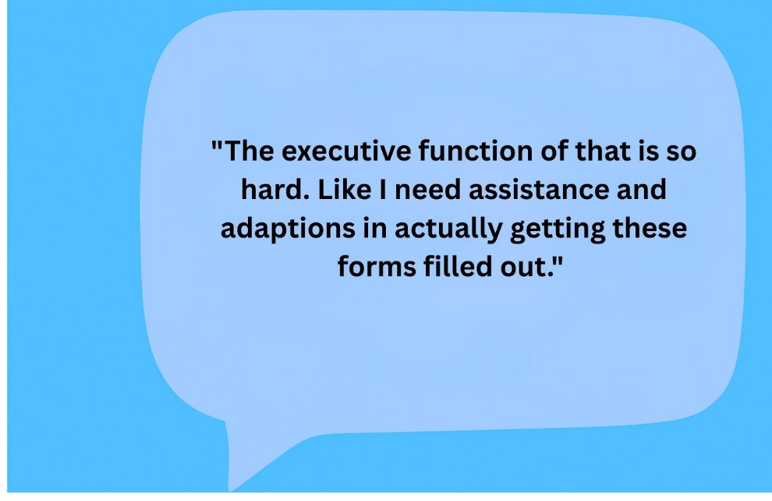
The documentation burden falls hardest on those least able to carry it

Slide 12
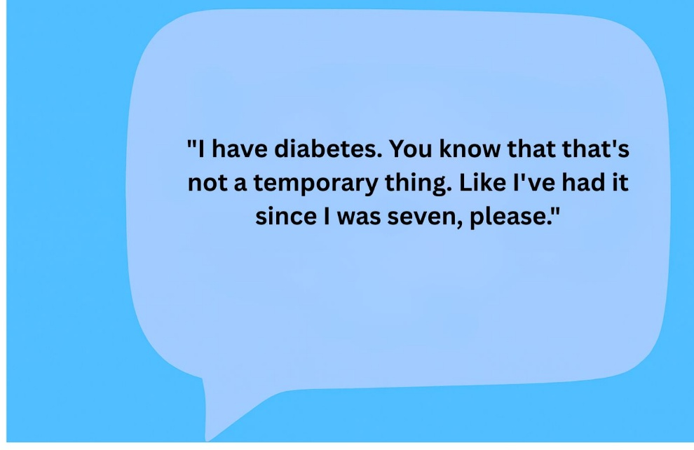
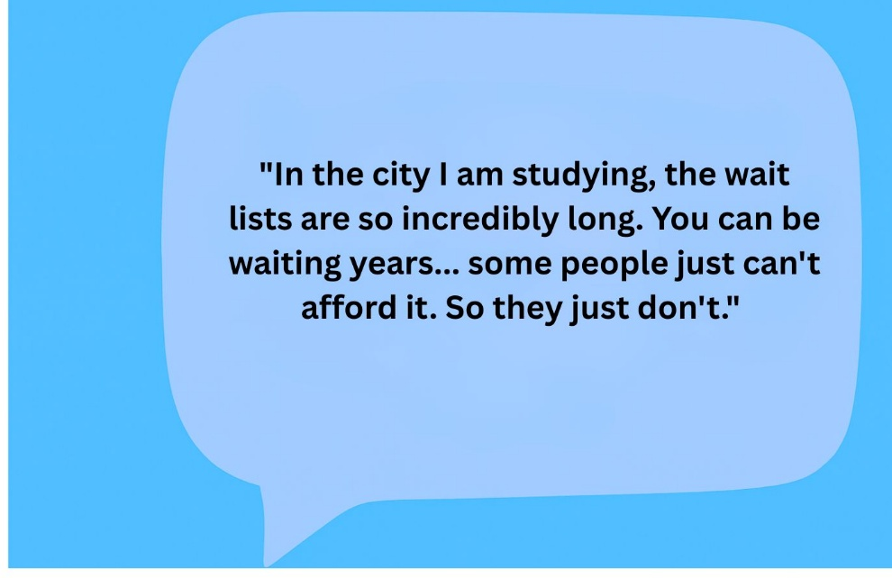
The documentation burden falls hardest on those least able to carry it cont…

Slide 13
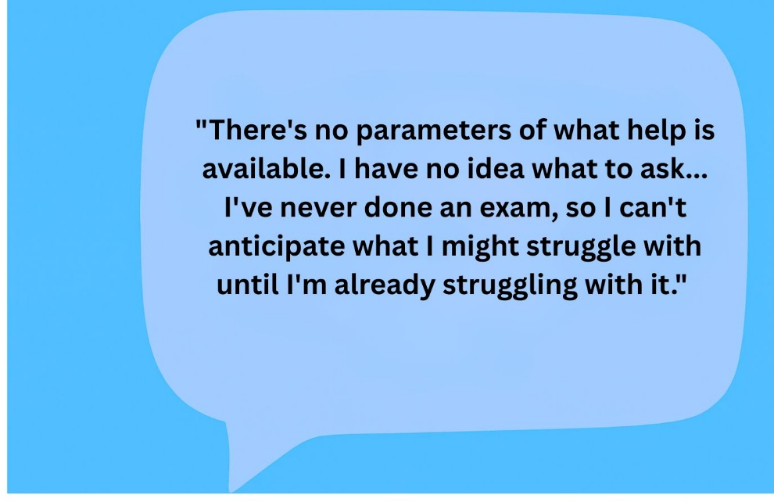
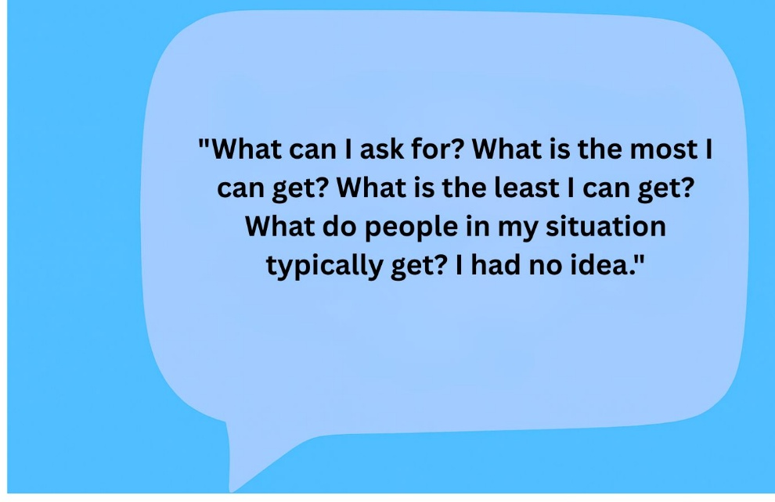
Students often don't know what support is available, or what to ask for

Slide 14
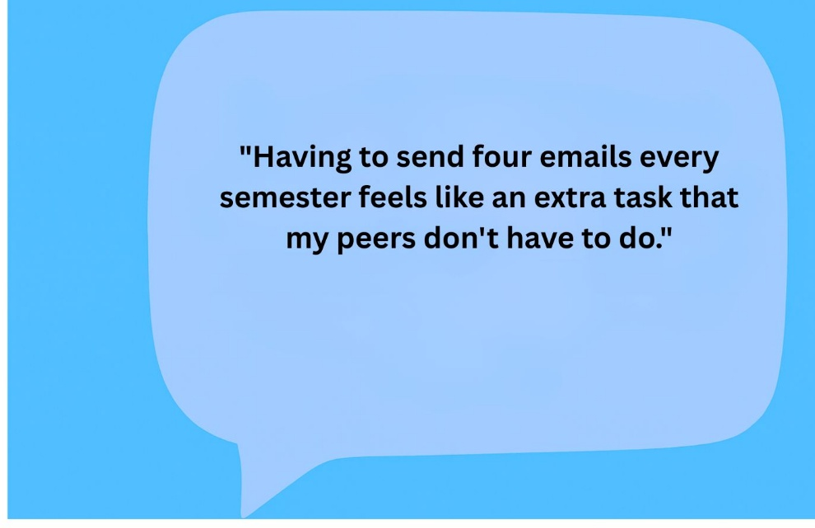
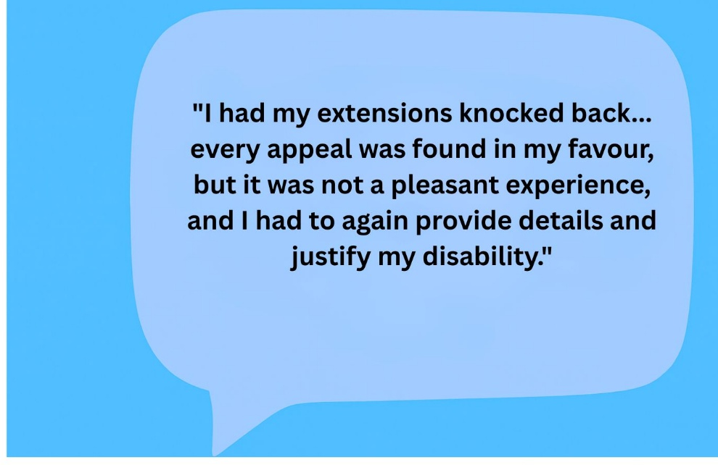
The burden of self-advocacy falls on students who are already stretched

Slide 15
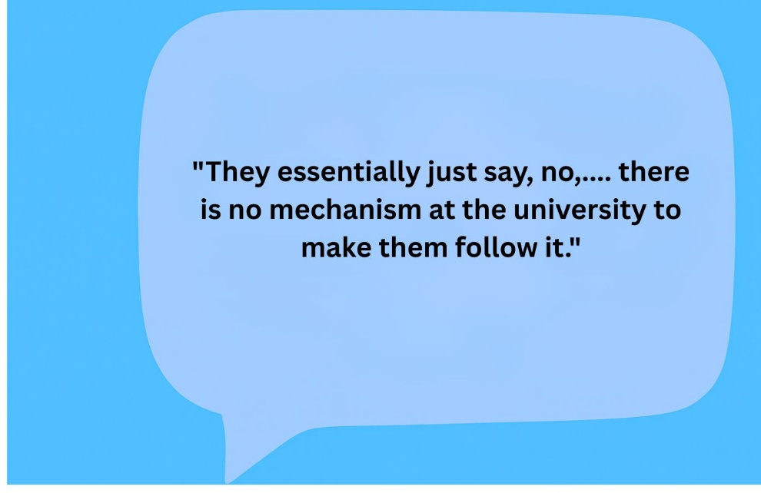
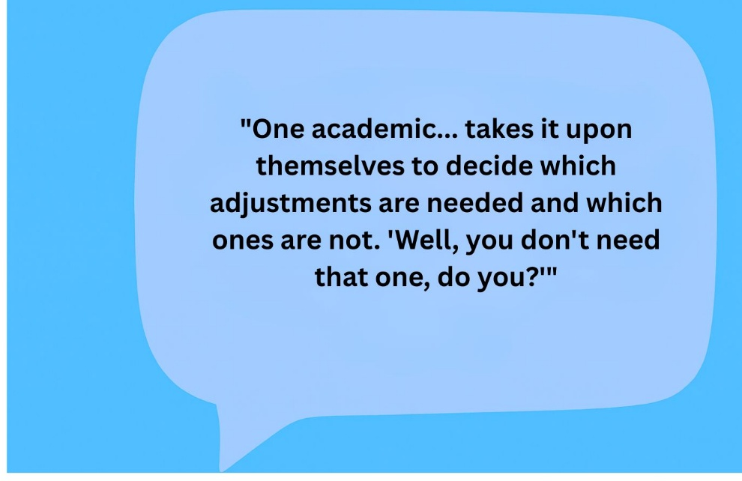
Computer say’s no!

Slide 16
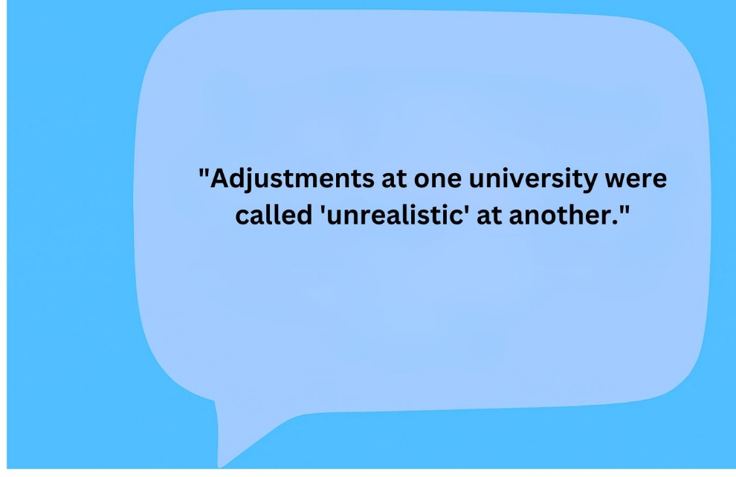
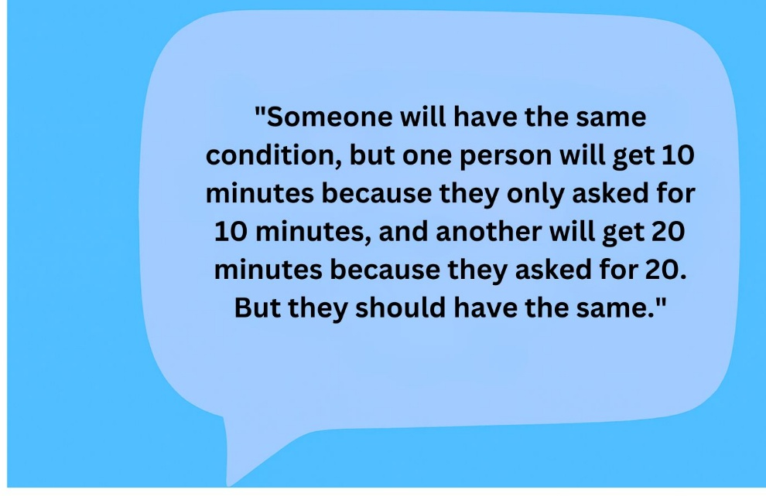
Experience varies enormously between institutions, and between practitioners at the same institution

Slide 17
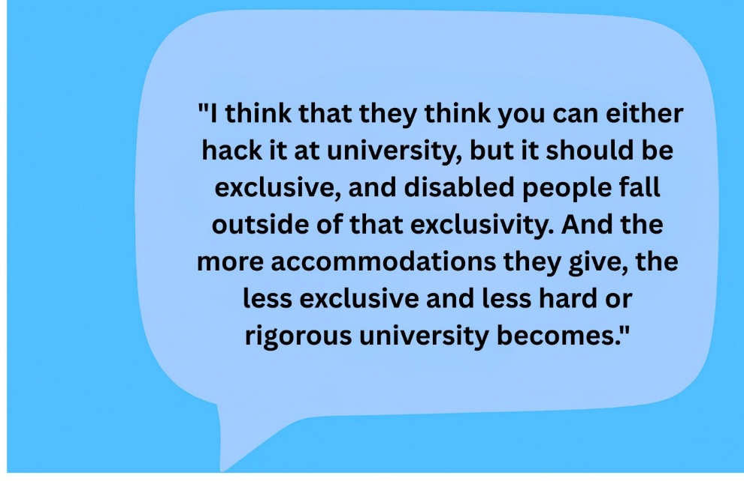
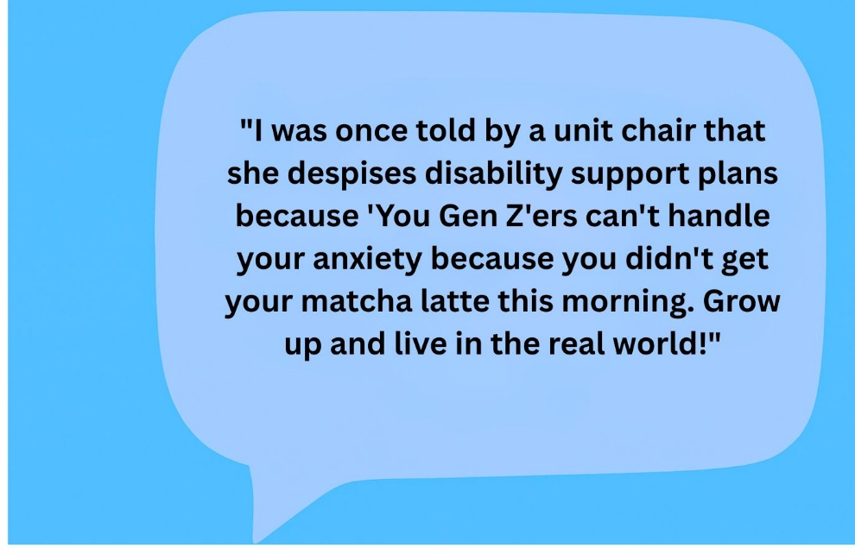
Ableism

Slide 18

What Disability Practitioners told us
“We're seen as more advisors rather than knowledge holders."

Slide 19
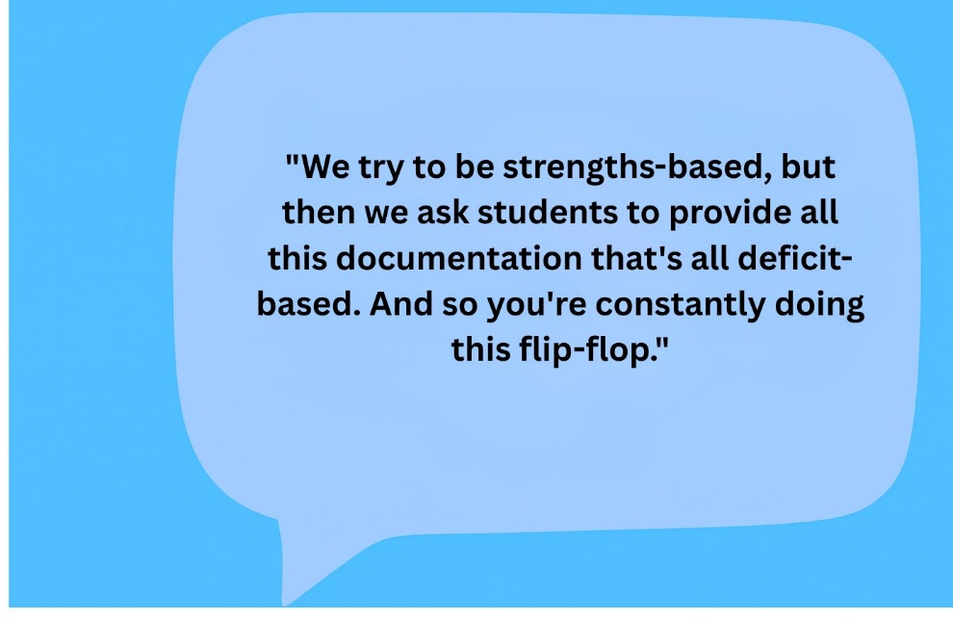
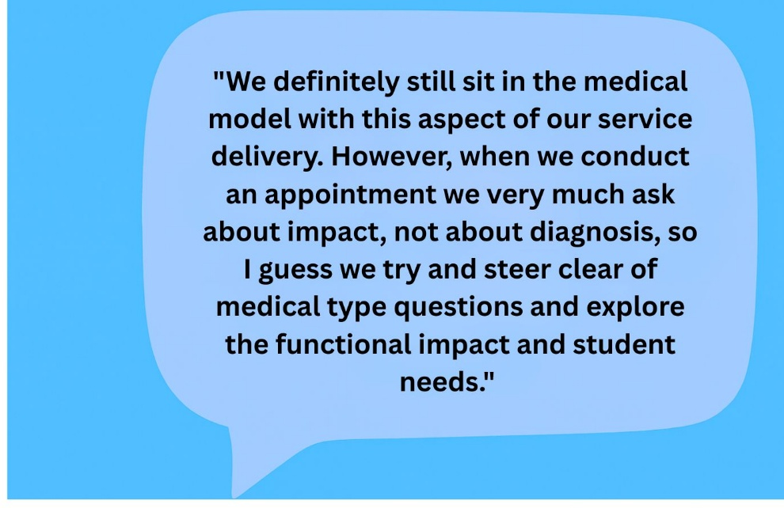
Practitioners are caught between the values they hold and the systems they operate in

Slide 20
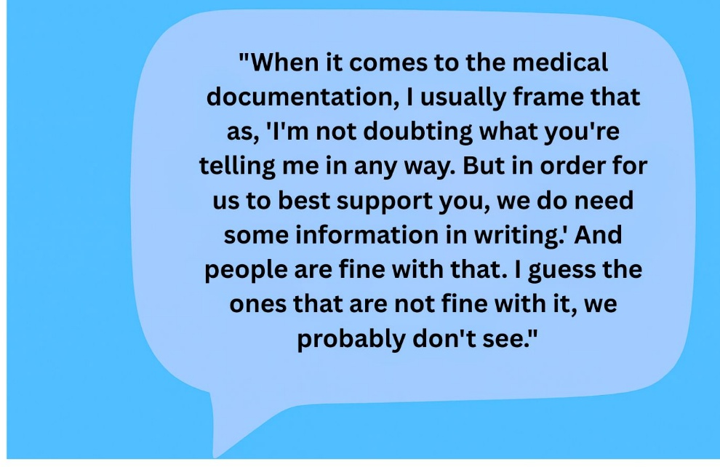
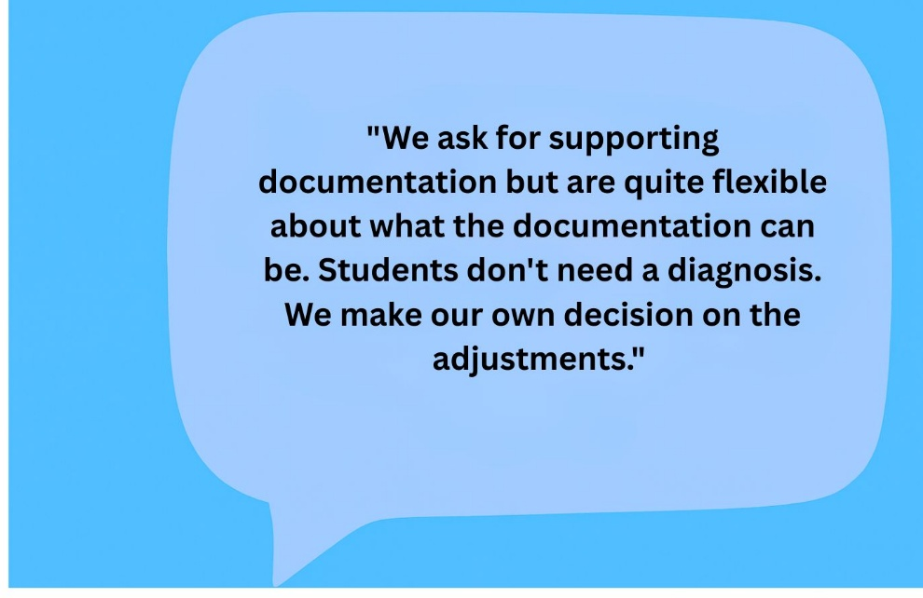
Documentation is the thing practitioners most struggle to justify

Slide 21
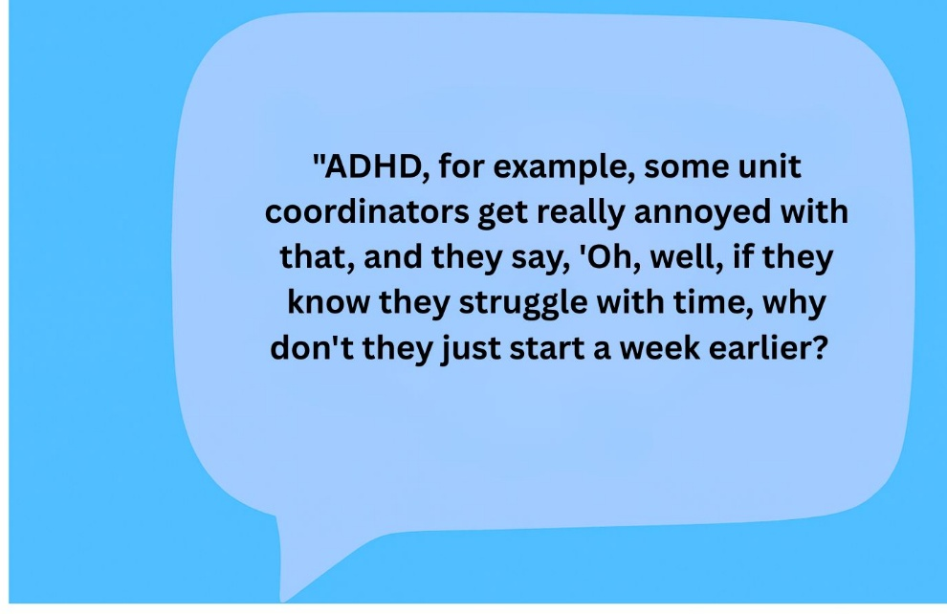
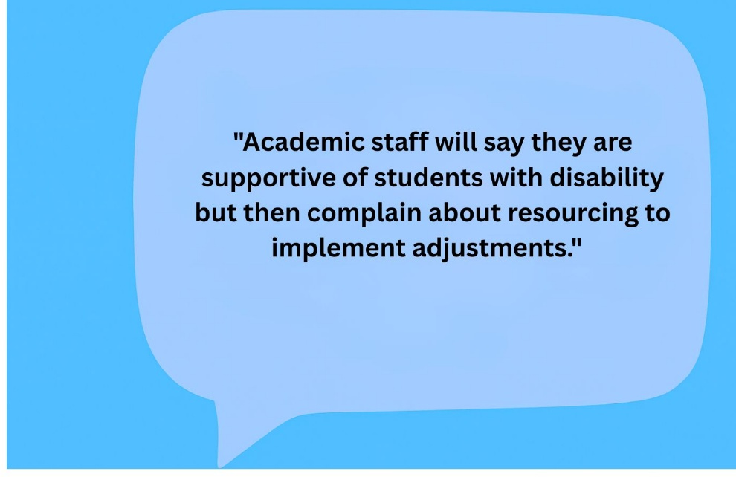
Academics are the biggest obstacle practitioners face, and practitioners feel powerless to do much about it

Slide 22
Other themes
Advocacy tension - Practitioners often feel caught between what a student needs and the limits of their role. Many want to advocate more actively but are constrained by professional boundaries or simply by not having enough time.
Professional recognition - Practitioners come from varied backgrounds such as social work, education, health but the role lacks a shared professional identity. Many feel their expertise is not recognised by the institution.
Workload and under-resourcing - High student numbers, under-resourced teams, and high staff turnover. Participants describe this as a sector-wide issue linked to staff feeling undervalued and overstretched.

Slide 23
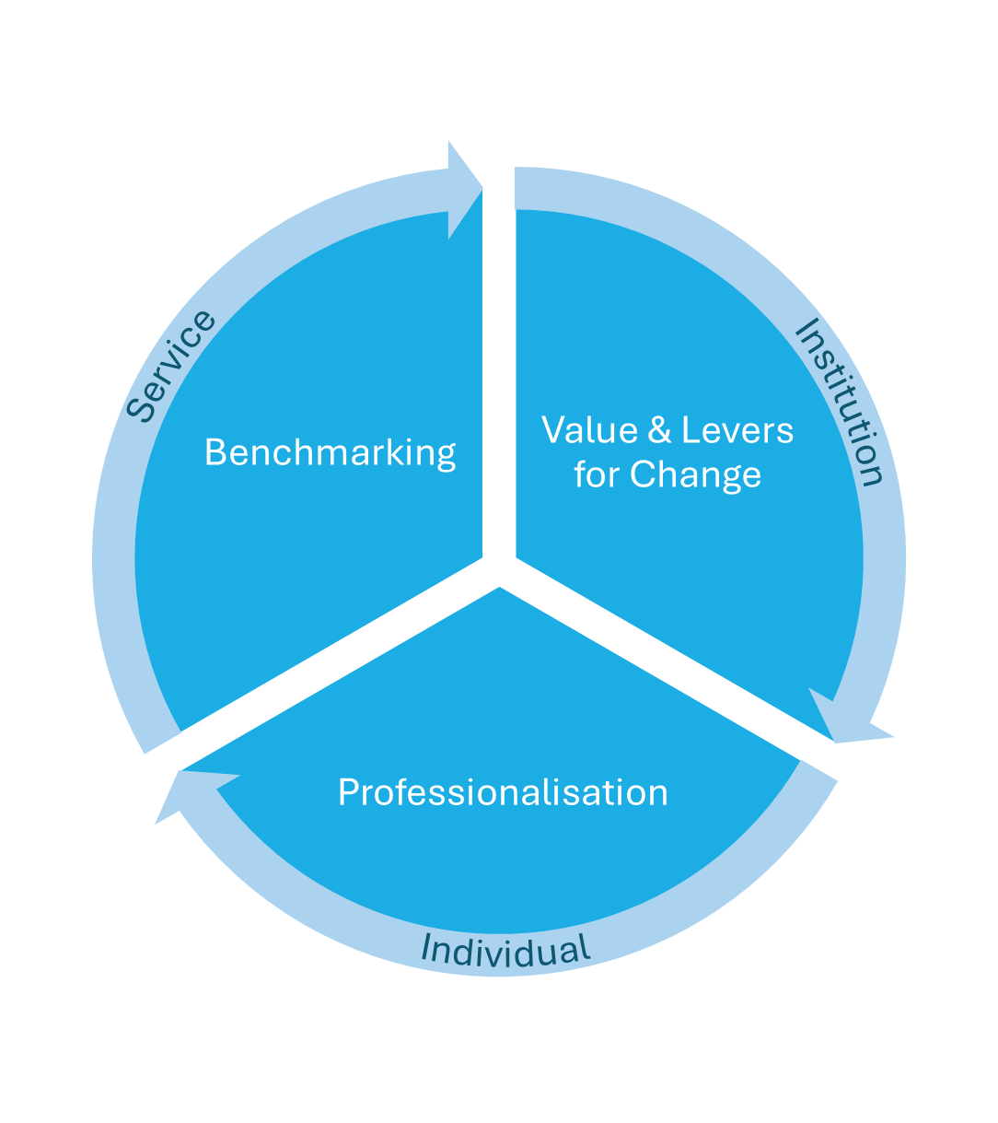
Refining the ideas

Slide 24

Disability Services Toolkit
The Numbers Game
Service Standards or Good Practice Guide
Service Benchmarking
Moderation
Student Voice

Slide 25

Professional Standards and Professionalisation:
Drafted from survey insights on important practitioner skills and attributes
Refined in consultation with practitioners, managers, and students
Consultation workshops
Professional Development framework

Slide 26

Next steps
Progressing the development of practitioner professional standards: testing workshops
Consult and finalise professional development framework
Benchmarking – developing, consulting & testing
Final report due April 2026

Slide 27


Any questions
Contact details
Darlene.McLennan@utas.edu.au

