Slide 1

Barriers before entry Opportunities to improve pre-admission guidance for disabled university applicants

Slide 2

Wadawarrung Land

Slide 3
Study contributors and positionality
Laura Gray, Deakin University​
Bryony McNeill, Deakin University​
Lise Mogensen, Western Sydney University​
Gisselle Gallego, University of Notre Dame​
Neera R. Jain, Waipapa Taumata Rau, University of Auckland​
Joanna Tai, Deakin University​
Jo Bishop, Bond University​
Matt Brett, Deakin University
The team includes disabled individuals, and family members of disabled people. We take a disability-affirming approach to our work.
We acknowledge that our insider perspectives as University educators and researchers may influence the way in which we navigate University websites and information.

Slide 4

A story about Ashley

Slide 5
Positions on disability
Recognise the limitations of the medical model of disability​
Disability is socially constructed, contextual and relational​
Move towards models of disability that affirm legal rights and recognise valuable differences​
First Nations concepts of disabilities as “conditions that reflect the normal range of human diversity” ​ (Puszka et al, Social Science and Medicine, 2022)

Slide 6
Why is this important?
UN Convention on the Rights of Persons with Disabilities mandates that persons with disabilities have access to inclusive, non-discriminatory, and accessible tertiary education, vocational training, and lifelong learning on an equal basis​
We need a health workforce that represents the communities it serves, including practitioners with disability​
There is growing evidence that this will help to address disparities in health outcomes for disabled community members and other minoritised individuals

Slide 7
Removing barriers
Higher education aspires to remove barriers for students with disability.
This needs to occur at all phases of the student lifecycle.

Slide 8
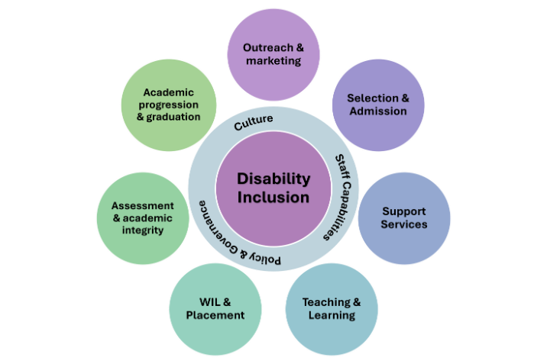
Inclusion across the student lifecycle
Inclusion needs to occur across the student lifecycle

Slide 9
Where to start

Slide 10
Ashley’s experience
Is the way we frame information about our courses truly inclusive?

Slide 11
Methods
We reviewed the public-facing websites of the 23 medical schools across Australia and New Zealand
Data extracted and coded using a framework approach​
Looked at domains​:
Framing of disability​
Ease of finding information​
Clarity regarding disclosure​
Information source & framing​

Slide 12
Overall outcomes
School | 1. Framing of Disability | 2. Ease of finding information | 3. Clarity regarding disclosure | 5. Information framing
1
2
3
4
5
6
7
8
9
10
11
12
13
14
15
16
17
18
19
20
21
22
23

Slide 13
Framing of disability
Rating | Definitions | Examples
No mention of disability | ”Disability" not mentioned on course page or linked pages (eg admissions) | The inherent requirements outline the essential skills and qualities necessary to start the Medical program. This information will help you determine if you are suited to pursue this degree.
Deficit framing | ”Disability" mentioned only in the context of referring to the potential challenges of studying or the availability of reasonable adjustments | Students with disabilities may not be able to complete their program if they cannot meet the essential requirements of core or compulsory courses. Before enrolling, we encourage students to review these requirements and the available support services.
Positive framing | Affirmative statement regarding inclusion of students with a disability | XXX University is committed to inclusivity and encourages applications from students with disabilities and from diverse social and cultural groups.

Slide 14
How are course requirements presented?
Rating | Definitions | Examples
Focusing on how students undertake tasks | Information framed around specific abilities or tasks, with no reference to adjustments | Good gross motor skills are essential for performing healthcare tasks efficiently and safely. These skills include lifting, carrying, pushing, pulling, standing, twisting, and bending. Students must be able to consistently and safely perform these tasks to prevent injuries to themselves and others.
Focusing on the outcome of tasks | Information framed around what the task is intended to achieve, with flexibility in how students meet these requirements; accommodations are referenced | "Medical students will be required to show their ability to gather information, perform appropriate procedures for their level of skill, and understand and fulfill their role in assisting during medical emergencies. They may access appropriate adjustments or assistive technologies in order to meet these requirements.

Slide 15
Clarity and transparency
 | Definitions | Examples
None | No information provided
Low | Applicants recommended to engage with IR or guidelines and/or reach out to the school | We encourage prospective students with disabilities or ongoing health conditions to reach out to XXX University.
Medium | Applicants requested to engage with IR or guidelines and reach out to the school; contact details are provided or process is detailed | We offer reasonable adjustments to support students with disabilities. If you have concerns about completing a medical program due to a disability, please contact us early for advice. This will help you make an informed decision about applying. Students must meet the inherent requirements for graduation from the medical program, with appropriate support and reasonable adjustments provided when possible.
High | Applicants requested to engage with IR or Guidelines and reach out to the school, contact details are provided or process is detailed, and transparency is provided regarding: - the rationale for disclosure (for example, to an admissions committee or a disability support service); - whether disclosure was a requirement of application; - whether disclosure was separate to the admissions process; and, - whether the institution would work in partnership with the applicant | You can enrol even if you are unsure about meeting all the inherent requirements. It’s important to note that the University cannot restrict enrolment or discriminate against students based on their disability. If you’re concerned about meeting a listed inherent requirement, you can contact Disability Services to discuss your specific situation. We will work with you to address your needs while protecting your pivacy.

Slide 16
Outcomes
No medical schools scored highly across all domains
There are achievable improvements most courses can make
Course review or accreditation processes can be helpful
Change is possible

Slide 17
What could make a difference?

Slide 18
Prompting questions for educators
Is information on the program’s requirements clearly accessible, non-exclusionary, and described in a manner appropriate for applicants unfamiliar with higher education or discipline-specific terminology?

Slide 19
Reflection question 2
Is information regarding possible adjustments and support structures clearly accessible prior to application?

Slide 20
Reflection question 3
Are disabled applicants encouraged and provided with clear pathways (including contact details) to access further information and initiate discussions regarding program requirements and possible adjustments?

Slide 21
Reflection question 4
Is it clear to potential applicants whether these discussions are confidential, constructive, collaborative, and clearly separated from selection processes?

Slide 22
Reflection question 5
Is it clear to applicants whether disclosure is a requirement of application or enrolment, or when, to whom, and why they may choose to disclose?

Slide 23
Reflection question 6
What training and resources do staff need to effectively carry out collaborative discussions with prospective disabled applicants?

Slide 24
Questions?
l.gray@deakin.edu.au
bryony.mcneill@deakin.edu.au

