Slide 1
ADCET Webinar 2026
All About ADCET
Rebecca Morris Darren Britten

Slide 2

Acknowledgement of country
ADCET is committed to the self-determination of First Nations people.
We acknowledge the palawa/pakana peoples of lutruwita upon whose lands ADCET is hosted.
We also acknowledge the traditional custodians of all the lands across Australia and pay our deep respect to Elders past and present.

Slide 3
Overview
Official welcome
ADCET – history and impact
Core purpose and audience
Services, activities and resources
Upcoming projects
Future plans
How you can make the most of ADCET

Slide 4
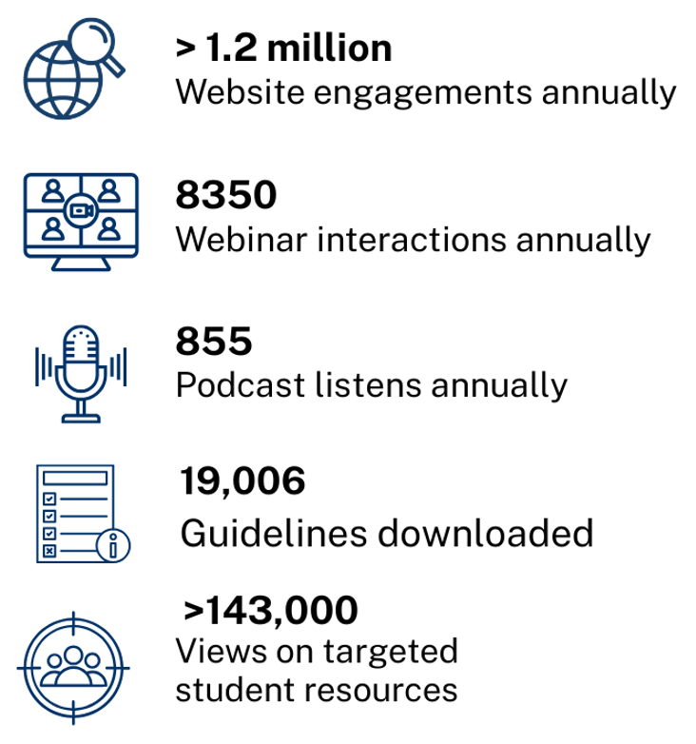
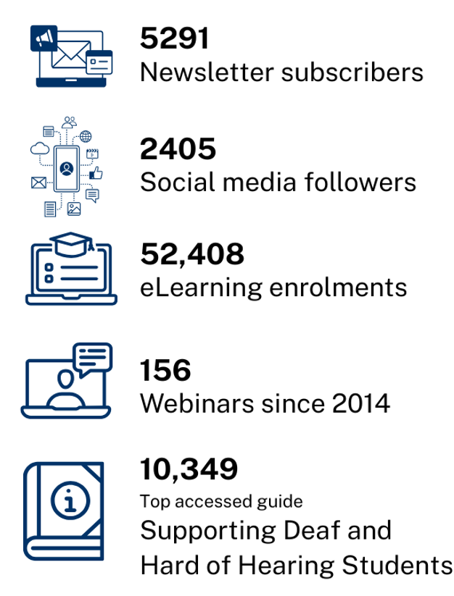
ADCET - Impact over time

Slide 5
Core Purpose & Audience
Provide practical guidance, leadership, and advice on disability in higher education and VET
Enable, improve, and accelerate institutional support for students with disability
Foster a 'build-it-once, use-it-many-times' approach to disability support and resources

Slide 6



Services, Activities & Resources
Online resources – content, information, updates, newsletter
Best practice, sharing information, case studies, webinars and podcasts
Disability practice in the spotlight
Professional development
Disability Awareness, ADCET Academy and eLearning programs

Slide 7
Services, Activities & Resources (2)
Annual Events
Universal Design for Learning (UDL) Symposium
Accessibility in Action Awards
Communities of Practice (CoP)
Disability Managers
UDL
Neurodiversity
Assistive Technology

Slide 8
Services, Activities & Resources (3)
Services
ADCET UDL Studio
ADCET Assist
Sector engagement, research and policy
Government liaison
Policy consultation
Sector submissions
Working/Advisory groups

Slide 9
Upcoming Projects & Resources
WIL eLearning program
DEWR VET resources
DIAP guidelines
Updated resources for Neurodivergent students
Lived experience advisory group – students
Expanded scope
New ADCET Academy training programs

Slide 10
How you can get involved
Join a CoP
Subscribe to our newsletter
Join the Aust-ed email list
Bookmark ADCET (things change often)
Get a badge - undertake an ADCET eLearning program
Come to the UDL symposium
Nominate a colleague for an AIA award
Attend a webinar / UDL Studio / ADCET Assist
Contact Us

Slide 11
Thank you
Thank you for listening
and a special thank you to our special guests Trina, Danielle, Ebe, Justin, Amy, Elizabeth & Katy
Questions

