Slide 1
Neurodiversity Paradigm 101
Beyond language, and towards paradigm shift in tertiary education

Slide 2

Acknowledgement of Country
I am joining from Ngunnawal and Ngambri lands. Sovereignty was never ceded.
Photo: Steve Bittinger

Slide 3

Acknowledgement of Diversity
Your lived, professional, and research-based expertise are all valid and valuable; and also produce assumptions and biases.

Slide 4
Engagement, and invitations to reflect
I don’t have all the answers.
What to do with discomfort?
My positionality (and bias)
UDL and inclusive practice are taken as read
Reminders:
You will get a recording and a copy of the slides
Turn on your captions and transcriptions
Go off in the chat, post questions as we go

Slide 5
Today’s session…
Understanding the Neurodiversity Paradigm
Where are we coming from? Unpacking the Pathology Paradigm
Moving forward in the Neurodiversity Paradigm
Wrap-up and further resources

Slide 6
Expectations and framing
This session is about:
Theory that drives practice
Understanding paradigm shift
Moving beyond language
This session is not about:
Autism & ADHD 101
Adjustment lists
Lived experience sharing for its own sake

Slide 7
Part 1: Understanding the Neurodiversity Paradigm
Core principles (Dr Nick Walker)
Neurodiversity is natural human variation
There is no "normal" brain - this is a culturally constructed fiction
Social dynamics around neurodiversity mirror other forms of diversity (power, inequality, creative potential)
"The neurodiversity paradigm is about understanding ourselves and others outside of the DSM" – Sonny Jane Wise (The Lived Experience Educator)

Slide 8
Definitions and terminology
We want to move beyond language, but we also need to get the language right…
Neurodiversity: the infinite variation of human functioning - this diversity is natural and expected in our population.
Neurotype: the set of traits and behaviours which make up an individual’s way of functioning.
Neurotypical: someone whose neurotype is not marginalised or pathologised.
Neurodivergent: someone whose neurotype is marginalised or pathologised.

Slide 9
Neuronormativity: The invisible standard
What it is: The belief in one "right" way to function
Capitalism, colonialism, productivity demands?
Examples in higher ed: Linear timelines, specific communication styles, particular learning methods valued over others

Slide 10
So, who are neurodivergent students?

Slide 11

Umbrella Model
Concept: Sonny Jane Wise, the Lived Experience Educator ©
PTSD + cPTSD
Plurality/System
Tourette’s
Anxiety
Autism
Epilepsy
Depression
Intellectual Disability
FASD
ADHD
Dyslexia, Dyscalculia, Dysgraphia, Dyspraxia
OCD
... and many more!

Slide 12

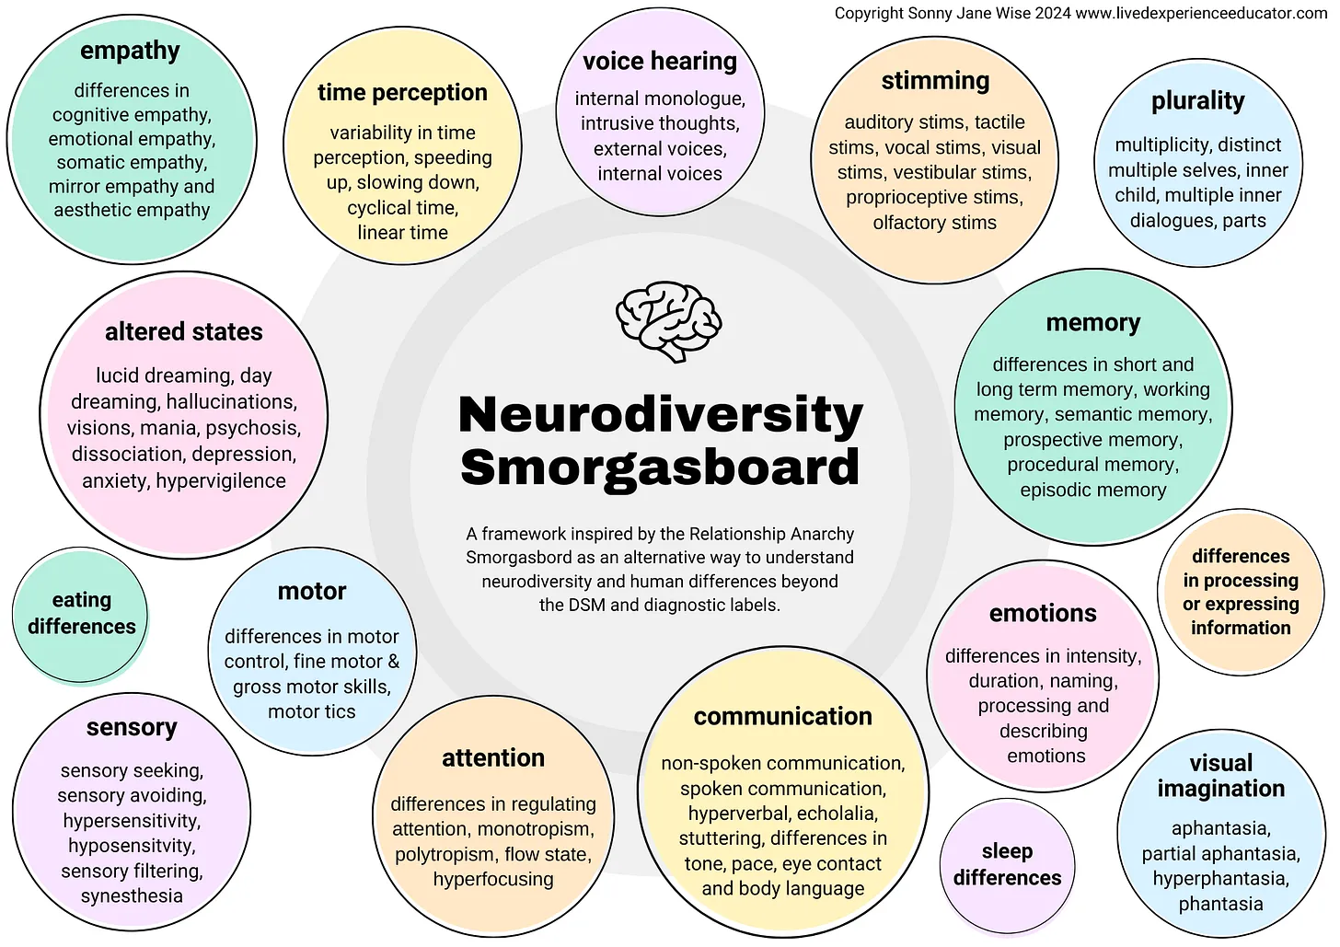
Smorgasbord Model
communication
empathy
motor skills
attention / focus
Concept: Sonny Jane Wise, the Lived Experience Educator ©
plurality / system
sensory preferences
stimming
voice hearing
emotions
sleep differences
and many more!

Slide 13
Common misunderstandings
“This person is neurodiverse”: one individual cannot be ‘diverse’. You’re probably looking for neurodivergent.
“We are looking for neurodiverse people”: only correct if you’re also including neurotypical people.
“This program is for neurodivergent people”: only correct if it is for all neurodivergent neurotypes. Be specific!

Slide 14

Biocertification and biopower
Biocertification: Requiring psychiatric authority to validate needs
How this shows up: Needing diagnoses to access support, "prove" your disability
Biopower: Using diagnoses as tools of social control (and withholding support)
Who gets left out? Who gets punished for non-compliance?

Slide 15
Reflections…
What (and who) drives our requirements for proof?
What if students didn't need to prove anything to access support? Does this make you anxious? Why?
Why do we need students to perform struggle, and have it validated by someone else, before we can help?
If we really want to embed neuro-affirming practice, we need to challenge these assumptions.
Still interested? Let’s play on…

Slide 16
Where are we coming from?
Clinical/ Pathology Paradigm assumptions
There is something wrong (medically, physically, mentally) with the individual that needs diagnosing and treating.
Professionals know better than individuals about what they need, based on theory, research, professional practice…
Success means the individual learns to function within our existing structures.

Slide 17
Pathology paradigm effects
Clinical/Pathology Paradigm assumes:
There's something wrong that needs fixing
Professionals know better than students about their needs
Individual deficit → individual adjustment
Success = conforming to institutional norms
This produces in our systems:
Adjustments that treat symptoms, not barriers
"Reasonable adjustment" gatekeeping
Students required to prove worthiness of support
Risk management over autonomy
Academic integrity processes that punish neurodivergent traits

Slide 18

Enter: the ‘paradigm-washing’ problem.
The impetus for this presentation in the first place! Let’s get uncomfortable.

Slide 19
What is paradigm-washing?
Paradigm-washing: Using the language of the neurodiversity paradigm without actually shifting our assumptions or practices.
We talk about celebrating difference whilst simultaneously requiring students to prove their deficits.
We claim to value diversity whilst punishing anyone who can't conform.
We call students neurodivergent while still requiring diagnostic evidence and feeding into biocertification and biopower dynamics!

Slide 20
The alternative?
The Neurodiversity Paradigm assumes:
Diversity is natural and valuable
Students are experts on their experience
Systemic barriers → systemic change
Success = access, belonging, autonomy
This produces in our systems:
Universal design for learning as baseline
Support without diagnosis requirements
Harm reduction approaches to crisis
Academic integrity processes that consider context

Slide 21
More reflections…
Can you see examples of paradigm washing in your university?
What do you think drives this?
We cannot just use the language. It’s not enough.

Slide 22
Practical applications: For disability support practitioners
Epistemic justice: Believing students about their needs
Harm reduction: Meeting students where they're at, not demanding treatment or recovery
Moving from individual accommodations to systemic change

Slide 23
Practical applications: For learning designers and academics
UDL as baseline, not "extra"
Assessment design that doesn't assume one way of demonstrating knowledge
Flexibility built in from the start

Slide 24
Practical applications: For institutional practice
Reducing diagnosis requirements where possible
Recognising that "academic integrity" frameworks can be neuronormative
Building genuine student voice into policy

Slide 25
Navigating tension
Name when systems are creating barriers
1
Document the impact of policies on students
2
Advocate for change even when it's slow
3
Find creative workarounds within existing structures
4
Build relationships with students based on trust, not control
5

Slide 26
Your role?
Advocate
Advocate for the paradigm in spaces where you have influence
Challenge
Challenge neuronormativity when you see it
Push back
Push back on individual adjustments as the only solution
Build
Build coalitions with other practitioners doing this work

Slide 27
Real universities are grounded in principles and values in which neurodivergence thrives.
Continue your learning and make this reality.

Slide 28
Further resources
Nick Walker: Neuroqueer Heresies
Sonny Jane Wise: We're All Neurodiverse
Higher Hopes Podcast (if you aren’t sick of my voice)
ADCET Resources (with a critical lens!)

Slide 29
Feedback, questions!
Ask your questions now or put them in the ADCET feedback form so we can look at developing resources to address them.
Thank you 🙏

