Slide 1
Understanding and supporting neurodivergent students
Teagan Menhenett
teagan.menhenett@gmail.com

Slide 2


Overview
Who am I?
(I love dogs)
What will this webinar cover?
What is neurodivergence?
Why is it important to learn about neurodivergence?
Challenges neurodivergent students face in higher education
How neurodivergent students can be supported
Presentation of an Open Education Resource (OER) for students and staff
Opportunity for questions

Slide 3

What is neurodivergence?
Neurodivergence refers to people whose brain functioning differs from the majority.
People whose brain functions in the same way as the majority are referred to as neurotypical.
Neurodiversity refers to all brains, neurodivergent and neurotypical.
Neurodivergence is not a deficit, it is a natural variation in human functioning

Slide 4

What is neurodivergence?
Many conditions come under the ‘neurodivergent umbrella’
Autism ADHD
Dyslexia, dysgraphia, dyscalculia
OCD
Traumatic brain injury
Neurodivergence can be acquired or lifelong
Neurodivergence means different things to different people: some see it as a superpower; some simply see it as the way their brain functions.

Slide 5

Why does learning about neurodivergence matter in higher education?
Neurodivergence students are increasingly accessing higher education, due to improved access, supports and understanding.
Similarly, diagnosis and awareness of neurodivergence is improving due to better understanding and education of presentation.
Given this, learning about neurodivergent students, the challenges they face, and how they can be supported, helps to promote an inclusive and accessible university environment.

Slide 6

What are the Challenges for Neurodivergent students at university?
Executive functioning
Time management, organisational skills, working memory, starting and completing tasks
Sensory sensitivities
Environments such as lecture halls and food courts which can lead to meltdowns, shutdowns, overwhelm
Communication differences
Tone, eye contact, stimming, masking, small talk
Burnout and fatigue
Mental illness and other co-occurring conditions

Slide 7

Intersectionality
The challenges neurodivergent students experience also intersect with their cultural background, gender identity, disability, and class, creating overlapping or compounding barriers in different areas such as
How their needs are perceived
How they access supports
How they are treated in educational spaces
E.g. BIPOC students, autistic females
Important to reflect on our biases and perceptions when engaging with any student, to ensure we are meeting students where there are at.

Slide 8

How can students be supported at university?
Executive functioning
Helping scaffold tasks and assessments
Allowing processing time when asking questions
Sensory sensitivities
Create a calm, predictable sensory environment or have designated quiet spaces
What if you can’t find a quiet space?
Supporting students with meltdowns and shutdowns
Communication differences
Accommodating of differences forms of communication
Trying to focus on words rather than tone
Understanding communication differences are not rudeness
Burnout
Access Plans, accommodations for students

Slide 9

How can students be supported at university?
Mental illness (other co-occurring conditions)
Counselling and psychological support services
Hidden Disability Sunflower lanyard
Peer-to-peer programs specific to neurodivergent students
ADHD support group
NAVIGATE program
Actively seeking lived experience input to inform changes.
Social stories for events
Training and education opportunities for both staff and students.

Slide 10

What are strengths of neurodivergent students?
It is important to also remember the strengths neurodivergent students bring to learning, rather than focusing only on the challenges they experience.
Some strengths can include,
Pattern recognition
Hyper-focus
Empathy
Strong sense of justice
Monotropism

Slide 11

Communication and teamwork skills to support neurodiversity
An online, freely available Open Education Resource (OER) created to support all students
The link will be shared in the chat now if you would like to have it open to look through
Worked with ADCET to ensure it is accessible and inclusive

Slide 12
What does this resource include?
A focus on teamwork and communication, enabling students to build key professional skills for their future careers.
Offers interactive activities, downloadable resources, structured group-based activities and reflections, and email templates for students.
Can easily be integrated into teaching or shared with students as a useful resource to support their learning.
Contains three key sections:
Getting Started
Teamwork
Communication

Slide 13
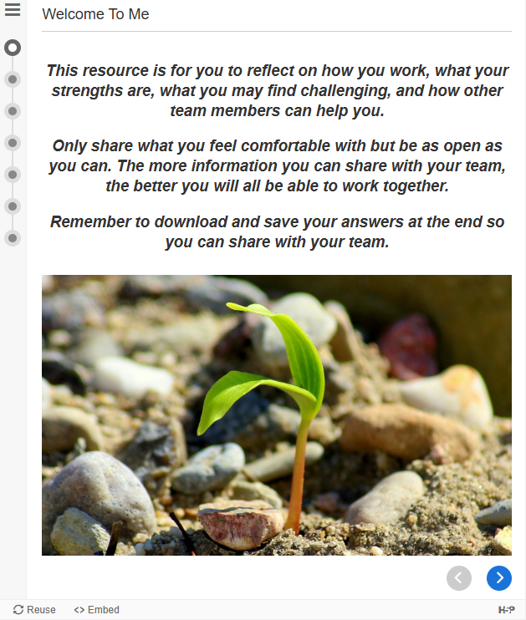
I. Getting started
Introduction to Disability
Introduction to Neurodiversity
Language to Use When Talking About Disability
How Do You Learn Best?
Screenshot from the chapter ‘How to You Learn Best?’

Slide 14
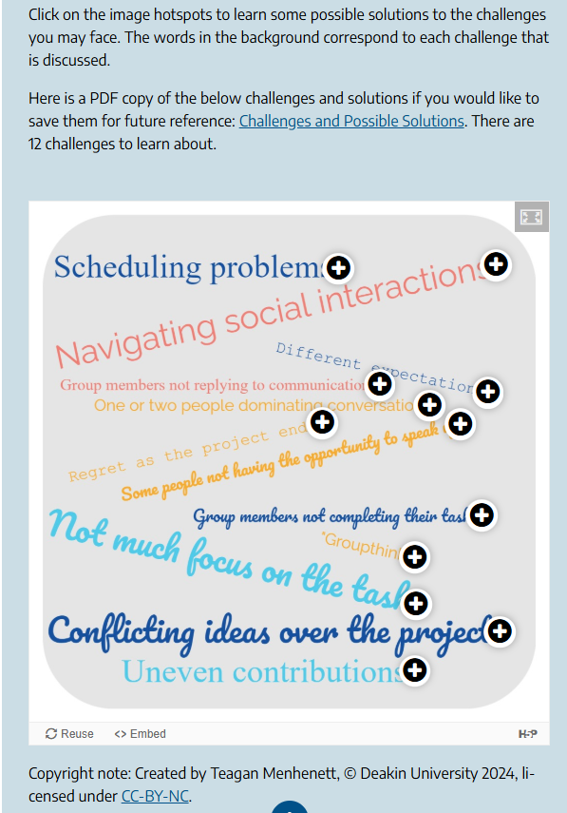
II. Teamwork
Introduction to Teamwork
Your 4-year Degree (may not be applicable to all degrees)
Your First Meeting as a Team
Team Stages
Challenges of Teamwork
Activities to Strengthen Teamwork Skills
As the Project is Finishing
Screenshot from the ‘Challenges of Teamwork’ chapter

Slide 15
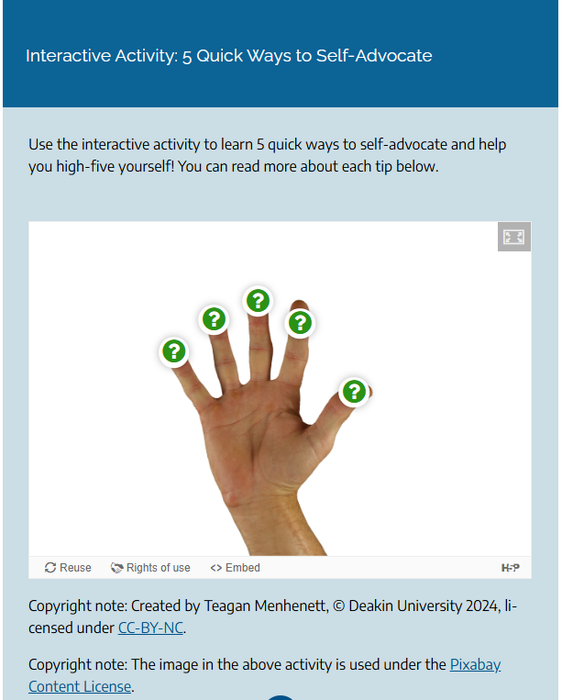
III. Communication
Communication Styles
Making Meetings Accessible
Self-Advocacy
Screenshot from the chapter ‘Self-Advocacy?’

Slide 16

What can you do from here?
Further your knowledge – the OER is a great place to start (and contains links to other useful resources).
Consider adjusting how you run your course or subject to better accommodate neurodivergent students – Universal Design for Learning.
Seek input from students with lived experience in neurodivergence to help inform how you create resources.

Slide 17

Questions

