Slide 1


How does ReadSpeaker TextAid help people with dyslexia?

Slide 2

TextAid Overview
1. Reading any text aloud on any device accurately and quickly
2. Changing the way text looks so it’s easier to follow
3. Helping you find the words you need and spelling words correctly
4. Complete and understand worksheets, forms and papers without the challenges of handwriting.

Slide 3
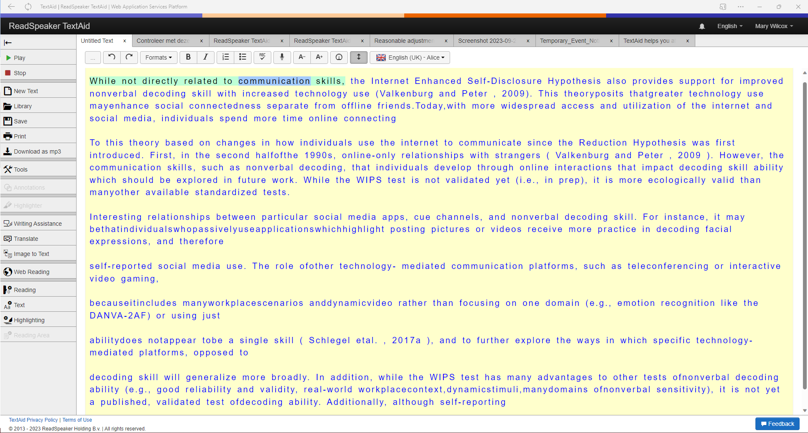
Confuse visually similar words such as cat and cot
With TextAid you can listen to text in any document, web page or even your own typing and identify errors.

Slide 4
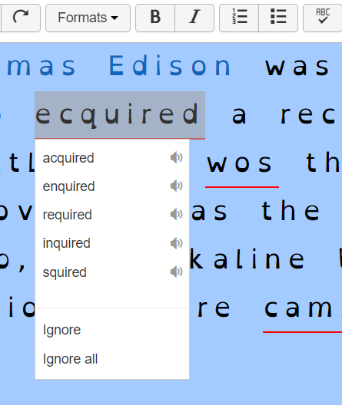
Spell erratically
The spell checker and word prediction identifies spelling errors and suggests words. You can listen to the suggestions.

Slide 5
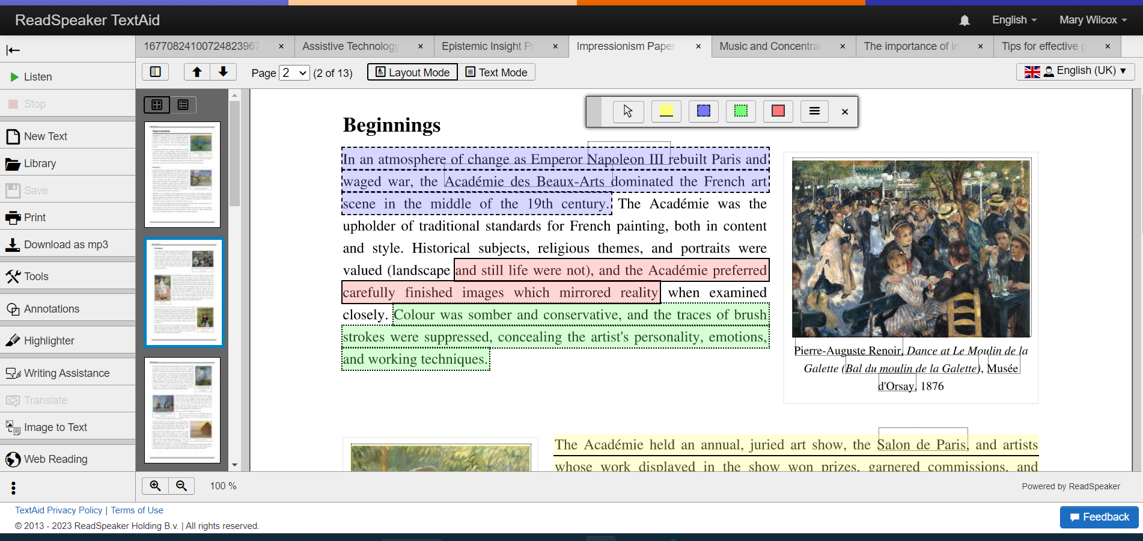
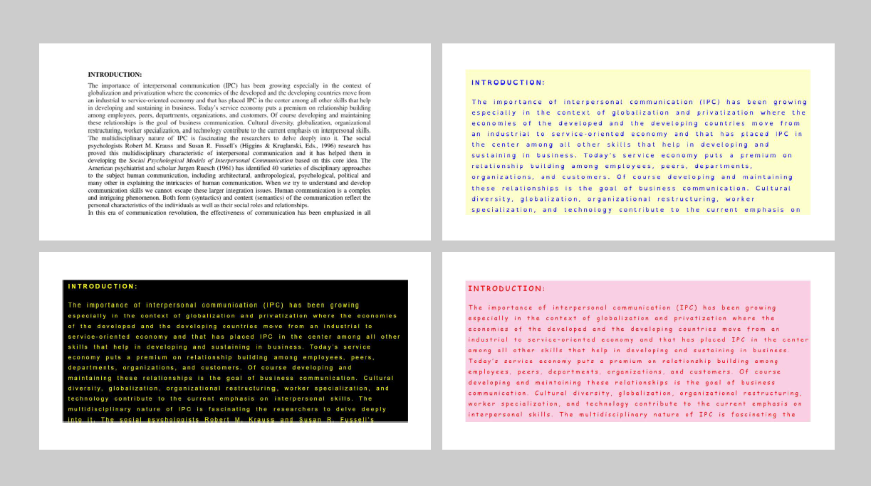
Find it hard to scan or skim text
The highlighter tool helps you extract important information from a document.
“Text Mode” makes any document more reader friendly by changing the way it looks.

Slide 6
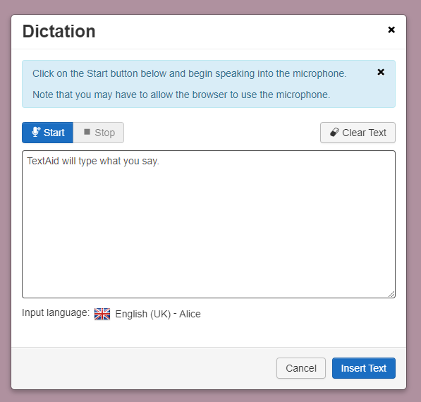
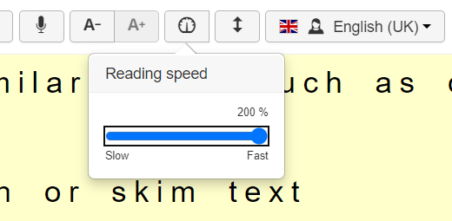
Read and write slowly
The dictate button types what you say so you can quickly get your thoughts onto the computer
TextAid can alter the reading speed. Listen to text at up to twice the average reading speed.

Slide 7
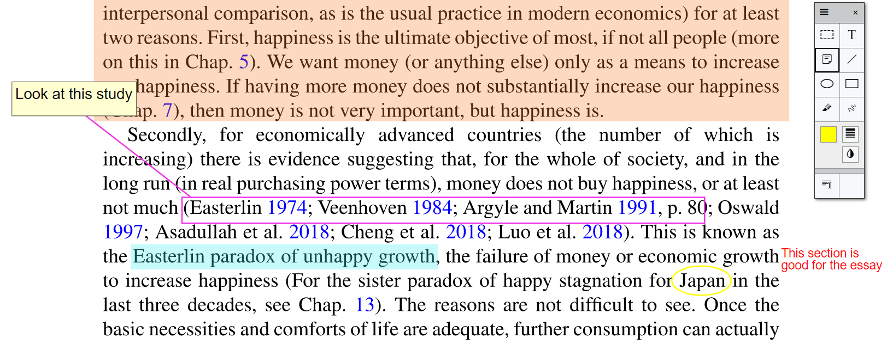
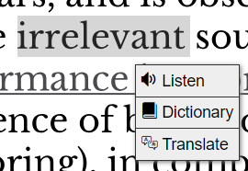
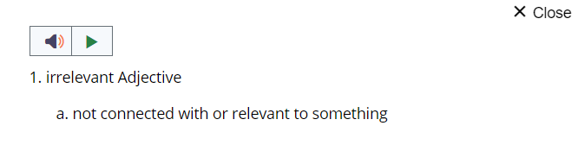
Need to re-read paragraphs to understand them
Right click and look up the meaning of words.
Make notes, highlight and draw shapes using the annotation tool which helps you to understand the text.

Slide 8
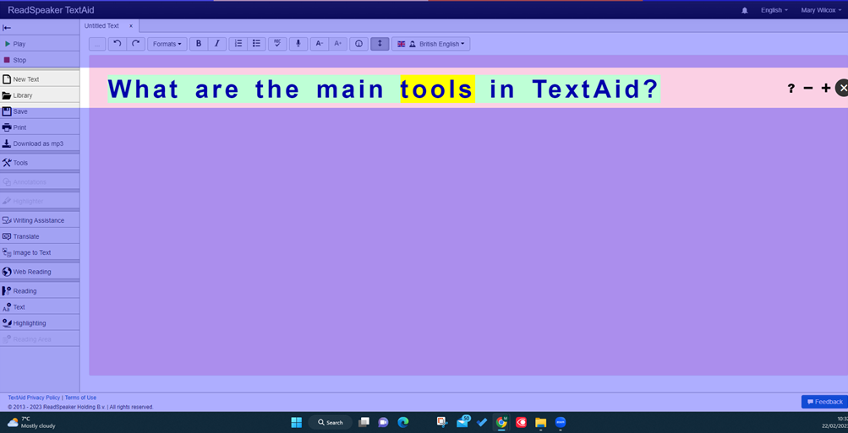
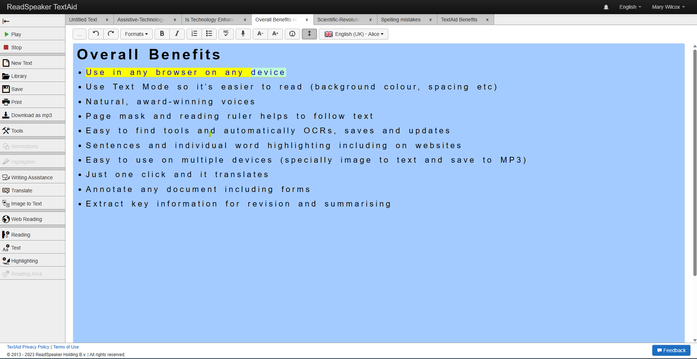
Find it hard to listen, maintain focus and concentrate
By listening at the same time as looking at text, you can focus better.
The “Word highlighting” and the “page mask” features help you to focus on one line at a time.

Slide 9

Feel sensations of mental overload/switching off
TextAid can be used on your phone so you can listen away from a computer. You feel less overwhelmed.

