Slide 1
Accessibility in Service (AIS) Framework

Slide 2

AIS Framework
Practical approach
Removing barriers
stepping beyond standard practice
Empowering students and staff

Slide 3
Introductory question
Accessibility is often addressed within learning environments but how accessible are our student support services?

Slide 4

AIS Development
Key Objectives
Embed accessibility standards & processes within the Student Experience
Review & benchmark accessibility practices
Identify gaps and develop solutions

Slide 5
AIS Framework Influences
STRATEGIC GOALS
ALLY NETWORKS
THE EQUITY INITIATIVES FRAMEWORK:
Access and Equity in Australian Higher Education
ACCESSIBILITY IN SERVICE FRAMEWORK
STUDENT INSIGHTS
EQUITY PROJECT INITIATIVES
PROFESSIONAL & LIVED EXPERIENCE
STAFF INSIGHTS
Diagram of how the Framework was informed.

Slide 6

Designing for maximum impact
AIS
Students
Organisation
Community

Slide 7
AIS Framework
Identifying needs
Service design and operating procedures to support accessibility
Increase staff awareness and confidence
Empower staff, embed practices and provide ongoing support
Collaboration and consistency between support services
& access to information

Slide 8
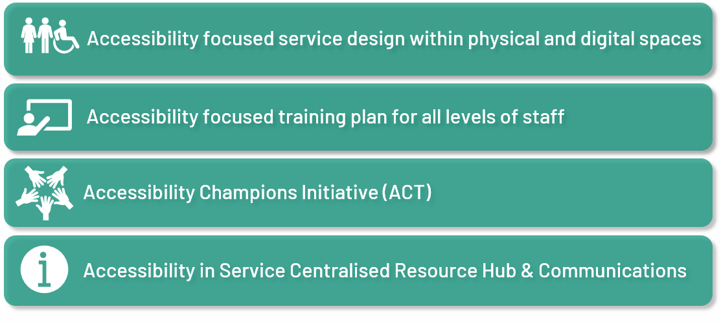
AIS Framework
Developing solutions

Slide 9

Section: Accessibility in Service Resource Hub
Accessibility focused service design

Slide 10


Accessible Service Design
Digital & physical service environments
Adjustments available for appointments
Low sensory appointment options
Video appointment availability
Assistive technology for self service
Dedicated meeting room
Operational Support for Accessibility
Standard Operating Procedures
Visible and proactive support for users
Quality assurance and auditing processes
Consistent messaging to support the embedding of inclusive practice and enhance psychological safety for staff
and students.

Slide 11

Section: Accessibility Service Resource Hub
Accessibility in Service Resource Hub

Slide 12

Resources & Information
Pain points:
Information across multiple platforms
Inconsistent resources
Limited awareness of new initiatives & services
Time required to search for relevant resources
Considerations:
Quality & Auditing
Updating
Pain points & considerations

Slide 13
AIS Resource Hub & Communications
AIS Centralised Resource Hub (WIKI)
AIS Teams Channel
Accessibility Champions
Staff Resources
Student Resources
Distributing tailored information
&
Opportunity to request guidance
Operations & Functions
Team Members
Resources relevant to equity cohorts
Internal & external
Quick guides
Contacts
Student socials & events
Support Services Student guides & tip sheets
External supports
Managed by the Accessibility Champions Team (ACT)

Slide 14

Section: Accessibility Champions Team
Accessibility Champions Team

Slide 15

Accessibility Champions
Mitigating risk for sustainable workplace volunteering
Leadership
Cost & resources
Interrupted workflow
Additional load
Staff
Extra workload
Fixed obligation
Unsupportive leadership
Volunteer
Unclear expectations
Unstructured operations

Slide 16

Accessibility Champions cont.
Creating engagement
Leadership
Minimal leadership involvement
Flexibility to support business needs
Improving service delivery
Student retention
Increased staff capability
Value of ongoing support & resources
Staff
Leadership support & recognition
Scheduling volunteer time
Skills development & leadership opportunities
Flexible levels of commitment
Clearly defined structure and processes
Process Toolkits
Autonomy & trust

Slide 17
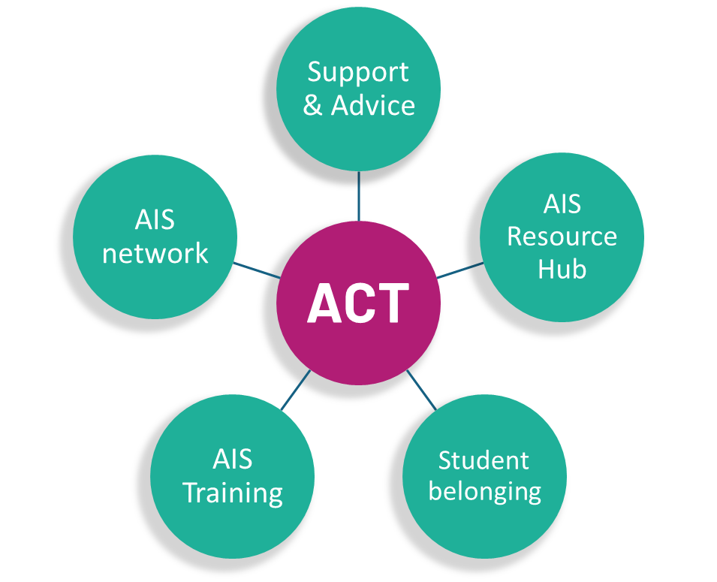
Accessibility Champion Team (ACT)
Accessibility: Embedding AIS practices & procedures
Champions: Enhancing student belonging by providing support, guidance and visibility
Team: Networking, sharing resources, improved communication and consistency
Engaging Champions helps break down stereotypes and plays a pivotal role in sustaining and growing an inclusive
culture.

Slide 18
ACT Operating Structure
Monthly Planning Meeting 1hr
PLANNING
RESOURCE, PROJECT & EVENT
RESOURCE DISTRIBUTION & COMMUNICATION
ORIENTATIONS & TRAINING
TEAM ADMINISTRATION
Task allocation
Process Toolkits – Guide, checklist, templates
While Champions are driven to engage in impactful work, they also have the opportunity to develop new skills
beyond the core training program - opening doors to experiences outside their usual roles.

Slide 19

Section: Accessibility focused training
Accessibility focused training

Slide 20

Training
Considerations
Relevance to role
Delivery mode
Duration
What’s available?
What’s missing?
Ongoing development

Slide 21
Training solutions
AIS INDUCTION Directorate Staff
AIS TRAINING PROGRAM
Student Hub
ACT TRAINING PROGRAM
Accessibility Champions
AIS TRAINING WORKSHOP
Casual Student Roles

Slide 22

AIS Induction
Setting expectations:
Legislation
Social Model of Disability & Ableism
Service Delivery Lens
Real life experiences of de-identified ECU Staff
Videos, scenarios, reflections & conversation
Delivered via Accessibility Champions Team
Creating training that includes relevant, real-life scenarios, sparks meaningful conversations and deepens
understanding of everyday barriers disabled people face.

Slide 23

Student Hub Training Program
Disability:
All levels of staff
Increasing awareness & confidence
Various learning formats
Continuous improvement & development: Case study workshops
Embedding training not only supports staff in servicing students but also sets an expectation of how we
approach accessibility.

Slide 24

ACT Training Program
Extended Program
Induction
Self paced online
Ally Networks
Mental Health, Disability, LGBTIQIA+, Aboriginal Torres Strait Islander People.
Ongoing development opportunities
When AC’s complete ECU Network training, they access quality learnings and become a Network ally. This supports
network membership and offers an opportunity for AC’s to support network initiatives and resources through AIS

Slide 25
Casual Student Training Workshop
Re-imagining training
Group interview
Setting expectations
Embedding AIS
Thinking about the bigger picture…
As students pursue their professional careers, they carry inclusive practice with them – shaping their future working
environments.

Slide 26
Measuring & evaluating success
Staff confidence levels
Engagement
Student satisfaction
Service effectiveness

Slide 27
Volunteer Voices AC’s & Staff feedback
“This is an important piece of work you are doing and is something that means a lot to me, both personally and professionally.”
~ Sonia Karan, Student Adviser & AC
“I believe that inclusivity is not only a responsibility but a vital part of the services we provide to students…. Every individual deserves equal access… This role is a unique opportunity to help create systems that break down barriers rather than build them. I am committed to contributing towards achieving that goal.”
~ Destiny Voerhuis, Student Adviser & AC
“I’ve faced a lot of challenges due to ADHD and other processing differences, and those experiences have given me a real understanding of how tough it can be to thrive in spaces that aren’t always built with neurodiversity in mind. I care deeply about creating a sense of belonging for everyone…”
~ Student Adviser & AC
“A couple of days after the training, I had a student come in wanting information about WIL. He seemed quite anxious and needed me to repeat information to him multiple times. He also needed continual guidance with what to say in an email to the school. With the training forefront of my mind, I feel I interacted with this student with a little more understanding. I don’t have lived experience of disability or anything similar, so the extra awareness was appreciated.
Michelle Shuck ~ Senior Student Advisor
“After the recent new events and assisting a student who has connection with Israel and Iran conflict, I feel being part of the ACT would have greatly helped during our interaction. Having the opportunities to access training, presentations and resources will enhance my skills benefiting my working environment, home environment and everyday life”
~ Sarah Osborne, Student Adviser & AC

Slide 28
AIS Framework: Highlights
Structured and sustainable operating model
Tailored training programs
Process Toolkits to increase capability and efficiency
Integrated network for support and guidance
Centralised hub of relevant and authoritative resources
Dedicated communications pathway

Slide 29
Thank you

