Slide 1
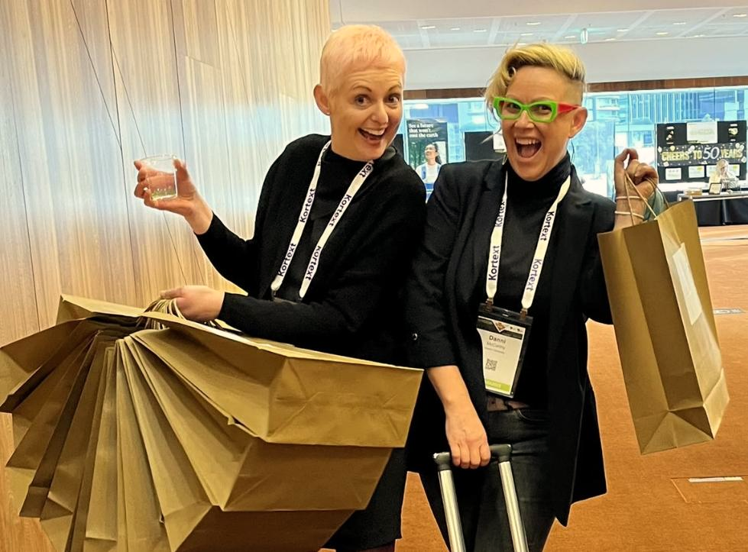
Strategic AF: Practical, tactical, (sometimes) fantastical approaches to equity initiatives
Lauren Hansen – Director, Graduate Employability
Danni Hamilton – Director, Learning Design (Acting)

Slide 2
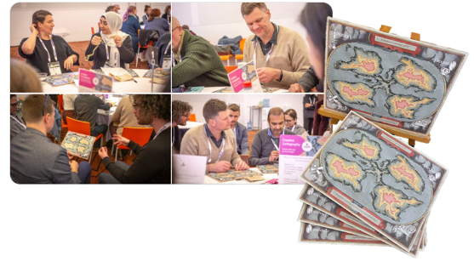
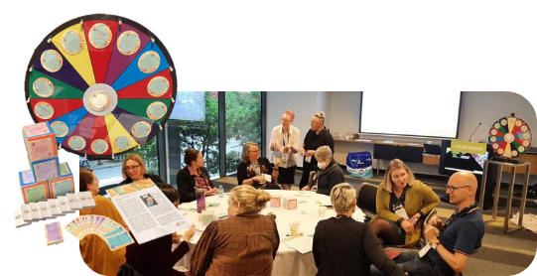
Today’s session
Share our tools, approaches and experiences delivering a range of projects that:
Foster transparency and collaboration to accelerate progress.
Align expertise and resources, uncovering opportunities and clarifying roles.
Build consensus and share knowledge to strengthen collective impact.
Hamsenism (n.): practice wisdom disguised as nonsense, engineered for getting stuff done.

Slide 3
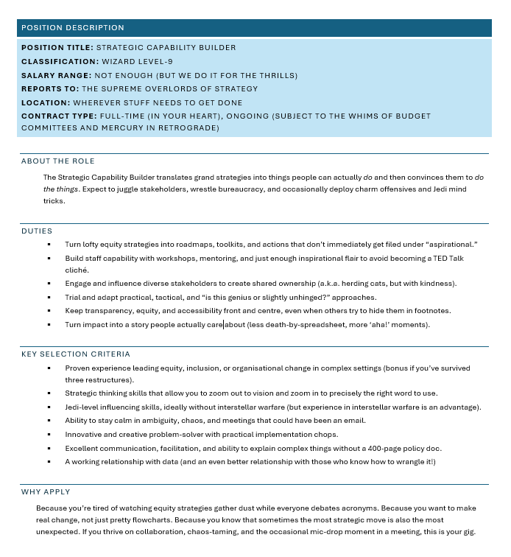
What is a Strategic Capability Builder?
Notes:
Position Description
Position Title: Strategic Capability Builder
Classification: Wizard Level-9
Salary Range: Not enough (but we do it for the thrills)
Reports To: The Supreme Overlords of Strategy
Location: WHEREVER STUFF NEEDS TO GET DONE
Contract Type: Full-time (in your heart), Ongoing (subject to the whims of budget committees and Mercury in retrograde)
About the Role
The Strategic Capability Builder translates grand strategies into things people can actually do and then convinces them to do the things. Expect to juggle stakeholders, wrestle bureaucracy, and occasionally deploy charm offensives and Jedi mind tricks.
Duties
Turn lofty equity strategies into roadmaps, toolkits, and actions that don’t immediately get filed under “aspirational.”
Build staff capability with workshops, mentoring, and just enough inspirational flair to avoid becoming a TED Talk cliché.
Engage and influence diverse stakeholders to create shared ownership (a.k.a. herding cats, but with kindness).
Trial and adapt practical, tactical, and “is this genius or slightly unhinged?” approaches.
Keep transparency, equity, and accessibility front and centre, even when others try to hide them in footnotes.
Turn impact into a story people actually care about (less death-by-spreadsheet, more ‘aha!’ moments).
Key Selection Criteria
Proven experience leading equity, inclusion, or organisational change in complex settings (bonus if you’ve survived three restructures).
Strategic thinking skills that allow you to zoom out to vision and zoom in to precisely the right word to use.
Jedi-level influencing skills, ideally without interstellar warfare (but experience in interstellar warfare is an advantage).
Ability to stay calm in ambiguity, chaos, and meetings that could have been an email.
Innovative and creative problem-solver with practical implementation chops.
Excellent communication, facilitation, and ability to explain complex things without a 400-page policy doc.
A working relationship with data (and an even better relationship with those who know how to wrangle it!)
Why Apply
Because you’re tired of watching equity strategies gather dust while everyone debates acronyms. Because you want to make real change, not just pretty flowcharts. Because you know that sometimes the most strategic move is also the most unexpected. If you thrive on collaboration, chaos-taming, and the occasional mic-drop moment in a meeting, this is your gig.

Slide 4

HAMSENISM: Name it and claim it!

Slide 5
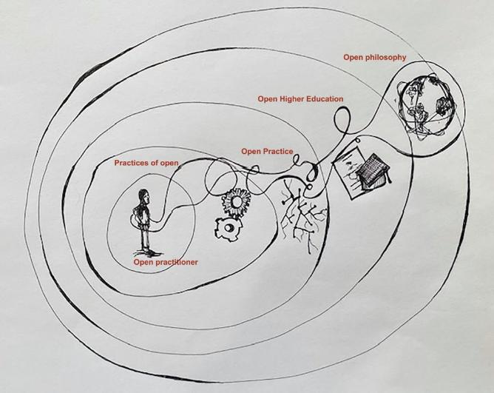
Working Open
Me
We
Us
As individuals, we have a personal practice (our life’s work)
Our personal practice occurs in relation to those in our teams…
…and in relation to the conditions of possibility in our institution and the sector.

Slide 6
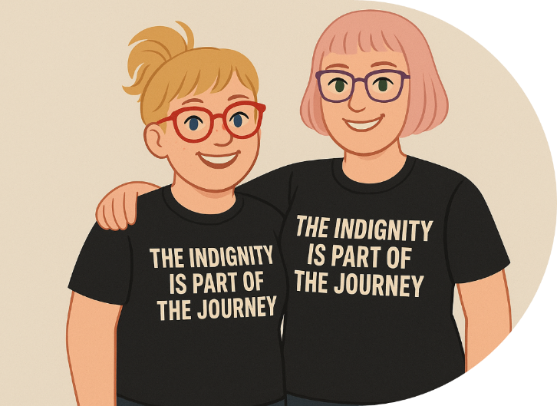
An Open Practice Stance
PEOPLE>
PROJECT>
PERSONAL

Slide 7
Foundations of Open Projects
Shared vision
Governance
Affordances
Communication
Accountability
Capability
What, why and how?
Authority, roles and responsibilities, project scope and boundaries
What do we have to work with? What do others have?
Clear key messaging, who speaks and when
Do the work, own mistakes, make amends
Do we have the expertise? Where can we find it and learn from it?

Slide 8
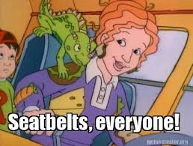
HAMSENISM: Are you on the bus?

Slide 9

Foster transparency and collaboration to accelerate progress.

Slide 10
Shared Understanding of Collaboration
Low Trust High Trust
PARALLEL COLLABORATION
DIALOGUE
REFLECTION
REVIEW
SEQUENTIAL COLLABORATION
SYNERGISTIC COLLABORATION
Participants synthesise their ideas to plan, organize, and complete the creation of a product that melds all contributions into a collective final product.
Participants complete stages of the work, building on each other’s contributions through a series of progressive steps. All are combined into a collective final product, or the process moves to another level of collaboration.
Participants work to each complete a component of the project. Elements are combined into a collective final product, or the process moves to another level of collaboration.
Participants exchange work for constructive mutual critique and to incorporate others’ perspectives. Participants evaluate which elements of each partner’s work should be included in the deliverables, and how they will be integrated into the whole.
Participants in the collaborative process agree on and work with the group’s communication expectations, timelines, processes, and tools. They exchange ideas to find shared purpose and coherence with the plans and/or tactics needed to coordinate their efforts.
Individuals align their own knowledge, attitudes, and skills with group efforts. Individuals make sense of and prepare their roles in collaborative efforts.
Salmons, J. (2019). Collaborating in a connected world, in Learning to Collaborate, Collaborating to Learn, (pp. 3-23). Sterling, VA: Stylus Publishing, LLC.

Slide 11
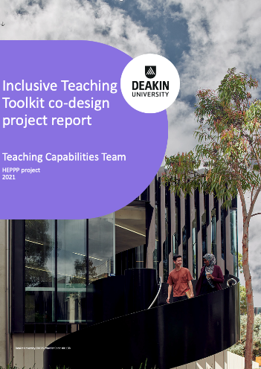
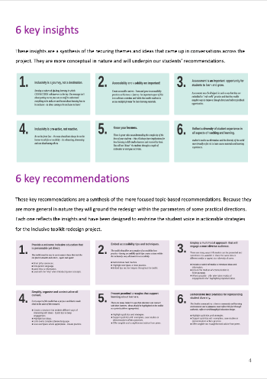
Tool: The Broken Prototype
Mid trust
Review as collaboration
Clear ownership
Low complexity
Connectivity: community of support
Accessibility: look and feel
Engagement: give me life
Simplicity: less is more
Credibility: fluid and dynamic
Multimodality: show don’t tell

Slide 12

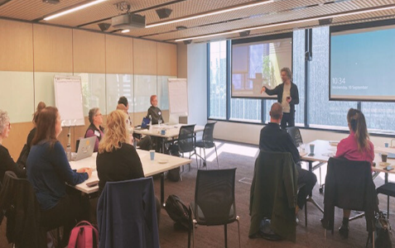
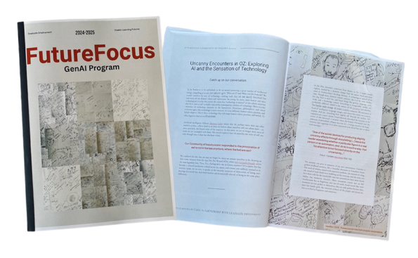
Evolution: FutureFocus GenAI Program
Very high trust
Synergistic collaboration
Shared ownership
Very high complexity

Slide 13
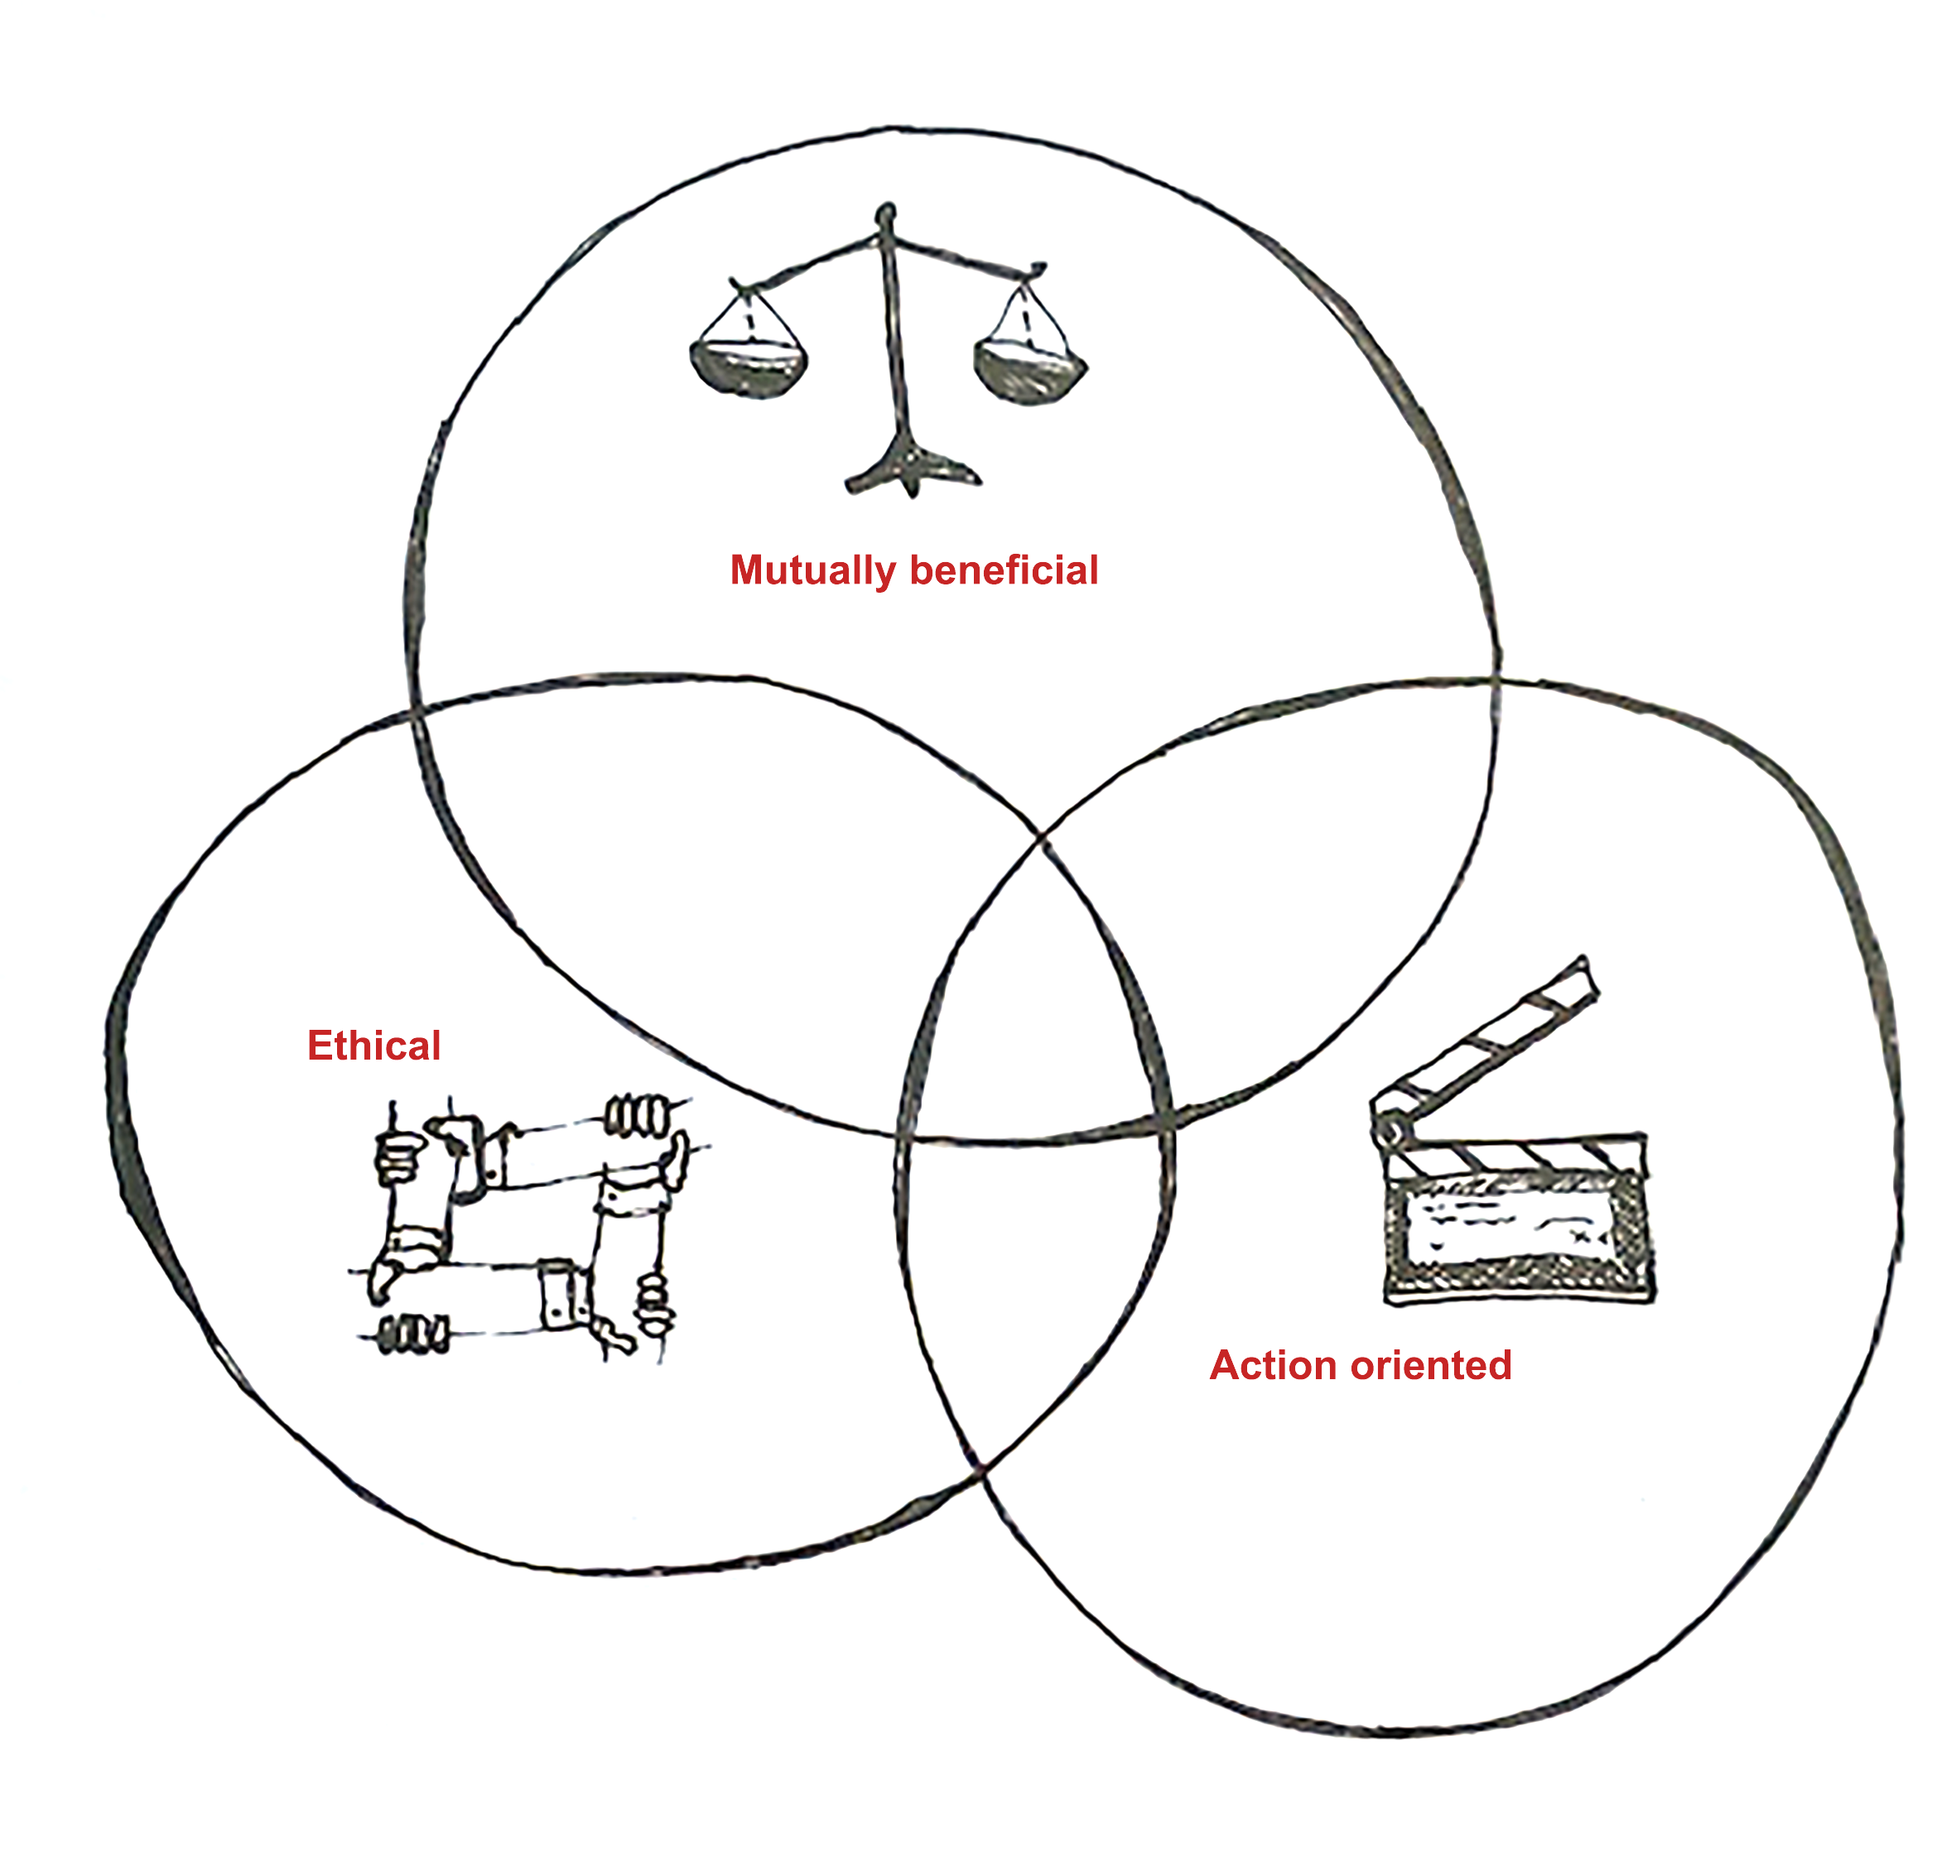
Strategy: The Open Alliance
Mutually Beneficial
Meets the strategic needs of all parties
Ethical
An ethics of care and indebtedness
Action-oriented
Putting our money where our mouths are

Slide 14
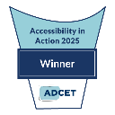
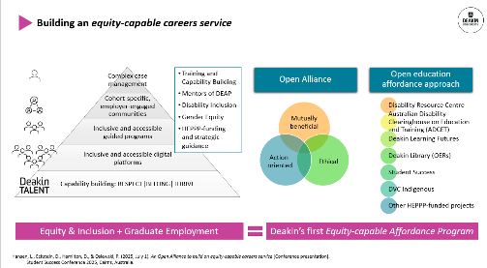
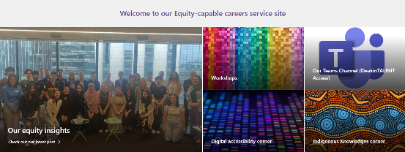
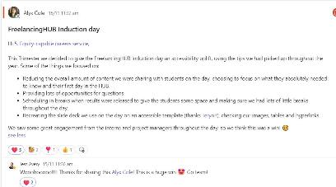
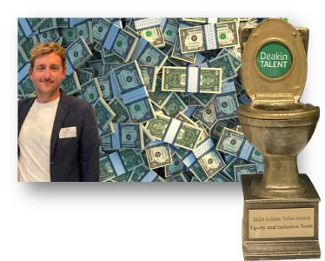
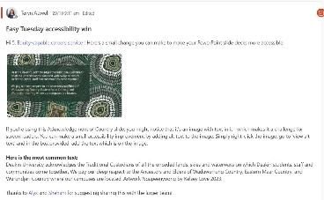
Example: Equity-capable Careers Service
Very high trust
Synergistic collaboration
Clear ownership
Low complexity
Highly commended

Slide 15
Align expertise and resources, uncovering opportunities and clarifying roles.

Slide 16
Approach: Open educational affordances
The art of open alliance: the purposeful bringing together of existing teams, resources, expertise for the fulfilment of shared endeavour
AFFORDANCE
What the environment offers
For university
Systemic change
The cultivation of open practices: the techniques, infrastructure, and support for creating impactful, affordable open content
Affordance Program
AFFORDABILITY
Being cheap enough for people to buy
Equity outcomes
For student
The pragmatic process of working open: bringing people, resources and contexts together in ways that integrate with existing systems, processes and projects.
AFFORD
The ability to do something because you have enough money, time, expertise
Capability building
For staff
Hamilton, D. (2024). Open Educational Affordance Approach (unpublished report). Deakin Learning Futures, Deakin University.
Hamilton, D., & Hansen, L. (2024). An artful becoming: the case for a practice-led research approach to open educational practice research. Teaching in Higher Education, 29(7), 1757–1774. https://doi.org/10.1080/13562517.2024.2336159

Slide 17
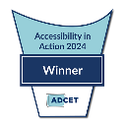
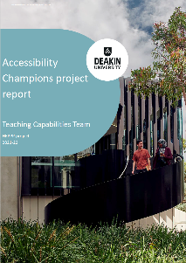
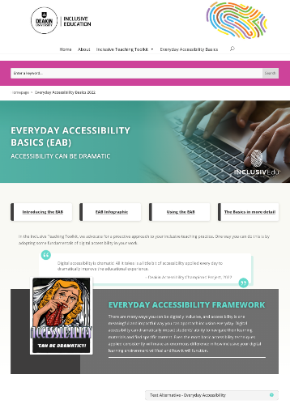

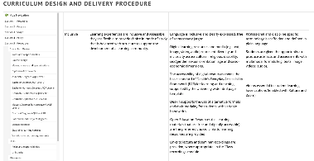
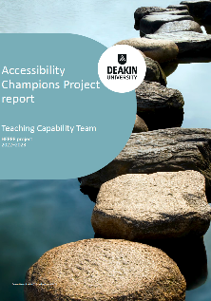
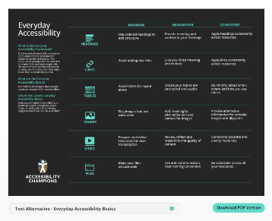
Example: Accessibility Champions Model
High trust
Sequential collaboration
Shared ownership
Low complexity

Slide 18
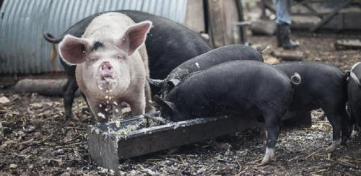
HAMSENISM: Beware of the dabbler!

Slide 19
Build consensus and share knowledge to strengthen collective impact.

Slide 20
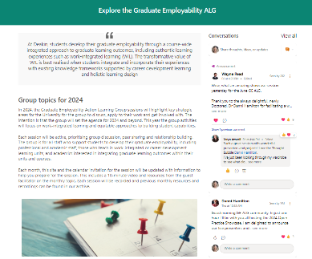
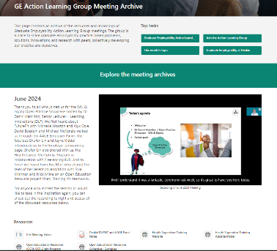
Building Open Communities
No more build it and they will come – go to where the work is being done (and to who is doing it!)
Action and process-oriented – come back to the foundations of Open projects
Distributed leadership model, but operations are built into workload and organisational planning
Create an experience where people can come as they are, when they can. This means:
Make it ‘snackable’. Engagements can be standalone
Normalise doing nothing – every little bit helps!

Slide 21
Example: Action Learning Group Model
Low trust (trust building)
Reflection and dialogue as collaboration
Shared ownership
Very high complexity
Action-oriented
Translate PD to change in practice
Bi-directional
Bridge the gap between strategy and practice
Privilege practice wisdom
Activist
Alliance with shared goals
Distributed leadership
Build practice through practice not discourse about practice
Guest facilitator, distributed leadership
Discussion, activity, peer sharing in breakout rooms
Action pack to translate to practice and collaboration
Flipped classroom, resources on intranet site and in archive

Slide 22
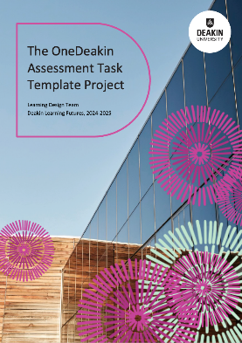
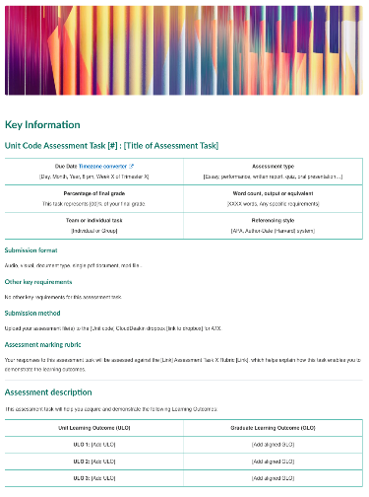
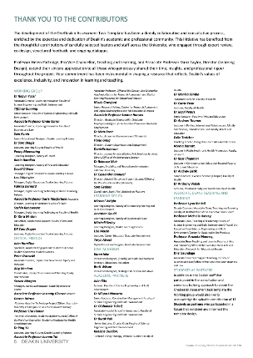
Example: Community Consultation and Consensus Building (CCCB) Approach
Mid trust
Parallel and sequential collaboration
Shared and unclear ownership
High complexity
Highly commended

Slide 23
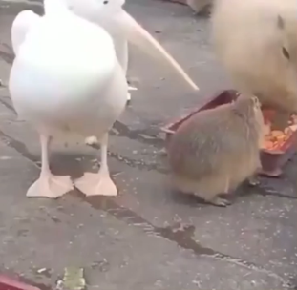
HAMSENISM: You know its working when the pelicans and seagulls attack

Slide 24
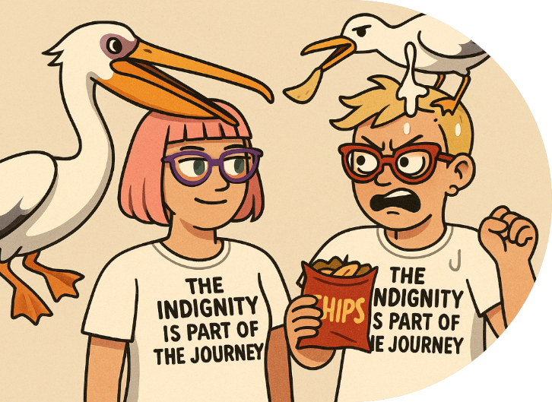
Questions and comments
We’ve shown you ours…

