Slide 1


Unlock Better Learning For All
With Assistive Technology

Slide 2

Jim Sprialis
Asia Pacific Account Manager

Slide 3
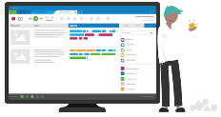


From our beginnings…
We expand into Higher Education institutions
Audio Notetaker launched
2007
2012

Slide 4



Executive Functioning demands in learning
Attention & concentration
Information processing & cognitive overload
Organization & planning skills
Engagement
Comprehension
Retention
“Am I taking it in?”
“Do I understand it?”
“Do I remember it?”

Slide 5
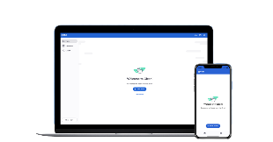


…to the introduction of Glean…
The Glean app launched
We became Glean
2020
2021

Slide 6


Simple learning tools
Beautifully simple learning tools that boost knowledge, skills, and confidence

Slide 7

Mission
To unlock better learning for everyone.
Vision
A world where every person has the tools and confidence to expand what’s possible through learning.

Slide 8
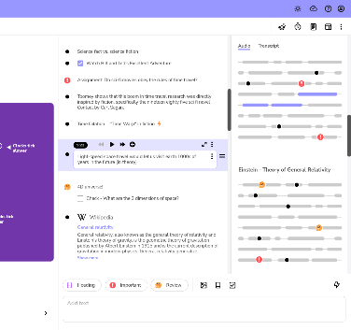

What is Genio Notes?
Built for accessible education, Genio is the market leading note taking technology, trusted by students, staff and faculty at over 1000 Higher Education Institutions.
95% of students said that using Genio helped improve how they learn
Empowering students to take better notes

Slide 9

The big challenges facing Higher Education

Slide 10
“Non-traditional” learners are now the “new majority” in higher education
77%
43%
34%
of learners are
time poor
of learners are
underprepared
of learners face
individual barriers
Data from The New Majority Learner Report 2025

Slide 11
65% of students with disabilities
will not register with services
Newman, L. A., Madaus, J. W., Lalor, A. R., & Javitz, H. S. (2019).
Support Receipt: Effect on Postsecondary Success of Students With Learning Disabilities.
Career Development and Transition for Exceptional Individuals, 42(1), 6-16. https://doi.org/10.1177/2165143418811288

Slide 12
The Disengagement Cycle
Poor learning experience or grades
Poor learning experience or grades
Loss of financial support
Loss of financial support
😥
😫
Reduced effort
Dropping out
Reduced effort
Lower confidence
Lower confidence
Disconnection to campus life
Stress
Disconnection to campus life
Stress

Slide 13
What can we do?

Slide 14
Continue to build accessibility and inclusivity into campus so students don’t need to self-advocate

Slide 15
Offer universal support institution wide that reframes the traditional student experience to provide more flexible and equitable access to and engagement with learning

Slide 16
The benefits of universal support
(
)
Students with disabilities are
When they do,
they are
The graduation rate is
2x
+70%
<50%
more likely to access universal support
more likely to graduate
so that’s a
big deal
Newman, L. A., Madaus, J. W., Lalor, A. R., & Javitz, H. S. (2019). Support Receipt: Effect on Postsecondary Success of Students With Learning Disabilities. Career Development and Transition for Exceptional Individuals, 42(1), 6-16. https://doi.org/10.1177/2165143418811288

Slide 17
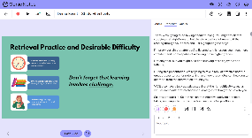
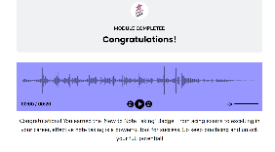
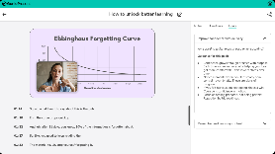

Unlock better learning for all with Genio tools
The Confident Notetaker’s Masterclass
Already available
New!
Coming soon…*

Slide 18

Video overview of Genio Notes

Slide 19

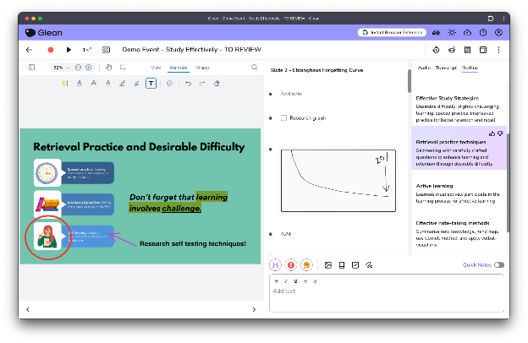
Some notable features
Live captions
Slide annotations
Scribble tool
Live captions
Text formatting
Browser extension
Event outline
Quizzing tool
Event scheduling
Equation support

Slide 20
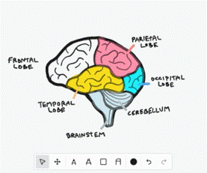
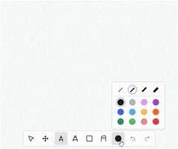
Scribble
Further support for students studying STEM and healthcare subjects
Create richer notes using colours, shapes, highlights and more
Capture content from class that isn’t easily typed
Allows students choice over how they engage with class content (typed or written)

Slide 21
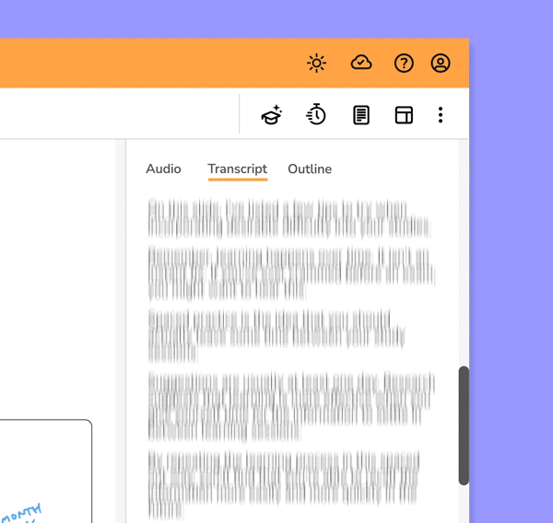
Outline: A safe, learning-first approach to AI
When prompted, Glean will summarise notes into a clear, digestible format.
Jump-start the learning process by nudging students to the important information hidden away in transcripts, slides, images and audio.
Requires students to engage with the material; to support rather than replace learning.

Slide 22
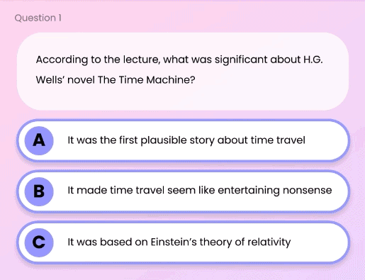
Quiz Me
With this feature, your students can:
Test themselves on recorded content via AI-generated multiple-choice questions
Get instant feedback on the effectiveness of their studies
Identify knowledge gaps

Slide 23
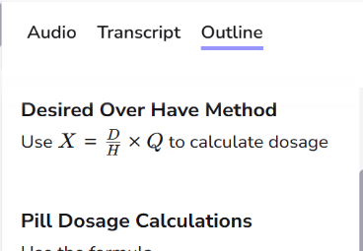
Formulas and Equations
Are now expressed in :
Outline
Quiz Me

Slide 24
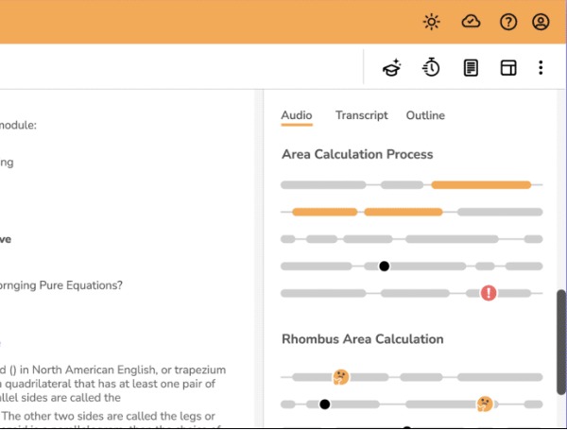
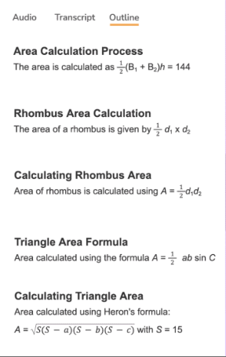
Formula and Equation support

Slide 25
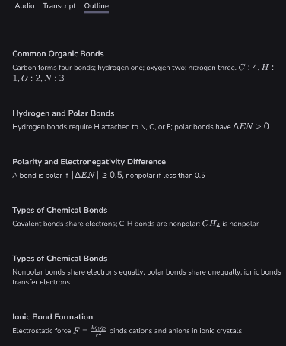
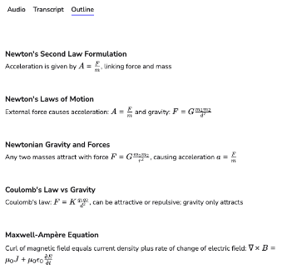

Formula and Equation support

Slide 26
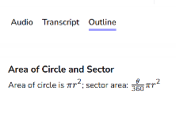
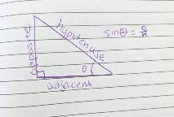
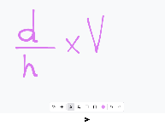
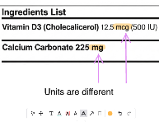
STEM Support in Genio Notes
Formula & Equations in Outline & Quiz Me
Import photos & diagrams
Scribble
Slide Annotations
Quickly find key equations and formulas in your Outline and test your knowledge in Quiz Me
Take photos with your mobile device and add them straight to your notes
Add your handwritten drawings, formula, and graphs using Scribble
Draw on your slides, add highlights, even make notes on your pre-lecture readings

Slide 27



How Genio supports STEM students' specific study challenges
Lots of contact time
Large lecture halls
Cumulative content
Use Event Reminder to sync with your calendar
Collections help to keep your notes organized
Use Audio clean up to get rid of background noise
With Offline mode, you can capture no matter the wifi situation
Active note taking means you learn the material, laying the foundation for more complex ideas
https://genio.co/blog/genio-notes-effective-study-for-stem-students

Slide 28

Genio Notes empowers better learning: capture audio & slides, annotate key moments, then refine notes with AI-powered transcripts, outlines, and quizzes.

Slide 29




An overview of Genio’s approach to the use of AI
Transparency
Transparency is key. To see how we use AI in Genio Notes, visit go.glean.co/ai-faq
Data
AI models from 3rd parties that Genio use will not be trained on Glean user data.
Efficiency
AI should not shortcut learning but should remove constraints and make it more efficient.
Productive Friction and AI
Control
AI features will not be forced upon learners. User should remain in control of their usage.

Slide 30
We’ve been supporting the “new majority”, and have seen impressive results
74%
81%
76%
of students said Genio Notes helped improve their study skills
of students said Genio Notes enabled them to enjoy their course more
of students said Genio notes made them more confident with note taking
Data from The 2025 Learner Impact Report

Slide 31
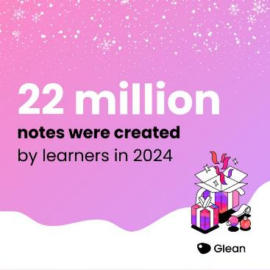
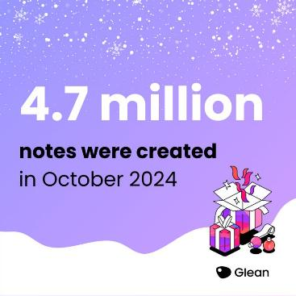
Some 2024 usage statistics

Slide 32
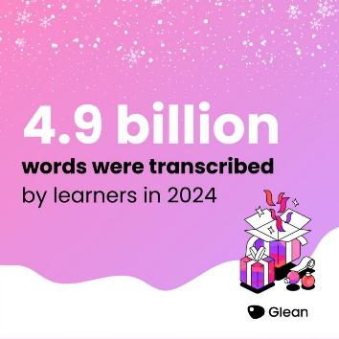

Some more 2024 usage statistics

Slide 33

From Impact to Opportunity
Our Proven Success Shows...
How Genio Notes transforms learning for thousands.
The power of effective tools in student hands.
  learning.
...But a Core Challenge Remains:
Many students lack fundamental note-taking skills.
The need for structured guidance in capturing knowledge.
Our Next Step: Empowering Every Student

Slide 34
When asked ‘What affects your ability to take ‘good’ notes while listening to academic English?’
49% of students listed their note taking skills as their main blocker
Joseph Siegel (18 Apr 2022): FACTORS AFFECTING NOTETAKING PERFORMANCE
International Journal of Listening, DOI: 10.1080/10904018.2022.2059484

Slide 35
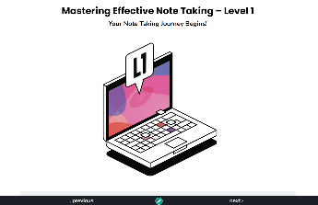
The Confident Notetaker’s Masterclass
Our first ever course!
The Confident Notetaker’s Masterclass is our brand new interactive course, teaching participants techniques and strategies to enhance the quality and efficiency of their notes before, during and after class.
The course is around an hour long and split into 7 modules, with multimedia content such as audio, interactive video, free text and multiple choice questions.
It is tool-agnostic - it teaches note taking strategies, techniques, and best practices, not how to use Genio Notes.

Slide 36
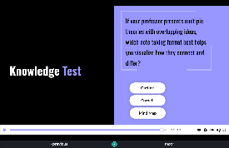
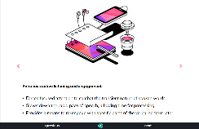
The Confident Notetaker’s Masterclass
Interactive content created by learning experts
Multiple means of engagement - audio, video, text, quizzes, self-reflection questions
Help learners develop crucial study skills
An alternative to resource-intensive institution-run study skills courses

Slide 37
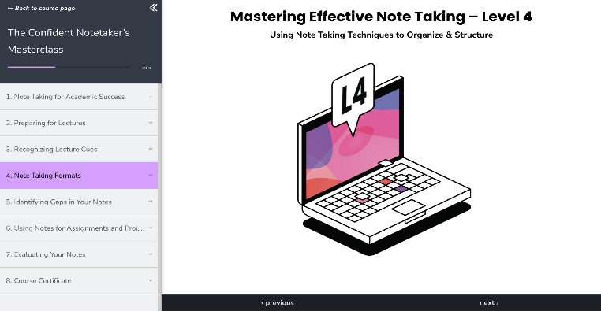

The Confident Notetaker’s Masterclass

Slide 38
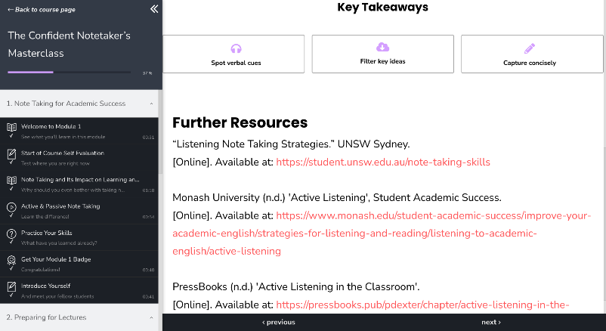
The Confident Notetaker’s Masterclass

Slide 39


Learners are already finding this super helpful 🎉
84%
94%
of learners said the course helped them build confidence in their note taking ability
of learners said the
course taught them
something new
Feedback from users during pre-launch testing

Slide 40

Masterclass course available now!
The Confident Notetaker’s
Masterclass
Live now for anyone with a Genio Notes account! 🎉

Slide 41

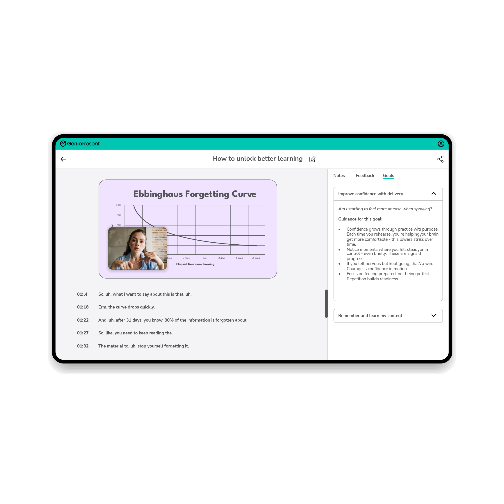
Announcing Genio Present
Don’t just survive your next presentation - own it.
A new presentation support tool from Genio.
A safe, supportive environment for students to rehearse their presentations, gain feedback, and build confidence in spoken delivery.
Tackle presentation anxiety
Build confidence through guided rehearsal
Grow skills through feedback

Slide 42

Video overview of Genio Present

Slide 43
Why are presentation skills important?
Promote Critical Thinking Requires you to organise thoughts, develop logical arguments, and respond to spontaneous questions.
Develop Communication Skills
Equip individuals with strong communication skills to improve employability and success in the workplace.
Assessment of Learning Oral presentations are a commonly used form of assessment in HE and usage is likely to increase.
Part of Everyday Work Presentations are a common part of modern jobs. Team meetings, client updates, pitching ideas, reporting results.

Slide 44
Genio present available in 2026
Genio Present is currently only available in the UK through the Disabled Students’ Allowance.
Later this year we’ll let you know when you’ll be able to access this tool.

Slide 45

We’re already unlocking better learning for students with our Institution Wide customers

Slide 46

“It has been my career goal to ensure everything is as universally accessible as possible to ALL students, and this gets me one step closer to achieving that monumental goal”
Pamela Farron, Berkshire Community College

Slide 47

Queensland University of Technology
Institution-Wide Adoption Driven By:
Disability & Accessibility Services
  Recognised significant engagement and academic gains for registered students.
  Students not registered with the service were requesting Genio for a more equitable learning experience
  Goal: Reduce reliance on paid note-takers; foster independent learning.
Student Champions
  Genio Champions actively promote benefits across campus.
Broader Impact
  Invaluable for all students beyond registered services (including international students)

Slide 48
UDL Case study - Volunteer State
Vol State had 58 Genio users before considering a site wide expansion. Leslie, the Director for Access, was a strong advocate with clear goals: enhancing accessibility and equipping faculty/staff to create equitable learning experiences.
Driven by UDL approach, Vol State upgraded to a Genio site wide license, strategically funded through Student Activity Fees which was driven solely through Disability Services. Licenses are managed by both DSS and a faculty member linked to TRIO department
Increase from 58 -> 1212 licensed students of which 608 have used the tool, and only 181 of those 608 have a registered accommodation.
11% increase in student retention for Genio users
Compelling data meant that Vol State successfully secured permanent site-wide funding for Genio moving forward

Slide 49
First years who use our tools are
11% more likely to persist from first to second semester
Data from Volunteer State Community College
Download the full case study from the Genio web site

Slide 50

The Genio Institution Wide Package
The Genio Institution Wide Package
(formerly known as Site Wide)
Provide our note taking tool to all students at your institution, not just those who are eligible for accommodations
Promote UDL activities on campus
Support the missing 65%
Provide support for the “new majority”
Bespoke Customer Success & Marketing support
+
+
+
?
Are you interested in learning more about
rolling out Genio Institution Wide?

Slide 51


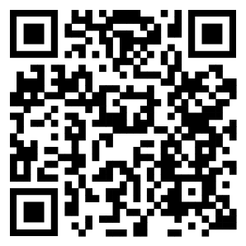
Questions?
Hello ADCET Genio page

Slide 52
Thank you

