Slide 1
Intentional action for equitable employment outcomes
ECU Centre for Employability – Inclusive Employability
ADCET Webinar: September 4, 2025

Slide 2

Acknowledgement of Country
I wish to acknowledge the Whadjuk Noongar people, the traditional Owners and custodians of the land on which ECU campuses are located.
I pay my respects to their elders past and present.

Slide 3



ECU Centre for Employability
Professor Justin Brown
Interim Director, Centre for Employability
Denise Bertilone
Inclusive Employability Officer
Emma Lovegrove
Inclusive Employability Officer
3
ECU Inclusive Employability

Slide 4
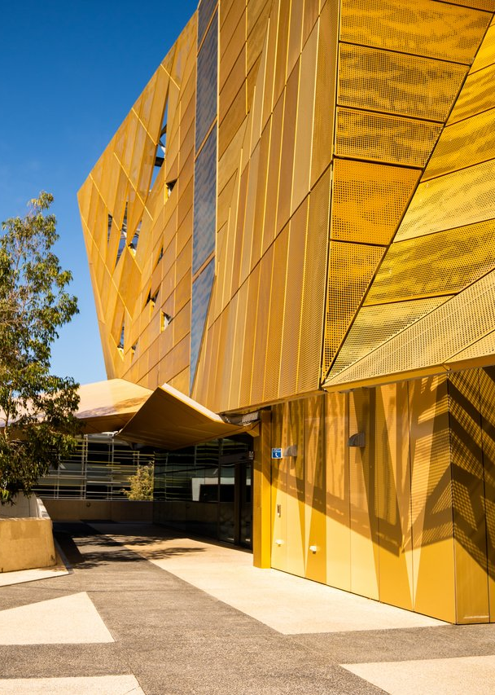
Centre for Employability
Internships (WIL)
Career & employability services
Employability in curriculum
Inclusive employability
Industry engagement
PhD internships

Slide 5
Inclusive Employability Pillars -
Student Empowerment
Inclusive Employability Pillars
Inclusive Governance
Staff
Engagement
Industry Engagement
Student Empowerment

Slide 6
Student empowerment
Inclusive career pathways
Strength in Diversity: enhancing your employment journey
ECU Student Journey to
Graduate Employment
Equitable access to tailored CDL
Empowerment and enablement
Inclusive Career Pathways

Slide 7
Strength in Diversity
Enhancing your employment journey
Goal: online resources to assist with a more successful transition into graduate employment
Key Drivers
Key Principles
Acknowledging and addressing the disparities in employment outcomes for students with disability
Led by people with diverse lived experiences, incorporating intersectionality and co-design
Reflective of workplace experiences
Targeted, nuanced approach
Promoting self-empowerment
Accessible, digital resources
Co-design process from inception
Co-creation of content
Collaborative approach within ECU
Equity of access to CDL

Slide 8
Discovery and Design…
Desktop discovery and early co-design discussions with
diverse students and ECU services.
6 undergraduates, 2 graduates
Note - half identified with more than one equity cohort.
Discussions covered experiences whilst studying, applying for work,
starting out in the workforce.
Co-creation of video content with students and graduates.
Feedback and evaluation for continuous improvement.

Slide 9
Led to lived experience insights…
Apprehension about navigating identity in the workplace
Question of how to assess inclusiveness of employers
The importance of knowing your rights and responsibilities
Embedded in-curricular, online platform
Minimal text in favour of student voices and video content,
learning from people with lived experience

Slide 10
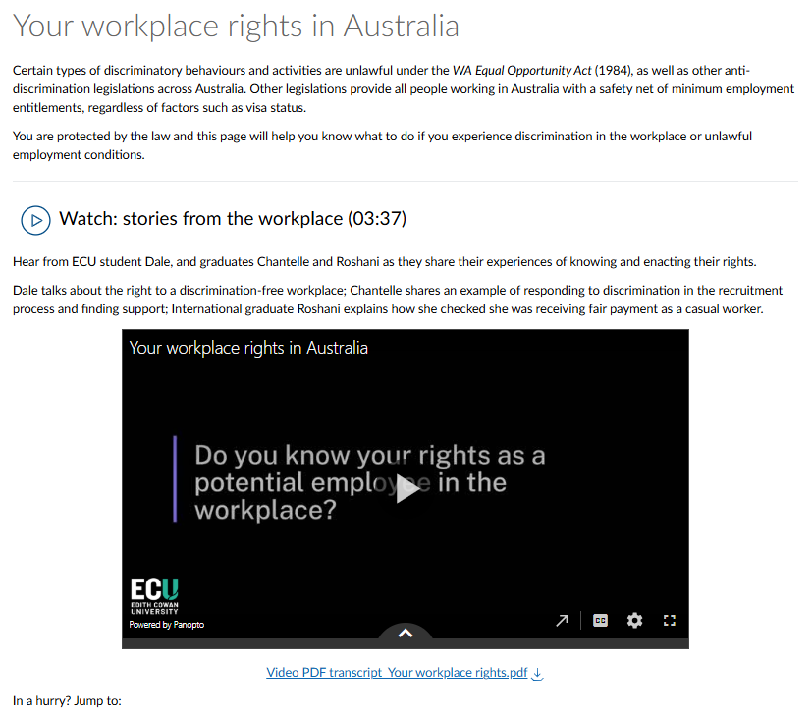
which led to…topic development…
Real-life stories speaking to:
Your workplace rights in Australia
Finding inclusive employers
Workplace culture and jobs in Australia
Balancing cultural responsibilities in
the workplace
Disability Pride
Workplace accommodations and
(self) advocacy
Coping with setbacks and discrimination
Bringing your authentic self to the workplace

Slide 11
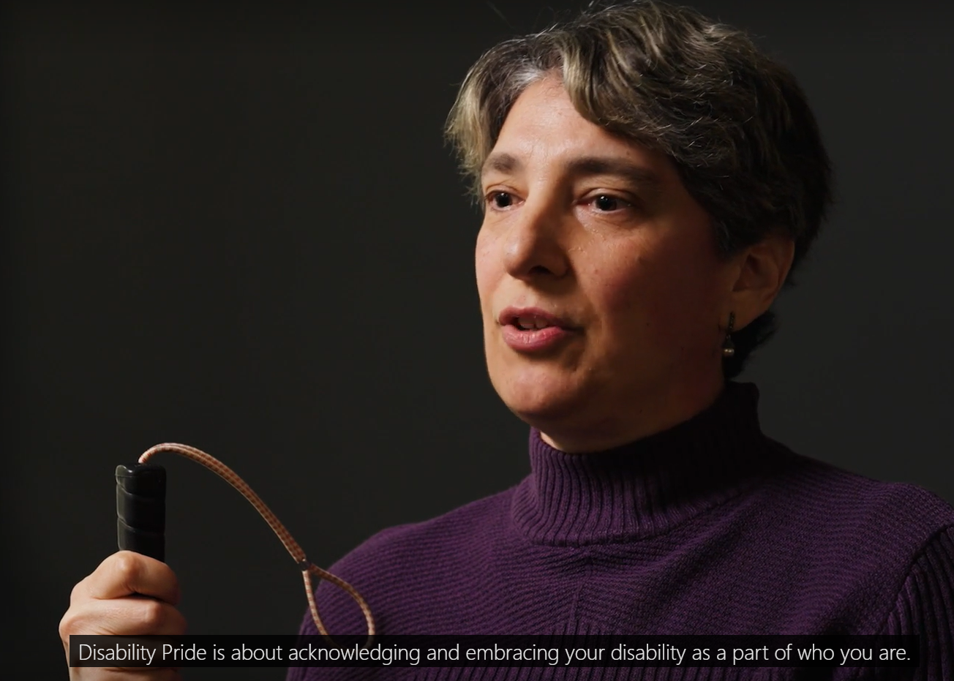

Real life stories from the workplace

Slide 12

Real life stories from the workplace

Slide 13

Real life stories from the workplace

Slide 14

Real life stories from the workplace

Slide 15
…and inclusive resource design.
Power of lived experience in resource design
Comparison of screen-reader experience and immersive
reader tools
Consideration of visual elements and alternative formats in Word
Identification of problematic hyperlinks and headers for
screen-reader users
Captions, transcripts and voice-overs for videos

Slide 16
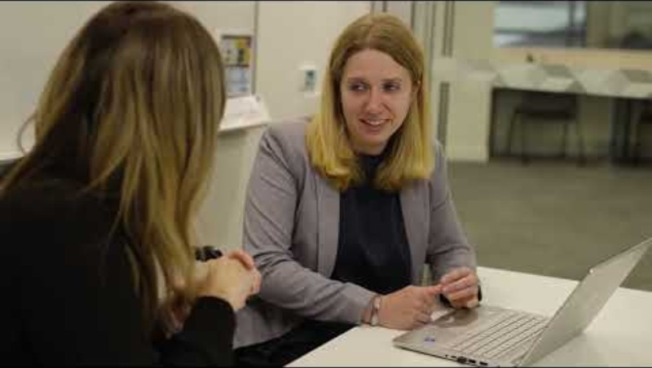
Journey to Graduate Employment
Positive visibility
Promote help-seeking behaviour
Strengths-based approach
Value of industry-based learning

Slide 17
Inclusive Employability Pillars –
Inclusive Governance
Inclusive Employability Pillars
Inclusive Governance
Staff
Engagement
Industry Engagement
Student Empowerment
ECU Inclusive Employability

Slide 18
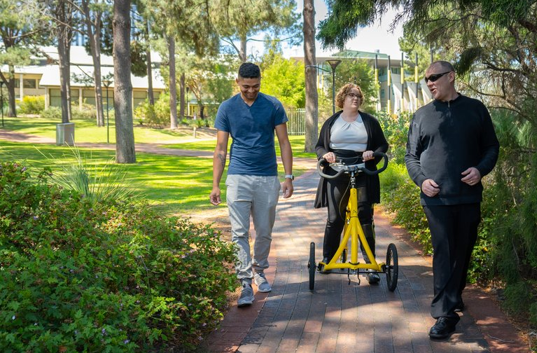
ECU WIL Procedure 2025
Goal: foster a systemic approach to the inclusion of students with disability in WIL
Assurance of Inclusive Practice:
Centre lived experience
Reframe the conversation
  from decision to discussion
Foster a culture of collaboration
Integrate inclusive design
  UD and digital accessibility

Slide 19
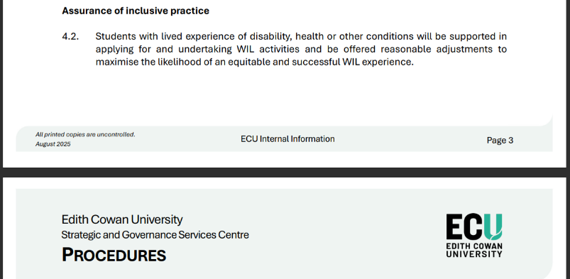
Assurance of Inclusive Practice

Slide 20
Inclusive Employability Pillars –
Staff Engagement
Inclusive Employability Pillars
Inclusive Governance
Staff
Engagement
Industry Engagement
Student Empowerment
ECU Inclusive Employability

Slide 21
Engaging ECU Staff
for equitable employability experiences
Inclusive Work-integrated Learning
Embedded Career Development Learning
Centre for Employability resources and support
Capacity building

Slide 22

Inclusive WIL
Goal: students with disability are equitably supported to participate in work-based WIL
Why?
How?
Intersectional identity and external responsibilities are an important factor in the engagement, success and well-being of students undertaking WIL.
Staff empowered and enabled to provide inclusive WIL experiences, supported through central resource provision and WIL community.
Diverse student body
Part-time, caring responsibilities,
English as second language, disability
Value of WIL to graduate outcomes
Engaging with the WIL Learning Community
Building an Inclusive WIL central repository
Fostering collaborative approaches
WIL Procedure

Slide 23
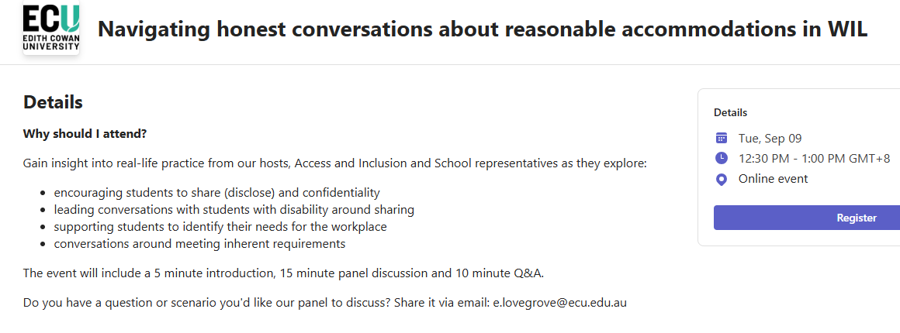
Lunch and Learns

Slide 24
Embedded Career Development Learning
Goal: support intentional embedding of CDL into course curriculum, facilitating equity of access
Why?
How?
Course curriculum that carefully embeds CDL empowers students to self-manage their employability and enhances confidence to connect to future employers.
Commence CDL in first-year and have a whole-of-course (program) plan guiding when and where students will encounter different aspects of CDL.
Inclusive by design: removes barriers, improves usability for diverse learning needs
Participation promotes career agency and self-determination
Intentional CDL: supports students to identify and articulate professional capabilities
Career development is a right, not an add on
Leverage learning and assessment: use authentic tasks to actively engage students
Plan for engagement with industry through WIL
Centralised CDL resources developed to enable staff capacity (including Strength in Diversity)
Curriculum designs supported by a Curriculum Consultant (Employability) and Career Advisers

Slide 25
Inclusive Employability Pillars –
Industry Engagement
Inclusive Employability Pillars
Inclusive Governance
Staff Engagement
Industry Engagement
Student Empowerment
ECU Inclusive Employability

Slide 26
Industry capacity building
Goal: industry partners confidently provide inclusive experiences for ECU students on placement
Work-integrated Learning
Supervisor Training
Centre for Employability
Inclusive Internships
Centre for Employability resources and support
Capacity building

Slide 27
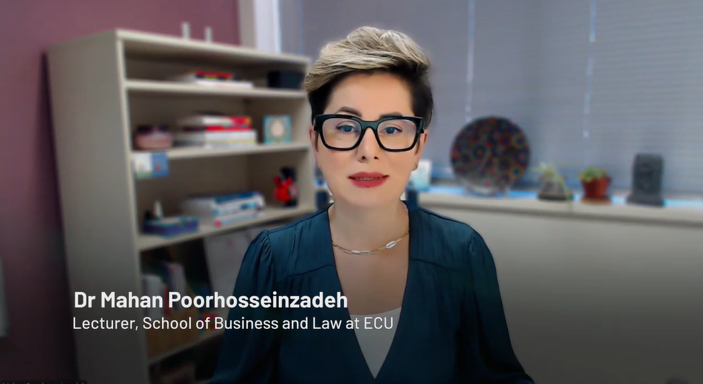
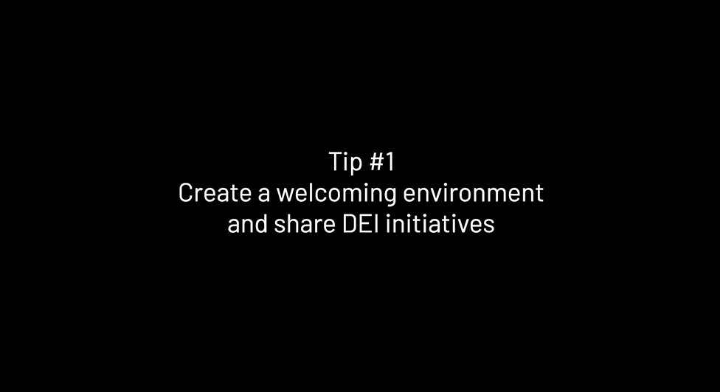
Work-integrated Learning
A guide for successful supervision
Reasonable accommodations
Intersectional power dynamics
Equity v.s. Equality
Universal Design tips
Fostering inclusive work-based WIL
with Dr Mahan Poorhosseinzadeh

Slide 28
Inclusive Internships
Universal design and targeted initiatives
Centre for Employability Internships
Targeted: Section 66R – affirmative measure initiative
Inclusive form design and recruitment practices
Encouraging flexible working arrangements
Facilitating collaborative approaches to reasonable accommodations
GradWISE

Slide 29
Summary: Pillars & Goals
Inclusive Employability Pillars
Inclusive Governance
Staff Engagement
Industry Engagement
Student Empowerment
Goal: online resources to assist with a more successful transition into graduate employment
Goal: foster a systemic approach to the inclusion of students with disability in WIL
Goal: students with disability are equitably supported to participate in
work-based WIL
Goal: industry partners confidently provide inclusive experiences for ECU students on placement
ECU Inclusive Employability

Slide 30
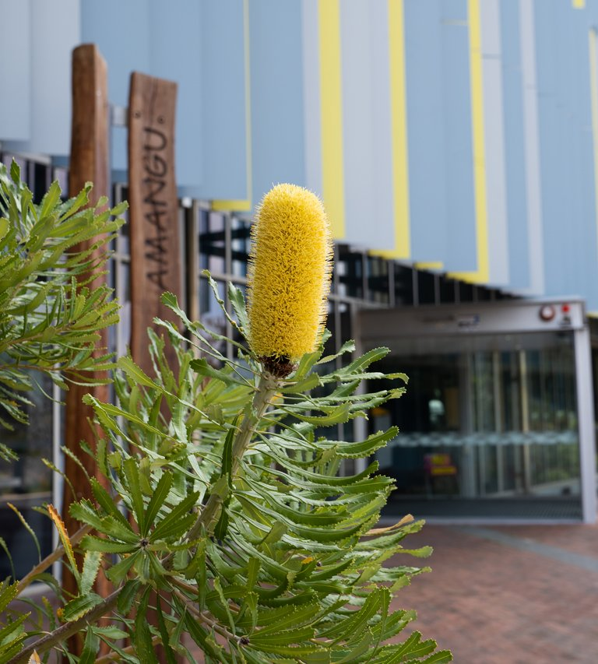
Next Steps
Where to from here?
Ongoing reflection and evaluation
Co-design with existing communities and work units to operationalize inclusion as BAU
Student voice and story-telling to foster aspiration from Outreach to Alumni

Slide 31

Questions
e.lovegrove@ecu.edu.au
d.bertilone@ecu.edu.au
j.brown@ecu.edu.au
Empowering ECU Students With Diverse Lived Experience: Paving the Way to Inclusive Employability

Slide 32
Thank you

