Slide 1
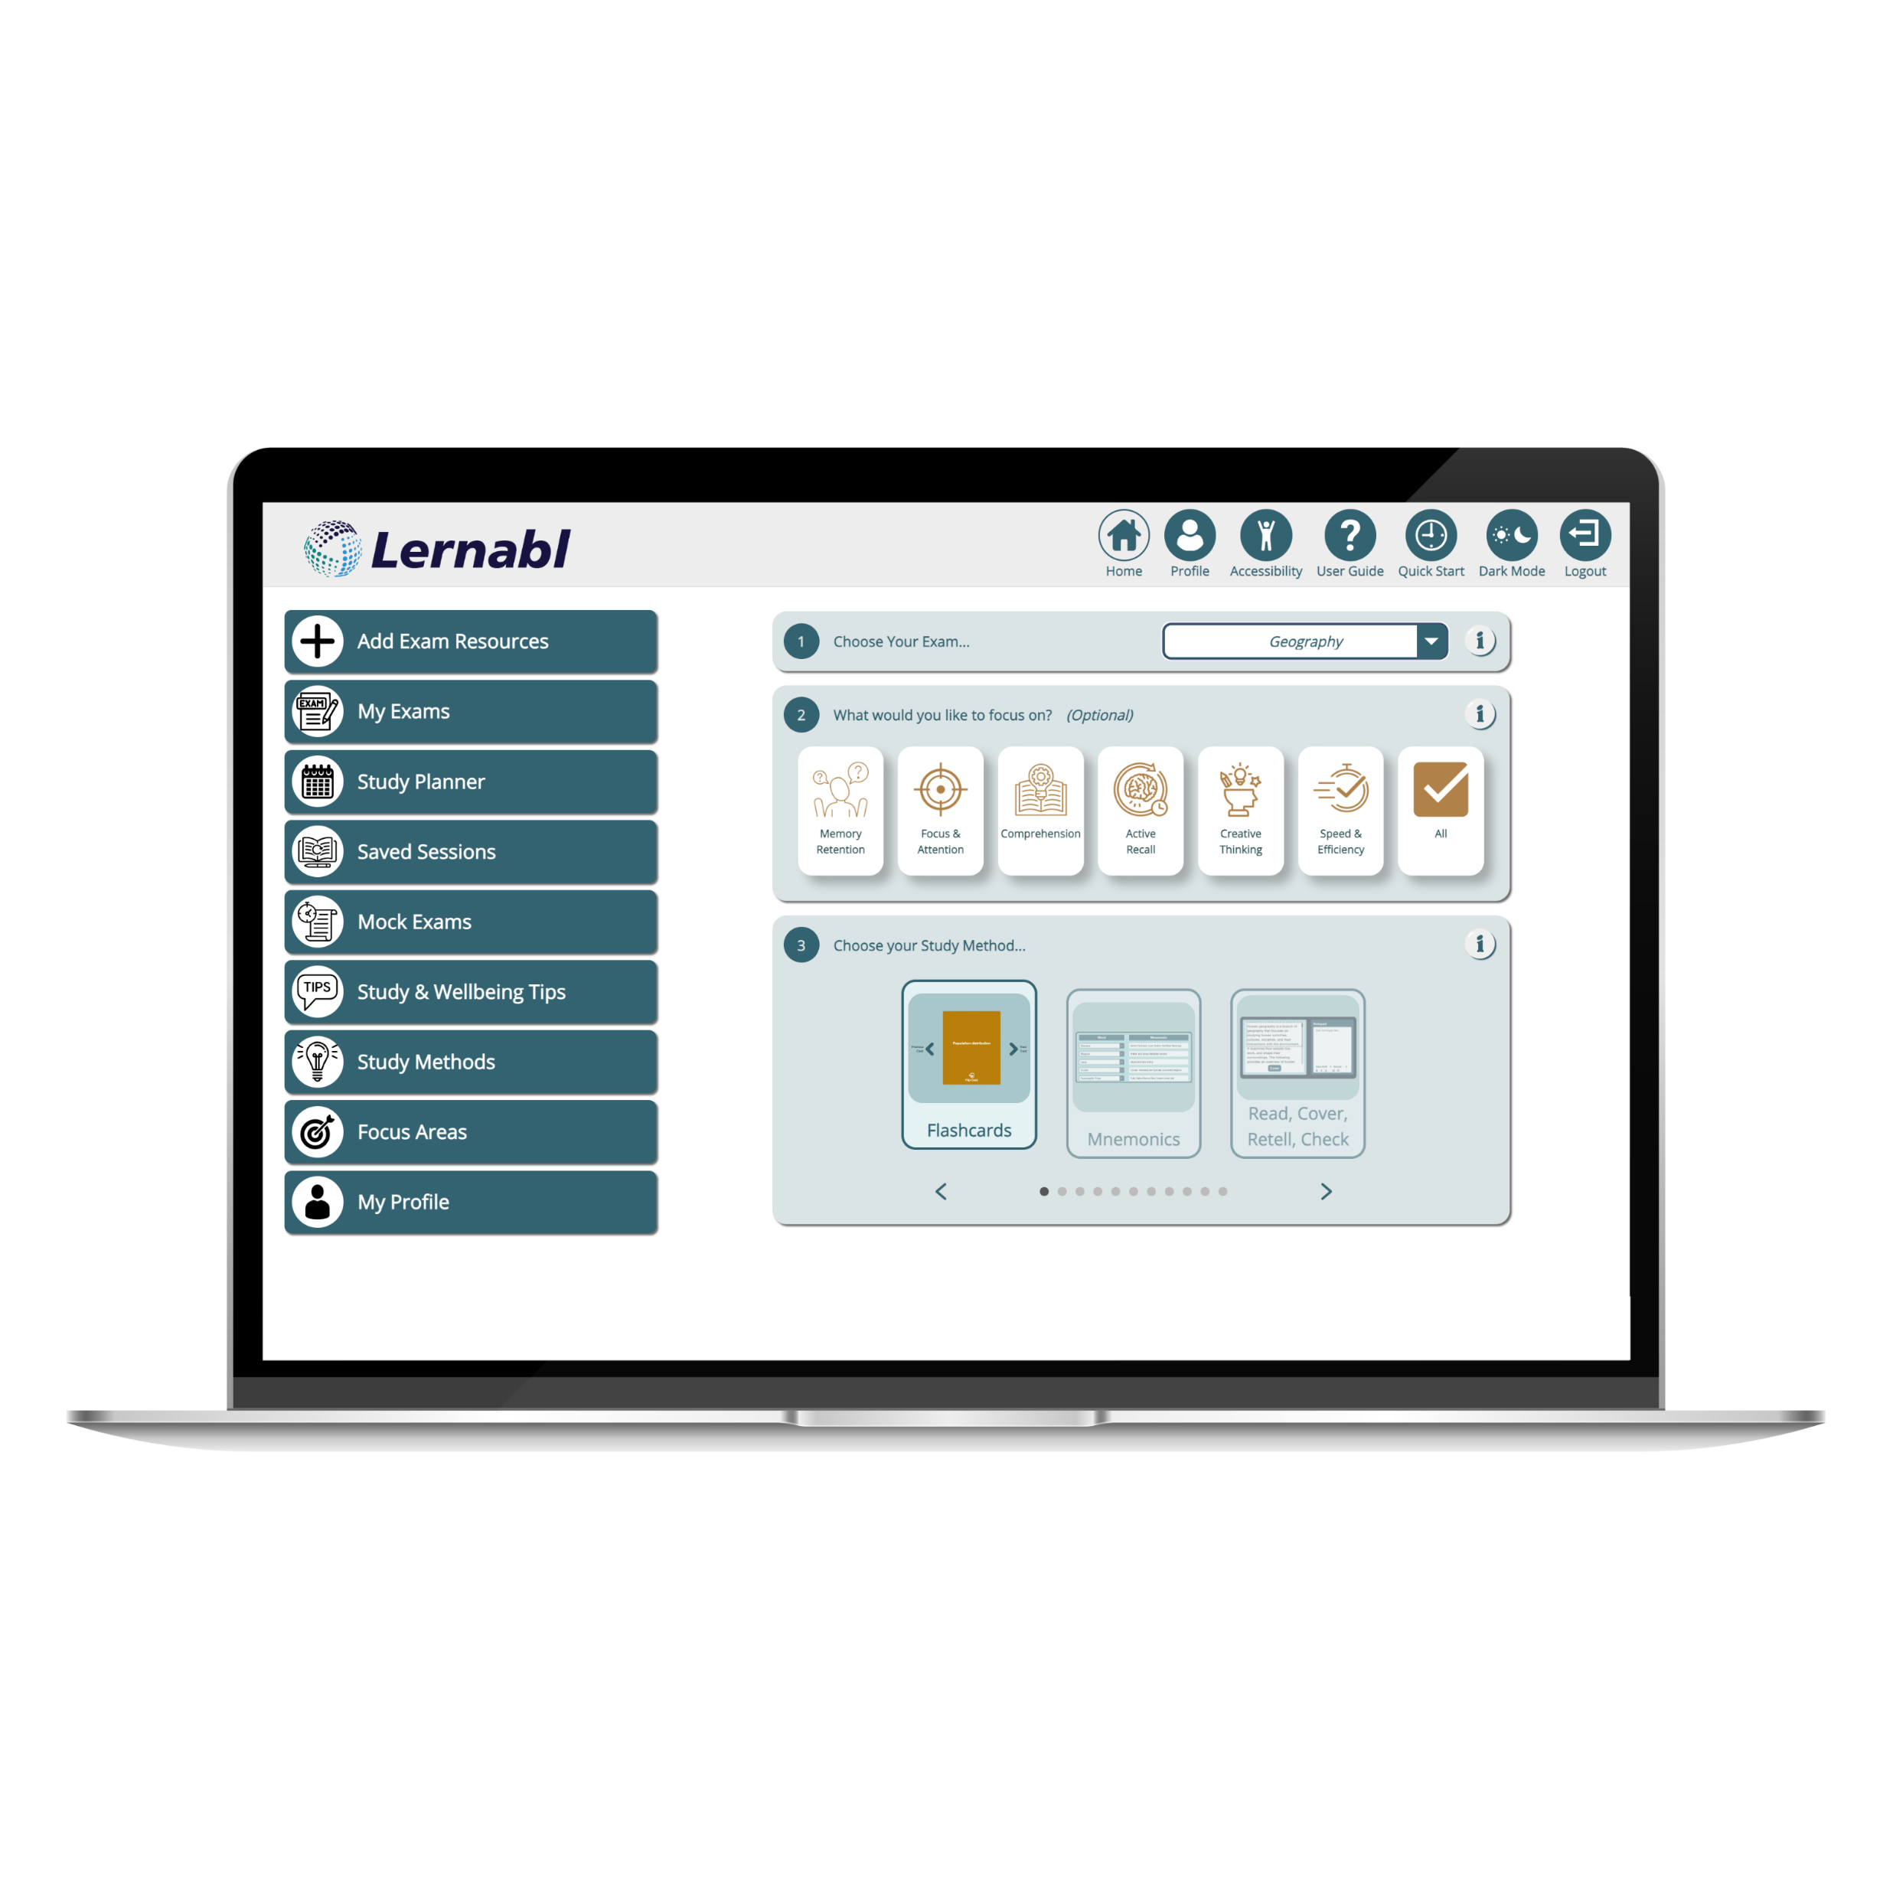
Lernabl

Slide 2
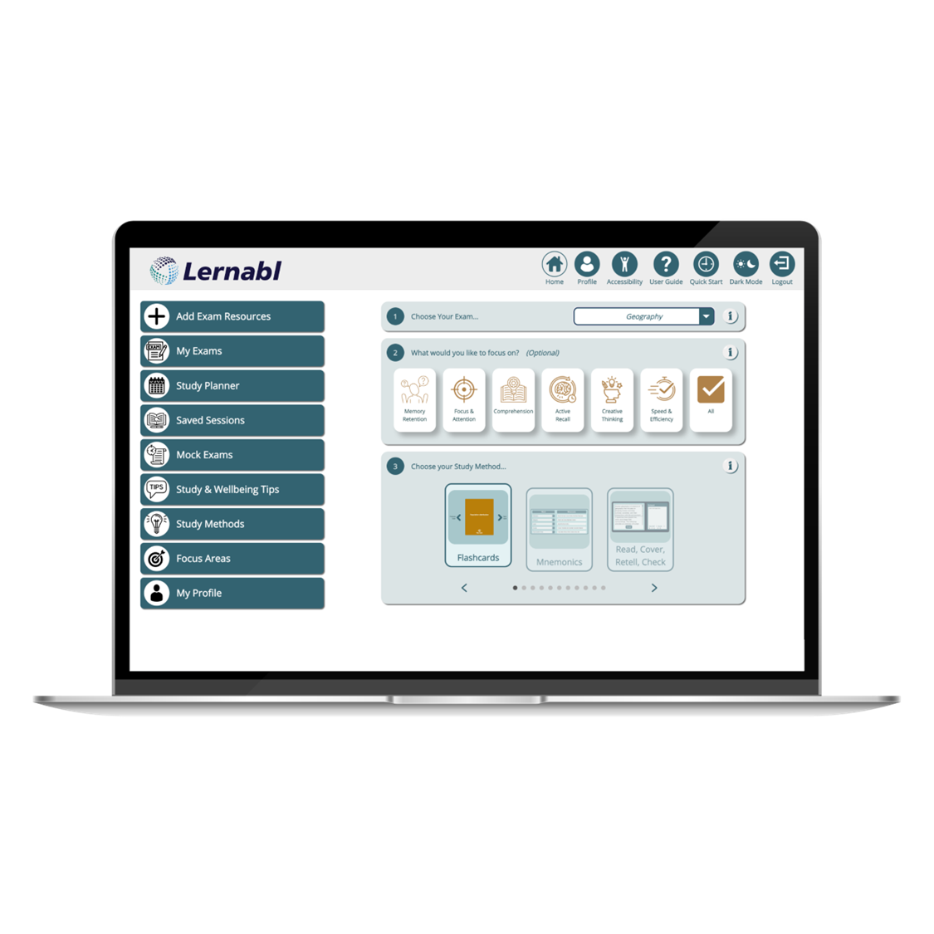
What is Lernabl?
Lernabl is a comprehensive and holistic solution for the entire revision/study process. Developed in response to students' demands for personalised and diverse study methods.
Unlike tools that focus on singular methods of revision such as flashcards or note-taking, Lernabl offers a suite of engaging, proven revision methods such as Cornell Notes, Flashcards, Concentration, Fill in the blanks and many more.
Lernabl is designed to be a year-round study aid, not just a cramming tool. Its scaffolded learning approach encourages the continuous addition of new material, which aligns with educational research promoting spaced repetition and retrieval practice as keys to effective learning.

Slide 3
Who is Lernabl For?
ADHD - Lernabl offers multiple features that cater to shorter attention spans and the need for interactive, engaging methods. Timed sessions across various revision methods help to structure study time and focus attention.
Dyslexia/Dyspraxia - Lernabl offers a multi-sensory learning approach with built in revision methods that focus on word-specific learning to improve spelling and text recognition skills such as, Cornell notes, fill in the blanks and Read Cover Retell Check revision methods as well as the Mock Exam feature. A variety of audio-visual elements also helps in catering to different information processing needs, for example, record audio and the text to speech revision methods.
Visual impairments-For students with visual impairments, Lernabl offers a range of features that can facilitate a more accessible learning experience. The Text-to-Speech functionality, for instance, allows students to absorb material audibly rather than visually, ensuring that they are not at a disadvantage when it comes to interacting with study content. Likewise, the Record Audio feature can be a valuable asset for these students, allowing them to create and play back audio recordings of key concepts for easier memorisation and recall.

Slide 4
Who is Lernabl For? (continued)
Autism Spectrum Conditions (ASC) - For students on the autism spectrum, routine and predictability can be incredibly beneficial. Lernabl offers a structured approach to revision, with timers within the various revision methods and step-by-step guides that can make the study process less overwhelming. The Mock exam feature allows a student to test their knowledge in a controlled scenario which can help them overcome the key disability impacts. The Study Planner offers an additional layer of support for students with ASC, giving them the ability to map out their study schedule and helping to manage time effectively.
Mental health conditions -Lernabl’s user-friendly interface and various engaging learning methods aim to reduce the stress and anxiety often associated with studying. Having the choice of multiple revision methods offers students the flexibility to pick what suits them best, which can be especially beneficial for those dealing with fluctuating mood states or concentration levels.
In addition, Lernabl's Study Planner can help students with anxiety by providing a structured, step-by-step approach to their study sessions. Users are able to access revision and well-being tips, rooted in psychological research, that aim to create a conducive study environment and offer emotional support. These tips can serve as proactive strategies to help students manage stress and enhance focus, making the study process less daunting and more achievable.

Slide 5
Time For A Demo

Slide 6
Why The Change To Lernabl?
To better reflect our evolving mission and the enhanced capabilities of our platform, Pro-Revise is officially rebranding to Lernabl.
The word revise was a little one dimensional. Lernabl is a great tool for the revision/study process, but it is also great for other areas of learning and building a student's subject knowledge.
In other areas of the world, the word revision can have a different meaning, so to avoid confusion we thought a name change was necessary so it was clear this tool can be used for exam preparation and revision.
This change marks a significant milestone in our journey towards providing students with more comprehensive and intuitive study tools. While our name is changing, our commitment to student success remains stronger than ever.

