Slide 1



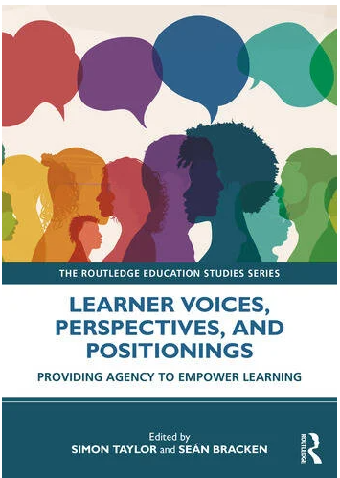

Empowering Learners through UDL:
A Researched Experience of Voice and Agency from UW
Dr Sean Bracken, Dr Anastasia Kennett and Helen Wilson

Slide 2

Centrality of learner voice
Voice cannot be expressed without inclusion and inclusion cannot exist without voice - Messiou (2019)

Slide 3
Overview
Provide an insight into the British Council funded project ‘Strengthening Higher Education in the UK and Indonesia through UDL and posit LV at the heart of the process.
Illustrate the profound impact that meaningful engagement with LV had on students, academics and the reform of curriculum.
Complement the narrative with reference to Dr Anastasia Kennet’s insights from her PhD heuristic inquiry research
Explore and identify ways that LV might be explored within your settings.

Slide 4
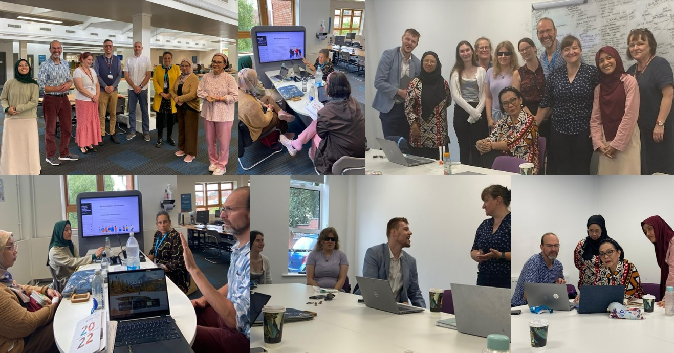
Montage of images

Slide 5

Co-construction with disabled learners
Learner voice
Gaining pre conference suggestions regarding what might work
Pre-planning of Participation at a LV seminar and round table discussion
Co-construction of professional development UDL modules
Meta-analysis and co-writing of a chapter
While bringing about change, individualised initiatives were less likely to be impactful, so formation of communities
of praxis were encouraged to better facilitate cross-institutional alliances that could identify and address systemic barriers to engagement.

Slide 6
Project aims (UI and UW)
To collaboratively develop, pilot, and evaluate Continuing Professional Development (CPD) modules in Universal Design for Learning
to help inform lecturers of the UDL framework, deepening knowledge and understanding
to provide practice examples and actionable tasks to develop lecturers' skills in applying UDL

Slide 7
Learner perspectives
Students had observed that:
Not all HE teachers were aware of what their needs might be and identified that training was an essential factor for fostering inclusion and belonging.
There was a need to more beyond reasonable adjustments and provide valuable insights into students’ requirements, experiences and the impact of positive and negative practice from their perspectives.
Having a voice literally became transformative firstly in terms of their own self worth and efficacy, while also transforming the perspectives that academics may have had of them, and it was facilitating a transformation of curriculum.

Slide 8
The importance of learner voice and agency
Learner conference attendance and contribution
  Teachers and conference attendees gained valuable in-depth insight into learner experience (a key highlight fed back by attendees)
Learner involvement with the collaborative workshops with UI and UW research team
  By using personal testimonies of students with diverse learning requirements, it enriched the transformative impact of future anticipatory inclusive design. The research team also learned from one anothers’ areas of strength in digital accessibility and learning to collaborate across a neurodiverse team
  Engaging students in the design and implementation of their educational experiences is essential for meaningful change.

Slide 9
Summing up
Summing up: Two sides of the same coin:
There are often inconsistencies between and student academic and student perceptions of the most effective UDL practices for promoting learning outcomes, highlighting the need for student feedback to better understand and plan for students’ needs (Varadhan et al, 2023)
Serrano-Johnson (2020) suggests that constructive student feedback can be a catalyst for academics and professional services colleagues to better understand and integrate UDL into their teaching.
Because the nature of student learning requirements were so diverse an increasingly comprehensive overview of requisite changes was revealed.

Slide 10
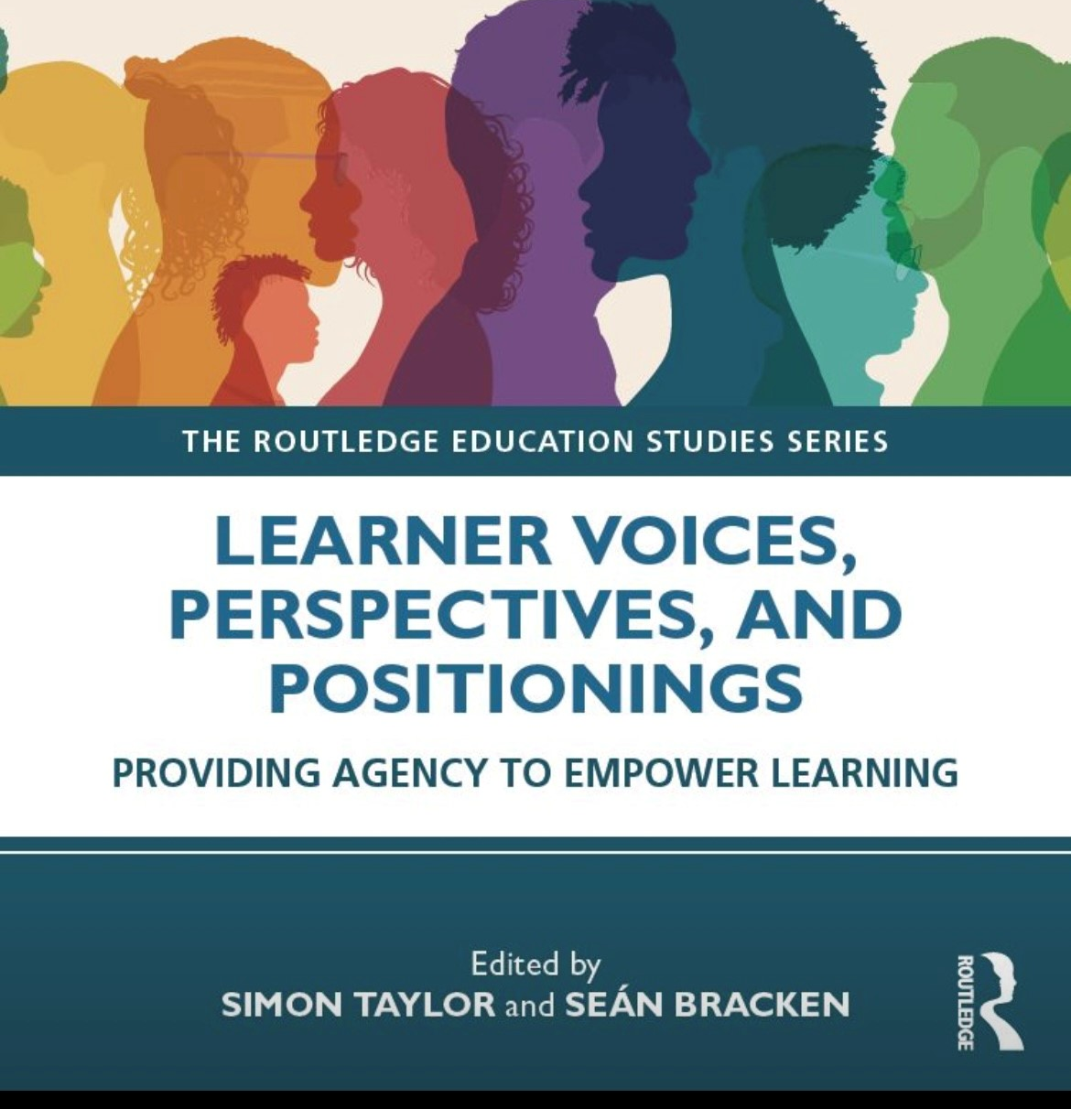
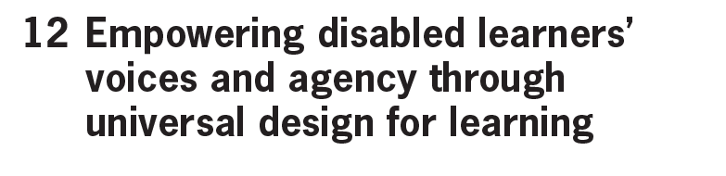
Book chapter
Reference:
Bracken, S Hopkins, A Kennett, A Lawrence, H Richardson, E Wedgbury, K & C. Wilson (2025) Empowering Disabled Learners’ Voices and Agency through Universal Design for Learning.
In, Taylor. S. and Bracken, S., Ed.S (2025) Learner Voices, Perspectives, and Positionings: Providing Agency to Empower Learning. London: Routledge (forthcoming).

Slide 11
Using the learner voice and examples
Key points highlighted in the chapter:
Learners with diverse learning needs (DLN) are experts by experience, they are the most fitting architects of their own learning design, but they require facilitative conditions of agency to realise their learning potentials.
UDL provides a framework for inclusivity in learning environments, however this ought to be applied flexibly and is never a “silver bullet” responding to all students’ needs.
Technology can play a significant role in enhancing learner agency.
Policy changes are necessary to support inclusive education, and these should be meaningfully and agentively informed by the disabled learners’ experiences.
Incorporating an international dimension to our educational experiences enables scope for widening our experiences and reflecting on our own cultural understandings of inclusion and accessibility for ALL learners.

Slide 12
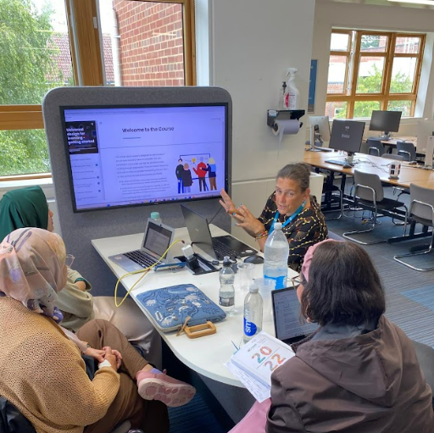
Collaborative
E-learning development
The result of collaborative workshops with learners, teachers and researchers (visits)
Module authors:
Dr Emma Richardson
Helen Wilson (PhD student and Project Research Assistant)
Astri Setiamurti from Universitas Indonesia
The e-learning underscores the need to support the purposeful application of the UDL principles to facilitate anticipatory inclusive design (Bracken, 2024).

Slide 13
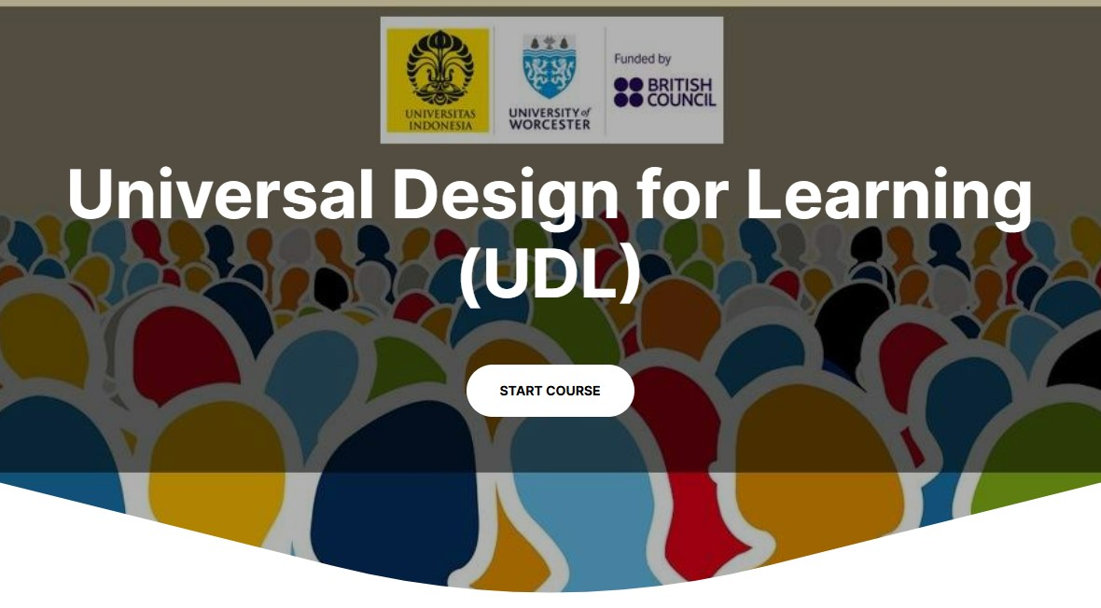
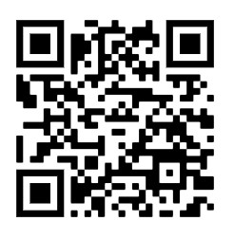
FREE access to the E-learning
Available in both English and Indonesian (Bahasa)
English e-learning content
Indonesian e-learning content
The course consists of 4 brief modules that consist of:
An introduction to Universal Design for Learning (UDL)
Multiple means of engagement
Multiple means of representation
Multiple means of action and expression

Slide 14
Further insights from Ana’s PhD study of DLN
Needing a trauma- informed safe space to regulate emotions,
Removing judgement through implementing trauma-informed practice,
Embracing understanding and representation to enable authentic interaction,
Removing fear by humanising those in positions of power, and
Promoting choice and autonomy.

Slide 15
Representation of students AND staff
By increasing representation of diverse staff members who may have greater empathy and who can draw on learned experiences meaningful partnership work with DLs can be promoted (Schley & Marchetti, 2022) – Kennett 2025
  Might this be a social actualization of multiple means of representation as shared in the UDL Framework 3.0?

Slide 16
Adopting a trauma informed approach
The trauma-informed approach of enabling ‘empowerment, voice, and choice’(is) (USDHHS, 2014) a form of empowerment linked not only to being the voice of change but also to witnessing change (Ashton-Hay & Williams, 2023; Cook-Sather, 2022; Dollinger & Hanna, 2023; State Government of Victoria, 2024). Such empowerment can be achieved by enabling DLN students to practice using their voice and autonomy in making choices that matter to them (Brown et al., 2020; Dollinger & Hanna, 2023; Gillett-Swan et al., 2024). In turn, DLN students gain a sense of autonomy and agency that can help move them toward seeking and offering more partnership approaches to staff.
Although partnership may not remove harm experienced by students in HE (Cook-Sather, 2022), partnerships that address the themes from this research could encourage diverse students to utilise their voice and move away from being silent (Ashton-Hay & Williams, 2023)

Slide 17

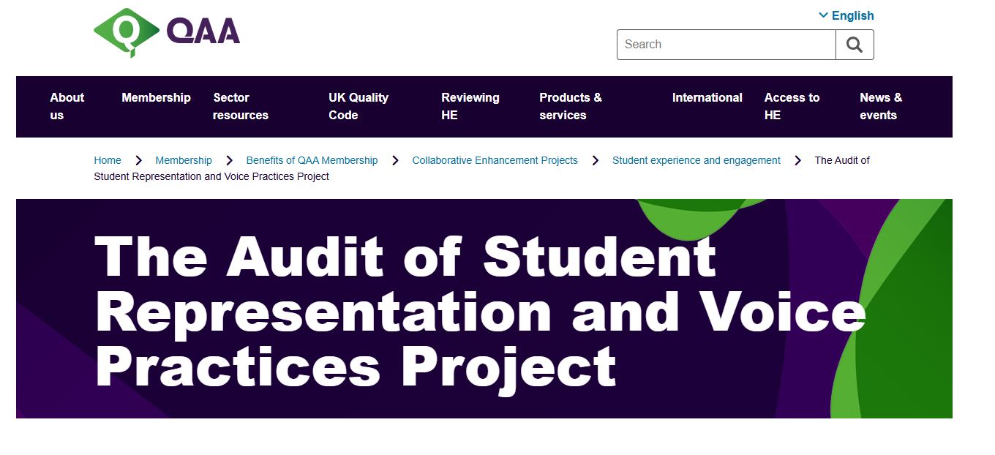
Meaningful voice making systems change
Sensory guide to The Hive - Library Services
QAA Student Panel: The Quality Assurance Agency for Higher Education (QAA) is an independent body which is responsible for safeguarding the standard and improving the quality of UK higher education.

Slide 18
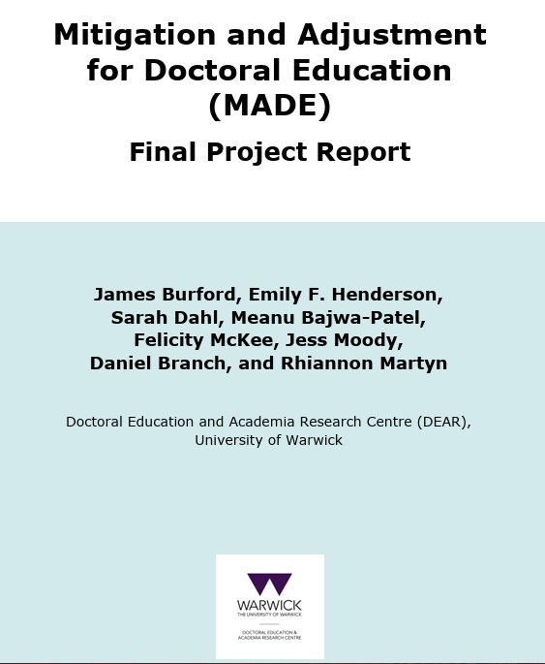
MADE Report
Implications for my own role as a doctoral programme lead
Review institutional requirements for doctoral assessment preparation
Engage with inclusive assessment scholarship within teaching and learning to develop critical understandings of what inclusive PGR assessment might look like.
Provide universal accommodations
Increase awareness and visibility of disabled students and their requirements.
Enhance approaches to PGR supervision to account for Reasonable Adjustments and Mitigating circumstances ensuring these are in place from the outset and then checking in over the PGR cycle

Slide 19

Think, pair, share (1, 2, 4) 15-minute activity
Step 1: REFLECT make some notes for 3 minutes provide ONE suggestion for how learner voice is currently used within your setting. AND if this presentation sparked any new ideas, make an additional ONE suggestion regarding how you could better promote and extend diverse learner voice either within your organisation or extended to impact on regional, state, federal or transnational contexts.
Step 2: Pair up and share 5 minutes
Step 3: Pair with another pair and SHARE your ideas 5 minutes (collate your notes)

Slide 20

sharing insights and wider presentation discussion

Slide 21
References and additional reading
Ashton-Hay., S. & Williams, D. (2023). What student voice is and is not: Connecting dialogue to evidence-based practice and inclusive mindsets. Journal of University Teaching and Learning Practice, 20(6). https://doi.org/10.53761/1.20.6.1
Australian Council for Student Voice. (2024). Inclusive student voice toolkit. Australian Council for Student Voice Ltd. https://www.studentvoice.org.au/learn/resource-hub/inclusive-student- voice-toolkit
Bracken, S Hopkins, A Kennett, A Lawrence, H Richardson, E Wedgbury, K & C. Wilson (2025) Empowering Disabled Learners’ Voices and Agency through Universal Design for Learning. In, Taylor. S. and Bracken, S., Ed.S (2025) Learner Voices, Perspectives, and Positionings: Providing Agency to Empower Learning. London: Routledge (forthcoming).
Brown, K., de Bie, A., Aggarwal, A., Joslin, R., Williams-Habibi, S. & Sivanesanathan, V. (2020). Students with disabilities as partners: A case study on user testing an accessibility website. International Journal for Students as Partners, 4(2), 97 – 109. https://doi.org/10.15173/ijsap.v4i2.4051
Cook-Sather, A. (2022). Co-creating equitable teaching and learning: Structuring student voice into higher education. Harvard Education Press.
Dollinger, M. & Hanna, L. (2023). Students with disabilities mentoring staff: Supporting scalableacademic development for inclusive education. International Journal for Academic Development, 1 – 3. https://doi-org.Apollo.work.ac.uk/10.1080/1360144X.2023.2262968
Dollinger, M. Rola, A., Finneran, R. & O’Shea, S. (2023). Conceptualising responsibility and hostility within work-integrated learning placements for students with disabilities. Disability and Society, 39(9), 2217 – 2235. https://doiorg. apollo.worc.ac.uk/10.1080/09687599.2023.2209276
Fricker, M. (2010). Epistemic injustice: Power and the ethics of knowing (Repr). Oxford University Press.

Slide 22
References and additional reading
Gillett-Swan, J. K., Willis, J., & Miles, P. (2024). Student wellbeing in vertical schools: A multilayered student voice approach for inclusion and inﬂuence. The Australian Educational Researcher. https://doi.org/10.1007/s13384-024-00765-6
Kennett, Anastasia (2025) Conceptualizing an inclusive approach to student voice in higher education: A heuristic inquiry. International Journal for Students as Partners. ISSN 2560-7367
Messiou, K. (2019). The missing voices: Students as a catalyst for promoting inclusive education. International Journal of Inclusive Education, 23(7–8), 768781.https://doi.org/10.1080/13603116.2019.1623326
Matthews, K. E. (2017). Five Propositions for Genuine Students as Partners Practice. International Journal for Students as Partners, 1(2), 1–9. https://doi.org/10.15173/ijsap.v1i2.3315
Schley, S. & Marchetti, C. (2022). Moving access to inclusion by making communication a priority: An inclusion mindset, Journal of Educational Innovation, Partnership and Change, 8(2). Retrieved from https://journals.studentengagement.org.uk/index.php/studentchangeagents/article/view/1 133
United States Department of Health and Human Services. (2014). SAMHSA’s Concept of Trauma and Guidance for a Trauma-Informed Approach. https://store.samhsa.gov/product/SAMHSA-s-Concept-of-Trauma-and-Guidance-for-a-Trauma-Informed-Approach/SMA14-4884.html.

Slide 23
References and additional reading
United States Department of Health and Human Services. (2014). SAMHSA’s Concept of Trauma and Guidance for a Trauma-Informed Approach. https://store.samhsa.gov/product/SAMHSA-s-Concept-of-Trauma-and-Guidance-for-a-Trauma-Informed-Approach/SMA14-4884.html.
State Government of Victoria. (2024). Student voice and disability inclusion. https://www.vic.gov.au/student-voice

