Slide 1


Leveraging AI to Create Inclusive Educational Podcasts
Theme: Generative AI and Assistive Technology (AT) as enablers of inclusion
Presented by Mark Shelton
University of Tasmania

Slide 2
Agenda
The AI Conundrum
Why Podcasts?
The Three Formats
Workshop – Quick Burst
Workshop – Chat Show
Workshop - Narrative

Slide 3
What are some of your concerns about incorporating AI into your content development?

Slide 4
The Research Tells us . . . .
“I am glad that I am not a young teacher, because I fear that this will eventually replace us.”
This is causing educators to "re-think the very nature of teaching, learning, and schooling"
“Only 33% of public-school teachers reported feeling "well prepared" or "very well prepared"
“all imaginable kinds of information and data can be found, the quality and value of which varies tremendously.”
“plagiarism is a rapidly growing problem in academia.”

Slide 5
Those quotes are from the 90’s – early 2000’s about teachers integrating the internet into their classrooms
Owston, R. D. (1997)
Trucano, M. (2013)
Auer, N. J., & Krupar, E. M. (2001)

Slide 6
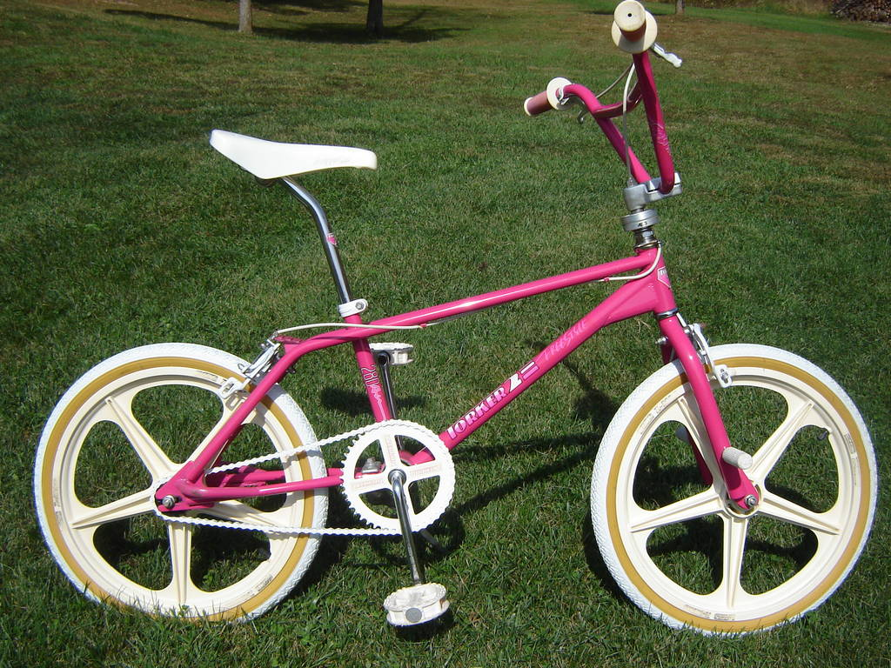
Before the internet in education. . .

Slide 7
Shifting the Mindset
  Reframe
  AI doesn't replace your expertise—it amplifies accessibility
  Reality
  You provide pedagogy and content, AI provides format conversion
  Result
  More students can access your teaching in their optimal format

Slide 8
Audio content and
Universal Design for Learning
  Multiple Means of Representation
  Same content, different format
  Accessibility
  Supports visual impairments, dyslexia, ADHD, EAL students
  Joy and Play
  UDL 3.0's new emphasis on engagement and incorporating storytelling
  Flexibility
  Learn while commuting, exercising, multitasking

Slide 9
People are already listening!
  Australia leads the world in podcasting listening, with a 20% increase in listenership over the past two years (2023-24).*
  Currently, 48% of Australians listen to podcasts monthly*
  65% of Australians aged between 18 - 39 and listen to a podcast at least monthly*
  36% listen to be informed, with an additional 29% saying they listen to be educated**
  * The Infinite Dial Report – 2024
  ** Nielsen Advanced Audience Data - 2024

Slide 10
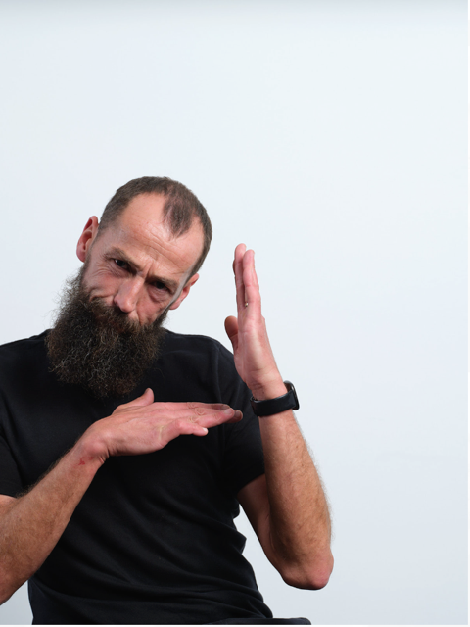
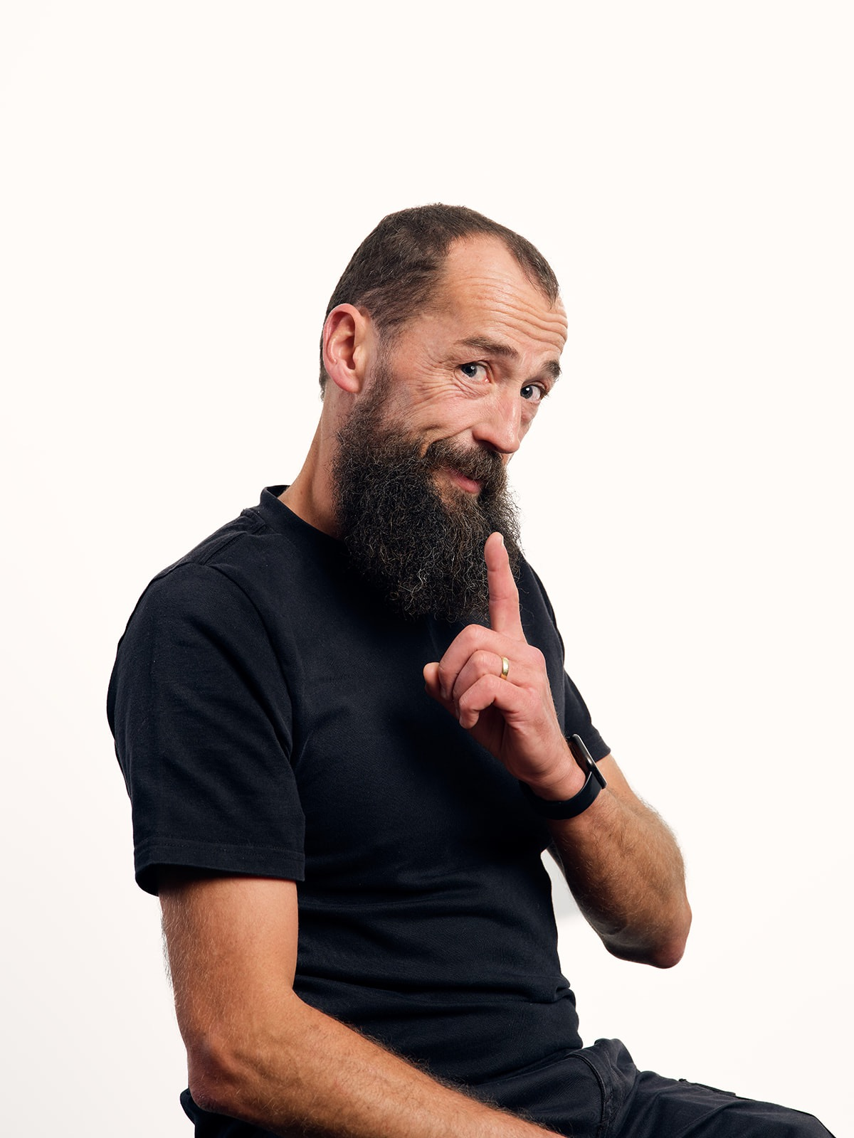
One of six million Australian’s that listen monthly to podcasts to be informed or educated . . .

Slide 11
Three Podcasting Formats
  Quick Burst (2-3 minutes)
  Single key concept, energetic delivery, rapid reinforcement. Accommodates shorter attention spans.
  Narrative (10-15 minutes)
  Story-driven deep exploration. Supports memory through story structure.
  Chat Show (10-15 minutes)
  Multiple perspectives accommodating diverse viewpoints

Slide 12
How the three formats support UDL
  Each format acts as a unique "cognitive tool" serving different learning functions (Drew, 2017)
  Support varied learning preferences: facts, stories, or discussion
  Attention spans and opportunities for learning vary – quick bursts vs. sustained engagement

Slide 13
  Let’s leverage AI to write 3 different types of podcasts

Slide 14
In a group, or on your own, choose ANY educational topic you teach!
  Topic Ideas:
  Key concept from your subject area
  Common student misconception
  Important process or procedure
  Essential vocabulary/terminology
  Exam preparation strategy
  Study technique or tip

Slide 15
Quick Burst
Basic AI Prompt
  Create a 2-3 minute "Quick Burst" educational podcast script about [YOUR TOPIC]
  Target audience: [Succinctly describe your students - level, course, specific needs]
  Learning objective: [What should students know/do after listening?]

Slide 16
Quick Burst
Structure
  Structure:
  Engaging hook in first 15 seconds
  3-5 key points maximum
  Include one memorable example or analogy
  End with specific action or reflection question
  Use conversational, enthusiastic tone

Slide 17
Quick Burst
Accessibility
Features
  Accessibility features:
  Simple, clear language appropriate for [student level]
  Define any technical terms immediately
  Include natural pauses for emphasis
  Provide pronunciation guide for difficult words

Slide 18
Quick Burst
Advanced Prompts
  Refinement Prompts:
  Make this more engaging for [refine audience description]
  Add a better hook at the beginning
  Simplify language for accessibility
  Include pronunciation guides for technical terms
  Add a stronger call to action at the end

Slide 19
  Let’s turn it into a podcast

Slide 20
Quick Burst ->
Chat Show
  Transformation Prompt
  Transform the Quick Burst script above into a chat show where I'll play both the host and guest:
  The host is a curious interviewer who asks engaging questions geared towards the learning objectives
  The guest is an expert who knows the quick burst topic well
  Duration: 8-10 minutes of conversation covering all Quick Burst content

Slide 21
Chat Show
Structure
  Structure
  Host introduces topic and guest (me)
  6-8 interview questions that draw out all the information
  Guest responses contain the Quick Burst content
  Host asks follow-up questions for clarity
  Host concludes with key takeaways
  Make the two roles feel like different people having a real conversation.

Slide 22
  Time for an AI generated voice

Slide 23
Chat Show ->
Narrative
  Chat Show:
  HOST: "Tell us about…”
  GUEST: "Well, in my experience...“
  Q&A dialogue format
  Information through conversation
  Narrative:
  "Dr. Sarah had seen this problem countless times...“
  Single storytelling voice
  Guest's insights woven into story
  Information through narrative arc

Slide 24
Narrative
Structure
  Transform the chat show interview above into an 8-10 minute narrative story that:
  Tells a story incorporating the guest’s insights, knowledge and opinions from the interview
  Uses third-person storytelling about the expert/situation
  Creates an engaging story arc with beginning, middle, end
  Convert the dialogue into descriptive storytelling while keeping all the valuable content.

Slide 25
Narrative
Approach
Common Narrative Approaches:
Timeline story: "The day that changed everything..."
Journey narrative: "Following the path of..."
Problem-solution arc: "The mystery that puzzled scientists..."
Character development: "Meet the person who discovered..."
Real-world scenario: "Imagine you're a..."

Slide 26
  Add some sound effects

Slide 27
Conclusion
Everyone benefits from multiple means of representation
This is UDL 3.0 in practice. This is inclusion through innovation.
Mark Shelton
Email - mark.shelton@utas.edu.au

Slide 28
  Questions

Slide 29
References
Auer, N. J., & Krupar, E. M. (2001). Mouse click plagiarism: The role of technology in plagiarism and the librarian's role in combating it. Library Trends, 49, 415-432.
Drew, C. (2017). Edutaining audio: An exploration of education podcast design possibilities. Educational Media International, 54(1), 48-62. https://doi.org/10.1080/09523987.2017.1324360
Edison Research. (2024). The Infinite Dial Australia 2024. https://47012339.fs1.hubspotusercontent-na1.net/hubfs/47012339/Infinite-Dial-2024-Australia-Full-Presentation.pdf
Nielsen. (2024, September 30). Nielsen data shows podcasts more popular than ever. Nielsen. https://www.nielsen.com/news-center/2024/nielsen-data-shows-podcasts-more-popular-than-ever-with-australian-audiences-as-number-of-older-listeners-jumps-49-in-just-12-months/
Owston, R. D. (1997). The World Wide Web: A technology to enhance teaching and learning? Educational Researcher, 26(2), 27-33.
Trucano, M. (2013, January 14). Will technology replace teachers? No, but... World Bank Blogs. https://blogs.worldbank.org/en/education/tech-and-teachers

