Slide 1


Implementing innovative and effective UDL 3.0 in YOUR classroom
Case Study and related activities to be undertaken during the workshop

Slide 2

Team Formation
Team Formation Survey
Teacher Tasks
Team Allocation
Student Tasks
Students submit team formation survey
  Pronouns
  Preferred name
  English first or additional language
  Study program
  Favourite animal species
  Students they would prefer to work with (up to 3)
  Students they would prefer not to work with (up to 1)
Teacher allocates students to teams
  Also use enrolment data (e.g. GPA)
  Student preferences
  Diversity in team composition
  Similarity of interests

Slide 3

Assignment Introduction
Team Formation Survey
Team Allocation
Teacher Tasks
Student Tasks
Assignment Introduction
Teacher introduces Discovery assignment
  Learning objectives
  Tasks
  Timeline and due dates
  Expectations for engagement with GenAI tools (declare & justify)
Key assignment elements
  Discovery topic of choice
  Research topic using credible scientific literature
    Documented research process
    Critical evaluation of literature in Annotated Bibliography
  Present live to the class
    Choice of format (oral presentation, skit, rap, interpretive dance!)

Slide 4
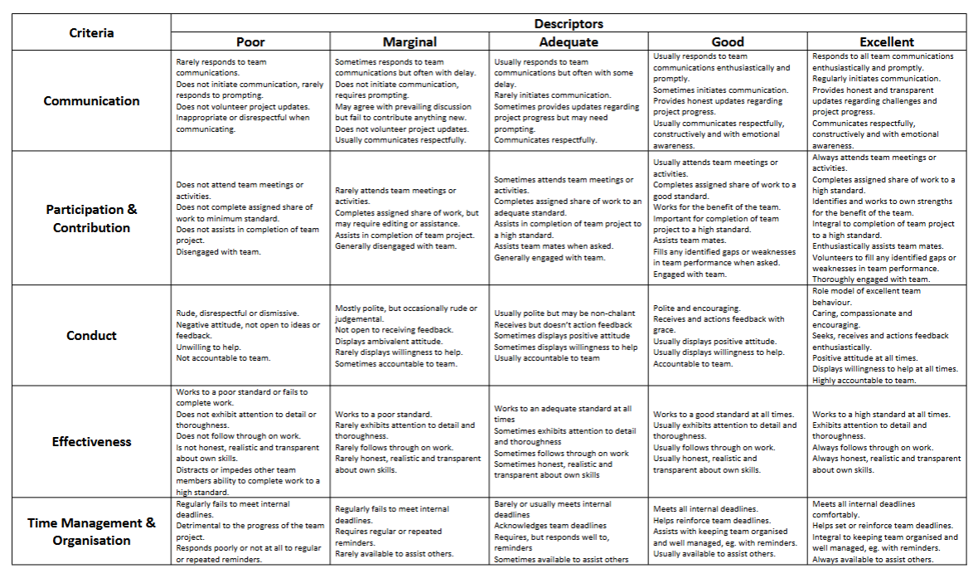

Teamwork Rubric Co-Design
Team Formation Survey
Team Allocation
Teacher Tasks
Student Tasks
Assignment Introduction
Teamwork Rubric Co-design
Teamwork Rubric Co-design
Facilitated discussion of teamwork
  Challenges, strategies, expectations, past experiences
  Teams discuss and draft teamwork rubric
    Identify criteria for effective teamwork
    Draft descriptors (poor, marginal, good, excellent)
Teams negotiate to form single class teamwork rubric
  One representative per team
  Negotiation facilitated by teacher
    Criteria, descriptors
  Teacher consolidates comments from all teams into single rubric
    Fill the gaps!

Slide 5

Commence Research
Team Formation Survey
Team Allocation
Teacher Tasks
Student Tasks
Assignment Introduction
Teamwork Rubric Co-design
Teamwork Rubric Co-Design
Project Planning and Commencement
Student teams work independently to progress their project
  Select and nominate topic
  Begin research – document research process
    Academic Integrity process
  Generate preliminary reference list
Mid-point submission
  Documentation of research process and preliminary reference list
  Ungraded, but checked for alignment with final annotated bibliography submission
  Assist with time management
  Give teams an opportunity to work under pressure
Submit Research Process & Reference List

Slide 6

Mid-Point Teammate Feedback
Team Formation Survey
Team Allocation
Teacher Tasks
Student Tasks
Assignment Introduction
Teamwork Rubric Co-design
Teamwork Rubric Co-Design
Project Planning and Commencement
Submit Research Process & Reference List
Students anonymously evaluate each of their teammates
  Tutorial activity on giving effective, constructive feedback
  Evaluate against class co-designed rubric
  Ratings and written comments
  Feedback fruits
Teacher checks feedback for appropriateness and respect
  Facilitates anonymous provision of feedback
Teammate Feedback
Teammate Feedback

Slide 7


Final Submissions
Team Formation Survey
Team Allocation
Teacher Tasks
Student Tasks
Assignment Introduction
Teamwork Rubric Co-design
Teamwork Rubric Co-Design
Project Planning and Commencement
Student teams present to class on their topic
  Choice of presentation format
  Evaluate against class co-designed rubric
  Ratings and written comments
Teacher moderates team grade based on the contributions of each individual member
  Peer contribution factor multiplier, typically +/- 10%
  Students individually accountable for grade
Submit Research Process & Reference List
Teammate Feedback
Teammate Feedback
Marking
Final presentation and submit bibliography

Slide 8
Teammate Evaluations &
Grade Moderation
Team Formation Survey
Team Allocation
Teacher Tasks
Student Tasks
Assignment Introduction
Teamwork Rubric Co-design
Teamwork Rubric Co-Design
Project Planning and Commencement
Students repeat evaluation each of their teammates
  Confidential!
  ‘People’s Choice’ peer evaluation
    Does not contribute to grade
  Assessed in real-time by teaching staff
Student teams submit annotated bibliography and declaration of GenAI use
  Annotated Bibliography assessed by teaching staff
  Checked for alignment with preliminary reference list
  Check GenAI use justified as ethical and appropriate
Annotated Bibliography + Presentation = Final Team Grade
Submit Research Process & Reference List
Teammate Feedback
Teammate Feedback
Marking
Final presentation and submit bibliography
Final Teammate Evaluation
Individual Grade Moderation

Slide 9
Activity 1
Map the case study against the key criteria of UDL 3.0
Each table will be allocated a distinct part of the learning activity to discuss and critically evaluate against the UDL criteria
15 min

Slide 10
Table Map for Activity 1
UDL Principle | Learning activity component
 | Team formation | Assignment introduction | Rubric design | Topic selection | Search strategy | Teamwork check in | Midpoint progress assessment | Final presentation | Grade moderation
Engagement Learner interest Belonging Joy and play Empathy/ restorative practices
Representation Diverse perspectives People, culture, language Multiple ways of knowing
Action and Expression Variety of communication Overlooked forms of expression Build accessible, inclusive spaces
Indicate if UDL principle is met using -, +, ++, +++

Slide 11
Activity 2
Discuss your own context
What parts of the case study are transferable?

Slide 12

Action
What will you do next week?
Next month?
Before the end of the year?

