Slide 1
Universal Design for Learning (UDL) in practice:
LEVEL 1 IMMERSIVE WORKSHOP

Slide 2
Acknowledgement
of Country
We acknowledge that Murdoch University is situated on the lands of the
Whadjuk and Binjareb Noongar people.
We pay our respect to their enduring and dynamic culture and the leadership of
Noongar elders past and present.
The boodjar (country) on which Murdoch University is located has,
for thousands of years, been a place of learning. We at Murdoch University
are proud to continue this long tradition.

Slide 3
Copyright notice

Slide 4
Participation Note
Please be aware this workshop includes a hands-on activity (15 mins duration) with paper that requires moderate hand dexterity and strength. There are 3 levels of difficulty providing options for your entry level. If you cannot participate in the activity independently you can pair up with another participant or if you prefer, simply observe. If you have low vision or are blind, we hope you will be able to participate by engaging with the physical tactile exemplars and the guidance of a partner or one of the presenters. Regardless of how you participate we believe there will be value for you in the experience and we would certainly value your input.
If you require support, please let us know.

Slide 5
About Us
Bec Inwood Learning Accessibility Consultant Murdoch Access & Inclusion | Raymond Rutgers Learning Accessibility Consultant Murdoch Access & Inclusion
Education Graduate Diploma of Secondary Education (Arts & Inclusive Education) Bachelor of Fine Art & Visual Culture (double major) Relevant professional background 25+ years experience in education settings Worked with learners from early childhood to mature adults in diverse settings, including schools, community groups/events and one on one instruction. | Education Learning Sciences, MSc Bachelor of Education, BEd Relevant professional background Management consultant (education), BMC Teacher nursing school (TAFE), Deltion College Teacher special education (secondary), Ambelt Support worker, Autismehuis

Slide 6
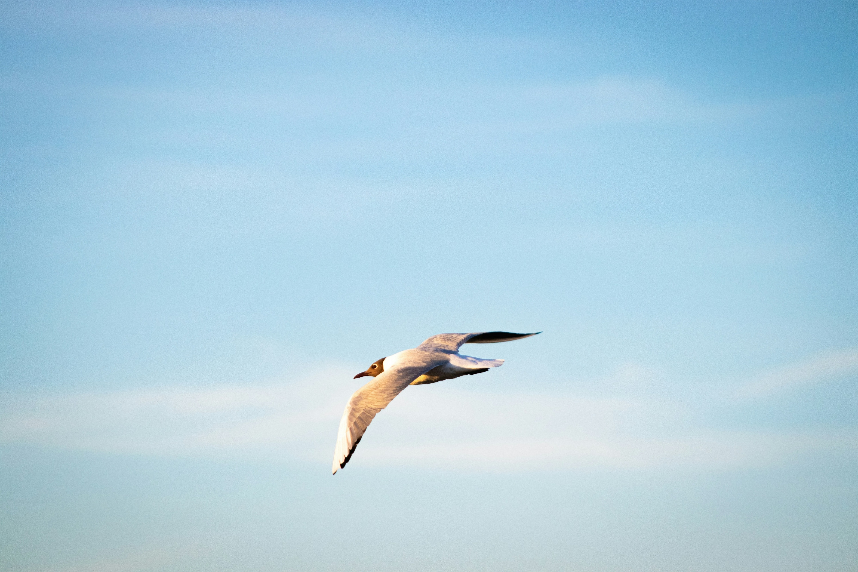
Overview of Workshop
In this workshop participants will :
Learn about UDL at Murdoch University and our scaling up plans
Experience UDL as a student through a practical, unique and creative immersive activity
Discuss our approach to winning over teaching staff and developing strong relationships as the foundation for building institution-wide adoption of UDL

Slide 7
Overview of UDL at Murdoch (10 mins)

Slide 8
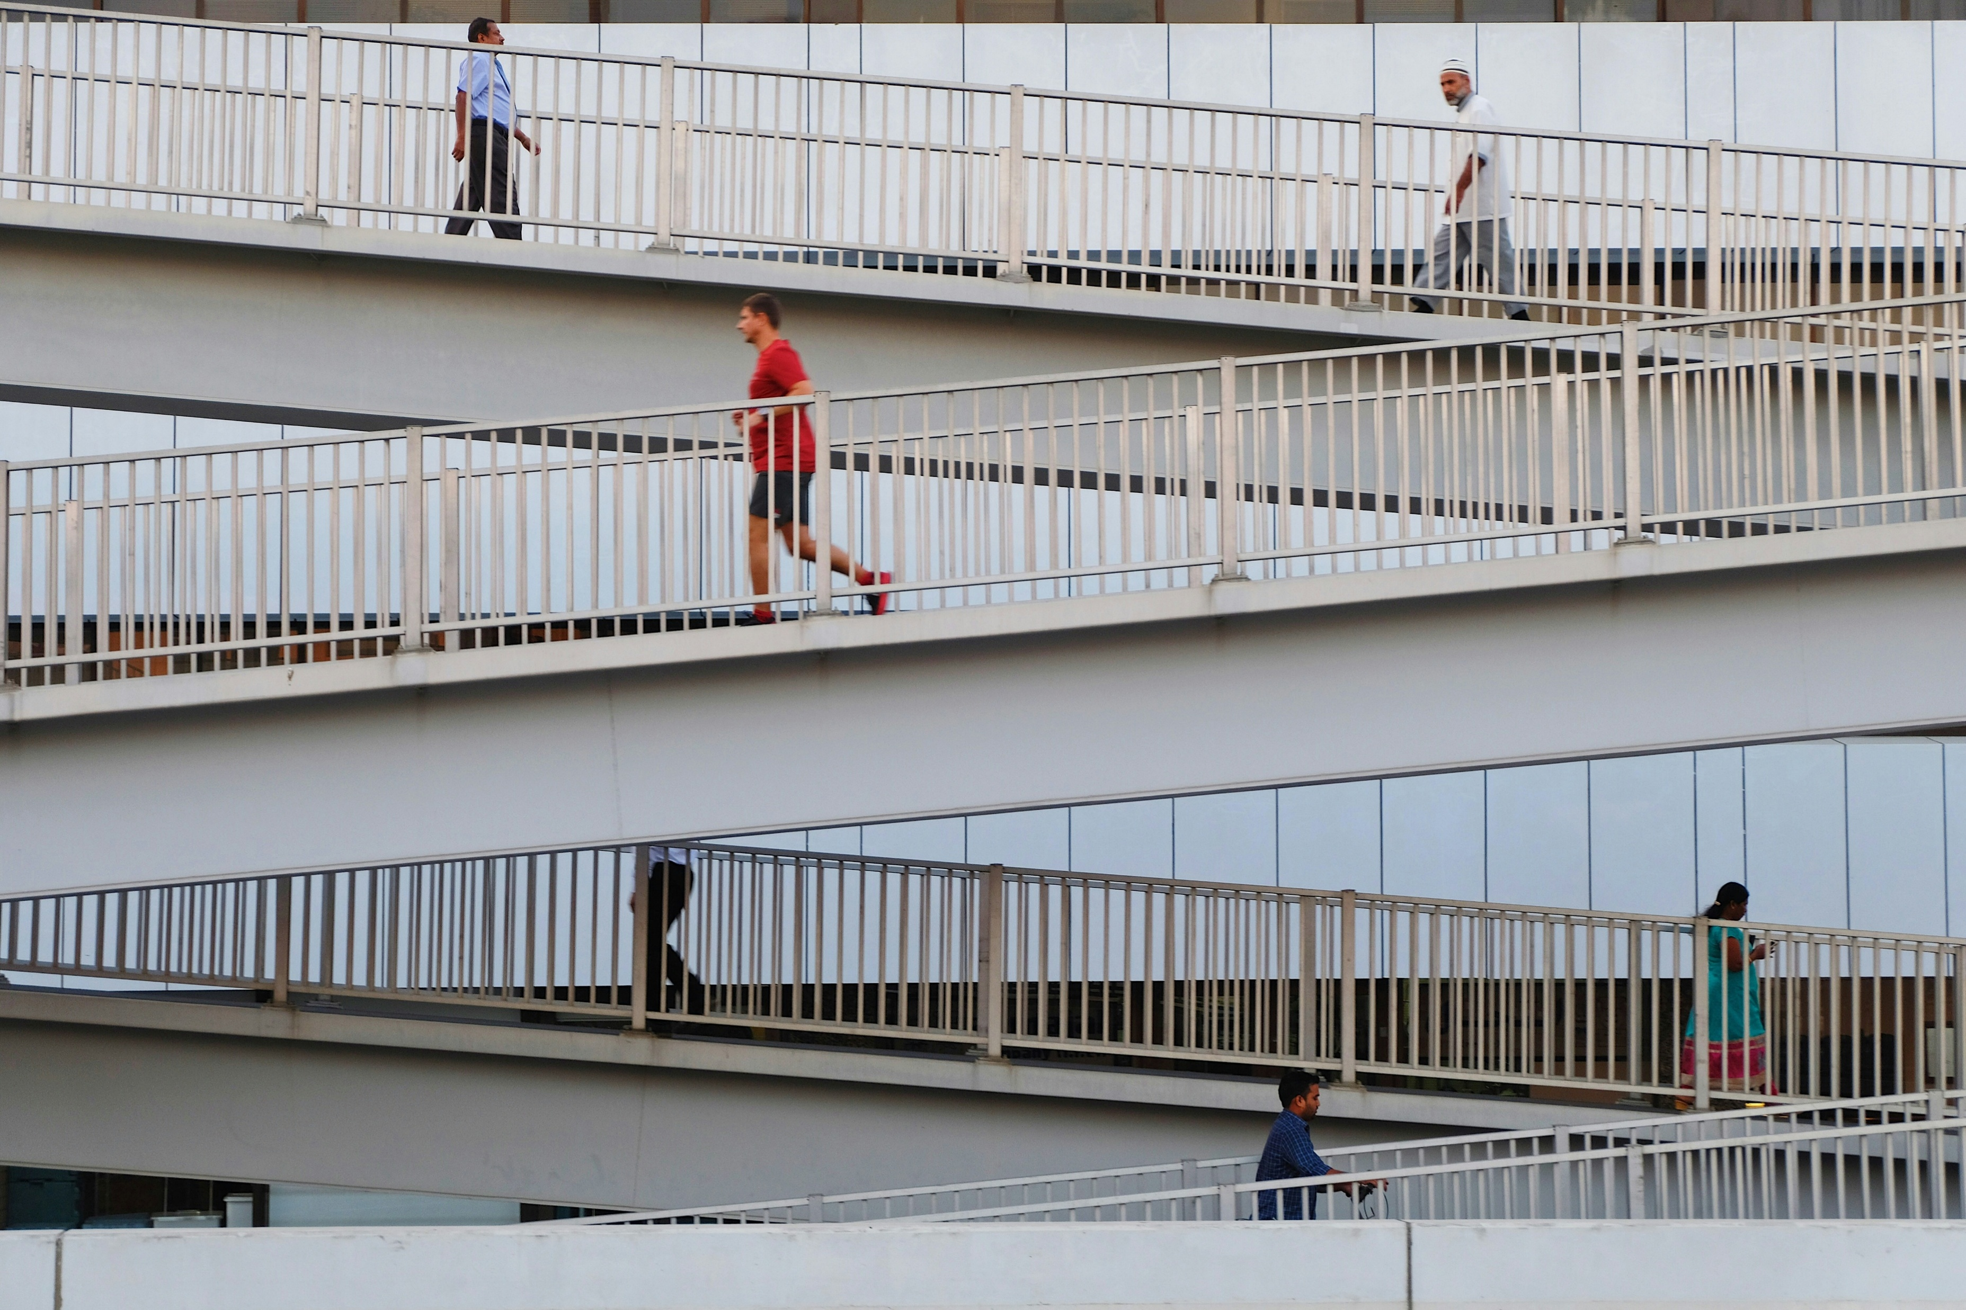
UDL at Murdoch
Developed a scaffolded series of 3 UDL workshops (~170 participants to date)
UDL fundamentals introduces key UDL principles and practices.
Level 1 workshop allows staff to experience UDL as students.
  - Particularly positive feedback re immersive activity.
Delivered bespoke sessions for Sciences, Law/Criminology, Chiropractic, Psychology, Nursing, Media, and IT.
  - Bespoke workshops had a higher attendance than general offerings

Slide 9
UDL at Murdoch : where we are now
Stronger relationships are forming between our team and academic staff.
Our advice is increasingly sought on an ad-hoc basis.
Collaborative UDL implementation is emerging among academic staff in several schools.
A nine-month UDL mentoring pilot, initiated by the School of Nursing, is currently underway. This includes development of further workshops (UDL for assessments and UDL for Classroom Engagement)

Slide 10
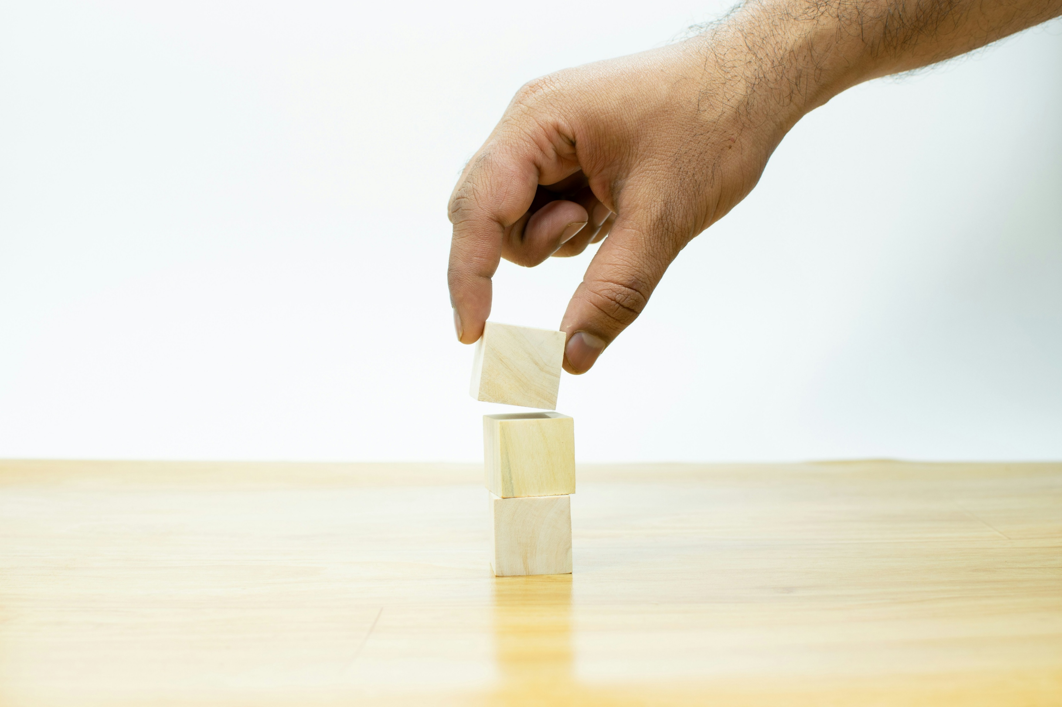
Scaling up:
Our goals 2026 and beyond
Expand our UDL mentoring program to include two new schools.
Establish a UDL Program Lead position to drive strategic implementation.
Engage new schools we have not yet partnered with.
Revisit schools we have worked with to support the expansion of UDL implementation.

Slide 11
Experience UDL as a Student (40 mins)

Slide 12
UDL Level 1 Workshop purpose
Who is it for?
Teaching academics who have some prior knowledge of UDL and the framework and are looking to expand their use of UDL.
What is the focus?
To win over teaching academics
To remind participants of what it is like to learn something new and challenging
To demonstrate UDL strategies that are practical and easy to replicate in any context
To promote a sustainable approach (plus one)

Slide 13
Overview of UDL Level 1 Workshop
Intro
Revise UDL relevance and purpose for inclusive teaching practice
Revise framework
Immersive Activity (UDL embedded)
Participate in structured activity to learn a new skill
Guide reflection and evaluation of experience
Reflection & Discussion
Discuss UDL strategies demonstrated, what worked; areas of improvement
Discuss UDL strategies for implementation in academics own context

Slide 14
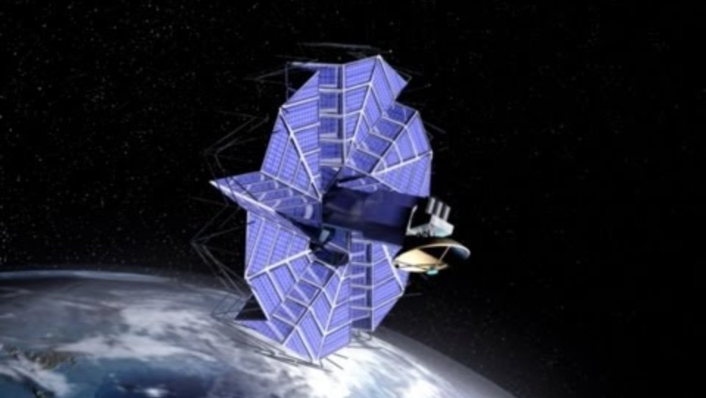
How we embedded UDL in workshop: Engagement
Hooks introducing immersive activity to pique interest & create connection
Structured self & collective reflection activities: (using marking rubric and guided discussions)
Nurture joy & play through interactive immersive activity
Multiple entry levels to optimise challenge

Slide 15
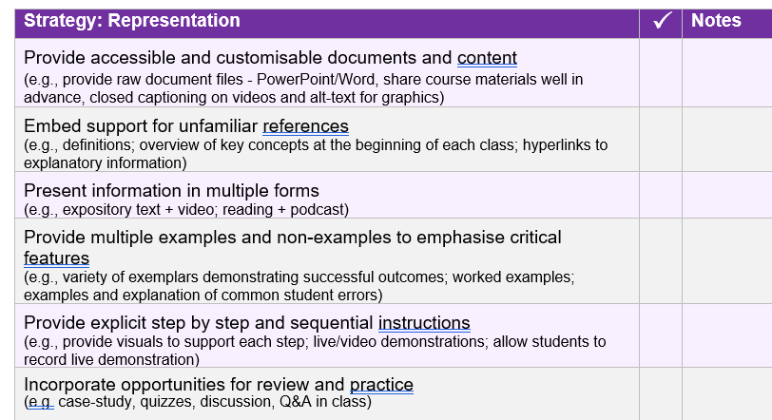
How we embedded UDL in workshop: Representation
Customisable content (Powerpoint; Word; CC)
Physical exemplars
Multiple media options for immersive activity instructions and resources
Key Vocabulary explained
Highlight demonstrated UDL strategies and connect to practical application in academics’ teaching

Slide 16

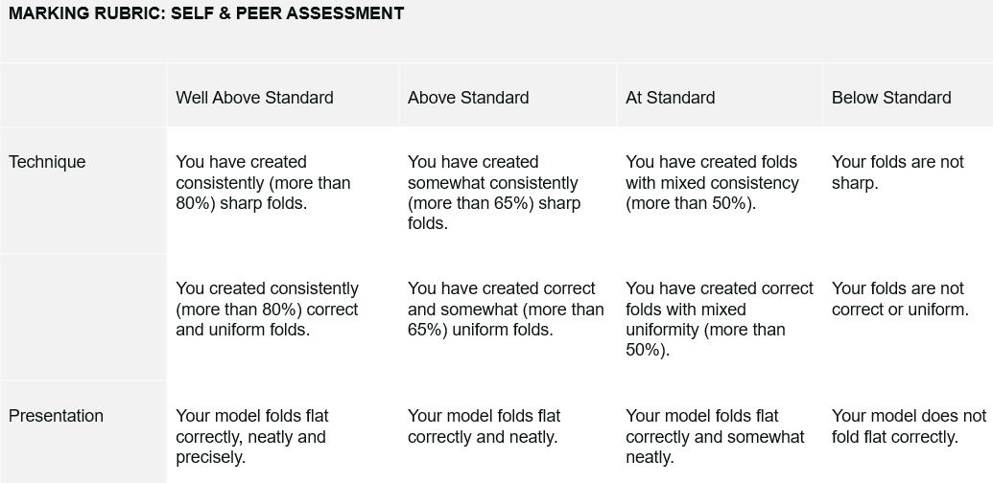

How we embedded UDL in workshop: Action & Expression
Variety of tools to assist paper handling
Variety of ways to engage and respond in discussion reflection (TPS, padlet)
Setting goals using marking rubric
Highlighted importance of opportunity to practise
Monitor/support progress by highlighting value of formative feedback (online quiz)

Slide 17
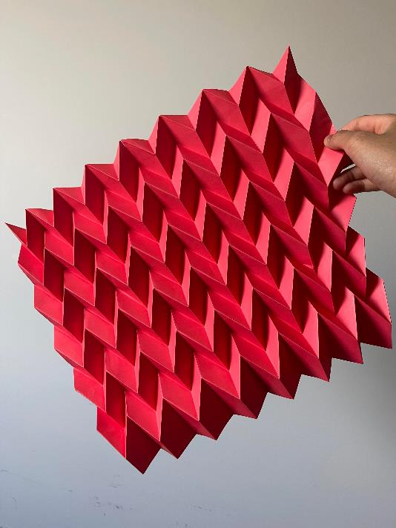
IMMERSIVE ACTIVITY: Intro
Activity Description: You have 15 minutes to learn the fundamentals of the miura-ori fold and apply it to create a 3d herringbone tessellation with paper.
Learning Objectives:
Identify relevant origami techniques
Create a 3d herringbone tessellation with paper using the miura-ori fold technique
Assess your own and another’s work using the marking rubric

Slide 18
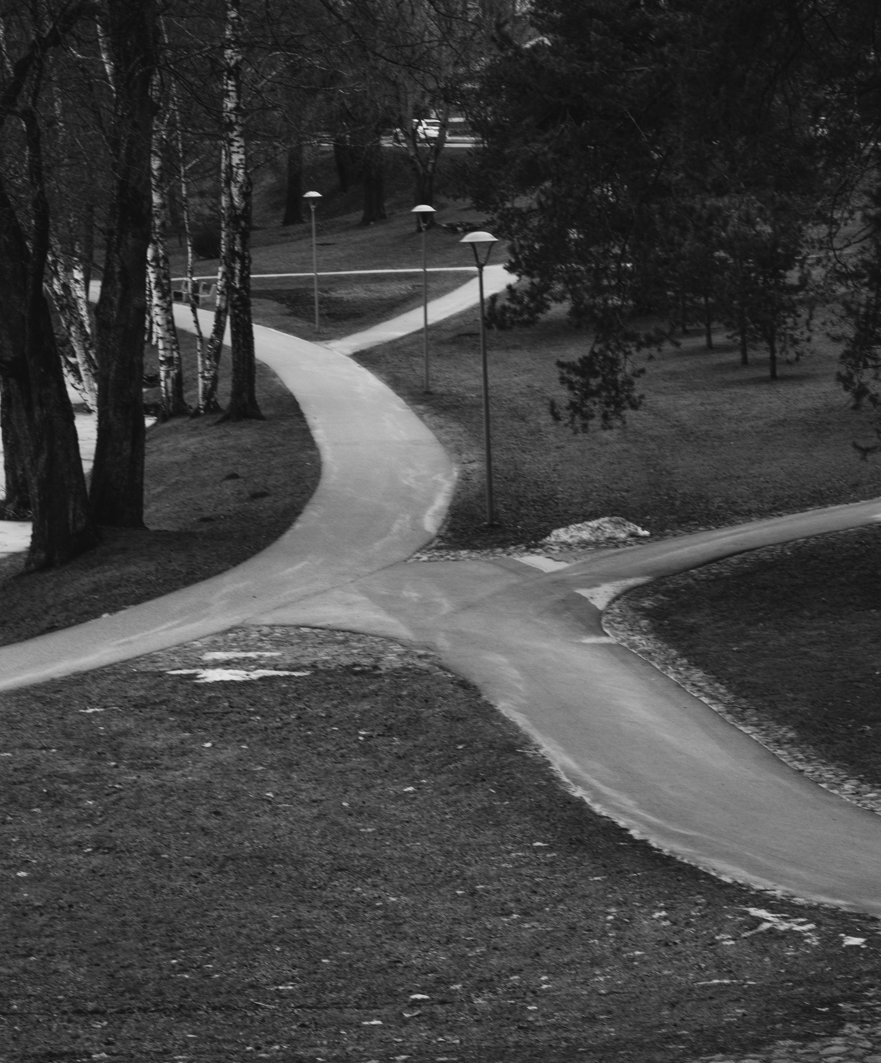
IMMERSIVE ACTIVITY: Scaffolded Support
  Choice of 3 skill levels
  Choice of printed instructions or video tutorials
  Variety of exemplars
  Self paced practice (multiple attempts)
  1:1 assistance provided by facilitators
  Peer-to-peer teaching

Slide 19
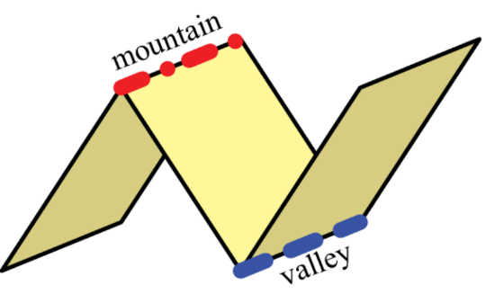
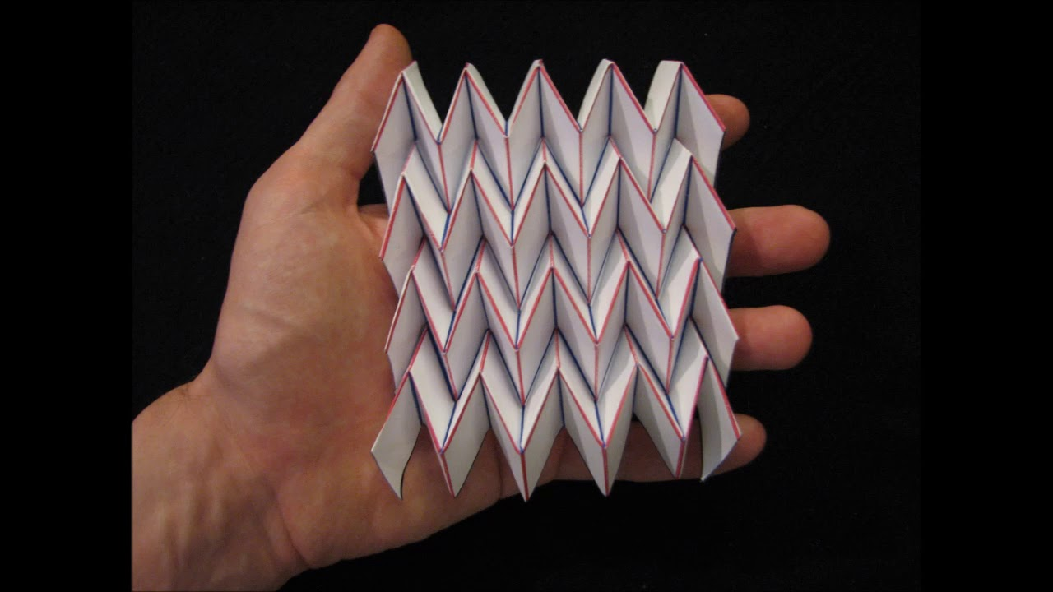
Key Terminology & technique
Terminology:
Mountain fold
Valley fold
Miura-ori fold
Tessellation
Image credit: Researchgate
https://www.researchgate.net/figure/A-crease-can-be-folded-as-either-a-mountain-fold-left-or-a-valley-fold-right_fig4_220104082
Image credit: Los Angeles Times. 2014. Miura-ori: Engineered origami metamaterial.https://www.latimes.com/81039289-132.html
Technique tips:
Crease firmly and sharply – you can use a ruler or other blunt edge tool
Mountains are easier to make than valleys

Slide 20
Set your goals
 | Well Above Standard | Above Standard | At Standard | Below Standard
Technique | You have created consistently (more than 80%) sharp folds. | You have created somewhat consistently (more than 65%) sharp folds. | You have created folds with mixed consistency (at least 50% correct). | Your folds are not sharp.
 | You created consistently (more than 80%) correct and uniform folds. | You have created correct and somewhat (more than 65%) uniform folds. | You have created correct folds with mixed uniformity (more than 50%). | Your folds are not correct or uniform.
Presentation | Your model folds flat correctly, neatly and precisely. | Your model folds flat correctly and neatly. | Your model folds flat correctly and somewhat neatly. | Your model does not fold flat correctly.

Slide 21
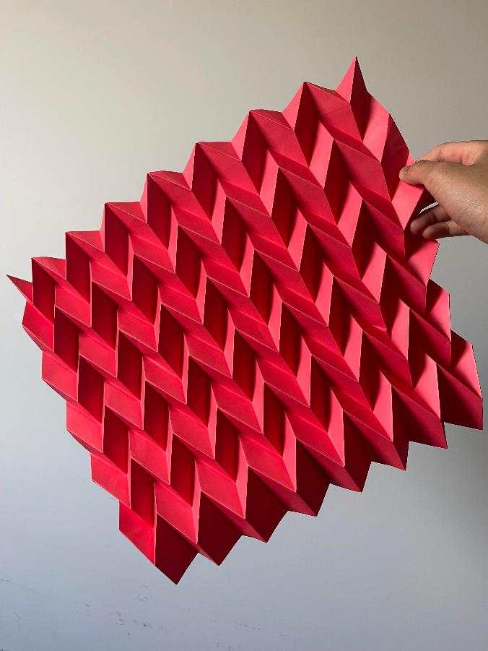
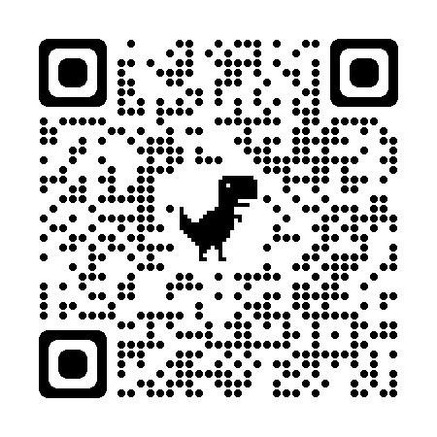
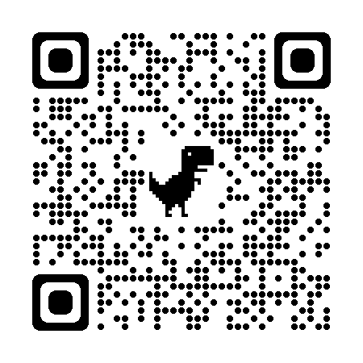
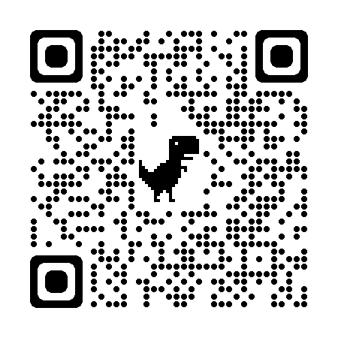
3d Herringbone Tessellation Video Tutorials
EASY
https://www.youtube.com/watch?v=lvE-1RS3VrY
INTERMEDIATE
https://www.youtube.com/watch?v=2-fh1sA09mc
CC not available; turn on Live Caption in Chrome
ADVANCED
https://www.youtube.com/watch?v=nw5RLvN7fYA

Slide 22
Formative feedback, Reflection & Discussion
To conclude :
Online quiz to assess memory of terminology (Blooket)
Think, Pair, Share Discussions (using the strategy list provided)
  Verbal Reflection on what worked well and areas of improvement
  Padlet Reflection on pinch points & UDL strategies to trial

Slide 23
Your Reflections (10 mins)

Slide 24
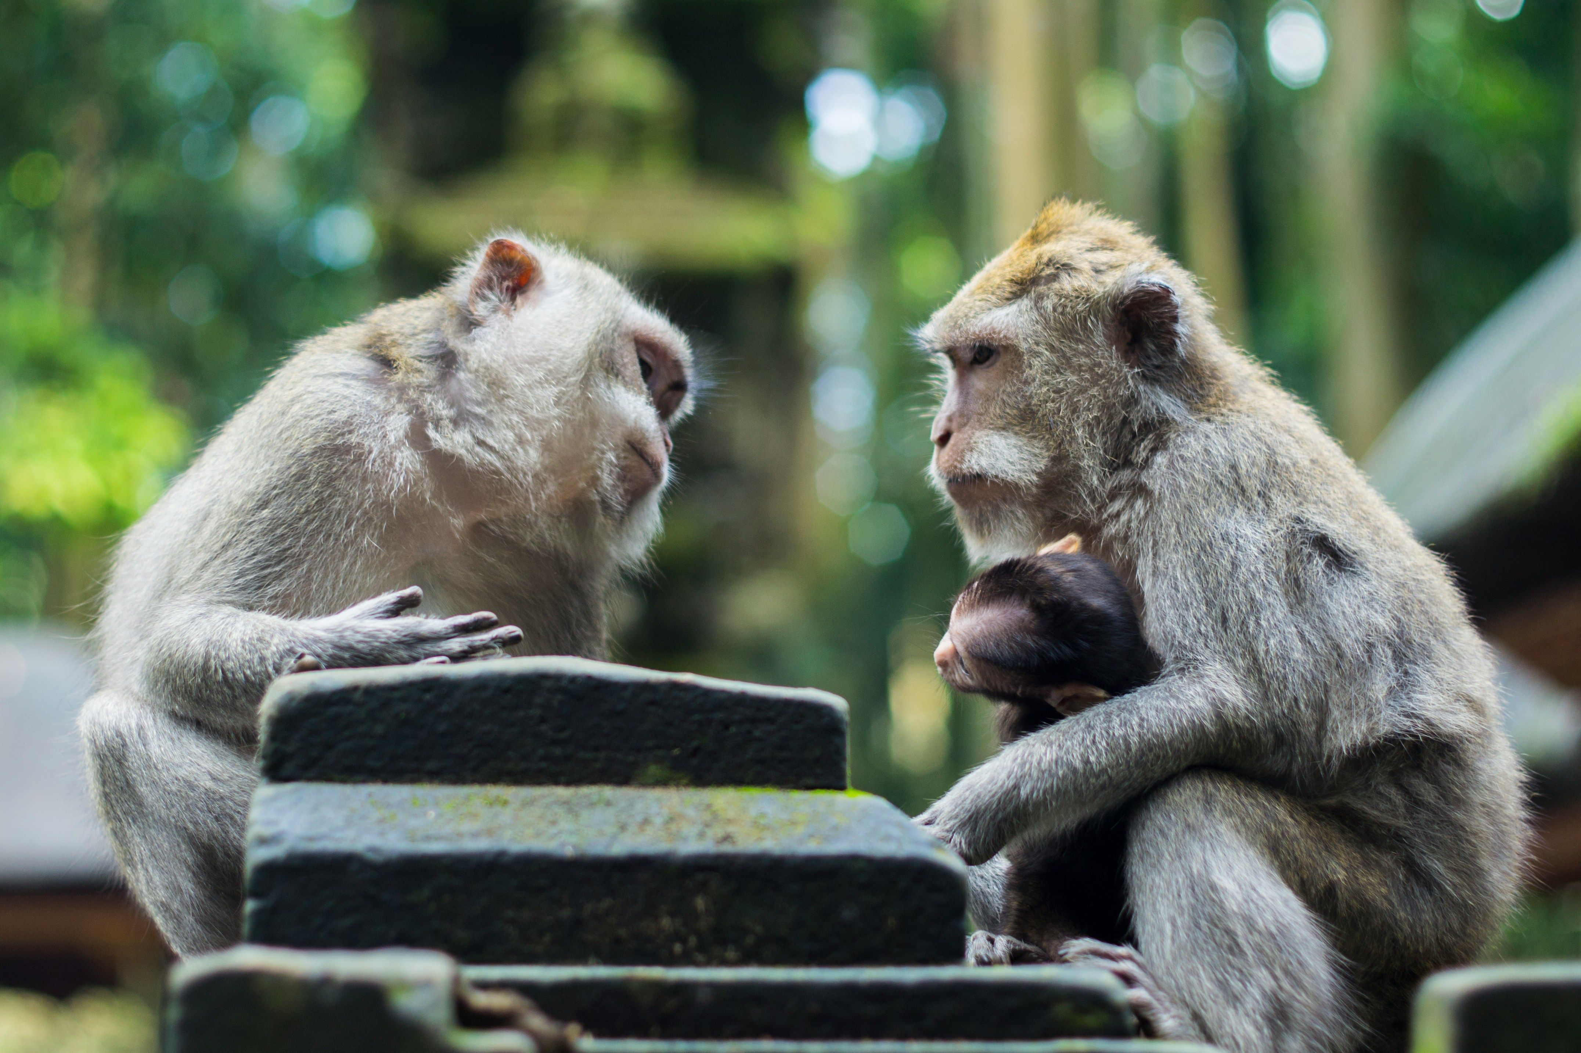
Discussion:
Inside outside circle or
Snowball variation
How did you feel throughout the immersive activity?
How do you feel about gamification/play based activities?
Would something like this work in your own institution?
Have you tried anything similar?

Slide 25
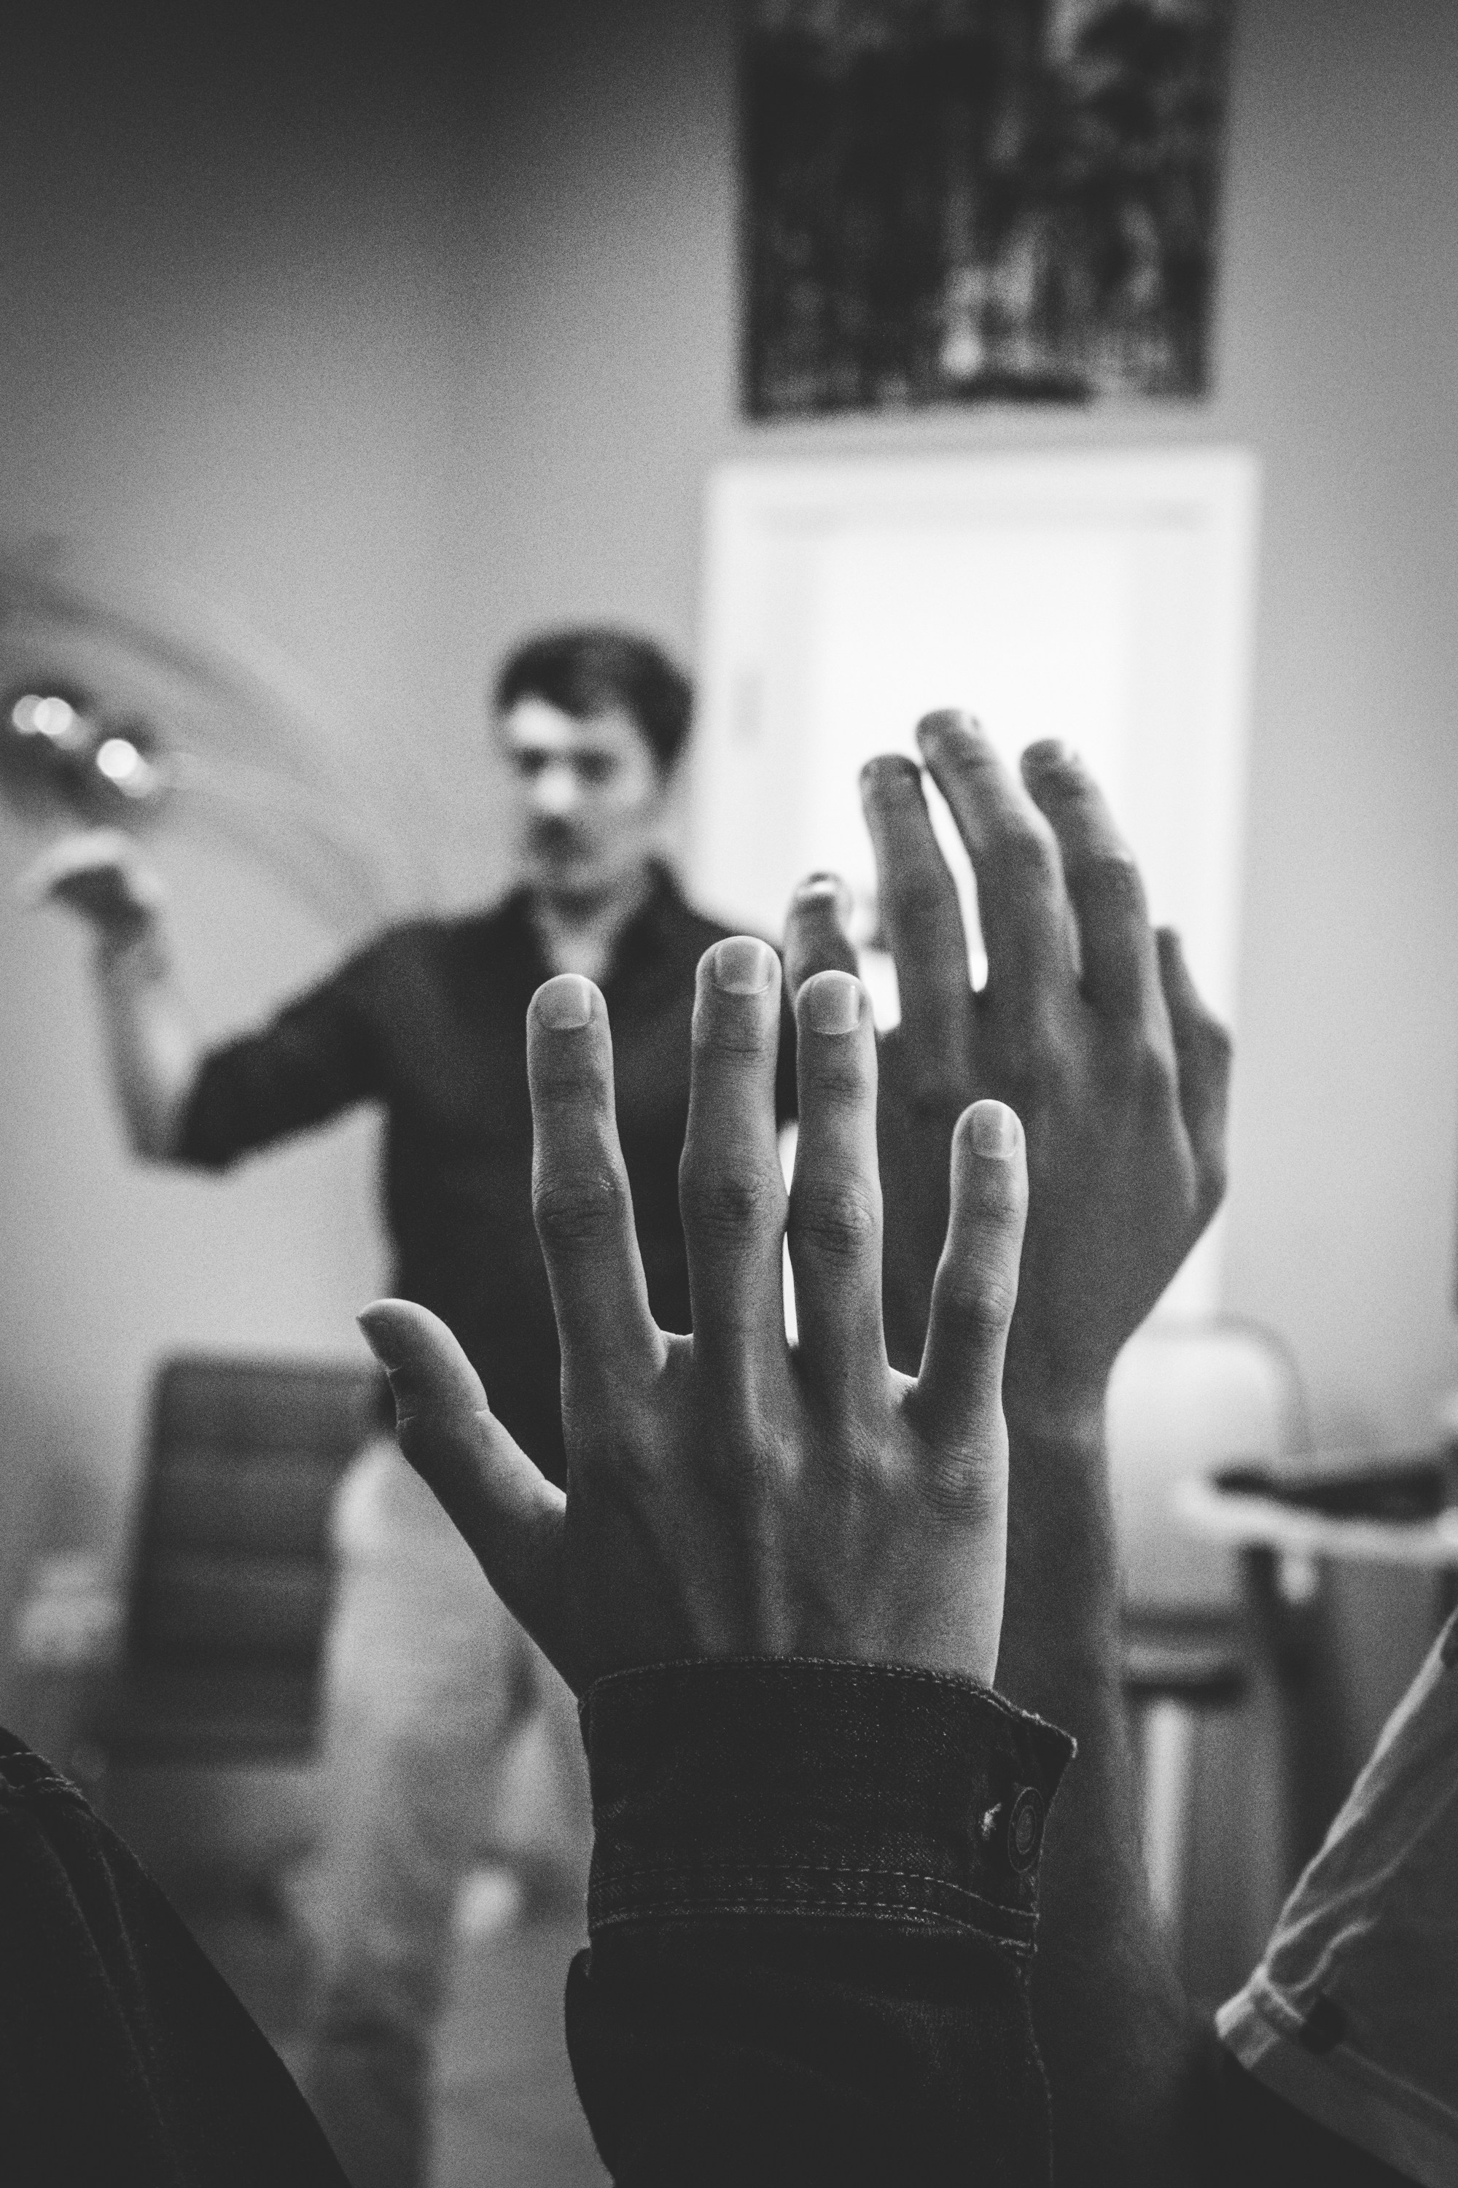
Your questions

Slide 26
Thank you

