Slide 1
Acknowledgement of Country
I would like to acknowledge the Gadigal people of the Eora Nation upon whose ancestral lands our city campus now stands. I would also like to pay respect to the Elders both past and present, acknowledging them as the traditional custodians of knowledge for this land.

Slide 2
Reclaiming “SLACKERS”: Co-designing accessibility with students
Ashley Willcox, Liz Penny and SLAC students

Slide 3
What we’ll be covering today
Context: About us & SLAC
How we operate
The student perspective on accessibility
Student experience

Slide 4
Context: About us and SLAC

Slide 5
About the Accessibility Service
Provide support and services to meet students access requirements
Partner with Faculty Academic Liaison Officers to deliver Access Plans and inclusive experiences
Improve process and practice based on student and stakeholder feedback
Link operational support, services and student experience with strategic focus on inclusion to enhance impact and actions

Slide 6




About the Inclusive Practices Team
We investigate good practices for designing for accessibility.
We support academic staff to implement inclusive practices.
We collaborate to improve systems, process and technologies.
We work with students with lived experience to amplify their voice.

Slide 7
Accessibility Services vs Inclusive Practices
Accessibility Services =
support for students
Inclusive Practices =
support for teaching staff

Slide 8
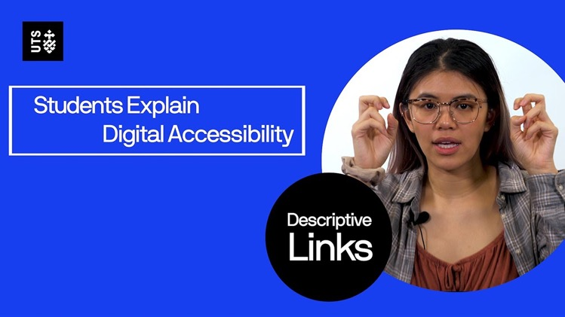
Student voice needed for staff to understand the impacts students experience

Slide 9
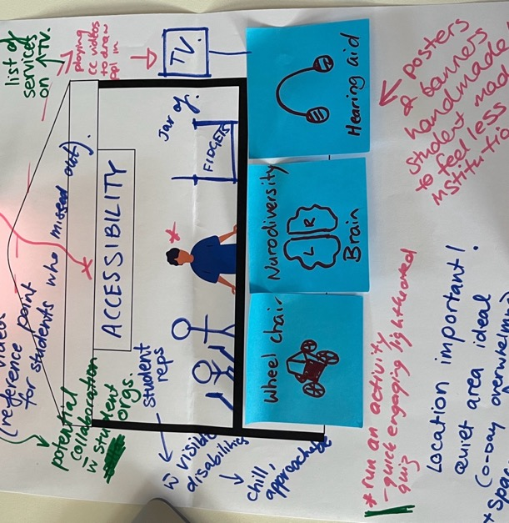
SLAC
SLAC (Student Learning Advisory Committee) is a collaboration between the Accessibility Service, the Education Portfolio and students aiming to change the narrative that students with disabilities are “SLAC”KERS. Instead, we share and gain insights on how to make UTS more accessible.

Slide 10
How we operate

Slide 11
Logistics
Students are in paid roles
We meet monthly for 3 hours
We split students in group tables, with a facilitator on each to facilitate conversation, take notes via Teams and monitor for any non-verbal conversation via Teams
We respond to student feedback via a survey to ensure we are making the sessions accessible

Slide 12
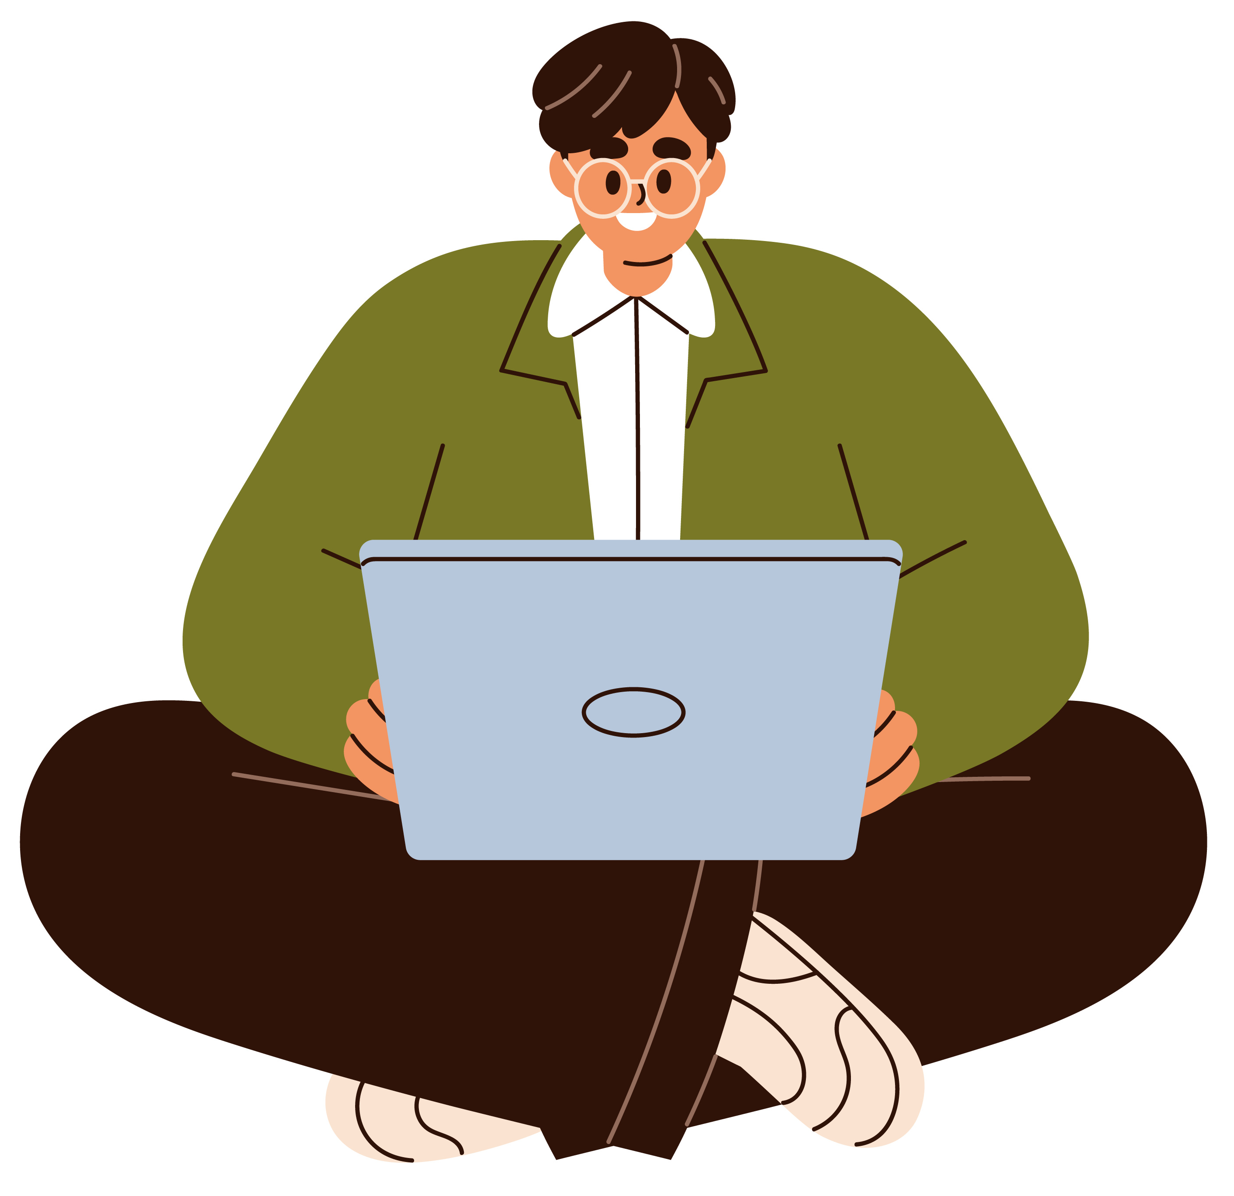
Themes: Continuous improvements
Accessibility Service
Embedding accessibility recommendations in learning and teaching
More broadly the student experience for students with disabilities and access requirements

Slide 13
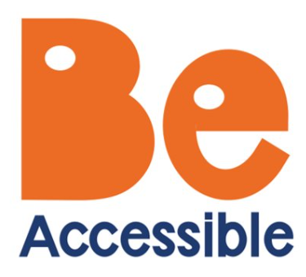
Themes: Projects/initiatives
Options for feedback on one-off projects/initiatives including:
Be accessible campaign
Special considerations review
Assessment reform
GenAI and chatbots

Slide 14
Additional work opportunities
We offer the students additional work opportunities examples:
Accessibility testing on specific tools
Promotion and events e.g. staffing and designing Open Day booth
Blog writing for to be distributed to the learning and teaching community

Slide 15
The student perspective on accessibility

Slide 16
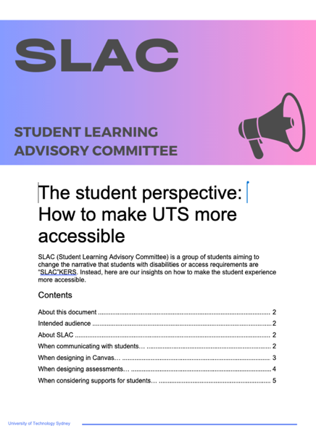
2023: The student perspective: How to make UTS more accessible
A report co-created with students during our final session in 2023.

Slide 17

2025 personas
Personas are fictional characters created based on research to represent different user types, to help understand users’ needs, experiences, and behaviour.
We have good results using them in workshops on UDL with academic staff.
We co-created personas of students with disabilities and access requirements with SLAC students to ensure authenticity.

Slide 18
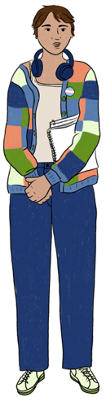
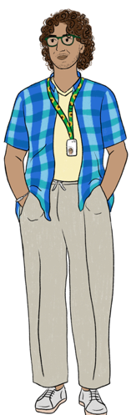
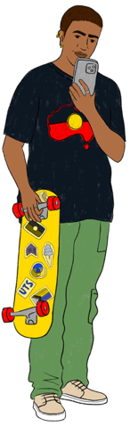
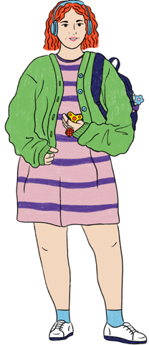
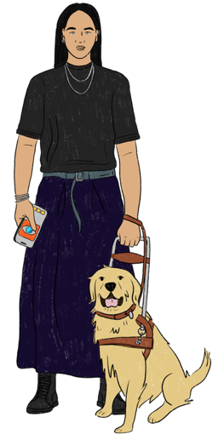
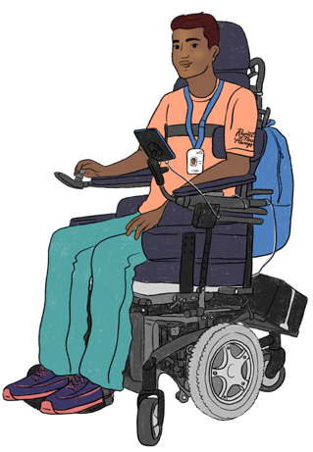
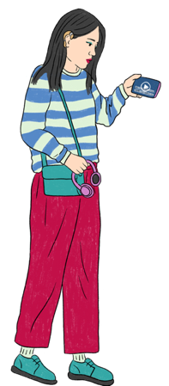
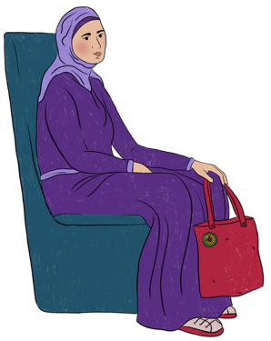
Introducing the personas
From left to right: Mai (medical condition), Andy (anxiety and depression), Coen (colour vision deficiency), Mohan (mobility impacts), Nasim (neurodivergent ADHD), Nerina (neurodivergent autism), Vinh (vision loss) and Hao (hard of hearing)

Slide 19
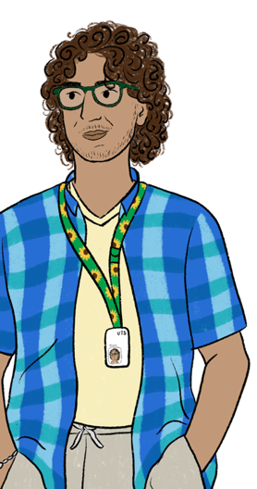
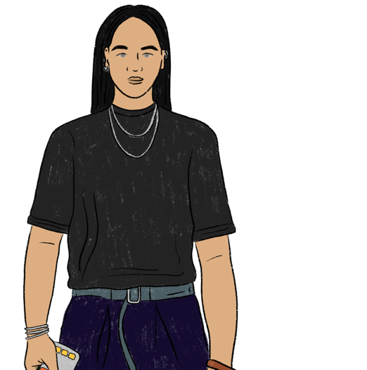
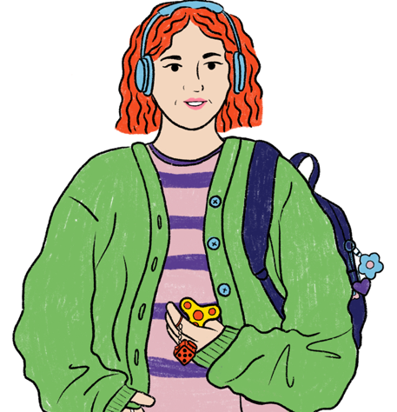
Example of how we use it in a workshop for teaching staff
Consistency and structure in Canvas are crucial for students like Nasim (neurodivergent), Nerina (neurodivergent), and Vinh (vision loss).
Clear navigation helps Nasim and Nerina manage their neurodivergence by reducing cognitive load and anxiety.
Vinh memorizes the structure to reduce fatigue and access materials effectively

Slide 20
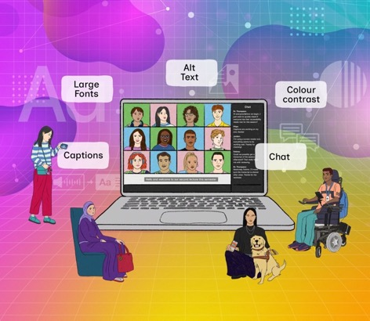
Be Accessible campaign
Influence the UTS culture towards a state where inclusion is the norm and inclusive practices are widespread
An evergreen campaign where content runs constantly and is updated annually and on a case-by-case basis to enhance influence
Co-designed with students to ensure that students experiences and voice is developed into campaign key messaging eg. When/feel impact statements
Starting with Academic staff as first target audience

Slide 21
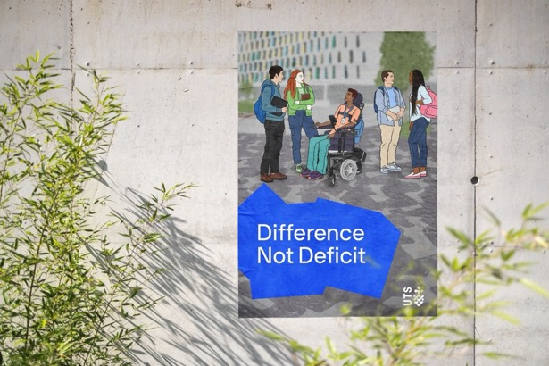
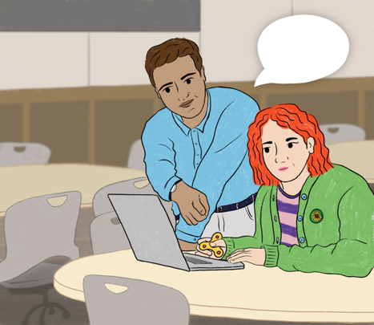
Be Accessible campaign images

Slide 22
Student experience

Slide 23
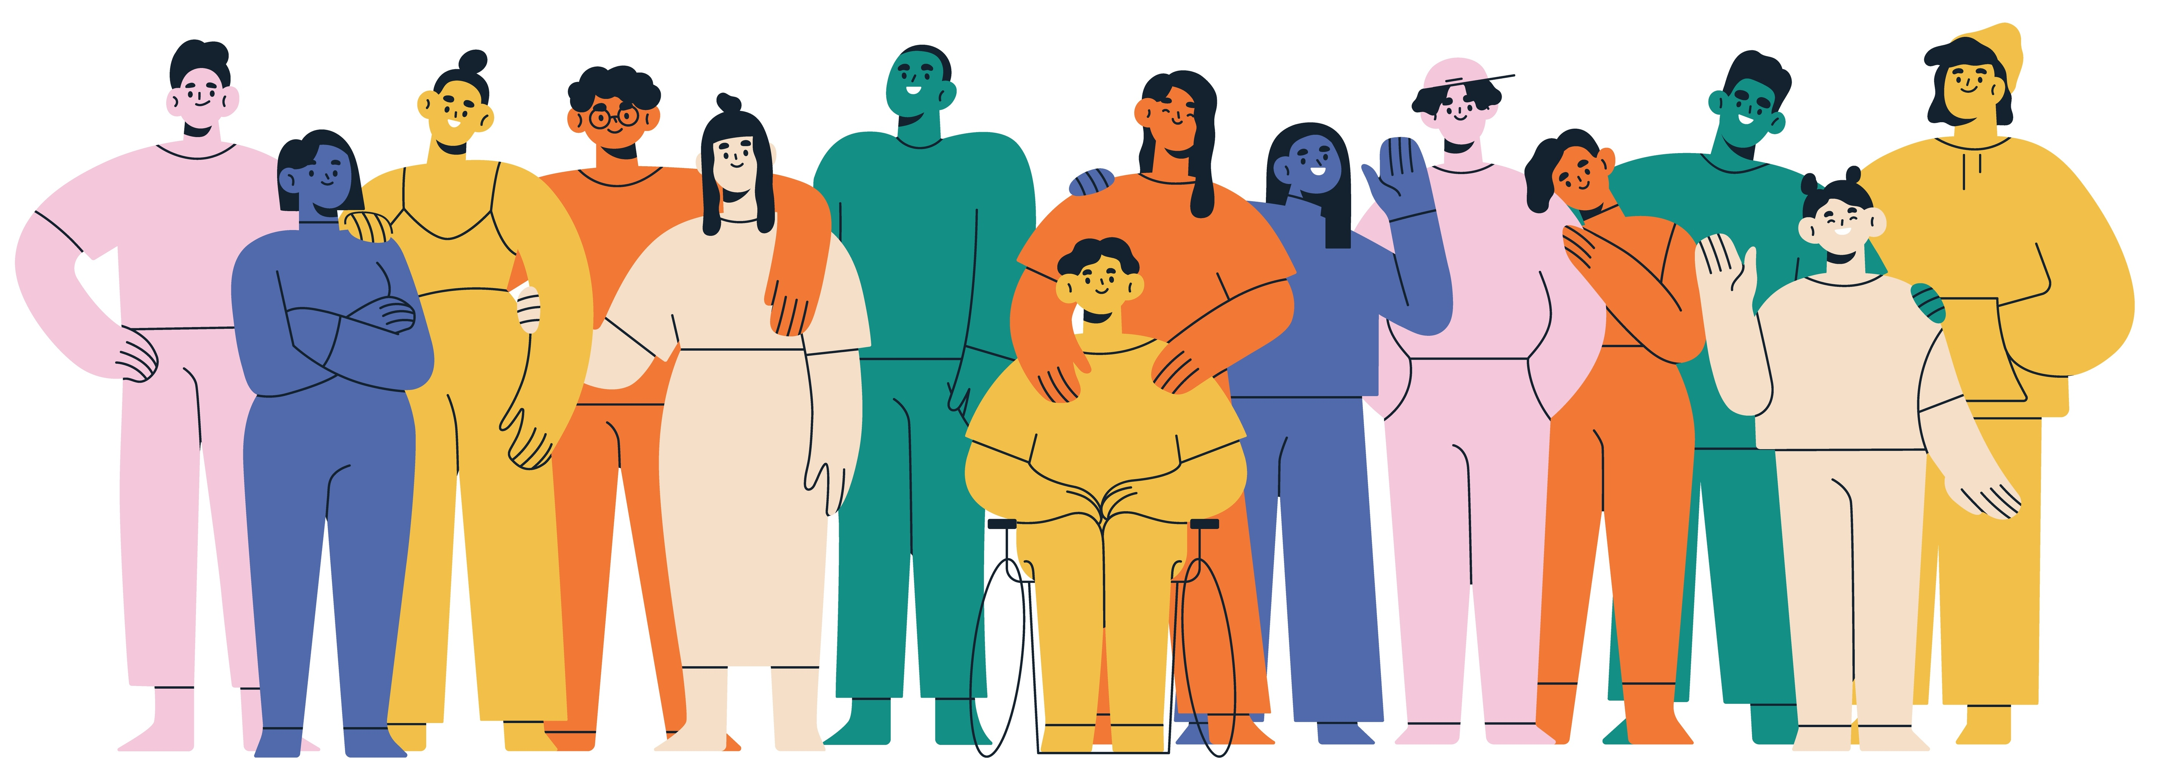
From students

