Slide 1
Empowering Students as Co-Designers:
Innovative Assessment Design for Equity and Engagement
Dr Karen-Anne Wong
karen-anne.wong@sydney.edu.au

Slide 2

diverse assessment options
UDL Principles
Student Submissions and Interviews
Peer Review and In-Class Workshopping

Slide 3
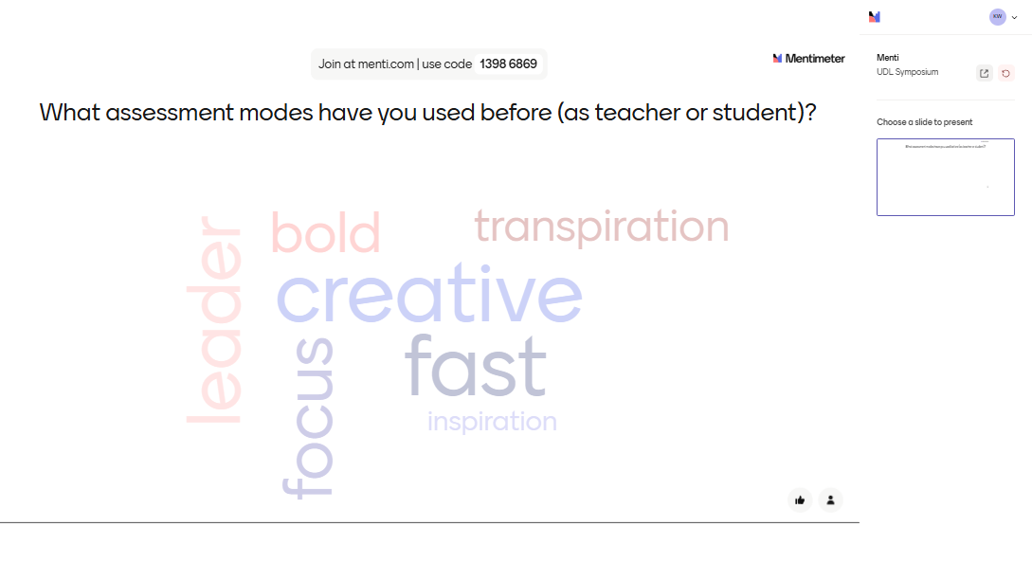
What assessment modes have you used before?

Slide 4
Multi-modal assessments
traditional essay, a photo essay, or a non-conventional multi-media project (such as a podcast, film or video, website, or creative work)

Slide 5
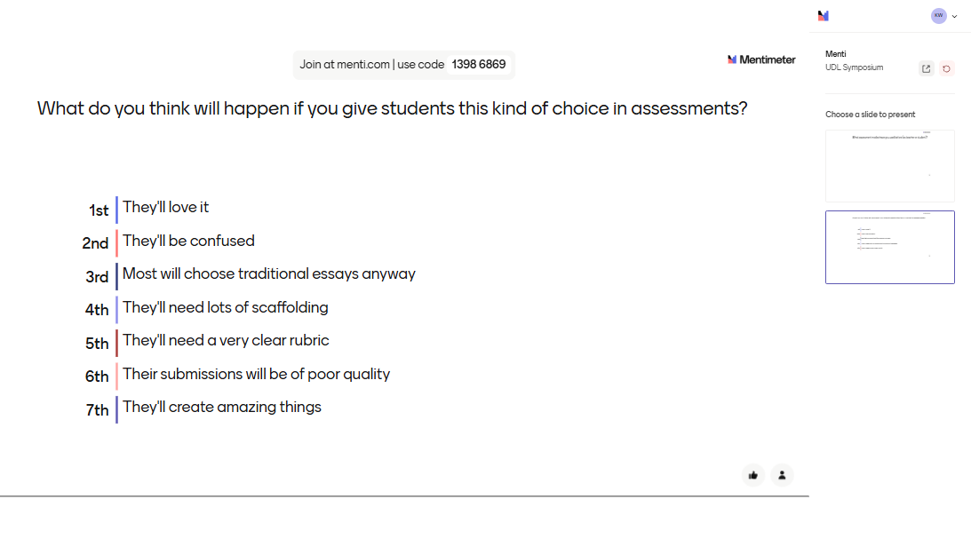
What do you think will happen if you give students this kind of choice in assessments?

Slide 6

UDL Considerations
Optimize choice and autonomy (7.1)
Cultivate multiple ways of knowing and making meaning (3.3)
Use multiple media for communication (5.1)
Build fluencies with graduated support for practice and performance (5.3)
Address biases related to modes of expression and communication (5.4)
Nurture joy and play (7.3)
https://udlguidelines.cast.org/action-expression/expression-communication/

Slide 7
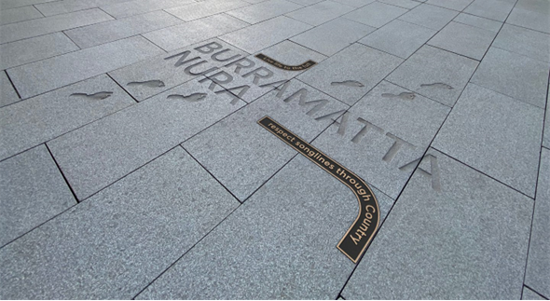
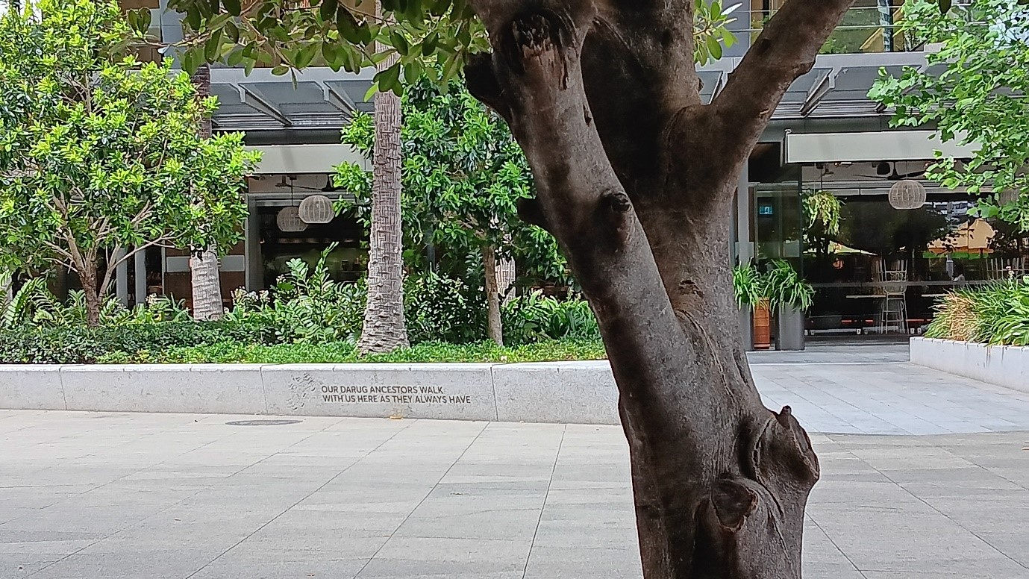
Joseph and Rebecca’s thoughts on the course…(thanks to Alessandra!) https://canvas.sydney.edu.au/courses/55009/pages/assessment-design-supporting-equity-and-diverse-expression
Joseph’s Autoethnographic Film: https://youtu.be/T2GdpIvHxnM
Photos are extracts from Rebecca’s photo essay on Parramatta Square

Slide 8
Peer Review and In-Class Workshopping
Week 9: Hurdle Task (not assessed by teaching team) - Draft/Notes/Research Plan of Case Study Project
  Used during in-class workshopping in final weeks of tutorials.
  Buddy-system pairs students across multiple weeks.
  Active feedback modelled, with detailed instructions on constructive criticism.
Week 13: Peer Learning Research Exercise
  Reflecting on the process of being part of a peer review relationship.
  Does not require a successful peer relationship to achieve a good mark.
Week 13: Final Case Study Project

Slide 9

UDL Considerations cont.
Foster collaboration, interdependence, and collective learning (8.3)
Foster belonging and community (8.4)
Offer action-oriented feedback (8.5)
Promote individual and collective reflection (9.3)
Represent a diversity of perspectives and identities in authentic ways (1.3)
Enhance capacity for monitoring progress (6.4)
https://udlguidelines.cast.org/engagement/emotional-capacity/empathy-restorative-practices/

Slide 10


Summary
Multi-model assessments help foster a more inclusive and equitable learning environment.
When optimised for choice, and scaffolded with collaborative, action-oriented feedback, they help students cultivate joy and play.
Students learn to express themselves with critical competencies beyond the traditional essay format.

Slide 11




Thank you
Dr Karen-Anne Wong
karen-anne.wong@sydney.edu.au

