Slide 1
The UDL Quandary of
Organisational Implementation
What we learned and what we would do now
UDL Symposium
June 2025

Slide 2
Acknowledgement of Country
We acknowledge the traditional owners of the land. It is a privilege to be sharing this land on which we live, work, and learn.
We recognise that this land has always been a place of teaching, learning and knowledge sharing.
We acknowledge the deep and enduring spiritual connection the
First Nation’s people have to this land and their ongoing contributions
to education.
We recognise that Aboriginal and Torres Strait Islanders have maintained their culture, heritage, beliefs, languages, and laws and these are of ongoing importance.
We commit ourselves to learning from the wisdom and knowledge of
the Traditional Owners and to fostering a spirit of respect, inclusivity,
and reconciliation within our community.

Slide 3
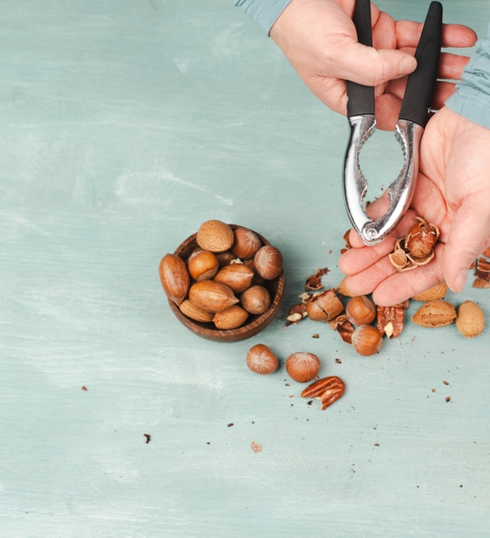
In a nutshell
Initial approach
Tools and strategies
Challenges
Successes and Failures
Divide between educator and
organisational practices
UDL 3.0
Reflections
Used under license from Shutterstock.com

Slide 4
Initial approach
TAFE SA initiative (result of audit)
  Dedicated teams
    Quality
    Teaching & Learning
    Centre for Educator Practice (CEP)
    Student Support
Legislative imperative
Social imperative

Slide 5

Determination:
UDL would be our True North
Used under license from Shutterstock.com

Slide 6
Tools & Strategies
Introduced language of inclusion and UDL
Created/promoted training about inclusive teaching & learning and UDL
Introduced Digital Accessibility platform (ALLY/Panorama)
Implemented Digital Tool Kit and Learning Design Planner
Developed additional inclusive learning design guidance
Co-designed Inclusive Teaching and Learning Road Map
Created models and exemplars
Organisational Mandate

Slide 7
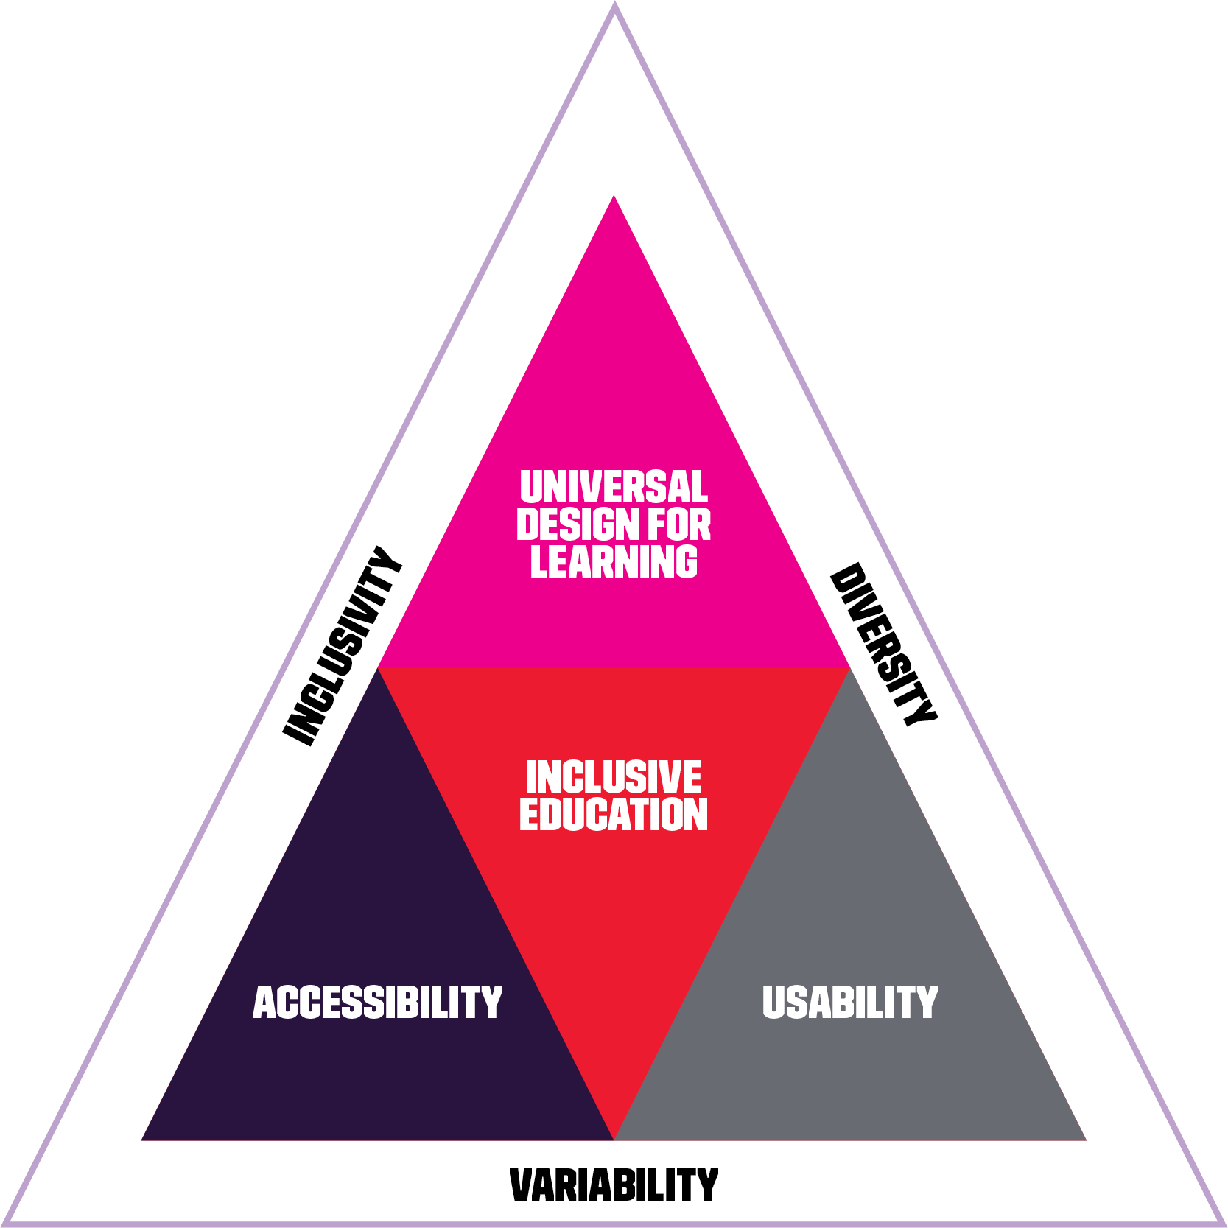


TAFE SA Inclusive Education Framework

Slide 8

Challenges
Individual versus organisational practices
Lack of baseline
Organisational buy in
Training package interpretation
Educator capability
UDL 3.0 and potential impact
Used under license from Shutterstock.com

Slide 9
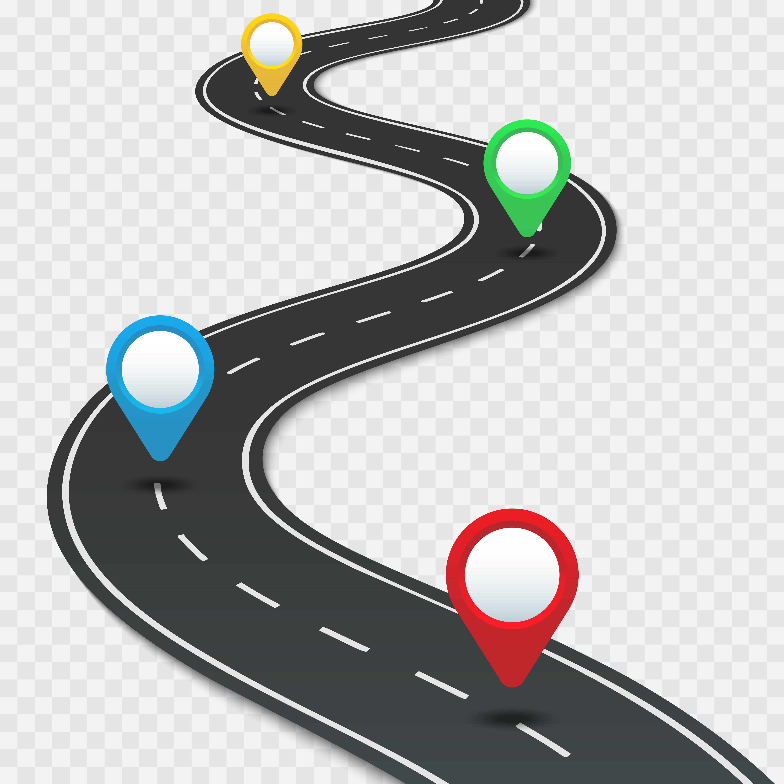
What we learned
Organisational journey:
Big Sell - Big Investment
Co-Design
Need to Establish the ‘What and why?’
for everyone
Student Perspectives/Data
Limited Approach
Used under license from Shutterstock.com

Slide 10
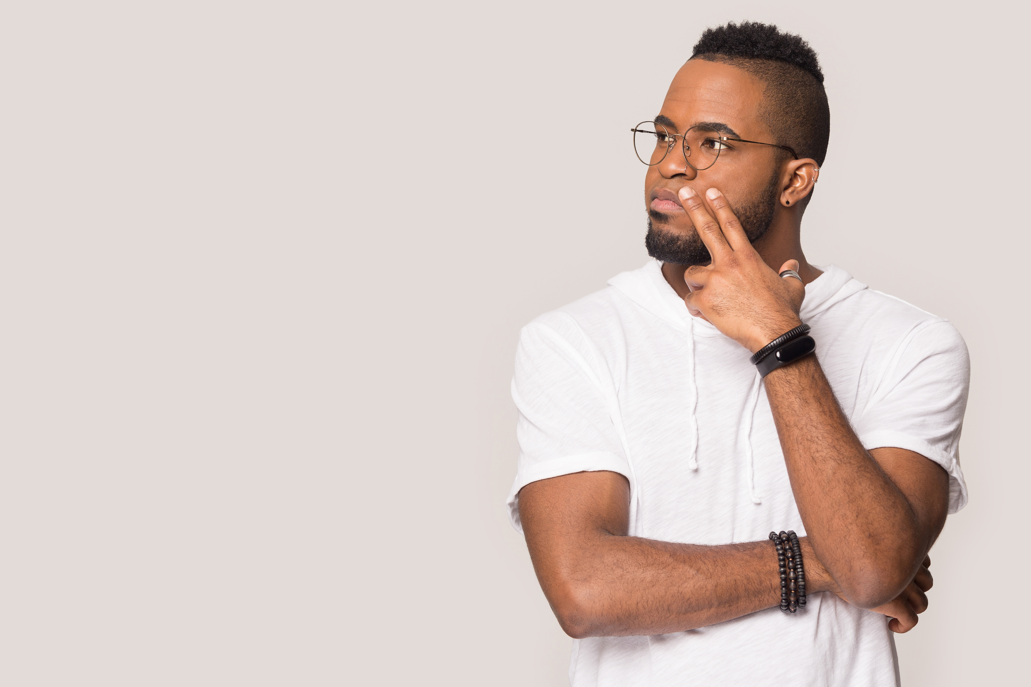

Individual journey
Educator overwhelm
Perseverance is key - wait
for the Aha moment
Need to see quick wins; and
be able to justify the change in practice
Need to nurture joy

Slide 11
What would we do differently now?
Ensure
Management/Leadership are committed
  Explicit in Strategies/Plans etc with KPIs
Requirements embedded in procurement processes
Project-based learning designers have capability
Involve students in consultation and design
Educator training is inclusive, upholds our design principles and practices, uses UDL

Slide 12
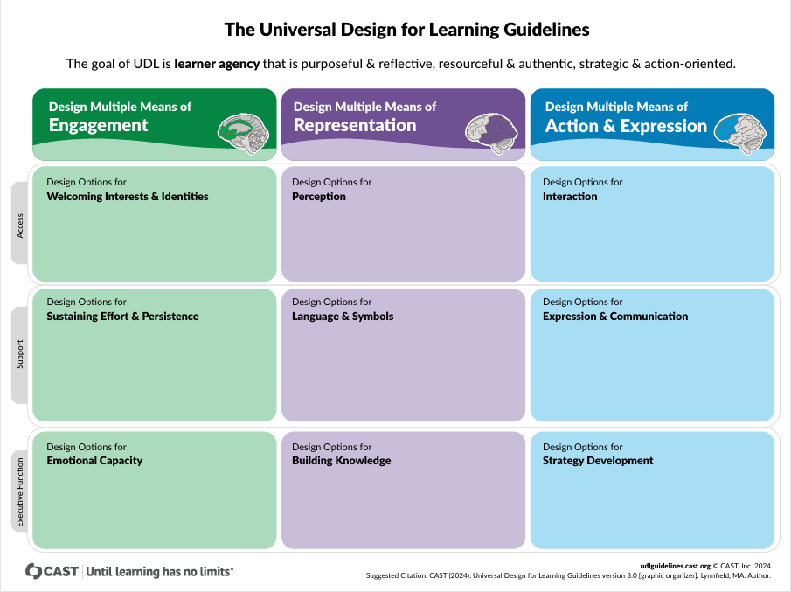
UDL 3.0
A challenge to...a win!

Slide 13
UDL 3.0
Simpler Language for educators
Design focus
More tools to support implementation
  Schoolwide Implementation Criteria (SIC)
Recognising that Teaching and Learning is only one of the Domains for successful UDL Implementation
Link to the ASQA Standards
  Quality Area 1 – Training and Assessment
  Quality Area 2 – VET student support

Slide 14




CAST Schoolwide Implementation Criteria (SIC)
Four domains
1. School Culture & Environment | 2.Teaching & Learning | 3.Leadership & Management | 4.Professional Development
CAST (2021). Universal Design for Learning Schoolwide Implementation Criteria (UDL-SIC) Guide. Wakefield, MA: CAST, Inc.

Slide 15

New focus points
Mindset shift from fixing the student to responding to student needs
Recognising that barriers and solutions
are multifaceted
Honoring and valuing a wide variety of communication, action, interaction & expression
Address our own biases
Challenging exclusionary practices
Used under license from Shutterstock.com

Slide 16

It’s not easy
On reflection
You need :
To be robust enough to adapt to changes
Patience, resilience & stickability
Willingness to adapt to the pace of adoption
To recognise there are a million moving parts

Slide 17

Moments that matter
Celebrate the small wins
Leverage every opportunity
Collaboration at all levels
Stay sane through ‘your people/tribe’ – Universal Design for Learning in Tertiary Education Community of Practice
Used under license from Shutterstock.com

Slide 18
THANK YOU
All images used under license from Shutterstock.com

