Slide 1
University Pathway Teachers’ Adoption of Universal Design for Learning
An Observational Case Study
UDL Symposium 2025
26 June 2025
Nelson Lo, FHEA, PhD Candidate
Special and Inclusive Education Designation
Sydney School of Education and Social Work
Faculty of Arts and Social Sciences
nelson.lo@sydney.edu.au
Lead Supervisor: Professor David Evans
Supervisor: Associate Professor Ilektra Spandagou

Slide 2
Acknowledgement of Country
We acknowledge Traditional Owners and Custodians of this land on which we meet today, the Gadigal people of the Eora Nation.
We pay our respects to their Elders, past, present and future.
We extend that respect to Aboriginal and Torres Strait Islander peoples here today.

Slide 3
Background: Rationale and Significance
1.
Inclusive
Education (IE) and
IE Practices
2.
Teachers’
Practices
3.
University
Pathways
Very limited is known about the teachers working in university pathway (UP) providers
What is it?
(Ainscow et al., 2006; Armstrong et al., 2010; Spandagou, 2020)
Why does this matter?
(UNESCO, 2015)
The Context
(Balloo et al., 2025; Department of Education, 2024; Lo et al., 2024)

Slide 4
The Context – University Pathways
An initiative offered by Australian universities in response to the contextual needs of diversity and inclusion in higher education (Agosti & Bernat, 2018; Brett & Pitman, 2018).
Primary option for students who require addition support to meet universities’ entry requirements (Department of Education, 2024).
                University Foundation, Diploma, Enabling, Preparation Programs
                Strong influence on the partner and feeder colleges in the UK and two-year community colleges in the US (Agosti & Bernat, 2018; Bode, 2013), but under-researched (Balloo et al., 2025; Lo et al., 2024).

Slide 5
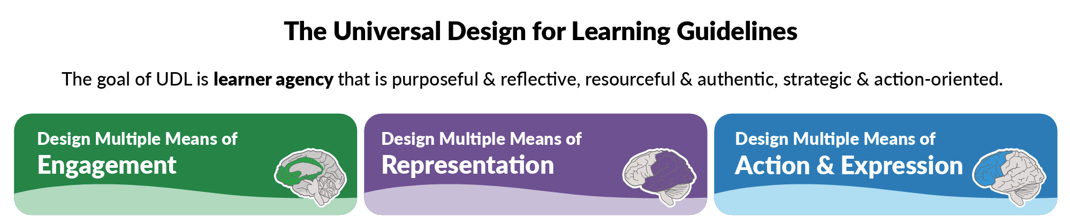
UDL as Inclusive Educational Practice in Higher Education
Why UDL?
  “A global framework for realizing inclusive practice in higher education” (Novak & Bracken, 2019, p. 1)
  Not just for students with disabilities but all students
  international students who come from diverse cultural and linguistic background (Fovet, 2019)
  A range of positive outcomes
  improved pass rates and 97% of student satisfaction (Dinmore & Stokes, 2015)

Slide 6
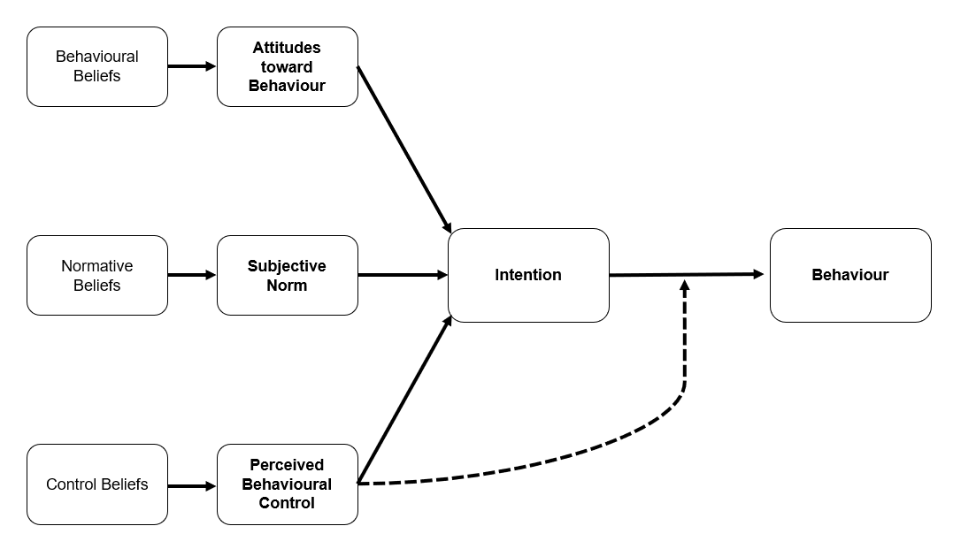
Why Observation? (1)
The Theory of Planned Behaviour (Ajzen, 1991)

Slide 7
Why Observation? (2)
Addressing the gaps in the literature
  Reliance on teachers or faculty members’ self-reported data.
  Attitudes towards inclusive education and/or students with disabilities in general
  (e.g., Cojocariu et al., 2025; Shah et al., 2024)
  Attitudes towards inclusive education and/or students with specific disabilities
  (e.g., Khouri et al., 2022; von Below et al., 2021)
  Attitudes, self-efficacy and/or willingness of adopting inclusive instruction, inclusive teaching strategies, universal design instructional techniques, universal design for instruction (e.g., Moriña, 2022; Timuş et al., 2024)
  Minimal use of other research methods, such as observational design to explore teachers’ actual behaviour in class.

Slide 8
Why Observation? (3)
Responding to Australian Universities Accord – Final Report
(Department of Education, 2024)
  Chapter 4: Delivering for Students
  4.3.2.2 Building the Evidence
  “Alongside survey data, increased and systematised use of peer review of teaching is also recommended” (p.176)
  Reliable and actional data…directly measure teaching performance

Slide 9
Research Questions
What is the level of UDL adopted by the university pathway teachers in this case study?
What is the relationship between the teachers’ intention to ensure students to fully access and participate in learning and their actual implementation of UDL?

Slide 10
The Observational Instrument
Universal Design for Learning Observation Measurement Tool (UDL-OMT)
(Basham et al., 2020)
32 items, categorised into four sections (Basham et al., 2020, p. 234):
Introducing and Framing New Materials* (7 items)
Sample item: A1.7 Identifies potential misunderstandings/misconceptions
Content Representation and Delivery (9 items)
Sample item: B1.7 Clarifies content-specific vocabulary, symbols and jargons
Expression of Understanding (7 items)
Sample item: C1.7 Facilities self-monitoring of progress
Activity and Engagement (9 items)
Sample item: D1.7 Provides for self-reflection and self-assessment
Rating
0 = no evidence of UDL
1 = incomplete evidence
2 = UDL is occurring
3 = dynamic, interactive use
of UDL

Slide 11
Participants - Recruitment
Two Participants – Teacher A and Teacher B
Recruited through purposive, convenience sampling.
Both participated in Stage 2 of the doctoral project, an online survey.
Came from the same university pathway provider.
Sessional employees of the university pathway provider.

Slide 12
Participants’ Information
 | Teacher A | Teacher B
Age | 42 years old | 42 years old
Department | Department of Business | Department of IT
Qualification | PhD | Master
Teachers’ Training | No formal qualification in teaching and/or education
Training in Special and/or Inclusive Education | No training in special and/or inclusive education Attended a two-hour professional development session on UDL
Teaching Experience | 20 years of teaching experience, with 1 year in university pathways | 2.5 years of teaching experience, in both university and university pathways
Observation | Each of them was observed for 12 hours 6 lessons each, for 2 hours each lesson
 | Live, did not consent to video recording | Live, consented to video recording

Slide 13
Results & Answer to RQ1
 | Teacher A (Business) | Teacher B (IT)
Absolute Inter-observer Agreement | 79.17% | 82.89%
Mean of the UDL-OMT (four sections combined) | M = 1.06 (SD = 0.12) | M = 1.15 (SD = 0.22)
Introducing and Framing New Materials | M = 1.24 (SD = 0.25) | M = 1.05 (SD = 0.12)
Content Representation and Delivery | M = 1.50 (SD = 0.14) | M = 0.85 (SD = 0.29)
Expression of Understanding | M = 1.14 (SD = 030) | M = 1.48 (SD = 0.37)
Activity and Engagement | M = 0.37 (SD = 0.17) | M = 1.24 (SD = 0.29)

Slide 14
Results & Answer to RQ1 – Teacher A (Business)
 | UDL 2.2 Version | UDL 3.0 Version
Dynamic, Interactive Use of UDL 2.83 out of 3.00 | Highlight patterns, critical features, big ideas, and relationships (3.2) | Highlight and explore patterns, critical features, big ideas, and relationships (3.2)
Areas for Improvement 0.00 out of 3.00 | Optimize individual choice and autonomy (7.1) Heighten salience of goals and objectives (8.1) Vary demands and resources to optimize challenge (8.2) Increase mastery-oriented feedback (8.4) Develop self-assessment and reflection (9.3) | Optimize choice and autonomy (7.1) Clarify the meaning and purpose of goals (8.1) Optimize challenge and support (8.2) Offer action-oriented feedback (8.5) Promote individual and collective reflection (9.3)

Slide 15
Results & Answer to RQ1 – Teacher B (IT)
 | UDL 2.2 Version | UDL 3.0 Version
Dynamic, Interactive Use of UDL 2.83 out of 3.00 | Activate or supply background knowledge (3.1) Guide information processing and visualization (3.3) | Connect prior knowledge to new learning (3.1) Cultivate multiple ways of knowing and making meaning (3.3)
Areas for Improvement 0.00 out of 3.00 | Offer ways of customizing the display of information (1.1) Offer alternatives for auditory information (1.2) Promote understanding across languages (2.4) | Support opportunities to customize the display of information (1.1) Support multiple ways to perceive information (1.2) Cultivate understanding and respect across languages and dialects (2.3) Address biases in the use of language and symbols (2.4)

Slide 16
Answer to RQ2
What is the relationship between the teachers’ intention to ensure students to fully access and participate in learning and their actual implementation of UDL?
The Theory of Planned Behaviour stipulates that intention is the antecedent of behaviour.
The two teachers both reported high intention (7.0 out of 7.0) in Stage 2 of the study. However, the observations indicated that their implementation of UDL was pre-emergent.
In this case study, the intention-behaviour relationship was weak.

Slide 17
Possible Explanation to the Result of RQ2
Actual behaviour control – follow up interview
Knowledge
- 4.3.2.3 Raising teaching quality and status (Department of Education, 2024)
Lack of autonomy and opportunities to collaborate
Instability of intention
Forgetting
Literal inconsistency – social desirability bias
(Ajzen, 2005, 2020; Ajzen & Dasgupta, 2015; Fishbein & Ajzen, 2010)

Slide 18
Limitations
Results are indicative not confirmatory
      Should be interpreted with caution
A small-scale study
      The two participants are from one single university pathway provider in Australia
      12 hours of lesson for each are just snapshots of the teaching period
            a longitudinal design in the future
Alignment with UDL 3.0
      The UDL-OMT did not capture the new considerations
            the need for an updated observation instrument.

Slide 19
References (1)
Agosti, C. I., & Bernat, E. (2018). University pathway programs: Types, origins, aims and defining traits. In C.I. Agosti & E.
Bernat (Eds.), University pathway programs: Local responses within a growing global trend (pp. 3-25). Springer.
Ainscow, M., Booth, T., & Dyson, A. (2006). Inclusion and the standards agenda: Negotiating policy pressures in England.
International Journal of Inclusive Education, 10(4-5). 295-308.
Ajzen, I. (1991). The theory of planned behaviour. Organizational Behaviour and Human Decision Processes, 50, 179-211.
Ajzen, I. (2005a). Attitudes, personality and behaviour (2nd ed.). Open University Press.
Ajzen, I. (2020). The theory of planned behaviour: Frequently asked questions. Human Behaviour and Emerging Technologies, 2(4), 314-324.
Ajzen, I., & Dasgupta, N. (2015). Explicit and implicit beliefs, attitudes, and intentions: The role of conscious and unconscious processes in human behaviour. In P. Haggard & N. Eitam (Eds.), The Sense of Agency (pp. 115-144). Oxford University Press.
Armstrong, A.C., Armstrong, D., & Spandagou, I. (2010). Inclusive education: Key themes. In A.C. Armstrong, D. Armstrong
& I. Spandagou (Eds.), Inclusive education: International policy & practice (pp. 3-13). SAGE Publications.
Balloo, K., Heron, M., & Baker, S. (2025). Awareness, understandings, and teaching practices surrounding academic oracy in university preparation pathways. Higher Education Research & Development, 44(4), 823-837.
Basham, J. D., J. E. Gardner, & Smith, S. J. (2020). Measuring the implementation of UDL in classrooms and schools: Initial field test results. Remedial and Special Education, 41(4), 231-243.
Bode, S. (2013). The first year experience in second year: Pathway college versus university direct entry [Conference paper]. The 24th ISANA International Education Conference, Brisbane, Queensland. http://isana.proceedings.com.au/docs/2013/Bode_Shirley.pdf
Brett, M., & Pitman, T. (2018). Positioning pathways provision within global and national contexts. In C.I. Agosti & E. Bernat (Eds.), University pathway programs: Local responses within a growing global trend (pp. 27-42). Springer.

Slide 20
References (2)
Cojocariu, V.-M., Amӑlӑncei, B.-M., Mareş, G., Cîrtitӑ-Buzoianu, C., & Mӑţӑ, L., (2025). Higher education teachers’ attitude towards inclusive education. Revista Româneascӑ pentru Educaţie Multidimensionalӑ, 17(1), 33-53.
Department of Education (2024). Australian universities accord – Final Report. https://www.education.gov.au/australian-universities-accord/resources/final-report
Dinmore, S. & Stokes, J. (2015). Creating inclusive university curriculum: Implementing universal design for learning in an enabling program. Widening Participation and Lifelong Learning, 17(4), 4-19.
Fishbein, M., & Ajzen, I. (2010). Predicting and changing behaviour: The reasoned action approach. Psychology Press.
Fovet, F. (2019). Not just about disability – Getting traction for UDL implementation with international students. In K. Novak, S. Bracken (Eds.), Transforming higher education through Universal Design for Learning: An international perspective (pp. 180-200). Routledge.
Khouri, M., Lipka, O., & Shecter-Lerner, M. (2022). University faculty perceptions about accommodations for students with learning disabilities. International Journal of Inclusive Education, 26(4), 365-377.
Lo, N. H. N., Spandagou, I., & Evans, D. (2024). University pathway teachers’ salient beliefs of inclusive education: An elicitation study of the Theory of Planned Behaviour. Higher Education Research & Development, 43(6), 1325–1340.
Moriña, A. (2022). Faculty members who engage in inclusive pedagogy: methodological and affective strategies for teaching. Teaching in Higher Education: Critical Perspectives, 27(3), 371-386.
Novak, K., & Bracken, S. (2019). Introduction. In K. Novak, S. Bracken (Eds.), Transforming higher education through Universal Design for Learning: An international perspective (pp. 1-8). Routledge.
Shah, S. B. Z., Yeo, D., & Chen, M. (2024). Faculty’s attitudes towards inclusive education for students with special educational needs (SENs) in Singapore. Higher Education Research & Development, 44(3), 736-752.

Slide 21
References (3)
Spandagou, I. (2020). Inclusive education: Principles and practice. In I. Spandagou, C. Little, D. Evans & M.L. Bonati (Eds.), Inclusive education in schools and early childhood settings (pp. 35-34). Springer.
Timuş, N., Bartlett, M. E., Bartlett, J. E., Ehrlich, S., & Babutsidze, Z. (2024). Fostering inclusive higher education through universal design for learning and inclusive pedagogy – EU and US faculty perceptions. Higher Education Research & Development, 43(2), 473-487.
United Nations Educational, Scientific and Cultural Organisation. (2015). Education 2030: Incheon declaration and framework for action toward inclusive and equitable equality education and lifelong learning for all (ED-2016/WS/28). UNESCO.
von Below, R., Spaeth, E., Horlin, C. (2021). Autism in higher education: dissonance between educators’ perceived knowledge and teaching behaviour. International Journal of Inclusive Education, 28(6), 940-957.

Slide 22
Any Questions?
Nelson.Lo@sydney.edu.au

