Slide 1
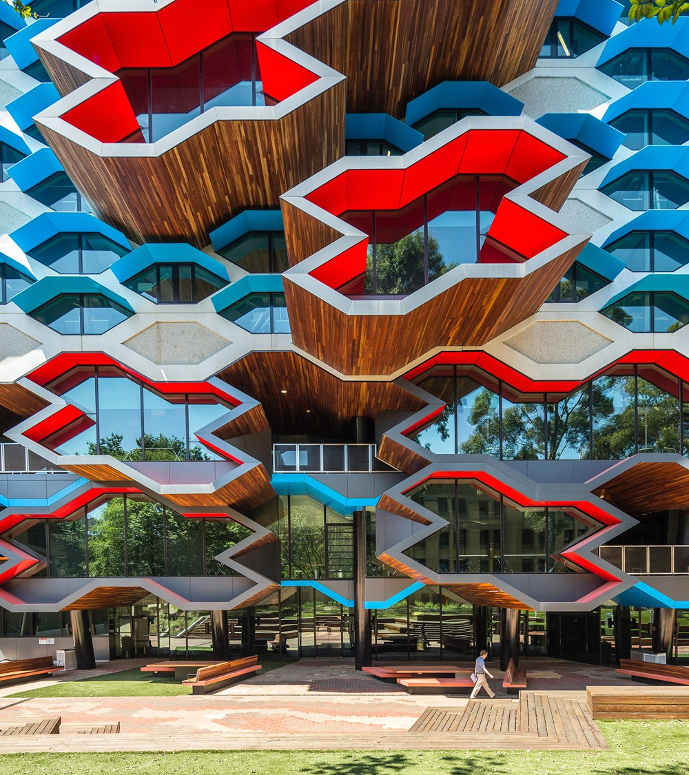
Teaching udl by doing udl: Modelling inclusive design IN INITIAL TEACHER EDUCATION dr ana garcia-melgar

Slide 2
OVERVIEW
Context, challenges and opportunities
Embedding UDL in initial teacher education
Multiple means of engagement: building interest and self-regulation
Multiple means of representation: accessibility and supporting knowledge construction
Multiple means of action and expression: assessment formats
Student feedback
Key learnings and recommendations

Slide 3

Context: initial teacher education
Bachelor of Education (Primary and Secondary pathways)
Inclusive Education Specialisation delivered entirely online
Student diversity: diverse cohort in terms of teaching experience, knowledge of inclusive education, demographics.

Slide 4
Gaps in teacher education
Research consistently shows significant gaps in pre-service teachers' understanding and application of inclusive learning design:
Knowledge gap: unprepared to support diverse learners effectively (Stites et al., 2018)
Skills Gap: traditional teacher education often focuses on theoretical understanding rather than practical application of UDL principles (European Agency for Special Needs and Inclusive Education, 2019)
Experience Gap: pre-service teachers rarely experience UDL as learners themselves, making it difficult to implement authentically in their own practice (Evmenova, 2018)

Slide 5
OPPORTUNITIES: online learning
Online learning settings provide unique opportunities to model UDL principles:
• Flexibility in engagement: multiple pathways for interaction and participation
• Multiple representation modes: various media formats and content delivery methods
• Firm goals, flexible means: multiple ways to demonstrate learning and understanding
• Built-in accessibility features

Slide 6

EMBEDDING UDL
Rationale: need to see UDL in practice to be able to apply it to their teaching
Steps: work through priorities based on student feedback and own observations (e.g. student assessment tasks)

Slide 7
What aspects of online learning have you found challenging or unhelpful?
Go to www.menti.com
Enter the code: code will be updated during live presentation

Slide 8
SUBJECT DESIGN: learning management system (LMS)
Consistent LMS layout with signposting
Multiple means of representation: short videos, guided readings, podcasts, individual and group activities
Focus on accessibility and reducing cognitive load

Slide 9
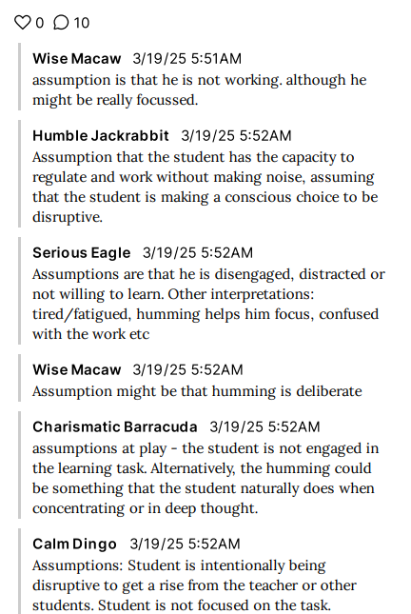
Engagement and motivation
Multiple and flexible opportunities for participation in synchronous and asynchronous activities
Diverse case studies and examples
Choice in assessment format and content

Slide 10
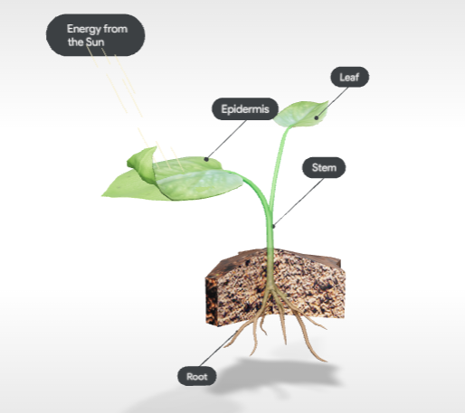
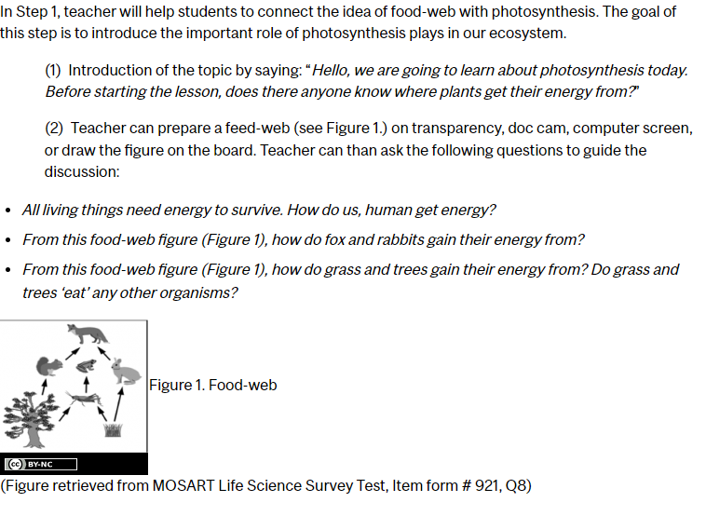
MULTIPLE MEANS OF REPRESENTATION

Slide 11
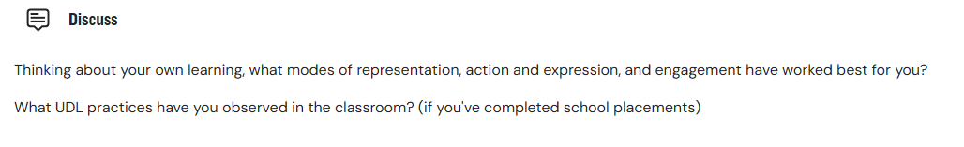
SCAFFOLDS AND SELF-MOnITORING
Weekly self-check activities (e.g. polls, quizzes)
Reflection questions to connect theory with practice
Mindmaps linking new and prior knowledge

Slide 12
EXAMPLE: TAKEAWAY MESSAGES
Multiple means of action and expression address variability in how students express themselves and navigate the learning environment
This principle has a focus on providing options for physical actions, expression and communication, and fostering executive skills
Assistive technologies support students with disabilities to engage with materials, the learning environment, communicate and express their understandings and learning
Consider what barriers are embedded in assessment tasks, and how you can provide students with multiple options to demonstrate what they have learned

Slide 13
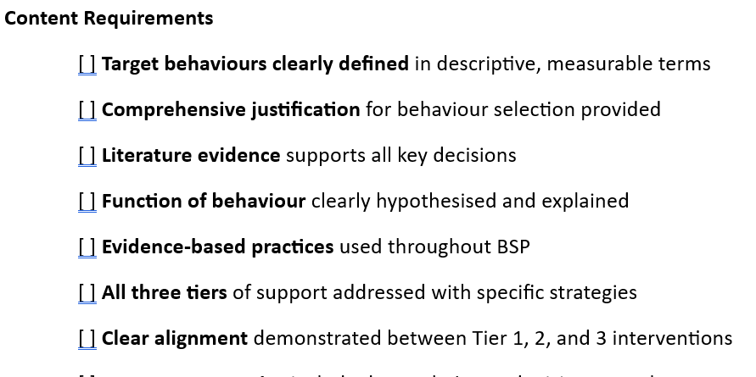
ASSESSMENT DESIGN
Flexibility in submission formats to demonstrate learning in assessment tasks
Choice on content (providing guidelines and requirements)
Assessment checklists

Slide 14
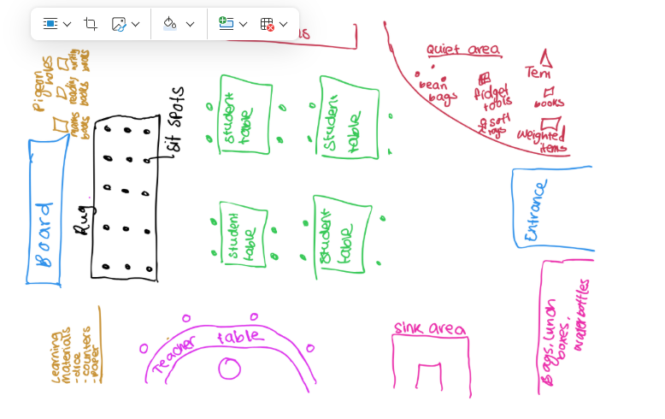
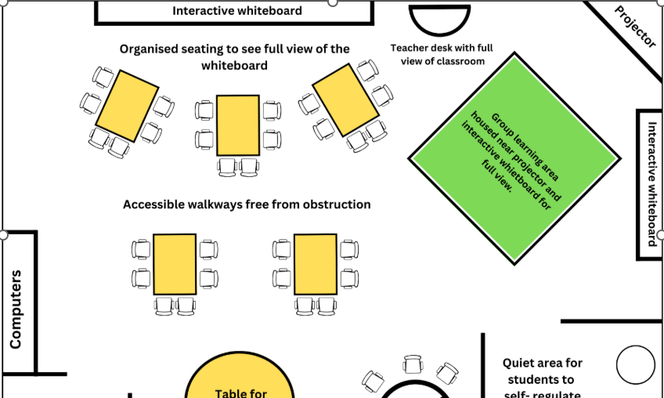
RESPONSE OPTIONS

Slide 15
EXAMPLE: CHOICEBOARDS
All: mini-lecture on key topics. Recap of weekly content.
Activity 1 – Choose from:
-Go through worked example of UDL lesson plan
-Work on case study: apply multiple means of representation
Activity 2 – Choose from:
-Work on first assessment task with peers
-Q&A with tutor
Optional: referencing refresher

Slide 16

STUDENT FEEDBACK
Increased confidence
Improved engagement
Satisfaction with subject design
Clear expectations
Embedded supports

Slide 17
KEY LEARNINGS
Pre-service teachers need to see UDL in practice to truly understand how it works
Deeper understanding of UDL and how to apply it to their own classrooms
Encourage self-reflection
Balance between choice and structure
LMS capabilities

Slide 18

RECOMMENDATIONS
Start small
Focus on access
Gather feedback and make adjustments

Slide 19
REFERENCES
European Agency for Special Needs and Inclusive Education. (2019). Teacher professional learning for inclusion: Literature review. Odense, Denmark: European Agency for Special Needs and Inclusive Education.
Evmenova, A. (2018). Preparing teachers to use Universal Design for Learning to support diverse learners. Journal of Online Learning Research, 4(2), 147-171.
Stites, M. L., Rakes, C. R., Noggle, A. K., & Shah, S. (2018). Preservice teacher perceptions of preparedness to teach in inclusive settings as an indicator of teacher preparation program effectiveness. Discourse and Communication for Sustainable Education, 9, 21-39

Slide 20
Thank you
latrobe.edu.au

