Slide 1
Universal design for learning as the basis for inclusive-digital education – analysis of an intervention program in higher education for teachers at vocational schools
Dr. René Wüthrich, Lecturer
Sydney, 26. June 2025

Slide 2
Topics
Vocational training Switzerland
Swiss Federal University for Vocational Education and Training (SFUVET)
The degree program for vocational teachers
Inclusive-digital education on the basis of UDL
Study
Conclusion

Slide 3
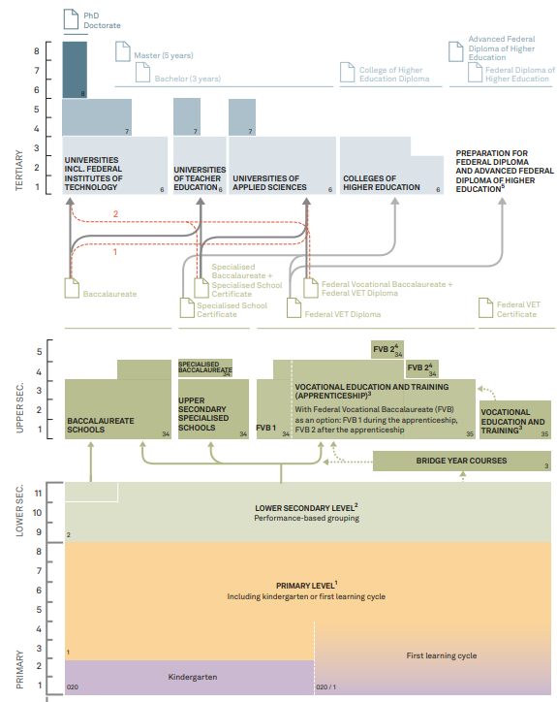
Vocational training in Switzerland
Figure 1: The Swiss education system at a glance
Basic vocational training lasts 2 to 4 years.
2-year basic vocational training (degree: Federal VET Certificate).
3-year and 4-year basic vocational training (degree: Federal VET Diploma).
3 learning locations: training company, vocational school, inter-company courses.
The Bring-Your-Own-Device (BYOD) approach is introduced at the most vocational schools.
EDK, 2024

Slide 4
The degree program for vocational teachers
The SFUVET is a national university and reports directly to the federal government.
The course lasts two years and takes place on a part-time basis.
Teachers can teach in the 2-, 3- and 4-year basic vocational training programs.
Students must have professional experience and a higher vocational qualification.
Students at the SFUVET are on average 38.6 years old when they start their studies and 42.7 years old when they graduate (internal data from the SFUVET).

Slide 5
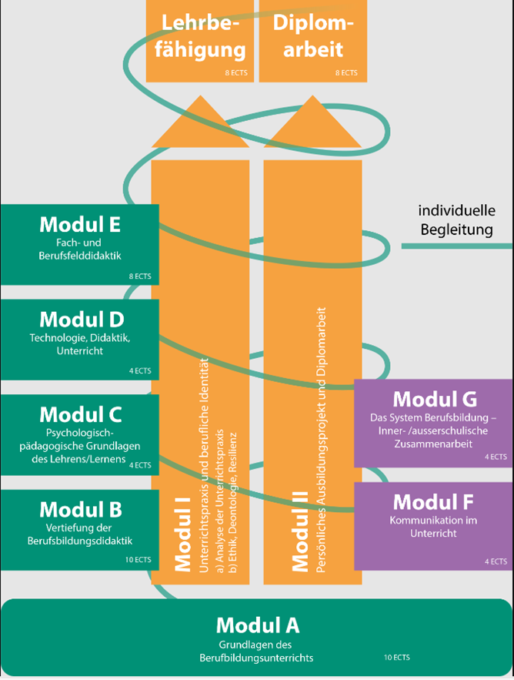
The degree program for vocational teachers
Figure 2: SFUVET training concept
Modules A-G are subject-specific.
Modules I and II are transversal.
Module A must be attended before the course.
Module B is the introduction to the course with in-depth study of vocational education didactics
Proportion of special educational content in the curriculum at approx 4% (Wüthrich, 2025c in press)
(SFUVET, 2024)

Slide 6
Inclusive-digital education on the basis of UDL
Switzerland has committed to achieving Goal 4 of the 2030 Agenda (EDA, 2020).
Inclusion and digitization are key cross-cutting themes in vocational education and training (Wüthrich, 2025b).
Inclusive digital education refers to a systemic approach that combines inclusion and digital transformation to enable equitable and accessible education (based on european-agency, 2022).
The European agency recommends the UDL framework model for teaching.
Inclusive-digital education is not currently anchored in vocational training (Wüthrich, 2025a; 2025b).

Slide 7
Study
How do students in teacher training experience the implementation of UDL in the context of inclusive-digital education, and to what extent does UDL as a didactic framework support the promotion of participation in the classroom?

Slide 8
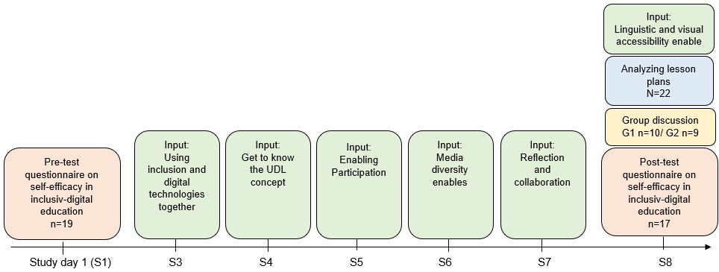
Study cont.
Figure 3: Research design

Slide 9
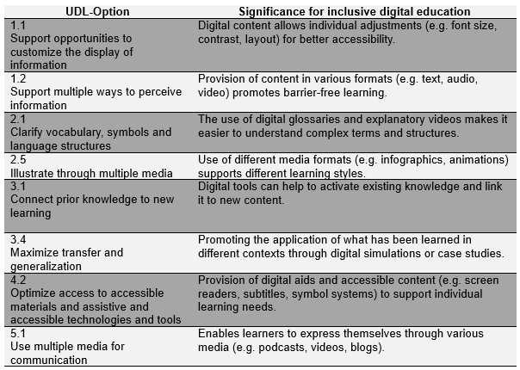
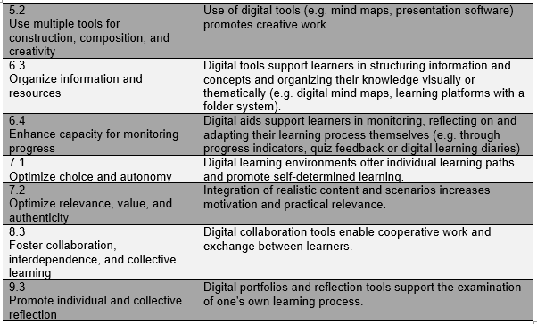
UDL options related to inclusive-digital education
Table 1: UDL options related to inclusive-digital education

Slide 10
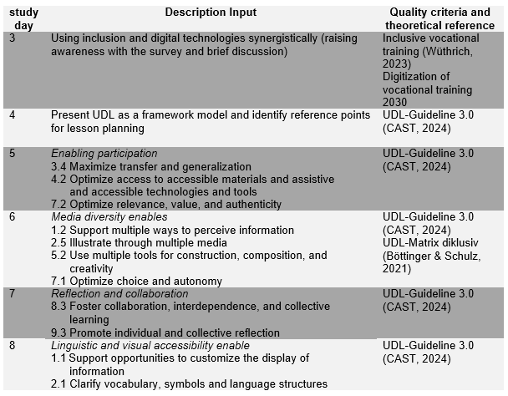
Intervention program procedure
Table 2: Overview of inputs provided during the intervention program
On each study day, a short input (max. 15 min.) and the task of identifying optimization possibilities in your own lesson planning.

Slide 11
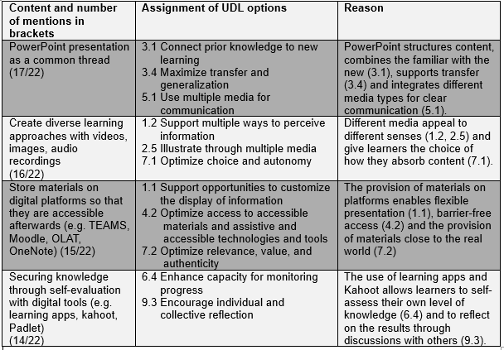
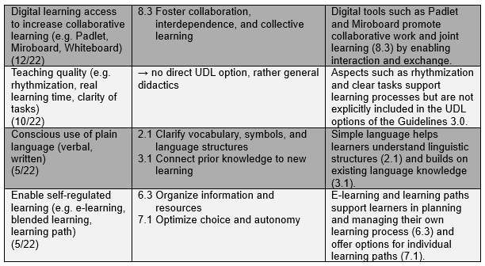
Results
Table 4: Findings for lesson planning

Slide 12
Conclusion
UDL as a cross-cutting topic in all pedagogical and didactic modules.
Regular reflection and exchange on UDL experiences.
The UDL guidelines 3.0 are more learner-oriented.
Practical phases in inclusive schools for realistic learning experiences.
Next steps: Using UDL-OMT (Basham et al., 2020) as a tool in the classroom.

Slide 13
Thank you! rene.wuethrich@ehb.swiss

