Slide 1
Universal Design for Learning: A Pilot Study on Improving Student Success Rates.
Associate Professor Kelly Linden
2025 Equity Fellow, Australian Centre for Student Equity and Success (ACSES)

Slide 2
Acknowledgement of Country
We would like to acknowledge the Wiradjuri, Ngunawal, Gundungarra and Biripai (or Biripi) peoples of Australia, who are the traditional owners and custodians of the lands on which Charles Sturt's campuses are located and pay respect to their Elders both past and present.

Slide 3

Charles Sturt University Context
Regional university, six main campuses located throughout regional New South Wales
Subject/Course
Of our undergraduate students, 56% are from regional, rural and remote (RRR) areas, 24% are from low-socioeconomic backgrounds, 7% of students are living with a disability and 4% of students identify as First Nations
Each year approximately 24,000 students are enrolled online and 10,500 students' study on campus and approximately 70% of students study part-time

Slide 4
Supporting diverse student cohorts
Well-developed, institution-wide transition pedagogy (Kift et al., 2010)
Universal Design for Learning framework (Rogers-Shaw et al., 2018)
Pedagogy of kindness (Teakel et al., 2024)
Intentional curriculum design
'What works'
Well-designed curriculum provides the foundation for student wellbeing

Slide 5
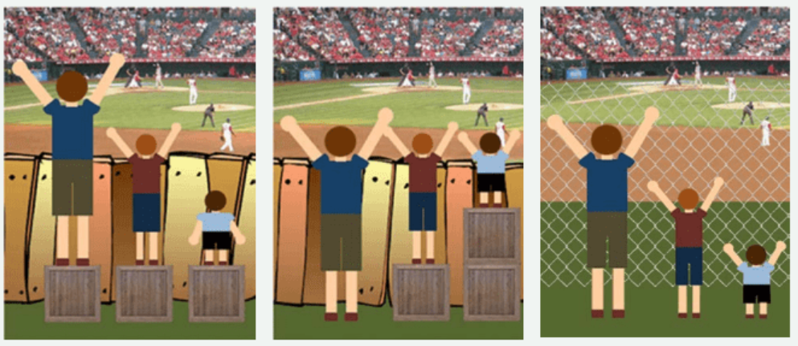
Diverse student cohorts
The aim of this initiative was to improve course level student success by developing and implementing a consistent set of guidelines for subject development to inform intentional and inclusive design.

Slide 6
How can we remove institutional barriers to enhance student success?

Slide 7
Approach
In 2023 and 2024, 17 subjects with an average number of 304 enrolled students from Bachelors of Nursing, Business and Education.
All subjects had low pass rates (67%).
A team of academic, professional and leadership staff worked together on subject level development, with a course level lens
Ethics approval (HREC Protocol No H21170)

Slide 8
Thorough subject analysis
  Enrolment patterns
  Student demographics
  Subject and QUILT evaluation
  Assessment submission data
  Student focus groups
    Pizza lunch or group Zoom sessions
    What did they like, what could be improved across the first year?

Slide 9
Who are our students 1?
Many students work a lot. Almost all the on-campus students we spoke with work more than 20 hours a week, with a number working close to full time.
The importance of consistency and clarity. Finding information can be difficult and overwhelming for a commencing student. Students can have difficulty finding lecture notes, readings and assessment instructions if they are not placed in a sensible and consistent location.

Slide 10
Who are our students 2?
Real-world examples. Students valued classes where academics were able to share relevant real-world examples and industry experiences, making strong connections between what they were learning in the subject and their application in their profession.

Slide 11
Who are our students 3?
Catching up. Students who missed a lecture or workshop found it difficult to catch up if recordings were not made available. Having this flexibility very important.
Feedback. The importance of quality feedback was mentioned regularly. Two students described an example where the feedback provided was so helpful, they did considerably better on the following assessment item.

Slide 12
What did they love?
Automatic 7-day extension. Without prompting, students from all sessions reported how much they liked the automatic 7-day extension.
Embedded tutors. Without prompting, the embedded tutor program was regularly mentioned as being incredibly helpful in skill-building and increasing student confidence.

Slide 13
What should be available in a first-year subject?
There was a lack of consistency in the experience students receive across their enrolment.
A set of principles were developed and tested with exemplars and templates
Minimum Expectations – what should be available in a first-year subject
  Scaffolding of content
  Delivery
  Assessment for learning

Slide 14
Scaffolding of content
  Volume of weekly learning.
  A weekly checklist
  Consistent sequencing of learning content and activities
  Pre-recorded concept lectures
  Alignment to learning outcomes and assessment tasks
  Learning activities are available throughout the content
  Embedded support, guidance on how to use technology
  Accessibility requirements

Slide 15
Delivery
  Welcome announcement
  Weekly announcements
  Consistent synchronous learning sessions
  Active and collaborative learning opportunities
  All recordings and resources are provided to students

Slide 16
Assessment
  Logically sequenced and scaffolded
  Clear task descriptions
  Take a course level view
  Opportunities for students to clarify
  Feedback must be provided on all tasks
  Avoid unnecessary hurdles

Slide 17
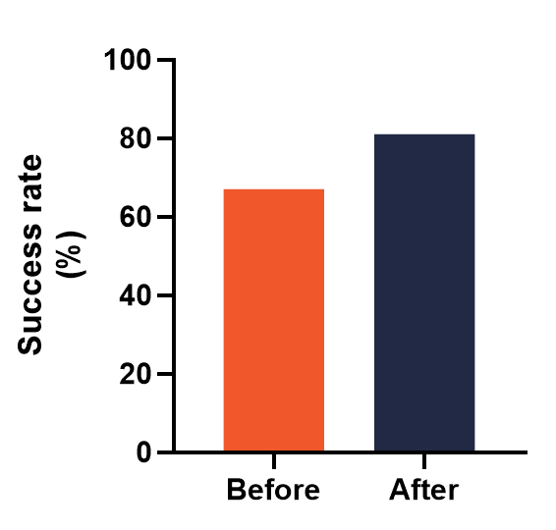
Average pass rate increased from 67% to 85%.

Slide 18
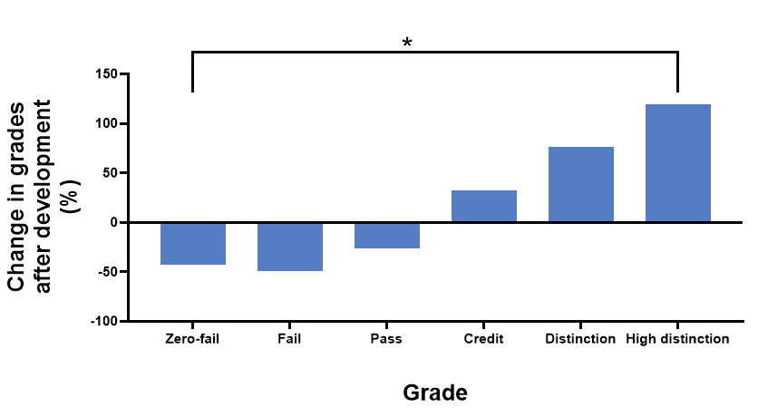
Grade distribution changes

Slide 19
Conclusion
We should aim for consistency in the experience students receive across their enrolment.
By incorporating the principles of Universal Design for Learning all students benefit from the experience
Developing minimum expectations can help to guide academics towards best practice

Slide 20
Additional data….
703 part-time university students from across Australia completed a survey.
When asked how important are each of the following in the design of your subjects/units/courses? The % of students who selected “very important”
  Well spaced out assessments (74%)
  Flexible assessment due dates/automatic extensions (69%)
  Consistent subject/unit site layout (68%)
  Learning content available early (66%)

Slide 21
Additional data continued….
  Clear distinctions between key and additional content (63%)
  Pre recorded lectures (60%)
  A variety of ways to interact with the learning content (55%)
  A weekly announcement clearly stating what needs to be completed next week (54%)
  University support (40%)
  Different assessment types (38%)
  Early assessment item due before census (21%)

Slide 22
I would like to thank my collaborators, Dr Noelia Roman and Dr Sarah Teakel for their help on this project.

