Slide 1

Leveraging AI and Assistive Technology to Enhance Inclusion in Higher Education
Hillary Goldthwait-Fowles Ph.D. ATP

Slide 2

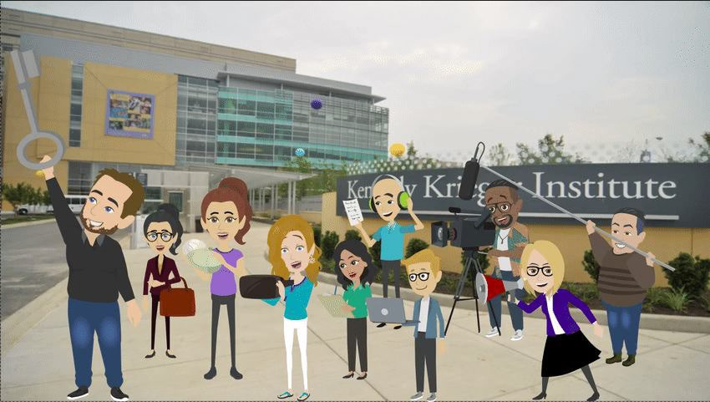

Get To Know Us!

Slide 3




Your Comfort Level with AI is:
1. Oh no! Not AI
2. Get away, AI!
3. Hmm.. AI..
4. I LOVE AI!!

Slide 4

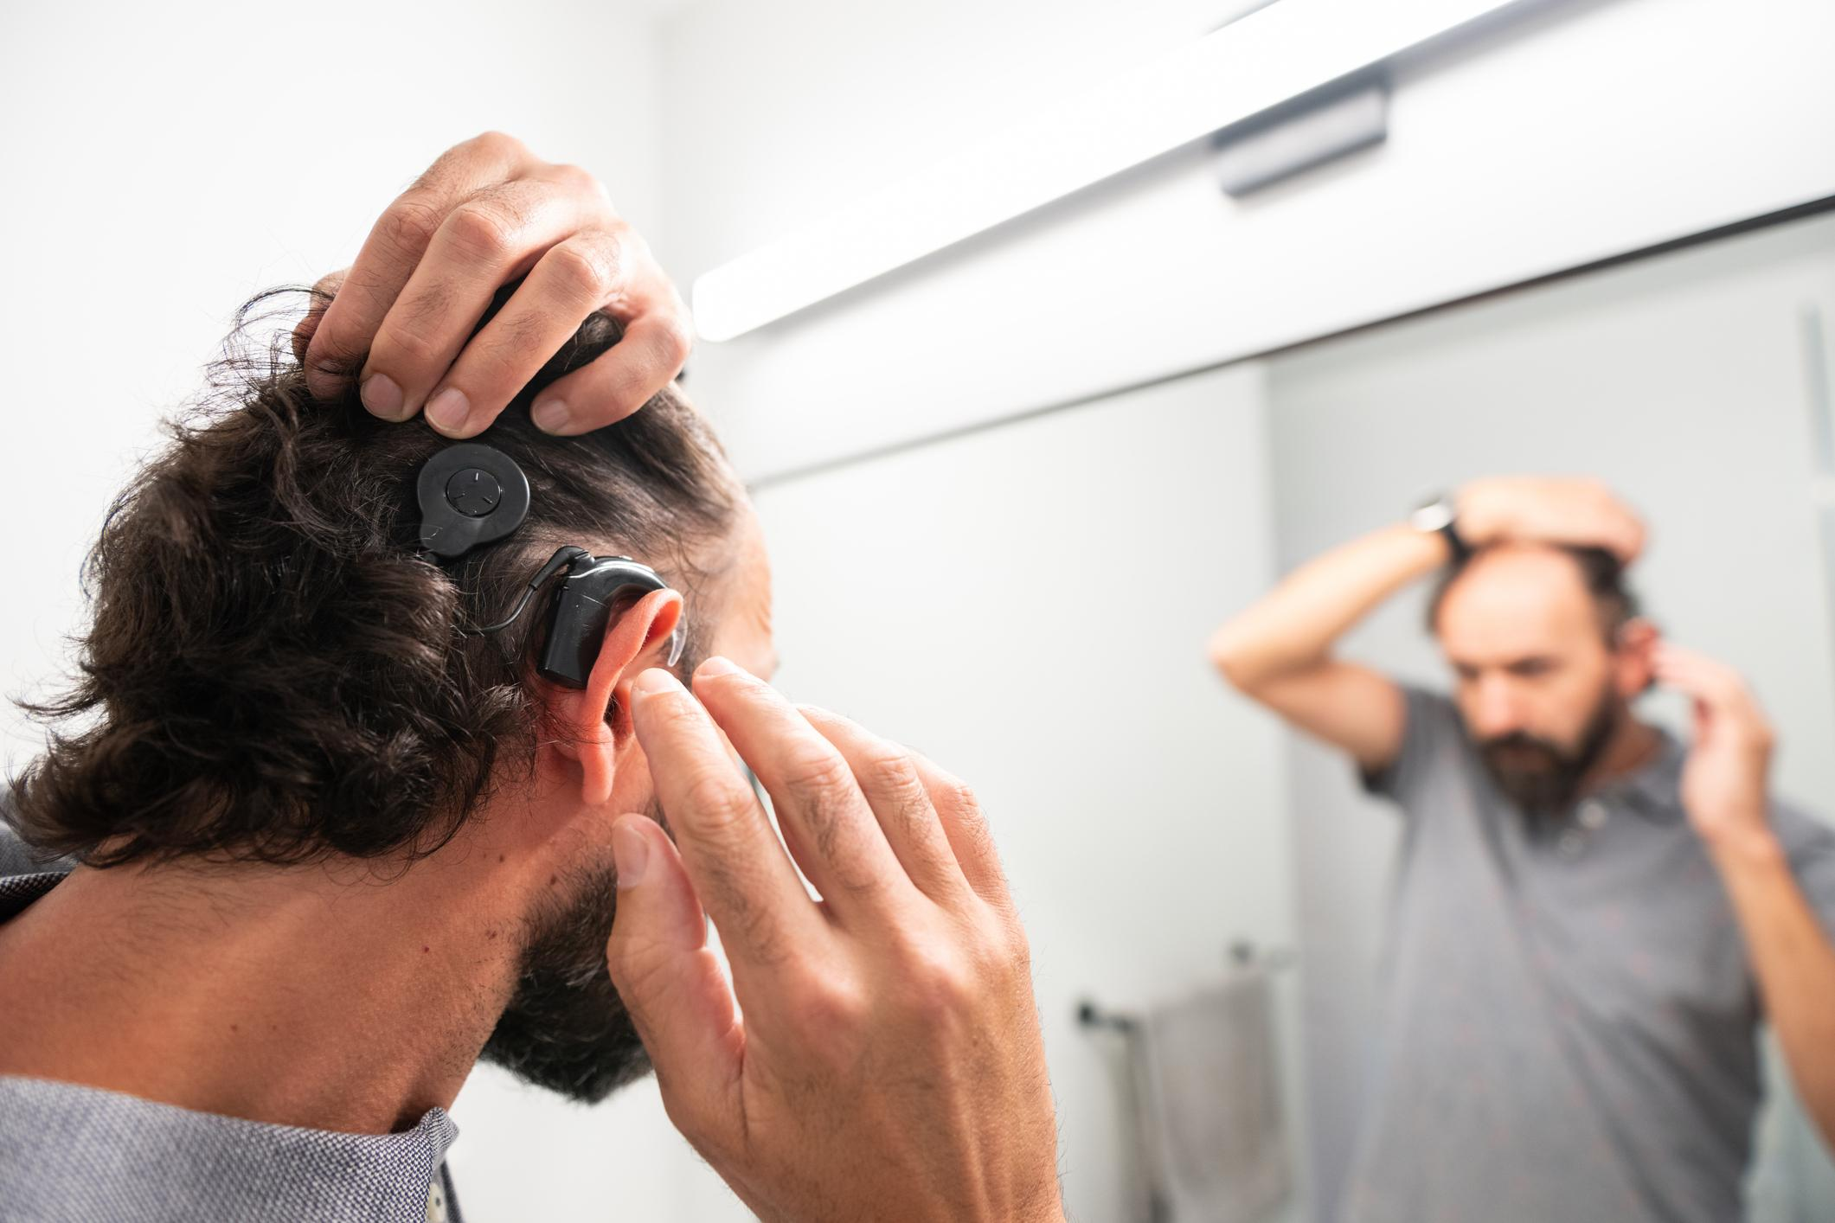

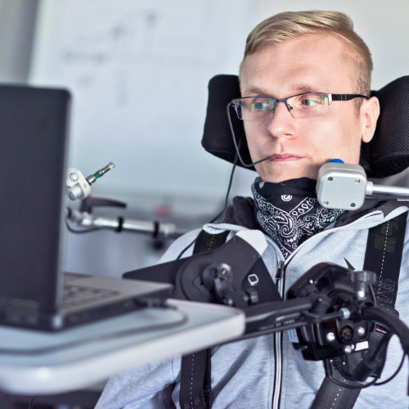
What is AT?

Slide 5




What is AEM?
Accessible educational materials (AEM) are designed for all learners, including those with disabilities.
In higher education, AEM can be:
  Text: Braille, large print, or digital formats
  Audio: Transcripts of audio content
  Video: Captioned videos
  Digital: Accessible digital content
These materials ensure that higer education is inclusive and accessible to everyone.

Slide 6


UDL as Foundational Practice
Leveraging Universal Design for Learning (UDL) in online education/training removes learning barriers by using flexible teaching methods.
By centering accessibility, it benefits all learners, especially those with learning challenges and English language learners, by accommodating individual strengths and needs.

Slide 7
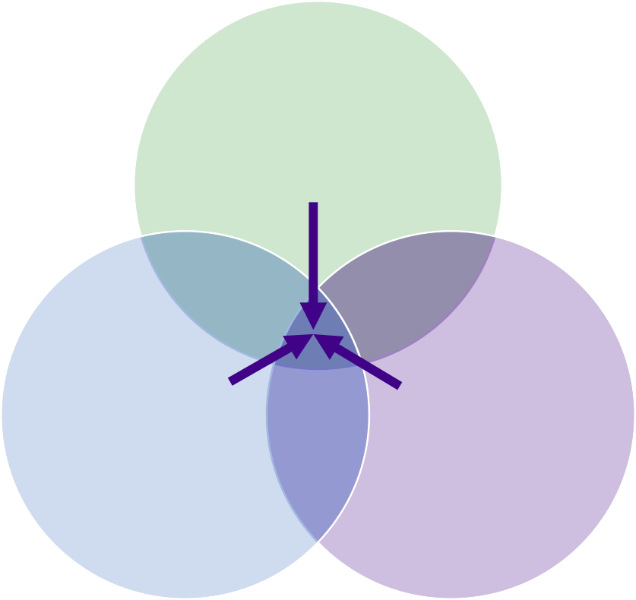
AT+AEM+UDL= The Trifecta of Access
AT
AEM UDL

Slide 8
AT+AEM+UDL= The Trifecta of Access
AT
AEM UDL
Inclusivity via Accessibility

Slide 9

AT+AEM+UDL= The Trifecta of Access
AT
AEM UDL
Inclusivity via Accessibility

Slide 10


Inclusivity IS Important in Higher Education
equitable learning opportunities
diverse workforce →
  diverse populations
break down barriers and reduce
disparities in employment
equips professionals with the
skills and awareness to be life long learners

Slide 11
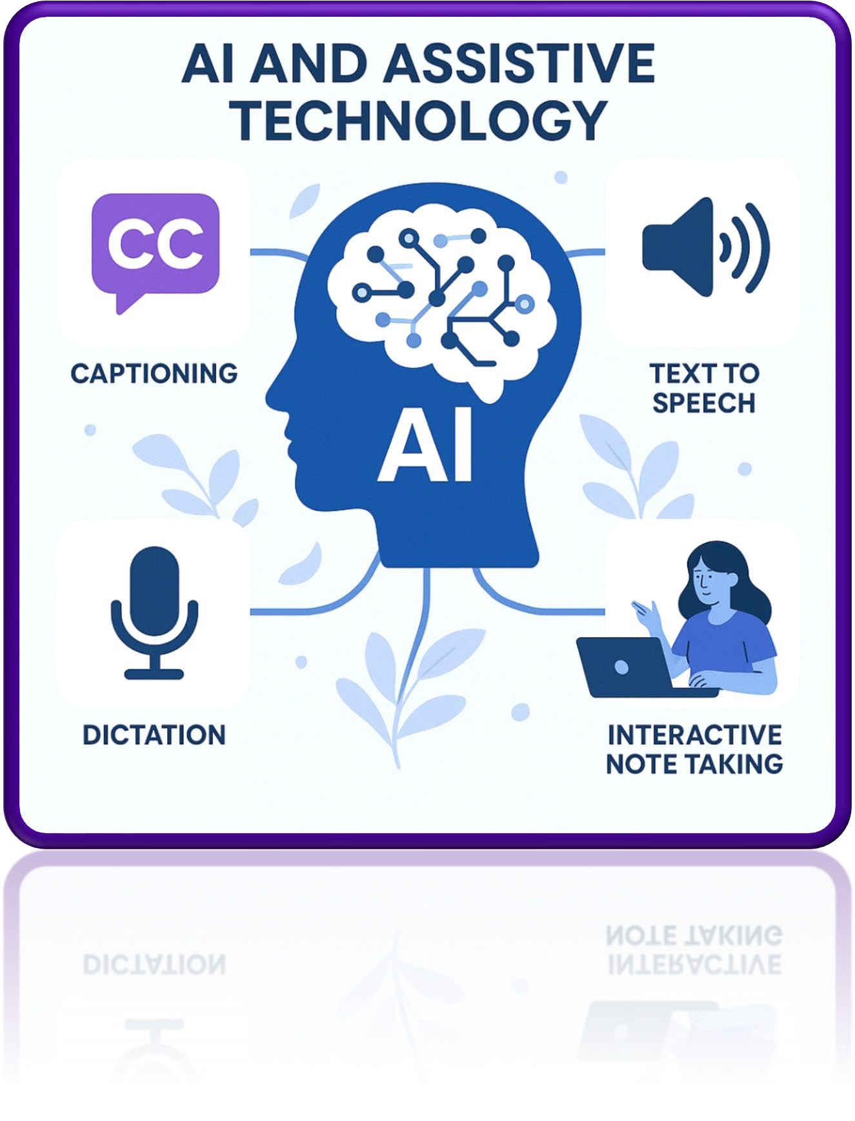
AI as AT
It’s always been there
Siri
Dictation Software
Text to Speech Software
Highlighting tools
Recorded Notetaking Apps (Glean)
Where it’s going
Study partner (Khanmingo)
Condense vast amounts of text for access (Estendio, NotebookLM)
Research partner (Elicit)
Thought partner

Slide 12
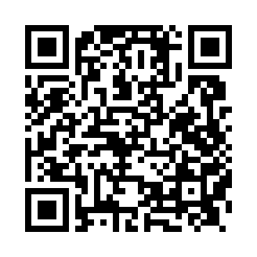
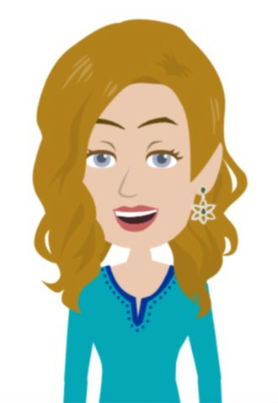
Resource Repository
https://bit.ly/ATAIUDL25

Slide 13
Your Comfort Level with AI is:
1. Oh no! Not AI
2. Get away, AI!
3. Hmm.. AI..
4. I LOVE AI!!

Slide 14

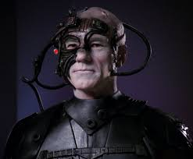
How Do We Begin?
It’s all about the:
Purpose
Form
Function
It’s also about the:
Prompt
It’s also about the:
Partnership

Slide 15

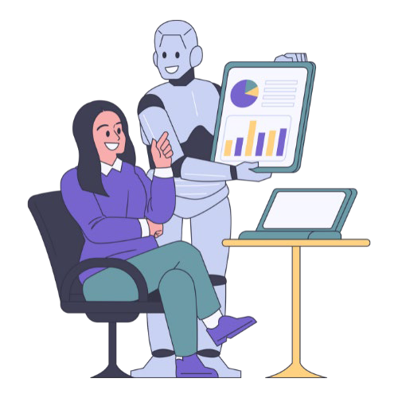
AI 101- Tools for Teachers
LUDIA- AI UDL Tool
  https://secure.smore.com/n/vcpmk
Chat GPT
Claude
Co-Pilot
Google Gemini
Apple Intelligence
Notebook LM
Elicit

Slide 16

Satya Nadella, CEO of Microsoft
“AI will be an integral part of solving the world’s biggest problems, but it must be developed in a way that reflects human values.”

Slide 17
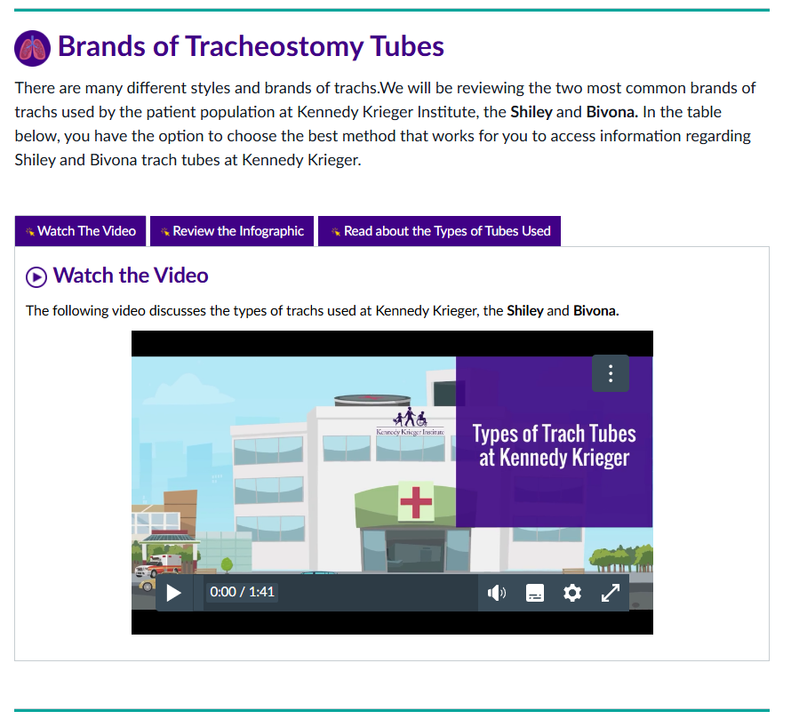
Kennedy Krieger Examples
Multiple Means of Representation (UDL)
AI Tool: Vyond
Nursing Department Training

Slide 18
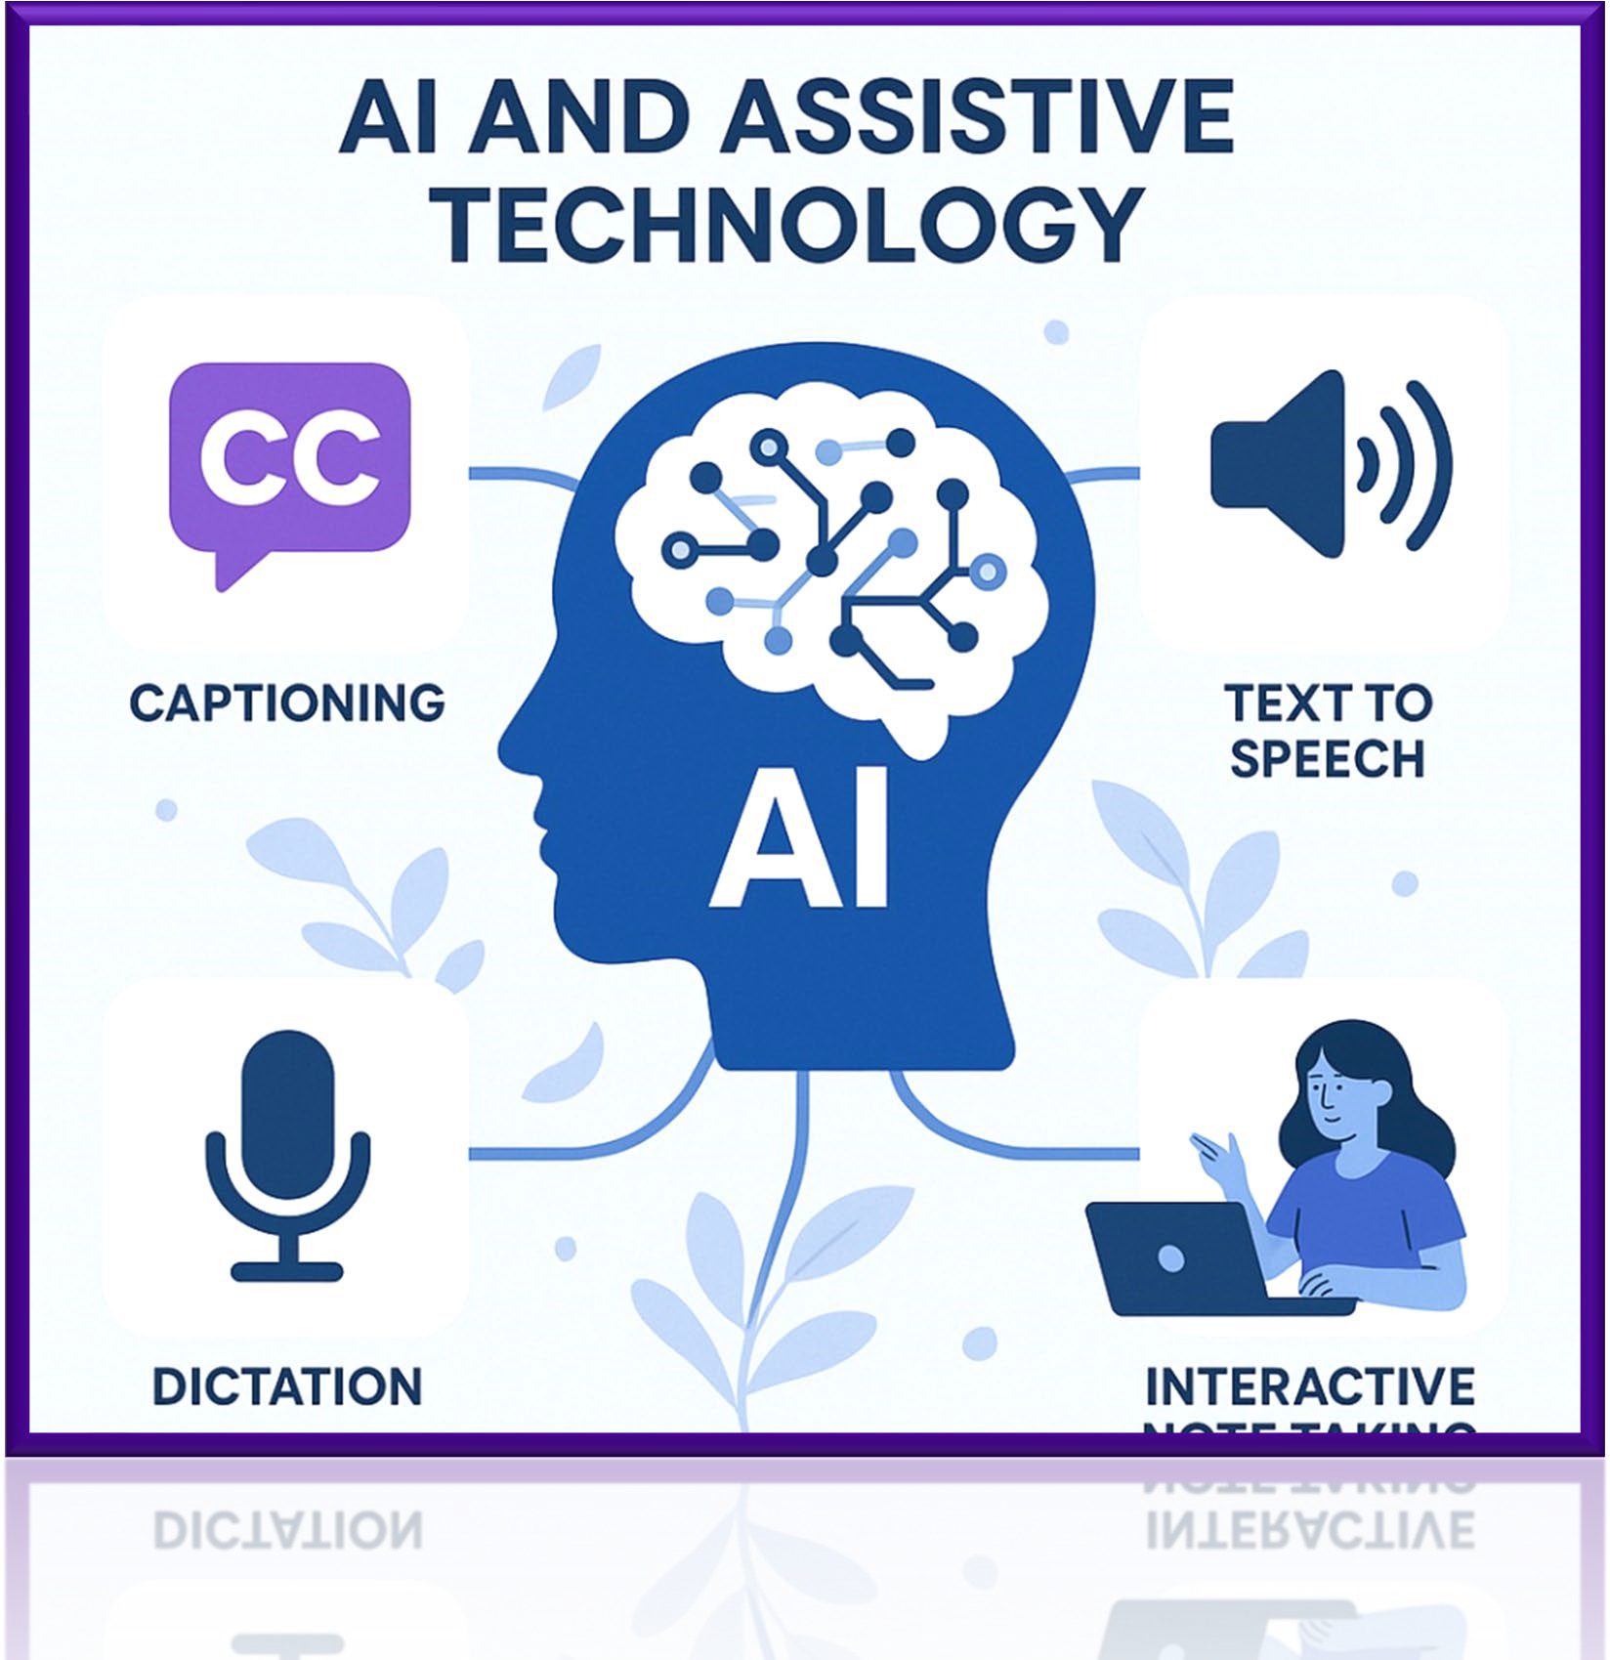
Kennedy Krieger Examples
Multiple Means of Representation (UDL)
AI Tool: ChatGPT Image creation

Slide 19
Your Comfort Level with AI is:
1. Oh no! Not AI
2. Get away, AI!
3. Hmm.. AI..
4. I LOVE AI!!

Slide 20
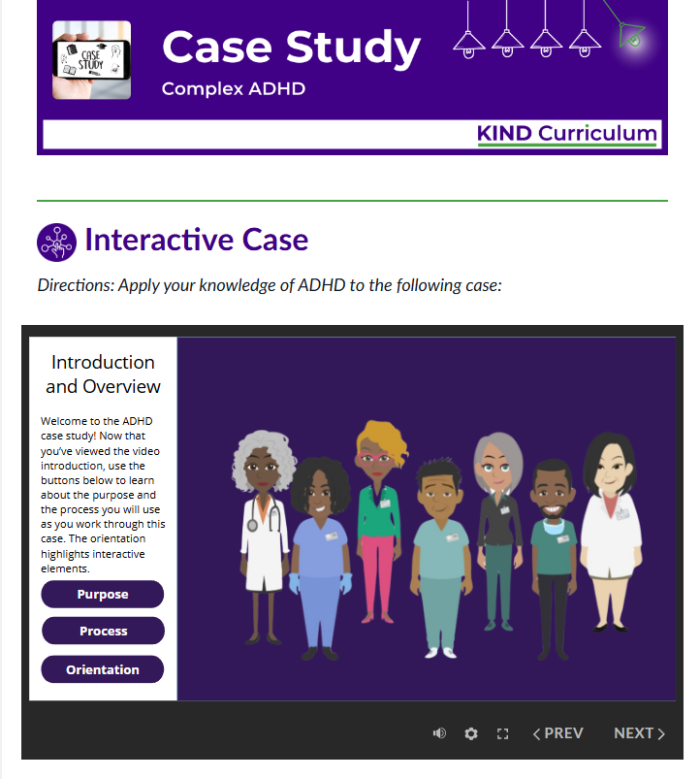
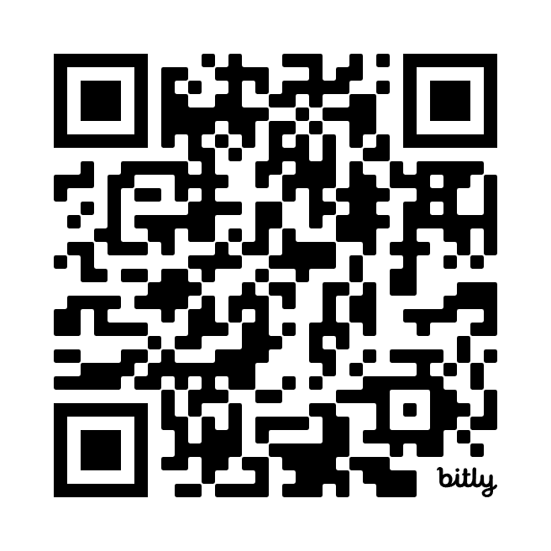
Kennedy Krieger Examples
Summative Case Scenario:
Kennedy Krieger Instruction in Neurodevelopmental Disabilities (KIND) Curriculum
Learn more:
https://bit.ly/KIND_2024

Slide 21
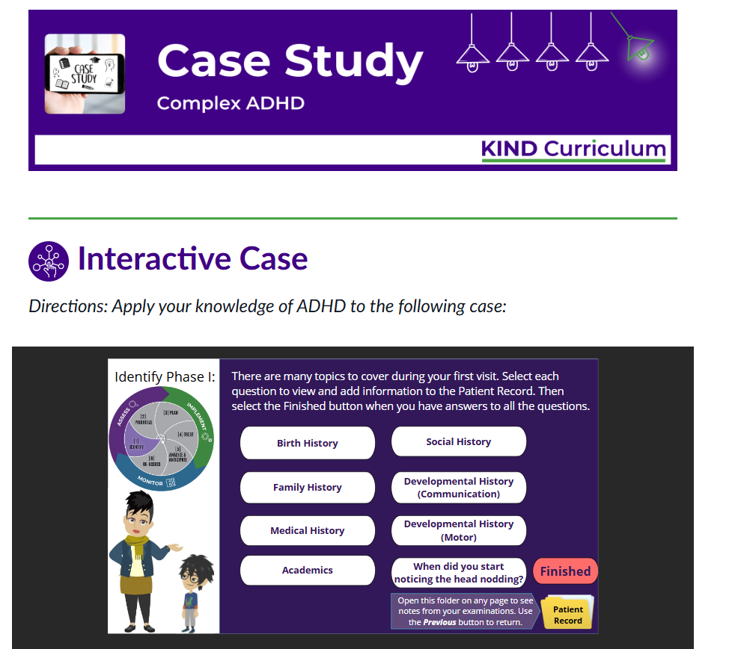
Kennedy Krieger Examples
Summative Case Scenario:
Kennedy Krieger Instruction in Neurodevelopmental Disabilities (KIND) Curriculum
Learn more:
https://bit.ly/KIND_2024

Slide 22
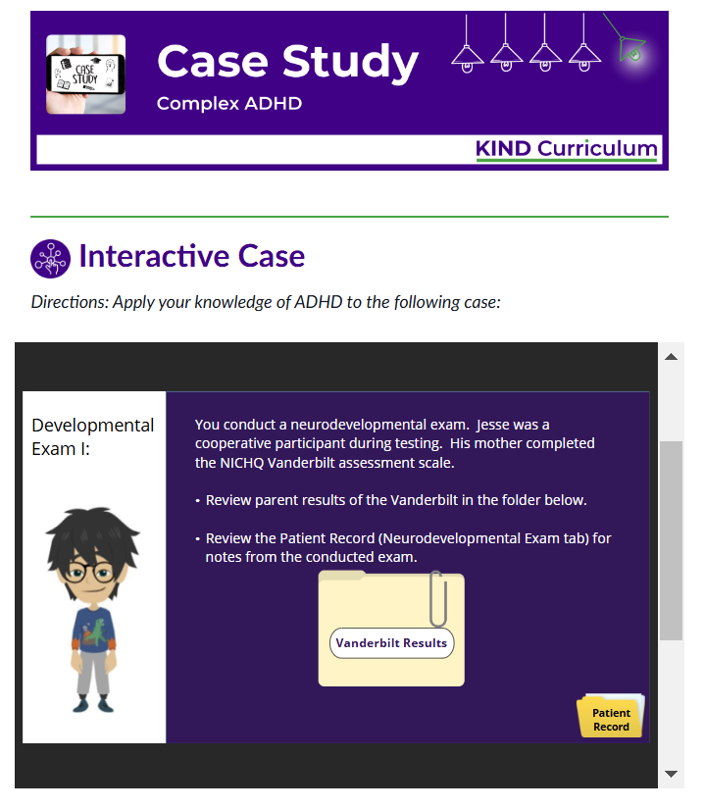
Kennedy Krieger Examples
Summative Case Scenario:
Kennedy Krieger Instruction in Neurodevelopmental Disabilities (KIND) Curriculum
Learn more:
https://bit.ly/KIND_2024

Slide 23
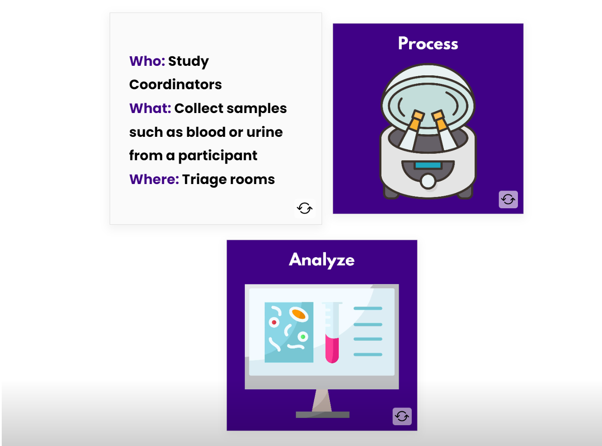
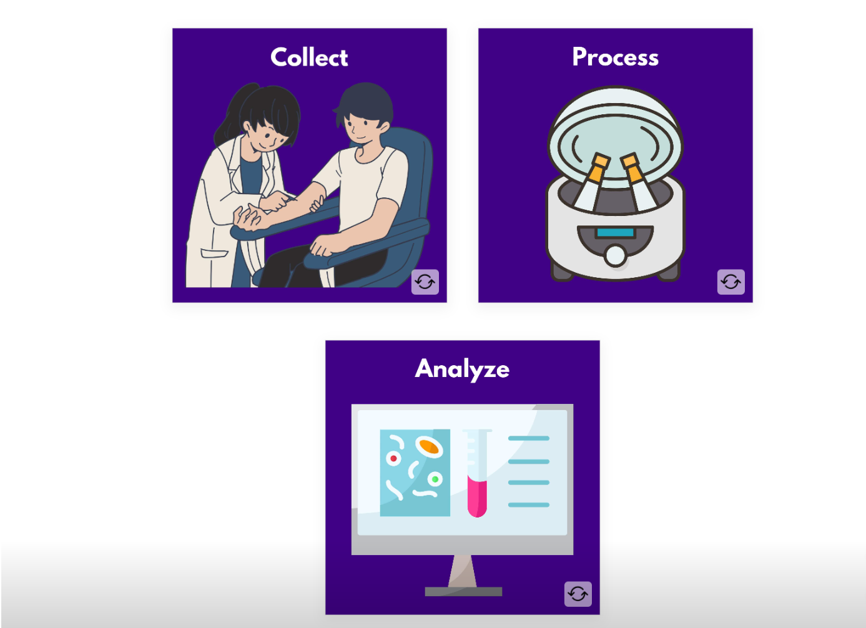
Kennedy Krieger Examples
Interactives
AI can help build tools

Slide 24
In Summary….
AT (with AI), AEM, UDL in online higher education → inclusive, effective, equitable learning
Better prepared professionals → Better workforce
Institutions should prioritize inclusivity through the integration of AI, AT, AEM, and UDL from conceptualization to design to implementation.

Slide 25
Your Comfort Level with AI is:
1. Oh no! Not AI
2. Get away, AI!
3. Hmm.. AI..
4. I LOVE AI!!

Slide 26
Resource Repository
https://bit.ly/ATAIUDL25

Slide 27
Thank You!!
Hillary Goldthwait-Fowles
Ph.D. ATP
goldthwait@kennedykrieger.org

