Slide 1
Rethinking Examinations in the Age of AI: Enhancing Student Agency and Inclusion Through Universal Design for Learning
Dr Kashmira Dave, Kylie Day, Jeanne Heath
University of New England

Slide 2


Exams : Not a new thing

Slide 3
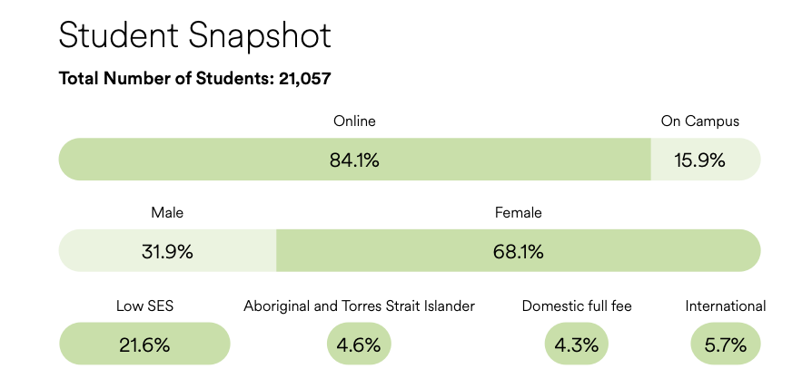
Accessibility is important for UNE

Slide 4

Challenges of equitable venue-based exams
Text-based questions
Scheduled time – ‘or else’
Long delays for deferred exams/re-sits
Travel
Ergonomic furniture
Special Equipment
Chemical Sensitivity
Lighting
Level access
Sensory overwhelm

Slide 5

A mother taking exam

Slide 6

Image of Honduras Bridge

Slide 7



LMS-Moodle vs ProctorU
Exam venue in ‘the cloud’
Exam ‘paper’ in ‘the cloud’
ProctorU
LMS-Moodle
Student ID and workspace check
Exam supervision
  View of student
  View of screen
  Secure Browser
Exam activity lives in Moodle
Marking happens here

Slide 8
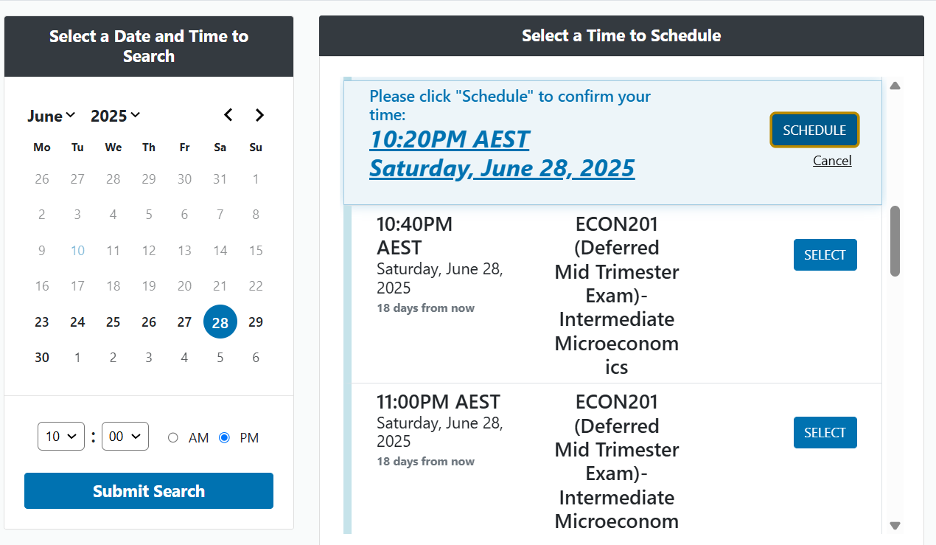
Exam scheduling

Slide 9

metaphor

Slide 10

Flexible exam scheduling
Exam availability windows (minimum 24 hours)
Students book into a start time that suits them
Further ability to override for students requiring extra flexibility
Exam design uses question banks and randomisation

Slide 11
Intentional increase in student agency
Increases accessibility
Students manage own exam clashes and cadence
Reduces ‘deferred exam’ applications
Improves student progression outcomes
Enabled move to ‘Compressed Exam Period’

Slide 12
Unique use of the platform
Compressed exam period
Not limited by ‘venue’ constraints
Stopped ‘micromanaging’ exam clashes
Two-week exam period now one week
Allows for one week break between teaching periods for students and staff

Slide 13
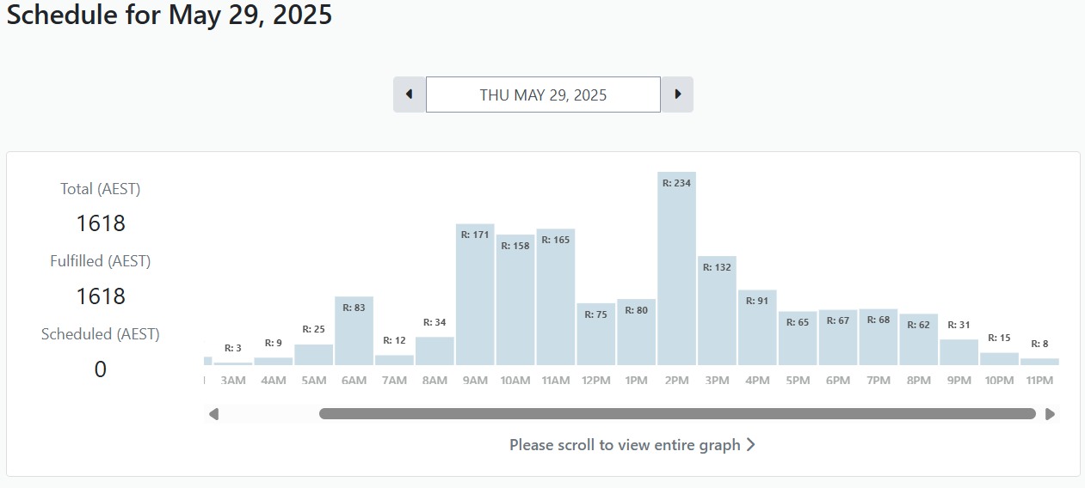
Typical exam bookings

Slide 14
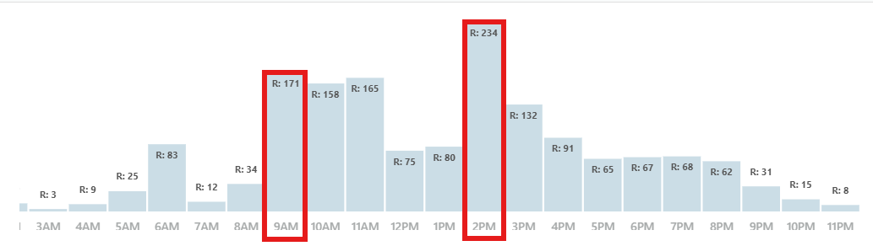
Previous ‘start times’ for 100% of students

Slide 15
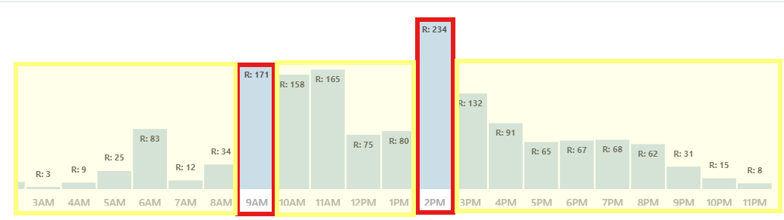
75% of students choose to schedule at different times, 39% outside of business hours

Slide 16
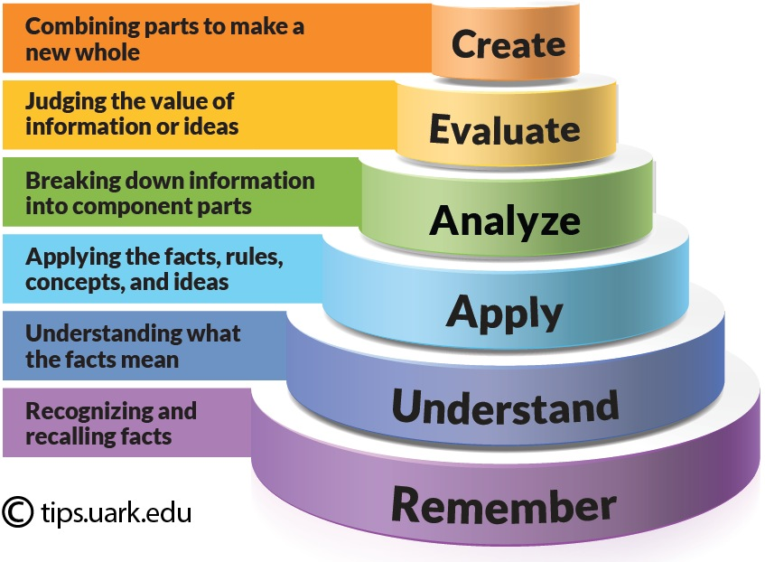
Catalyst and enabler of better exam design
Bloom’s taxonomy as a base for exam design

Slide 17

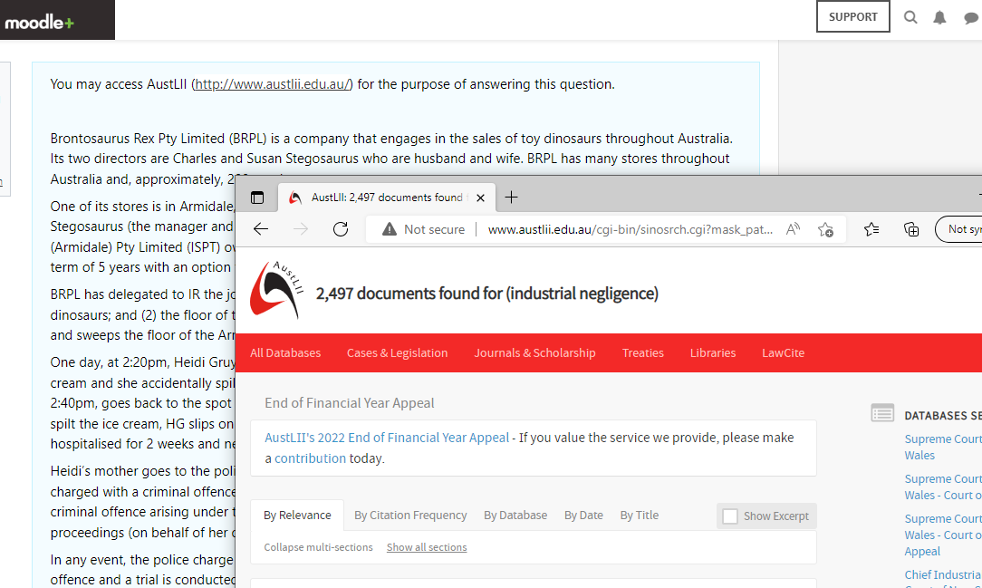
Better exam design
Industry relevant tools & resources
VS

Slide 18
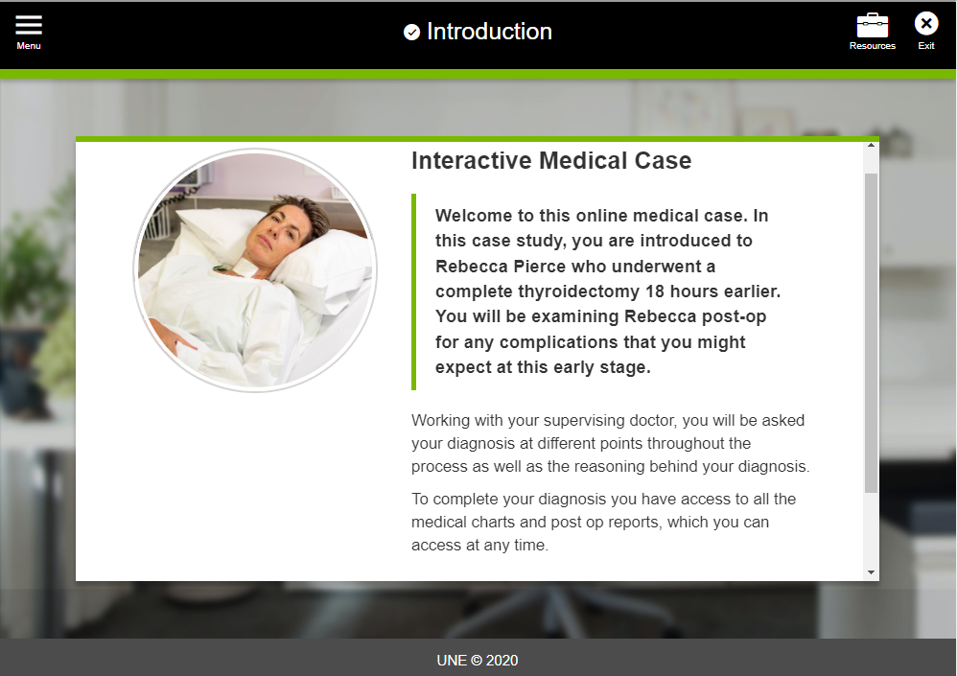
Better exam design
Interactivity
VS

Slide 19
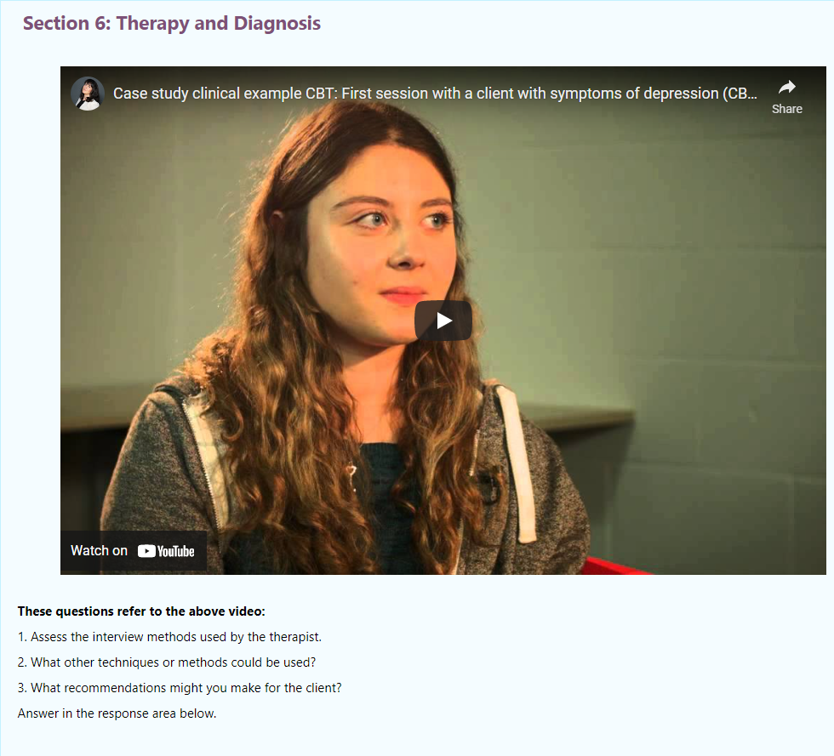
Better exam design
Authentic Assessment
VS

Slide 20
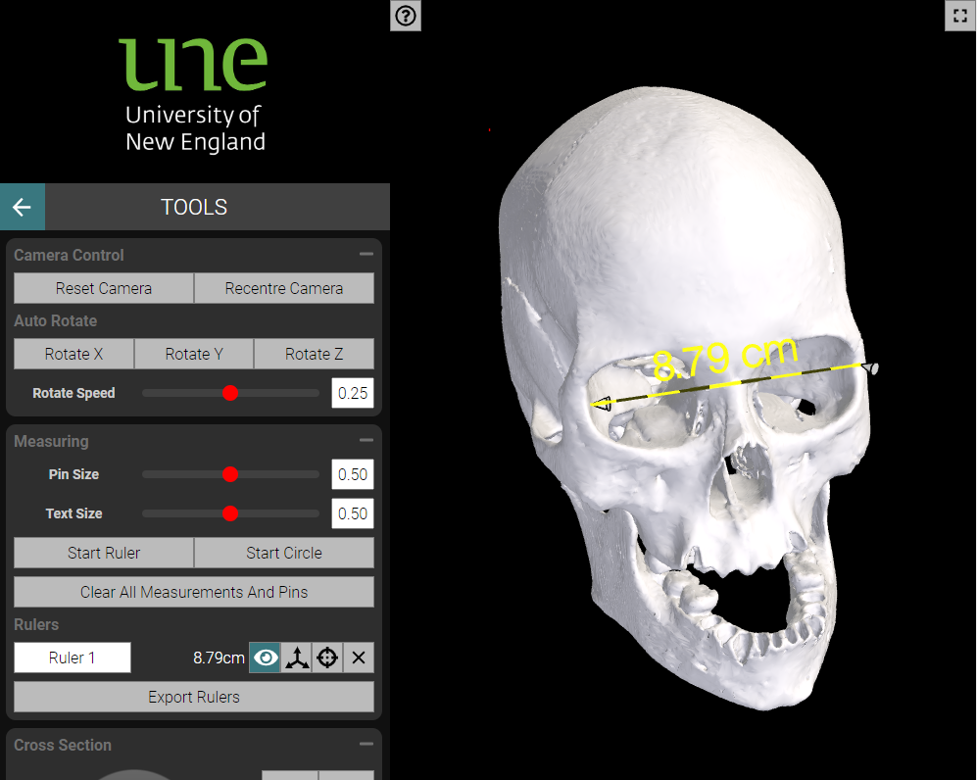
Better exam design
Rich media
VS

Slide 21
Outcomes
Students have agency over time and place
Increased accessibility
82% Satisfied or Very Satisfied with the platform (+ 11% neutral)
Institutional Benefits
Flexible, more authentic assessment
ID verification, proactive live supervision
Ability to control OR allow use of GenAI
Resilience to risk, responsive to students

Slide 22

Ideas come from the edges….

Slide 23

We don’t need to do this alone….

Slide 24

From little things….
Starting something at your university?
Don’t wait for permission
Demonstration beats Explanation

Slide 25

Questions ?

