Slide 1

Beyond Accommodation: Embedding Inclusive Assessment for Institutional Change
Nattalia Godbold (Project officer) & Chris Frost (eLearning Manager)
University of Queensland (UQ)

Slide 2

Acknowledgement of Country
  UQ acknowledges the Traditional Owners and their custodianship of the lands on which we meet.
  Artwork: The Brisbane River pattern from A Guidance Through Time by Casey Coolwell and Kyra Mancktelow

Slide 3

Research Questions
Questions
How do students understand inclusive assessment at UQ?
How do educators provide inclusive assessment at UQ?
Focus
Understanding inclusive and equitable assessment across the university
Opportunity
A Teaching Innovation Grant (TIG) to explore inclusive practices across the university

Slide 4
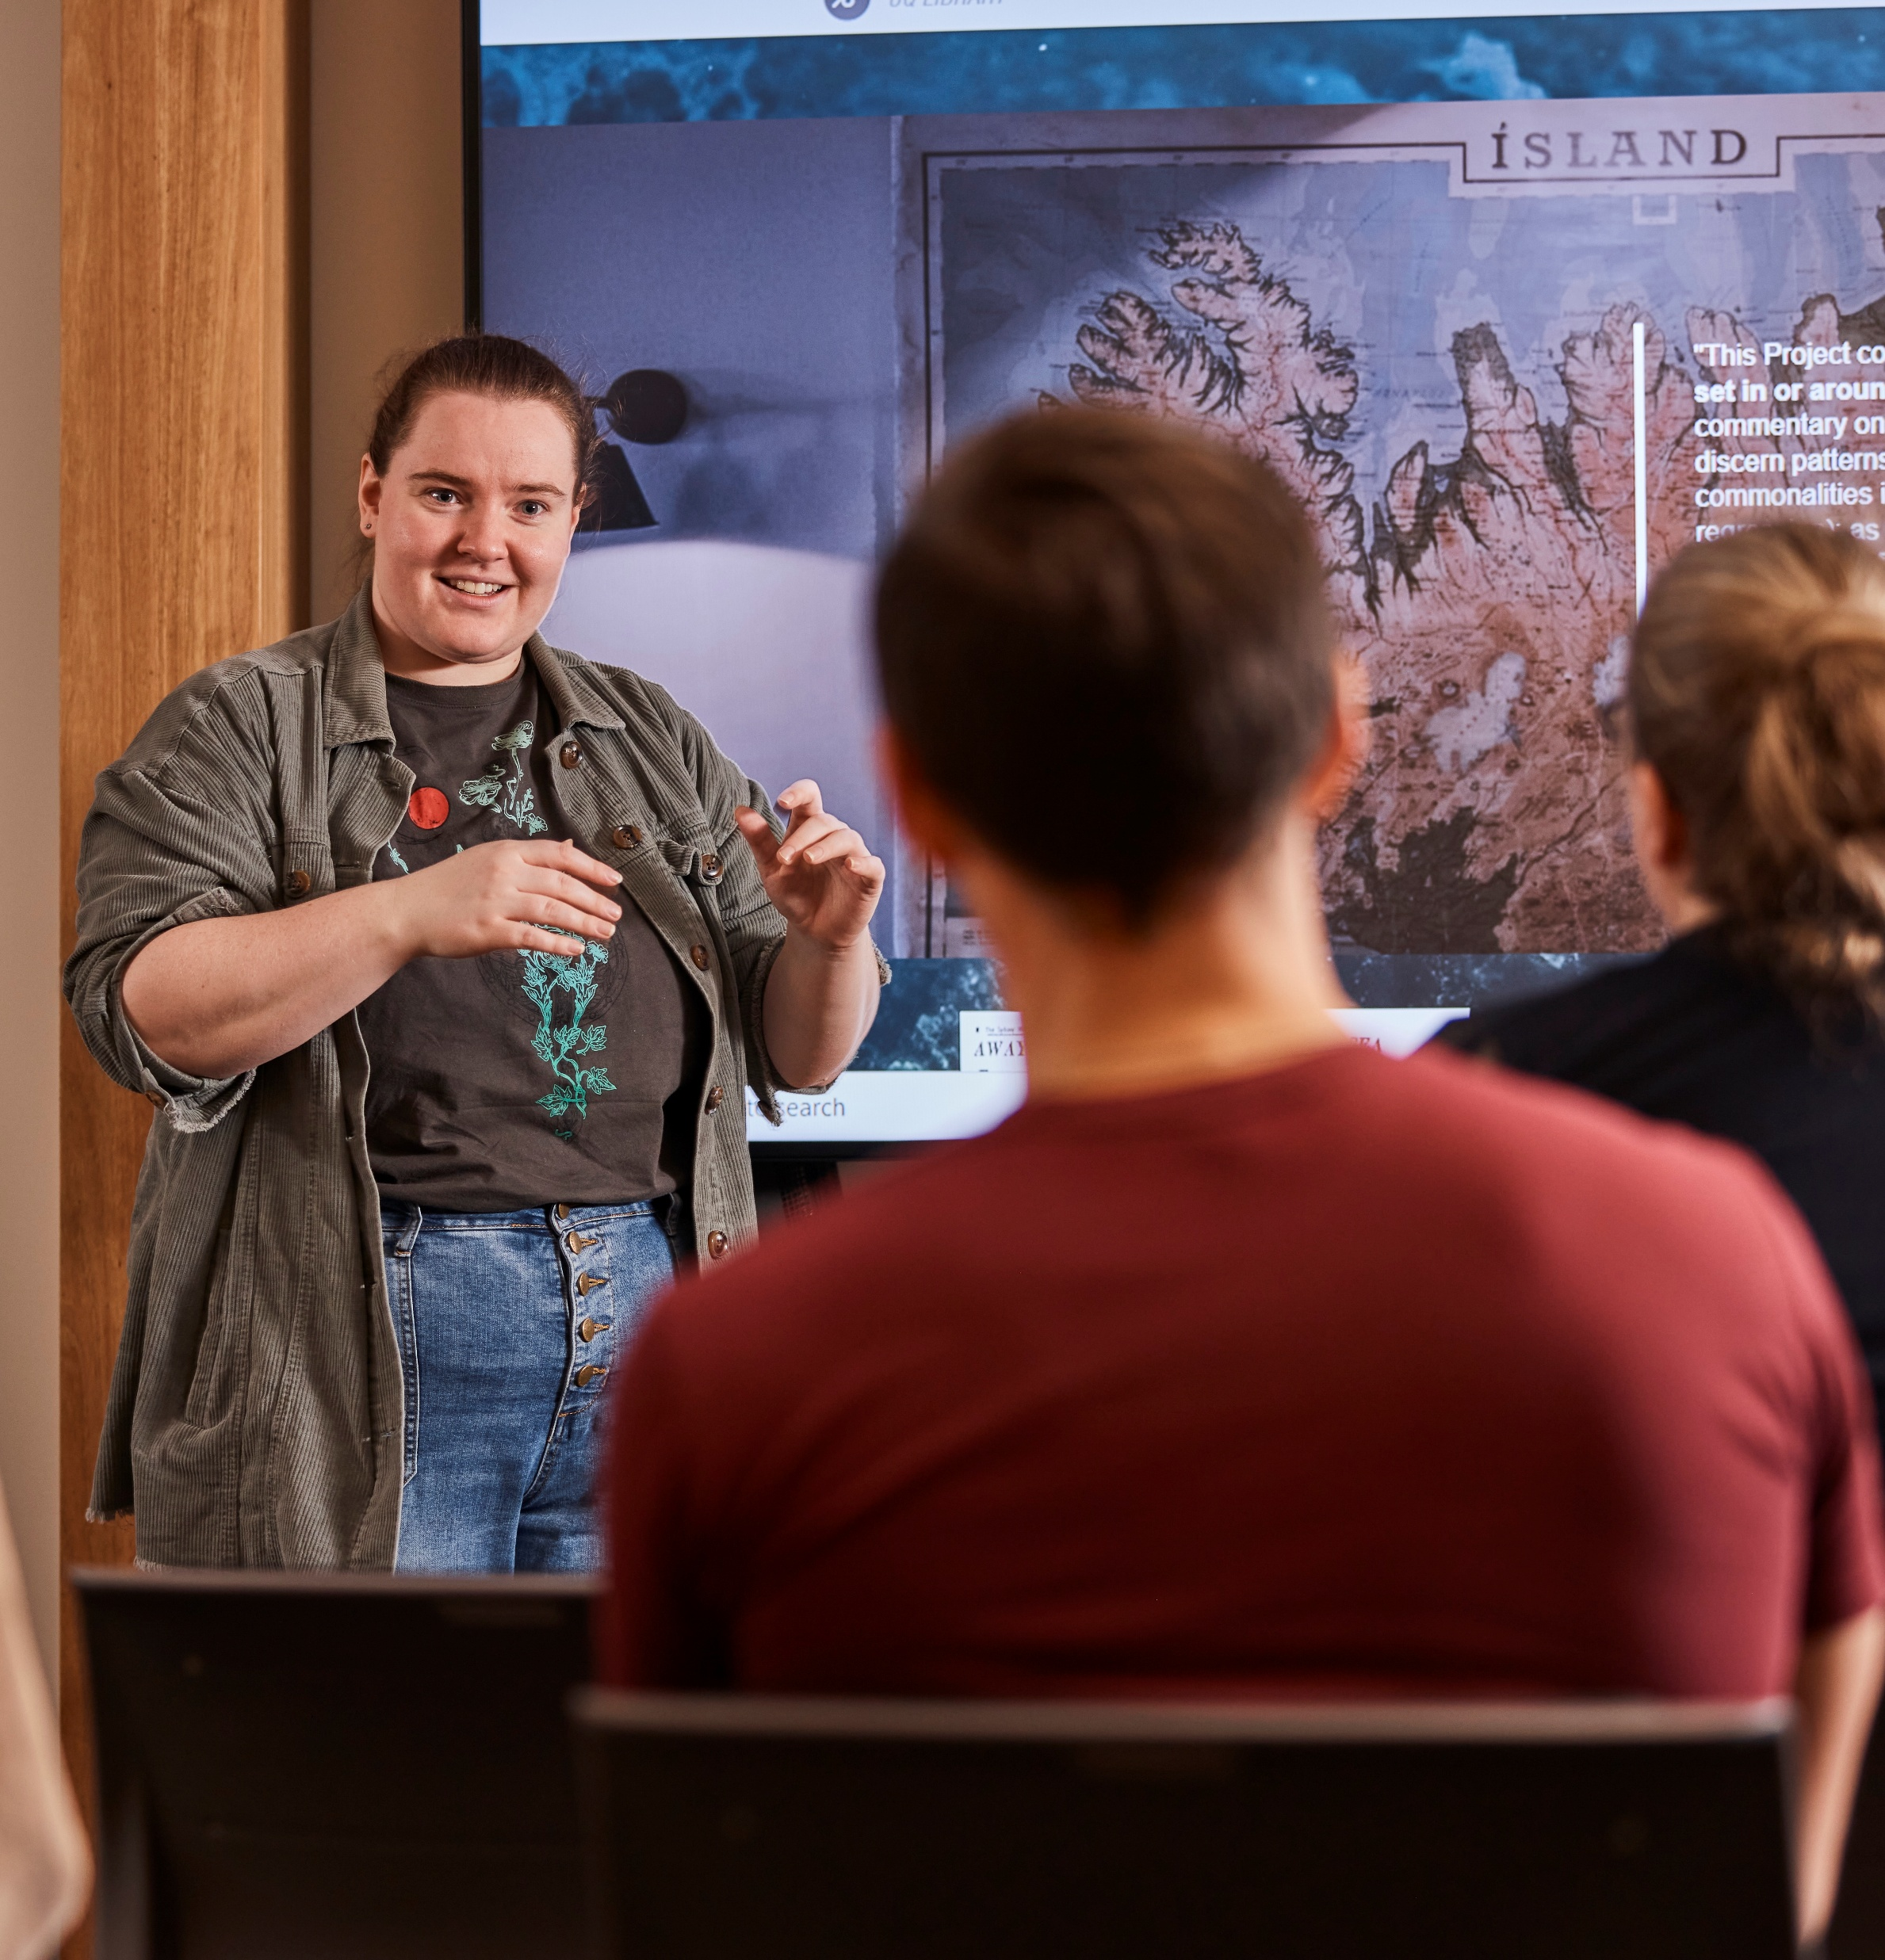
Project
Key components
Student focus groups
Survey of educators, based on themes found in focus groups
Review of UQ’s Assessment Ideas Factory (AIF)
Development of an inclusive assessment framework

Slide 5
Four Themes From Focus Groups
Equity, Access & Student Agency
Student Experience of Assessment
Assessment Outcomes
Relationships & Communication
“If I have the option to do a presentation or an essay, I can pick what I’m best at, and I feel more confident showing what I know.
“It was just amazing to be given the choice... that helped me engage more with what I was learning.
“I get really anxious with exams, so having the option to submit a portfolio meant I could take my time... I was actually learning from it.
“When my tutor asked us how we wanted to be assessed, I felt respected—it was the first time someone asked us.
Four focus groups were conducted with diverse students.
We aimed to understand what helps them feel included, learn, and show what they know.

Slide 6
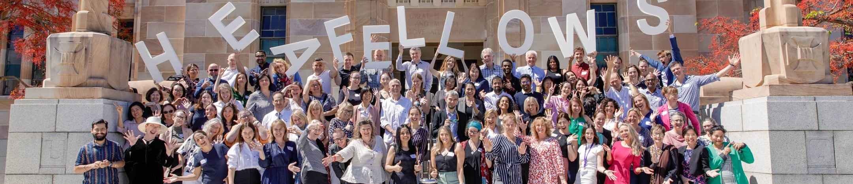
The Journey
Reviewing the UQ Assessment Ideas Factory online database
Survey of Higher Education Academy fellows, based on student feedback
Adding new inclusion tagging

Slide 7
Inclusive assessment framework
Informed by UDL 3.0 principles, student focus groups, and scholarly literature
Framework Theme | Description | Some aligned UDL Considerations
Inclusive | Eliminates barriers with: Choice or variety of formats Creative expression Developmental learning | Connect prior knowledge to new learning (3.1) Nurture joy and play (7.3) Vary and honor the methods for response, navigation, and movement (4.1)
Authentic | Personally meaningful to students’ values or future careers | Optimize relevance, value, and authenticity (7.2) Foster belonging and community (8.4) Recognize expectations, beliefs, and motivations (9.1)
Valid | Clear links to learning outcomes | Clarify the meaning and purpose of goals (8.1) Set meaningful goals (6.1)

Slide 8
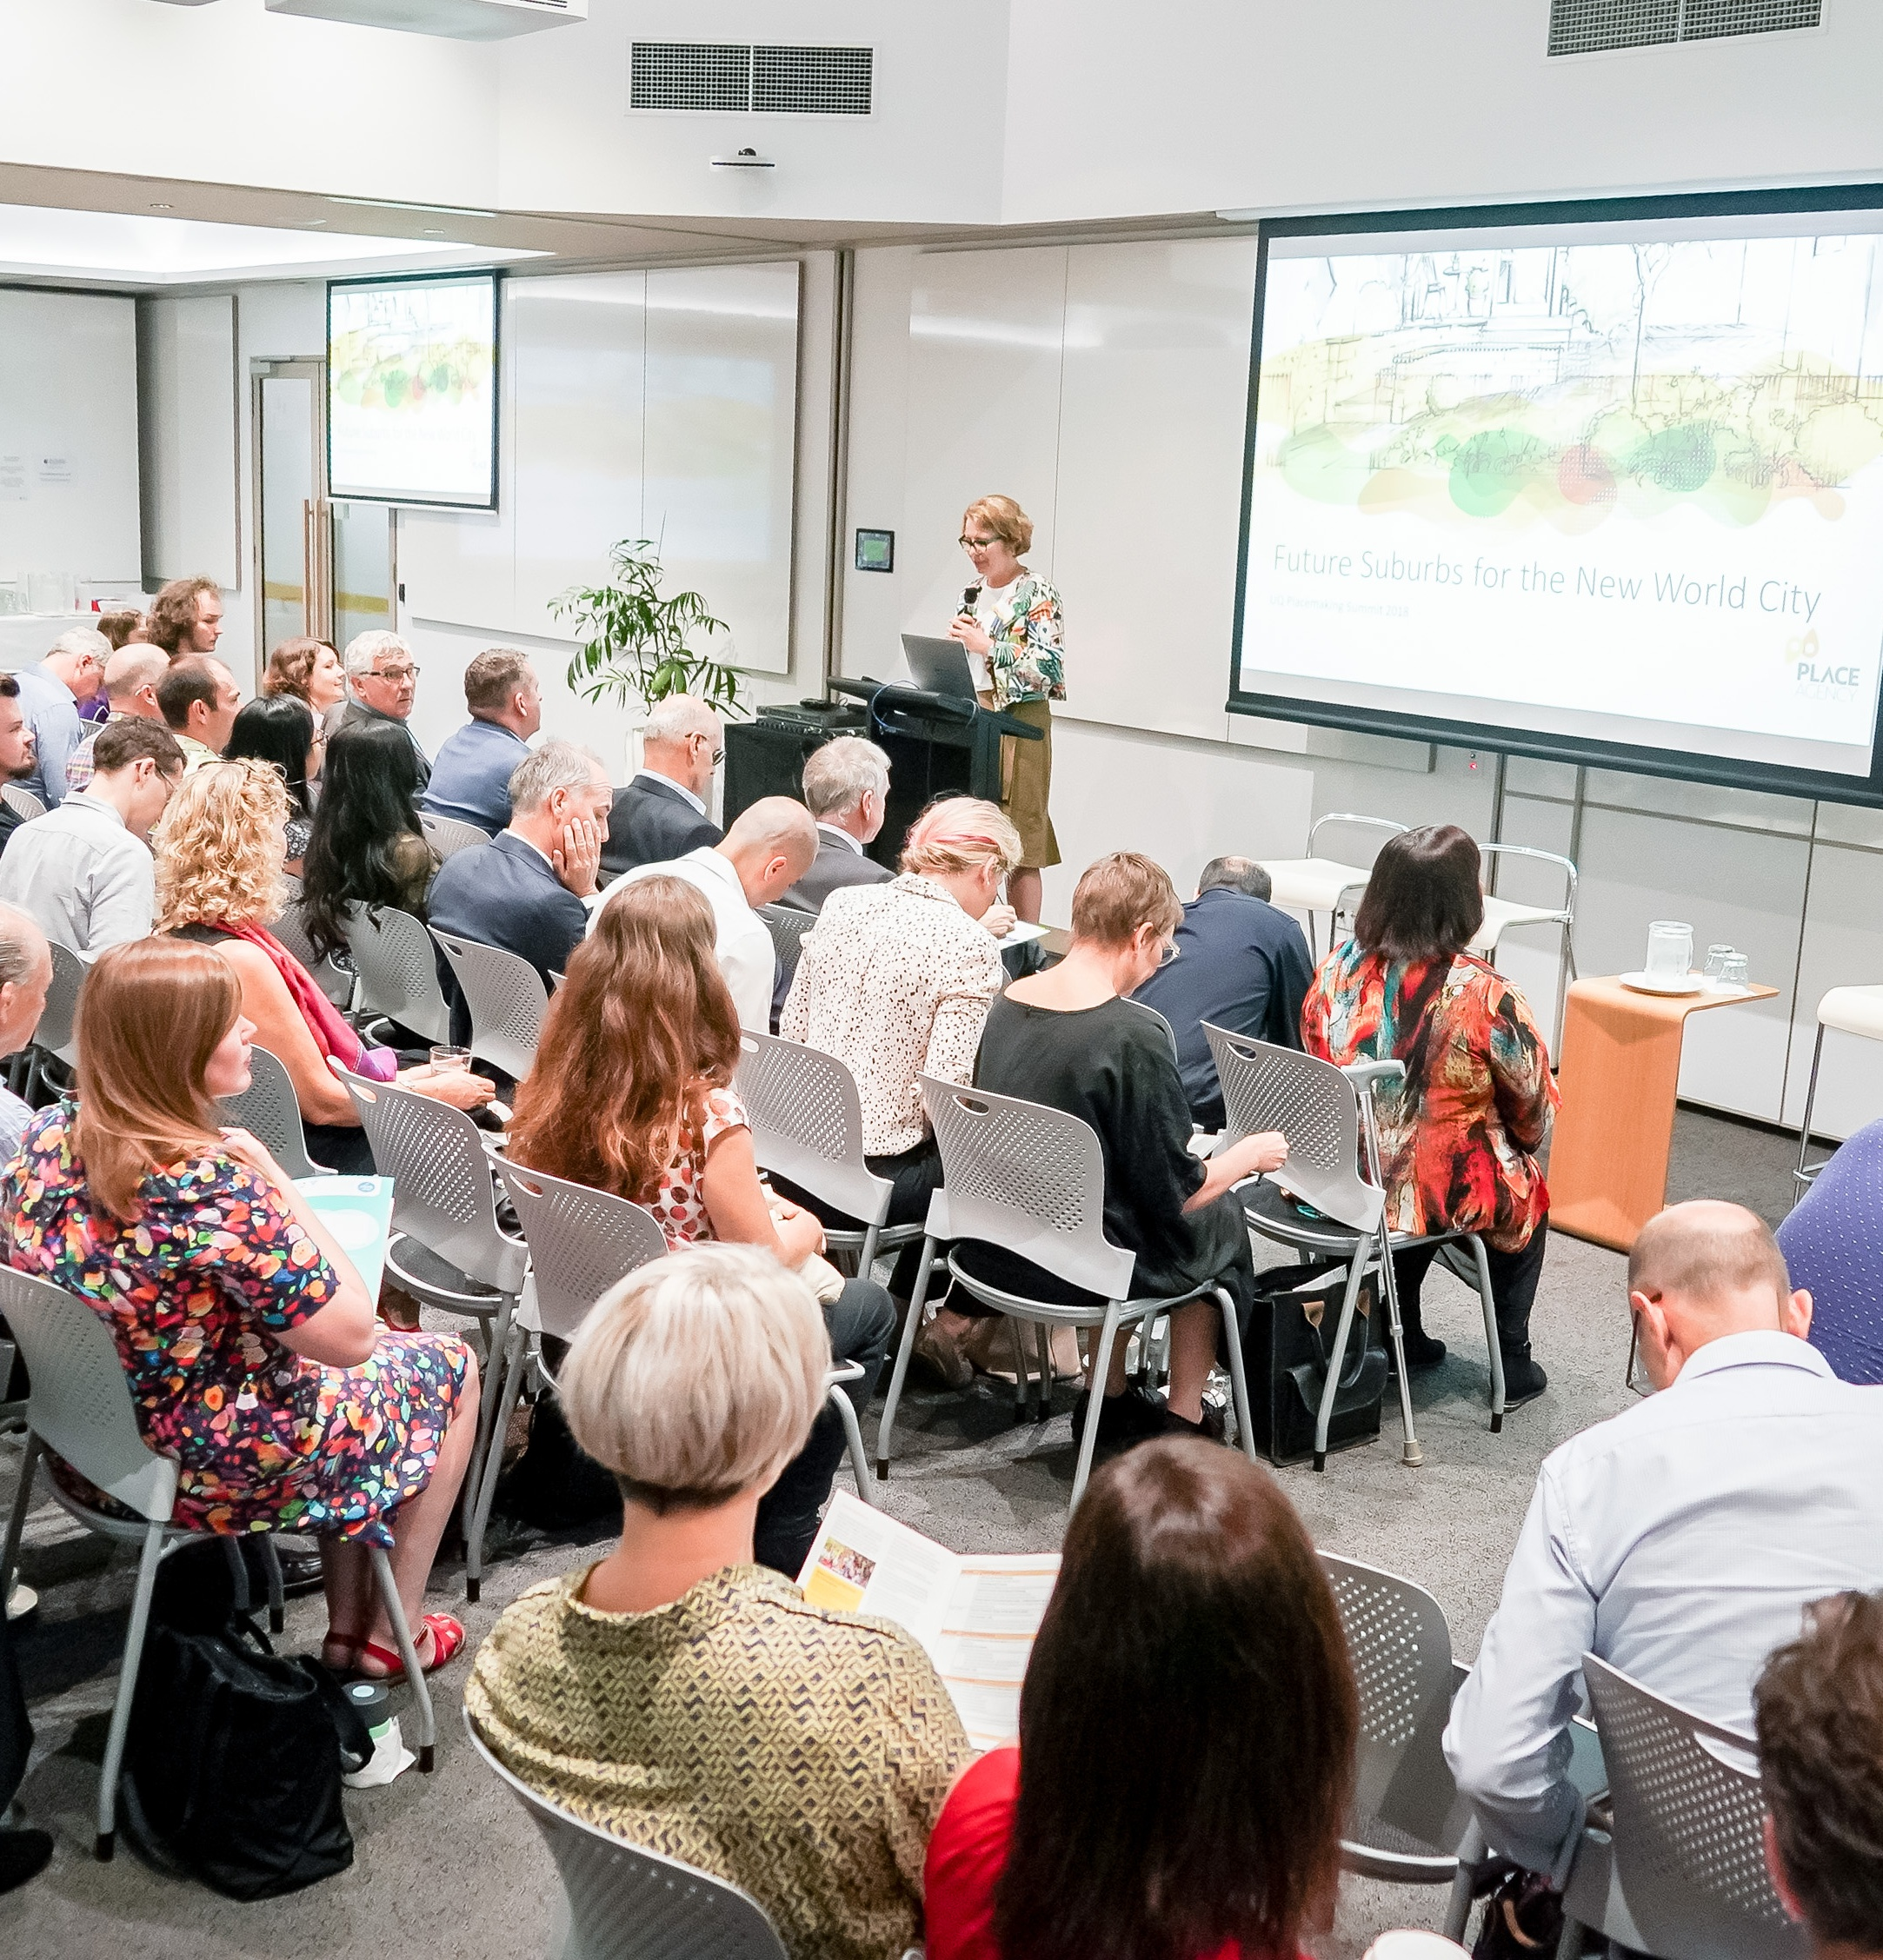
Looking Ahead
Launching the framework at UQ Teaching and Learning Week 2025
Seeking a follow-on grant project
Our project collaborators
Professor Gwendolyn Lawrie
Associate Professor Deanne Gannaway
Aliisa Mylonas

