Slide 1

Enhancing Authentic Engagement in Group Assignments
Using learner data to offer practical strategies for improving student engagement.
Presented by Jessica Zanuttini PhD FHEA
USYD Researcher Profile

Slide 2
Acknowledgment of Country
I would like to acknowledge the Traditional Custodians of the land on which we are meeting, the Gadigal People of the Eora Nation, and pay my respects to Elders past, present, and emerging.

Slide 3
Presentation Agenda
Nature of collaborative group work in higher education
Overview of study procedure
Common barriers and facilitators to collaborative group work
Strategies to support collaborative group work
  Speed interviewing for group formation
  Team charters for goal setting and accountability
  Reflective collaborative statements for process-orientated assessment

Slide 4
Anecdotally… before implementation
Before implementation of speed interviewing, team charters, and collaborative statements:
Students had a negative attitude towards group work
Students felt burdened by group work
Many reports of ‘free riding’ or ‘social loafing’
Observation/admitting to the ‘sucker effect’ (reduced personal efforts)
Reports of dissatisfaction with collective grades
Reports of group conflict after grade release
Requests for separate marking

Slide 5
Nature of Collaborative Group Work
Collaborative group work has been an established pedagogical practice since the 1970s (Slavin, 1991)
Group tasks support students in developing essential collaboration and communication skills (Rundle, 2014)
Collaborative group work mirrors authentic workplace dynamics, helping students transition into professional environments where teamwork is expected (Aaron et al., 2012)
Collaborative group work presents persistent challenges and is often associated with negative attitudes (Song et al., 2025)
Collaborative group work results in mixed learning outcomes (Joo, 2017)

Slide 6
Research Questions For a Phenomenological Approach
1. How do university students enrolled in special and inclusive education units, perceive and articulate their experiences of group work in the unit?
2. What are the key facilitators and barriers identified by university students as they engage with collaborative group work activities while enrolled in special and inclusive education units?

Slide 7



Procedure
Ethics Approval
DVC-E approval to use documents submitted with student assignments
Downloaded Material
18 Team Charters
131 Collaborative Statements across three S&IE units between 2021 & 2024
Content Analysis
Inductive and deductive content analysis (facilitators and barriers)

Slide 8
Collaborative Statements Table
Year & Semester | Unit Code | Team Charters | Collaborative Statements | Language used
2021 S2 | EDPD6015 | 0 | 2 (50%) | ”Can submit”
2021 S2 | EDUF3031 | 0 | 8 (36%) | ”Can submit”
2022 S2 | EDPD6015 | 0 | 0 | ”Can submit”
2022 S2 | EDUF3031 | 0 | 0 | ”Can submit”
2023 S1 | EDPD5005 | 2 | 0 | ”Can submit”
2023 S1 | EDUF3031 | 2 | 31 (67%) | “encouraged to”
2023 S2 | EDPD6015 | 2 | 2 (50%) | “encouraged to”
2023 S2 | EDUF3031 | 1 | 25 (81%) | “encouraged to”
2024 S1 | EDUP5005 | 3 | 6 (75%) | “encouraged to”
2024 S1 | EDUF3031/2022 | 4 | 28 (78%) | “encouraged to”
2024 S2 | EDPD6015 | 1 | 9 (100%) | “expected to”
2024 S2 | EDUF3031 | 3 | 20 (83%) | “encouraged to”

Slide 9
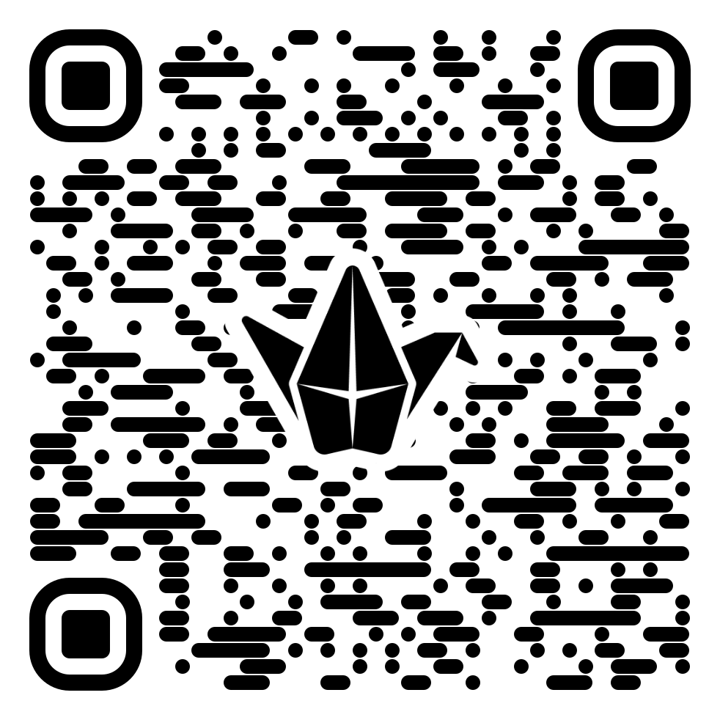
Common Barriers
What do you think are the common barriers to successful collaborative group work?
https://tinyurl.com/788s3nyr

Slide 10
Findings: Common Barriers
Deductive content analysis revealed the following subthemes:
  Time constraints and scheduling conflicts
  Communication challenges and misunderstandings
  Workload distribution and contribution
  Conflict
  Task ambiguity and complexity
  Team member absence

Slide 11
Findings: Common Facilitators
Deductive content analysis revealed the following subthemes:
  Open communication
  Planning and organisation
  Positive group dynamics
  Leveraging individual strengths and expertise
  Review and feedback processes
  Team charters or agreed work practices

Slide 12
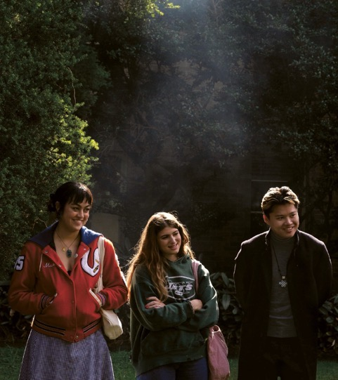
Strategies to Support Collaborative Group Work
Speed interviewing for group formation
Team charters for goal setting and accountability
Reflective collaborative statements for process-orientated assessment

Slide 13
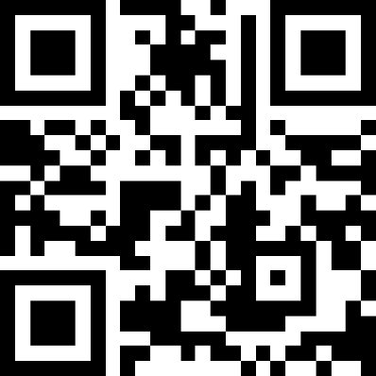
Speed Interviewing (Sublett et al., 2022)
Based on the speed-dating method
Codesign element
2-weeks before, students are prepared to discuss:
  What they can offer to a team & their goals
  What they are looking for in team members
Facilitation materials are provided (e.g., recording forms, name tags)
Release of results asap
Teaching@Sydney article: https://tinyurl.com/yfkec53h
Guide and materials: https://tinyurl.com/5n7wymn8

Slide 14
Speed Interviewing & UDL
Characteristic | Link to UDL Guidelines | Consideration
Learner agency over grouping | Welcoming interests and identities | Optimization choice and autonomy (7.1)
Preparation and sharing of expectations and goals | Emotional capacity | Recognize expectations, beliefs, and motivations (9.1)
Interpretations of own/others strengths and weaknesses | Emotional capacity | Develop awareness of self and others (9.2)

Slide 15
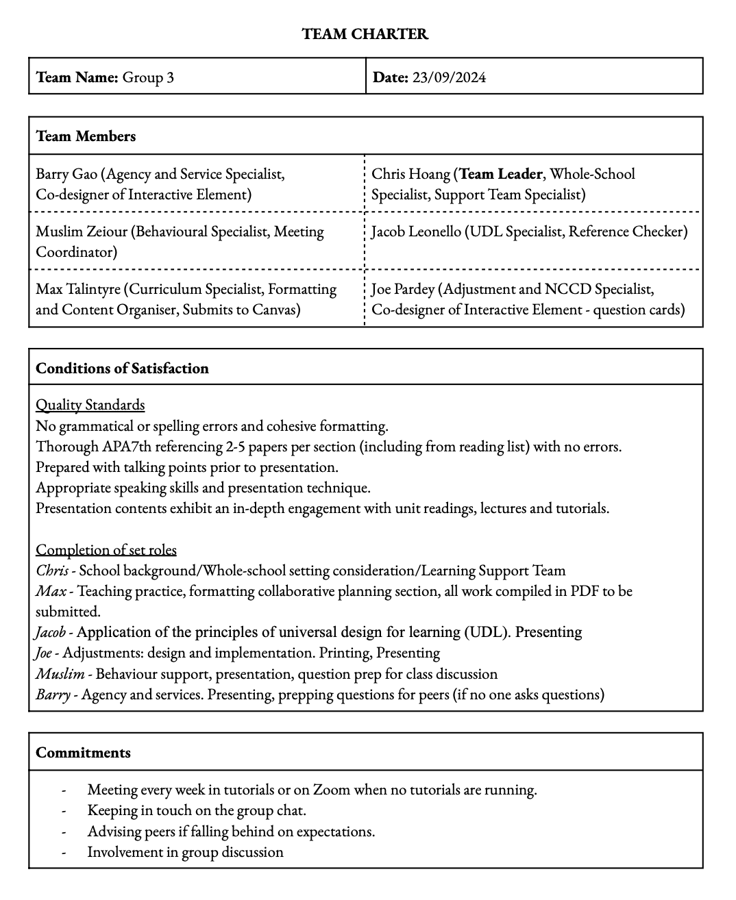
Team Charters

Slide 16
What are Team Charters?
Team charters provide a foundation for shared expectations (i.e., collaboration and communication norms) (Barron, 2000)
Team charters are a tool for accountability and motivation by describing roles and responsibilities (Mathieu & Rapp, 2009)
Team charters provide support for a structured collaboration through explicit process descriptions (e.g., decision making, conflict resolution) (Hunsaker et al., 2011)
Team charters are most effective with instructor involvement (Aaron et al., 2014)

Slide 17
Shared Team Charter Resources
Sydney's Student Charter 2020
Teaching@Sydney article on supporting online group work
Orientation and tips in this 5-minute video from UBC
University of Otago Developing a team charter
Group work tips from Sydney
More detailed guidance on group work from UTS and WSU
Sydney's Group work: Collaborative Learning resource on Canvas (enrolment required)

Slide 18
Team Charters & UDL
Characteristic | Link to UDL Guidelines | Consideration
Recording shared goals | Sustaining effort and persistence | Clarifying the meaning and purpose of goals (8.1)
Provision of resources | Sustaining effort and persistence | Optimize challenge and support (8.2)
Encouraging shared goals, commitments, responsibilities | Sustaining effort and persistence | Foster collaboration, interdependence, and collective learning (8.3)
Describing processes for dealing with challenges and conflicts | Strategy development | Anticipate and plan for challenges (6.2)

Slide 19
Reflective Collaborative Statements
Your statement can be written individually or as a group
Your statement doesn’t need to be long
Your statement might reflect on the following questions:
  How successful was your group’s collaboration?
  Was this a positive experience for each group member?
  What did your group do well?
    What contributed to your group’s success?
  What challenges did your group face?
    How did you overcome these challenges?
    Why didn’t you overcome these challenges?
  What supports were required to support your collaboration?
    Did you have access to these supports?
  How did you develop and maintain collaboration and communication?
  Anything else you wish for the marker to know about the collaboration

Slide 20
Exemplar quotes (Undergrad Mandatory S&IE Unit)
"[Our collaboration] has been highly rewarding, providing us with valuable insights into effective teamwork and collaborative planning that will undoubtedly benefit our practice as future teachers.”
"...we always ended up with a better idea than what we individually offered, and helpful discussions to help us understand the concepts more thoroughly.”
"Overall, our group’s collaboration over the course of this task allowed us as pre-service teachers to consider how we might implement similar opportunities for communication in our future classrooms."

Slide 21
Collaborative Statements & UDL
Characteristic | Link to UDL Guidelines | Consideration
Option for individual and/or collective reflection | Emotional capacity | Promote individual and collective reflection (9.3)
Encouraging personal reflection that is shared with others | Perception | Represent a diversity of perspectives (1.3)

Slide 22
Anecdotally… after implementation
Before implementation:
Students had a negative attitude towards group work
Students felt burdened by group work
Many reports of ‘free riding’ or ‘social loafing’
Observation/admitting to the ‘sucker effect’ (reduced personal efforts)
Reports of dissatisfaction with collective grades
Reports of group conflict after grade release
Requests for separate marking
After implementation:
Neutral attitude towards group work
Few reports of ‘free riding’ or ‘social loafing’ (during collaboration)
No reports of group conflict
No requests for separate marking
No reports of dissatisfaction with collective grades

Slide 23
References
Aaron, J. R., McDowell, W. C., & Herdman, A. O. (2014). The Effects of a Team Charter on Student Team Behaviors. Journal of Education for Business, 89(2), 90–97. https://doi.org/10.1080/08832323.2013.763753
Barron, B. (2000). Achieving coordination in collaborative problem-solving groups. Journal of the Learning Sciences, 9, 403–436.
Hunsaker, P., Pavett, C., & Hunsaker, J. (2011). Increasing student learning effectiveness with team charters. Journal of Education for Business, 86, 127–139.
Joo, M.-H. (2017). Students’ group work contribution: Influence of work preference, gender, and individual assessment. Social Behavior and Personality, 45(1), 19–28. https://doi.org/10.2224/sbp.5385
Mathieu, J. E., & Rapp, T. L. (2009). Laying the foundation for successful team performance trajectories: The roles of team charters and performance strategies. Journal of Applied Psychology, 94, 90–103.
Rundle, O. (2014). Creating a healthy group work learning environment in law classes. QUT Law Review, 14(1), 63–80. https://doi.org/10.5204/qutlr.v14i1.519
Song, M. H., Lim, J., Lee, S., Ihm, J., & Park, J. (2025). Enhancing group outcomes: the role of individual preparation in collaborative learning. BMC Medical Education, 25(1), 524–10. https://doi.org/10.1186/s12909-025-06925-1
Sublett, L. W., Johnston, A. M., Walther, C. A. P., Seahorn, C., Moreno, G. L., & Brownlee, L. (2024). Speed-Interviewing for Classroom Group Formation: How a Clever Twist on the Classic “Speed-Dating” Tradition Enhances Small Group Coursework. Teaching of Psychology, 51(4), 478–483. https://doi.org/10.1177/00986283221134034
Slavin, R. E. (1991). Synthesis of research of cooperative learning. Educational Leadership, 48(5), 71–82.

