Slide 1





Universal Design for Learning (UDL).
Building a Culture of Inclusion in Maynooth University, Ireland.
Dr Margaret Flood
Presenting on behalf of the Maynooth University Fellow Team
Ollscoil Mhá Nuad
Maynooth University
Education Department

Slide 2

Invitation to participate
Please use this space in a manner that facilitates your learning.
Sit in chairs or on the floor/steps, lie on the floor, stand up, move around, come in and out, eat and drink, take a moment.
Write, type, draw, say it
Be respectful of how everyone is using the space for their learning.

Slide 3
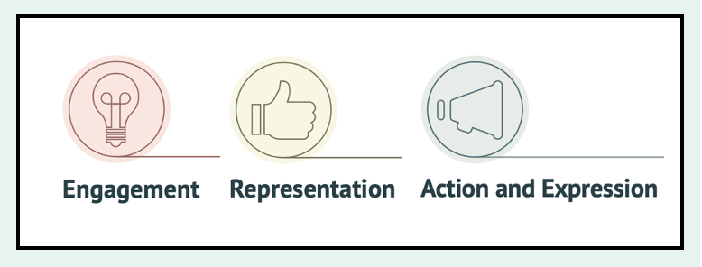
Building a culture of inclusion
Who
Why
What
How

Slide 4
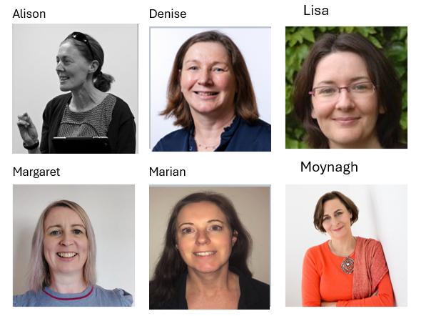
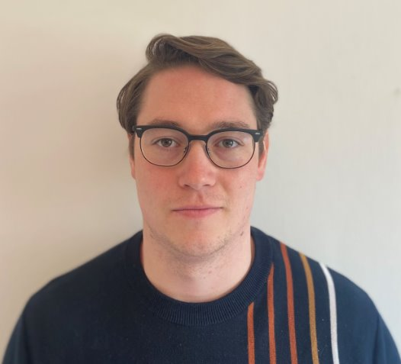
Who?
Cross-faculty academics with varying knowledge of UDL supported by our (MU) Centre for Teaching and Learning colleagues.
Patrick

Slide 5
Why. Values and policy
Alignment with national policy and initiatives: PATH 4 and UDL Charter for tertiary education
To support MU’s commitment to EDI principles
To support the enactment of UDL for inclusive education in teaching and learning practice at Maynooth University.
The intention of a UDL Fellowship: prestige, profile, cross-faculty, collaborative learning, building UDL awareness and capacity
Surfacing and bringing together pockets of good practice

Slide 6
What. The project
The project aim
Embedding UDL principles in teaching, learning and assessment practices as part of inclusive education.

Slide 7
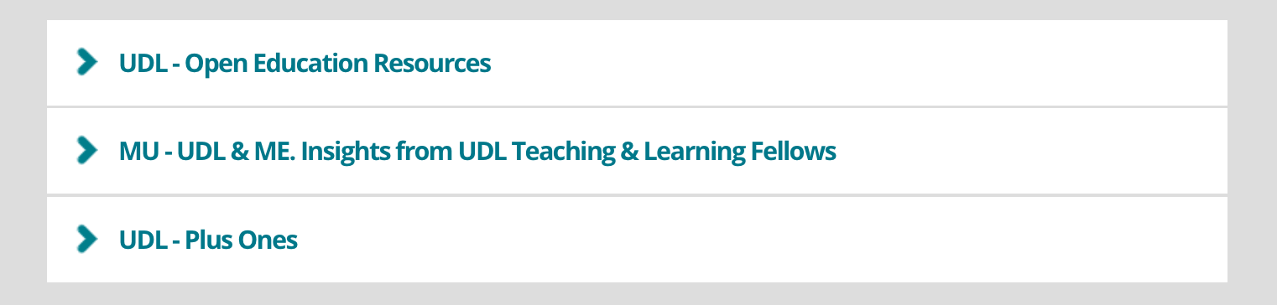

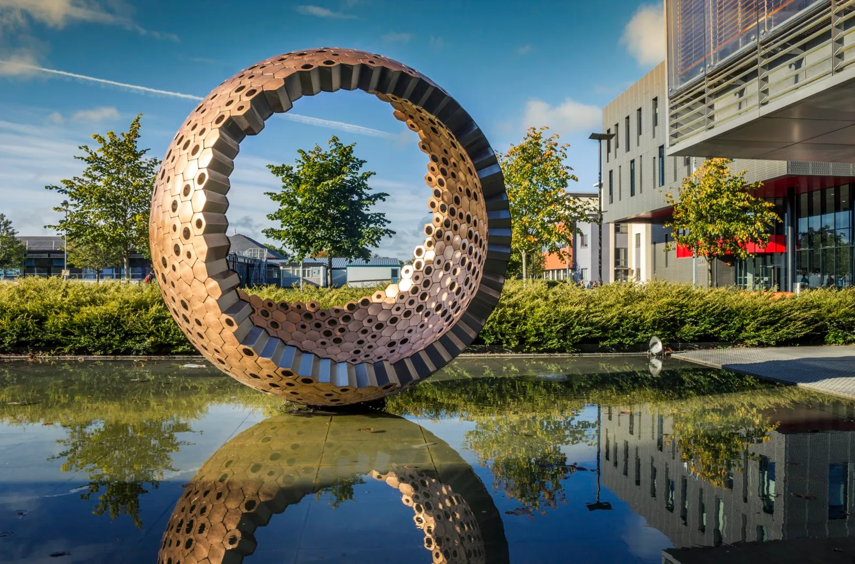
What. The project content
Resources
Awareness Raising Campaign
MU Exemplars
This Photo by Unknown Author is licensed under CC BY-ND

Slide 8
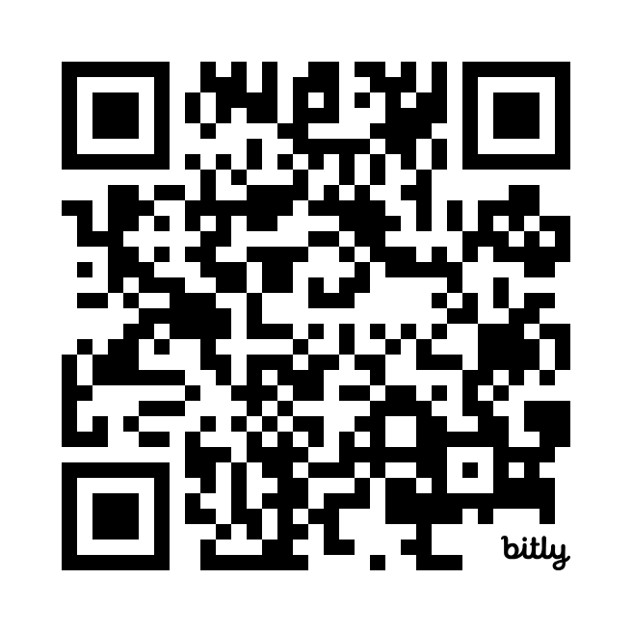
How. Open Education Resources
Positive Outcomes of Universal Design for Learning (UDL)
Universal Design for Learning (UDL) and Inclusive Education in Maynooth University
Anticipating and Addressing Challenges in Universal Design for Learning (UDL) Implementation for Success
What is Universal Design for Learning (UDL)? Principles and Guidelines
Please note the Guidelines in the above OER (2.2) have been updated, and the current version (3.0) is available here
What Does the Research Tell us about Universal Design for Learning (UDL)?
Why is Universal Design for Learning (UDL) Important in Maynooth University?
https://www.maynoothuniversity.ie/centre-teaching-and-learning/ctl-projects/path-initiative

Slide 9
How. MU-UDL & U Awareness campaign
Year 1
Social Justice Week
4 week campaign
  What is UDD
  One small step to UDL-get some ideas
  One small step to UDL-Pledge your plus one
  Open mic-share your plus one
UDL Fellow comic strips
Year 2
5 week campaign
  MU-UDL & U: UDL & U Awareness Raising Campaign, Launch
  “MU-UDL & U: Who in UDL?” with Dr Margaret Flood
  MU-UDL & U: Design for Representation with Prof Moynagh Sullivan
  MU-UDL & U: Design for Action & Expression with Prof Denise Rooney
  MU-UDL & U: Engagement, Sharing Plus One practice with Prof Marian Crowley-Henry
Survey
Report

Slide 10
How? One change-Plus one approach
Plus One - Creating an Inclusive Space
Plus One - Design for Choice in Assessment/Action and Expression
Plus One - Diversifying Ways to Participate
Plus One - Using Graphic Books
Plus One - Inviting Students to Share Other Resources
Plus One - Linking Learning Outcomes to Action and Expression
Plus One - Providing Students with Choice of Content
Plus One - Recording Videos of Pre-Lab Talks
Plus One - Clear Slide Design for Presentations
Plus One - Using Audio Books and Podcasts
https://www.maynoothuniversity.ie/centre-teaching-and-learning/ctl-projects/path-initiative

Slide 11
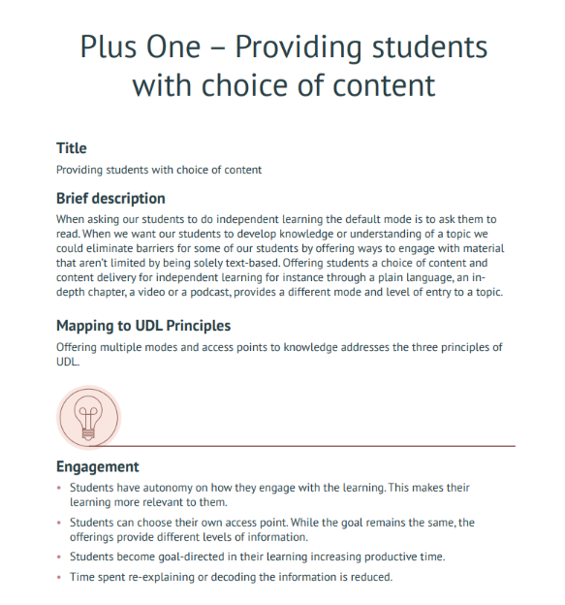
Explore a Plus One
Notes:
Print plus ones to bring

Slide 12
Impact: For Fellows
Through their work together and in collaboration with the University community, colleagues and students, the UDL Fellows have come to a shared understanding of the importance of seeing Universal Design for Learning as an integral aspect of the broader campus-wide commitment to inclusive higher education. The Fellows understand this as a whole of institution endeavor which incorporates research, policy and practice. They acknowledge the complexity of the achievement of inclusion while remaining determined to incrementally move towards a more inclusive campus.

Slide 13
Impact: for MU
To date the team has:
Created a hub of resources available to all staff
Increased UDL awareness – 2 awareness campaigns
Liaised with senior leaders regarding inclusive education in Maynooth University
Worked with international reviewers and hosted an international speaker for two staff professional learning events
Received national and international recognition of our work
Two reports
Moodle
Impacts teaching, learning and assessment-impacts our learners!
Notes:
Mags

Slide 14
Impact: Returning to the ‘Who’. Our students

Slide 15

Thank you for your time.
Margaret.flood@mu.ie

