Slide 1

Universal Design for Learning Symposium
Building an Institutional Culture of UDL: Empowering University Faculty to Foster Learner Agency
June 25-26, 2025

Slide 2
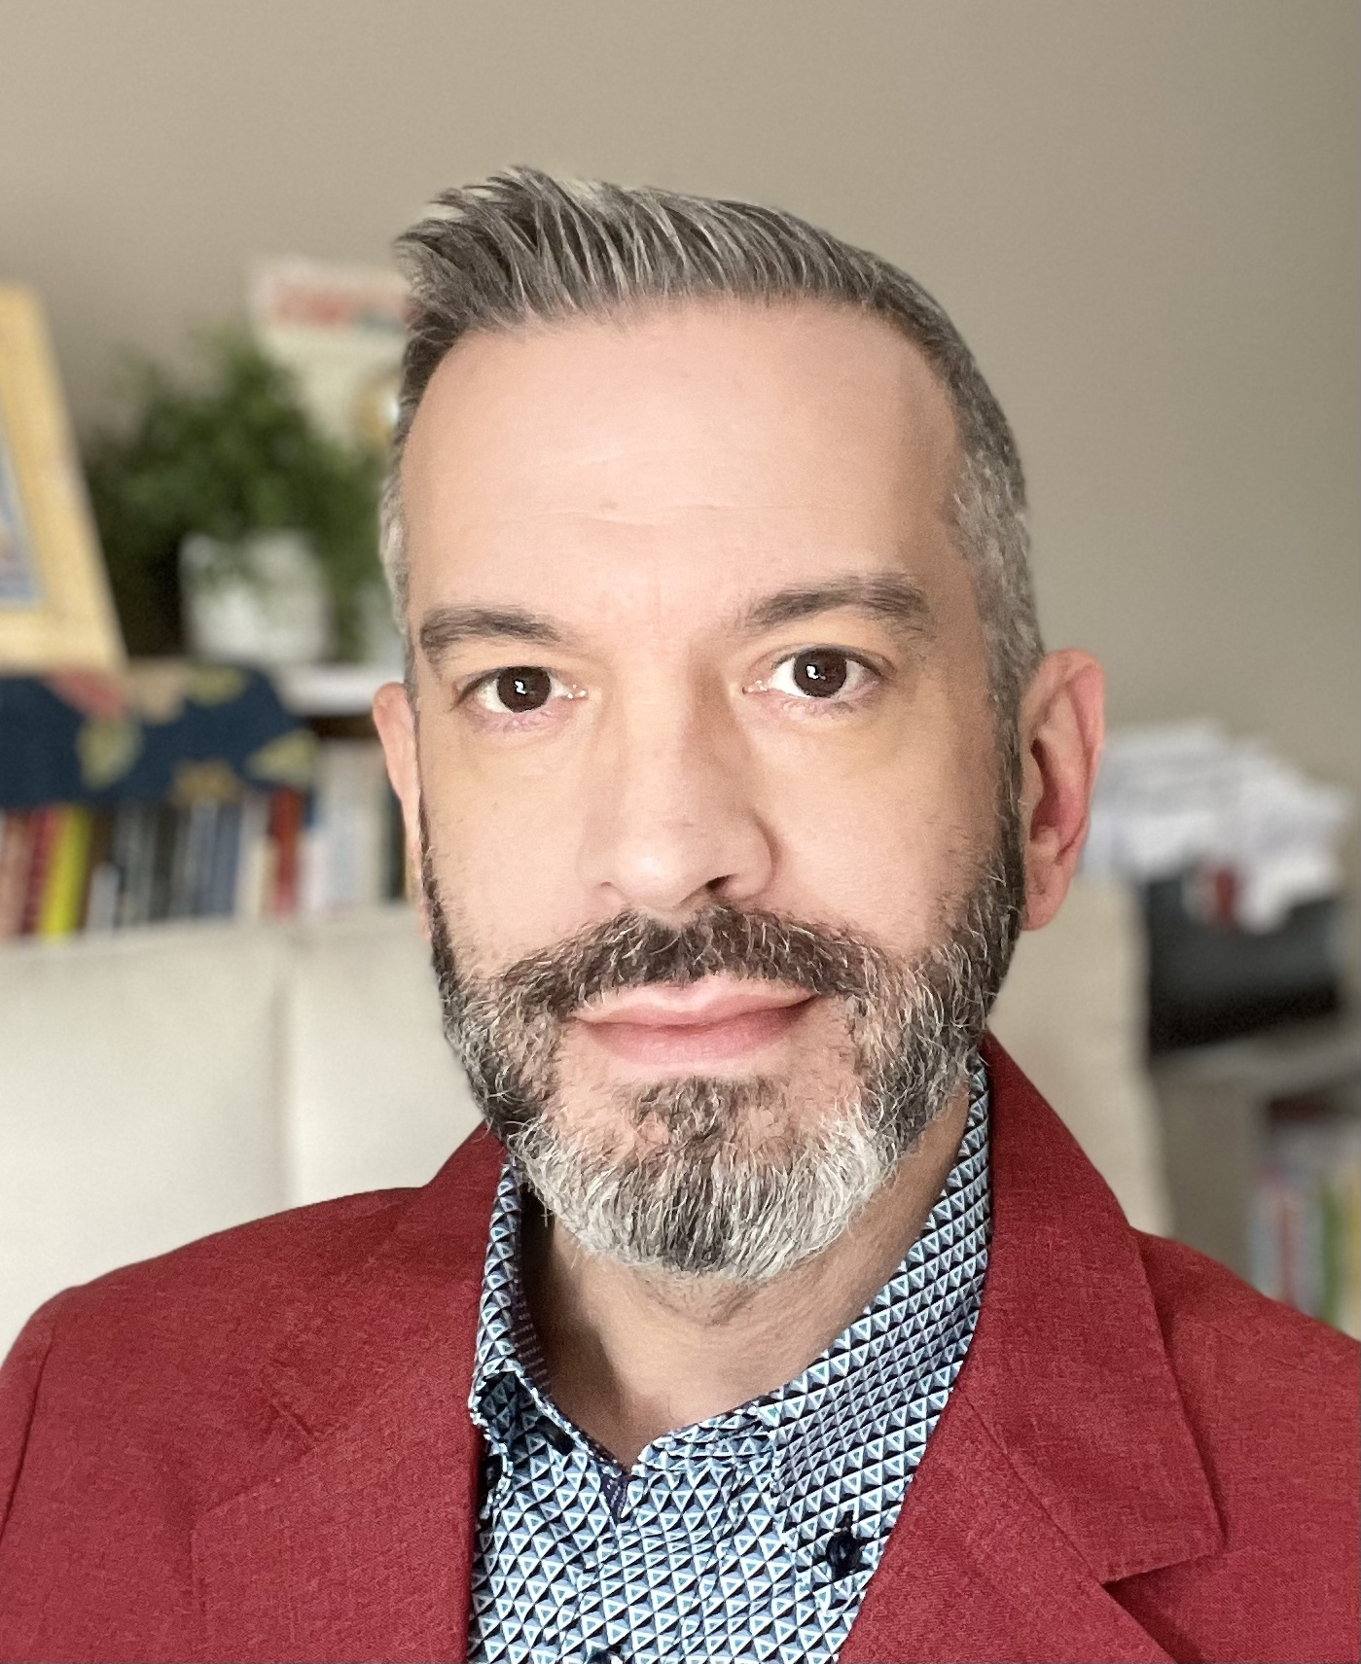
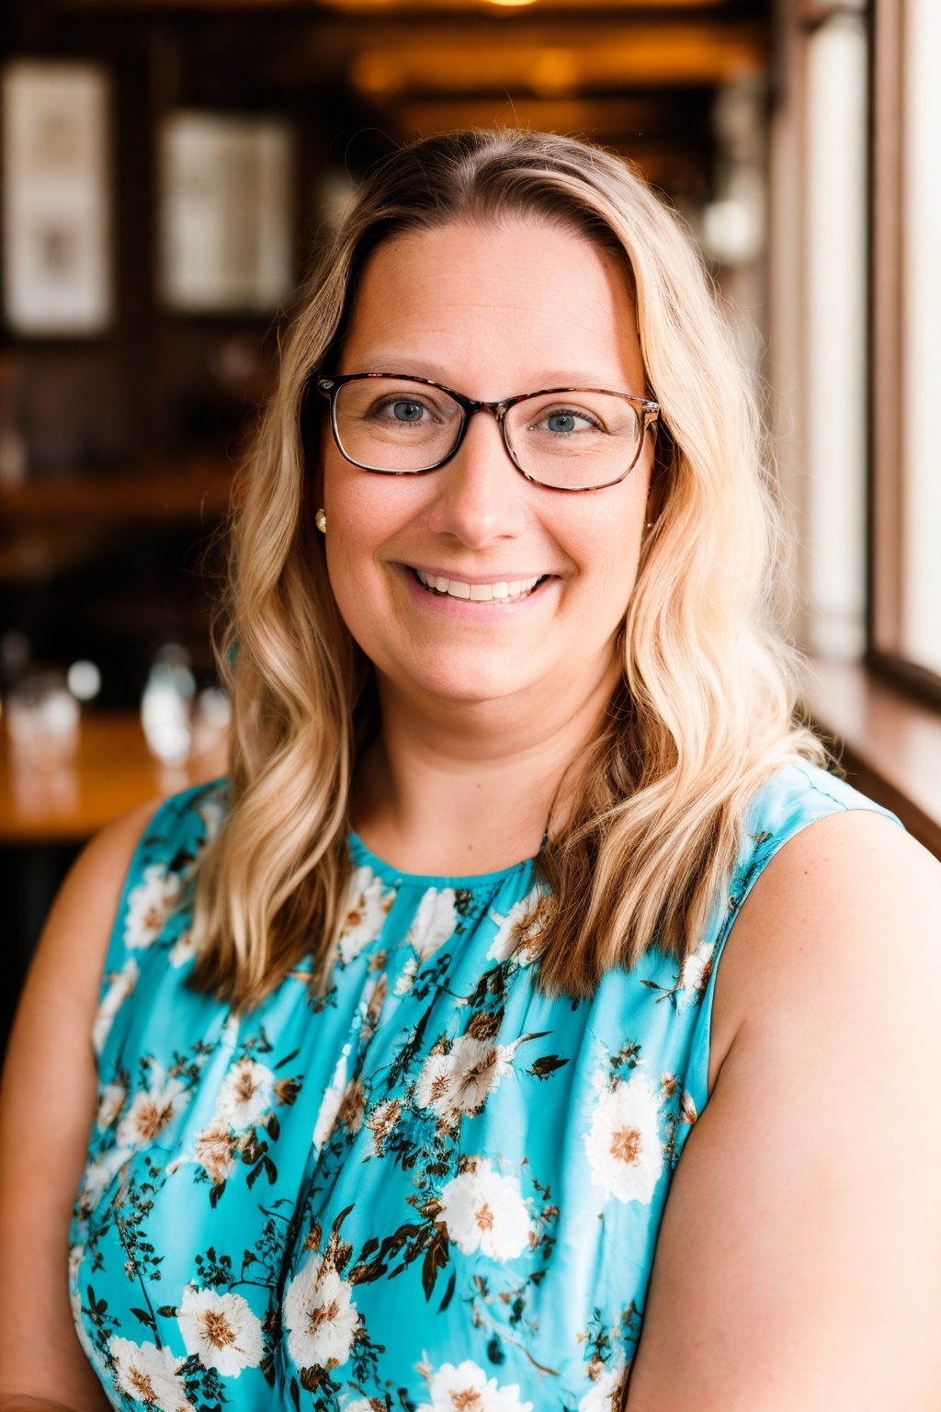
About us
_{Robert LeGary}
Annjanette Bennar
Director and Associate Professor, M.Ed. Teacher Leadership Program at Goodwin University and University of Bridgeport
Senior UDL Teaching Fellow
20 years in special education leadership
Teaching in higher education since 2003
Director of Center for Teaching Excellence at Goodwin University
Senior UDL Teaching Fellow
Co-facilitated over 14 UDL institutes for faculty
20+ years teaching technology

Slide 3
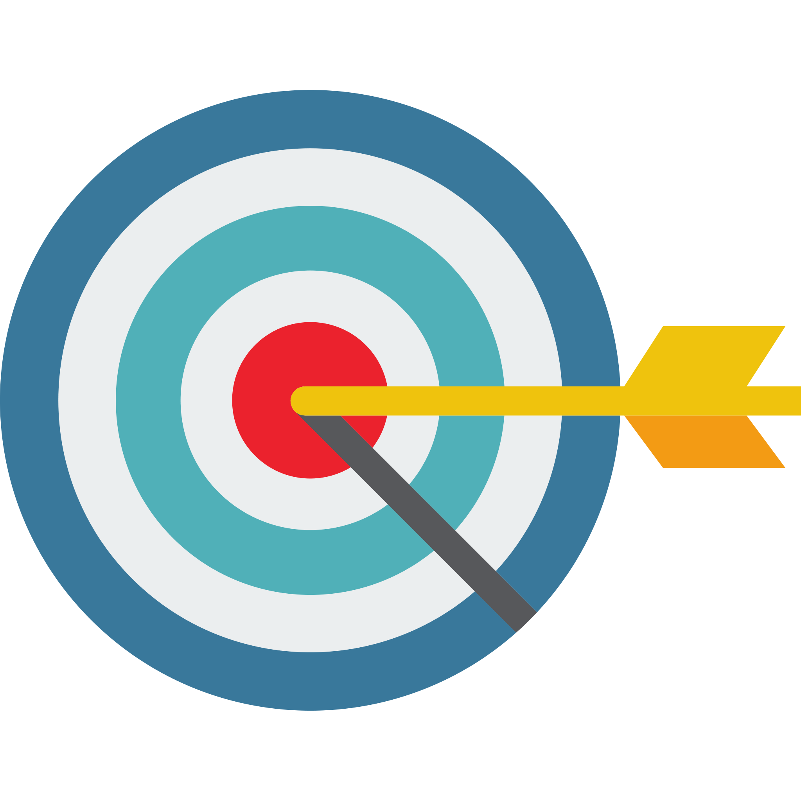
Agenda for Session
Background of Goodwin University
History of UDL at Goodwin
Multi-faceted approach to faculty professional development
UDL Institutional Initiatives
Benefits to Faculty and Students

Slide 4

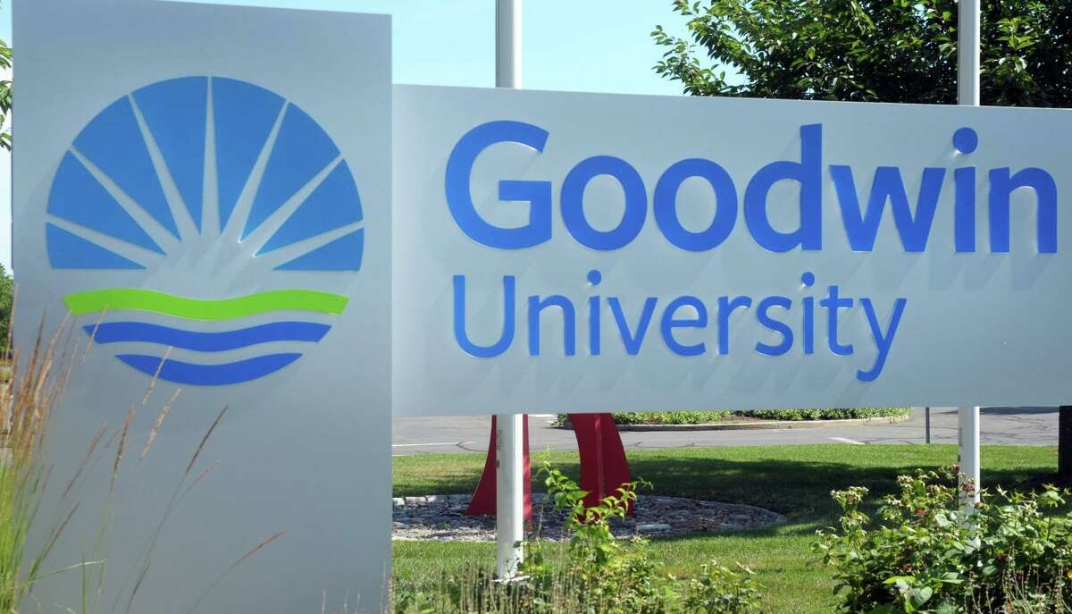
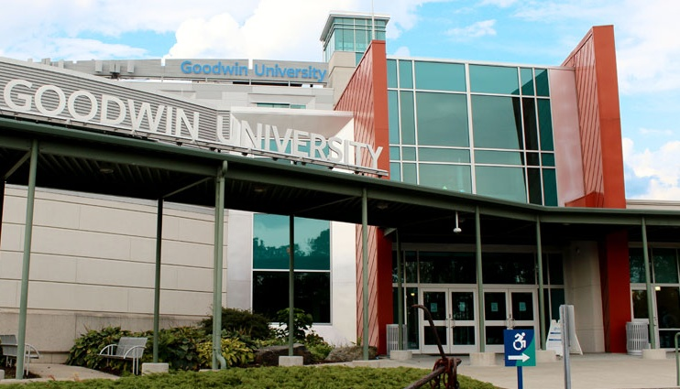
About Goodwin University
Located in United States of America
  East Hartford, Connecticut
Open enrollment model
Highly diverse student population
85% of student body is female
59% are first-generation students
Median age is 29

Slide 5
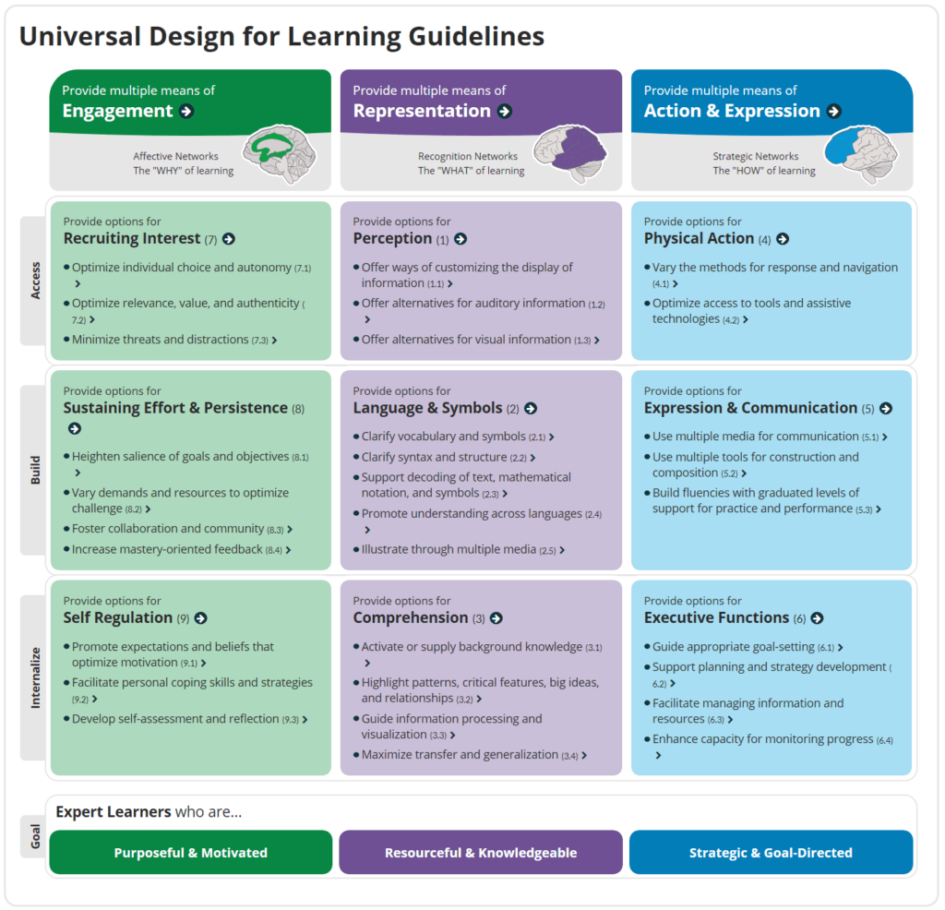
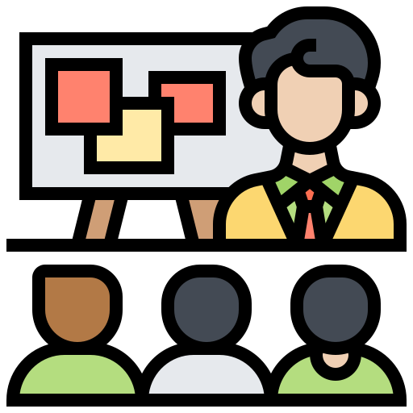
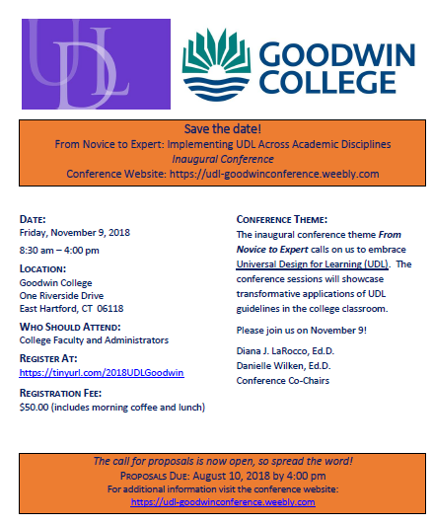
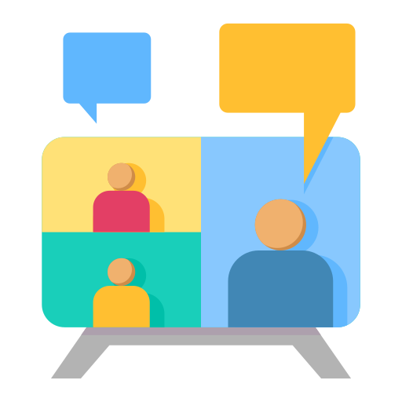

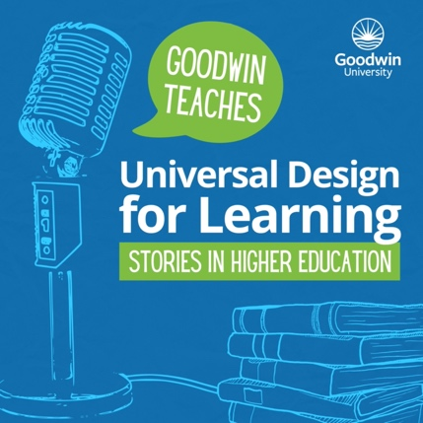
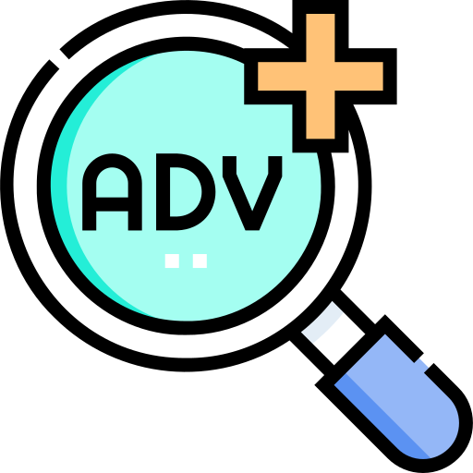
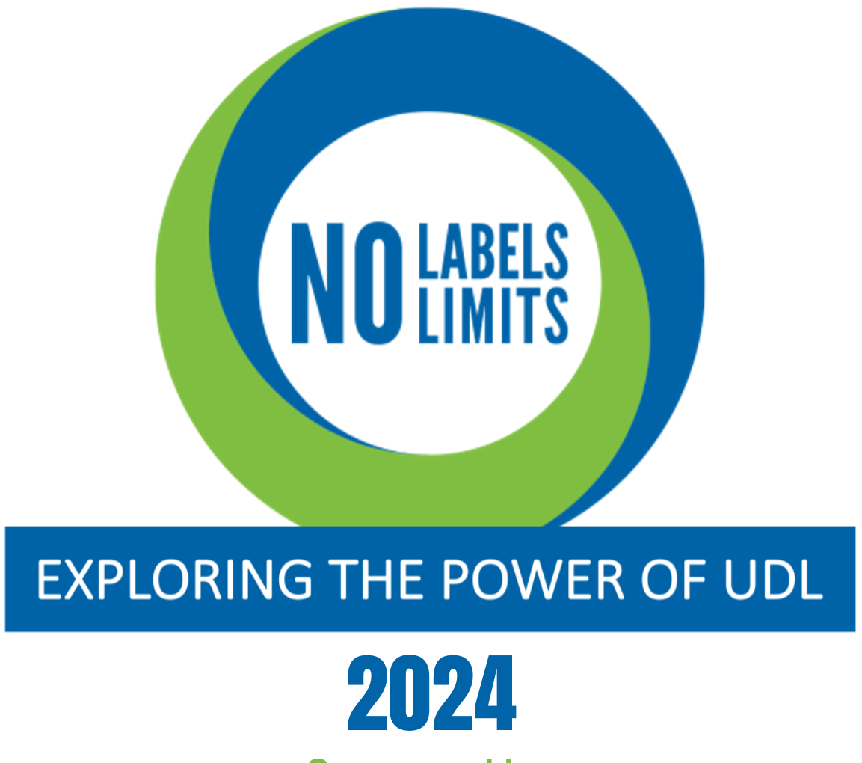
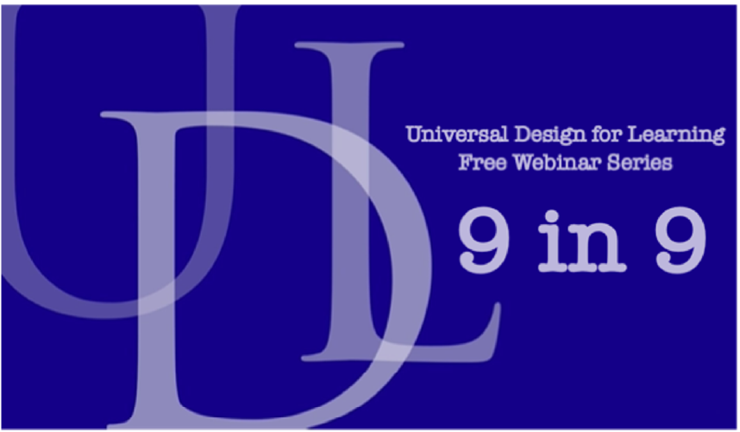
UDL at
2016 – UDL implemented
2017- 1st Cohort of Faculty Trained
2018 -2019– 1st & 2nd UDL Conference and training continues
2020 – Moved to Virtual trainings, 1st institute outside the university
2022 Implemented Advanced UDL & continued trainings
2023 – UDL Podcasts
& continued training inside and outside of Goodwin
2021 – UDL Book & continued trainings
2024 & 2025 – Conference and 9-in-9 series

Slide 6
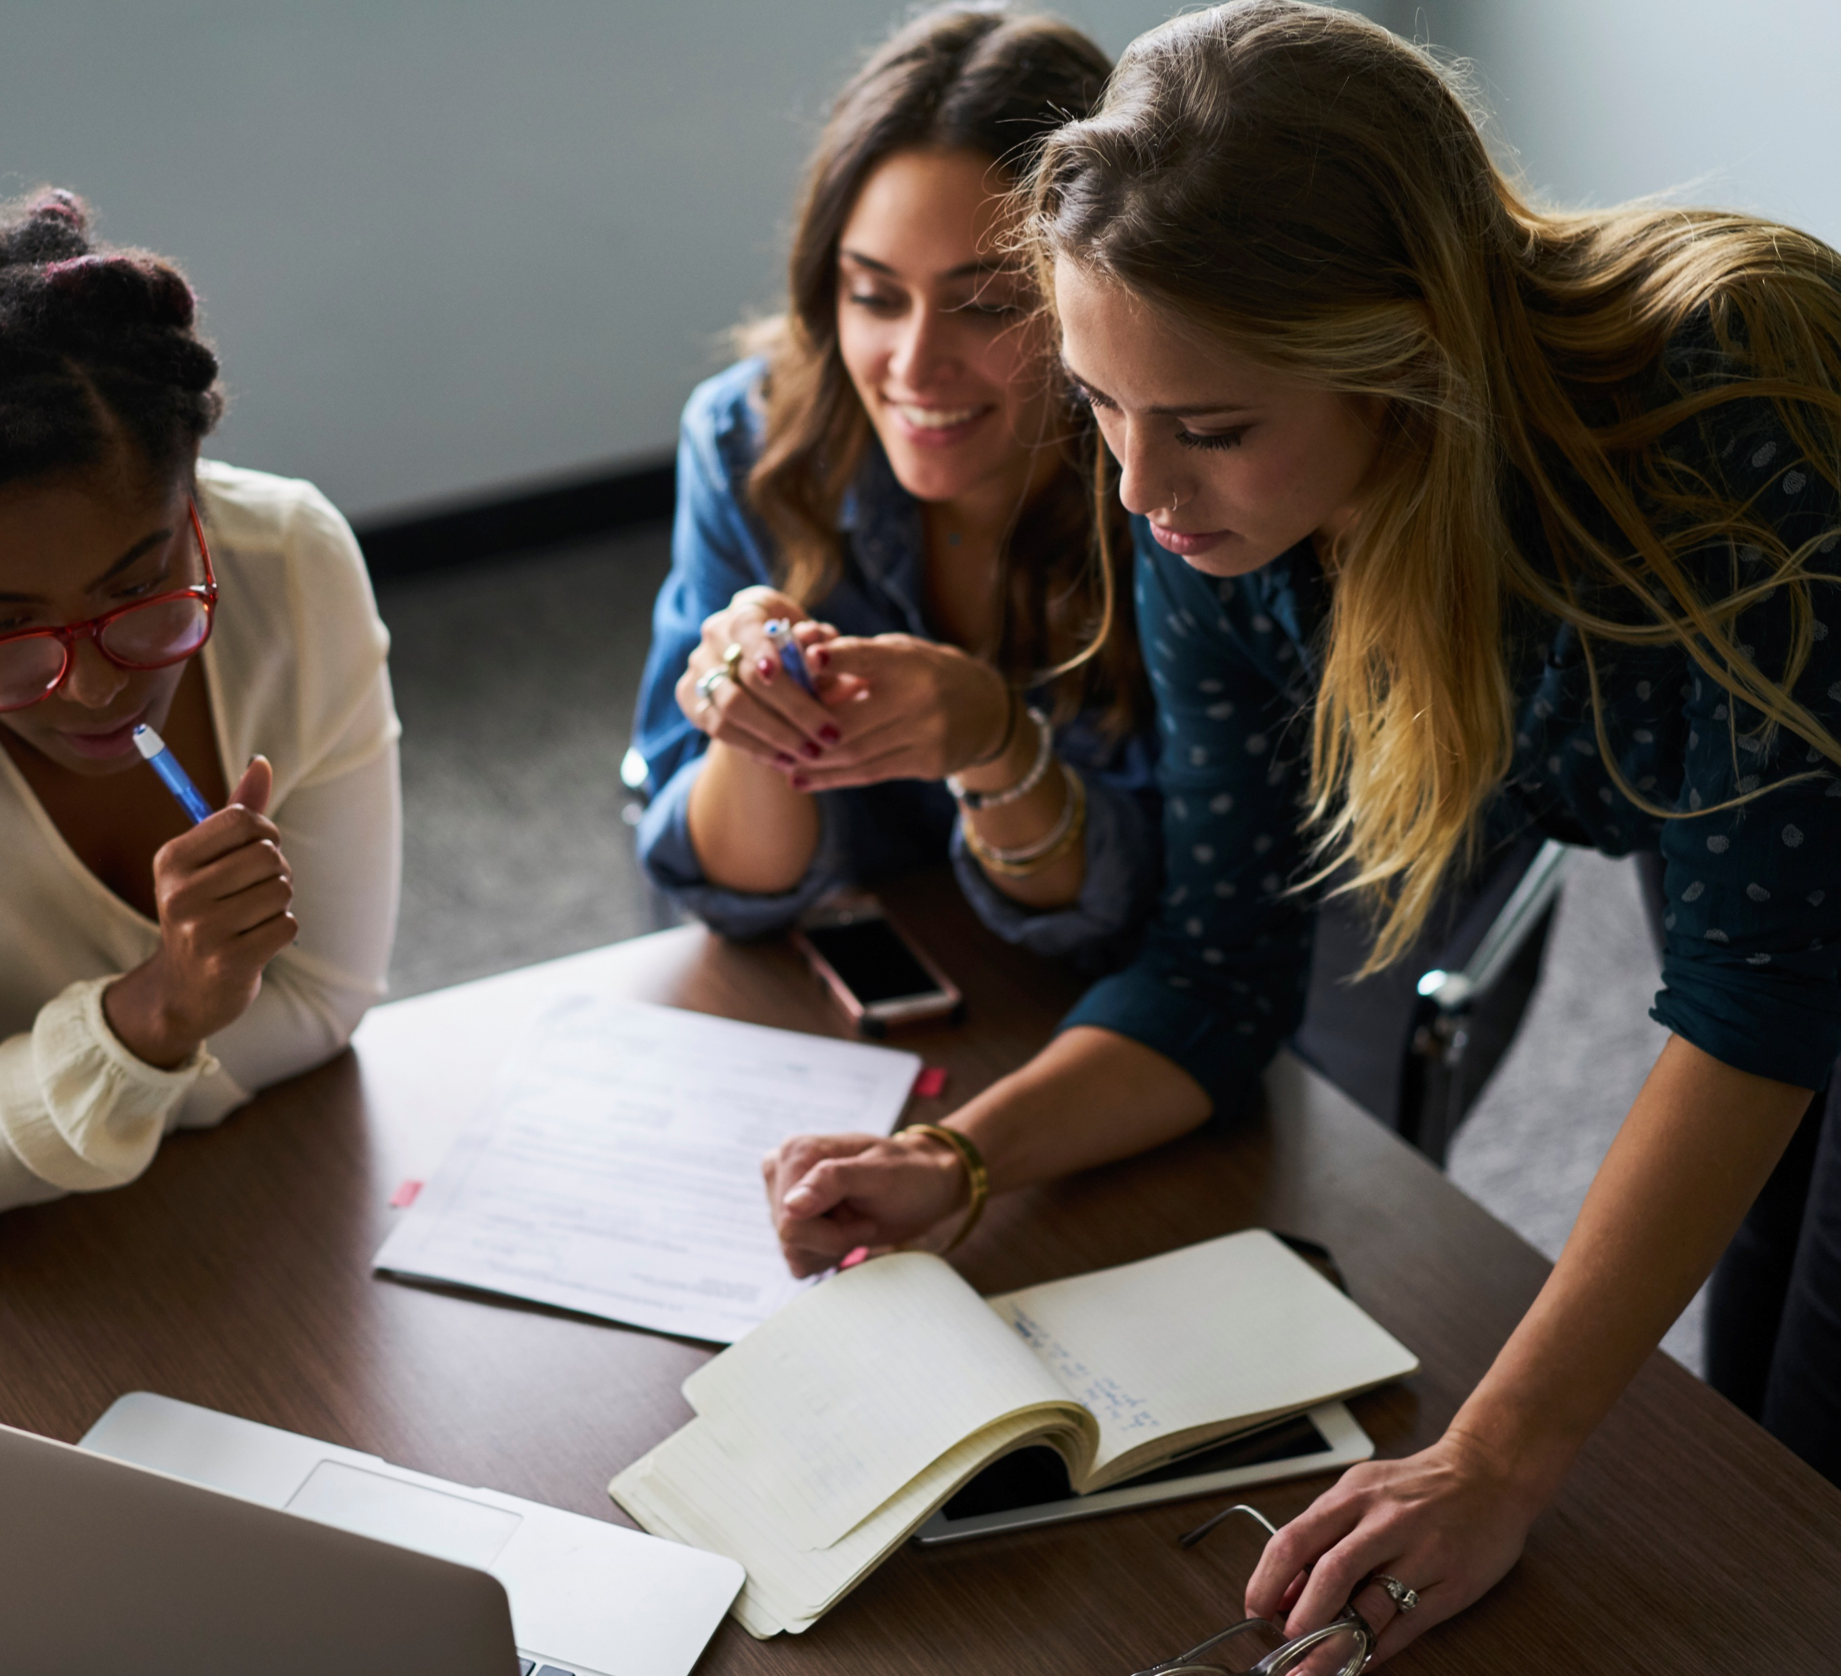

UDL Faculty Institutes
Format
  Cohort Model
  Interdisciplinary
  12 participants
  Includes a stipend and title of “UDL Teaching Fellow”
  Eight 3-hour Sessions over 4-6 months
Job-Embedded
  Based in faculty's daily practice
  Focus on courses being taught
Opportunity to Learn
  Adult learning principles
  Community of practice
  Active, collaborative learning

Slide 7

Faculty Transformation
From Knowledge Disseminators to Learning Designers
Shift from content delivery to learning facilitation
Proactive design for learner variability
Critical self-reflection on teaching practices
Asset-based view of student abilities
Authentic application of UDL principles
Faculty not only learn how UDL strategies can be applied to reduce barriers but also how the same strategies can be applied across disciplines.

Slide 8
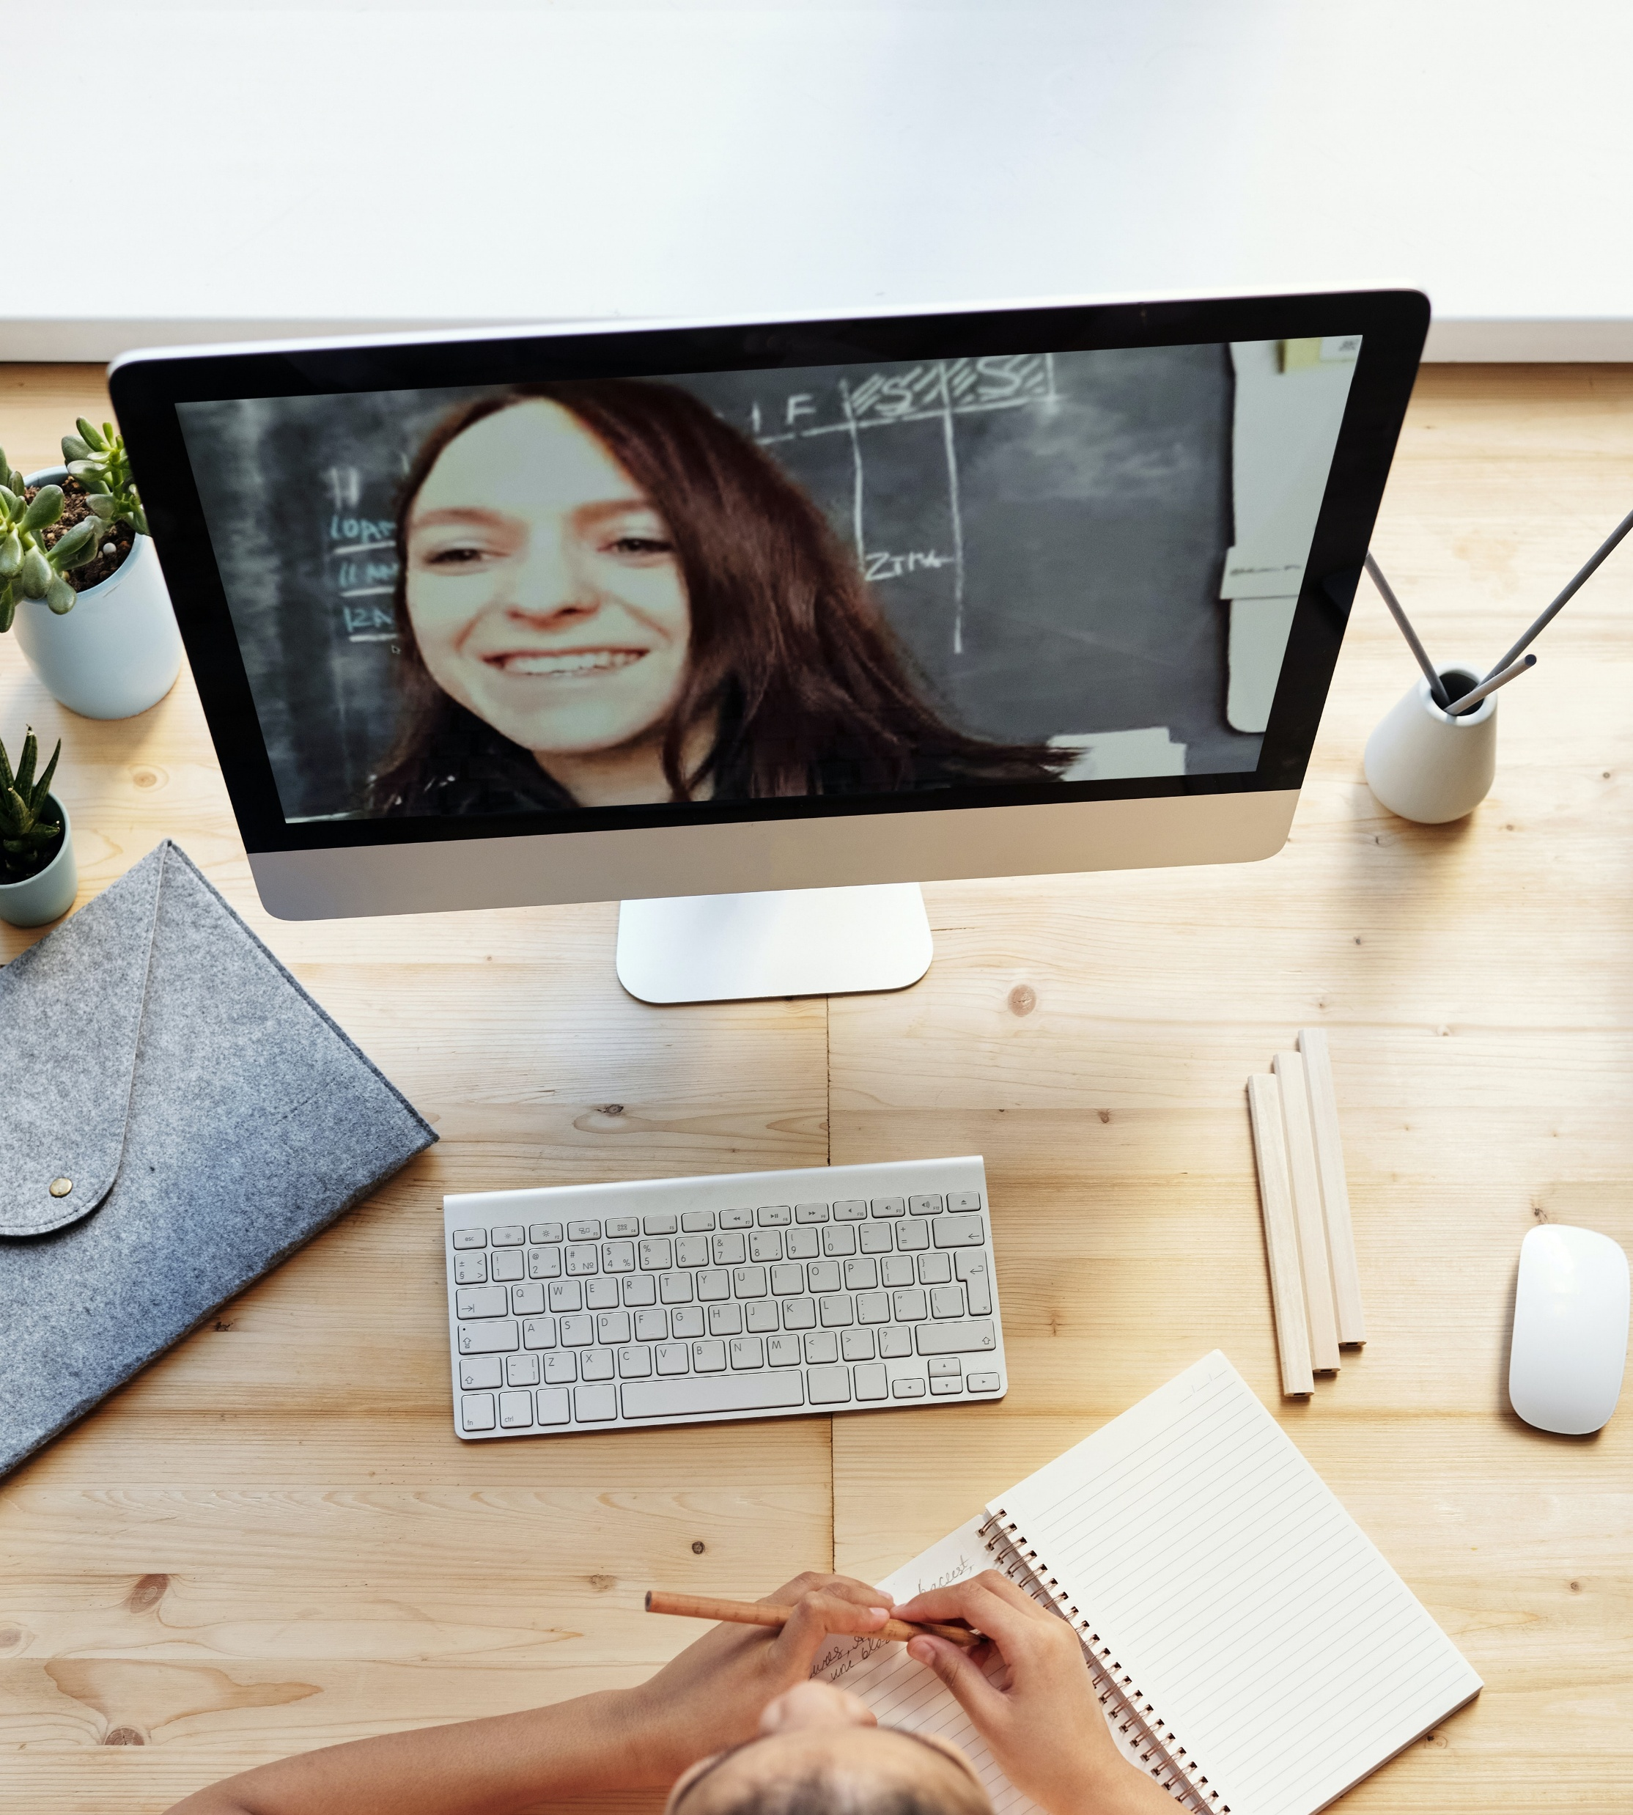
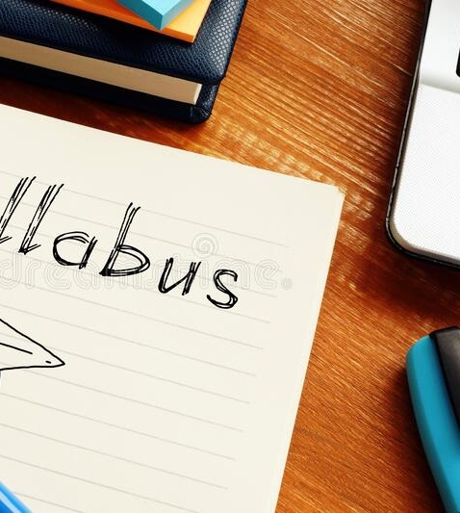
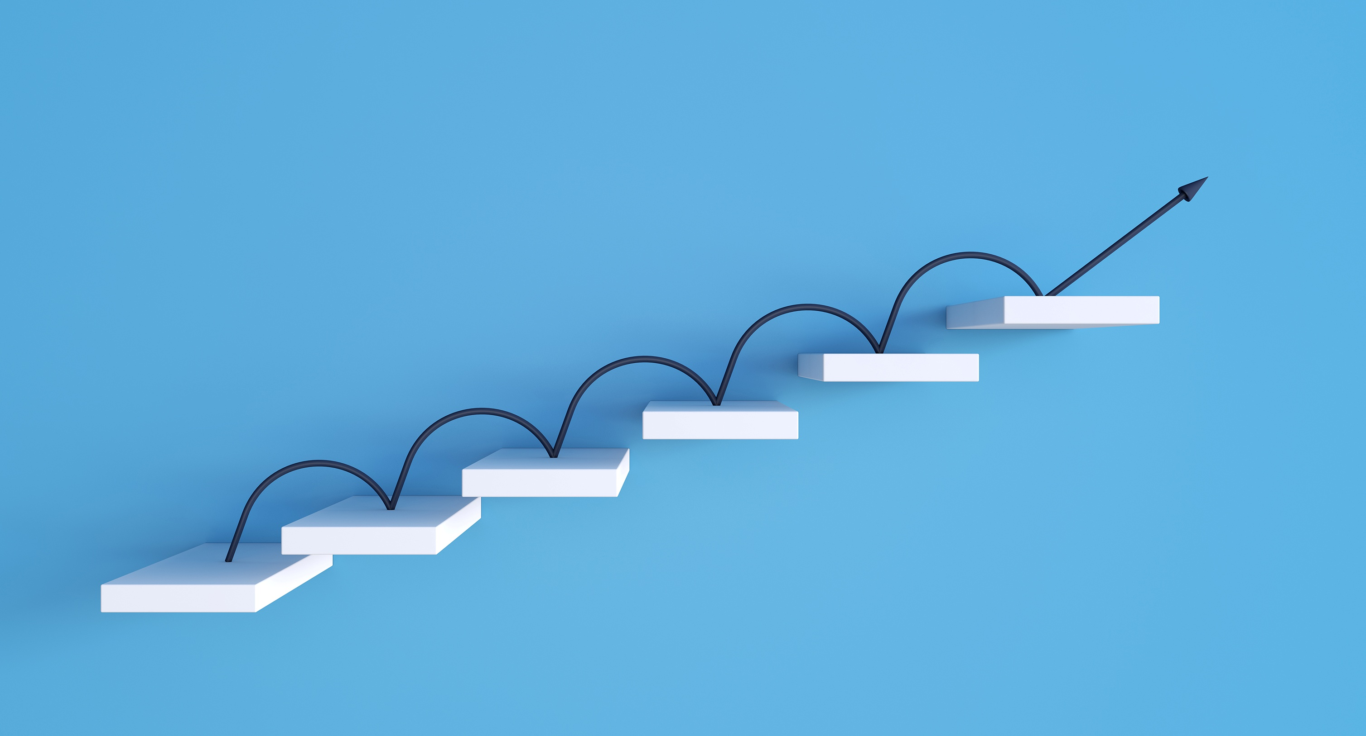
Impact on Course Design
Examples of Faculty Innovations:
Syllabi: Multiple formats, clear expectations, student choice
Content: Varied representation, chunked material, scaffolded learning
Assessments: Flexible options, authentic demonstrations of learning
Engagement: Leveraging student interests and cultural backgrounds
Executive Functioning: Templates, checklists, time management tools

Slide 9


Building Community Through UDL
Expanding Beyond Classrooms:
Teaching Fellows Community: Ongoing collaboration and support
9-in-9 Overtime Webinar Series: Monthly UDL insights
UDL Podcast: Sharing stories of transformation
Annual UDL Conference: "Agents of Learning: UDL 3.0 in Action"
Cross-Institutional Partnerships: Implementation at partner educational institutions
A shared lexicon has emerged and UDL has been embraced as a conceptual framework across the university.

Slide 10
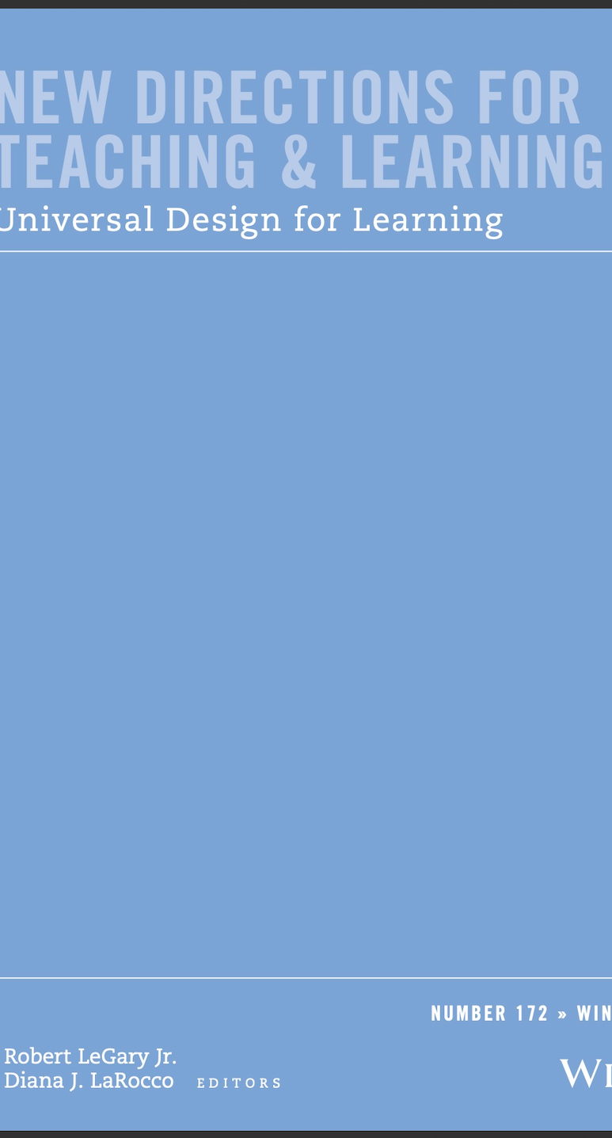

Publications
Laist, R., Sheehan, D., & Brewer, N. (Eds.). (2022). UDL university: Designing for variability across the postsecondary curriculum. CAST Professional Publishing.
LeGary, R., & LaRocco, D. (Eds.). (2023). Universal design for learning [Special issue]. New Directions for Teaching and Learning, 172.

Slide 11
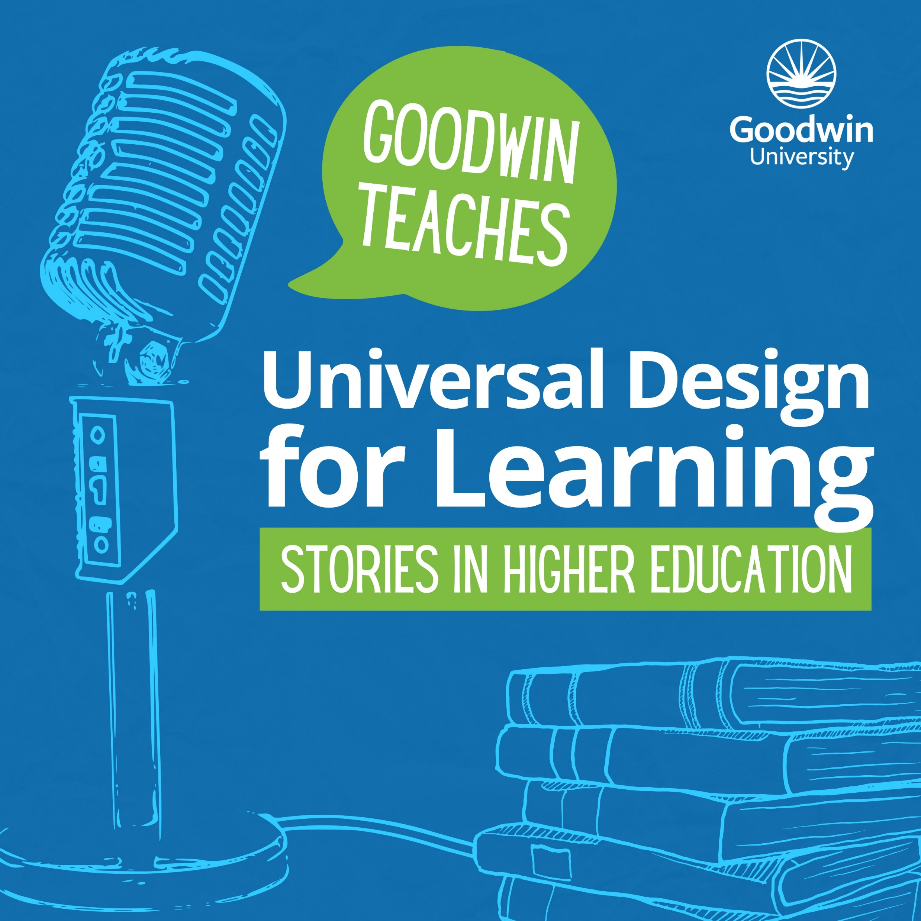
"Goodwin Teaches: Universal Design for Learning Stories in Higher Education" Podcast
Features transformative UDL stories from higher education faculty showcasing inclusive teaching practices
Structured interviews cover educators' backgrounds, UDL interest, student impacts, and broader educational implications
Targets higher education faculty, graduate students, and practitioners seeking inclusive teaching strategies

Slide 12
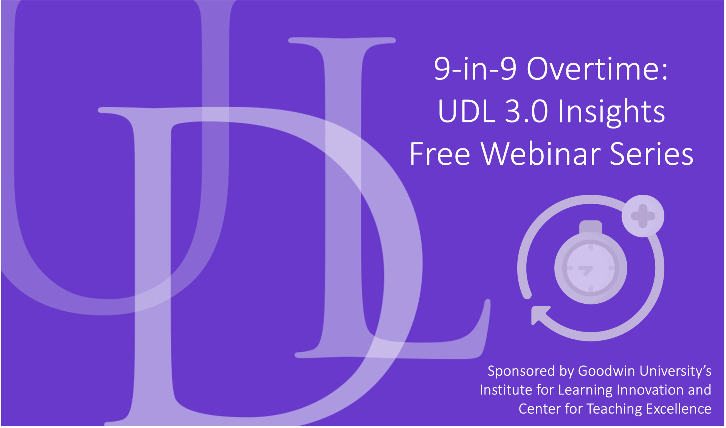
9 in 9 Webinar Series
UDL experts in higher education facilitate interactive hour-long online workshops on UDL implementation
Sessions provide practical strategies adaptable across disciplines
Targeted audience includes faculty, instructional designers, librarians, tutors, and academic advisors
Each webinar delivers focused, actionable UDL 3.0 tools and resources

Slide 13
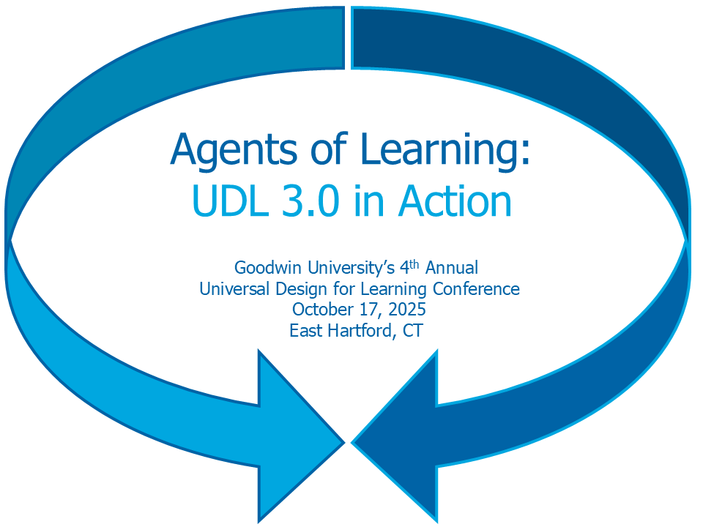
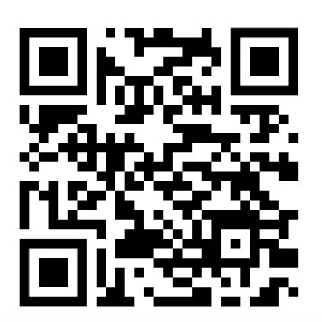
Annual National Conference
"Agents of Learning" theme explores UDL 3.0's focus on student-driven education
Learning-driven design shifts beyond accessibility toward empowered learner engagement
Sessions demonstrate course elements that validate identities while building self-direction
Conference explores innovative content representation and assessment for dynamic learning.

Slide 14
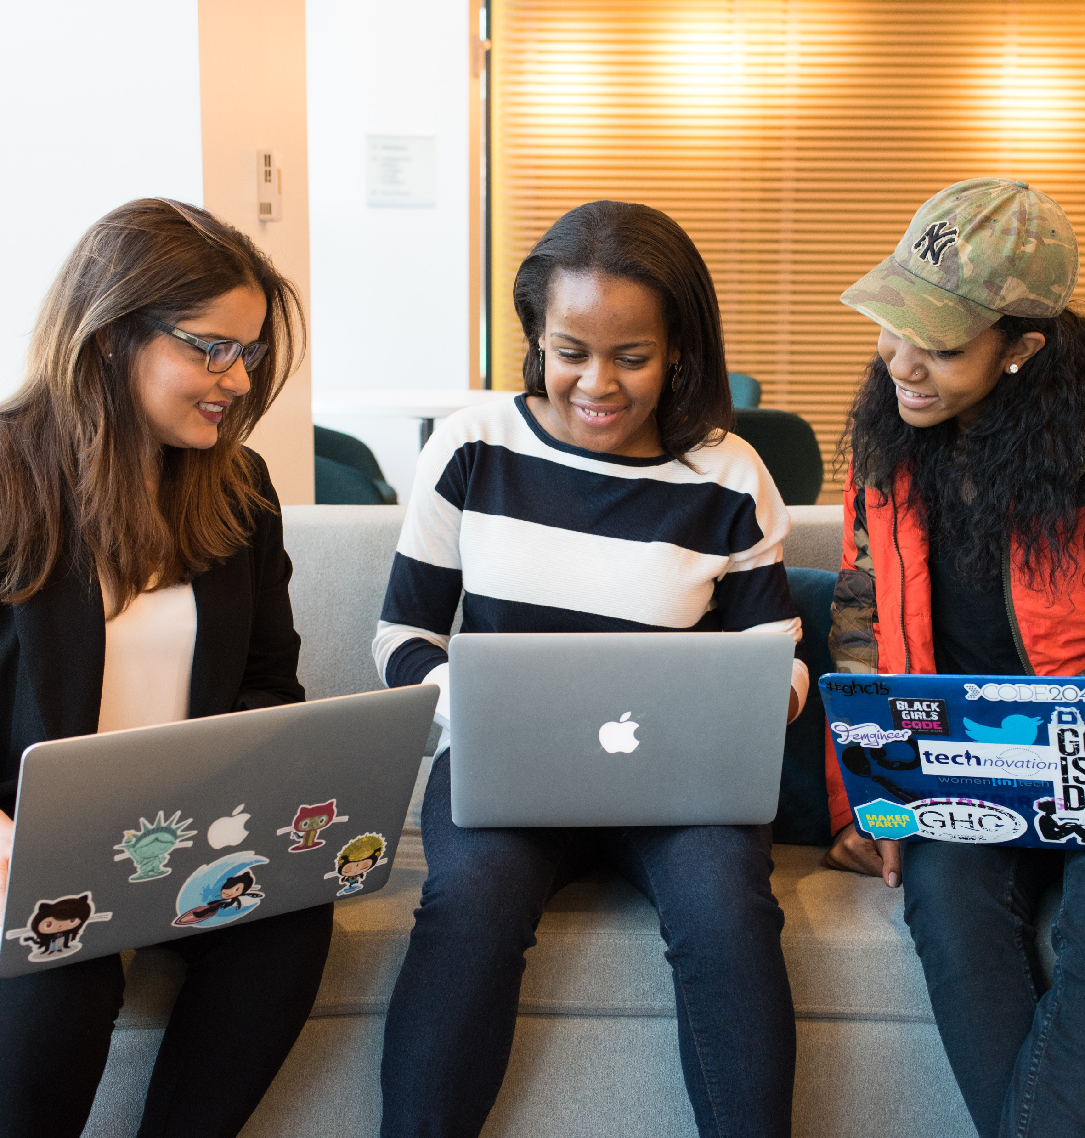
Student Experiences
In Their Own Words:
"The teaching method the professor applies is very dynamic... She uses many tools, so the student has a better understanding."
"I appreciate how the professor broke the assignments into smaller steps with helpful templates."
"I love how the professor provides weekly video announcements about what is due and key points from the material."

Slide 15
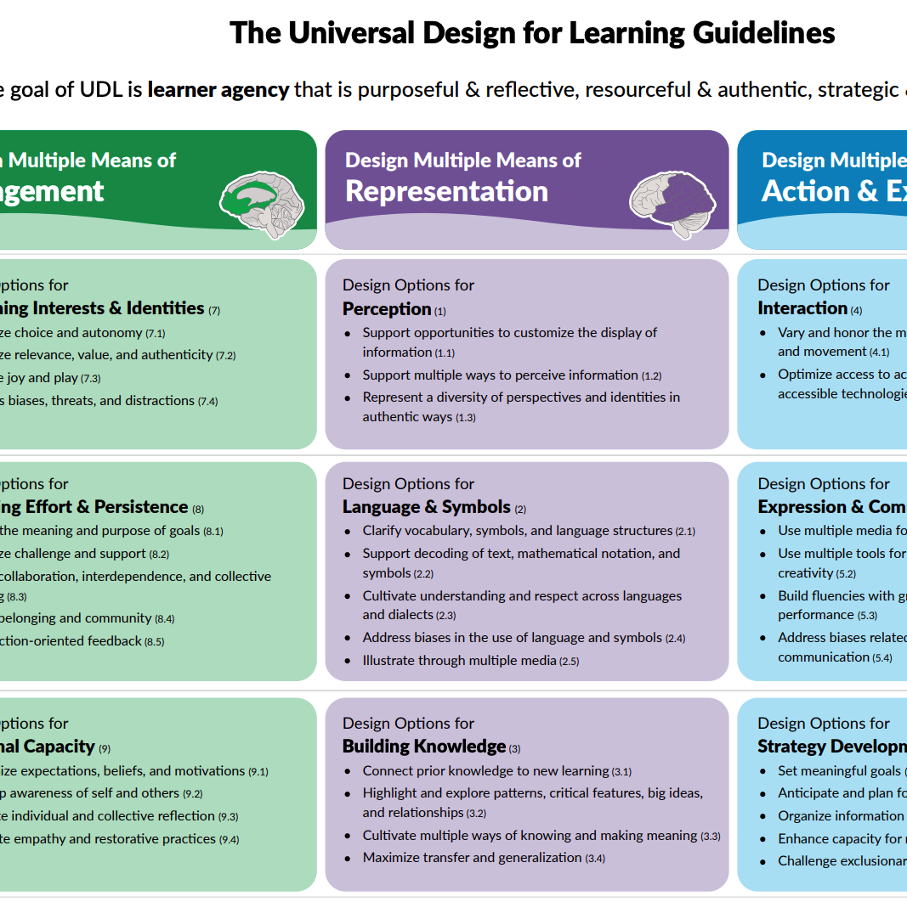
Challenges and Lessons Learned
Navigating the UDL Journey:
Time Constraints: Balancing teaching loads with professional development
Discipline Specificity: Adapting UDL principles across diverse content areas
Assessment of Impact: Developing meaningful metrics for success
Sustainability: Building systems for long-term adoption
Institutional Coordination: Aligning schedules, resources, and initiatives

Slide 16
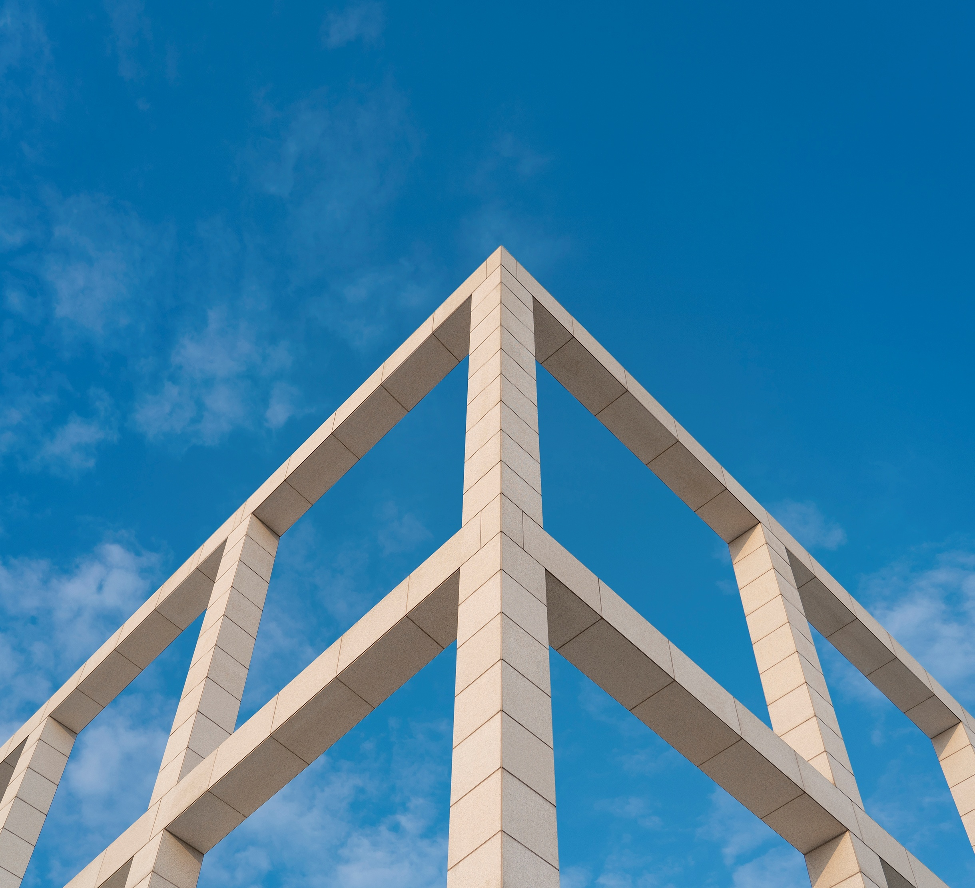
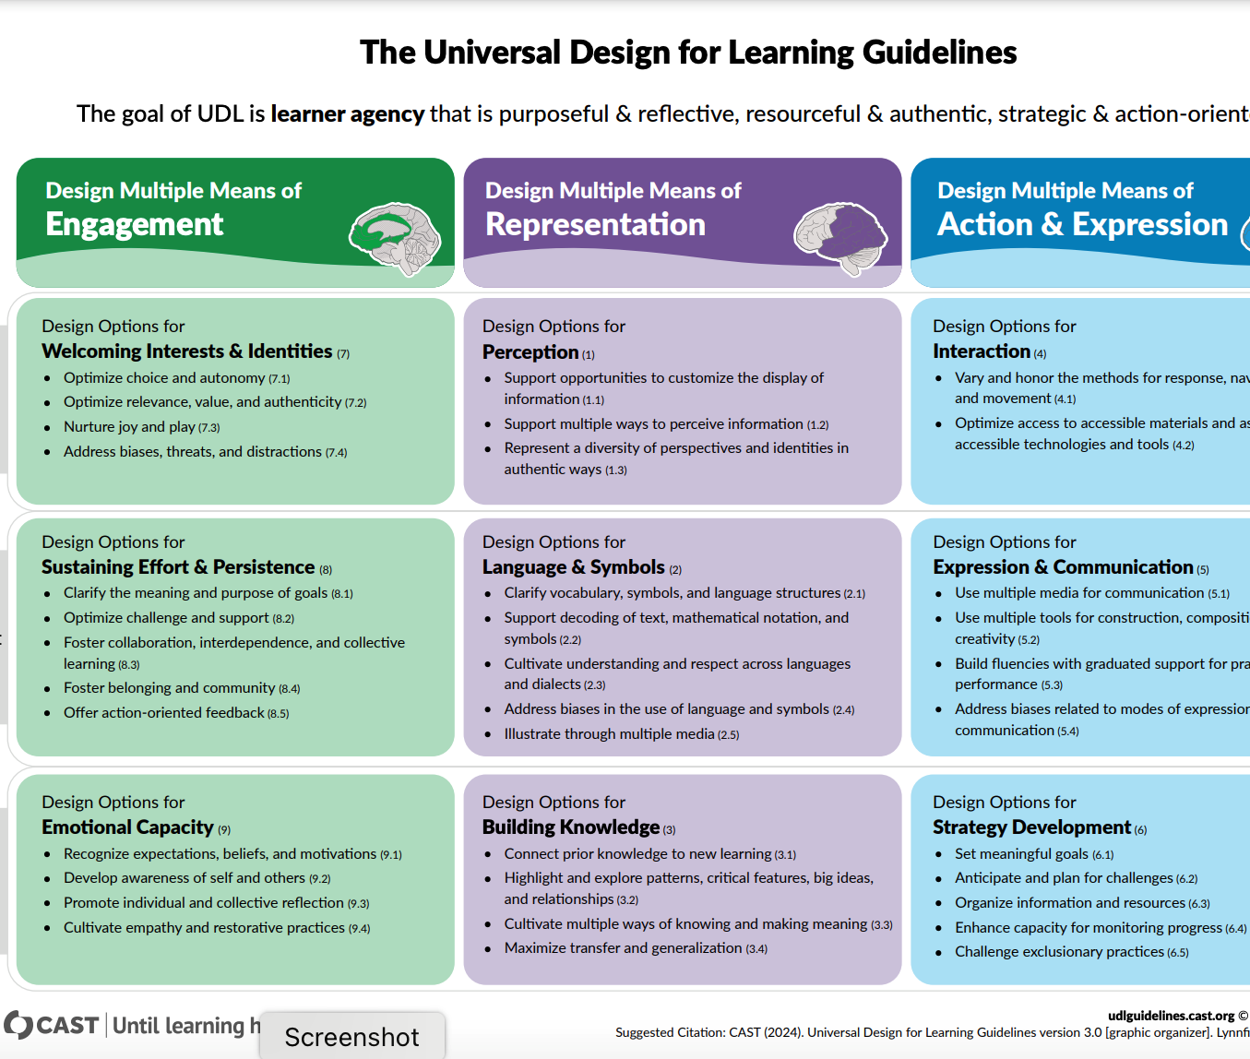
Recommendations for Implementation
Building Your UDL Culture:
Secure administrative commitment and resources
Design professional learning that is sustained and intensive
Embed learning in faculty's daily teaching responsibilities
Apply asset-based pedagogical practices
Create communities of practice across disciplines
Recognize and celebrate faculty innovations
Document and share impact on student learning

Slide 17
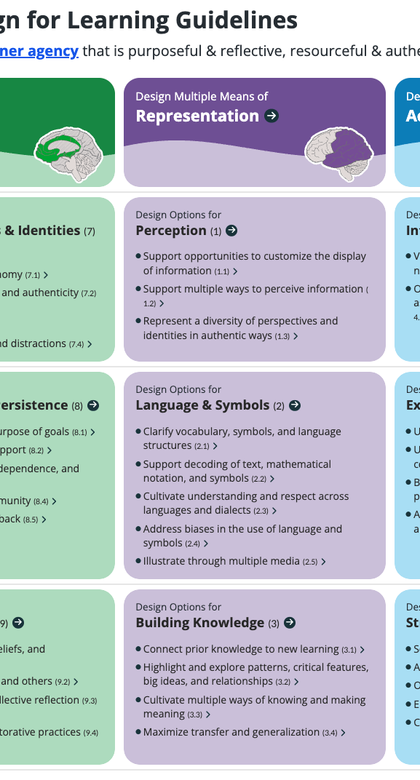
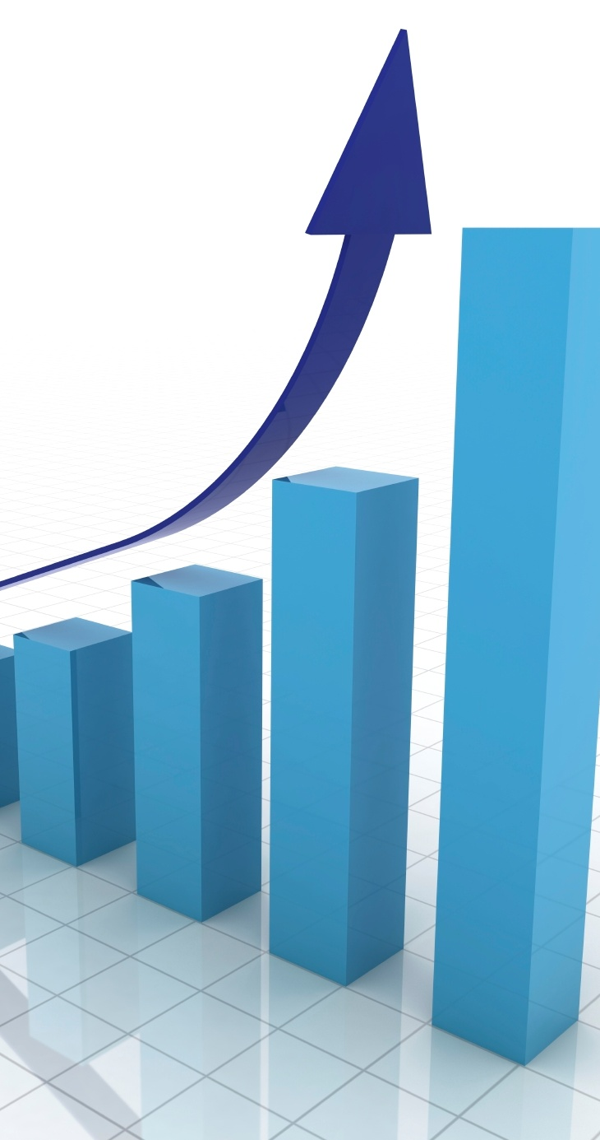
Scaling Up UDL Institution-Wide
Key Strategies for Success:
Administrative Leadership: Clear vision and ongoing support
Resource Commitment: Funding, time, and recognition
Faculty Ownership: Voluntary participation and leadership
Cohort Model: Building communities of practice
Continuous Improvement: Advanced institutes and ongoing development

Slide 18

Thank you!
Any Questions?
Robert LeGary
rlegary@goodwin.edu
Annjanette Bennar
abennar@goodwin.edu

Slide 19
References
CAST (2024). Universal Design for Learning Guidelines version 3.0. Retrieved from https://udlguidelines.cast.org​
The Goodwin Institute of Learning Innovation (2025). UDL Expertise. Retrieved from https://www.goodwin.edu/guili/udl-expertise
Laist, R., Sheehan, D., & Brewer, N. (Eds.). (2022). UDL university: Designing for variability across the postsecondary curriculum. CAST Professional Publishing.​​
LeGary, R., & LaRocco, D. (2023). Job-embedded professional learning: Facilitating faculty implementation of UDL. New Directions for Teaching and Learning, 172, 93-103.

