Slide 1

Toward an Institution-Wide Approach for Embedding UDL in Tertiary Education Settings
Erin Leif (Monash University)
Amanda Gigliotti (University of Wollongong)

Slide 2
Workshop overview
Purpose: Explore institutional strategies for embedding UDL using principles of interdependence and collective learning.
Identify enablers and barriers to UDL adoption.
Collaborate on strategies for systemic implementation.
Reflect on your institutional context.

Slide 3
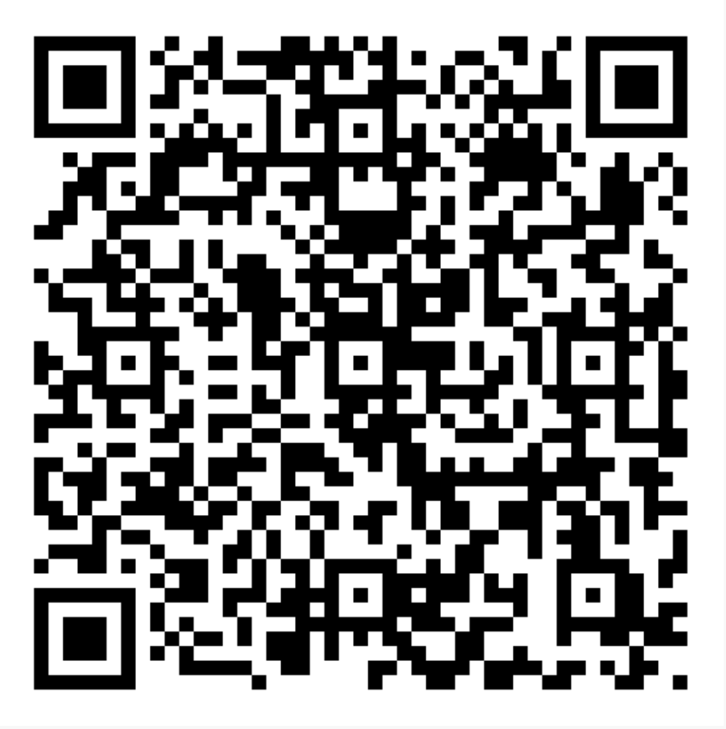
Before we Begin
Use this link to access the PPT and handouts for this session. Please take a moment to download:
  1. PPT Slides
  2. Word Document Slides
  3. Example Goals for Embedding UDL
  4. Strategy Mapping Template
  5. Strategy Mapping Worked Example 1
  6. Strategy Mapping Worked Example 2
  https://drive.google.com/drive/folders/1pXu5uUUUMi8qcxY1p3deMH2BgAVk6P54?usp=share_link

Slide 4
What Actually is UDL?
Universal Design for Learning (UDL) is:
  A proactive planning framework
  Focused on removing barriers to participation and learning
  Anchored in flexibility, accessibility, and inclusivity

Slide 5
Why An Institutional Approach?
UDL in higher education goes beyond individual practice
Whole-of-institution implementation ensures:
  Consistent student experience
  Sustainability and scalability
  Shared responsibility and leadership

Slide 6
Principles for systems level change
Interdependence:
  Mutual reliance across educators, leaders, support staff, and students
Collective Learning:
  Cross-functional collaboration and reflective practice
  Building institutional knowledge and capacity

Slide 7
UDL Consideration 8.3
Foster collaboration, interdependence, and collective learning
  Collectively generating knowledge and learning from one another’s diversity of ideas, perspectives, and lived experiences is central to the learning process
  Creating communities, teams, and partnerships that can push and extend each other’s thinking and practice care for one another is a powerful way to sustain effort and persistence, and to support learners to thrive more broadly
  Connected to these notions of collaboration and collective learning is the idea of interdependence — a reminder that we are all interconnected, our decisions and actions impact others, and learners can support one another

Slide 8
Key Enabler Areas (Part 1)
Leadership and Strategy
• Institutional policies, plans, and leadership priorities that support UDL adoption
• Visible commitment from senior leaders and alignment with broader equity goals
Professional Learning
• Opportunities for staff to build UDL knowledge and skills
• Access to training, mentoring, and inclusive teaching communities
Curriculum and Pedagogy
• Designing units and assessments with UDL principles in mind
• Planning for multiple means of engagement, representation, and expression

Slide 9
Key Enabler Areas (Part 2)
Student Voice
• Involving students in course design
• Using student feedback to improve inclusive practices
Culture and Collaboration
• Building shared language, recognition, and interdepartmental partnerships
• Encouraging collaboration across teaching, support, and leadership roles
Monitoring Progress
• Tracking, reviewing, and improving UDL practices and policies over time
• Identifying barriers and using feedback loops for continuous improvement

Slide 10
Interdependence across Enablers
Enablers are not isolated, but interconnected. For example:
  Leadership strategies that incentivize collaboration.
  Monitoring that informs targeted professional learning.
  Student feedback that drives curriculum redesign.
These enablers work in synergy - progress in one area can strengthen efforts across others.

Slide 11
Activity #1 - Goal Setting
First, spend a few minutes reviewing some sample goals aligned to each enabler area on the Example Goals for Embedding UDL document
Next, spend a few minutes developing your own goal. What is one small thing you can do to start to embed UDL more systemically in your institution?

Slide 12
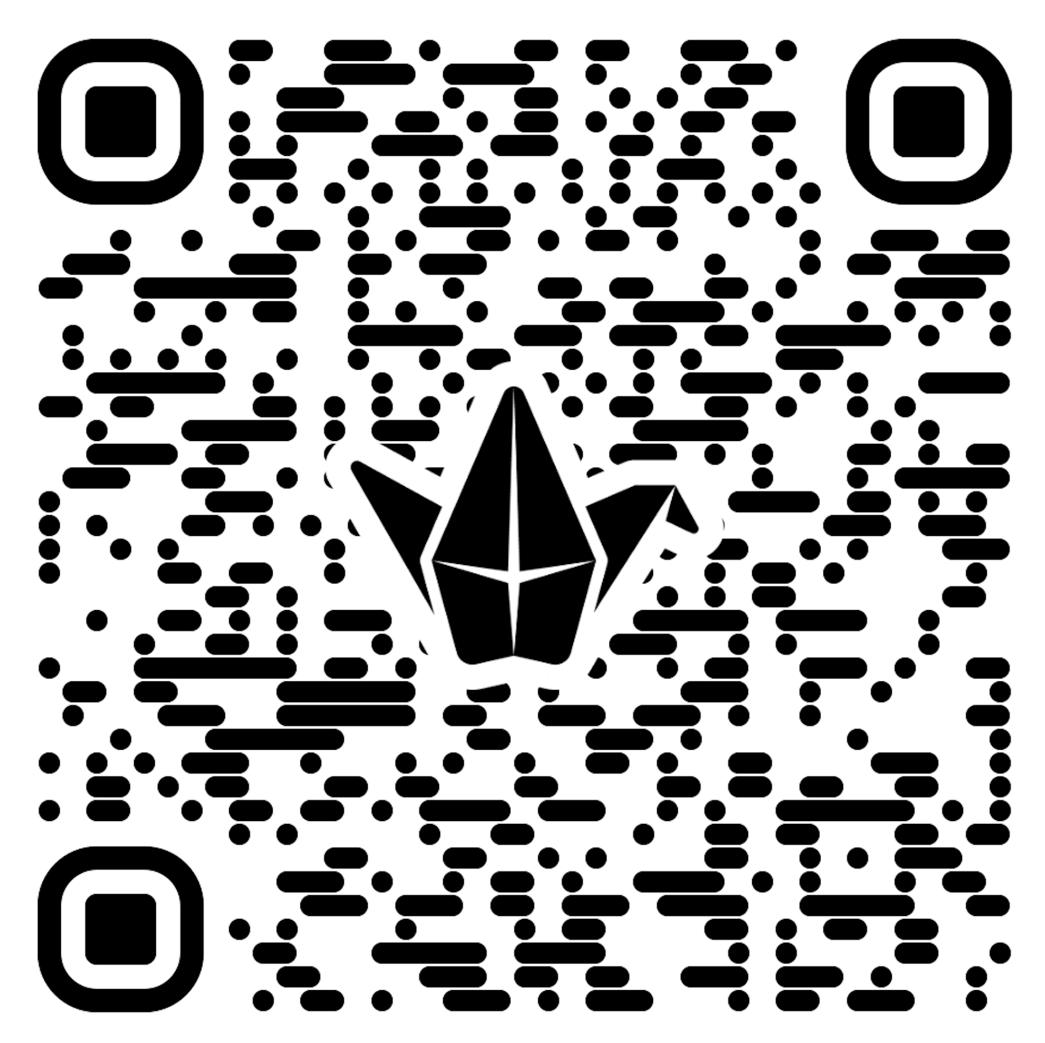
Share your Goal!
https://padlet.com/erinleif/share-your-goal-g11ypah5ugpxsmmq

Slide 13
ACTIVITY #2: Strategy Mapping
Let’s look at a worked example together: https://docs.google.com/document/d/1j2LX4jkDO3knBLfD4xTSuwgdLC7wNwvB/edit

Slide 14
Your Turn – Open the Strategy Map Template
Step 1: Identify one goal area to adopt or scale UDL in your institution
Step 2: Map enablers across the system by:
• Reviewing each enabler area (Leadership, Learning, Curriculum, etc.)
• Noting example enablers and adding your own actions or ideas
Step 3: Develop strategies by outlining:
• Short-term actions (next 6 months)
• Long-term plans (1–2 years)
• Needed resources or partnerships
Step 4: Reflect on:
• What interdependence means in your context and how to build it
• How to foster collective learning to support UDL adoption

Slide 15
Discussion
Share 1–2 key reflection from your institutional enablers and strategy mapping activity
What support or collaboration would help this succeed?
What’s next?

Slide 16

Thank You!
Erin.Leif@monash.edu
agigliot@uow.edu.au

