Slide 1

Making the Potential of UDL a Reality:
Challenging Barriers to Institution-Wide UDL Adoption
Presenting Today:
Dr Katie Butler &
Dr Carl Leonard
Research team:
Associate Professor Jill Duncan,
Dr Katie Butler,
Dr Carl Leonard,
Dr Judith Foggett,
Associate Professor Angela Page,
Dr Laura Roche
The University of Newcastle | Equity, Diversity and Inclusion Unit and School of Education

Slide 2
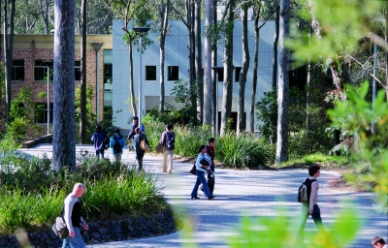
Study Overview
We wanted to discover the current level of understanding of UDL among academics, as well as what influenced their ability to practice UDL in their teaching.
113 teaching academics from a
regional university.
32% were somewhat familiar with UDL
and 9.7% were very familiar.
31.1% had incorporated UDL into their
teaching, with 9.5% incorporating UDL
into all teaching activities.

Slide 3

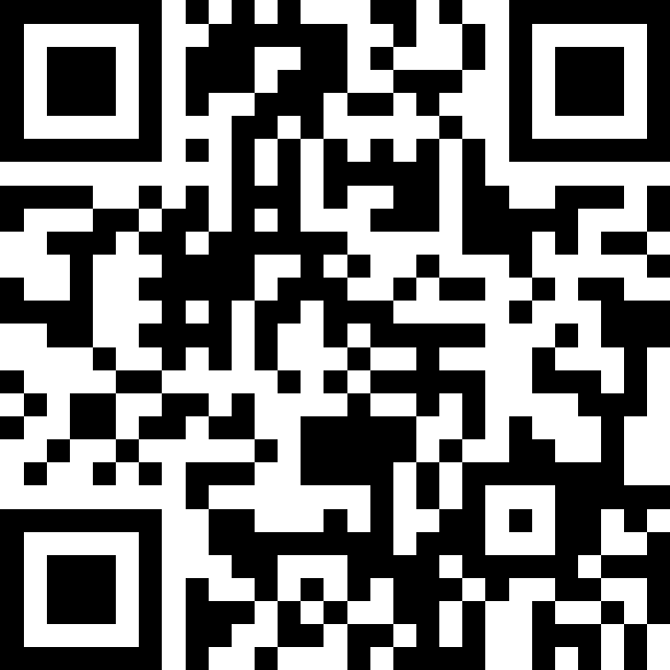
Finding the Time
Resources
Support
Time restraints
Workload
https://app.sli.do/event/iZXN89knVC6M3opnwhcxbf

Slide 4

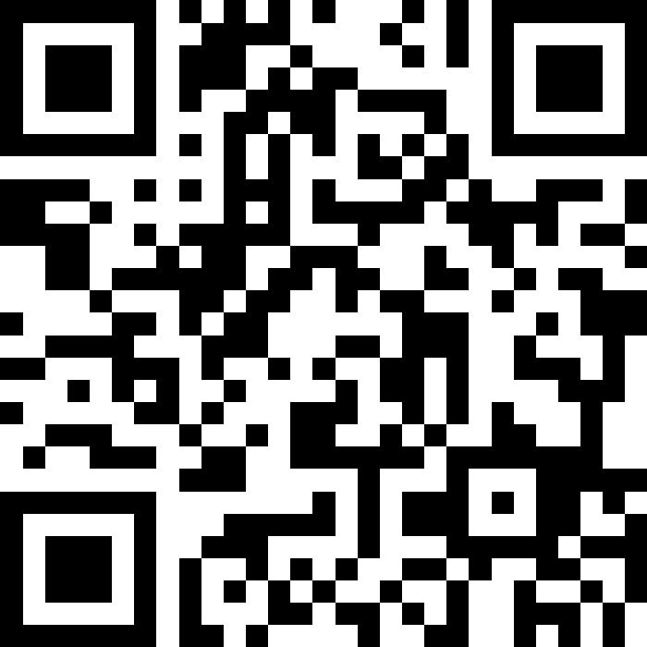
Learning how to Implement UDL
Familiarity with UDL
Implementation uncertainty
Formal training needs
Membership and community
https://app.sli.do/event/gYBfAPJTXwZ59he7UD4Mu2

Slide 5

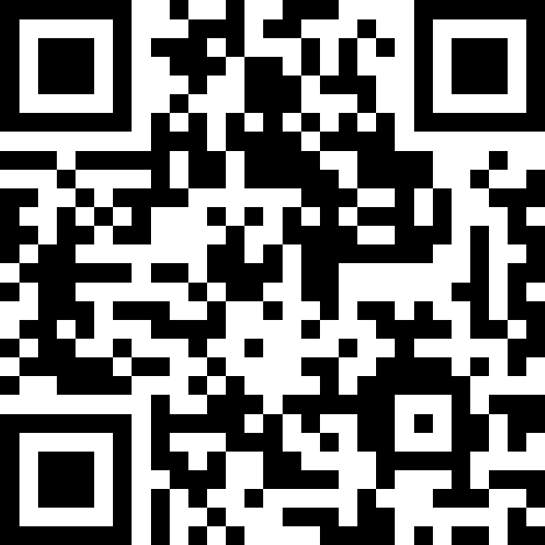
Overcoming Institutional Barriers
Skill limitations
Tool adequacy
Policy restrictions
Class sizes
Course design and control
https://app.sli.do/event/kULhZkB6htD5ZWvhHx7M4Z

Slide 6
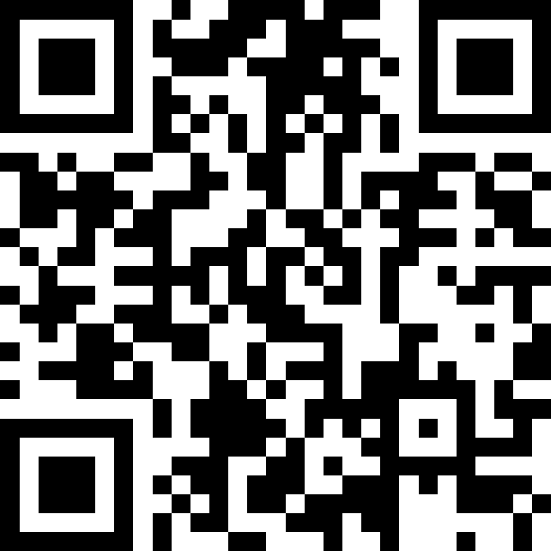

Addressing Implementation
Framework navigation
Effectiveness assurance
Student engagement and inclusivity efforts
https://app.sli.do/event/oSEzhoGsNPxdYqJD4rjKsu

Slide 7
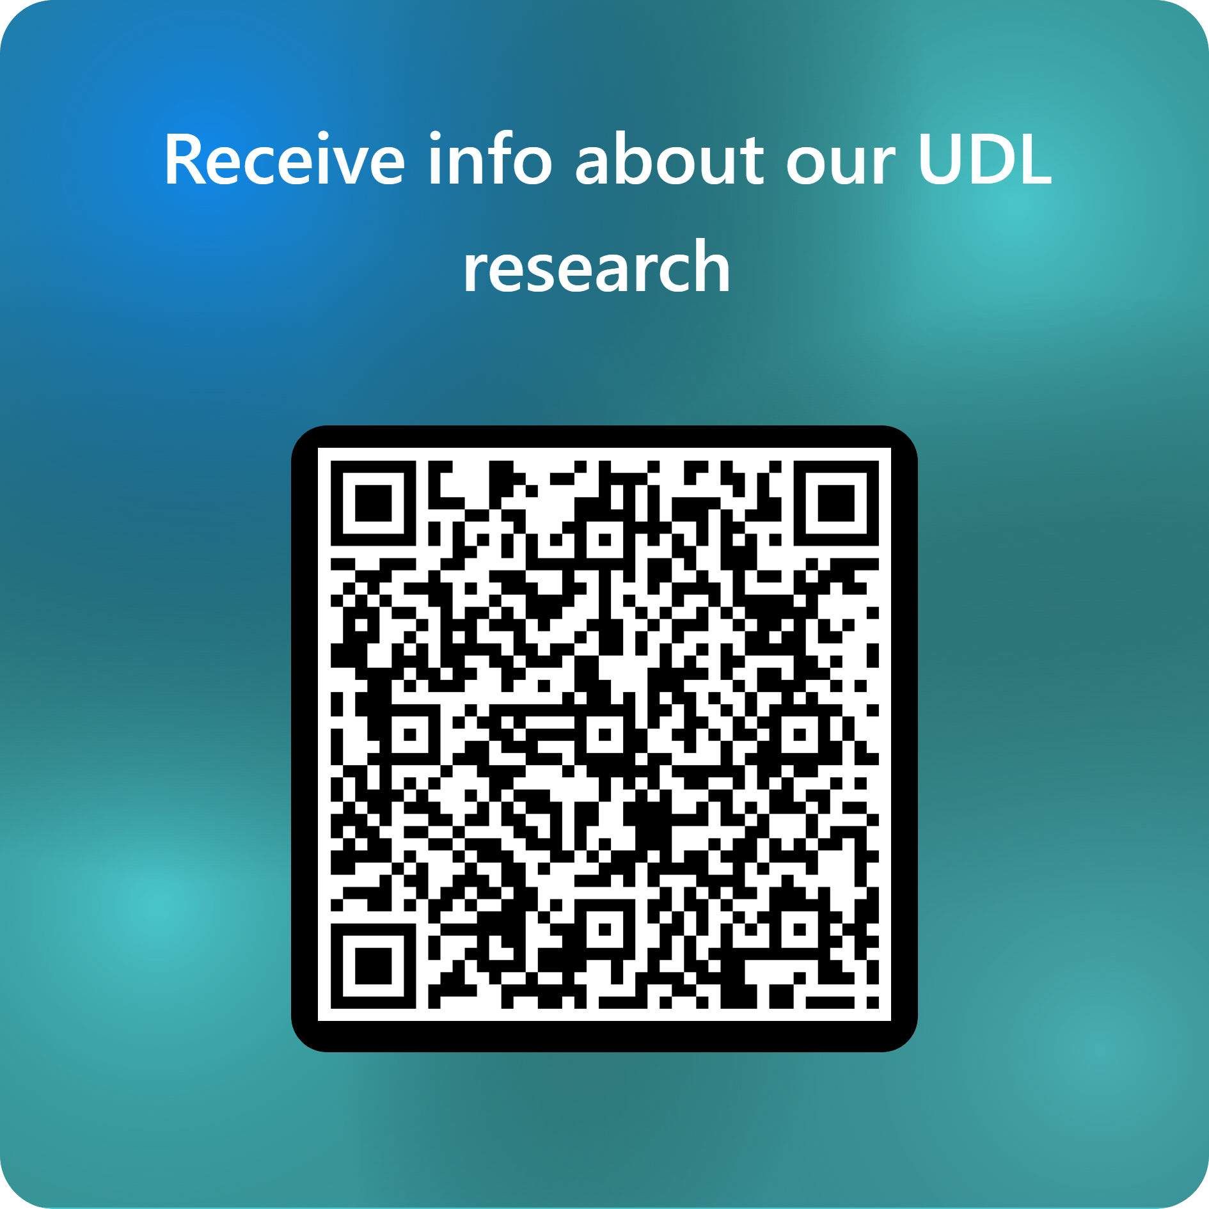
Q&A and, stay up-to-date with our research
https://forms.office.com/r/szaCgVeTxE

